Slide 1
Selling Virtually with SOCIAL STYLE®

Slide 2
The Current Situation – Selling Virtually
How we used to sell…much of it we can’t do anymore:
Coffee catch-ups
Informal intelligence gathering
Informal relationship building
Face-to-face meetings
Workbook, Page 1
1

Slide 3
The Consequence
Less client contact—and more formal when it does occur:
Harder to build trust
Harder to qualify
Harder to get critical information
We need far greater precision with our sales efforts, and greater accuracy interpreting our client’s buying behavior than ever before.
Workbook, Page 1
2

Slide 4
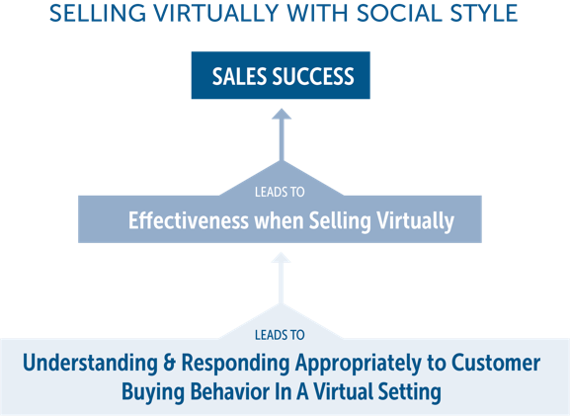
Workbook, Page 2
3

Slide 5
Our Objective: Making The Shift
CURRENT POSITION
DESIRED POSITION
I don’t want another meeting
I don’t want another Zoom session
I don’t want more discovery sessions
I don’t want more ‘pitches’
You are good to spend time with
Happy to do a Zoom session with you
You are useful
You are my kind of person
I don’t want to give you my time
I want to give you my time
Workbook, Page 3
4

Slide 6
The Platinum Rule: Treat Others the Way They Want to be Treated
Workbook, Page 4
5

Slide 7
Selling Virtually with Versatility
Virtual SOCIAL STYLE Profiling
Setting the Virtual Stage
Managing the Virtual Stage
Additional Resources
Workbook, Page 4
6

Slide 8
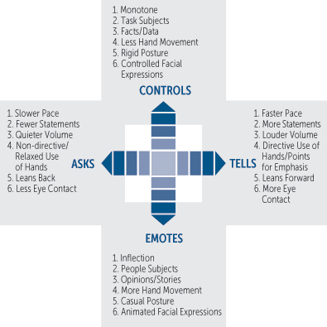
1. Virtual Profiling
Workbook, Page 5
7

Slide 9
Style Hypothesis from Email
These “markers” can differentiate the Styles with 57% accuracy:
Driving – Short, no “Hi,” focused on task, personal at the end, tell assertive
Expressive – “Hi,” “!,” emoticons, wordy, unstructured, opinions, tell assertive
Amiable – You before them, “How are you?”, hello & goodbye, ask assertive
Analytical – Organized, lists, logical sequence, supporting facts, ask assertive
Workbook, Page 6
8

Slide 10
Your hypothesis?
1. Hmm… Thanks! Don’t know who sent. Will complete the other pieces over the next few weeks – have a bit of travel coming up. Have a good weekend!
2. Morning Rachael,
I hope you’re well and we are looking forward to seeing you at the conference. How did your last conference go? I know you were a little concerned because it was a new group. I am just working with Cindy to coordinate travel to Port Douglas – would you mind sending over your flight preferences (flying into Cairns) along with your FF number?
Many thanks,
Mandy
3. Paul,
This was a one off incident and I have tasked Raj to investigate with the vendor.
Sarah
9

Slide 11
Style Hypothesis from LinkedIn
Review summary, roles descriptions and recommendations that others have written about them:
Assertiveness: Fewer, or more, statements
Responsiveness: Task or people subjects; facts or opinions and stories
10

Slide 12
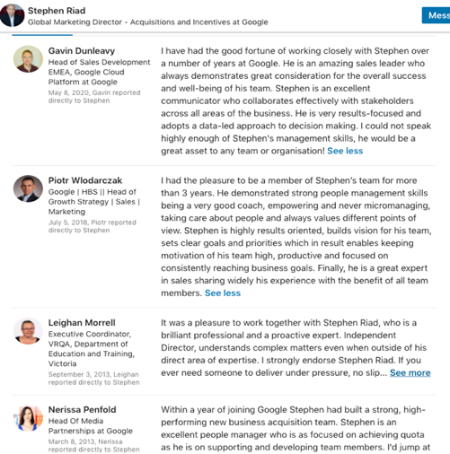
11

Slide 13
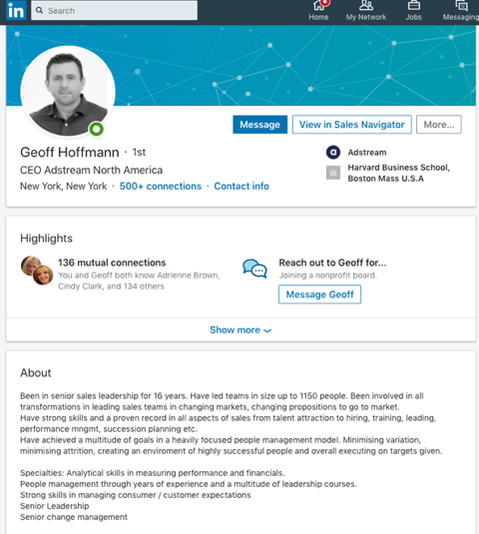
Your Hypothesis?
12

Slide 14
Profiling in Virtual Meetings
13

Slide 15
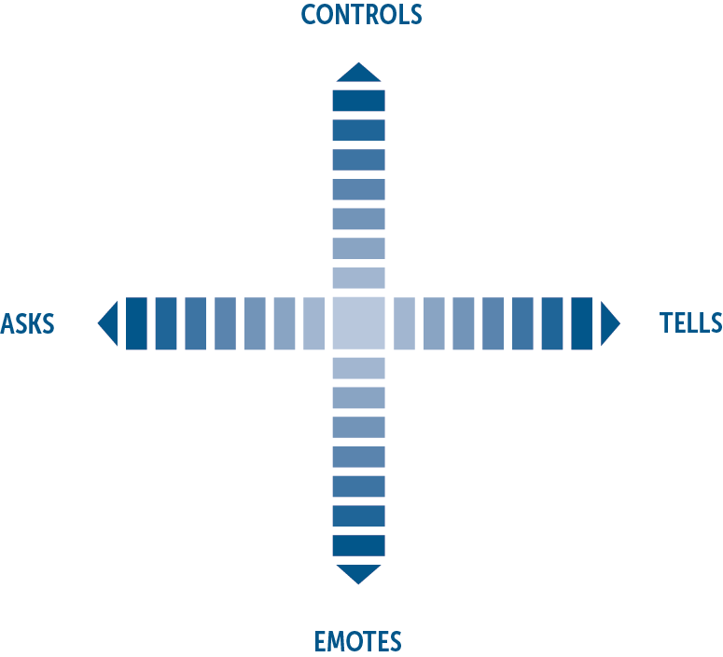
SOCIAL STYLE® Highlights
Analytical Style
Slower-paced, slower to act
Makes strong efforts to organize
Shows less concern for relationships
Works in the historical time frame
Takes action cautiously
Tends to avoid personal involvement
Driving Style
Faster-paced
Makes efforts to control
Less concerned for caution in relationships
Works in the present time frame
Tends to direct the actions of others
Tends to avoid inaction
Amiable Style
Slower-paced
Makes efforts to relate
Shows less concern for effecting change
Works in the present time frame
Shows supportive action
Tends to avoid conflict
Expressive Style
Faster-paced
Makes efforts to involve
Shows less concern for routine
Works in the future time frame
Tends to act impulsively
Tends to avoid isolation
Workbook, Page 7
14

Slide 16
2. Setting the Virtual Sales Stage
15

Slide 17
Our Objective
CURRENT POSITION
DESIRED POSITION
I don’t want another meeting
I don’t want another Zoom session
I don’t want more discovery sessions
I don’t want more ‘pitches’
You are good to spend time with
Happy to do a Zoom session with you
You are useful
You are my kind of person
I don’t want to give you my time
I want to give you my time
16

Slide 18
Virtual Versatility for All Styles
Be on the call 5 mins. prior to the start
Open all documents prior to entering
Organize all screens prior to entering
Enter with camera and mic on
Check your background
Ensure you are not “nostril view”
Make sure your face is illuminated well
Ensure you are framed well
Dress one level above your customer
Know or hypothesize their End State
17

Slide 19
End State – Surface & Depth
 | Surface | Depth
Fix
Prevent
Accomplish
18

Slide 20
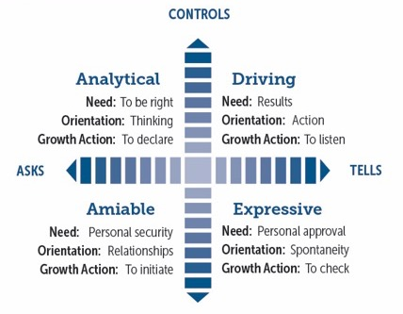
Need, Orientation & Growth Action
Workbook, Page 9
19

Slide 21
Encouraging Your Customer to Be Versatile
ANALYTICAL STYLE
Sell “voicing their opinions” in the meeting as a critical data point to ensure the most logical decisions are made.
DRIVING STYLE
Sell “listening” in the meeting as a way they can achieve their results, saving time, money or effort.
Growth Action: Declare a Stance
Growth Action: To Listen
AMIABLE STYLE
Sell “voicing their concerns” in the meeting as a critical aspect to ensure strong relationships.
EXPRESSIVE STYLE
Sell “checking themselves” in the meeting as a way to improve their personal brand.
Growth Action: Initiate Their Will
Growth Action: Check Their Behavior
Workbook, Page 10
20

Slide 22
Setting the Virtual Sales Stage
ANALYTICAL STYLE
DO
Share agenda/detail/questions beforehand
Call before meeting detail is sufficient?
Be serious, formal and measured
DON’T
Expect high conversation involvement
Focus on personal relationship
Be flippant
DRIVING STYLE
DO
State the expected outcome of the meeting
Ask for their approval of the agenda
Allow them control of meeting settings
DON’T
Start late
Be a gatekeeper on meeting entry
Be disorganized
AMIABLE STYLE
DO
Co-create the agenda
Be 5 mins early for social chat
Enter with camera and mic on
DON’T
Assume interest because they agreed to meet
Jump right to task in communications
Involve others without letting them know
EXPRESSIVE STYLE
DO
Ask for their ‘insight’ on the agenda
Acknowledge them immediately
Casual and informal approach
DON’T
Provide too much detail in advance
Recap the past
Too tightly structure the meeting
Workbook, Page 11
21

Slide 23
3. Managing the Virtual Sales Stage
22

Slide 24
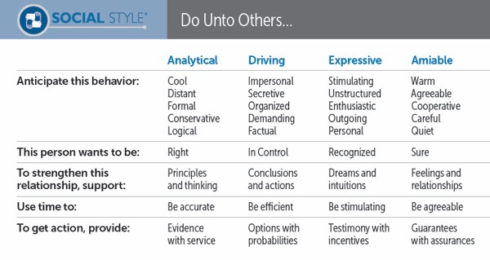
Anticipate & Accept Behavior—Don’t Judge It
Workbook, Page 12
23

Slide 25
Behaviors to Expect During Virtual Meetings
ANALYTICAL STYLE
They will approach the virtual team in much the same way they approach in-person teams
Will often be quiet, when they do speak, they will focus on tasks and information related to work topics
Don’t mistake lack of involvement as acceptance or resistance—ask them
DRIVING STYLE
They are likely to make their presence known, may be less collaborative, may try to dominate conversations
Don’t mistake multi-tasking for indifference, they may have already decided to buy—ask them
AMIABLE STYLE
Generally, be less talkative
May be hesitant to disagree or offer their viewpoints if they think it will be contrary to the opinions of the rest of the team
Don’t mistake agreement as endorsement—ask them
EXPRESSIVE STYLE
Most talkative
Be cautious about allowing for too little structure in your meetings
Do not needlessly stifle them during meetings but have meeting structure
Don’t mistake energy for buying signals—ask them
Workbook, Page 13
24

Slide 26
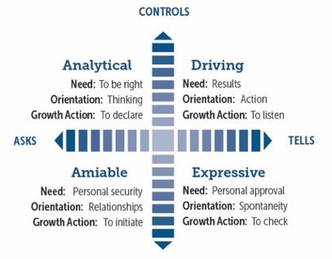
Enhancing Your Virtual Versatility
Focus on their Style Need
Support their Style Orientation
Take your Style Growth Action
Workbook, Page 12
25

Slide 27
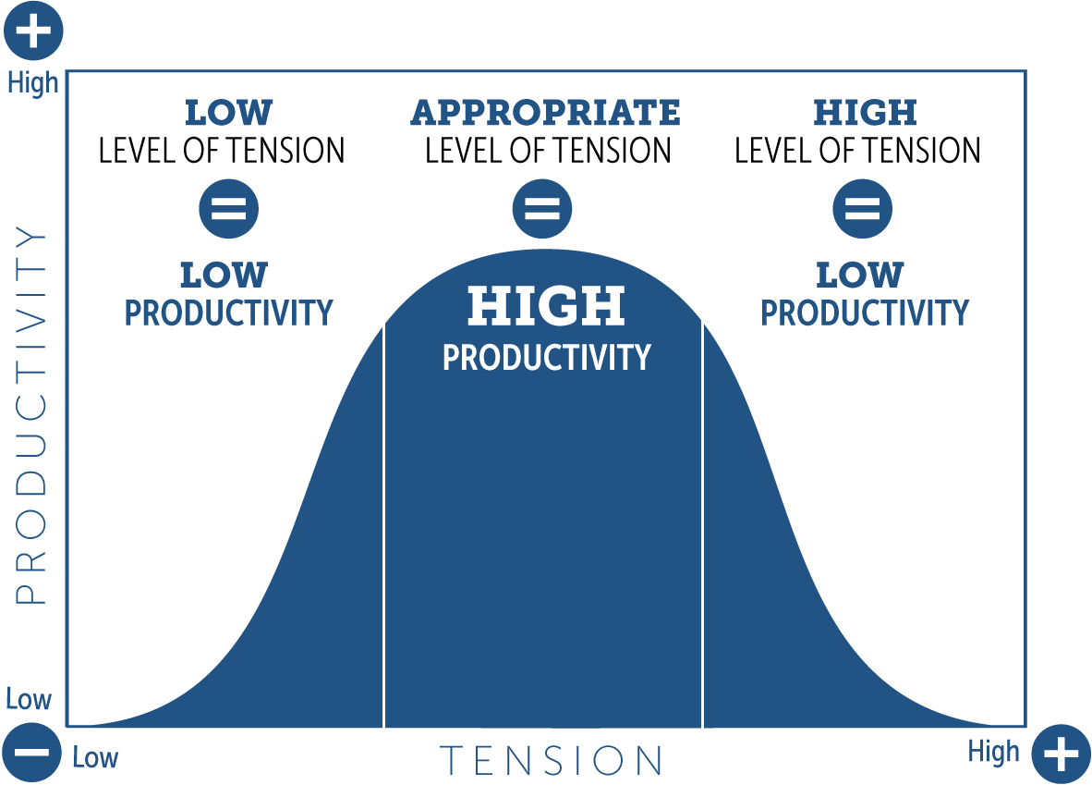
Tuning Into Tension
Tension — A force that stimulates buying activity.
Sale Stalls
Sale Progresses
Sale Derails
Workbook, Page 14
26

Slide 28
Tuning Into Tension
ANALYTICAL STYLE
DO
Show agenda and time parameters
Support data with source information
Insert “pauses” for questions
DON’T
Rely on visual images without data
Move too quickly through the information
End the meeting without asking if they need more detail
DRIVING STYLE
DO
Show objectives up front
Ask them to share their expectations
Revisit the objectives throughout
DON’T
Show too many details
Assume they’re paying attention
End the meeting without follow-up actions
AMIABLE STYLE
DO
Find a personal connection at the beginning
Ask open-ended questions
Show images of people
DON’T
Assume they’re agreeing with you
Spend too much time on facts
End the meeting without drawing out their feelings about your ideas
EXPRESSIVE STYLE
DO
Use more images than text
Move at a quick pace
Let them build on ideas you share
DON’T
Take their feedback personally
Appear uncommitted to your goals
End the meeting without allowing them to speak their mind
Workbook, Page 18
27

Slide 29
Selling to a Purchasing Committee
ANALYTICAL STYLE
If they believe the purchasing committee is making a decision too quickly, they may try to slow down the process
May be reluctant to state their opinions on the purchase decision to others
Provide them with all the information they need to come to a decision and let them know they can chat with you individually as required
DRIVING STYLE
They will want some control over the decision
They may try to rush the process to the frustration of other committee members
Keep them in a productive state by maintaining a focus on the overall goals to be achieved by a decision in your favor
AMIABLE STYLE
The are more hesitant to speak forcefully about their opinions or concerns
They can become uncomfortable and reluctant to state any disagreements openly
You can usually avert this behavior by specifically asking if all questions have been answered at each step of the sales conversation
EXPRESSIVE STYLE
They will be very vocal with their opinions during any committee decision-making process
They may act impulsively without considering all the relevant facts or implications
Allow them to vent and provide them with persuasive Style-appropriate information about personal impacts
Workbook, Page 19
28

Slide 30
Building Relationships Virtually
ANALYTICAL STYLE
Communicate when there is a specific reason to do so
Share interesting third-party data and research that relates to their job
Find a way to help them test their thinking
Like and support their activities on LinkedIn
DRIVING STYLE
Communicate only when especially necessary
Share innovations that relate to efficiency gains that relates to their role
Find a way to provide value that saves time or money but costs them nothing
Like and support their activities on LinkedIn
AMIABLE STYLE
Periodically, check in to see how they are doing
Invite them to be part of a group that is related to their role
Find a way you can help them personally
EXPRESSIVE STYLE
Every now and then ask for their thoughts in their area of expertise
Invite them to participate in a keynote, podcast, webinar, etc. (that is not a testimonial for you in disguise)
Find a way to increase their personal brand
Workbook, Page 20
29

Slide 31
Earning Trust Virtually
ANALYTICAL STYLE
Prove that you are capable
Show the logic behind statements
Focus on quality
Prepare and know their organization
Communicate the pros and cons
Let the personal relationship develop; don’t push it
DRIVING STYLE
Show confidence in your abilities
Inform them if demands cannot be met
Be candid
Keep up with fast pace
Communicate your understanding of their desired results
Be efficient with their time
AMIABLE STYLE
Share personal information
Be genuine, sincere and authentic
Show your commitment to helping them
Empathize with their needs
Avoid unnecessary pressure
Remember the names of their key relationships
EXPRESSIVE STYLE
Have a casual, open approach
Don’t unnecessarily conceal your feelings
Avoid challenging or competing with them
Show enthusiasm for their ideas, hunches and insights
Give them your undivided attention
Talk about non-work topics
Workbook, Page 21
30

Slide 32
Additional Resources
31

Slide 33
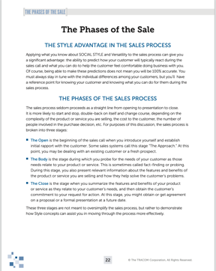
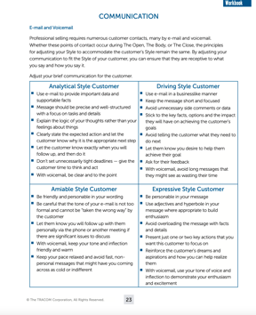
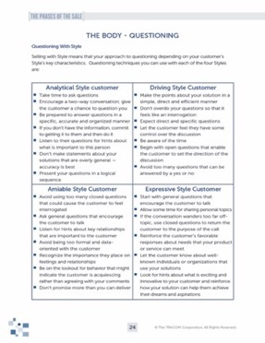
Versatility & The Sales Process
32

Slide 34
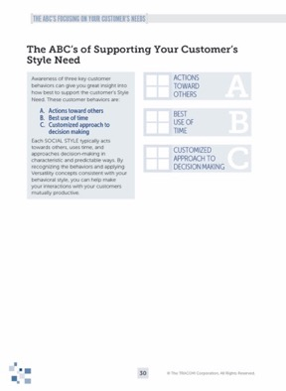
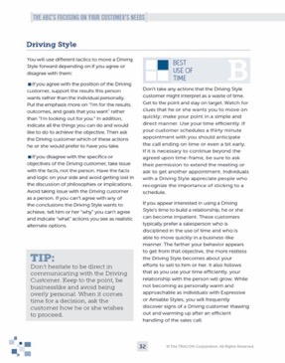
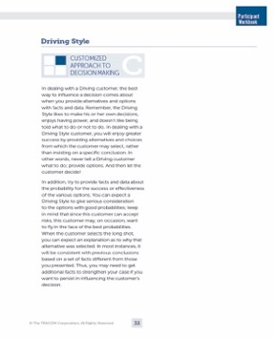
ABC’s of Selling with Style
33

Slide 35
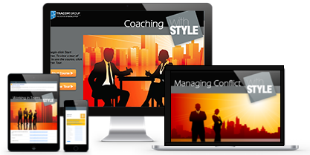
Post-Training: SOCIAL STYLE Navigator®
All learners can access Navigator through TRACOM Learning, once they have a Profile Report
SOCIAL STYLE Estimator
Brief survey evaluates the behavior of others to
estimate their Style
SOCIAL STYLE Advisor
Prep for meetings, negotiations, presentations
Style and Versatility best practices for many
situations
eLearning modules
Helps learners apply Style concepts to teams,
coaching and managing conflict
34

Slide 36
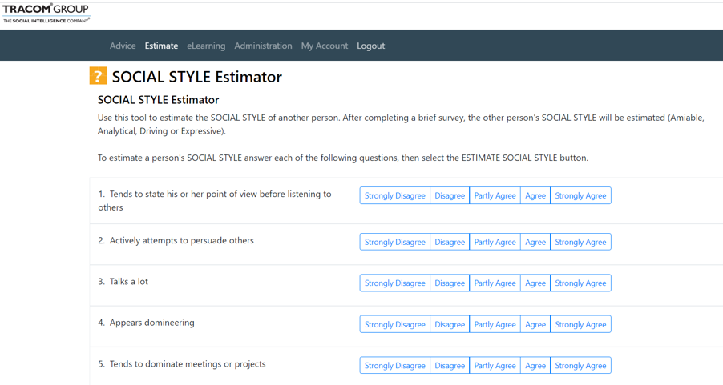
35

Slide 37
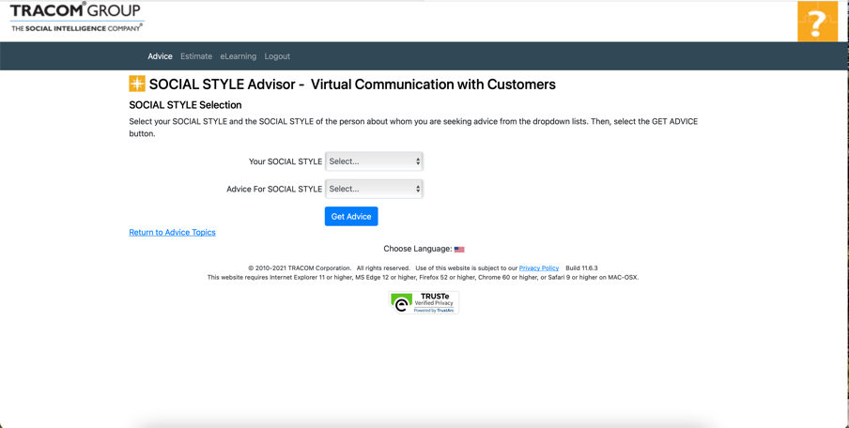
36

Slide 38
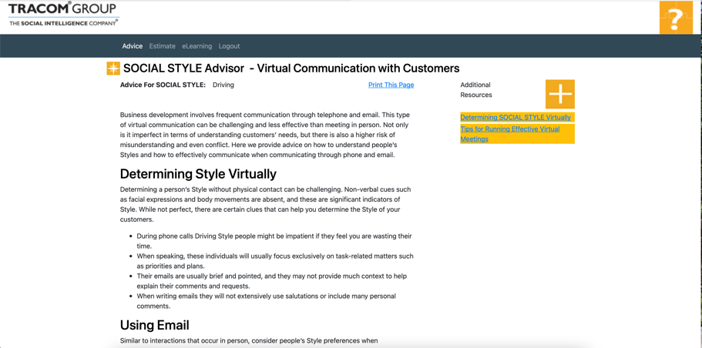
37

Slide 39
Summary: Sell in the Way Customers Want to Buy
Profile your customer
Accept your customer’s behavior; don’t judge
Focus on the Style Need of your customers
Support their Style Orientation
Avoid exhibiting behaviors that their Style rejects
Take your Growth Action
38

Slide 40
Optional Training Activity: Debriefing Learner Profiles
Facilitator can choose from three assessment options:
Versatility Checkup Profile
SOCIAL STYLE® & Versatility Multi-Rater Profile
SOCIAL STYLE® & Versatility Self-Perception Profile
39

Slide 41
Your Profile: Versatility Checkup
40

Slide 42
Your Versatility
Ratings from Others determines Versatility; approx. 65% of people perceive their behavior differently from their raters
Versatility is independent from Style, and is an indicator of success
Competence and Feedback can outweigh Presentation over time
Your Versatility rating is based on your observable behaviors; it is not a “good”/“bad” or “like”/“dislike” rating
Consult previous multi-rater (360) feedback, if possible; seek feedback from non-raters; also consult course materials
Versatility is a choice; it can be learned and improved through behavior change
41

Slide 43
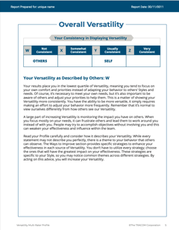
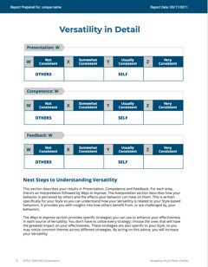
Your Versatility
Average scoring is higher than Assertiveness and Responsiveness
“W” doesn’t mean “weakness” or absence of Versatility, but an opportunity to be more consistent
“Z” doesn’t mean “no room for improvement”
42

Slide 44
Your Profile: SOCIAL STYLE® & Versatility (Multi-Rater)
43

Slide 45
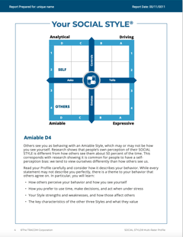
Your SOCIAL STYLE®
Ratings from Others determine Style; approx. 50% of people perceive their Style differently from their raters
Style forms early, developing through early adulthood and becoming stable over time in different situations
Descriptions are general; Style doesn’t describe an individual precisely.
We demonstrate behaviors of all Styles; Style is determined by patterns of behavior
There’s no best Style; all have strengths & weaknesses
Style is not a predictor of success
44

Slide 46
Your Versatility
Ratings from Others determines Versatility; approx. 65% of people perceive their behavior differently from their raters
Versatility is independent from Style, and is an indicator of success
Competence and Feedback can outweigh Presentation over time
Your Versatility rating is based on your observable behaviors; it is not a “good”/“bad” or “like”/“dislike” rating
Consult previous multi-rater (360) feedback, if possible; seek feedback from non-raters; also consult course materials
Versatility is a choice; it can be learned and improved through behavior change
45

Slide 47
Your Versatility
Average scoring is higher than Assertiveness and Responsiveness
“W” doesn’t mean “weakness” or absence of Versatility, but an opportunity to be more consistent
“Z” doesn’t mean “no room for improvement”
46

Slide 48
Your Profile: SOCIAL STYLE® & Versatility (Self-Perception)
47

Slide 49
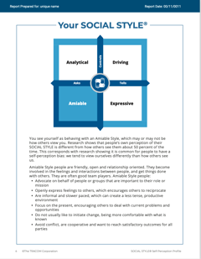
Your SOCIAL STYLE®
Style forms early, developing through early adulthood and becoming stable over time in different situations
Descriptions are general; Style doesn’t describe an individual precisely
We demonstrate behaviors of all Styles; Style is determined by patterns of behavior
There’s no best Style; all have strengths and weaknesses
Style is not a predictor of success
48

Slide 50
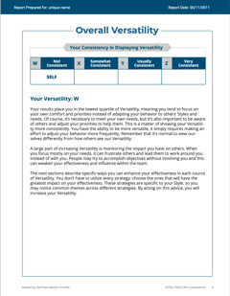
Your Versatility
Versatility is independent from Style, and is an indicator of success
Your Versatility rating is based on your observable behaviors; it is not a “good”/“bad” or “like”/“dislike” rating
Versatility is a choice; it can be learned and improved through behavior change
49

Slide 51
Your Versatility
“W” doesn’t mean “weakness” or absence of Versatility, but an opportunity to be more consistent
“Z” doesn’t mean “no room for improvement”
50

Slide 52
Thank You!
51

Slide 53
Selling Virtually with SOCIAL STYLE®

