Slide 1
Venta enfocada en los resultados™
Notes:
2 Minutes
WELCOME participants to the session and REVIEW key points about TRACOM’s SOCIAL STYLE Model:
One of the most widely used and highly regarded behavioral models in use today.
Will help you develop insight about your behavioral strengths and weaknesses, and your customers’ behavioral preferences.
Originally developed in the 1960s by psychologists David Merrill and Roger Reid.
Used worldwide by millions of people.
PROGRAM BENEFITS
SAY Working successfully with customers depends on developing good relationships. You can do this by understanding your own Style and, more importantly, other people’s Styles. This allows you to practice Versatility by adjusting your behavior to meet other people’s Style preferences. Research shows that people who consistently show Versatility are more effective in their jobs than people who don’t show Versatility.

Slide 2
Pasos para aumentar la eficacia interpersonal
Hacer algo por los demás
Controlarse a uno mismo
Reconozca su influencia en los demás
Gestione su propio comportamiento
Observe objetivamente a los demás
Ayude a satisfacer las necesidades del Estilo de los demás
Conocerse a uno mismo
Conocer a los demás
Notes:
5 Minutes (Workbook, page 2)
SAY This program will bring you on a journey. The ultimate goal is to work more effectively with your customers and others. We’ll get there through a process that starts with understanding yourself and how your behavior affects your productivity and relationships. We refer to these as “know yourself” and “control yourself.”
Most importantly though, you’ll begin to focus on understanding others and their preferences for getting work done. This is called “know others.” With this understanding of others’ behavioral styles, you’ll begin to practice your Versatility, which is “do something for others.”
We’ll talk more about these four steps later, but as we progress through the program, you’ll see how they are applied.
By the end of the program, you’ll have insight into your own Style and behavior, and the Style of at least one of your customers. You’ll build on this knowledge to develop more effective ways of working with your customers through practicing Versatility.

Slide 3
Objetivos de aprendizaje
Cómo predecir el comportamiento de los clientes.
Qué causa estrés a los clientes.
Cómo reconocer y satisfacer sus necesidades.
Cómo prepararse para las reuniones y adaptar la comunicación.
Cómo ganarse la confianza de los clientes.
Notes:
2 Minutes
SAY Ultimately, this course will help you have more success with your customers. In particular, you’re going to learn specific strategies:
How to predict your customers’ behavior, and an understanding of why they behave that way.
What causes customers to become stressed, and how your own behavior can contribute to this.
How to recognize their needs and meet those needs.
How to prepare for meetings and tailor your communication to different customers.
Ultimately, how to earn their trust.

Slide 4
SOCIAL STYLE Y VERSATILIDAD
UN ELEMENTO CLAVE DE LOS RESULTADOS DE VENTAS
Como resultado de la formación SOCIAL STYLE y Versatilidad, los profesionales de ventas indican que:
Un 92 %
Un 87 %
Un 58 %
creó más
aumentó su capacidad para
informó que
RELACIONES POSITIVAS CON LOS CLIENTES
INFLUIR O PERSUADIR A LOS CLIENTES
CERRÓ VENTAS IMPOSIBLES DE OTRO MODO
La Versatilidad aumenta al mismo ritmo que el rendimiento en el trabajo.
Notes:
2 MINUTES (Workbook, page 4)
SAY In the first part of the program, you’ll learn about Style. This will help you understand your customers and how they prefer to interact with you.
The second part of the program focuses on Versatility, which is how well you meet others’ Style needs.
Versatility is the application of SOCIAL STYLE—when you understand your customers’ Style needs, you can help them meet those needs. This helps them feel more valued and sets the stage for them to have a better relationship with you. If you consistently show Versatility, you can be more effective.
You can read the stats on this slide. Research has found that salespeople who practice SOCIAL STYLE and Versatility have more success.

Slide 5
Presentaciones
Nombre
Puesto de trabajo
Cliente anónimo: qué es lo más frustrante
Notes:
10 Minutes
Have participants introduce themselves by revealing the topics listed on the slide.
ASK participants to think of one customer they have a difficult relationship with, and briefly describe their main frustration(s) with this person WITHOUT NAMING THE PERSON.
If Group is too large for verbal introductions, do this through chat.
TIP: You might want to record participants’ “What is Most Frustrating” on a flip chart (or virtual white board). The purpose of the session is to learn how to improve these relationships.
Make sure you have a Profile for each participant who completed the online Questionnaire by the deadline.
DO NOT pass out the Profiles at this time.
If you are delivering a virtual program, options and instructions for downloading profiles are given later in this guide.

Slide 6
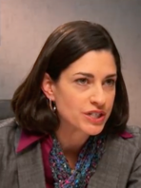
El Estilo en acción
Observaciones
Opiniones
Kyle
Lana
AJ
Abby
Notes:
15 Minutes (Workbook, page 5)
INTRODUCE the video: Four individuals participate in a meeting to discuss a product that is missing a client’s expectations.
ASK participants to write down their observations and opinions of each character on page 5 of the Participant Workbook.
PLAY Part 1.
DEBRIEF the video by asking participants to briefly share their thoughts on the characters. Many of the participants’ comments will be subjective observations.

Slide 7
Mi cliente: primeras impresiones
Piense en el cliente que ha identificado anteriormente. Póngale un nombre ficticio y escriba lo siguiente:
Las primeras impresiones que tuvo de esa persona (desde las primeras conversaciones).
Notes:
5 Minutes (Workbook, page 6)
SAY Think about the customer you identified during our “Introduction” exercise.
SAY Give your customer a fictional name and then write down:
First impressions you had of that person (from your first interactions).
DEBRIEF the exercise by asking participants to briefly share the information about their customer.
SAY The information you shared is typical about how we feel about and react to others. Some information is objective and observable—and some of it is subjective (how we feel about them). Today, we’re going to show you a more objective and reliable way to understand behavior; then based on this, find ways to work more effectively and with less frustration.

Slide 8
Dimensiones del comportamiento
La Asertividad y La Receptividad.
Notes:
SAY We’re going to talk about behavior and how to accurately observe people’s behavior.

Slide 9
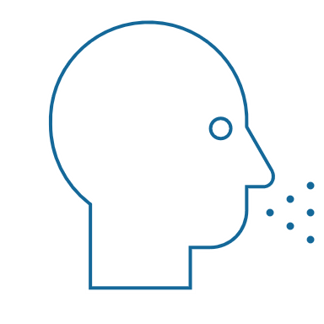
Comportamientos observables frente a personalidad
Comportamiento
Lo que se dice (verbal) y se hace (no verbal)
SOCIAL STYLE® Es un patrón de acciones que las otras personas observan y en el que coinciden para describir el comportamiento de uno mismo.
Comportamiento observable
Decir/Hacer
Personalidad
Comportamiento interpersonal
Lo que se dice y hace durante la interacción con otras personas
Personalidad
Todo lo que es una persona: sus ideas, valores, esperanzas y sueños
Notes:
4 Minutes (Workbook, page 7)
SAY Behavior and personality are not the same things. Observable behavior is like the crust of a pie. Personality is like the inside and outside of the pie.
ASK What makes up personality?
CONDUCT a quick facilitated discussion to solicit participants’ responses. They should say things such as:
Values, hopes, attitudes, beliefs.
Things that are not necessarily observable.
These internal qualities are more subjective in nature.
SAY Style is like the crust, because it’s on the outside and observable. By observing behavior, we can find ways to define and discuss what we see. Then, we can begin to understand how this behavior affects ourselves and others.

Slide 10
Comportamientos “Decir y hacer”
Rasgos
Honesto
Inteligente
Arrogante
Motivado
Centrado
Sincero
Crítico
Comportamiento observable
Tranquilo
Más lento
Facialmente controlado
Más control sobre la expresividad facial
Menor contacto visual
Postura corporal relajada
Inclinación hacia atrás
Alborotador
Más rapido
Facialmente animado
Más animación en las expresiones faciales
Más contacto visual
Postura corporal rígida
Inclinación hacia adelante
Juicios
Me gusta
Me disgusta
Me interesa
Me irrita
Desconfío de ella
Lo odio
Confío en él
DECIR
HACER
Notes:
5 Minutes (Workbook, page 8)
SAY When we first meet people, we often form immediate impressions, even after just a few seconds. This is subconscious (below our level of awareness) and happens immediately.
DESCRIBE
Traits Column: What we think we know about a person, based on interactions; subjective opinions.
Judgments Column: Our reactions to others; conclusions or evaluations we make, based on our subjective opinions.
Observable Behavior Column: Things others “Say and Do”; more objective and observable behaviors.
SAY Traits and Judgments are most subjective in nature and contain positive or negative descriptions.
Observable Behavior is objective and contains no positive or negative value.
Observable Behavior is an important tool for assessing others’ Styles. By focusing on Observable Behavior, you gain objectivity, which is critical for understanding people’s Styles.

Slide 11
La Asertividad y La Receptividad.
Notes:
SAY We measure observable behavior on two dimensions: Assertiveness and Responsiveness

Slide 12
La Asertividad
El grado en que “preguntamos” o “decimos” cuando interactuamos con otras personas
Más Preguntar
Preguntar con algo de Decir
Decir con algo de Preguntar
Más Decir
Notes:
2 Minutes (Workbook, page 9)
SAY To become more effective with others, we follow a behavioral model. There are two dimensions of behavior that define SOCIAL STYLE: Assertiveness and Responsiveness.
Assertiveness is the degree to which we ask or tell when interacting with others. The two anchors for Assertiveness are Ask on the left side of the continuum and Tell on the right side of the continuum.
Assertiveness is a measurement of how we try to influence others to take action. If you are more “Tell” Assertive, you state your opinions directly. You tend to declare your viewpoints and try to direct the actions of others.
For example, if you want to have lunch with someone, you might say, “Let’s have lunch today!”
If you are more “Ask” Assertive, you tend to be more cautious and reserved about sharing your opinions. You attempt to influence others in a more quiet, low-key, questioning manner.
For example, if you want to have lunch with someone, you might say, “Would you like to have lunch with me today?”

Slide 13
Comportamientos de la asertividad
DECIR | Comportamientos verbales
Más lento
Ritmo del discurso
Más rápido
Menos
Cantidad de discurso
Más
Más bajo
Volumen de voz
Más alto
PREGUNTA
DICE
Relajado
Uso de las manos
Autoritario
Inclinarse hacia atrás
Postura corporal
Inclinarse hacia adelante
Menos directo
Contacto visual
Mas directo
HACER | Comportamientos no verbales
Notes:
3 Minutes (Workbook, page 10)
SAY The Assertiveness scale helps predict a person’s behavior because it represents a “theme” or typical pattern. There are verbal and non-verbal clues to indicate a person’s Assertiveness.
ASK participants for examples of verbal and non-verbal clues for Ask-Assertive and Tell-Assertive individuals.
DESCRIBE the verbal and non-verbal indicators of Assertiveness:
Verbal: Ask-Assertive individuals use a slower pace, less quantity (fewer words), and quieter volume. Tell-Assertive individuals use a faster pace, talk more, and a louder volume.
Non-Verbal: Ask-Assertive individuals show relaxed hands and gestures, lean back, and use less direct eye contact. Tell-Assertive individuals have a directive use of hands, lean forward, and use more direct eye contact.

Slide 14
L Asertividad
Pistas verbales
Pistas no verbales
Kyle
Lana
AJ
Abby
Notes:
10 Minutes (Workbook, page 11)
PLAY the same Video Part 1, again, now that participants have been introduced to Assertiveness.
ASK them to observe verbal and non-verbal “Say and Do” behaviors and record their observations on page 11 of their Participant Workbook.
DISCUSS video characters related to Assertiveness.
ASK participants to share some subjective “Say and Do” verbal and non-verbal behaviors of each of the team members. Think about speech characteristics such as pace, quantity, and volume for verbal behaviors and use of hands, posture, and eye contact for non-verbal behaviors.
ASK What is different about your observations from the first time you saw the video? (Answer: They are much more objective.) This contrasts with the subjective observations participants made earlier.
ASK Based on your understanding of the Assertiveness dimension, where do you think each of the characters falls on the Assertiveness continuum?
SAY Assertiveness is neither positive nor negative; it is neutral. There is no good or bad place on the Assertiveness scale. Your level of Assertiveness only becomes positive or negative when used appropriately or inappropriately.

Slide 15
Cliente: Observaciones de asertividad
DECIR | Comportamientos verbales
Más lento
Ritmo del discurso
Más rápido
Menos
Cantidad de discurso
Más
Más bajo
Volumen de voz
Más alto
PREGUNTA
DICE
Relajado
Uso de las manos
Autoritario
Inclinarse hacia atrás
Postura corporal
Inclinarse hacia adelante
Menos directo
Contacto visual
Mas directo
HACER | Comportamientos no verbales
Notes:
10 Minutes (Workbook, page 12)
SAY Using the customer that you identified earlier, think about, and then write down, that person’s Assertiveness behaviors. Include the person’s verbal and non-verbal behaviors. Think about their speech characteristics such as pace, quantity, and volume for verbal behaviors and use of hands, posture, and eye contact for non-verbal behaviors.
DEBRIEF the exercise by asking participants to briefly share the information about their customer’s Ask or Tell Assertive behaviors.
RECORD their information on a virtual white board or flip chart.
ASK What is different about your observations from the first time you described this person?
Answer: They are much more objective. This contrasts with the subjective observations participants made earlier.
ASK Based on your understanding of the Assertiveness dimension, where do you think your customer falls on the Assertiveness continuum?
EMPHASIZE that Assertiveness is neither positive nor negative; it is neutral. There is no good or bad place on the Assertiveness scale.

Slide 16
La Receptividad
Más Controlar
Controla con algo de Demostrar emociones
El grado en que controlamos o mostramos emociones cuando interactuamos con otras personas.
Demuestra emociones con algo de Controlar
Más Demostrar emociones
Notes:
2 Minutes (Workbook, page 13)
SAY Responsiveness is the degree to which people tend to control (don’t outwardly display emotions) or emote (outwardly display emotions).
The two descriptive anchors for the Responsiveness scale are Controls on the top of the continuum and Emotes on the bottom of the continuum.
Responsiveness is also the extent to which you react to emotional appeals or displays.
If you control your emotions, you usually don’t react to emotional appeals and are more likely to focus on ideas, data, and tasks. You are less likely to share your feelings publicly.
If you are more emoting, you share and display your emotions with others. You are more likely to respond to emotional appeals and displays from others.

Slide 17
Comportamientos de La Receptividad
DECIR | Comportamientos verbales
HACER | Comportamientos no verbales
Controla
Menos modulación
La tarea
Hechos/Datos
Menos
Rígida
Controlada
Emoción en la voz
Asuntos del discurso
Formación de descriptivos
Uso de las manos
Postura corporal
Expresión facial
Más modulación
Las personas
Opiniones/ Historias
Más
Informal
Animada
Demuestra emociones
Notes:
3 Minutes (Workbook, page 14)
SAY The Responsiveness scale, like the Assertiveness scale, helps us to predict a person’s behavior because it is a “theme” or typical pattern.
ASK participants for their opinions on the verbal and non-verbal clues of Control- and Emote-oriented individuals.
DESCRIBE the verbal and non-verbal clues to responsive behavior as noted on the slide.
SAY Responsiveness is neither a positive nor a negative quality; it is neutral.
Assertiveness and Responsiveness do not affect each other — they are independent of each other.

Slide 18
La Receptividad
Pistas verbales
Pistas no verbales
Kyle
Lana
AJ
Abby
Notes:
10 Minutes (Workbook, page 15)
REPLAY Video Part 1 again, now that participants have been introduced to Responsiveness.
ASK participants to observe verbal and non-verbal Say/Do behaviors.
SAY Think about verbal clues such as vocal emotion, subjects, and what each team member describes. What did you observe? For non-verbal clues, think about use of hands, posture, and facial expressions.
ASK Based on your understanding of Responsiveness, where do you think each of the characters falls on the Responsiveness scale?
SAY The Assertiveness and Responsiveness dimensions assess behavior, not personality or intelligence, and they are independent of each other.

Slide 19
Cliente: Observaciones de la receptividad
DECIR | Comportamientos verbales
HACER | Comportamientos no verbales
Controla
Menos modulación
La tarea
Hechos/Datos
Menos
Rígida
Controlado
Emoción en la voz
Asuntos del discurso
Formación de descriptivos
Uso de las manos
Postura corporal
Expresión facial
Más modulación
Las personas
Opiniones/ Historias
Más
Informal
Animado
Demuestra emociones
Notes:
10 Minutes (Workbook, page 16)
SAY Using the customer that you identified earlier, think about, and then write down, that person’s Responsiveness behaviors. Include their verbal and non-verbal behaviors. Think about speech characteristics such as emotion in their voice, subjects of speech, forms of descriptors, and non-verbal behaviors such as use of hands, body posture, and use of facial expressions.
DEBRIEF the exercise by asking participants to briefly share the information about their customer’s Control or Emote Responsiveness Behaviors.
RECORD their information on a virtual white board or flip chart.
ASK What is different about your observations from the first time you described this person?
Answer: They are much more objective. This difference contrasts with the subjective observations participants made earlier.
ASK Based on your understanding of the Responsiveness Dimension, where do you think your customer falls on the Responsiveness continuum?

Slide 20
El modelo SOCIAL STYLE Model™
Notes:
SAY Now that you understand Assertiveness and Responsiveness, we’ll see how they form the SOCIAL STYLE Model.

Slide 21
El modelo SOCIAL STYLE ModelTM
Controla
Asertivo con preguntar Más control
Estilo Analítico
Asertivo con decir Más control
Estilo Motivador
Pregunta
Dice
Asertivo con preguntar Más demostrar emociones
Estilo Afable
Asertivo con decir Más demostrar emociones
Estilo Expresivo
Demuestra emociones
Notes:
4 Minutes (Workbook, page 17)
CLICK TO REVEAL EACH QUADRANT
SAY By combining Assertiveness and Responsiveness, the four SOCIAL STYLEs are formed.
No individual will display one Style exclusively; but, in a short time, you can determine the patterns that define a person’s Style. Once you know a person’s Style, you can adjust your behavior to develop a more effective relationship.

Slide 22
El modelo SOCIAL STYLE Model
Controla
Analítico
Serio
Exigente
Lógico
Indeciso
Motivador
Independiente
Formal
Práctico
Dominante
Pregunta
Dice
Afable
Alentador
Leal
Abierto
Flexible
Expresivo
Fuerte
Animado
Aventurero
Impulsivo
Demuestra emociones
Notes:
5 Minutes (Workbook, page 18)
CLICK TO SPEAK ABOUT EACH QUADRANT (text becomes darker)
Review the summaries for each Style. Note that each Style contains positive descriptors and one negative descriptor. This illustrates the significance of perception. A Driving Style person might see themselves as Independent, Formal, and Practical, while others might perceive the same behavior as Dominating.
Solicit questions/ comments.
KEY POINTS:
Style descriptions are generalizations about each Style.
People with the same Style exhibit similar behaviors, but are still individuals.
Perceptions can vary. What you see as strengths in yourself, others might view negatively.

Slide 23
¿Qué Estilo está en acción?
¿Qué Estilo tiene cada personaje?
Kyle
Lana
AJ
Abby
Notes:
3 Minutes (Workbook, page 19)
REFERENCE the video characters from earlier exercises.
ASK What do you think the SOCIAL STYLE of each video character is?
DISCUSS the behaviors of the characters and how those are indicative of their Styles.
IMPORTANT: Do not advance the slide until you’ve discussed the behavior of each character. The next slide reveals each character’s Style.

Slide 24
SOCIAL STYLE
Controla
Analítico
Motivador
Lana
Kyle
Pregunta
Dice
Afable
Expresivo
AJ
Abby
Demuestra emociones
Notes:
2 Minutes (Workbook, page 19)
Kyle – Driving
Lana – Analytical
AJ – Amiable
Abby – Expressive
DISCUSS the behaviors of the characters and how those are indicative of their Styles.

Slide 25
SOCIAL STYLE del cliente
Controla
Asertivo con preguntar Más control
Estilo Analítico
Asertivo con decir Más control
Estilo Motivador
Pregunta
Dice
Asertivo con preguntar Más demostrar emociones
Estilo Afable
Asertivo con decir Más demostrar emociones
Estilo Expresivo
Demuestra emociones
Notes:
5 Minutes (Workbook, page 20)
SAY Using the customer that you identified earlier, determine their Style. This is only a preliminary estimate. As we continue through the program, you might re-estimate the person’s Style.
DEBRIEF the exercise by asking participants to share their customer’s Style, and how this behavioral assessment relates to their initial impressions of the person (which may have been more subjective).
RECORD their information on a virtual white board or flip chart.
SAY You will use their Style as a framework for developing more effective interactions with this person.

Slide 26
Necesidad, orientación y acción de crecimiento
Necesidad
El objetivo de cada Estilo
Orientación El comportamiento común que se utiliza para satisfacer la necesidad
Acción de crecimiento
Comportamiento que rara vez se utiliza en cada Estilo. Usar este comportamiento con más frecuencia aumentaría la eficacia de este Estilo
Notes:
2 Minutes (Workbook, page 21)
SAY Remember that the Style descriptions are generalizations about each Style. While people with the same Style generally exhibit similar characteristics, each person is still unique.
SAY Each Style has a Need, an Orientation, and a Growth Action. By recognizing these things about each Style, we can understand their motivations and what drives their behavior.
DEFINE:
Need – The goal of each Style.
Orientation – The common behavior used to achieve the need.
Growth Action – Behavior that is rarely used by each Style. Using this behavior more often would increase this Style’s effectiveness.
SAY Understanding the need, orientation, and growth action of each Style will help you better relate to others’ Styles and enhance your effectiveness with them.

Slide 27
SOCIAL STYLE Características clave
Controla
Analítico
Necesidad: Estar en lo cierto
Orientación: Pensar
Acción de crecimiento: Expresar
Motivador
Necesidad: Resultados
Orientación: Acción
Acción de crecimiento: Escuchar
Pregunta
Dice
Afable
Necesidad: Seguridad personal
Orientación: Relaciones
Acción de crecimiento: Iniciar
Expresivo
Necesidad: Aprobación personal
Orientación: Espontaneidad
Acción de crecimiento: Comprobar
Demuestra emociones
Notes:
6 Minutes (Workbook, page 21)
CLICK TO REVEAL THE TEXT IN EACH QUADRANT.
REVIEW each Style.
ASK How do need, orientation, and growth action manifest themselves in the video characters? Specifically, how does each team member’s behavior show their need, orientation, and growth action?

Slide 28
Comportamientos de SOCIAL STYLE
Controla
Analítico
Ritmo más pausado
Se esfuerza por organizar
Se preocupa menos por las relaciones
Trabaja en el marco temporal del pasado
Actúa con cautela
Evita la implicación personal
Motivador
Ritmo más acelerado
Desea marcar el ritmo
Se preocupa menos por las relaciones
Trabaja en el marco temporal actual
Dirige las acciones de los demás
Evita la inacción
Pregunta
Dice
Afable
Ritmo más pausado
Hace esfuerzos por empatizar
Se preocupa menos por provocar el cambio
Trabaja en el marco temporal actual
Demuestra actos de apoyo
Evita el conflicto
Expresivo
Ritmo más acelerado
Se esfuerza por participar
Se preocupa menos por las rutinas
Trabaja en el marco temporal del futuro
Actúa impulsivamente
Evita el aislamiento
Demuestra emociones
Notes:
5 Minutes (Workbook, page 22)
CLICK TO SPEAK ABOUT EACH QUADRANT
DESCRIBE the typical behaviors of the four SOCIAL STYLEs. These behaviors are related to the Style needs, orientations, and growth actions.

Slide 29
Comportamientos del cliente
Controla
Analítico
Menos social, profesional
Menor contacto visual directo
Escucha atentamente antes de opinar
Hace preguntas sobre los detalles
Puede evitar expresar una opinión o tomar una decisión
Motivador
Menos social, profesional
Contacto visual más directo
Es directo con las opiniones
Puede hacer preguntas difíciles
Puede perder atención o tratar de tomar el control
Pregunta
Dice
Afable
Amable y accesible
Asentir con la cabeza y otras muestras de aliento
Habla menos que los demás
Hace preguntas sobre a las personas sobre cómo se sienten afectadas
Puede someterse a las decisiones del grupo
Expresivo
Sociable y accesible al comienzo de la reunión
Habla más que los demás
Puede desviarse de la agenda y hablar sobre diversos temas
Es directo con las opiniones
Puede afrontar las situaciones directamente
Demuestra emociones
Notes:
4 Minutes (Workbook, page 23)
CLICK TO REVEAL THE TEXT IN EACH QUADRANT.
REVIEW the customer behaviors. These behaviors are typical Style-related behaviors specific to working with customers.
ENCOURAGE participants to share stories about their customers.

Slide 30
La tensión del cliente
Controla
Analítico
Falta de enfoque y organización
Apremio para lograr una venta rápida
Atención a las generalidades sin tener en cuenta los detalles
Demasiado cambio sin tener en cuenta las consecuencias
Motivador
Falta de estructura y resultados claros
No recibir la oportunidad de expresar sus opiniones
Carencia de soluciones de fondo
Progreso lento
¿Qué causa estrés en cada Estilo?
Pregunta
Dice
Afable
Demasiada formalidad y concentración en las tareas
Falta de colaboración para dar soluciones
Se centra en la venta en lugar de en la relación a largo plazo
Demasiado cambio y demasiado rápido
Expresivo
Que no se reconozcan sus contribuciones
Demasiados detalles
Demasiada estructura sin que haya una conversación fluida
Carencia de atención específica en las posibilidades futuras
Demuestra emociones
Notes:
6 Minutes (Workbook, page 24)
ASK Given a customer’s Style need and typical behaviors, what will cause stress for them?
FACILITATE a discussion of each Style before revealing the text.
CLICK TO REVEAL THE TEXT IN EACH QUADRANT.
The Driving Style need is results, so what’s going to raise their tension in a sales meeting?
Lack of focus; disorganization; not being allowed to state their opinions; no bottom-line solutions; progress is too slow.
Expressive Style stressors:
Not being recognized; too many details; too much structure without free-flowing conversation; not enough focus on future possibilities.
Amiable Style stressors:
Too much formality; lack of collaboration towards solutions; focus on the sale instead of on long-term relationship; too much change too quickly.
Analytical Style stressors:
Lack of structure and clear outcomes; pushiness to achieve quick sale; focus on generalities without considering details; too much change without considering consequences.
ENCOURAGE participants to share stories about their customers.

Slide 31
Comportamiento de refuerzo
Controla
Analítico
EVITA: Se retira para reducir la tensión personal
Motivador
AUTOCRÁTICO: Se hace cargo de reducir la tensión personal
Comportamiento exagerado que se utiliza para reducir la tensión
Pregunta
Dice
Afable
CONSIENTE: Se deja llevar para reducir la tensión personal
Expresivo
ATACA: Afronta la situación para reducir la tensión personal
Demuestra emociones
Notes:
5 Minutes (Workbook, page 25)
CLICK TO REVEAL THE TEXT IN EACH QUADRANT.
SAY When customers are feeling stressed, their behavior can be categorized: each Style falls into a type of extreme backup behavior to try and reduce tension.
DESCRIBE each Style’s backup behavior. Remember, each Style’s goal is to get their Style need met.
ASK What are some common ways that each Style might show their backup behavior?
Driving: Will get frustrated by slow progress or barriers and try to take control of the situation.
Expressive: Will get upset if they aren’t given opportunities to express themselves or show their contributions, and might verbally confront others.
Amiable: If they feel that a relationship is being threatened, they will stay quiet and acquiesce instead of firmly stating their opinions.
Analytical: If they feel that things are moving too fast without taking into account important details, they will withdraw and refuse to contribute.
SAY Next we’ll talk about some specific strategies for working with customers.

Slide 32
Satisfacer las necesidades del cliente
Controla
Analítico
Pruebas e información: compártalas con ellos
Transparencia: quieren ver y entender los procesos
Ser comprendido: demuestre que entiende sus problema.
Tiempo para pensar: no presione para que tomen decisiones rápidas
Motivador
Resultados: entregue según lo acordado y rápidamente, si es posible
Competencia: muestre las capacidades de su equipo
Franqueza: sea directo y profesional
Eficiencia: respete su tiempo y póngase a trabajar rápidamente
Pregunta
Dice
Afable
Socialización: tómese tiempo para conocerlos
Seguridad: trate de minimizar sus riesgos
Compromiso y consenso: haga que otras personas participen para obtener la aprobación
Transmitir confianza: comunique que proyectos similares han tenido éxito en el pasado
Expresivo
Apoyo: ayude a que forme sus puntos de vista
Aprobación: no compita con ellos por el reconocimiento
Respeto e importancia: les gusta la atención, especialmente de los altos cargos
Voz: dé tiempo para hablar, incluso si no es algo específico del propósito de la reunión
Demuestra emociones
Notes:
8 Minutes (Workbook, page 26)
ASK With these backup behaviors in mind, and understanding what causes stress for each Style, what are some ways to meet your customers’ needs? Start with the Driving Style, what ideas do you have?
CLICK TO REVEAL THE TEXT IN EACH QUADRANT.
REVIEW the needs and strategies to meet each Style’s needs and facilitate discussion of each Style.
ENCOURAGE participants to share stories about their customers.

Slide 33
Observar el Estilo de manera virtual
Notes:
10 Minutes (whole section on Observing Style Virtually)
SAY Working with customers and trying to sell remotely has its own unique challenges. You can still use Style to your advantage. Let’s briefly see how people of different Styles might communicate using text messages.

Slide 34
Llamo para ver si ha tenido la oportunidad de ver el vídeo que le he enviado sobre las últimas actualizaciones tecnológicas.
¿Qué piensa?
Notes:
The following five slides are examples of “observable” behavior in text messages.
SAY By observing the behaviors of others, even through simple communication like texting, we can TRY to determine how people prefer to communicate and prefer to be communicated with.
Review example slides:
There is a lot of change happening at our organization, so I sent this text to four of my customers. Then I waited for their responses.

Slide 35
Llamo para ver si ha tenido la oportunidad de ver el vídeo que le he enviado sobre las últimas actualizaciones tecnológicas.
¿Qué piensa?
¡Hola! Veo que son muchos cambios que se van a aplicar muy rápido.
Habrá que formar a mi equipo sobre las nuevas características. ¿Puede ayudarnos con eso?
Notes:
SAY Here is the first response from a customer.

Slide 36
Llamo para ver si ha tenido la oportunidad de ver el vídeo que le he enviado sobre las últimas actualizaciones tecnológicas.
¿Qué piensa?
¡Es emocionante! He echado un vistazo rápido y las nuevas características parecen sensacionales.
Le llamaré la semana que viene.
Notes:
SAY This is the second response from another customer.

Slide 37
Llamo para ver si ha tenido la oportunidad de ver el vídeo que le he enviado sobre las últimas actualizaciones tecnológicas.
¿Qué piensa?
Me parece que estas nuevas actualizaciones nos van a ayudar a ser más eficientes y nos ahorrarán algo de esfuerzo. Sin embargo, antes de adaptarnos a la nueva versión, necesitaremos planificar la formación de mi equipo. ¿Hay algún proceso establecido para eso?
Notes:
SAY Here’s the response from a third customer.

Slide 38
Llamo para ver si ha tenido la oportunidad de ver el vídeo que le he enviado sobre las últimas actualizaciones tecnológicas.
¿Qué piensa?
Tiene buen aspecto. Le llamaré cuando esté listo para ponerlo en marcha.
Notes:
SAY And finally, this response from a fourth customer.
Keep these texts in mind as we’ll be revisiting them later.

Slide 39
Diga qué Estilo es.
Llamo para ver si ha tenido la oportunidad de ver el vídeo que le he enviado sobre las últimas actualizaciones tecnológicas.
¿Qué piensa?
Notes:
SAY This is the text I first sent out. How about the responses I received? Knowing what you know so far about SOCIAL STYLE, can you guess which Style each response is from?

Slide 40
Controla
Asertivo con preguntar Más control
Estilo Analítico
Asertivo con decir Más control
Estilo Motivador
¡Hola! Veo que son muchos cambios que se van a aplicar muy rápido. Habrá que formar a mi equipo sobre las nuevas características. ¿Puede ayudarnos con eso?
Pregunta
Dice
Asertivo con preguntar Más demostrar emociones
Estilo Afable
Asertivo con decir Más demostrar emociones
Estilo Expresivo
Demuestra emociones
Notes:
SAY Which Style might this person be?
AMIABLE
SAY This person is personable (“Hi!”) and concerned that things are moving fast. They are showing concern for the team’s ability to adapt the new technology, and they specifically ask for help. It indicates Ask Assertiveness and Emote Responsiveness.

Slide 41
Controla
Asertivo con preguntar Más control
Estilo Analítico
Asertivo con decir Más control
Estilo Motivador
¡Es emocionante! He echado un vistazo rápido y las nuevas características parecen sensacionales. Le llamaré la semana que viene.
Pregunta
Dice
Asertivo con preguntar Más demostrar emociones
Estilo Afable
Asertivo con decir Más demostrar emociones
Estilo Expresivo
Demuestra emociones
Notes:
ASK How about this one—what Style?
EXPRESSIVE
SAY This person uses a lot of exclamation marks to show enthusiasm and wants to interact. They also mention “I took a quick look,” indicating they didn’t pay close attention to the video or details. It indicates Tell Assertiveness and Emote Responsiveness.

Slide 42
Controla
Asertivo con preguntar Más control
Estilo Analítico
Asertivo con decir Más control
Estilo Motivador
Me parece que estas nuevas actualizaciones nos van a ayudar a ser más eficientes y nos ahorrarán algo de esfuerzo. Sin embargo, antes de adaptarnos a la nueva versión, necesitaremos planificar la formación de mi equipo. ¿Hay algún proceso establecido para eso?
Pregunta
Dice
Asertivo con preguntar Más demostrar emociones
Estilo Afable
Asertivo con decir Más demostrar emociones
Estilo Expresivo
Demuestra emociones
Notes:
ASK Which Style might this person be?
ANALYTICAL
SAY This person likes things to be efficient but is hesitant to adapt the new technology until the team is trained and ready. They also ask a clarifying question – “Do you have a process in place for this?” It indicates Ask Assertiveness and Control Responsiveness.

Slide 43
Controla
Asertivo con preguntar Más control
Estilo Analítico
Asertivo con decir Más control
Estilo Motivador
Tiene buen aspecto. Le llamaré cuando esté listo para ponerlo en marcha.
Pregunta
Dice
Asertivo con preguntar Más demostrar emociones
Estilo Afable
Asertivo con decir Más demostrar emociones
Estilo Expresivo
Demuestra emociones
Notes:
ASK And finally, what Style might this be?
DRIVING
SAY This person is being direct and brief. They also communicate that they will initiate contact when they’re ready (“Don’t call me, I’ll call you.”). It indicates Tell Assertiveness and Control Responsiveness.

Slide 44
Puntos clave
El Estilo no es la personalidad.
Es solo el comportamiento observable.
El comportamiento es una tendencia continua, no una dicotomía.
La gente se comporta con un Estilo la mayor parte del tiempo.
No hay un Estilo “mejor”.
Notes:
2 Minutes (Workbook, page 28)
REVIEW the key points.
Style is not personality.
Style refers only to observable behavior.
Behavior is a continuum, not an “either/or.”
People behave with one Style most of the time.
There is no “best” Style.

Slide 45
El perfil SOCIAL STYLE
Notes:
SAY Now that you’re familiar with the Model, each of you will review your own SOCIAL STYLE Profile.

Slide 46
La Asertividad
El grado en que una persona tiende a preguntar o decir.
D
C
B
A
Más Preguntar
Preguntar con algo de Decir
Decir con algo de Preguntar
Más Decir
Más Asertivo con preguntar que el 75 % de la población
Más Asertivo con preguntar que el 50 % de la población
Más Asertivo con decir que el 50 % de la población
Más Asertivo con decir que el 75 % de la población
Notes:
2 Minutes
SAY Before you read your SOCIAL STYLE Profile, let me describe how your results are determined. The dimensions of behavior are normed. This means that Assertiveness is reported in quartiles.
Review the information on the slide concerning percentiles of people in each of the four quartiles.

Slide 47
La Receptividad
1
Más Controlar
Más Receptivo con control que el 75 % de la población
2
Controla con algo de Demostrar emociones
Más Receptivo con control que el 50 % de la población
El grado en que una persona tiende a controlar o demostrar emociones.
3
Demuestra emociones con algo de Controlar
Más Receptivo con demostrar emociones que el 50 % de la población
4
Más Demostrar emociones
Más Receptivo con demostrar emociones que el 75 % de la población
Notes:
2 Minutes
SAY In the same way, Responsiveness is reported in quartiles.
Review the information on the slide concerning percentiles of people in each of the four quartiles.

Slide 48
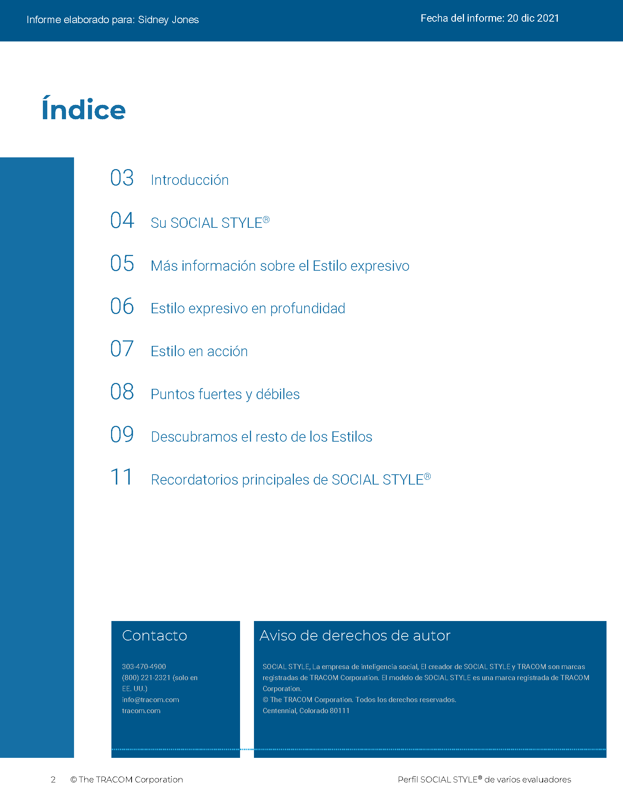
© The TRACOM Corporation. Todos los derechos reservados.
48
Notes:
20 Minutes
REVIEW the Profile pages on the following slides so participants understand the layout of the profile. After you’ve reviewed the slides, distribute individuals’ profiles.
If delivering a virtual program, participants will have already received their profiles. Note that you are only covering the SOCIAL STYLE section of the profile; the Versatility profile will be reviewed later.
PROVIDE ample time for participants to read and absorb their profiles. Do not continue until it is evident that all participants have finished reading their profiles.
ASK if there are any questions, surprises, or concerns.
ASK If your self-perception results were different, what might have caused the difference in views?
EXPLAIN TRACOM’s research shows that over 50% of the time, people see themselves differently from how others see them. Reiterate that there is no “best Style” and all Styles can be successful salespeople. Offer to be available during the break to answer individual questions or concerns.
NOTE: It is recommended that you take a break here and make yourself available for one-on-one conversations as participants may have questions or concerns they do not want to discuss publicly.

Slide 49
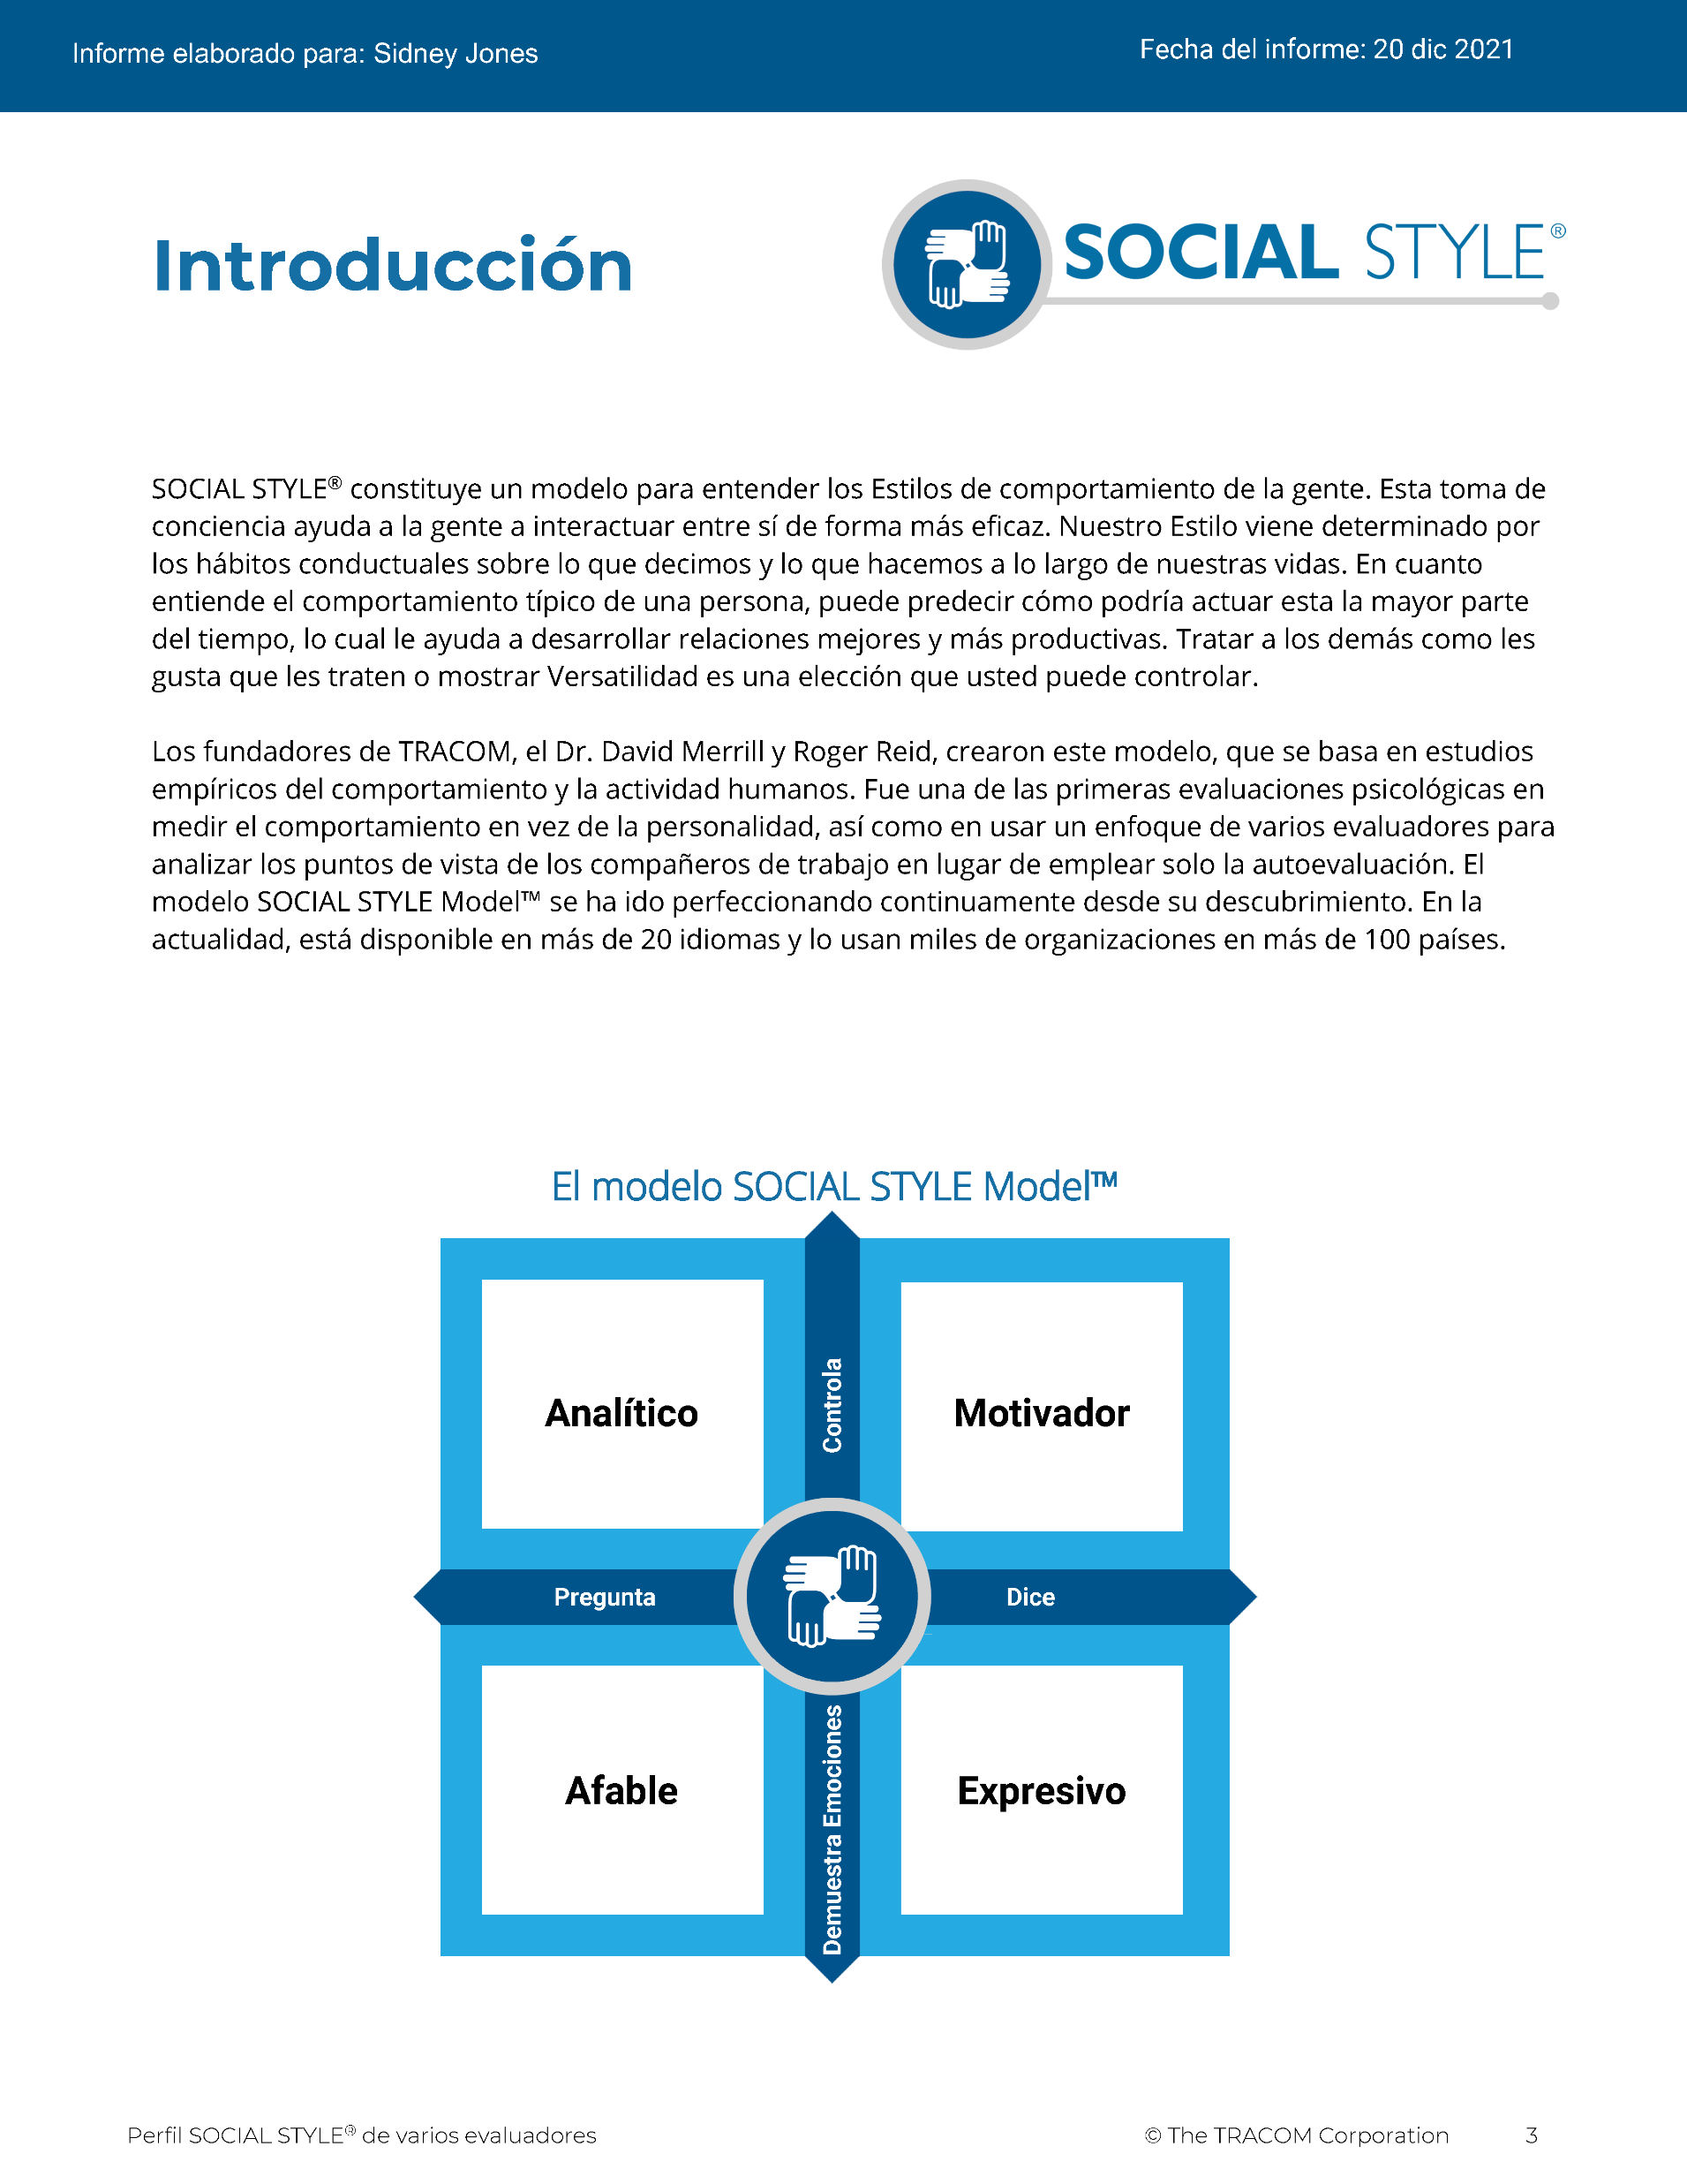
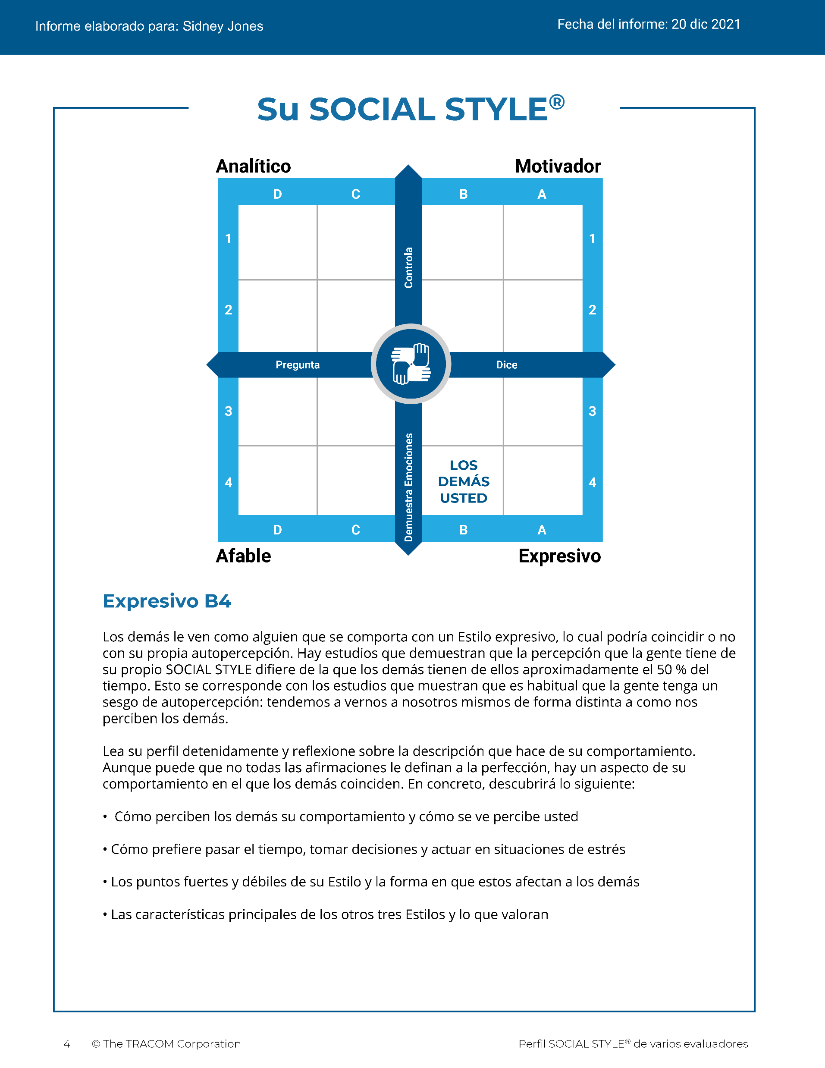
© The TRACOM Corporation. Todos los derechos reservados.
49
Notes:
Continue reviewing.

Slide 50
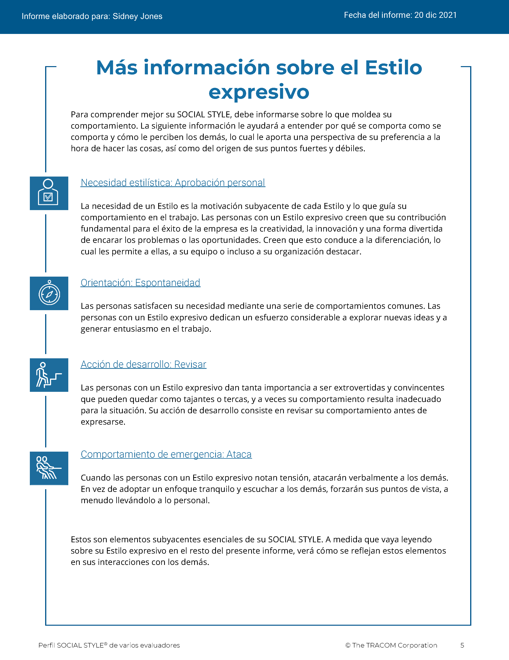
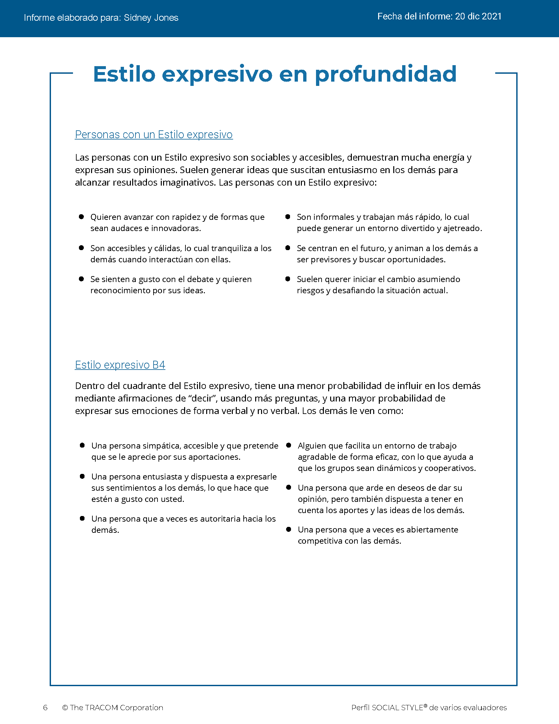
© The TRACOM Corporation. Todos los derechos reservados.
50
Notes:
Continue reviewing.

Slide 51
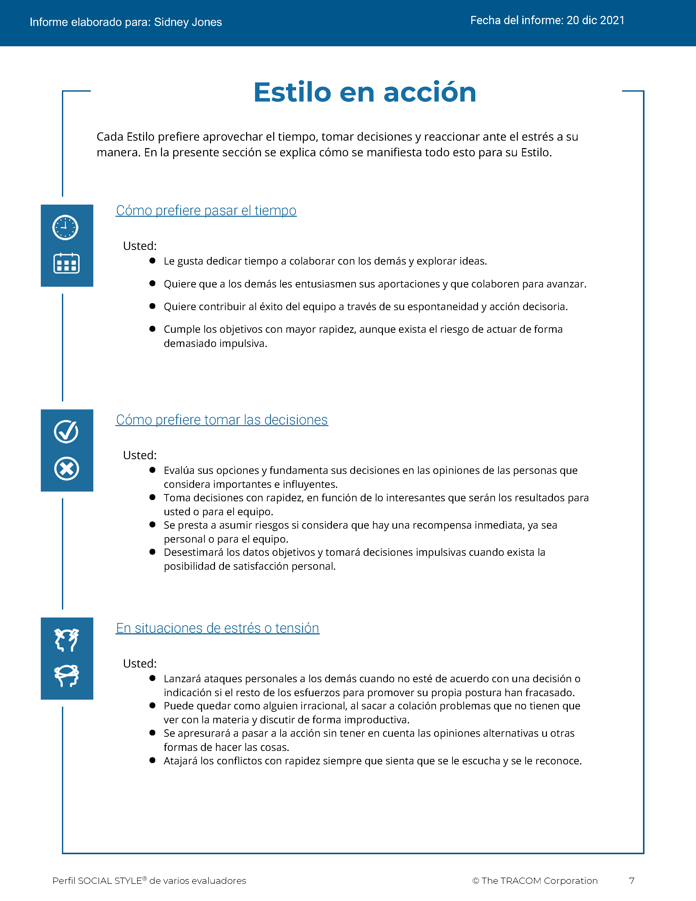
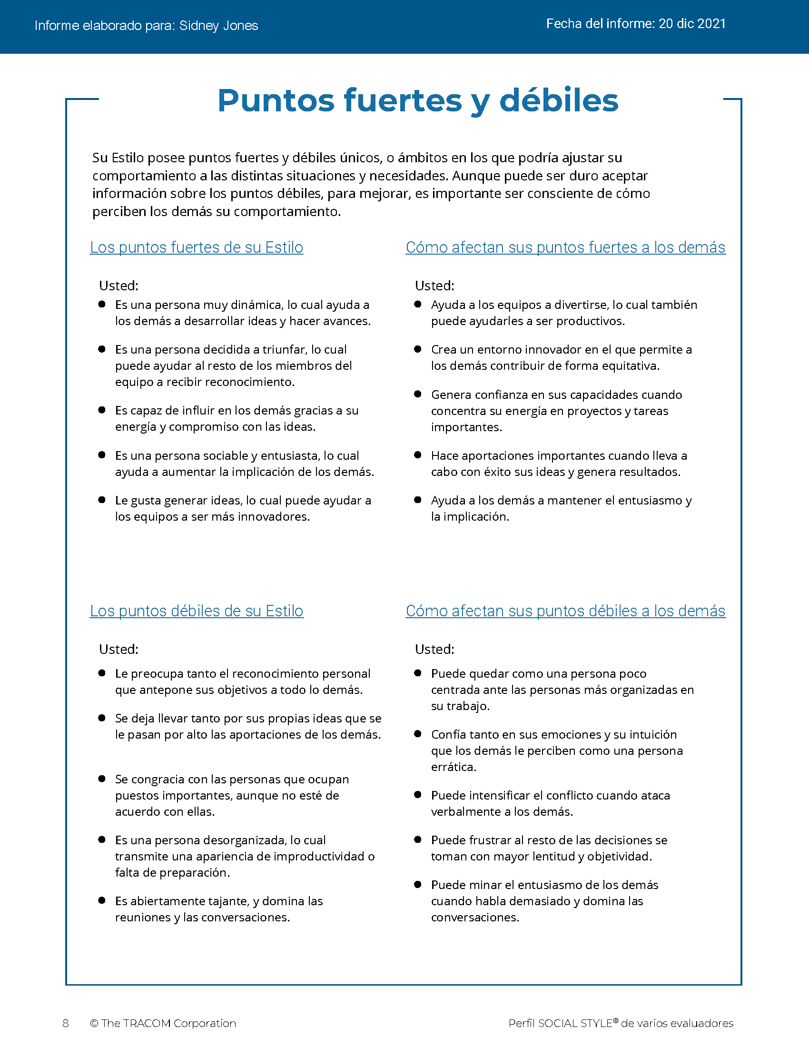
© The TRACOM Corporation. Todos los derechos reservados.
51
Notes:
Continue reviewing.

Slide 52
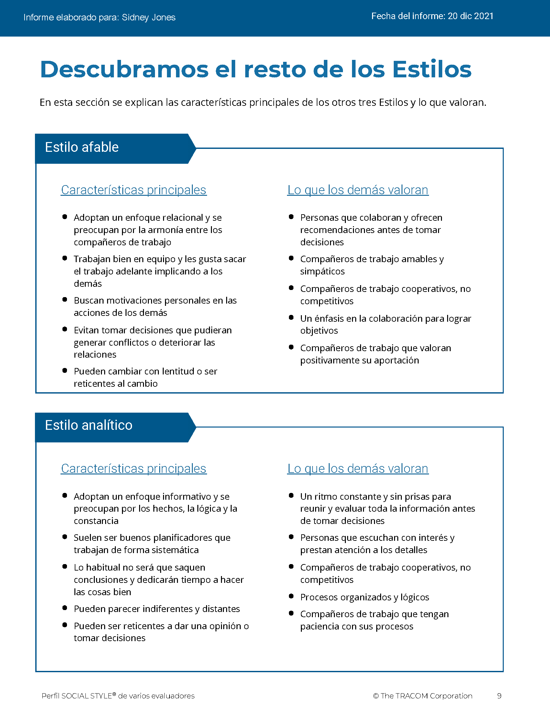
© The TRACOM Corporation. Todos los derechos reservados.
52
Notes:
Continue reviewing.

Slide 53
Materiales virtuales: Cómo acceder a su perfil
Inicie sesión en tracomlearning.com.
Introduzca su nombre de usuario y contraseña.
Descargue su informe.
Notes:
OPTIONAL: FOR VIRTUAL DELIVERY ONLY.
USE THE NEXT TWO SLIDES IF LEARNERS DOWNLOAD THEIR PROFILES DURING THE SESSION.
20 Minutes

Slide 54
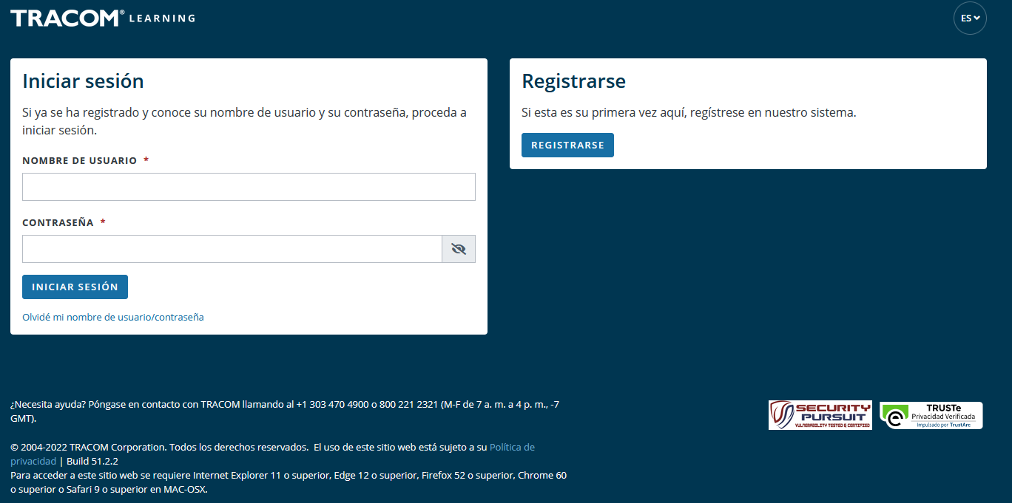
1. Vaya a tracomlearning.com
2. Introduzca su nombre de usuario y contraseña y pulse “Iniciar sesión”.
Notes:
SAY Login to tracomlearning.com. Use the same username and password as when you completed the assessment (survey).

Slide 55
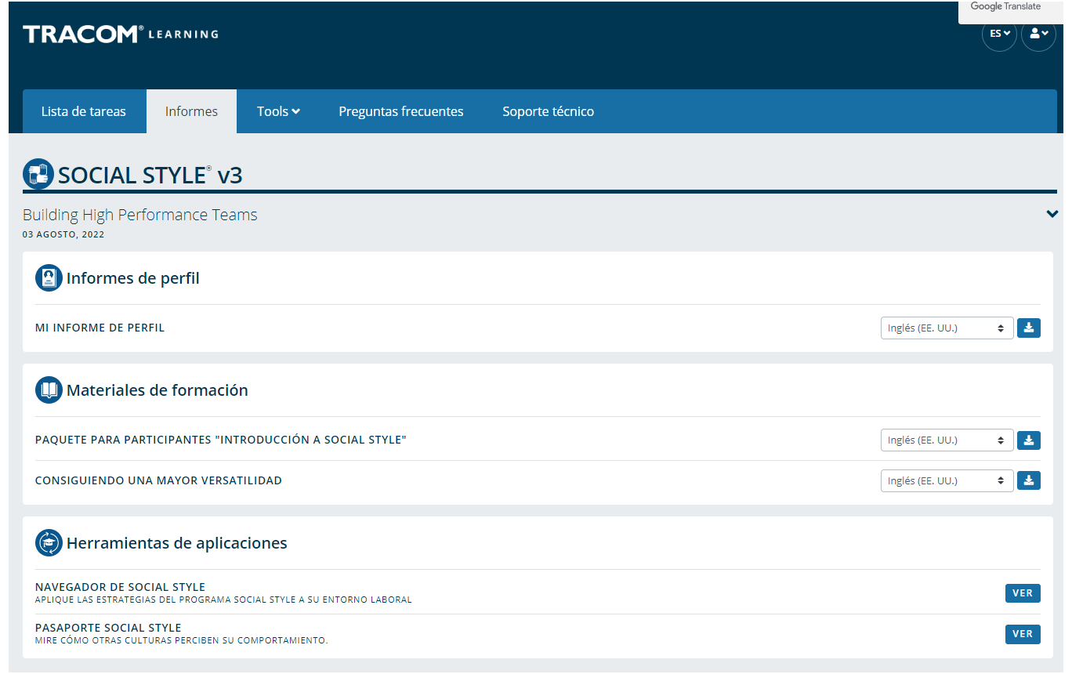
Descargue su perfil en la sección “Profile Reports” (Informes del perfil) haciendo clic en el icono “Download” (Descargar)
Notes:
SAY Your profile will be listed under “Profile Reports.” Click to download as a pdf.
Note: If the Learner selects the download button and the PDF does not open up (i.e., the screen just flashes), it is an indicator that their pop-up blockers are on. They need to allow pop-ups from tracomlearning.com and click the download button again. The profile report will open in a separate window. They can then save the profile report locally if they wish.

Slide 56
Conózcase y controle su Estilo
SOCIAL STYLE
Comportamientos de mi Estilo que frustran a los clientes de este Estilo
Algo que puedo hacer para controlar el comportamiento de mi Estilo
Motivador
Expresivo
Afable
Analítico
Notes:
10 Minutes (Workbook, page 29)
The purpose of this exercise is to help people begin to understand how some of their Style behavior can be challenging for customers and others. A later exercise will require learners to determine specific ways they can increase their Versatility towards people of other Styles.
SAY Each of us has behavior that frustrates others. Write down a brief list of your Style behaviors that frustrate customers of other Styles. Then, determine one specific thing you can do to control this behavior. Use the insights you discovered from your profiles to help.
ASK for volunteers to provide a sample of responses and write them on a flipchart. If delivering virtually, learners can chat some of their responses as a way of engaging the group.
SAY Next you will learn more about your own Versatility.

Slide 57
Técnicas para observar el Estilo
No saque conclusiones precipitadas
Manténgase objetivo
Separe el comportamiento de Estilo de la función o posición de la persona
Una cantidad moderada de estrés puede sacar a relucir el Estilo de las personas
Salga de la escena (sea un observador)
1
2
3
4
5
Notes:
5 Minutes (Workbook, page 29)
SAY The more accurately we are able to observe our customers’ Styles, the better we will be able to adapt our own behavior and “Do something for others” to increase Versatility.
DESCRIBE the best practices:
Don’t jump to conclusions about someone’s Style
Be an objective observer
Separate Style behavior from someone’s role or position
A moderate amount of stress can clarify someone’s Style
Get out of the way (be an observer)
ASK if there are any questions.

Slide 58
Versatilidad
Notes:
1 Minute
SAY You now have a good understanding of Style. What you learned from your profile is going to be useful during the next section, where we learn about Versatility and how to adjust to the Style needs of others.

Slide 59
Versatilidad es lo bien que uno se adapta a las necesidades del Estilo de los demás
Notes:
2 Minutes (Workbook, page 30)
SAY Versatility is a measure of your consistency in adjusting to the Style needs of others.
At the beginning of the program, we reviewed some statistics on Versatility. Research has found that Style and Versatility significantly help salespeople’s performance.
Versatility is completely within your control, so it is your choice to be versatile with others. You can be highly versatile with one group and show low Versatility with another group. It depends on the circumstances and how much you value your interpersonal effectiveness with each group.
It is completely independent of SOCIAL STYLE: Any Style can show Versatility and be successful.
Versatility is NOT the same as likeability. A person can be well liked but not have high Versatility. The opposite can also be true. Versatility helps you develop better working relationships, but it is separate from your personal likeability.

Slide 60
Las cuatro fuentes de la Versatilidad
El uso apropiado de
Imagen
Presentación
Competencia
Feedback
Genera una
mayor Versatilidad
Notes:
6 Minutes (Workbook, page 31)
Image remains a part of the Versatility model because it’s important for building relationships. Describe Versatility in a timeline:
SAY You show Versatility in four areas.
Image – When you first meet a new person at work, you form an impression about this person based on what you see, consciously or not. Essentially Image is a first impression: Are you dressed appropriately for the situation, for the work culture, for the client, and so on?
Note that Image is not measured as part of your Profile. This is because:
Image is difficult to observe in virtual environments. We can’t observe very well how people are dressed, and because there is a wide variety of dress codes, even within companies and teams, it is less relevant to measure Image in this way.
Raters don’t always like answering questions about people’s Image without understanding the context of how Image is explained in training.
Image is still important for many people and companies, which is why it’s part of the model. However, you won’t receive a measure of your Image.
Presentation – When a person communicates in meetings or other public venues, you’ll notice how clear they are at helping people understand their points. Do they use clear language? Are their examples effective? Do they take others’ Styles into account?
Competence – Over time, you’ll observe this person in a variety of situations. Are they reliable and do they persevere during difficult times? Are they flexible when change happens? Are they optimistic most of the time? Do they show creativity?
Feedback – Finally, this is the most interpersonal part of Versatility. Are they a good listener? Do they show empathy for others’ situations? Do they meet the needs of other people’s Styles? Do they develop good relationships with others?

Slide 61
La Versatilidad en acción
¿Qué ha hecho cada persona para actuar con Versatilidad?
¿Cuáles han sido sus comportamientos específicos?
Kyle
Lana
AJ
Abby
Notes:
12 Minutes (Workbook, page 32)
SAY We are now going to revisit our video characters in a continuation of their earlier meeting.
ASK participants to take notes in their participant workbooks on page 32 as they watch the video:
What did each person do to act with Versatility?
What were their specific behaviors?
PLAY the video, Part 2.
CONDUCT a debrief of the video, soliciting participants’ responses to the above questions.

Slide 62
Perfil de Versatilidad
Notes:
1 Minute
SAY Now you will learn about the Versatility Profile and will review your profile. There is a lot of information about Versatility—not only how you’re perceived, but also simple strategies to adjust your behavior and increase Versatility.
This profile is a resource for you. You will use it for the Versatility exercises during the rest of the program.

Slide 63
Versatilidad
Una medida de la constancia con que se adapta a las necesidades del Estilo de los demás
W | Nada constante | X | Algo constante | Y | Normalmente constante | Z | Muy constante
Notes:
2 Minutes
SAY We measure Versatility on a scale ranging from W to Z. These are normed quartiles, just like Assertiveness and Responsiveness.
When you aren’t consistent in your behavior, you’re usually focusing on your own Style needs. When you consistently show Versatility, you’re focusing on meeting others’ Style needs.
Your profile will show your results on this scale, ranging from W (not consistent) to Z (very consistent).

Slide 64
El significado de cada posición en la Versatilidad
 | 1 | 2 | 3 | 4 | 5
 | Totalmente en desacuerdo | En desacuerdo | Ni de acuerdo Ni en desacuerdo | De acuerdo | Totalmente de acuerdo
1. Afronta las situaciones nuevas con una perspectiva positiva. | ◯ | ◯ | ◯ | ◯ | ◯
2. Crea buenas relaciones con los compañeros de trabajo. | ◯ | ◯ | ◯ | ◯ | ◯
3. Presenta ideas de manera eficaz a los grupos. | ◯ | ◯ | ◯ | ◯ | ◯
W | X Y | Z
Constancia
Notes:
3 Minutes
Before delivering Versatility profiles, explain the meaning of the positions.
SAY Before reviewing your results in more detail, let’s put your results into context. This graph shows several sample items that measure Versatility.
You and your raters (if multi-rater) responded to these items using the scale ranging from ‘strongly disagree’ to ‘strongly agree’. TRACOM assigns values to each of these scale points: 1 to 5.
When rating Versatility, most people respond at the higher end of the rating scale. This makes sense since most people have at least some abilities in these areas. This means that the cutoff for achieving Z Versatility is very high, approximately 4.5 or higher.
Similarly, to score either an X or Y requires scores between 3.5 and 4.5. These are approximate values used for purposes of explanation.
Importantly, if you receive a W in any area of Versatility, this DOES NOT mean that your raters (if multi-rater) or yourself evaluated you at the low end of the rating scale. On the contrary, almost nobody scores at the lowest end – 1 or 2. For people with a W result, most of their ratings fluctuate between 2 and 4, resulting in an average score of slightly less than 3.5.
So, putting this into context, a W rating means that you are not showing as much consistency in these behaviors as you could. With effort and more consistency, your evaluation would improve.
Set the context:
W does not mean that you lack ability.
It doesn’t mean that your raters (if Multi-rater) evaluated you at the lowest end of the rating scale.
It doesn’t mean they don’t like you or don’t think you’re effective (if multi-rater)
It does mean that you’re not highly consistent in your behavior; you do these things some of the time but could do them more often.
It does mean that your raters (if multi-rater) evaluated you between ‘disagree’ and ‘agree’, on average.
Note that these cutoff values (3.5 and 4.5) are only for demonstration – they aren’t the exact values in TRACOM’s norms, but they are close.
Giving the context is critical because it helps to ease people’s automatic reactions to the profile.
Then:
Help people focus on just one area to improve. This increases chances of success.
What is ‘low hanging fruit?’ Something they can improve quickly.

Slide 65
Versatilidad general
La constancia de su comportamiento con Versatilidad
W | Nada constante | X | Algo constante | Y | Normalmente constante | Z | Muy constante
 |  | LOS DEMÁS |  | UNO MISMO
Notes:
2 Minutes
SAY Overall Versatility is a combination of your results in three areas: Presentation, Competence, and Feedback.
The “Others” position is the average of your raters’ evaluations. The “Self” position is where you evaluated yourself.
Like Assertiveness and Responsiveness, Versatility is normed in quartiles: W, X, Y, and Z.
Versatility is all about consistency of behavior.
A lower Versatility score does NOT mean you lack ability or that you never demonstrate these abilities.
What it DOES mean is that you aren’t showing consistency in your behavior.
By making small changes to your behavior and acting with more consistency, you can increase your Versatility. (Recall that the difference in values between W and Z are small but meaningful.)

Slide 66
La Versatilidad al detalle
Presentación: X
W | Nada constante | X | Algo constante | Y | Normalmente constante | Z | Muy constante
 |  | LOS DEMÁS |  |  |  | UNO MISMO
La constancia de su comportamiento con Versatilidad
Competencia: Y
W | Nada constante | X | Algo constante | Y | Normalmente constante | Z | Muy constante
 |  |  |  | LOS DEMÁS |  | UNO MISMO
Feedback: X
W | Nada constante | X | Algo constante | Y | Normalmente constante | Z | Muy constante
 |  | LOS DEMÁS |  | UNO MISMO
Notes:
2 Minutes
Each source of Versatility is explained the same as Overall Versatility – it is a measure of consistency of behavior.
Remember that Image is not measured because:
Image is difficult to observe in virtual environments. We can’t see very well how people are dressed, and because there is a wide variety of dress codes, even within companies and teams, it is less relevant to measure Image in this way.
Raters don’t always like answering questions about people’s Image without understanding the context of how Image is explained in training.
Image is still important for many people and companies, which is why it’s part of the Model. However, you won’t receive a measure of your Image.
Presentation – When a person communicates in meetings or other public venues, you’ll notice how clear they are at helping people understand their points. Do they use clear language? Are their examples effective? Do they take others’ Styles into account?
Competence – Over time, you’ll observe this person in a variety of situations. Are they reliable and do they persevere during difficult times? Are they flexible when change happens? Are they optimistic most of the time? Do they show creativity?
Feedback – Finally, this is the most interpersonal part of Versatility. Are they a good listener? Do they show empathy for others’ situations? Do they meet the needs of other people’s Styles? Do they develop good relationships with others?

Slide 67
© The TRACOM Corporation. Todos los derechos reservados.
67
Notes:
20 Minutes
Review the Profile pages so participants understand the layout of the Profile. After you’ve reviewed the profile, distribute individuals’ profiles.
PROVIDE ample time for participants to read and absorb their reports. Do not continue until it is evident that all participants have finished reading their reports.
ASK if there are any questions, surprises, or concerns.
ASK If your self-perception results were different, what might have caused the difference in views?
NOTE: It is recommended that you take a break here and make yourself available for one-on-one conversations as participants may have questions or concerns they do not want to discuss with the entire class.

Slide 68
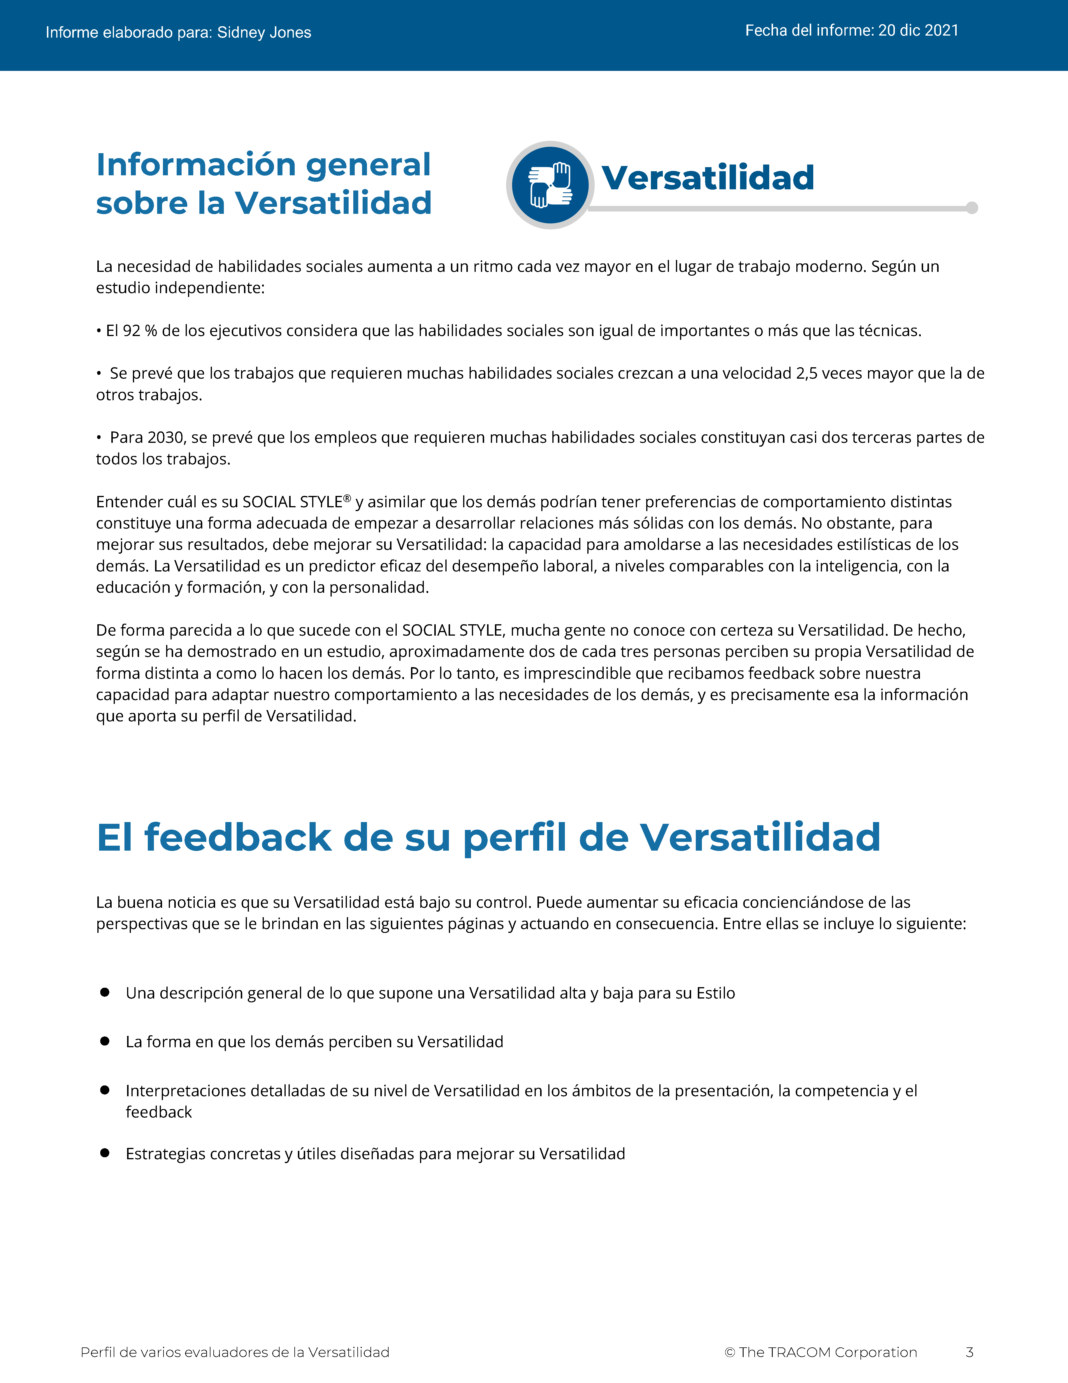
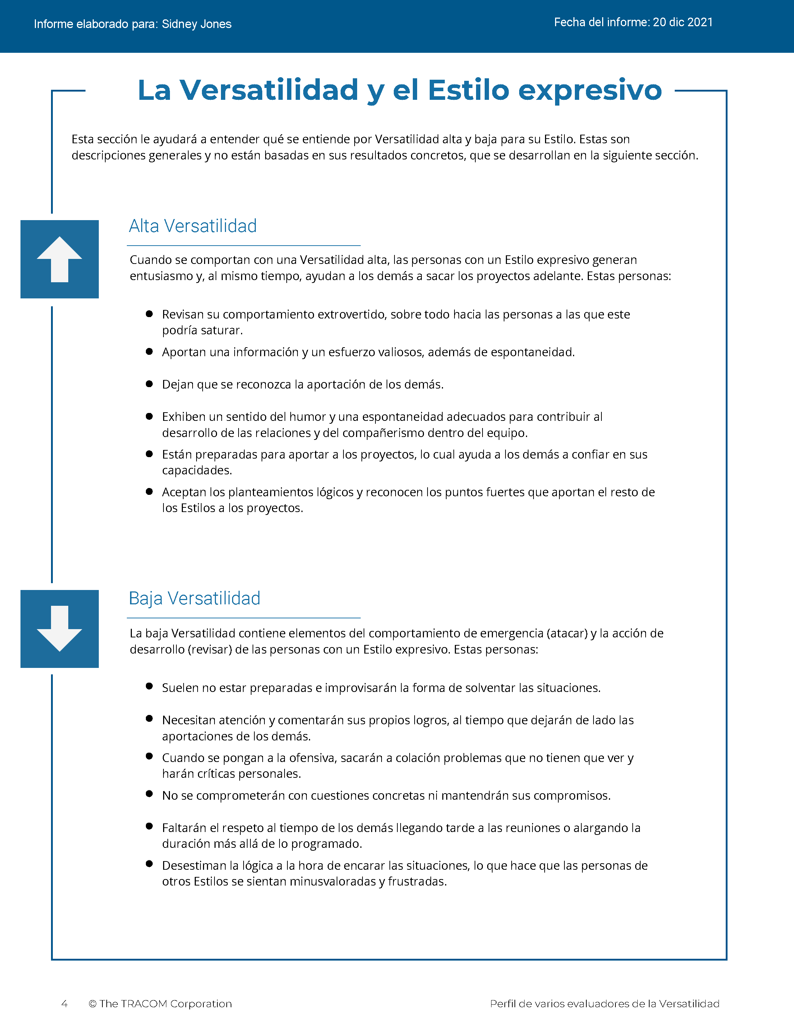
© The TRACOM Corporation. Todos los derechos reservados.
68
Notes:
Continue reviewing.

Slide 69
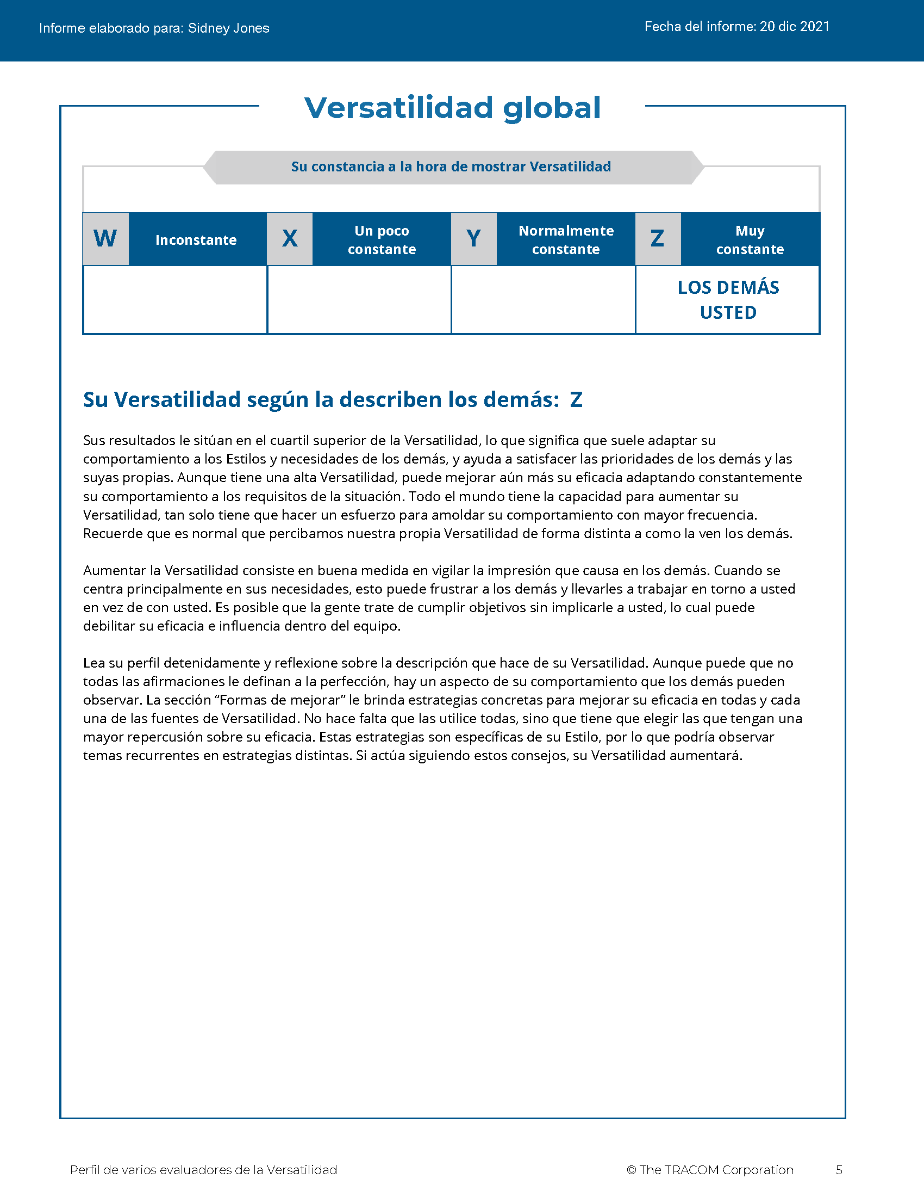
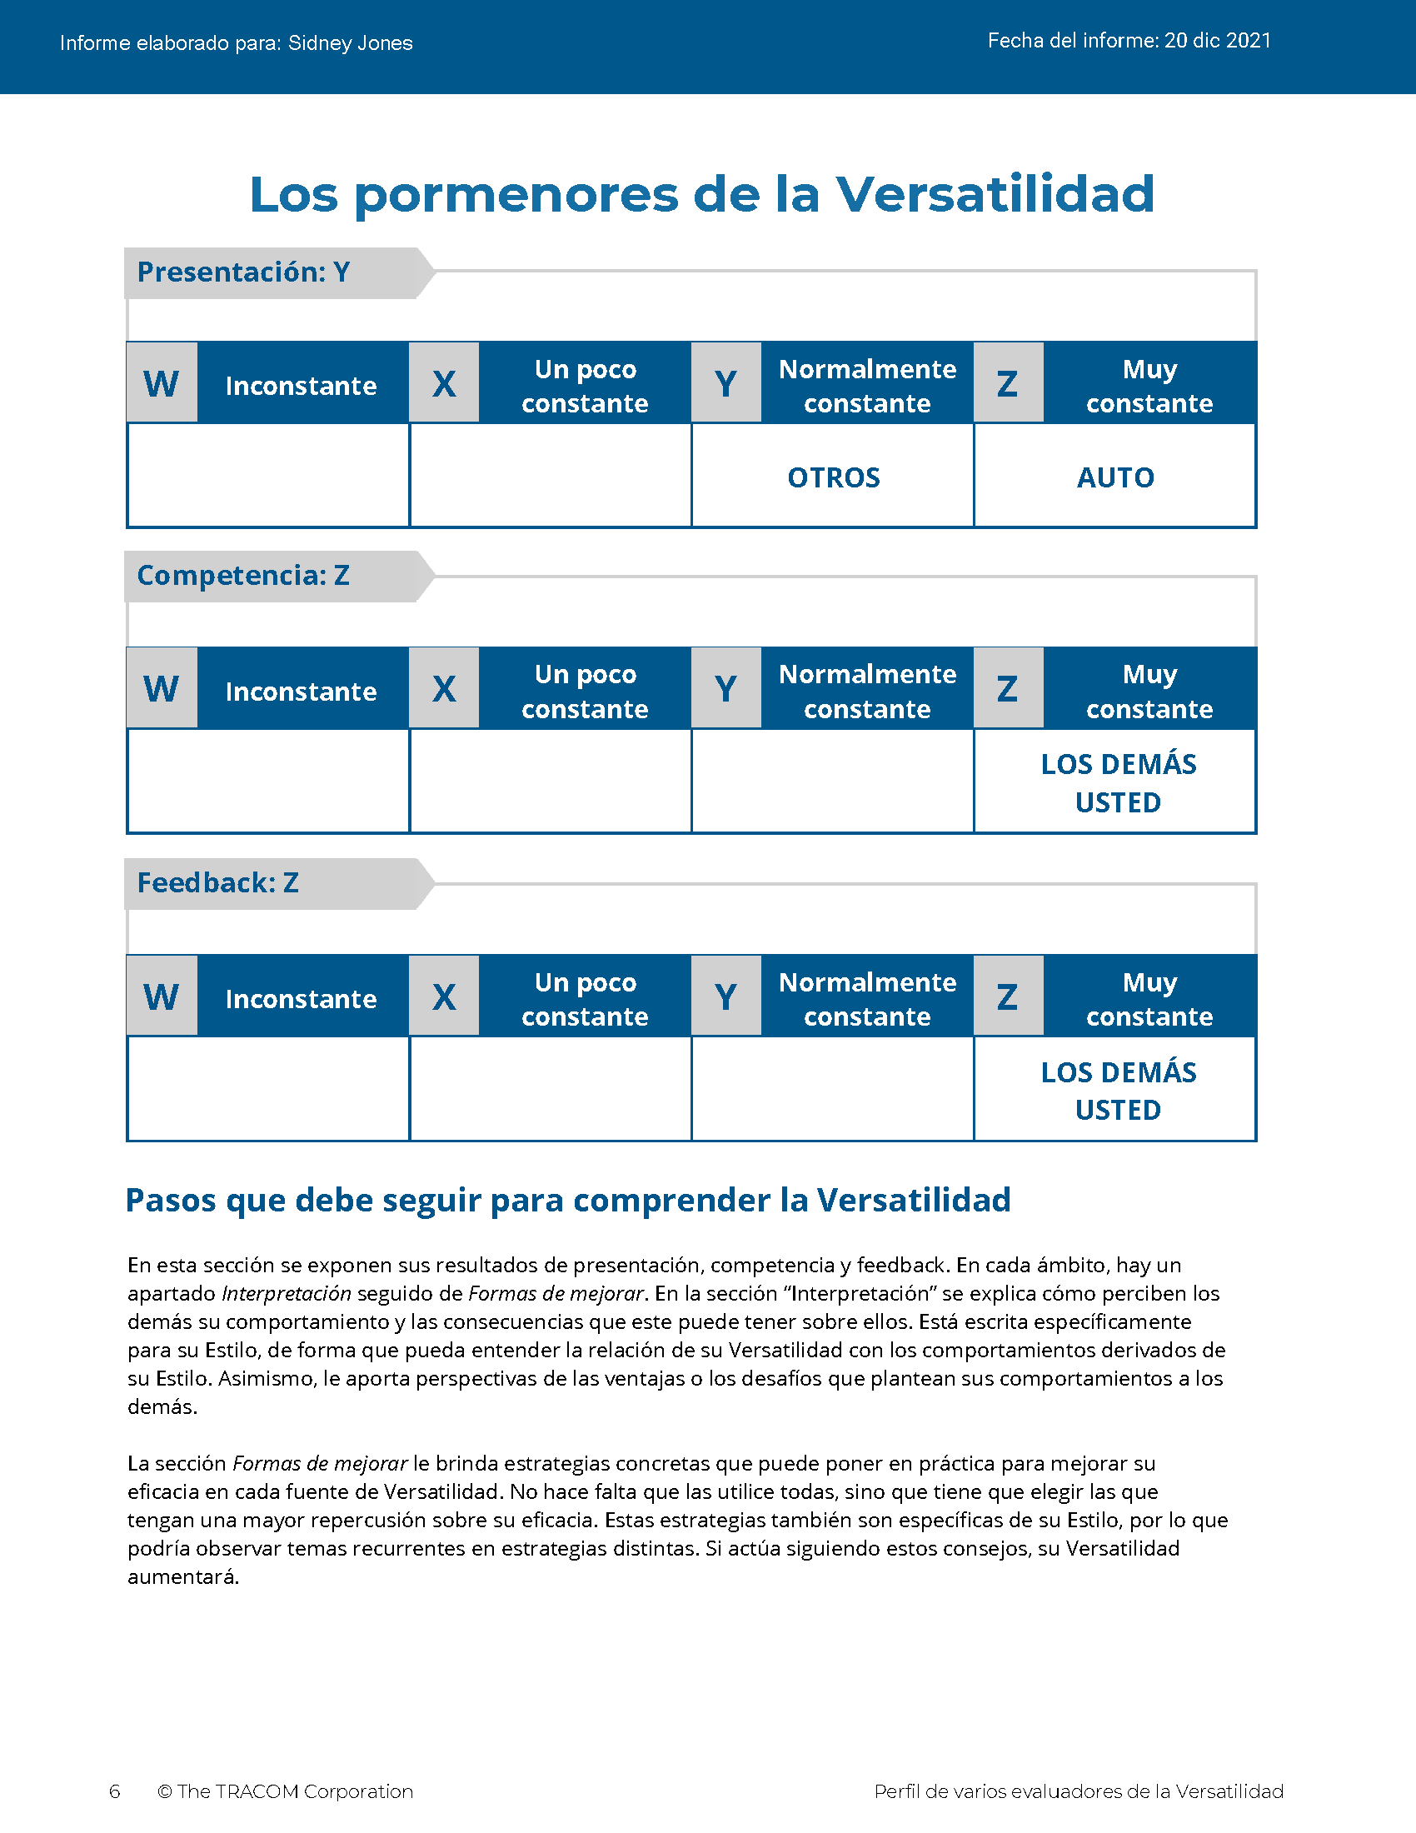
© The TRACOM Corporation. Todos los derechos reservados.
69
Notes:
Continue reviewing.

Slide 70
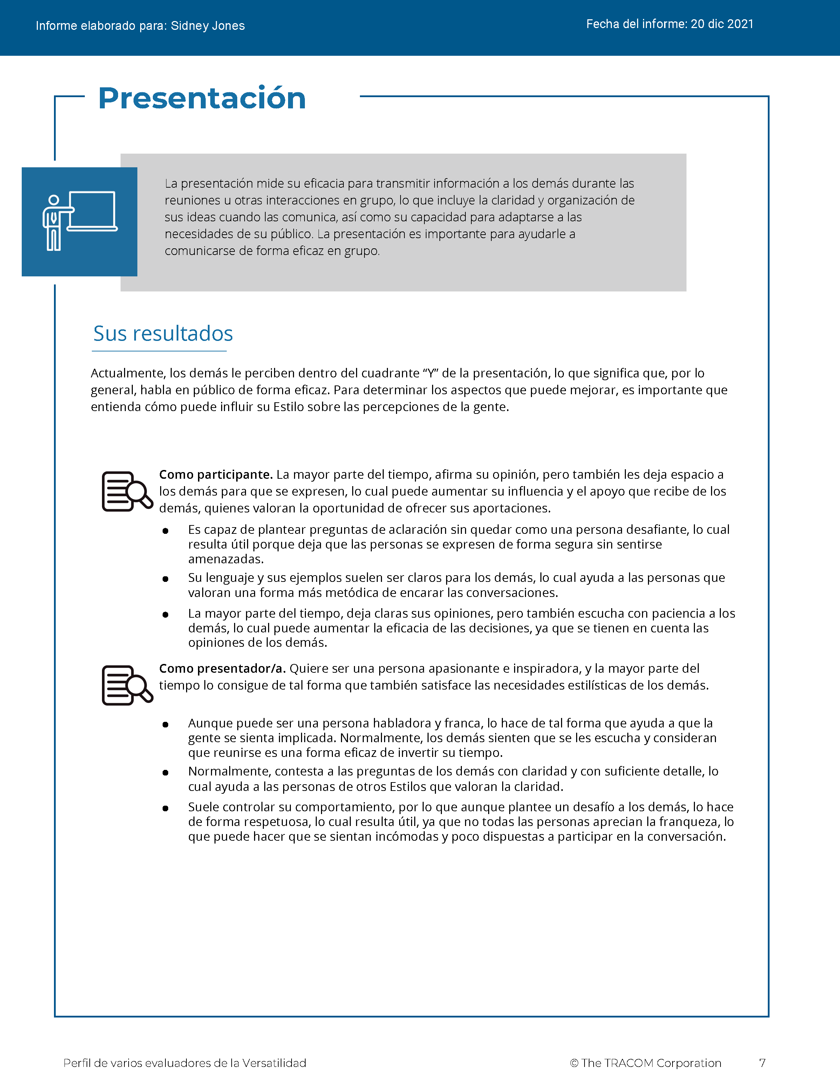
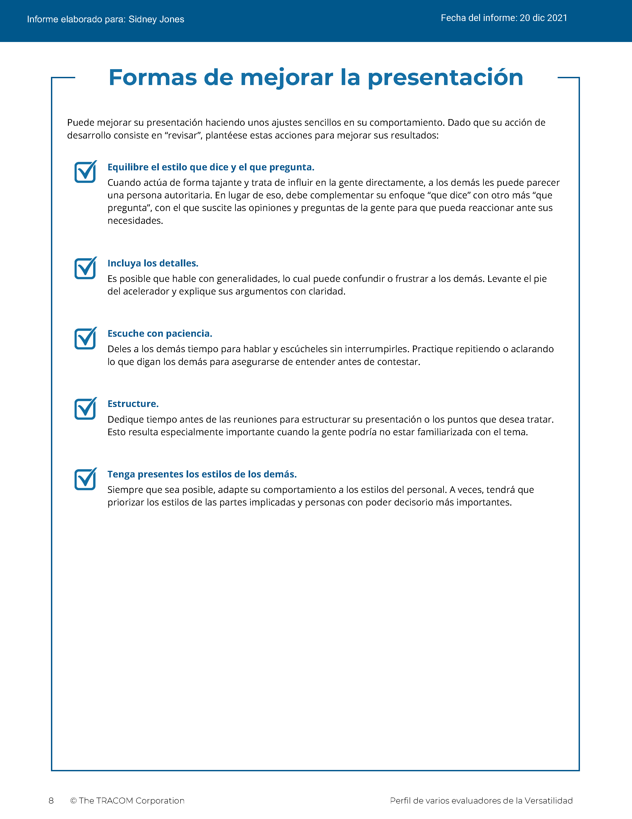
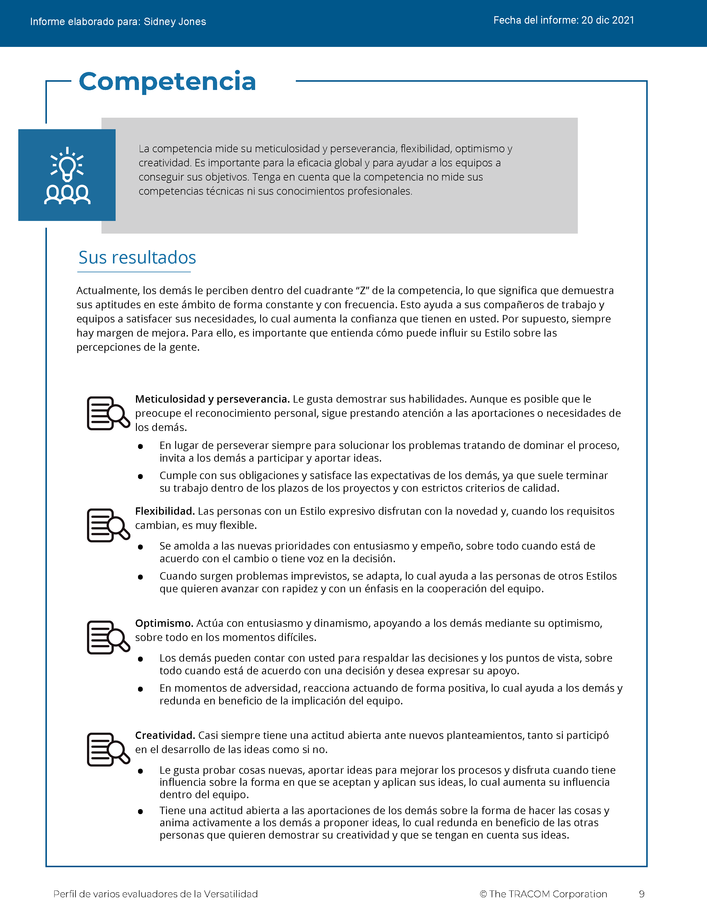
© The TRACOM Corporation. Todos los derechos reservados.
70
Notes:
Continue reviewing.

Slide 71
Pasos para aumentar la eficacia interpersonal
Hacer algo por los demás
Controlarse a uno mismo
Reconozca su influencia en los demás
Gestione su propio comportamiento
Observe objetivamente a los demás
Ayude a satisfacer las necesidades del Estilo de los demás
Conocerse a uno mismo
Conocer a los demás
Notes:
5 Minutes (Workbook, page 33)
SAY At the beginning of the program, we talked about the four steps for increasing interpersonal effectiveness. Now that you’ve reviewed your Versatility profiles, let’s review these again as we think about ways to adjust behavior to increase Versatility.
REVIEW the four steps for increasing interpersonal effectiveness:
1. Know Yourself by recognizing the impact your Style has on others.
2. Control Yourself by managing your own Style behavior and being tolerant of others’ Styles.
3. Know Others by observing them more objectively.
4. Do Something For Others by helping them meet their Style needs. This eases their tension and opens the door for them to act with Versatility towards you.
SAY To finish the program, we’re going to focus on Doing Something for Others. You’re going to create an action plan to increase Versatility with your customers. First, we’ll review some strategies for showing Versatility towards each Style. This will give you important information for creating your action plan.

Slide 72
Preparar las reuniones
Controla
Analítico
SE DEBE
Compartir agenda de antemano
Verificar que los detalles de la reunión sean suficientes
Estar bien preparado
NO SE DEBE
Esperar mucha conversación
Centrar la atención en las relaciones personales
Desestimar sus aportes
Motivador
SE DEBE
Indicar los resultados esperados
Obtener su aprobación de la agenda
Permitir el control de los detalles de la reunión
NO SE DEBE
Empezar tarde
Ser desorganizado
Bloquear decisiones innecesariamente
Pregunta
Dice
Afable
SE DEBE
Crear la agenda en colaboración
Acudir temprano para la fase de socialización
Entrar con la cámara y el micrófono activados
NO SE DEBE
Asumir interés porque se aceptó la reunión
Pasar directamente a asumir la tarea de las comunicaciones
Hacer que otros participen sin avisarles de antemano
Expresivo
SE DEBE
Pedir su opinión sobre la agenda
Saludarlos de inmediato
Permitir cierta diversión
NO SE DEBE
Proporcionar demasiados detalles por adelantado
Recapitular lo anterior con detalle
Estructurar demasiado la reunión
Demuestra emociones
Notes:
6 Minutes (Workbook, page 34)
SAY Part of showing Versatility is recognizing customers’ needs and preparing ahead of time. Here are some meeting strategies for each Style.
CLICK TO REVEAL THE TEXT IN EACH QUADRANT.
REVIEW the do’s and don’ts when preparing for meetings.

Slide 73
Personalizar los mensajes
Controla
Analítico
Lo que hemos hecho hasta ahora, en base a la información, es esto...
Suponemos lo siguiente…
Los riesgos son los siguientes…
En base a ello, recomendamos…
Motivador
Vamos a conseguir los resultados que desea.
Contamos con un experimentado equipo de primer nivel.
Nuestro equipo le conseguirá objetivos rápidamente.
Podemos empezar de inmediato.
Pregunta
Dice
Afable
Lo que va a seguir igual y lo que va a cambiar es lo siguiente.
Ya hemos hecho esto muchas veces antes.
Esta es la lista de personas a las que puede llamar para consultar.
Nos comprometemos a trabajar en colaboración.
Expresivo
Es un placer ayudarle a poner esto en marcha.
Cuando se complete el cambio, usted va a ser un alto directivo a nivel internacional.
Va a significar un gran avance para usted y su organización.
La alta dirección respalda este cambio por completo.
Demuestra emociones
Notes:
6 Minutes (Workbook, page 35)
SAY Most of us fall into the habit of communicating with people in ways that are comfortable for us, without thinking of the needs of the customer. This is often because we’re rushed and send out quick emails. Communicating in Style-specific ways is very important for meeting your customers’ needs. Here are some simple strategies for tailoring your messages to each Style.
CLICK TO REVEAL THE TEXT IN EACH QUADRANT.
REVIEW the techniques for tailoring messages to each Style.

Slide 74
Usar la Versatilidad para ganarse la confianza
Controla
Analítico
Demuestre que es capaz
Exprese la lógica detrás de las propuestas
Céntrese en la calidad
Prepárese con anticipación y conozca su organización
Exprese los pros y los contras
Deje que crezca la relación personal sin presiones
Motivador
Muestre confianza en sus habilidades
Infórmele si no se puede cumplir con lo exigido
Sea franco
Adáptese al ritmo rápido
Comunique que ha comprendido los resultados deseados
Sea eficiente con su tiempo
Pregunta
Dice
Afable
Comparta la información personal que sea relevante
Sea original y sincero
Muestre su compromiso para ayudar
Empatice con sus necesidades
Evite presiones innecesarias
Recuerde los nombres de las personas clave con quien están relacionados
Expresivo
Mantenga una postura informal y abierta
No oculte innecesariamente sus sentimientos
Evite desafiarlos o competir con ellos
Muestre entusiasmo por sus ideas y puntos de vista
Présteles toda su atención
Hable de temas no relacionados con el trabajo
Demuestra emociones
Notes:
8 Minutes (Workbook, page 36)
ASK Given a customer’s Style need, what are some ways to earn trust?
FACILITATE a discussion of each Style before revealing the text.
ASK What are some ways to earn trust from people of each Style? Think about their Style needs—what do they value from salespeople?
CLICK TO REVEAL THE TEXT IN EACH QUADRANT.

Slide 75
Plan de acción de Versatilidad
Elaborar un plan de acción para aumentar la Versatilidad con los clientes.
Instrucciones:
Evalúe el Estilo del cliente que ha identificado.
¿Cómo puede obstaculizar su Estilo en la mejora de la relación? (Piense en la acción de crecimiento de su Estilo).
¿Qué acciones puede llevar a cabo para aumentar la Versatilidad con este cliente?
En su grupo de trabajo, discuta su plan y pida la opinión del grupo.
75
Notes:
30 Minutes (Workbook, page 37)
SAY Use the insights you’ve learned and create a specific plan for yourself. Writing down your intentions is a proven way of making sure you actually do something. Decide on just one or two things you can do differently.
Remember your Style growth actions, since managing your own Style behavior is an important part of being versatile.
REVIEW the Style growth actions:
Driving: to listen
Expressive: to check
Amiable: to initiate
Analytical: to declare
SAY When you’ve finished this, we will put you in small breakout groups to share your insights and give feedback to one another.
CREATE breakout groups of 2 to 3 people.

Slide 76
Observar la Versatilidad de forma virtual
Notes:
10 Minutes (whole section on Observing Versatility Virtually)
SAY Briefly, before we finish—remember those text messages we reviewed earlier? Let’s bring Versatility into those conversations.

Slide 77
Llamo para ver si ha tenido la oportunidad de ver el vídeo que le he enviado sobre las últimas actualizaciones tecnológicas. ¿Qué piensa?
Notes:
SAY We had four responses to this message. Let’s look at how the person who sent this message might respond to each of these individuals. Is the person showing Versatility in each message?

Slide 78
¡Hola! Veo que son muchos cambios que se van a aplicar muy rápido. Habrá que formar a mi equipo sobre las nuevas características. ¿Puede ayudarnos con eso?
Parece un cambio muy grande, pero estas actualizaciones van a mejorar la colaboración de su equipo. Voy a redactar un plan para formar a su equipo y estaré disponible en caso de que surja algún problema. Estoy aquí para ayudarle a usted y al equipo.
Notes:
SAY This message came from the Amiable Style customer.
Click to reveal.
SAY And here is the response. What do you think? Is the salesperson showing Versatility toward the Amiable Style person? What would you add or change to the response?
NOTE: The salesperson is making an effort to meet the person’s Style needs by reassuring them about the changes. The salesperson offers to help the customer by developing a training plan, then reassures them that they will be supported.

Slide 79
¡Es emocionante! He echado un vistazo rápido y las nuevas características parecen sensacionales. Le llamaré la semana que viene.
Sí, las actualizaciones van a funcionar muy bien. Hablamos más tarde.
Notes:
SAY This message came from the Expressive Style person.
Click to reveal.
SAY And here is the response. What do you think? Is the salesperson showing Versatility toward the Expressive Style customer?
Is the response focused on their own needs, or the Expressive Style person’s needs? What would be a more effective response?
NOTE: The salesperson is diminishing the customer’s enthusiasm. A more effective response would be to reflect the enthusiasm by reiterating how great the new upgrades are and how excited the salesperson is about the changes, then offer to set up a call with the customer.

Slide 80
Me parece que estas nuevas actualizaciones nos van a ayudar a ser más eficientes y nos ahorrarán algo de esfuerzo. Sin embargo, antes de adaptarnos a la nueva versión, necesitaremos planificar la formación de mi equipo. ¿Hay algún proceso establecido para eso?
Hemos probado las actualizaciones y muestran una mejora significativa en el rendimiento. Le enviaré los datos, junto con una agenda de formación y las fechas disponibles. Si necesita cualquier cosa más, dígamelo.
Notes:
SAY This message came from the Analytical Style customer.
Click to reveal.
SAY And here is the response. What do you think? Is the salesperson showing Versatility toward the Analytical Style person? What would you add or change to the response?
NOTE: The salesperson is making an effort to meet the customer’s Analytical Style needs by recognizing their need to prepare ahead of time by getting training. The salesperson offers to send more detailed information about the upgrades as an effort to give the customer more information and alleviate any remaining concerns. They also open the conversation to more input by offering to help in any other way.

Slide 81
Tiene buen aspecto. Le llamaré cuando esté listo para ponerlo en marcha.
De acuerdo.
Notes:
SAY This message came from the Driving Style customer.
Click to reveal.
SAY And here is the response. What do you think? Is the salesperson showing Versatility toward the Driving Style customer?
Is the response focused on their own needs, or the Driving Style person’s needs? What would be a more effective response?
NOTE: Though Driving Style people appreciate brevity, the salesperson is dismissive and is missing important elements of the customer’s Style. The salesperson should recognize that the customer probably hasn’t reviewed the upgrades in detail. The salesperson should state that they are there to help move forward, and also offer options to meet with the customer to discuss the changes and listen to their input.

Slide 82
Próximos pasos
Practique la Versatilidad. Guarde su plan de acción en un lugar cercano para tenerlo como referencia.
SOCIAL STYLE Navigator cuenta con consejos sobre muchas situaciones de ventas, junto con recursos adicionales.
SOCIAL STYLE Passport le permite ver cómo encajaría en otro país.
Notes:
5 Minutes (Workbook, page 38)
SHARE key “takeaways” with the class:
The key to more effective performance is to practice what you’ve learned. Keep your Versatility Action Plan nearby as a reminder. As you begin to experience positive results, this will reinforce your commitment to practice Versatility.
There are additional resources that will help you. TRACOM’s SOCIAL STYLE Navigator contains advice for working with customers in a variety of situations, such as giving presentations, advancing the sale, and having difficult conversations. You can access this resource by logging in at tracomlearning.com.
NOTE the following slides describe SOCIAL STYLE Navigator in more detail.

Slide 83
SOCIAL STYLE Navigator®
SOCIAL STYLE Estimator Una breve encuesta que estima el Estilo de las personas
SOCIAL STYLE Advisor
Preparación para reuniones, negociaciones y presentaciones.
Mejores prácticas de Estilo y Versatilidad para muchas situaciones
Módulos de aprendizaje electrónico Se aplican los conceptos de Estilo a los equipos, para gestionar los conflictos y entrenamiento
SOCIAL STYLE Navigator® es una marca registrada de TRACOM Corporation
Notes:
1 Minute
SAY You now have free and unlimited access to SOCIAL STYLE Navigator, the on-demand micro-learning tool that helps you apply Style and Versatility.
SOCIAL STYLE Navigator includes:
SOCIAL STYLE Estimator
The Estimator survey provides users with an interactive tool that evaluates observable behavior in others to determine their Style and helps you plan ahead for successful interactions.
SOCIAL STYLE Advisor
Use Advisor topics to prepare “just-in-time” for meetings, negotiations or sales presentations with advice on navigating Style and Versatility best practices to maximize high-performing relationships.
eLearning modules
Continue your learning journey via micro-learning that reinforces ways to apply SOCIAL STYLE and Versatility to Working in Teams, Coaching and Managing Conflict.

Slide 84
Acceso a SOCIAL STYLE Navigator®
Disponible en tracomlearning.com
Notes:
1 Minute
SAY Available through www.tracomlearning.com
Enter your username and password for free, unlimited access to SOCIAL STYLE Navigator®

Slide 85
Notes:
Optional demonstration, time permitting

Slide 86
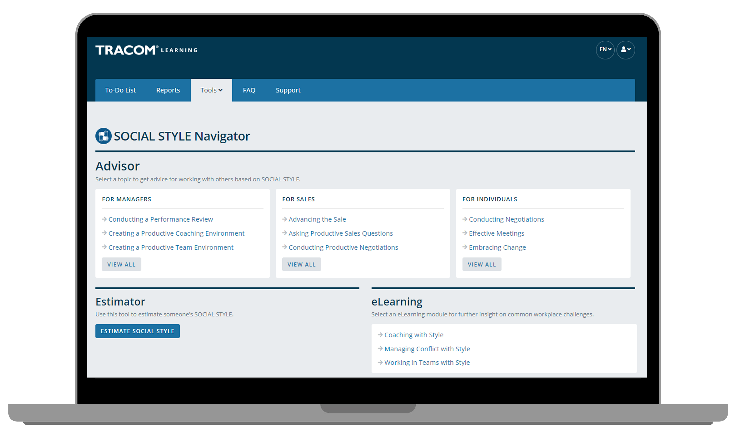
Notes:
Optional demonstration, time permitting

Slide 87
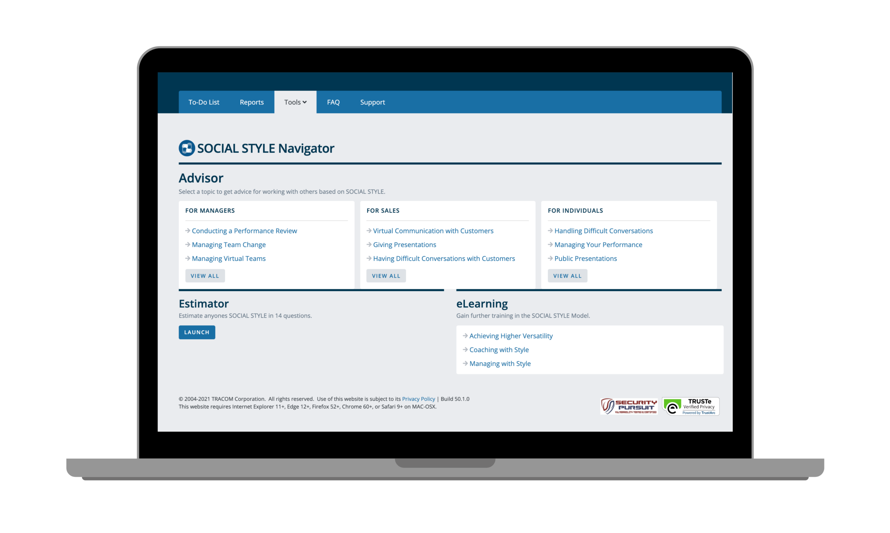
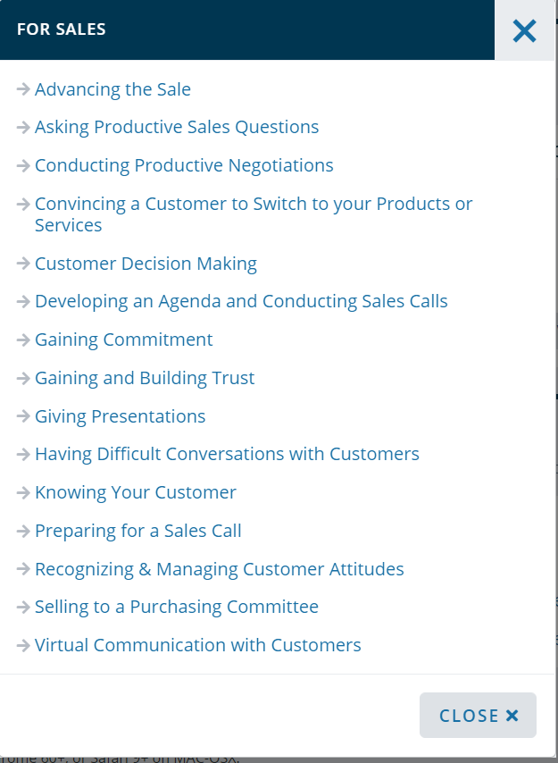
Notes:
Optional demonstration, time permitting

Slide 88
Notes:
Optional demonstration, time permitting

Slide 89
Notes:
Optional demonstration, time permitting

Slide 90
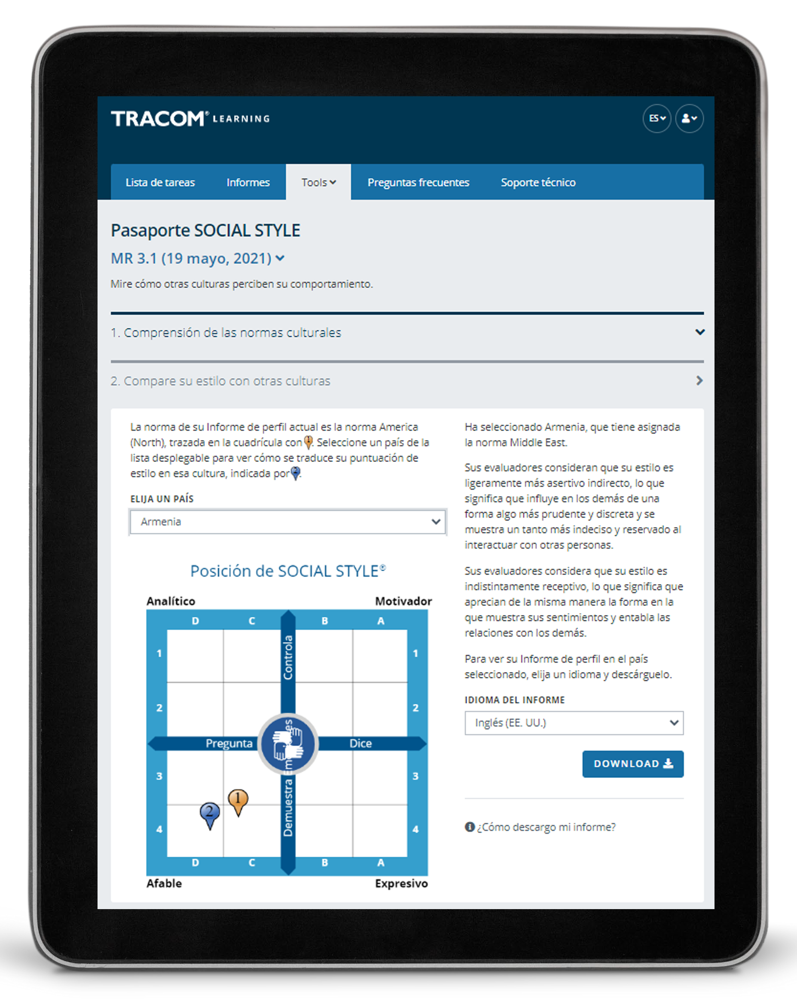
Pasaporte SOCIAL STYLE
Notes:
Optional demonstration, time permitting
The SOCIAL STYLE Passport allows you to see how you would profile in another country. It’s also available at tracomlearning.com.

Slide 91
91
Notes:
THANK participants and conclude the session.

