Slide 1
結果本位の営業TM
Notes:
2 Minutes
WELCOME participants to the session and REVIEW key points about TRACOM’s SOCIAL STYLE Model：
One of the most widely used and highly regarded behavioral models in use today.
Will help you develop insight about your behavioral strengths and weaknesses, and your customers’ behavioral preferences.
Originally developed in the 1960s by psychologists David Merrill and Roger Reid.
Used worldwide by millions of people.
PROGRAM BENEFITS
SAY Working successfully with customers depends on developing good relationships. You can do this by understanding your own Style and, more importantly, other people’s Styles. This allows you to practice Versatility by adjusting your behavior to meet other people’s Style preferences. Research shows that people who consistently show Versatility are more effective in their jobs than people who don’t show Versatility.

Slide 2
対人効果を 向上させる ステップ
ほかの人のために何かをする
自分をコントロールする
自分がほかの人に与える影響を自覚する
自分の行動を管理する
ほかの人を客観的に観察する
ほかの人がスタイル別ニーズを 満たせるよう支援する
自分を知る
ほかの人々を知る
Notes:
5 Minutes (Workbook, page 2)
SAY This program will bring you on a journey. The ultimate goal is to work more effectively with your customers and others. We’ll get there through a process that starts with understanding yourself and how your behavior affects your productivity and relationships. We refer to these as “know yourself” and “control yourself.”
Most importantly though, you’ll begin to focus on understanding others and their preferences for getting work done. This is called “know others.” With this understanding of others’ behavioral styles, you’ll begin to practice your Versatility, which is “do something for others.”
We’ll talk more about these four steps later, but as we progress through the program, you’ll see how they are applied.
By the end of the program, you’ll have insight into your own Style and behavior, and the Style of at least one of your customers. You’ll build on this knowledge to develop more effective ways of working with your customers through practicing Versatility.

Slide 3
学習内容
顧客の行動を予測する方法。
顧客のストレスの原因。
相手のニーズを認識し満たす方法。
ミーティングの準備とコミュニケーションの調整方法。
顧客の信頼を得る方法。
Notes:
2 Minutes
SAY Ultimately, this course will help you have more success with your customers. In particular, you’re going to learn specific strategies:
How to predict your customers’ behavior, and an understanding of why they behave that way.
What causes customers to become stressed, and how your own behavior can contribute to this.
How to recognize their needs and meet those needs.
How to prepare for meetings and tailor your communication to different customers.
Ultimately, how to earn their trust.

Slide 4
ソーシャル・スタイルと対応性
営業実績の重要な要素
ソーシャル・スタイルと対応性トレーニングの結果について、営業担当者は次のように報告しています。
92%
87%
58%
はより
は
によると
ポジティブな 顧客関係を構築
顧客への影響力や説得能力が向上
以前は成約できなかった セールス契約に成功
対応性が高まると、仕事のパフォーマンスも向上します。
Notes:
2 MINUTES (Workbook, page 4)
SAY In the first part of the program, you’ll learn about Style. This will help you understand your customers and how they prefer to interact with you.
The second part of the program focuses on Versatility, which is how well you meet others’ Style needs.
Versatility is the application of SOCIAL STYLE—when you understand your customers’ Style needs, you can help them meet those needs. This helps them feel more valued and sets the stage for them to have a better relationship with you. If you consistently show Versatility, you can be more effective.
You can read the stats on this slide. Research has found that salespeople who practice SOCIAL STYLE and Versatility have more success.

Slide 5
導入
名前
職務上の役割
匿名化した顧客 – 最もいらだたしいこと
Notes:
10 Minutes
Have participants introduce themselves by revealing the topics listed on the slide.
ASK participants to think of one customer they have a difficult relationship with, and briefly describe their main frustration(s) with this person WITHOUT NAMING THE PERSON.
If Group is too large for verbal introductions, do this through chat.
TIP：You might want to record participants’ “What is Most Frustrating” on a flip chart (or virtual white board). The purpose of the session is to learn how to improve these relationships.
Make sure you have a Profile for each participant who completed the online Questionnaire by the deadline.
DO NOT pass out the Profiles at this time.
If you are delivering a virtual program, options and instructions for downloading profiles are given later in this guide.

Slide 6
アクションに表れるスタイルの特徴
観察
意見
カイル
ラナ
AJ
アビー
Notes:
15 Minutes (Workbook, page 5)
INTRODUCE the video：Four individuals participate in a meeting to discuss a product that is missing a client’s expectations.
ASK participants to write down their observations and opinions of each character on page 5 of the Participant Workbook.
PLAY Part 1.
DEBRIEF the video by asking participants to briefly share their thoughts on the characters. Many of the participants’ comments will be subjective observations.

Slide 7
担当顧客 – 第一印象
前に特定した顧客について考えてみましょう。仮名を付け、以下を書き留めます。
自分が相手に感じた第一印象（最初のやり取りから）
Notes:
5 Minutes (Workbook, page 6)
SAY Think about the customer you identified during our “Introduction” exercise.
SAY Give your customer a fictional name and then write down：
First impressions you had of that person (from your first interactions).
DEBRIEF the exercise by asking participants to briefly share the information about their customer.
SAY The information you shared is typical about how we feel about and react to others. Some information is objective and observable—and some of it is subjective (how we feel about them). Today, we’re going to show you a more objective and reliable way to understand behavior; then based on this, find ways to work more effectively and with less frustration.

Slide 8
行動分析軸
自己主張度と感情表現度
Notes:
SAY We’re going to talk about behavior and how to accurately observe people’s behavior.

Slide 9
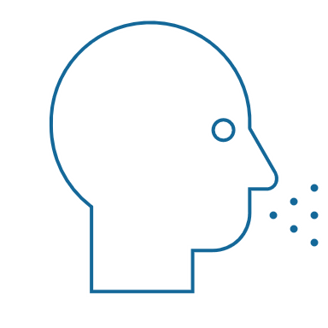
観察できる言動面の特徴と性格
行動
自分の発言（言語的）と 動作（非言語的）
ソーシャル・スタイル（SOCIAL STYLE®） ほかの人々が観察でき、 人によってその行動の説明に食い違いが生じないような アクションパターン
観察できる言動面の特徴
言/動
性格
対人行動
人とのやり取りでの言動
性格
その人のすべて。 考え、価値観、希望、夢など
Notes:
4 Minutes (Workbook, page 7)
SAY Behavior and personality are not the same things. Observable behavior is like the crust of a pie. Personality is like the inside and outside of the pie.
ASK What makes up personality?
CONDUCT a quick facilitated discussion to solicit participants’ responses. They should say things such as:
Values, hopes, attitudes, beliefs.
Things that are not necessarily observable.
These internal qualities are more subjective in nature.
SAY Style is like the crust, because it’s on the outside and observable. By observing behavior, we can find ways to define and discuss what we see. Then, we can begin to understand how this behavior affects ourselves and others.

Slide 10
発言行動と動作行動
特徴
正直
知的
尊大
モチベーションが 高い
自己中心的
誠実
批判的
観察できる言動面の特徴
物静か
ペースが遅め
顔の表情に出にくい
抑揚の少ない声
あまり目を合わせない
自然体
後傾
にぎやか
ペースが速め
顔の表情が豊か
抑揚の目立つ声
よく目を合わせる
堅苦しい
前傾
判断
この人は好きだ
この人は気に障る
この人は興味深い
この人には いらだたされる
この人は 信じられない
この人は嫌いだ
この人は 信じられる
言
やる
Notes:
5 Minutes (Workbook, page 8)
SAY When we first meet people, we often form immediate impressions, even after just a few seconds. This is subconscious (below our level of awareness) and happens immediately.
DESCRIBE
Traits Column: What we think we know about a person, based on interactions; subjective opinions.
Judgments Column: Our reactions to others; conclusions or evaluations we make, based on our subjective opinions.
Observable Behavior Column: Things others “Say and Do”; more objective and observable behaviors.
SAY Traits and Judgments are most subjective in nature and contain positive or negative descriptions.
Observable Behavior is objective and contains no positive or negative value.
Observable Behavior is an important tool for assessing others’ Styles. By focusing on Observable Behavior, you gain objectivity, which is critical for understanding people’s Styles.

Slide 11
自己主張度と感情表現度
Notes:
SAY We measure observable behavior on two dimensions：Assertiveness and Responsiveness

Slide 12
自己主張度
人とのやり取りで「意見を聞く」傾向、「意見を主張する」傾向の強さ
意見を 聞きがち
意見を聞く 一方で時には 意見を主張する
意見を主張する 一方で時には 意見を聞く
自分の意見を 主張しがち
Notes:
2 Minutes (Workbook, page 9)
SAY To become more effective with others, we follow a behavioral model. There are two dimensions of behavior that define SOCIAL STYLE: Assertiveness and Responsiveness.
Assertiveness is the degree to which we ask or tell when interacting with others. The two anchors for Assertiveness are Ask on the left side of the continuum and Tell on the right side of the continuum.
Assertiveness is a measurement of how we try to influence others to take action. If you are more “Tell” Assertive, you state your opinions directly. You tend to declare your viewpoints and try to direct the actions of others.
For example, if you want to have lunch with someone, you might say, “Let’s have lunch today!”
If you are more “Ask” Assertive, you tend to be more cautious and reserved about sharing your opinions. You attempt to influence others in a more quiet, low-key, questioning manner.
For example, if you want to have lunch with someone, you might say, “Would you like to have lunch with me today?”

Slide 13
行動における自己主張度
言 | 言語的行動
遅め
話すペース
速め
人より少ない
話す量
人より多い
人より小さい
話し声の音量
人より大きい
意見を聞く
意見を 主張する
リラックス
手ぶり
指図
後傾
身体の姿勢
前傾
少なめ
目の合わせ方
多め
動 | 非言語的行動
Notes:
3 Minutes (Workbook, page 10)
SAY The Assertiveness scale helps predict a person’s behavior because it represents a “theme” or typical pattern. There are verbal and non-verbal clues to indicate a person’s Assertiveness.
ASK participants for examples of verbal and non-verbal clues for Ask-Assertive and Tell-Assertive individuals.
DESCRIBE the verbal and non-verbal indicators of Assertiveness:
Verbal: Ask-Assertive individuals use a slower pace, less quantity (fewer words), and quieter volume. Tell-Assertive individuals use a faster pace, talk more, and a louder volume.
Non-Verbal: Ask-Assertive individuals show relaxed hands and gestures, lean back, and use less direct eye contact. Tell-Assertive individuals have a directive use of hands, lean forward, and use more direct eye contact.

Slide 14
自己主張度
言語的手がかり
非言語的手がかり
カイル
ラナ
AJ
アビー
Notes:
10 Minutes (Workbook, page 11)
PLAY the same Video Part 1, again, now that participants have been introduced to Assertiveness.
ASK them to observe verbal and non-verbal “Say and Do” behaviors and record their observations on page 11 of their Participant Workbook.
DISCUSS video characters related to Assertiveness.
ASK participants to share some subjective “Say and Do” verbal and non-verbal behaviors of each of the team members. Think about speech characteristics such as pace, quantity, and volume for verbal behaviors and use of hands, posture, and eye contact for non-verbal behaviors.
ASK What is different about your observations from the first time you saw the video? (Answer: They are much more objective.) This contrasts with the subjective observations participants made earlier.
ASK Based on your understanding of the Assertiveness dimension, where do you think each of the characters falls on the Assertiveness continuum?
SAY Assertiveness is neither positive nor negative; it is neutral. There is no good or bad place on the Assertiveness scale. Your level of Assertiveness only becomes positive or negative when used appropriately or inappropriately.

Slide 15
顧客： 自己主張度の観察
言 | 言語的行動
遅め
話すペース
速め
人より少ない
話す量
人より多い
人より小さい
話し声の音量
人より大きい
意見を聞く
意見を 主張する
リラックス
手ぶり
指図
後傾
身体の姿勢
前傾
少なめ
目の合わせ方
多め
動 | 非言語的行動
Notes:
10 Minutes (Workbook, page 12)
SAY Using the customer that you identified earlier, think about, and then write down, that person’s Assertiveness behaviors. Include the person’s verbal and non-verbal behaviors. Think about their speech characteristics such as pace, quantity, and volume for verbal behaviors and use of hands, posture, and eye contact for non-verbal behaviors.
DEBRIEF the exercise by asking participants to briefly share the information about their customer’s Ask or Tell Assertive behaviors.
RECORD their information on a virtual white board or flip chart.
ASK What is different about your observations from the first time you described this person?
Answer：They are much more objective. This contrasts with the subjective observations participants made earlier.
ASK Based on your understanding of the Assertiveness dimension, where do you think your customer falls on the Assertiveness continuum?
EMPHASIZE that Assertiveness is neither positive nor negative; it is neutral. There is no good or bad place on the Assertiveness scale.

Slide 16
感情表現度
感情表現を 抑えがち
感情表現を抑える一方で時には 感情を表す
人とのやり取りで感情表現を 抑える傾向、または感情を 表す傾向の強さ
感情を表す 一方で時には 感情表現を抑える
感情を 表しがち
Notes:
2 Minutes (Workbook, page 13)
SAY Responsiveness is the degree to which people tend to control (don’t outwardly display emotions) or emote (outwardly display emotions).
The two descriptive anchors for the Responsiveness scale are Controls on the top of the continuum and Emotes on the bottom of the continuum.
Responsiveness is also the extent to which you react to emotional appeals or displays.
If you control your emotions, you usually don’t react to emotional appeals and are more likely to focus on ideas, data, and tasks. You are less likely to share your feelings publicly.
If you are more emoting, you share and display your emotions with others. You are more likely to respond to emotional appeals and displays from others.

Slide 17
感情を表す行動
言 | 言語的行動
動 | 非言語的行動
感情表現を抑える
人より平板
タスク
事実/データを提示
人より少ない
硬い
抑制
声に表れた 感情
話の主題
説明の仕方
手ぶり
身体の姿勢
顔の表情
人より抑揚が大きい
ほかの人々
意見/ストーリーを 伝える
人より多い
カジュアル
表情豊か
感情を表す
Notes:
3 Minutes (Workbook, page 14)
SAY The Responsiveness scale, like the Assertiveness scale, helps us to predict a person’s behavior because it is a “theme” or typical pattern.
ASK participants for their opinions on the verbal and non-verbal clues of Control- and Emote-oriented individuals.
DESCRIBE the verbal and non-verbal clues to responsive behavior as noted on the slide.
SAY Responsiveness is neither a positive nor a negative quality; it is neutral.
Assertiveness and Responsiveness do not affect each other — they are independent of each other.

Slide 18
感情表現度
言語的手がかり
非言語的手がかり
カイル
ラナ
AJ
アビー
Notes:
10 Minutes (Workbook, page 15)
REPLAY Video Part 1 again, now that participants have been introduced to Responsiveness.
ASK participants to observe verbal and non-verbal Say/Do behaviors.
SAY Think about verbal clues such as vocal emotion, subjects, and what each team member describes. What did you observe? For non-verbal clues, think about use of hands, posture, and facial expressions.
ASK Based on your understanding of Responsiveness, where do you think each of the characters falls on the Responsiveness scale?
SAY The Assertiveness and Responsiveness dimensions assess behavior, not personality or intelligence, and they are independent of each other.

Slide 19
顧客：感情表現度の観察
言 | 言語的行動
動 | 非言語的行動
感情表現を抑える
人より平板
タスク
事実/データを提示
人より少ない
硬い
抑制
声に表れた感情
話の主題
説明の仕方
手ぶり
身体の姿勢
顔の表情
人より抑揚が大きい
ほかの人々
意見/ストーリーを伝える
人より多い
カジュアル
表情豊か
感情を表す
Notes:
10 Minutes (Workbook, page 16)
SAY Using the customer that you identified earlier, think about, and then write down, that person’s Responsiveness behaviors. Include their verbal and non-verbal behaviors. Think about speech characteristics such as emotion in their voice, subjects of speech, forms of descriptors, and non-verbal behaviors such as use of hands, body posture, and use of facial expressions.
DEBRIEF the exercise by asking participants to briefly share the information about their customer’s Control or Emote Responsiveness Behaviors.
RECORD their information on a virtual white board or flip chart.
ASK What is different about your observations from the first time you described this person?
Answer：They are much more objective. This difference contrasts with the subjective observations participants made earlier.
ASK Based on your understanding of the Responsiveness Dimension, where do you think your customer falls on the Responsiveness continuum?

Slide 20
ソーシャル・スタイルTM モデル
Notes:
SAY Now that you understand Assertiveness and Responsiveness, we’ll see how they form the SOCIAL STYLE Model.

Slide 21
ソーシャル・スタイルTM モデル
感情表現を抑える
主張を尋ねる 感情表現を抑える
アナリティカル スタイル
自己主張する 感情表現を抑える
ドライビング スタイル
意見を 主張する
意見を聞く
主張を尋ねる 感情を表す
エミアブル スタイル
自己主張する 感情を表す
エクスプレッシブ スタイル
感情を表す
Notes:
4 Minutes (Workbook, page 17)
CLICK TO REVEAL EACH QUADRANT
SAY By combining Assertiveness and Responsiveness, the four SOCIAL STYLEs are formed.
No individual will display one Style exclusively; but, in a short time, you can determine the patterns that define a person’s Style. Once you know a person’s Style, you can adjust your behavior to develop a more effective relationship.

Slide 22
ソーシャル・スタイルモデル
感情表現を抑える
アナリティカル
生真面目
厳密
論理的
優柔不断
ドライビング
自立的
堅苦しい
実利主義
支配的
意見を聞く
意見を 主張する
エミアブル
協力的
信頼できる
オープン
柔軟
エクスプレッシブ
強気
表情豊か
冒険を好む
衝動的
感情を表す
Notes:
5 Minutes (Workbook, page 18)
CLICK TO SPEAK ABOUT EACH QUADRANT (text becomes darker)
Review the summaries for each Style. Note that each Style contains positive descriptors and one negative descriptor. This illustrates the significance of perception. A Driving Style person might see themselves as Independent, Formal, and Practical, while others might perceive the same behavior as Dominating.
Solicit questions/ comments.
KEY POINTS:
Style descriptions are generalizations about each Style.
People with the same Style exhibit similar behaviors, but are still individuals.
Perceptions can vary. What you see as strengths in yourself, others might view negatively.

Slide 23
このアクションに表れたスタイルは？
各人物のスタイルは？
カイル
ラナ
AJ
アビー
Notes:
3 Minutes (Workbook, page 19)
REFERENCE the video characters from earlier exercises.
ASK What do you think the SOCIAL STYLE of each video character is?
DISCUSS the behaviors of the characters and how those are indicative of their Styles.
IMPORTANT：Do not advance the slide until you’ve discussed the behavior of each character. The next slide reveals each character’s Style.

Slide 24
ソーシャル・スタイル
感情表現を抑える
アナリティカル
ドライビング
ラナ
カイル
意見を聞く
意見を 主張する
エミアブル
エクスプレッシブ
AJ
アビー
感情を表す
Notes:
2 Minutes (Workbook, page 19)
Kyle – Driving
Lana – Analytical
AJ – Amiable
Abby – Expressive
DISCUSS the behaviors of the characters and how those are indicative of their Styles.

Slide 25
顧客のソーシャル・スタイル
感情表現を抑える
主張を尋ねる 感情表現を抑える
アナリティカル スタイル
自己主張する 感情表現を抑える
ドライビング スタイル
意見を聞く
意見を 主張する
主張を尋ねる 感情を表す
エミアブル スタイル
自己主張する 感情を表す
エクスプレッシブ スタイル
感情を表す
Notes:
5 Minutes (Workbook, page 20)
SAY Using the customer that you identified earlier, determine their Style. This is only a preliminary estimate. As we continue through the program, you might re-estimate the person’s Style.
DEBRIEF the exercise by asking participants to share their customer’s Style, and how this behavioral assessment relates to their initial impressions of the person (which may have been more subjective).
RECORD their information on a virtual white board or flip chart.
SAY You will use their Style as a framework for developing more effective interactions with this person.

Slide 26
ニーズ、指向性、成長を促すアクション
ニーズ
各スタイルの目標
指向性 ニーズを満たすために取る代表的な行動
成長を促すアクション
各スタイルでほとんど見られない行動。この行動の頻度を上げると、このスタイルの対人効果が向上
Notes:
2 Minutes (Workbook, page 21)
SAY Remember that the Style descriptions are generalizations about each Style. While people with the same Style generally exhibit similar characteristics, each person is still unique.
SAY Each Style has a Need, an Orientation, and a Growth Action. By recognizing these things about each Style, we can understand their motivations and what drives their behavior.
DEFINE:
Need – The goal of each Style.
Orientation – The common behavior used to achieve the need.
Growth Action – Behavior that is rarely used by each Style. Using this behavior more often would increase this Style’s effectiveness.
SAY Understanding the need, orientation, and growth action of each Style will help you better relate to others’ Styles and enhance your effectiveness with them.

Slide 27
ソーシャル・スタイルの主要タイプ
感情表現を抑える
アナリティカル
ニーズ：誤謬がないこと
指向性：考え方
成長を促すアクション： 宣言すること
ドライビング
ニーズ：結果
指向性：アクション
成長を促すアクション： 人の話をじっくり聞くこと
意見を聞く
意見を 主張する
エミアブル
ニーズ：保身
指向性：人間関係
成長を促すアクション： 自分から行動を始めること
エクスプレッシブ
ニーズ：自分が認められること
指向性：作為のなさ
成長を促すアクション：チェック すること
感情を表す
Notes:
6 Minutes (Workbook, page 21)
CLICK TO REVEAL THE TEXT IN EACH QUADRANT.
REVIEW each Style.
ASK How do need, orientation, and growth action manifest themselves in the video characters? Specifically, how does each team member’s behavior show their need, orientation, and growth action?

Slide 28
ソーシャル・スタイル別行動特徴
感情表現を抑える
アナリティカル
ペースが遅め
調整に努める
人間関係への関心が低い
過去の時間枠で作業する
慎重にアクションを取る
個人的な関与を避ける
ドライビング
ペースが速め
自分でペースを決めたい
人間関係への関心が低い
現在の時間枠で作業する
ほかの人のアクションを指図する
アクションがない状態を避ける
意見を聞く
意見を 主張する
エミアブル
ペースが遅め
共感に努める
変化をもたらすことへの関心が低い
現在の時間枠で作業する
協力しようとアクションを起こす
対立を避ける
エクスプレッシブ
ペースが速め
参加に努める
決まり切った仕事への関心が低い
将来の時間枠で作業する
衝動的に行動する
孤立を避ける
感情を表す
Notes:
5 Minutes (Workbook, page 22)
CLICK TO SPEAK ABOUT EACH QUADRANT
DESCRIBE the typical behaviors of the four SOCIAL STYLEs. These behaviors are related to the Style needs, orientations, and growth actions.

Slide 29
顧客の行動
感情表現を抑える
アナリティカル
社交性に欠け、ビジネスライク
相手の目を直に見る時間が少なめ
自分の意見を主張するより人の意見をじっくり聞く
詳細について尋ねる
意見や決断を避けることもある
ドライビング
社交性に欠け、ビジネスライク
相手の目を直に見る時間が多め
直接的な意見を言う
答えにくい質問をすることもある
エンゲージメントを止めたり、支配を試みたりすることもある
意見を 主張する
意見を聞く
エミアブル
フレンドリーで親しみやすい
うなずきなど、相手を励ますサイン
口数が少なめ
周囲に及ぼす影響について尋ねる
グループの決定に迎合することもある
エクスプレッシブ
ミーティング開始当初は社交的で親しみやすい
人より多く話す
場合によりアジェンダから離れ、多様なトピックについて話すこともある
直接的な意見を言う
対立することもある
感情を表す
Notes:
4 Minutes (Workbook, page 23)
CLICK TO REVEAL THE TEXT IN EACH QUADRANT.
REVIEW the customer behaviors. These behaviors are typical Style-related behaviors specific to working with customers.
ENCOURAGE participants to share stories about their customers.

Slide 30
顧客の緊張度
感情表現を抑える
アナリティカル
集中力と組織力がない
迅速な売上を強硬に求められる
全体的傾向を重視して細部を考慮 しない
変更が多く、結果を考慮しない
ドライビング
構造と明確な結果がない
意見を主張する機会を与えられない
最終的な解決策がない
進行が遅い
各スタイルにとって何がストレスの原因になりますか？
意見を 主張する
意見を聞く
エミアブル
堅苦しく、仕事にばかり集中する
ソリューションに向けたコラボレーションがない
長期的関係ではなく営業に集中する
大きく急な変化
エクスプレッシブ
貢献が認められていない
細部にこだわりすぎ
型にはまり、自由な会話の流れがない
将来の可能性に十分に焦点を当てていない
感情を表す
Notes:
6 Minutes (Workbook, page 24)
ASK Given a customer’s Style need and typical behaviors, what will cause stress for them?
FACILITATE a discussion of each Style before revealing the text.
CLICK TO REVEAL THE TEXT IN EACH QUADRANT.
The Driving Style need is results, so what’s going to raise their tension in a sales meeting?
Lack of focus; disorganization; not being allowed to state their opinions; no bottom-line solutions; progress is too slow.
Expressive Style stressors:
Not being recognized; too many details; too much structure without free-flowing conversation; not enough focus on future possibilities.
Amiable Style stressors:
Too much formality; lack of collaboration towards solutions; focus on the sale instead of on long-term relationship; too much change too quickly.
Analytical Style stressors:
Lack of structure and clear outcomes; pushiness to achieve quick sale; focus on generalities without considering details; too much change without considering consequences.
ENCOURAGE participants to share stories about their customers.

Slide 31
後退行動
感情表現を抑える
アナリティカル
回避行動：対人緊張度を 和らげるために引き下がる
ドライビング
独裁的行動：対人緊張度を 和らげるために責任を負う
緊張度を和らげるために 大げさに行動する
意見を聞く
意見を 主張する
エミアブル
同調行動：対人緊張度を 和らげるために同調する
エクスプレッシブ
攻撃的行動：対人緊張度を 和らげるために対立する
感情を表す
Notes:
5 Minutes (Workbook, page 25)
CLICK TO REVEAL THE TEXT IN EACH QUADRANT.
SAY When customers are feeling stressed, their behavior can be categorized: each Style falls into a type of extreme backup behavior to try and reduce tension.
DESCRIBE each Style’s backup behavior. Remember, each Style’s goal is to get their Style need met.
ASK What are some common ways that each Style might show their backup behavior?
Driving: Will get frustrated by slow progress or barriers and try to take control of the situation.
Expressive: Will get upset if they aren’t given opportunities to express themselves or show their contributions, and might verbally confront others.
Amiable: If they feel that a relationship is being threatened, they will stay quiet and acquiesce instead of firmly stating their opinions.
Analytical: If they feel that things are moving too fast without taking into account important details, they will withdraw and refuse to contribute.
SAY Next we’ll talk about some specific strategies for working with customers.

Slide 32
顧客のニーズの充足
感情表現を抑える
アナリティカル
証拠と情報：相手と共有する
透明性：相手はプロセスを把握・理解し たいと考えている
理解を得るには、 相手の問題に理解を示す
考える時間を与え、 即断即決を迫ら ない
ドライビング
結果：できる限り、合意したとおり迅速に結果を出す
コンピタンス：チームの能力を示す
率直さ：率直かつプロフェッショナルであること
効率性：相手の時間を尊重し、すぐに仕事に取り掛かる
意見を 主張する
意見を聞く
エミアブル
交流：時間をかけて相手を知る
安全性：相手のリスクが最小限になるよう努める
エンゲージメントとコンセンサス：承認を得るため、決断にほかの人を巻き込む
安心：同様のプロジェクトが以前に成功したことを知らせる
エクスプレッシブ
サポート：相手のビジョンの実現を支援する
承認：相手と評価を競わないこと
尊重と重要性：特にリーダーからの注目を好む
発言：ミーティングの趣旨から外れていても、話す時間を与える
感情を表す
Notes:
8 Minutes (Workbook, page 26)
ASK With these backup behaviors in mind, and understanding what causes stress for each Style, what are some ways to meet your customers’ needs? Start with the Driving Style, what ideas do you have?
CLICK TO REVEAL THE TEXT IN EACH QUADRANT.
REVIEW the needs and strategies to meet each Style’s needs and facilitate discussion of each Style.
ENCOURAGE participants to share stories about their customers.

Slide 33
スタイルの オンライン観察
Notes:
10 Minutes (whole section on Observing Style Virtually)
SAY Working with customers and trying to sell remotely has its own unique challenges. You can still use Style to your advantage. Let’s briefly see how people of different Styles might communicate using text messages.

Slide 34
お送りした最新の技術アップグレー
ドに関するビデオをご覧いただく
機会はあっただろうかと思い、
ご連絡しています。
お考えをお聞かせください。
Notes:
The following five slides are examples of “observable” behavior in text messages.
SAY By observing the behaviors of others, even through simple communication like texting, we can TRY to determine how people prefer to communicate and prefer to be communicated with.
Review example slides:
There is a lot of change happening at our organization, so I sent this text to four of my customers. Then I waited for their responses.

Slide 35
お送りした最新の技術アップグレー
ドに関するビデオをご覧いただく
機会はあっただろうかと思い、
ご連絡しています。
お考えをお聞かせください。
こんにちは！
急激な変化が押し寄せています。
当チームでは、新機能に関する
トレーニングを必要としています。
ご助力いただけませんか？
Notes:
SAY Here is the first response from a customer.

Slide 36
お送りした最新の技術アップグレー
ドに関するビデオをご覧いただく
機会はあっただろうかと思い、
ご連絡しています。
お考えをお聞かせください。
ワクワクします！ ざっと見てみましたが、新機能はすばらしいですね。
来週お電話します。
Notes:
SAY This is the second response from another customer.

Slide 37
お送りした最新の技術アップグレードに
関するビデオをご覧いただく機会はあった
だろうかと思い、ご連絡しています。
お考えをお聞かせください。
新しいアップグレードにより、効率が
向上し、労力を削減できると思います。
ただし皆で新しいリリースに適応する
前に、チームのトレーニングを計画する
必要があります。そのためのプロセスは
用意されていますか？
Notes:
SAY Here’s the response from a third customer.

Slide 38
お送りした最新の技術アップグレー
ドに関するビデオをご覧いただく
機会はあっただろうかと思い、
ご連絡しています。
お考えをお聞かせください。
いいですね。 実装する時間ができたら、
お電話します。
Notes:
SAY And finally, this response from a fourth customer.
Keep these texts in mind as we’ll be revisiting them later.

Slide 39
該当するスタイルを当ててみましょう。
お送りした最新の技術アップグレー
ドに関するビデオをご覧いただく
機会はあっただろうかと思い、
ご連絡しています。
お考えをお聞かせください。
Notes:
SAY This is the text I first sent out. How about the responses I received? Knowing what you know so far about SOCIAL STYLE, can you guess which Style each response is from?

Slide 40
感情表現を抑える
主張を尋ねる 感情表現を抑える
アナリティカル スタイル
自己主張する 感情表現を抑える
ドライビング スタイル
こんにちは！
急激な変化が押し寄せています。
当チームでは、新機能に関する
トレーニングを必要としています。
ご助力いただけませんか？
意見を 聞く
意見を 主張する
主張を尋ねる 感情を表す
エミアブル スタイル
自己主張する 感情を表す
エクスプレッシブ スタイル
感情を表す
Notes:
SAY Which Style might this person be?
AMIABLE
SAY This person is personable (“Hi!”) and concerned that things are moving fast. They are showing concern for the team’s ability to adapt the new technology, and they specifically ask for help. It indicates Ask Assertiveness and Emote Responsiveness.

Slide 41
感情表現を抑える
主張を尋ねる 感情表現を抑える
アナリティカル スタイル
自己主張する 感情表現を抑える
ドライビング スタイル
ワクワクします！ ざっと見てみましたが、新機能はすばらしいですね。
来週お電話します。
意見を 聞く
意見を 主張する
主張を尋ねる 感情を表す
エミアブル スタイル
自己主張する 感情を表す
エクスプレッシブ スタイル
感情を表す
Notes:
ASK How about this one—what Style?
EXPRESSIVE
SAY This person uses a lot of exclamation marks to show enthusiasm and wants to interact. They also mention “I took a quick look,” indicating they didn’t pay close attention to the video or details. It indicates Tell Assertiveness and Emote Responsiveness.

Slide 42
感情表現を抑える
主張を尋ねる 感情表現を抑える
アナリティカル スタイル
自己主張する 感情表現を抑える
ドライビング スタイル
新しいアップグレードにより、効率が
向上し、労力を削減できると思います。
ただし皆で新しいリリースに適応する
前に、チームのトレーニングを計画する
必要があります。そのためのプロセスは
用意されていますか？
意見を 聞く
意見を 主張する
主張を尋ねる 感情を表す
エミアブル スタイル
自己主張する 感情を表す
エクスプレッシブ スタイル
感情を表す
Notes:
ASK Which Style might this person be?
ANALYTICAL
SAY This person likes things to be efficient but is hesitant to adapt the new technology until the team is trained and ready. They also ask a clarifying question – “Do you have a process in place for this?” It indicates Ask Assertiveness and Control Responsiveness.

Slide 43
感情表現を抑える
主張を尋ねる 感情表現を抑える
アナリティカル スタイル
自己主張する 感情表現を抑える
ドライビング スタイル
いいですね。 実装する時間ができたら、
お電話します。
意見を 聞く
意見を 主張する
主張を尋ねる 感情を表す
エミアブル スタイル
自己主張する 感情を表す
エクスプレッシブ スタイル
感情を表す
Notes:
ASK And finally, what Style might this be?
DRIVING
SAY This person is being direct and brief. They also communicate that they will initiate contact when they’re ready (“Don’t call me, I’ll call you.”). It indicates Tell Assertiveness and Control Responsiveness.

Slide 44
キーポイント
スタイルと性格は別のものです。
観察可能な行動のみ参照します。
行動は連続体であり、「明分」できません。
ほとんどの場合、人は1つのスタイルの範囲内で行動します。
スタイルに優劣はありません。
Notes:
2 Minutes (Workbook, page 28)
REVIEW the key points.
Style is not personality.
Style refers only to observable behavior.
Behavior is a continuum, not an “either/or.”
People behave with one Style most of the time.
There is no “best” Style.

Slide 45
ソーシャル・スタイルのプロファイル
Notes:
SAY Now that you’re familiar with the Model, each of you will review your own SOCIAL STYLE Profile.

Slide 46
自己主張度
人の意見を聞く傾向、自分が意見を主張する傾向の強さ。
D
C
B
A
意見を 聞きがち
意見を聞く 一方で時には 意見を主張する
意見を主張する 一方で時には 意見を聞く
自分の意見を 主張しがち
人口の75%より主張を 聞きがち
人口の50%より主張を 聞きがち
人口の50%より
自分の意見を
主張しがち
人口の75%より
自分の意見を
主張しがち
Notes:
2 Minutes
SAY Before you read your SOCIAL STYLE Profile, let me describe how your results are determined. The dimensions of behavior are normed. This means that Assertiveness is reported in quartiles.
Review the information on the slide concerning percentiles of people in each of the four quartiles.

Slide 47
感情表現度
1
感情表現を 抑えがち
人口の75%よりも感情表現を
抑えがち
2
感情表現を抑える一方で時には 感情を表す
人口の50%よりも
感情を表しがち
感情表現を抑える 傾向、感情を 表す傾向の強さ。
3
感情を表す 一方で時には 感情表現を抑える
人口の50%よりも感情を表しがち
4
感情を 表しがち
人口の75%よりも 感情を表しがち
Notes:
2 Minutes
SAY In the same way, Responsiveness is reported in quartiles.
Review the information on the slide concerning percentiles of people in each of the four quartiles.

Slide 48
© The TRACOM Corporation. All Rights Reserved.
48
Notes:
20 Minutes
REVIEW the Profile pages on the following slides so participants understand the layout of the profile. After you’ve reviewed the slides, distribute individuals’ profiles.
If delivering a virtual program, participants will have already received their profiles. Note that you are only covering the SOCIAL STYLE section of the profile; the Versatility profile will be reviewed later.
PROVIDE ample time for participants to read and absorb their profiles. Do not continue until it is evident that all participants have finished reading their profiles.
ASK if there are any questions, surprises, or concerns.
ASK If your self-perception results were different, what might have caused the difference in views?
EXPLAIN TRACOM’s research shows that over 50% of the time, people see themselves differently from how others see them. Reiterate that there is no “best Style” and all Styles can be successful salespeople. Offer to be available during the break to answer individual questions or concerns.
NOTE: It is recommended that you take a break here and make yourself available for one-on-one conversations as participants may have questions or concerns they do not want to discuss publicly.

Slide 49
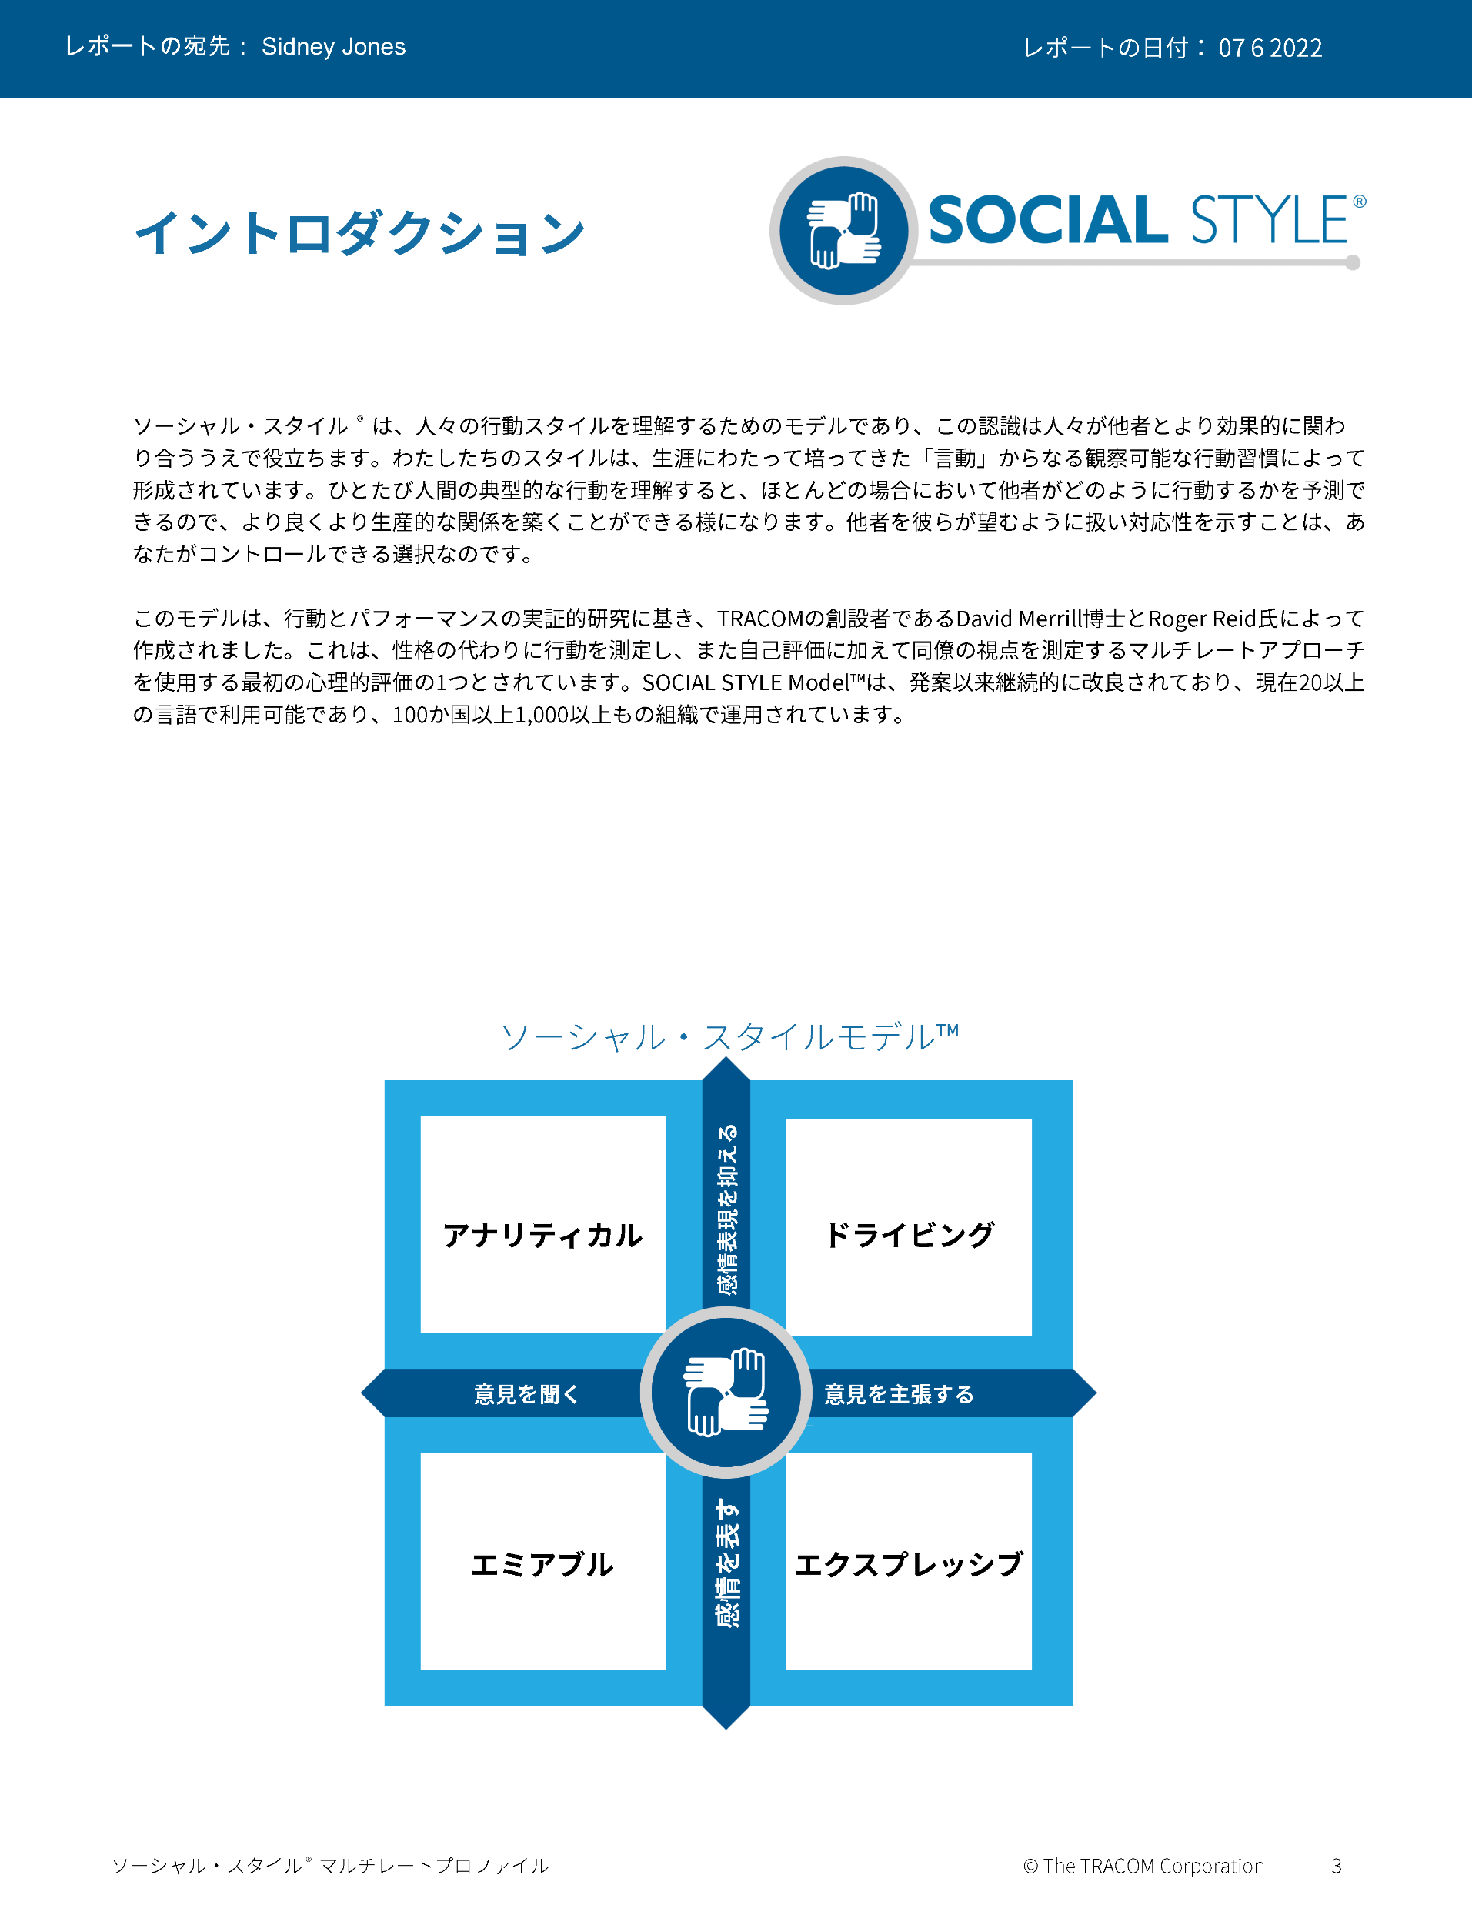
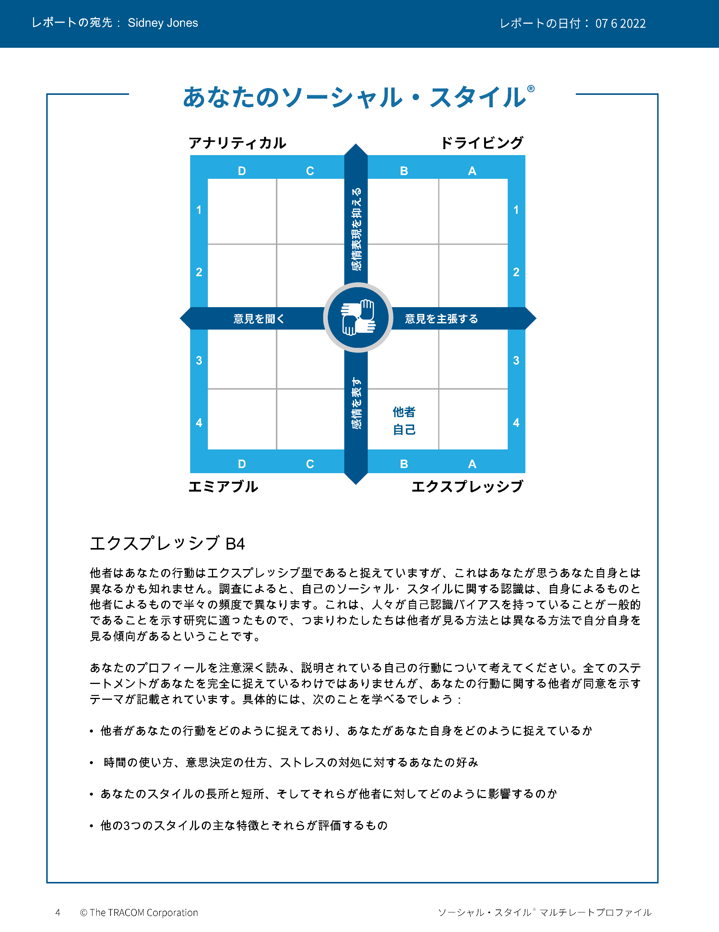
© The TRACOM Corporation. All Rights Reserved.
49
Notes:
Continue reviewing.

Slide 50
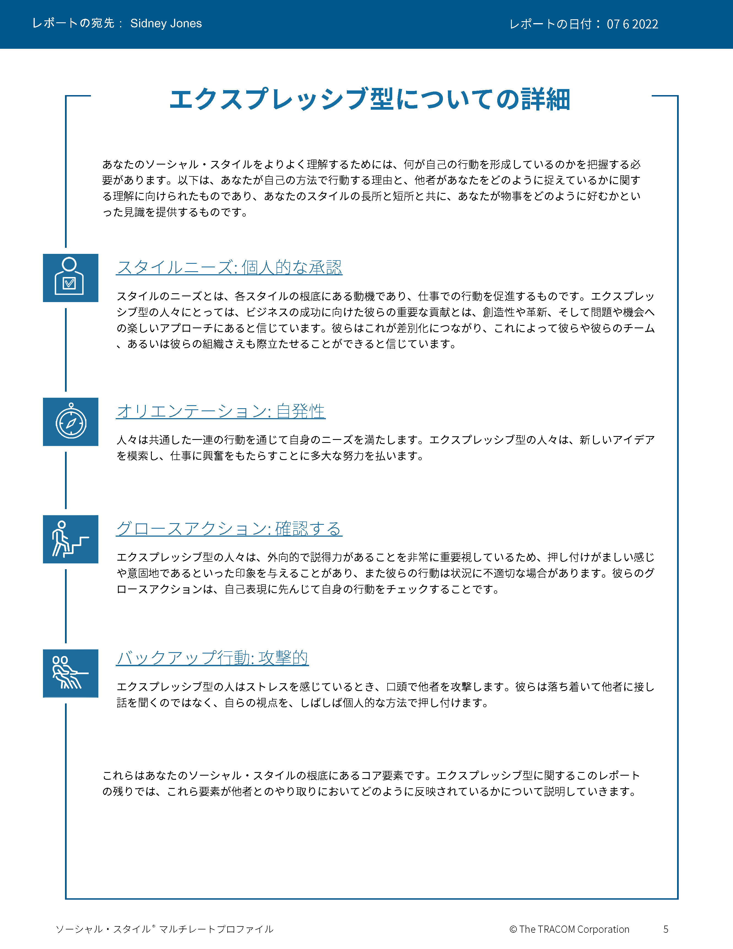
© The TRACOM Corporation. All Rights Reserved.
50
Notes:
Continue reviewing.

Slide 51
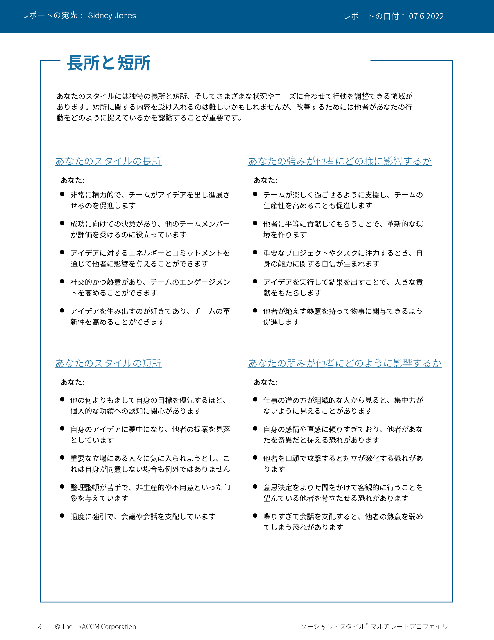
© The TRACOM Corporation. All Rights Reserved.
51
Notes:
Continue reviewing.

Slide 52
© The TRACOM Corporation. All Rights Reserved.
52
Notes:
Continue reviewing.

Slide 53
オンライン配信： 自分のプロファイルにアクセスする方法
tracomlearning.comにログインします
ユーザー名とパスワードを入力します
レポートをダウンロードします
Notes:
OPTIONAL：FOR VIRTUAL DELIVERY ONLY.
USE THE NEXT TWO SLIDES IF LEARNERS DOWNLOAD THEIR PROFILES DURING THE SESSION.
20 Minutes

Slide 54
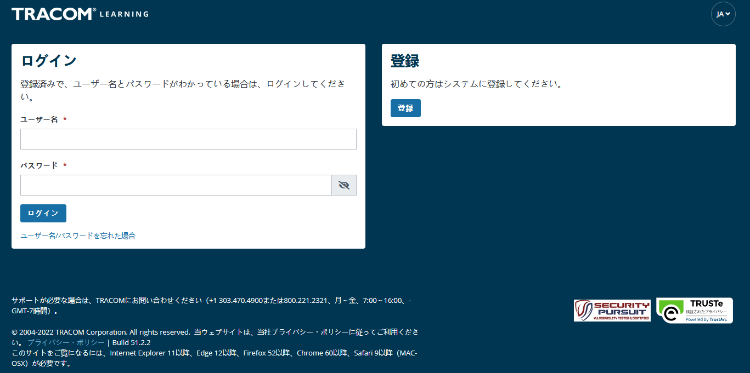
1. tracomlearning.comにアクセスします
2. ユーザー名とパスワードを
入力し、「ログイン」を
押します
Notes:
SAY Login to tracomlearning.com. Use the same username and password as when you completed the assessment (survey).

Slide 55
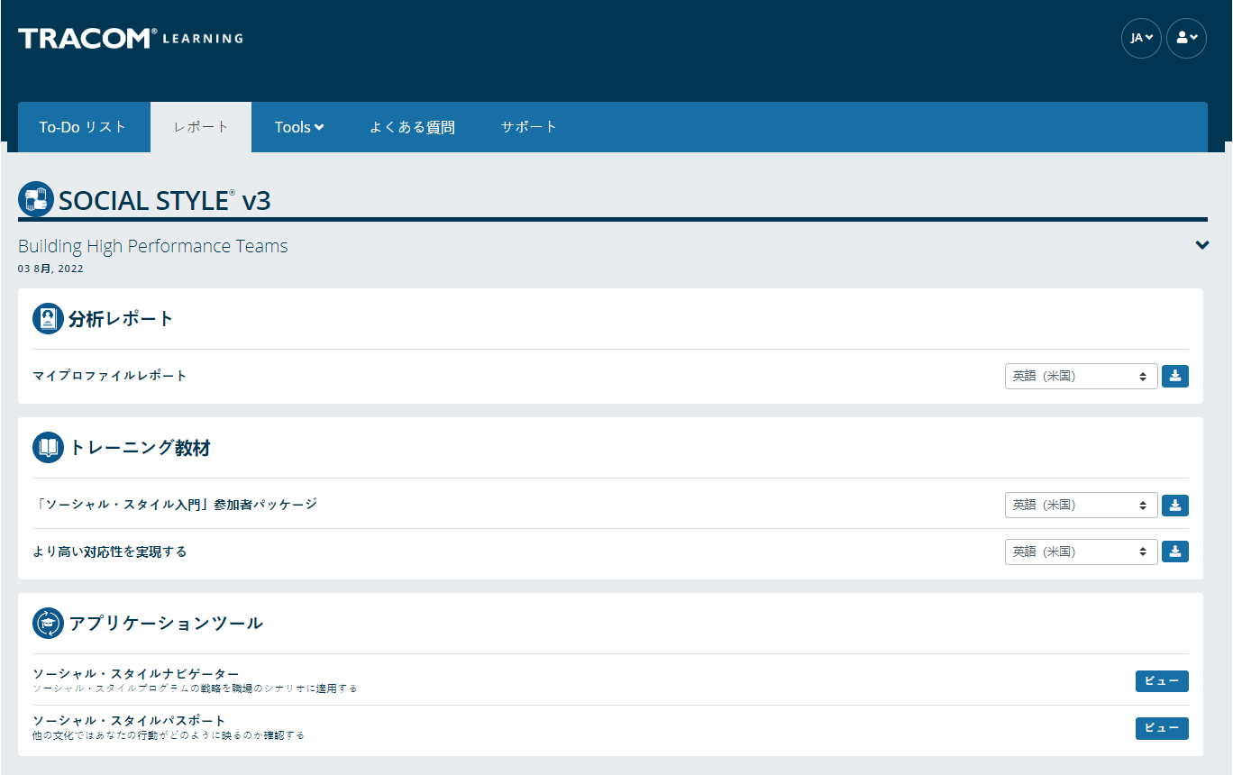
「Profile Reports」（プロファイルレポート）セクションに移動し、「ダウンロード」アイコンをクリックしてプロファイルをダウンロードします。
Notes:
SAY Your profile will be listed under “Profile Reports.” Click to download as a pdf.
Note： If the Learner selects the download button and the PDF does not open up (i.e., the screen just flashes), it is an indicator that their pop-up blockers are on. They need to allow pop-ups from tracomlearning.com and click the download button again. The profile report will open in a separate window. They can then save the profile report locally if they wish.

Slide 56
自分を知り、コントロールする
ソーシャル・スタイル
自分と同じスタイルの人がお客様を いらだたせる行動（お客様のスタイル別）
自分がスタイルに起因する行動をコントロールするために講じられる対策の一例
ドライビング
エクスプレッシブ
エミアブル
アナリティカル
Notes:
10 Minutes (Workbook, page 29)
The purpose of this exercise is to help people begin to understand how some of their Style behavior can be challenging for customers and others. A later exercise will require learners to determine specific ways they can increase their Versatility towards people of other Styles.
SAY Each of us has behavior that frustrates others. Write down a brief list of your Style behaviors that frustrate customers of other Styles. Then, determine one specific thing you can do to control this behavior. Use the insights you discovered from your profiles to help.
ASK for volunteers to provide a sample of responses and write them on a flipchart. If delivering virtually, learners can chat some of their responses as a way of engaging the group.
SAY Next you will learn more about your own Versatility.

Slide 57
スタイル観察のテクニック
結論を急がない
客観性を保つ
スタイルによる行動を個人の役割や立場から切り離す
適度なストレス下に置くことで、各人のスタイルがわかり やすくなる
邪魔をしない（観察に専念）
1
2
3
4
5
Notes:
5 Minutes (Workbook, page 29)
SAY The more accurately we are able to observe our customers’ Styles, the better we will be able to adapt our own behavior and “Do something for others” to increase Versatility.
DESCRIBE the best practices:
Don’t jump to conclusions about someone’s Style
Be an objective observer
Separate Style behavior from someone’s role or position
A moderate amount of stress can clarify someone’s Style
Get out of the way (be an observer)
ASK if there are any questions.

Slide 58
対応性
Notes:
1 Minute
SAY You now have a good understanding of Style. What you learned from your profile is going to be useful during the next section, where we learn about Versatility and how to adjust to the Style needs of others.

Slide 59
対応性とは、ほかの人のスタイル別 ニーズにどれだけうまく適応できるかです
Notes:
2 Minutes (Workbook, page 30)
SAY Versatility is a measure of your consistency in adjusting to the Style needs of others.
At the beginning of the program, we reviewed some statistics on Versatility. Research has found that Style and Versatility significantly help salespeople’s performance.
Versatility is completely within your control, so it is your choice to be versatile with others. You can be highly versatile with one group and show low Versatility with another group. It depends on the circumstances and how much you value your interpersonal effectiveness with each group.
It is completely independent of SOCIAL STYLE: Any Style can show Versatility and be successful.
Versatility is NOT the same as likeability. A person can be well liked but not have high Versatility. The opposite can also be true. Versatility helps you develop better working relationships, but it is separate from your personal likeability.

Slide 60
対応性の4つの源
適切に適用される
イメージ
プレゼン
テーション
コンピタンス
フィードバック
その結果が
高い対応性
Notes:
6 Minutes (Workbook, page 31)
Image remains a part of the Versatility model because it’s important for building relationships. Describe Versatility in a timeline:
SAY You show Versatility in four areas.
Image – When you first meet a new person at work, you form an impression about this person based on what you see, consciously or not. Essentially Image is a first impression: Are you dressed appropriately for the situation, for the work culture, for the client, and so on?
Note that Image is not measured as part of your Profile. This is because:
Image is difficult to observe in virtual environments. We can’t observe very well how people are dressed, and because there is a wide variety of dress codes, even within companies and teams, it is less relevant to measure Image in this way.
Raters don’t always like answering questions about people’s Image without understanding the context of how Image is explained in training.
Image is still important for many people and companies, which is why it’s part of the model. However, you won’t receive a measure of your Image.
Presentation – When a person communicates in meetings or other public venues, you’ll notice how clear they are at helping people understand their points. Do they use clear language? Are their examples effective? Do they take others’ Styles into account?
Competence – Over time, you’ll observe this person in a variety of situations. Are they reliable and do they persevere during difficult times? Are they flexible when change happens? Are they optimistic most of the time? Do they show creativity?
Feedback – Finally, this is the most interpersonal part of Versatility. Are they a good listener? Do they show empathy for others’ situations? Do they meet the needs of other people’s Styles? Do they develop good relationships with others?

Slide 61
アクションに表れる対応性
行動面で対応性を発揮 するために、それぞれは 何をしましたか？
具体的にはどのような 行動を取りましたか？
カイル
ラナ
AJ
アビー
Notes:
12 Minutes (Workbook, page 32)
SAY We are now going to revisit our video characters in a continuation of their earlier meeting.
ASK participants to take notes in their participant workbooks on page 32 as they watch the video:
What did each person do to act with Versatility?
What were their specific behaviors?
PLAY the video, Part 2.
CONDUCT a debrief of the video, soliciting participants’ responses to the above questions.

Slide 62
対応性プロファイル
Notes:
1 Minute
SAY Now you will learn about the Versatility Profile and will review your profile. There is a lot of information about Versatility—not only how you’re perceived, but also simple strategies to adjust your behavior and increase Versatility.
This profile is a resource for you. You will use it for the Versatility exercises during the rest of the program.

Slide 63
対応性
ほかの人のスタイル別ニーズに対応するときの自分の一貫性を示す尺度
W | 一貫性が欠如 | X | ある程度の 一貫性を保持 | Y | 通常は一貫性を保持 | Z | 非常に高い 対応性を保持
Notes:
2 Minutes
SAY We measure Versatility on a scale ranging from W to Z. These are normed quartiles, just like Assertiveness and Responsiveness.
When you aren’t consistent in your behavior, you’re usually focusing on your own Style needs. When you consistently show Versatility, you’re focusing on meeting others’ Style needs.
Your profile will show your results on this scale, ranging from W (not consistent) to Z (very consistent).

Slide 64
各対応性ポジションの意味
 | 1 | 2 | 3 | 4 | 5
 | まったく 当てはまらない | 当てはまら ない | 一部当てはまり 一部当てはまらない | 当てはまる | 大いに 当てはまる
1. 前向きな見通しを持って、新しい状況に取り組みます。 | ◯ | ◯ | ◯ | ◯ | ◯
2. 同僚と良好な関係を築きます。 | ◯ | ◯ | ◯ | ◯ | ◯
3. 効果的な方法でグループにアイデアを提示します。 | ◯ | ◯ | ◯ | ◯ | ◯
W | X Y | Z
一貫性
Notes:
3 Minutes
Before delivering Versatility profiles, explain the meaning of the positions.
SAY Before reviewing your results in more detail, let’s put your results into context. This graph shows several sample items that measure Versatility.
You and your raters (if multi-rater) responded to these items using the scale ranging from ‘strongly disagree’ to ‘strongly agree’. TRACOM assigns values to each of these scale points：1 to 5.
When rating Versatility, most people respond at the higher end of the rating scale. This makes sense since most people have at least some abilities in these areas. This means that the cutoff for achieving Z Versatility is very high, approximately 4.5 or higher.
Similarly, to score either an X or Y requires scores between 3.5 and 4.5. These are approximate values used for purposes of explanation.
Importantly, if you receive a W in any area of Versatility, this DOES NOT mean that your raters (if multi-rater) or yourself evaluated you at the low end of the rating scale. On the contrary, almost nobody scores at the lowest end – 1 or 2. For people with a W result, most of their ratings fluctuate between 2 and 4, resulting in an average score of slightly less than 3.5.
So, putting this into context, a W rating means that you are not showing as much consistency in these behaviors as you could. With effort and more consistency, your evaluation would improve.
Set the context:
W does not mean that you lack ability.
It doesn’t mean that your raters (if Multi-rater) evaluated you at the lowest end of the rating scale.
It doesn’t mean they don’t like you or don’t think you’re effective (if multi-rater)
It does mean that you’re not highly consistent in your behavior; you do these things some of the time but could do them more often.
It does mean that your raters (if multi-rater) evaluated you between ‘disagree’ and ‘agree’, on average.
Note that these cutoff values (3.5 and 4.5) are only for demonstration – they aren’t the exact values in TRACOM’s norms, but they are close.
Giving the context is critical because it helps to ease people’s automatic reactions to the profile.
Then:
Help people focus on just one area to improve. This increases chances of success.
What is ‘low hanging fruit?’ Something they can improve quickly.

Slide 65
全般的な対応性
対応性を発揮した行動の一貫性
W | 一貫性が欠如 | X | ある程度の 一貫性を保持 | Y | 通常は 一貫性を保持 | Z | 非常に高い 一貫性を保持
 |  | ほかの人 |  | 自分
Notes:
2 Minutes
SAY Overall Versatility is a combination of your results in three areas: Presentation, Competence, and Feedback.
The “Others” position is the average of your raters’ evaluations. The “Self” position is where you evaluated yourself.
Like Assertiveness and Responsiveness, Versatility is normed in quartiles: W, X, Y, and Z.
Versatility is all about consistency of behavior.
A lower Versatility score does NOT mean you lack ability or that you never demonstrate these abilities.
What it DOES mean is that you aren’t showing consistency in your behavior.
By making small changes to your behavior and acting with more consistency, you can increase your Versatility. (Recall that the difference in values between W and Z are small but meaningful.)

Slide 66
対応性の詳細
プレゼンテーション：X
W | 一貫性が欠如 | X | ある程度の 一貫性を保持 | Y | 通常は 一貫性を保持 | Z | 非常に高い 一貫性を保持
 |  | ほかの人 |  |  |  | 自分
対応性を発揮した 行動の一貫性
コンピタンス：Y
W | 一貫性が欠如 | X | ある程度の 一貫性を保持 | Y | 通常は 一貫性を保持 | Z | 非常に高い 一貫性を保持
 |  |  |  | ほかの人 |  | 自分
フィードバック：X
W | 一貫性が欠如 | X | ある程度の 一貫性を保持 | Y | 通常は 一貫性を保持 | Z | 非常に高い 一貫性を保持
 |  | ほかの人 |  | 自分
Notes:
2 Minutes
Each source of Versatility is explained the same as Overall Versatility – it is a measure of consistency of behavior.
Remember that Image is not measured because:
Image is difficult to observe in virtual environments. We can’t see very well how people are dressed, and because there is a wide variety of dress codes, even within companies and teams, it is less relevant to measure Image in this way.
Raters don’t always like answering questions about people’s Image without understanding the context of how Image is explained in training.
Image is still important for many people and companies, which is why it’s part of the Model. However, you won’t receive a measure of your Image.
Presentation – When a person communicates in meetings or other public venues, you’ll notice how clear they are at helping people understand their points. Do they use clear language? Are their examples effective? Do they take others’ Styles into account?
Competence – Over time, you’ll observe this person in a variety of situations. Are they reliable and do they persevere during difficult times? Are they flexible when change happens? Are they optimistic most of the time? Do they show creativity?
Feedback – Finally, this is the most interpersonal part of Versatility. Are they a good listener? Do they show empathy for others’ situations? Do they meet the needs of other people’s Styles? Do they develop good relationships with others?

Slide 67
© The TRACOM Corporation. All Rights Reserved.
67
Notes:
20 Minutes
Review the Profile pages so participants understand the layout of the Profile. After you’ve reviewed the profile, distribute individuals’ profiles.
PROVIDE ample time for participants to read and absorb their reports. Do not continue until it is evident that all participants have finished reading their reports.
ASK if there are any questions, surprises, or concerns.
ASK If your self-perception results were different, what might have caused the difference in views?
NOTE: It is recommended that you take a break here and make yourself available for one-on-one conversations as participants may have questions or concerns they do not want to discuss with the entire class.

Slide 68
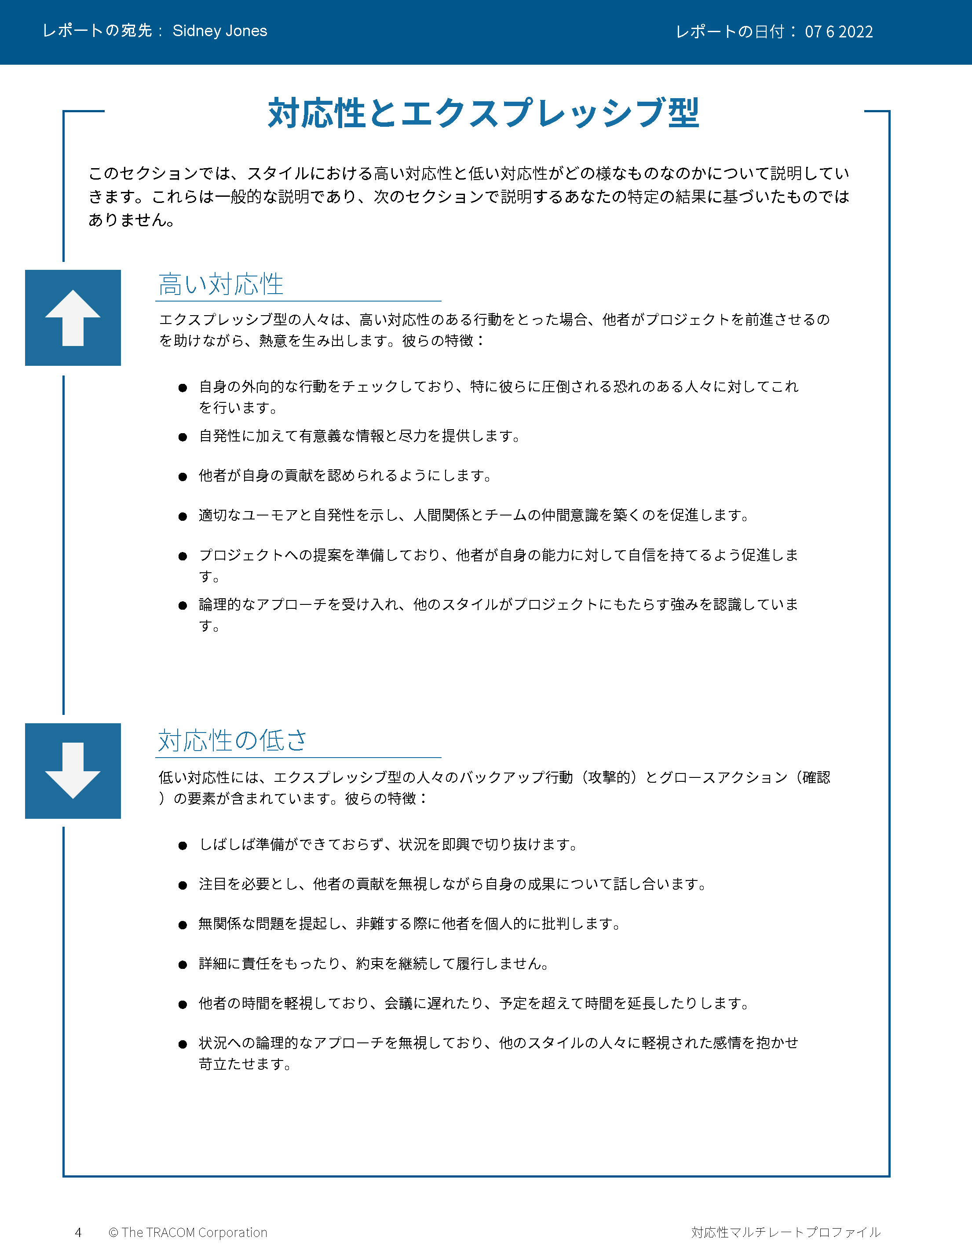
© The TRACOM Corporation. All Rights Reserved.
68
Notes:
Continue reviewing.

Slide 69
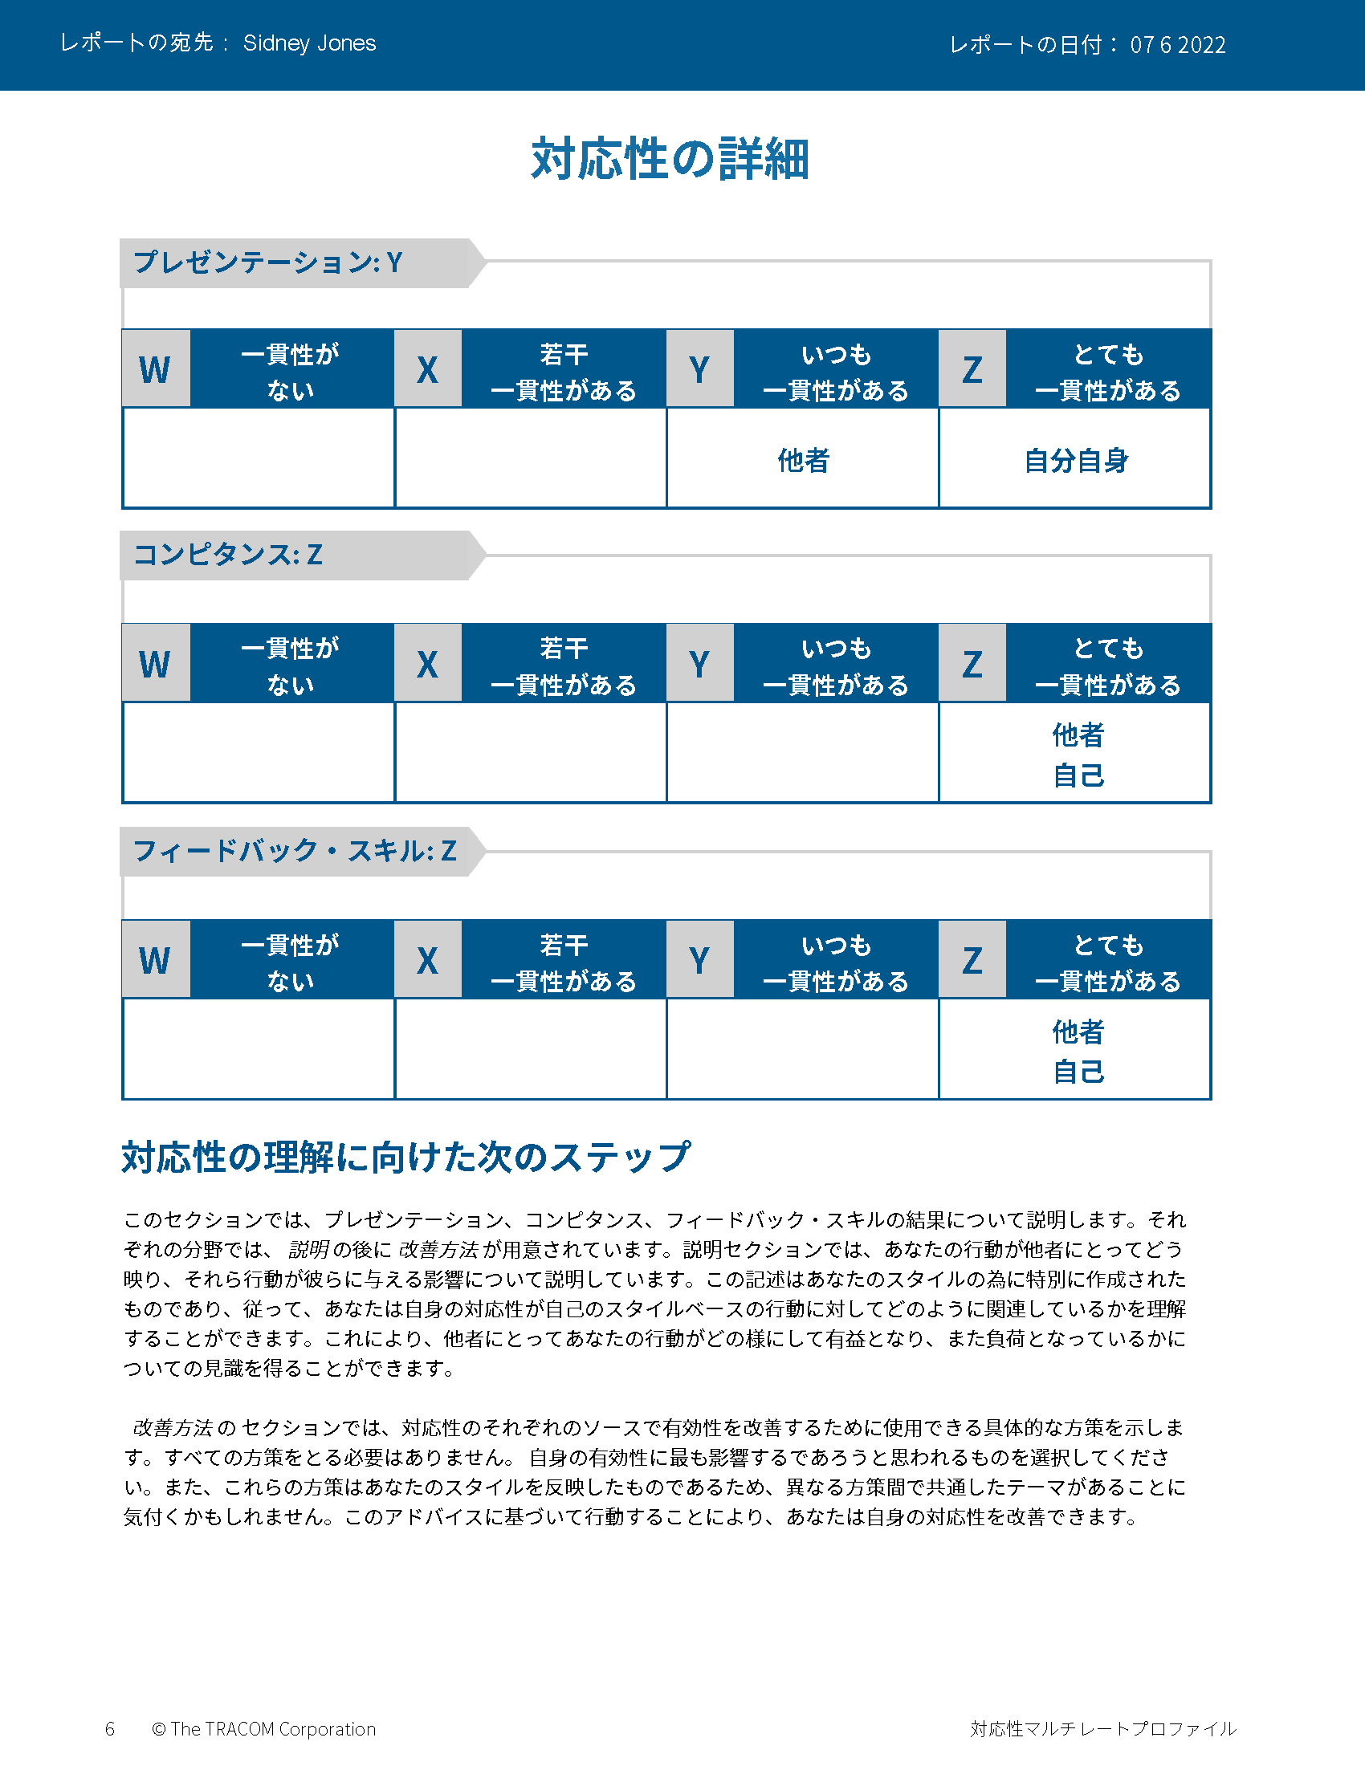
© The TRACOM Corporation. All Rights Reserved.
69
Notes:
Continue reviewing.

Slide 70
© The TRACOM Corporation. All Rights Reserved.
70
Notes:
Continue reviewing.

Slide 71
対人効果を 向上させる ステップ
ほかの人のために何かをする
自分をコントロールする
自分がほかの人に与える影響を自覚する
自分の行動を管理する
ほかの人を客観的に観察する
ほかの人がスタイル別ニーズを 満たせるよう支援する
自分を知る
ほかの人々を知る
Notes:
5 Minutes (Workbook, page 33)
SAY At the beginning of the program, we talked about the four steps for increasing interpersonal effectiveness. Now that you’ve reviewed your Versatility profiles, let’s review these again as we think about ways to adjust behavior to increase Versatility.
REVIEW the four steps for increasing interpersonal effectiveness:
1. Know Yourself by recognizing the impact your Style has on others.
2. Control Yourself by managing your own Style behavior and being tolerant of others’ Styles.
3. Know Others by observing them more objectively.
4. Do Something For Others by helping them meet their Style needs. This eases their tension and opens the door for them to act with Versatility towards you.
SAY To finish the program, we’re going to focus on Doing Something for Others. You’re going to create an action plan to increase Versatility with your customers. First, we’ll review some strategies for showing Versatility towards each Style. This will give you important information for creating your action plan.

Slide 72
ミーティングの準備
感情表現を抑える
アナリティカル
おすすめの行動
事前にアジェンダを共有する
ミーティングの詳細が十分であることを確認する
十分に準備する
避けるべき行動
たくさんの会話を覚悟する
対人関係を重視する
相手の意見を無視する
ドライビング
おすすめの行動
想定される結果を述べる
アジェンダについて承認を得る
ミーティングの詳細をコントロールできるようサポートする
避けるべき行動
取り掛かりが遅い
混乱状態
必要もないのに意思決定を妨げる
意見を 主張する
意見を聞く
エミアブル
おすすめの行動
アジェンダを共同作成する
早めに入室して交流を深める
カメラとマイクをオンにして入室する
避けるべき行動
会うことに同意してくれた以上、興味を持ってくれていると思い込む
コミュニケーションのタスクに移動
事前に知らせずにほかの人を巻き込む
エクスプレッシブ
おすすめの行動
アジェンダに関する意見を聞く
すぐに相手を認める
楽しむ
避けるべき行動
先に詳細を伝えすぎる
過去を詳しく振り返る
ミーティングの構成を厳密に固定しすぎる
感情を表す
Notes:
6 Minutes (Workbook, page 34)
SAY Part of showing Versatility is recognizing customers’ needs and preparing ahead of time. Here are some meeting strategies for each Style.
CLICK TO REVEAL THE TEXT IN EACH QUADRANT.
REVIEW the do’s and don’ts when preparing for meetings.

Slide 73
メッセージの調整
感情表現を抑える
アナリティカル
情報に基づき、これまでに行った 対処は次のとおりです...
私たちは次のような仮定を立ててい ます…
わかっているリスクは次のとおりです…
以上に基づき、おすすめするのは…
ドライビング
ご要望の結果を実現いたします。
経験豊富な「第一人者」チームに当たらせます。
当社のチームがお客様にすばやく成功をお届けします。
すぐに始められます。
意見を 主張する
意見を聞く
エミアブル
こちらが今までどおりの点と変更 点です。
これまでにも皆で何度もやってきたことです。
こちらはお電話いただける照会先のリストです。
協力して取り組むことを誓います。
エクスプレッシブ
ビジョンの実現に向け、お手伝いできることを楽しみにしています。
これが完成すれば、御社は世界一のリーダーになります！
これはお客様と御社にとって大きな飛躍となります。
複数の上級管理職が本件を全面的にサポートしています！
感情を表す
Notes:
6 Minutes (Workbook, page 35)
SAY Most of us fall into the habit of communicating with people in ways that are comfortable for us, without thinking of the needs of the customer. This is often because we’re rushed and send out quick emails. Communicating in Style-specific ways is very important for meeting your customers’ needs. Here are some simple strategies for tailoring your messages to each Style.
CLICK TO REVEAL THE TEXT IN EACH QUADRANT.
REVIEW the techniques for tailoring messages to each Style.

Slide 74
信頼獲得に向けた対応性の発揮
感情表現を抑える
アナリティカル
自分の有能さを証明して見せる
提案の背後にあるロジックを示す
品質にこだわる
事前に準備し、相手の組織を理解する
長所と短所を伝える
対人関係を育てつつも、押し付けがましくならないよう注意する
ドライビング
能力面の自信を示す
要求に応じられない場合は通知する
率直に話す
速いペースを維持する
相手が望む結果についての自分なりの理解を伝える
相手の時間を無駄にしない
意見を 主張する
意見を聞く
エミアブル
必要に応じて個人情報を共有する
嘘偽りがなく誠実であること
相手を助けるための自らのコミットメントを示す
相手のニーズに共感する
不要なプレッシャーを避ける
重要な関係者の名前を覚えておく
エクスプレッシブ
カジュアルでオープンなアプローチを取る
必要もないのに自分の気持ちを隠さない
相手への挑戦や相手との競争を避ける
自分のアイデアや洞察に熱中して見せる
相手にすべての注意を傾ける
仕事以外の話題について話す
感情を表す
Notes:
8 Minutes (Workbook, page 36)
ASK Given a customer’s Style need, what are some ways to earn trust?
FACILITATE a discussion of each Style before revealing the text.
ASK What are some ways to earn trust from people of each Style? Think about their Style needs—what do they value from salespeople?
CLICK TO REVEAL THE TEXT IN EACH QUADRANT.

Slide 75
対応性強化アクションプラン
顧客への対応性を高めるためのアクションプランを作成します。
指示：
特定した顧客のスタイルについて検討します。
より良い関係を築くうえで、自分のスタイルでは何が課題になりますか？ （スタイルの成長を促すアクションについて検討）
この顧客への対応性を高めるために、どのようなアクションを取りますか？
小グループで自分の計画について話し合い、グループ内でフィードバックをもらってください。
75
Notes:
30 Minutes (Workbook, page 37)
SAY Use the insights you’ve learned and create a specific plan for yourself. Writing down your intentions is a proven way of making sure you actually do something. Decide on just one or two things you can do differently.
Remember your Style growth actions, since managing your own Style behavior is an important part of being versatile.
REVIEW the Style growth actions:
Driving：to listen
Expressive：to check
Amiable：to initiate
Analytical：to declare
SAY When you’ve finished this, we will put you in small breakout groups to share your insights and give feedback to one another.
CREATE breakout groups of 2 to 3 people.

Slide 76
オンラインでの 対応性観察
Notes:
10 Minutes (whole section on Observing Versatility Virtually)
SAY Briefly, before we finish—remember those text messages we reviewed earlier? Let’s bring Versatility into those conversations.

Slide 77
お送りした最新の技術アップグレードに関するビデオをご覧いただく機会はあっただろうかと思い、ご連絡しています。お考えをお聞かせください。
Notes:
SAY We had four responses to this message. Let’s look at how the person who sent this message might respond to each of these individuals. Is the person showing Versatility in each message?

Slide 78
こんにちは！ 急激な変化が押し寄せています。当チームでは、新機能に関するトレーニングを
必要としています。ご助力いただけませんか？
変化は大きそうですが、これらのアップ
グレードはチームでのコラボレーションの
向上に役立ちます。私は皆さんのチームの
トレーニング計画に取り組み、問題が発生し
たら利用できるようにします。
私は皆さんとチームのためにここにいます！
Notes:
SAY This message came from the Amiable Style customer.
Click to reveal.
SAY And here is the response. What do you think? Is the salesperson showing Versatility toward the Amiable Style person? What would you add or change to the response?
NOTE：The salesperson is making an effort to meet the person’s Style needs by reassuring them about the changes. The salesperson offers to help the customer by developing a training plan, then reassures them that they will be supported.

Slide 79
ワクワクします！ざっと見てみましたが、
新機能はすばらしいですね。
来週お電話します。
ええ、アップグレードはかなりうまくいくでしょう。また後でお話ししましょう。
Notes:
SAY This message came from the Expressive Style person.
Click to reveal.
SAY And here is the response. What do you think? Is the salesperson showing Versatility toward the Expressive Style customer?
Is the response focused on their own needs, or the Expressive Style person’s needs? What would be a more effective response?
NOTE：The salesperson is diminishing the customer’s enthusiasm. A more effective response would be to reflect the enthusiasm by reiterating how great the new upgrades are and how excited the salesperson is about the changes, then offer to set up a call with the customer.

Slide 80
新しいアップグレードにより、効率が向上し、
労力を削減できると思います。ただし皆で
新しいリリースに適応する前に、チームの
トレーニングを計画する必要があります。
そのためのプロセスは用意されていますか？
アップグレードをテストしたところ、パフォーマン
スが大幅に向上していました。そのデータも、トレーニングのアジェンダや選択可能な日付と一緒にお送りします。ほかにサポートできることがあれば、お声をおかけください。
Notes:
SAY This message came from the Analytical Style customer.
Click to reveal.
SAY And here is the response. What do you think? Is the salesperson showing Versatility toward the Analytical Style person? What would you add or change to the response?
NOTE：The salesperson is making an effort to meet the customer’s Analytical Style needs by recognizing their need to prepare ahead of time by getting training. The salesperson offers to send more detailed information about the upgrades as an effort to give the customer more information and alleviate any remaining concerns. They also open the conversation to more input by offering to help in any other way.

Slide 81
いいですね。 実装する準備ができたら、お電話します。
わかりました。
Notes:
SAY This message came from the Driving Style customer.
Click to reveal.
SAY And here is the response. What do you think? Is the salesperson showing Versatility toward the Driving Style customer?
Is the response focused on their own needs, or the Driving Style person’s needs? What would be a more effective response?
NOTE：Though Driving Style people appreciate brevity, the salesperson is dismissive and is missing important elements of the customer’s Style. The salesperson should recognize that the customer probably hasn’t reviewed the upgrades in detail. The salesperson should state that they are there to help move forward, and also offer options to meet with the customer to discuss the changes and listen to their input.

Slide 82
次のステップ
対応性を発揮する練習を積みましょう。アクションプランはいつでも参照できるよう手元に置いておきます。
SOCIAL STYLE Navigatorには、多様なセールス状況に関するアドバイスと追加のリソースが組み込まれています。
ソーシャル・スタイル・パスポートを利用すると、 自分がほかの国ではどのプロファイルになるか がわかります。
Notes:
5 Minutes (Workbook, page 38)
SHARE key “takeaways” with the class：
The key to more effective performance is to practice what you’ve learned. Keep your Versatility Action Plan nearby as a reminder. As you begin to experience positive results, this will reinforce your commitment to practice Versatility.
There are additional resources that will help you. TRACOM’s SOCIAL STYLE Navigator contains advice for working with customers in a variety of situations, such as giving presentations, advancing the sale, and having difficult conversations. You can access this resource by logging in at tracomlearning.com.
NOTE the following slides describe SOCIAL STYLE Navigator in more detail.

Slide 83
SOCIAL STYLE Navigator®
SOCIAL STYLE Estimator （ソーシャル・スタイル推定調査票） ほかの人のスタイルを推定するための簡単な アンケート
ソーシャル・スタイルアドバイザー
ミーティング、商談、プレゼンテーションの準備
多様な状況に応じたスタイルと対応性のベストプラクティス
eラーニングモジュール スタイルの概念をチームに適用し、対立の管理、コーチングを通じてさらに優れた対応性を実現
SOCIAL STYLE Navigator® は、TRACOM Corporationの登録商標です
Notes:
1 Minute
SAY You now have free and unlimited access to SOCIAL STYLE Navigator, the on-demand micro-learning tool that helps you apply Style and Versatility.
SOCIAL STYLE Navigator includes:
SOCIAL STYLE Estimator
The Estimator survey provides users with an interactive tool that evaluates observable behavior in others to determine their Style and helps you plan ahead for successful interactions.
SOCIAL STYLE Advisor
Use Advisor topics to prepare “just-in-time” for meetings, negotiations or sales presentations with advice on navigating Style and Versatility best practices to maximize high-performing relationships.
eLearning modules
Continue your learning journey via micro-learning that reinforces ways to apply SOCIAL STYLE and Versatility to Working in Teams, Coaching and Managing Conflict.

Slide 84
SOCIAL STYLE Navigator®への アクセス
tracomlearning.comから 利用可能
Notes:
1 Minute
SAY Available through www.tracomlearning.com
Enter your username and password for free, unlimited access to SOCIAL STYLE Navigator®

Slide 85
Notes:
Optional demonstration, time permitting

Slide 86
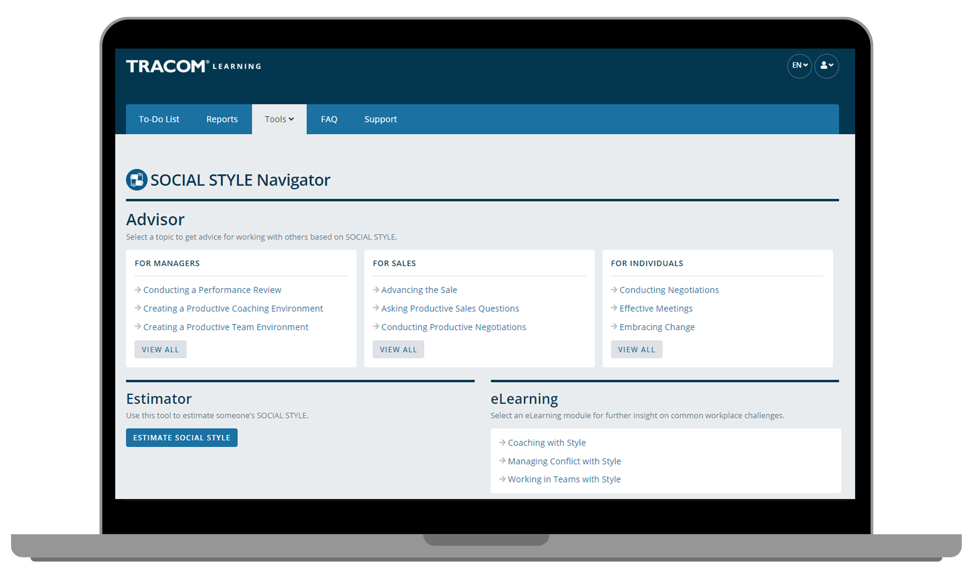
Notes:
Optional demonstration, time permitting

Slide 87
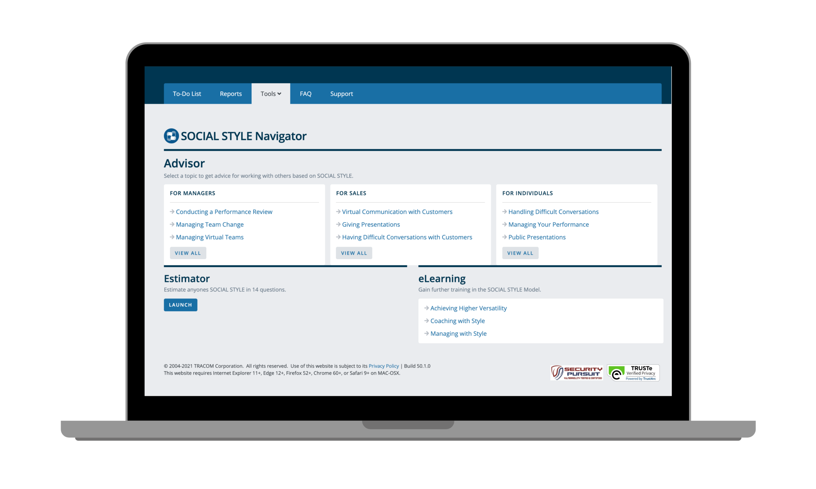
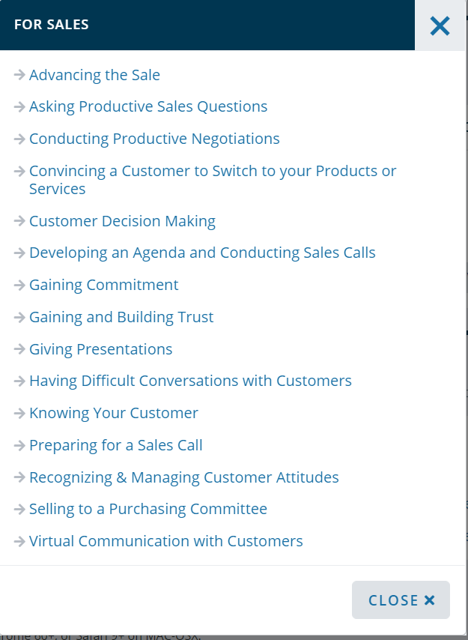
Notes:
Optional demonstration, time permitting

Slide 88
Notes:
Optional demonstration, time permitting

Slide 89
Notes:
Optional demonstration, time permitting

Slide 90
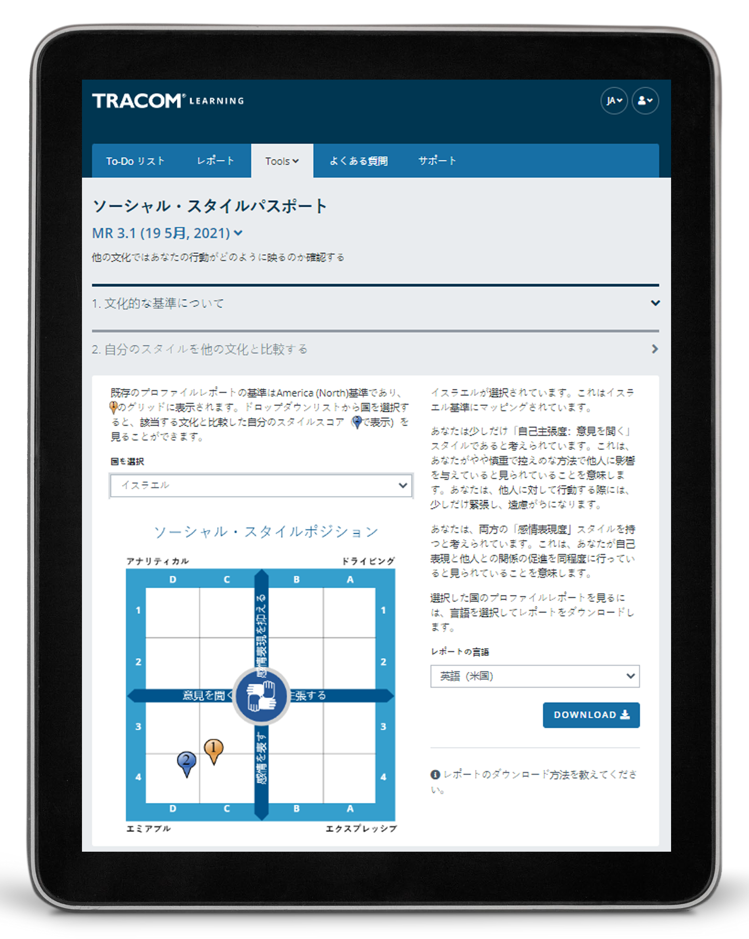
ソーシャル・スタイル・パスポート
Notes:
Optional demonstration, time permitting
The SOCIAL STYLE Passport allows you to see how you would profile in another country. It’s also available at tracomlearning.com.

Slide 91
91
Notes:
THANK participants and conclude the session.

