Slide 1
Ergebnisorientiertes Verkaufen™
Notes:
2 Minutes
WELCOME participants to the session and REVIEW key points about TRACOM’s SOCIAL STYLE Model:
One of the most widely used and highly regarded behavioral models in use today.
Will help you develop insight about your behavioral strengths and weaknesses, and your customers’ behavioral preferences.
Originally developed in the 1960s by psychologists David Merrill and Roger Reid.
Used worldwide by millions of people.
PROGRAM BENEFITS
SAY Working successfully with customers depends on developing good relationships. You can do this by understanding your own Style and, more importantly, other people’s Styles. This allows you to practice Versatility by adjusting your behavior to meet other people’s Style preferences. Research shows that people who consistently show Versatility are more effective in their jobs than people who don’t show Versatility.

Slide 2
Schritte zur Steigerung der zwischenmenschlichen Effektivität
Etwas für andere tun
Sich selbst kontrollieren
Erkennen Sie Ihren Einfluss auf andere
Steuern Sie Ihr eigenes Verhalten
Beobachten Sie andere objektiv
Helfen Sie, die Stil-Bedürfnisse anderer zu erfüllen
Sich selbst kennen
Andere kennen
Notes:
5 Minutes (Workbook, page 2)
SAY This program will bring you on a journey. The ultimate goal is to work more effectively with your customers and others. We’ll get there through a process that starts with understanding yourself and how your behavior affects your productivity and relationships. We refer to these as “know yourself” and “control yourself.”
Most importantly though, you’ll begin to focus on understanding others and their preferences for getting work done. This is called “know others.” With this understanding of others’ behavioral styles, you’ll begin to practice your Versatility, which is “do something for others.”
We’ll talk more about these four steps later, but as we progress through the program, you’ll see how they are applied.
By the end of the program, you’ll have insight into your own Style and behavior, and the Style of at least one of your customers. You’ll build on this knowledge to develop more effective ways of working with your customers through practicing Versatility.

Slide 3
Was Sie lernen werden
Wie man das Verhalten der Kunden vorhersagen kann.
Was Stress für die Kunden bedeutet.
Wie man ihre Bedürfnisse erkennt und erfüllt.
Wie Sie sich auf Besprechungen vorbereiten und die Kommunikation anpassen.
Wie man das Vertrauen der Kunden gewinnt.
Notes:
2 Minutes
SAY Ultimately, this course will help you have more success with your customers. In particular, you’re going to learn specific strategies:
How to predict your customers’ behavior, and an understanding of why they behave that way.
What causes customers to become stressed, and how your own behavior can contribute to this.
How to recognize their needs and meet those needs.
How to prepare for meetings and tailor your communication to different customers.
Ultimately, how to earn their trust.

Slide 4
SOCIAL STYLE & ANPASSUNGSFÄHIGKEIT
EIN SCHLÜSSELELEMENT DER VERTRIEBSLEISTUNG
Als Ergebnis des SOCIAL STYLE- und Anpassungsfähigkeitstrainings berichten Vertriebsfachleute Folgendes:
92 %
87 %
58 %
entwickelten
verbesserten ihre Fähigkeit,
berichteten über
POSITIVERE KUNDENBEZIEHUNGEN
KUNDEN ZU BEEINFLUSSEN ODER ZU ÜBERZEUGEN
VERKAUFSABSCHLÜSSE, DIE SONST VIELLEICHT NICHT ZUSTANDE GEKOMMEN WÄREN
Mit zunehmender Anpassungsfähigkeit steigt auch die Arbeitsleistung.
Notes:
2 MINUTES (Workbook, page 4)
SAY In the first part of the program, you’ll learn about Style. This will help you understand your customers and how they prefer to interact with you.
The second part of the program focuses on Versatility, which is how well you meet others’ Style needs.
Versatility is the application of SOCIAL STYLE—when you understand your customers’ Style needs, you can help them meet those needs. This helps them feel more valued and sets the stage for them to have a better relationship with you. If you consistently show Versatility, you can be more effective.
You can read the stats on this slide. Research has found that salespeople who practice SOCIAL STYLE and Versatility have more success.

Slide 5
Einführung
Name
Berufliche Tätigkeit
Anonymer Kunde – Was frustriert Sie am meisten?
Notes:
10 Minutes
Have participants introduce themselves by revealing the topics listed on the slide.
ASK participants to think of one customer they have a difficult relationship with, and briefly describe their main frustration(s) with this person WITHOUT NAMING THE PERSON.
If Group is too large for verbal introductions, do this through chat.
TIP: You might want to record participants’ “What is Most Frustrating” on a flip chart (or virtual white board). The purpose of the session is to learn how to improve these relationships.
Make sure you have a Profile for each participant who completed the online Questionnaire by the deadline.
DO NOT pass out the Profiles at this time.
If you are delivering a virtual program, options and instructions for downloading profiles are given later in this guide.

Slide 6
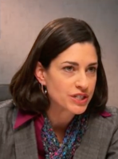
Der Stil in Aktion
Beobachtungen
Meinungen
Kyle
Lana
AJ
Abby
Notes:
15 Minutes (Workbook, page 5)
INTRODUCE the video: Four individuals participate in a meeting to discuss a product that is missing a client’s expectations.
ASK participants to write down their observations and opinions of each character on page 5 of the Participant Workbook.
PLAY Part 1.
DEBRIEF the video by asking participants to briefly share their thoughts on the characters. Many of the participants’ comments will be subjective observations.

Slide 7
Mein Kunde – Erste Eindrücke
Denken Sie an den Kunden, den Sie zuvor identifiziert haben. Geben Sie ihm einen fiktiven Namen und schreiben Sie Folgendes auf:
Erste Eindrücke, die Sie von dieser Person hatten (aus Ihren ersten Interaktionen)
Notes:
5 Minutes (Workbook, page 6)
SAY Think about the customer you identified during our “Introduction” exercise.
SAY Give your customer a fictional name and then write down:
First impressions you had of that person (from your first interactions).
DEBRIEF the exercise by asking participants to briefly share the information about their customer.
SAY The information you shared is typical about how we feel about and react to others. Some information is objective and observable—and some of it is subjective (how we feel about them). Today, we’re going to show you a more objective and reliable way to understand behavior; then based on this, find ways to work more effectively and with less frustration.

Slide 8
Verhaltensdimensionen
Einflussnahme und Gefühlsausdruck
Notes:
SAY We’re going to talk about behavior and how to accurately observe people’s behavior.

Slide 9
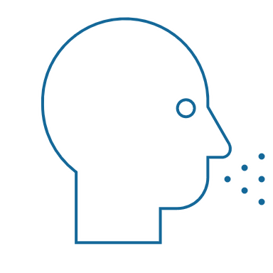
Wahrnehmbares Verhalten vs. Persönlichkeit
Verhalten
Was Sie sagen (verbal) und was Sie tun (nonverbal)
SOCIAL STYLE® Ein bestimmtes Verhaltensmuster, das andere Personen an Ihnen beobachten können und mit dem sie Sie beschreiben würden
Wahrnehmbares Verhalten
Sagen / Tun
Persönlichkeit
Zwischenmenschliches Verhalten
Was Sie sagen und tun, wenn Sie mit einer oder mehreren Personen interagieren
Persönlichkeit
Alles, was eine Person ausmacht: ihre Ideen, Werte, Hoffnungen und Träume
Notes:
4 Minutes (Workbook, page 7)
SAY Behavior and personality are not the same things. Observable behavior is like the crust of a pie. Personality is like the inside and outside of the pie.
ASK What makes up personality?
CONDUCT a quick facilitated discussion to solicit participants’ responses. They should say things such as:
Values, hopes, attitudes, beliefs.
Things that are not necessarily observable.
These internal qualities are more subjective in nature.
SAY Style is like the crust, because it’s on the outside and observable. By observing behavior, we can find ways to define and discuss what we see. Then, we can begin to understand how this behavior affects ourselves and others.

Slide 10
Sagen & Tun-Verhaltensweisen
Eigenschaften
Ehrlich
Intelligent
Arrogant
Motiviert
Egozentrisch
Aufrichtig
Kritisch
Wahrnehmbares Verhalten
Ruhig
Langsameres Tempo
Beherrschtere Mimik
Weniger modulierter Stimme
Weniger Augenkontakt
Lockere Haltung
Zurückgelehnt
Laut
Höheres Tempo
Lebhaftere Mimik
Stärker modulierter Stimme
Mehr Augenkontakt
Starre Haltung
Nach vorne gelehnt
Bewertungen
Ich mag ihn
Er nervt mich
Sie interessiert mich
Er ärgert mich
Ich traue ihr nicht
Ich hasse ihn
Ich vertraue ihm
SAGEN
TUN
Notes:
5 Minutes (Workbook, page 8)
SAY When we first meet people, we often form immediate impressions, even after just a few seconds. This is subconscious (below our level of awareness) and happens immediately.
DESCRIBE
Traits Column: What we think we know about a person, based on interactions; subjective opinions.
Judgments Column: Our reactions to others; conclusions or evaluations we make, based on our subjective opinions.
Observable Behavior Column: Things others “Say and Do”; more objective and observable behaviors.
SAY Traits and Judgments are most subjective in nature and contain positive or negative descriptions.
Observable Behavior is objective and contains no positive or negative value.
Observable Behavior is an important tool for assessing others’ Styles. By focusing on Observable Behavior, you gain objectivity, which is critical for understanding people’s Styles.

Slide 11
Einflussnahme und Gefühlsausdruck
Notes:
SAY We measure observable behavior on two dimensions: Assertiveness and Responsiveness

Slide 12
Einflussnahme
Das Ausmaß, in dem wir in der Interaktion mit anderen „fragen“ oder „anordnen“
Stärker fragend
Fragend mit einigem Anordnen
Anordnend mit einigem Fragen
Stärker anordnend
Notes:
2 Minutes (Workbook, page 9)
SAY To become more effective with others, we follow a behavioral model. There are two dimensions of behavior that define SOCIAL STYLE: Assertiveness and Responsiveness.
Assertiveness is the degree to which we ask or tell when interacting with others. The two anchors for Assertiveness are Ask on the left side of the continuum and Tell on the right side of the continuum.
Assertiveness is a measurement of how we try to influence others to take action. If you are more “Tell” Assertive, you state your opinions directly. You tend to declare your viewpoints and try to direct the actions of others.
For example, if you want to have lunch with someone, you might say, “Let’s have lunch today!”
If you are more “Ask” Assertive, you tend to be more cautious and reserved about sharing your opinions. You attempt to influence others in a more quiet, low-key, questioning manner.
For example, if you want to have lunch with someone, you might say, “Would you like to have lunch with me today?”

Slide 13
Verhaltensweisen der Einflussnahme
SAGEN | Verbale Verhaltensweisen
Langsamer
Redegeschwindigkeit
Schneller
Weniger
Redemenge
Mehr
Leiser
Sprechlautstärke
Lauter
FRAGEND
ANORDNEND
Entspannt
Gebrauch der Hände
Anweisend
Lehnt sich zurück
Körperhaltung
Lehnt sich vor
Weniger direkt
Augenkontakt
Direkter
TUN | Nonverbale Verhaltensweisen
Notes:
3 Minutes (Workbook, page 10)
SAY The Assertiveness scale helps predict a person’s behavior because it represents a “theme” or typical pattern. There are verbal and non-verbal clues to indicate a person’s Assertiveness.
ASK participants for examples of verbal and non-verbal clues for Ask-Assertive and Tell-Assertive individuals.
DESCRIBE the verbal and non-verbal indicators of Assertiveness:
Verbal: Ask-Assertive individuals use a slower pace, less quantity (fewer words), and quieter volume. Tell-Assertive individuals use a faster pace, talk more, and a louder volume.
Non-Verbal: Ask-Assertive individuals show relaxed hands and gestures, lean back, and use less direct eye contact. Tell-Assertive individuals have a directive use of hands, lean forward, and use more direct eye contact.

Slide 14
Einflussnahme
Verbale Anhaltspunkte
Nonverbale Anhaltspunkte
Kyle
Lana
AJ
Abby
Notes:
10 Minutes (Workbook, page 11)
PLAY the same Video Part 1, again, now that participants have been introduced to Assertiveness.
ASK them to observe verbal and non-verbal “Say and Do” behaviors and record their observations on page 11 of their Participant Workbook.
DISCUSS video characters related to Assertiveness.
ASK participants to share some subjective “Say and Do” verbal and non-verbal behaviors of each of the team members. Think about speech characteristics such as pace, quantity, and volume for verbal behaviors and use of hands, posture, and eye contact for non-verbal behaviors.
ASK What is different about your observations from the first time you saw the video? (Answer: They are much more objective.) This contrasts with the subjective observations participants made earlier.
ASK Based on your understanding of the Assertiveness dimension, where do you think each of the characters falls on the Assertiveness continuum?
SAY Assertiveness is neither positive nor negative; it is neutral. There is no good or bad place on the Assertiveness scale. Your level of Assertiveness only becomes positive or negative when used appropriately or inappropriately.

Slide 15
Kunde: Beobachtungen zur Einflussnahme
SAGEN | Verbale Verhaltensweisen
Langsamer
Redegeschwindigkeit
Schneller
Weniger
Redemenge
Mehr
Leiser
Sprechlautstärke
Lauter
FRAGEND
ANORDNEND
Entspannt
Gebrauch der Hände
Anweisend
Lehnt sich zurück
Körperhaltung
Lehnt sich vor
Weniger direkt
Augenkontakt
Direkter
TUN | Nonverbale Verhaltensweisen
Notes:
10 Minutes (Workbook, page 12)
SAY Using the customer that you identified earlier, think about, and then write down, that person’s Assertiveness behaviors. Include the person’s verbal and non-verbal behaviors. Think about their speech characteristics such as pace, quantity, and volume for verbal behaviors and use of hands, posture, and eye contact for non-verbal behaviors.
DEBRIEF the exercise by asking participants to briefly share the information about their customer’s Ask or Tell Assertive behaviors.
RECORD their information on a virtual white board or flip chart.
ASK What is different about your observations from the first time you described this person?
Answer: They are much more objective. This contrasts with the subjective observations participants made earlier.
ASK Based on your understanding of the Assertiveness dimension, where do you think your customer falls on the Assertiveness continuum?
EMPHASIZE that Assertiveness is neither positive nor negative; it is neutral. There is no good or bad place on the Assertiveness scale.

Slide 16
Gefühlsausdruck
Stärker kontrollierend
Kontrollierend und etwas emotional
Das Ausmaß, in dem wir Emotionen kontrollieren oder zeigen, wenn wir mit anderen interagieren
Emotional und etwas kontrollierend
Eher emotional
Notes:
2 Minutes (Workbook, page 13)
SAY Responsiveness is the degree to which people tend to control (don’t outwardly display emotions) or emote (outwardly display emotions).
The two descriptive anchors for the Responsiveness scale are Controls on the top of the continuum and Emotes on the bottom of the continuum.
Responsiveness is also the extent to which you react to emotional appeals or displays.
If you control your emotions, you usually don’t react to emotional appeals and are more likely to focus on ideas, data, and tasks. You are less likely to share your feelings publicly.
If you are more emoting, you share and display your emotions with others. You are more likely to respond to emotional appeals and displays from others.

Slide 17
Verhaltensweisen beim Gefühlsausdruck
SAGEN | Verbale Verhaltensweisen
TUN | Nonverbale Verhaltensweisen
Kontrolliert
Weniger Modulation
Aufgabe
Fakten/Daten
Weniger
Starr
Kontrolliert
Emotionen in der Stimme
Redethemen
Form der Beschreibungen
Gebrauch der Hände
Körperhaltung
Gesichtsausdruck
Mehr Modulation
Menschen
Meinungen/Geschichten
Mehr
Lässig
Animiert
Emotional
Notes:
3 Minutes (Workbook, page 14)
SAY The Responsiveness scale, like the Assertiveness scale, helps us to predict a person’s behavior because it is a “theme” or typical pattern.
ASK participants for their opinions on the verbal and non-verbal clues of Control- and Emote-oriented individuals.
DESCRIBE the verbal and non-verbal clues to responsive behavior as noted on the slide.
SAY Responsiveness is neither a positive nor a negative quality; it is neutral.
Assertiveness and Responsiveness do not affect each other — they are independent of each other.

Slide 18
Gefühlsausdruck
Verbale Anhaltspunkte
Nonverbale Anhaltspunkte
Kyle
Lana
AJ
Abby
Notes:
10 Minutes (Workbook, page 15)
REPLAY Video Part 1 again, now that participants have been introduced to Responsiveness.
ASK participants to observe verbal and non-verbal Say/Do behaviors.
SAY Think about verbal clues such as vocal emotion, subjects, and what each team member describes. What did you observe? For non-verbal clues, think about use of hands, posture, and facial expressions.
ASK Based on your understanding of Responsiveness, where do you think each of the characters falls on the Responsiveness scale?
SAY The Assertiveness and Responsiveness dimensions assess behavior, not personality or intelligence, and they are independent of each other.

Slide 19
Kunde: Beobachtungen zum Gefühlsausdruck
SAGEN | Verbale Verhaltensweisen
TUN | Nonverbale Verhaltensweisen
Kontrolliert
Weniger Modulation
Aufgabe
Fakten/Daten
Weniger
Starr
Kontrolliert
Emotionen in der Stimme
Redethemen
Form der Beschreibungen
Gebrauch der Hände
Körperhaltung
Gesichtsausdruck
Mehr Modulation
Menschen
Meinungen/Geschichten
Mehr
Lässig
Animiert
Emotional
Notes:
10 Minutes (Workbook, page 16)
SAY Using the customer that you identified earlier, think about, and then write down, that person’s Responsiveness behaviors. Include their verbal and non-verbal behaviors. Think about speech characteristics such as emotion in their voice, subjects of speech, forms of descriptors, and non-verbal behaviors such as use of hands, body posture, and use of facial expressions.
DEBRIEF the exercise by asking participants to briefly share the information about their customer’s Control or Emote Responsiveness Behaviors.
RECORD their information on a virtual white board or flip chart.
ASK What is different about your observations from the first time you described this person?
Answer: They are much more objective. This difference contrasts with the subjective observations participants made earlier.
ASK Based on your understanding of the Responsiveness Dimension, where do you think your customer falls on the Responsiveness continuum?

Slide 20
SOCIAL STYLE-Modell™
Notes:
SAY Now that you understand Assertiveness and Responsiveness, we’ll see how they form the SOCIAL STYLE Model.

Slide 21
SOCIAL STYLE-ModellTM
Kontrolliert
Fragende Einflussnahme Eher kontrolliert
Analytischer Stil
Anordnende Einflussnahme Eher kontrolliert
Treibender Stil
Fragend
Anordnend
Fragende Einflussnahme Eher emotional
Rücksichtsvoller Stil
Anordnende Einflussnahme Eher emotional
Expressiver Stil
Emotional
Notes:
4 Minutes (Workbook, page 17)
CLICK TO REVEAL EACH QUADRANT
SAY By combining Assertiveness and Responsiveness, the four SOCIAL STYLEs are formed.
No individual will display one Style exclusively; but, in a short time, you can determine the patterns that define a person’s Style. Once you know a person’s Style, you can adjust your behavior to develop a more effective relationship.

Slide 22
SOCIAL STYLE-Modell
Kontrolliert
Analytisch
Seriös
Anspruchsvoll
Logisch
Unentschlossen
Treibend
Unabhängig
Formell
Praktisch
Dominierend
Fragend
Anordnend
Rücksichtsvoll
Unterstützend
Zuverlässig
Offen
Zugänglich
Expressiv
Energisch
Animiert
Abenteuerlustig
Impulsiv
Emotional
Notes:
5 Minutes (Workbook, page 18)
CLICK TO SPEAK ABOUT EACH QUADRANT (text becomes darker)
Review the summaries for each Style. Note that each Style contains positive descriptors and one negative descriptor. This illustrates the significance of perception. A Driving Style person might see themselves as Independent, Formal, and Practical, while others might perceive the same behavior as Dominating.
Solicit questions/ comments.
KEY POINTS:
Style descriptions are generalizations about each Style.
People with the same Style exhibit similar behaviors, but are still individuals.
Perceptions can vary. What you see as strengths in yourself, others might view negatively.

Slide 23
Welcher Stil ist in Aktion zu sehen?
Welchen Stil hat jeder Charakter?
Kyle
Lana
AJ
Abby
Notes:
3 Minutes (Workbook, page 19)
REFERENCE the video characters from earlier exercises.
ASK What do you think the SOCIAL STYLE of each video character is?
DISCUSS the behaviors of the characters and how those are indicative of their Styles.
IMPORTANT: Do not advance the slide until you’ve discussed the behavior of each character. The next slide reveals each character’s Style.

Slide 24
SOCIAL STYLE
Kontrolliert
Analytisch
Treibend
Lana
Kyle
Fragend
Anordnend
Rücksichtsvoll
Expressiv
AJ
Abby
Emotional
Notes:
2 Minutes (Workbook, page 19)
Kyle – Driving
Lana – Analytical
AJ – Amiable
Abby – Expressive
DISCUSS the behaviors of the characters and how those are indicative of their Styles.

Slide 25
SOCIAL STYLE des Kunden
Kontrolliert
Fragende Einflussnahme Eher kontrolliert
Analytischer Stil
Anordnende Einflussnahme Eher kontrolliert
Treibender Stil
Fragend
Anordnend
Fragende Einflussnahme Eher emotional
Rücksichtsvoller Stil
Anordnende Einflussnahme Eher emotional
Expressiver Stil
Emotional
Notes:
5 Minutes (Workbook, page 20)
SAY Using the customer that you identified earlier, determine their Style. This is only a preliminary estimate. As we continue through the program, you might re-estimate the person’s Style.
DEBRIEF the exercise by asking participants to share their customer’s Style, and how this behavioral assessment relates to their initial impressions of the person (which may have been more subjective).
RECORD their information on a virtual white board or flip chart.
SAY You will use their Style as a framework for developing more effective interactions with this person.

Slide 26
Bedarf, Orientierung und Wachstumsmaßnahme
Bedarf
Das Ziel eines jeden Stils
Orientierung Das übliche Verhalten zur Erreichung des Ziels
Wachstumsmaßnahme
Verhalten, das nur selten von den einzelnen Stilen verwendet wird. Eine häufigere Anwendung dieses Verhaltens würde die Wirksamkeit dieses Stils erhöhen
Notes:
2 Minutes (Workbook, page 21)
SAY Remember that the Style descriptions are generalizations about each Style. While people with the same Style generally exhibit similar characteristics, each person is still unique.
SAY Each Style has a Need, an Orientation, and a Growth Action. By recognizing these things about each Style, we can understand their motivations and what drives their behavior.
DEFINE:
Need – The goal of each Style.
Orientation – The common behavior used to achieve the need.
Growth Action – Behavior that is rarely used by each Style. Using this behavior more often would increase this Style’s effectiveness.
SAY Understanding the need, orientation, and growth action of each Style will help you better relate to others’ Styles and enhance your effectiveness with them.

Slide 27
SOCIAL STYLE Hauptmerkmale
Kontrolliert
Analytisch
Bedarf: Recht haben
Orientierung: Überlegen
Wachstumsmaßnahme: Deklarieren
Treibend
Bedarf: Resultate
Orientierung: Maßnahmen
Wachstumsmaßnahme: Zuhören
Fragend
Anordnend
Rücksichtsvoll
Bedarf: Persönliche Sicherheit
Orientierung: Beziehungen
Wachstumsmaßnahme: Einleiten
Expressiv
Bedarf: Persönliche Anerkennung
Orientierung: Spontanität
Wachstumsmaßnahme: Überprüfen
Emotional
Notes:
6 Minutes (Workbook, page 21)
CLICK TO REVEAL THE TEXT IN EACH QUADRANT.
REVIEW each Style.
ASK How do need, orientation, and growth action manifest themselves in the video characters? Specifically, how does each team member’s behavior show their need, orientation, and growth action?

Slide 28
SOCIAL STYLE-Verhaltensweisen
Kontrolliert
Analytisch
Langsameres Tempo
Bemüht sich um die Organisation
Weniger Sorge um Beziehungen
Arbeit im vergangenen Zeitrahmen
Ergreift Maßnahmen vorsichtig
Vermeidet persönliches Engagement
Treibend
Schnelleres Tempo
Will das Tempo vorgeben
Weniger Sorge um Beziehungen
Arbeitet im gegenwärtigen Zeitrahmen
Steuert die Handlungen anderer
Vermeidet Untätigkeit
Fragend
Anordnend
Rücksichtsvoll
Langsameres Tempo
Bemüht sich, etwas nachvollziehen zu können
Weniger Sorge hinsichtlich der Durchführung von Veränderungen
Arbeitet im gegenwärtigen Zeitrahmen
Zeigt unterstützende Maßnahmen
Vermeidet Konflikte
Expressiv
Schnelleres Tempo
Bemüht sich, sich zu engagieren
Weniger Sorge um Routinen
Arbeitet im zukünftigen Zeitrahmen
Handelt impulsiv
Vermeidet Isolation
Emotional
Notes:
5 Minutes (Workbook, page 22)
CLICK TO SPEAK ABOUT EACH QUADRANT
DESCRIBE the typical behaviors of the four SOCIAL STYLEs. These behaviors are related to the Style needs, orientations, and growth actions.

Slide 29
Verhaltensweisen des Kunden
Kontrolliert
Analytisch
Weniger sozial, sachlich
Weniger direkter Augenkontakt
Hört vor einer Meinungsäußerung aufmerksam zu
Stellt Fragen zu Details
Vermeidet es evtl., eine Meinung zu äußern oder eine Entscheidung zu treffen
Treibend
Weniger sozial, sachlich
Mehr direkter Blickkontakt
Direkt mit Meinungen
Stellt evtl. herausfordernde Fragen stellen
Zieht sich evtl. zurück oder versucht, die Kontrolle zu übernehmen
Fragend
Anordnend
Rücksichtsvoll
Freundlich und ansprechbar
Kopfnicken und andere Zeichen der Ermutigung
Spricht weniger als andere
Stellt Fragen zu den Auswirkungen auf die Menschen
Fügt sich evtl. den Entscheidungen der Gruppe
Expressiv
Kontaktfreudig und ansprechbar zu Beginn des Treffens
Spricht mehr als andere
Weicht evtl. von der Tagesordnung ab und spricht über verschiedene Themen
Direkt mit Meinungen
Ist evtl. konfrontativ
Emotional
Notes:
4 Minutes (Workbook, page 23)
CLICK TO REVEAL THE TEXT IN EACH QUADRANT.
REVIEW the customer behaviors. These behaviors are typical Style-related behaviors specific to working with customers.
ENCOURAGE participants to share stories about their customers.

Slide 30
Spannungen beim Kunden
Kontrolliert
Analytisch
Mangelnde Konzentration und Organisation
Aufdringlichkeit, um einen schnellen Verkaufsabschluss zu erreichen
Fokus auf Allgemeinheiten ohne Berücksichtigung von Details
Zu viele Veränderungen ohne Berücksichtigung der Folgen
Treibend
Mangel an Struktur und klaren Ergebnissen
Keine Möglichkeit zum Äußern der eigenen Meinung
Keine ganzheitlichen Lösungen
Langsamer Fortschritte
Was verursacht Stress für die einzelnen Stile?
Fragend
Anordnend
Rücksichtsvoll
Zu viel Formalität und Fokus auf Aufgaben
Mangelnde Zusammenarbeit bei der Lösungsfindung
Konzentration auf den Verkauf und nicht auf eine langfristige Beziehung.
Zu viele und zu schnelle Veränderungen
Expressiv
Keine Anerkennung für Beiträge
Zu viele Details
Zu viel Struktur ohne freie Gespräche
Zu wenig Fokus auf zukünftige Möglichkeiten
Emotional
Notes:
6 Minutes (Workbook, page 24)
ASK Given a customer’s Style need and typical behaviors, what will cause stress for them?
FACILITATE a discussion of each Style before revealing the text.
CLICK TO REVEAL THE TEXT IN EACH QUADRANT.
The Driving Style need is results, so what’s going to raise their tension in a sales meeting?
Lack of focus; disorganization; not being allowed to state their opinions; no bottom-line solutions; progress is too slow.
Expressive Style stressors:
Not being recognized; too many details; too much structure without free-flowing conversation; not enough focus on future possibilities.
Amiable Style stressors:
Too much formality; lack of collaboration towards solutions; focus on the sale instead of on long-term relationship; too much change too quickly.
Analytical Style stressors:
Lack of structure and clear outcomes; pushiness to achieve quick sale; focus on generalities without considering details; too much change without considering consequences.
ENCOURAGE participants to share stories about their customers.

Slide 31
Sicherheitsverhalten
Kontrolliert
Analytisch
VERMEIDET: Zieht sich zurück, um persönliche Anspannung abzubauen
Treibend
AUTOKRATISCH: Übernimmt die Verantwortung für den Abbau persönlicher Anspannung
Übertriebenes Verhalten, um Anspannung zu verringern
Fragend
Anordnend
Rücksichtsvoll
GIBT NACH: Zieht mit, um persönliche Anspannung abzubauen
Expressiv
GREIFT AN: Konfrontiert, um persönliche Anspannung abzubauen
Emotional
Notes:
5 Minutes (Workbook, page 25)
CLICK TO REVEAL THE TEXT IN EACH QUADRANT.
SAY When customers are feeling stressed, their behavior can be categorized: each Style falls into a type of extreme backup behavior to try and reduce tension.
DESCRIBE each Style’s backup behavior. Remember, each Style’s goal is to get their Style need met.
ASK What are some common ways that each Style might show their backup behavior?
Driving: Will get frustrated by slow progress or barriers and try to take control of the situation.
Expressive: Will get upset if they aren’t given opportunities to express themselves or show their contributions, and might verbally confront others.
Amiable: If they feel that a relationship is being threatened, they will stay quiet and acquiesce instead of firmly stating their opinions.
Analytical: If they feel that things are moving too fast without taking into account important details, they will withdraw and refuse to contribute.
SAY Next we’ll talk about some specific strategies for working with customers.

Slide 32
Erfüllen von Kundenbe- dürfnisse
Kontrolliert
Analytisch
Belege und Informationen: mit der Person teilen
Transparenz: die Person möchte Ihre Prozesse sehen und verstehen
Verstanden zu werden: zeigen, dass Sie Probleme der Person verstehen
Zeit zum Nachdenken: keinen Druck für schnelle Entscheidungen ausüben
Treibend
Ergebnisse: möglichst schnell und wie vereinbart liefern
Kompetenz: die Fähigkeiten Ihres Teams zeigen
Aufrichtigkeit: offen und professionell sein
Effizienz: die Zeit der Person respektieren und schnell zur Sache kommen
Fragend
Anordnend
Rücksichtsvoll
Kontaktpflege: sich für das Kennenlernen Zeit nehmen
Sicherheit: versuchen, die Risiken für die Person zu minimieren
Engagement und Konsens: andere in Entscheidungen einbeziehen, um Zustimmung zu erhalten
Beruhigung: mitteilen, dass ähnliche Projekte bereits erfolgreich durchgeführt wurden
Expressiv
Unterstützung: helfen, die Visionen der Person zu verwirklichen
Genehmigung: konkurrieren Sie nicht mit der Person um Anerkennung
Respekt und Wichtigkeit: die Kunden mögen Aufmerksamkeit, besonders von Führungskräften
Stimme: der Person Redezeit einräumen, auch wenn es nicht um den Zweck der Besprechung geht
Emotional
Notes:
8 Minutes (Workbook, page 26)
ASK With these backup behaviors in mind, and understanding what causes stress for each Style, what are some ways to meet your customers’ needs? Start with the Driving Style, what ideas do you have?
CLICK TO REVEAL THE TEXT IN EACH QUADRANT.
REVIEW the needs and strategies to meet each Style’s needs and facilitate discussion of each Style.
ENCOURAGE participants to share stories about their customers.

Slide 33
Virtuelles Beobachten des Stils
Notes:
10 Minutes (whole section on Observing Style Virtually)
SAY Working with customers and trying to sell remotely has its own unique challenges. You can still use Style to your advantage. Let’s briefly see how people of different Styles might communicate using text messages.

Slide 34
Ich wollte nachfragen, ob Sie sich bereits das Video über unsere neuesten technischen Verbesserungen ansehen konnten.
Was meinen Sie dazu?
Notes:
The following five slides are examples of “observable” behavior in text messages.
SAY By observing the behaviors of others, even through simple communication like texting, we can TRY to determine how people prefer to communicate and prefer to be communicated with.
Review example slides:
There is a lot of change happening at our organization, so I sent this text to four of my customers. Then I waited for their responses.

Slide 35
Ich wollte nachfragen, ob Sie sich bereits das Video über unsere neuesten technischen Verbesserungen ansehen konnten.
Was meinen Sie dazu?
Hallo! Es kommen zahlreiche Veränderungen schnell auf uns zu.
Mein Team muss hinsichtlich der neuen Funktionen geschult werden. Können Sie uns dabei helfen?
Notes:
SAY Here is the first response from a customer.

Slide 36
Ich wollte nachfragen, ob Sie sich bereits das Video über unsere neuesten technischen Verbesserungen ansehen konnten.
Was meinen Sie dazu?
Das ist aufregend! Ich habe einen kurzen Blick darauf geworfen, und die neuen Funktionen sehen großartig aus!
Ich rufe Sie nächste Woche an!
Notes:
SAY This is the second response from another customer.

Slide 37
Ich wollte nachfragen, ob Sie sich bereits das Video über unsere neuesten technischen Verbesserungen ansehen konnten.
Was meinen Sie dazu?
Meiner Meinung nach werden uns die neuen Upgrades helfen, effizienter zu sein und einiages an Aufwand zu sparen. Bevor wir jedoch die neue Version anpassen, müssen wir eine Schulung für mein Team planen. Gibt es bei Ihnen dafür einen vorhandenen Prozess?
Notes:
SAY Here’s the response from a third customer.

Slide 38
Ich wollte nachfragen, ob Sie sich bereits das Video über unsere neuesten technischen Verbesserungen ansehen konnten.
Was meinen Sie dazu?
Sieht gut aus. Ich rufe Sie an, wenn ich zur Umsetzung bereit bin.
Notes:
SAY And finally, this response from a fourth customer.
Keep these texts in mind as we’ll be revisiting them later.

Slide 39
Nennen Sie diesen Stil!
Ich wollte nachfragen, ob Sie sich bereits das Video über unsere neuesten technischen Verbesserungen ansehen konnten.
Was meinen Sie dazu?
Notes:
SAY This is the text I first sent out. How about the responses I received? Knowing what you know so far about SOCIAL STYLE, can you guess which Style each response is from?

Slide 40
Kontrolliert
Fragende Einflussnahme Eher kontrolliert
Analytischer Stil
Anordnende Einflussnahme Eher kontrolliert
Treibender Stil
Hallo! Es kommen zahlreiche Veränderungen schnell auf uns zu. Mein Team muss hinsichtlich der neuen Funktionen geschult werden. Können Sie uns dabei helfen?
Fragend
Anordnend
Fragende Einflussnahme Eher emotional
Rücksichtsvoller Stil
Anordnende Einflussnahme Eher emotional
Expressiver Stil
Emotional
Notes:
SAY Which Style might this person be?
AMIABLE
SAY This person is personable (“Hi!”) and concerned that things are moving fast. They are showing concern for the team’s ability to adapt the new technology, and they specifically ask for help. It indicates Ask Assertiveness and Emote Responsiveness.

Slide 41
Kontrolliert
Fragende Einflussnahme Eher kontrolliert
Analytischer Stil
Anordnende Einflussnahme Eher kontrolliert
Treibender Stil
Das ist aufregend! Ich habe einen kurzen Blick darauf geworfen, und die neuen Funktionen sehen großartig aus!
Ich rufe Sie nächste Woche an!
Fragend
Anordnend
Fragende Einflussnahme Eher emotional
Rücksichtsvoller Stil
Anordnende Einflussnahme Eher emotional
Expressiver Stil
Emotional
Notes:
ASK How about this one—what Style?
EXPRESSIVE
SAY This person uses a lot of exclamation marks to show enthusiasm and wants to interact. They also mention “I took a quick look,” indicating they didn’t pay close attention to the video or details. It indicates Tell Assertiveness and Emote Responsiveness.

Slide 42
Kontrolliert
Fragende Einflussnahme Eher kontrolliert
Analytischer Stil
Anordnende Einflussnahme Eher kontrolliert
Treibender Stil
Meiner Meinung nach werden uns die neuen Upgrades helfen, effizienter zu sein und einiges an Aufwand zu sparen. Bevor wir jedoch die neue Version anpassen, müssen wir eine Schulung für mein Team planen. Gibt es bei Ihnen dafür einen vorhandenen Prozess?
Fragend
Anordnend
Fragende Einflussnahme Eher emotional
Rücksichtsvoller Stil
Anordnende Einflussnahme Eher emotional
Expressiver Stil
Emotional
Notes:
ASK Which Style might this person be?
ANALYTICAL
SAY This person likes things to be efficient but is hesitant to adapt the new technology until the team is trained and ready. They also ask a clarifying question – “Do you have a process in place for this?” It indicates Ask Assertiveness and Control Responsiveness.

Slide 43
Kontrolliert
Fragende Einflussnahme Eher kontrolliert
Analytischer Stil
Anordnende Einflussnahme Eher kontrolliert
Treibender Stil
Sieht gut aus. Ich rufe Sie an, wenn ich zur Umsetzung bereit bin.
Fragend
Anordnend
Fragende Einflussnahme Eher emotional
Rücksichtsvoller Stil
Anordnende Einflussnahme Eher emotional
Expressiver Stil
Emotional
Notes:
ASK And finally, what Style might this be?
DRIVING
SAY This person is being direct and brief. They also communicate that they will initiate contact when they’re ready (“Don’t call me, I’ll call you.”). It indicates Tell Assertiveness and Control Responsiveness.

Slide 44
Wichtige Punkte
Stil ist nicht gleich Persönlichkeit.
Bezieht sich nur auf beobachtbares Verhalten.
Verhalten ist ein Kontinuum, kein „entweder/oder“.
Die Menschen verhalten sich die meiste Zeit in Übereinstimmung mit einem bestimmten Stil.
Es gibt keinen „besten“ Stil.
Notes:
2 Minutes (Workbook, page 28)
REVIEW the key points.
Style is not personality.
Style refers only to observable behavior.
Behavior is a continuum, not an “either/or.”
People behave with one Style most of the time.
There is no “best” Style.

Slide 45
SOCIAL STYLE-Profil
Notes:
SAY Now that you’re familiar with the Model, each of you will review your own SOCIAL STYLE Profile.

Slide 46
Einflussnahme
Das Ausmaß, in dem eine Person dazu neigt, zu fragen oder anzuordnen.
D
C
B
A
Stärker fragend
Fragend mit einigem Anordnen
Anordnend mit einigem Fragen
Stärker anordnend
Stärkere fragende Einflussnahme als 75 % der Bevölkerung
Stärkere fragende Einflussnahme als 50 % der Bevölkerung
Stärkere anordnende Einflussnahme als 50 % der Bevölkerung
Stärkere anordnende Einflussnahme als 75 % der Bevölkerung
Notes:
2 Minutes
SAY Before you read your SOCIAL STYLE Profile, let me describe how your results are determined. The dimensions of behavior are normed. This means that Assertiveness is reported in quartiles.
Review the information on the slide concerning percentiles of people in each of the four quartiles.

Slide 47
Gefühlsausdruck
1
Stärker kontrollierend
Stärkere kontrollierende Reaktion als 75 % der Bevölkerung
2
Kontrollierend und etwas emotional
Stärkere kontrollierende Reaktion als 50 % der Bevölkerung
Das Ausmaß, in dem eine Person dazu neigt, Emotionen zu kontrollieren oder zu zeigen.
3
Emotional und etwas kontrollierend
Stärkere emotionale Reaktion als 50 % der Bevölkerung
4
Eher emotional
Stärkere emotionale Reaktion als 75 % der Bevölkerung
Notes:
2 Minutes
SAY In the same way, Responsiveness is reported in quartiles.
Review the information on the slide concerning percentiles of people in each of the four quartiles.

Slide 48
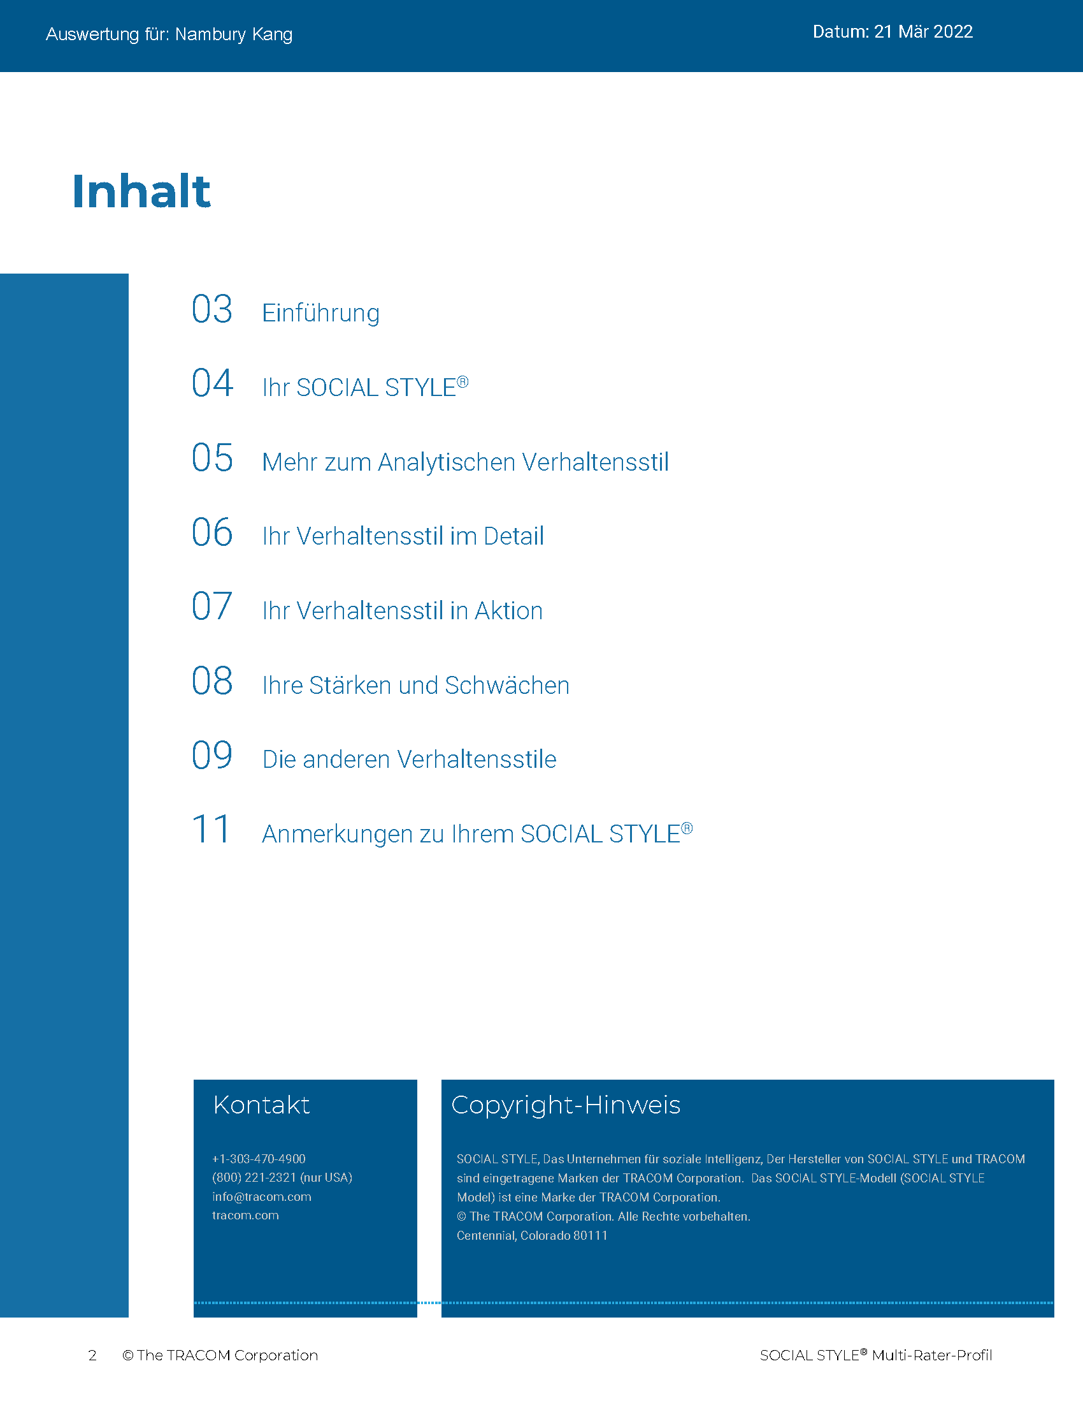
© The TRACOM Corporation. Alle Rechte vorbehalten.
48
Notes:
20 Minutes
REVIEW the Profile pages on the following slides so participants understand the layout of the profile. After you’ve reviewed the slides, distribute individuals’ profiles.
If delivering a virtual program, participants will have already received their profiles. Note that you are only covering the SOCIAL STYLE section of the profile; the Versatility profile will be reviewed later.
PROVIDE ample time for participants to read and absorb their profiles. Do not continue until it is evident that all participants have finished reading their profiles.
ASK if there are any questions, surprises, or concerns.
ASK If your self-perception results were different, what might have caused the difference in views?
EXPLAIN TRACOM’s research shows that over 50% of the time, people see themselves differently from how others see them. Reiterate that there is no “best Style” and all Styles can be successful salespeople. Offer to be available during the break to answer individual questions or concerns.
NOTE: It is recommended that you take a break here and make yourself available for one-on-one conversations as participants may have questions or concerns they do not want to discuss publicly.

Slide 49
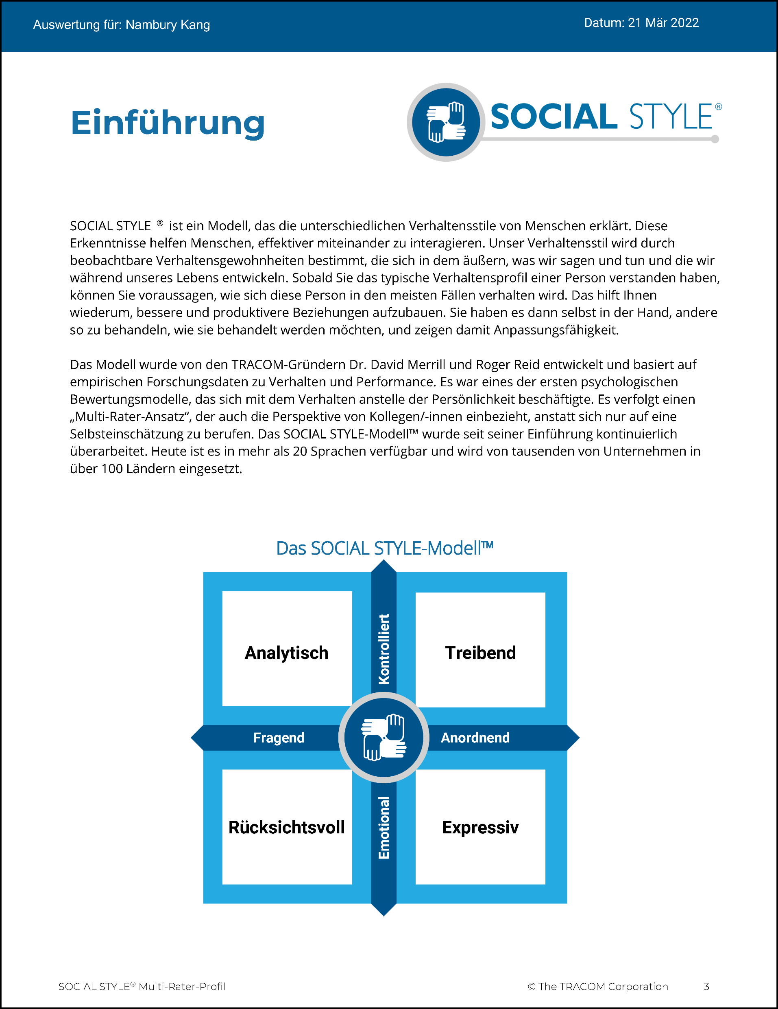
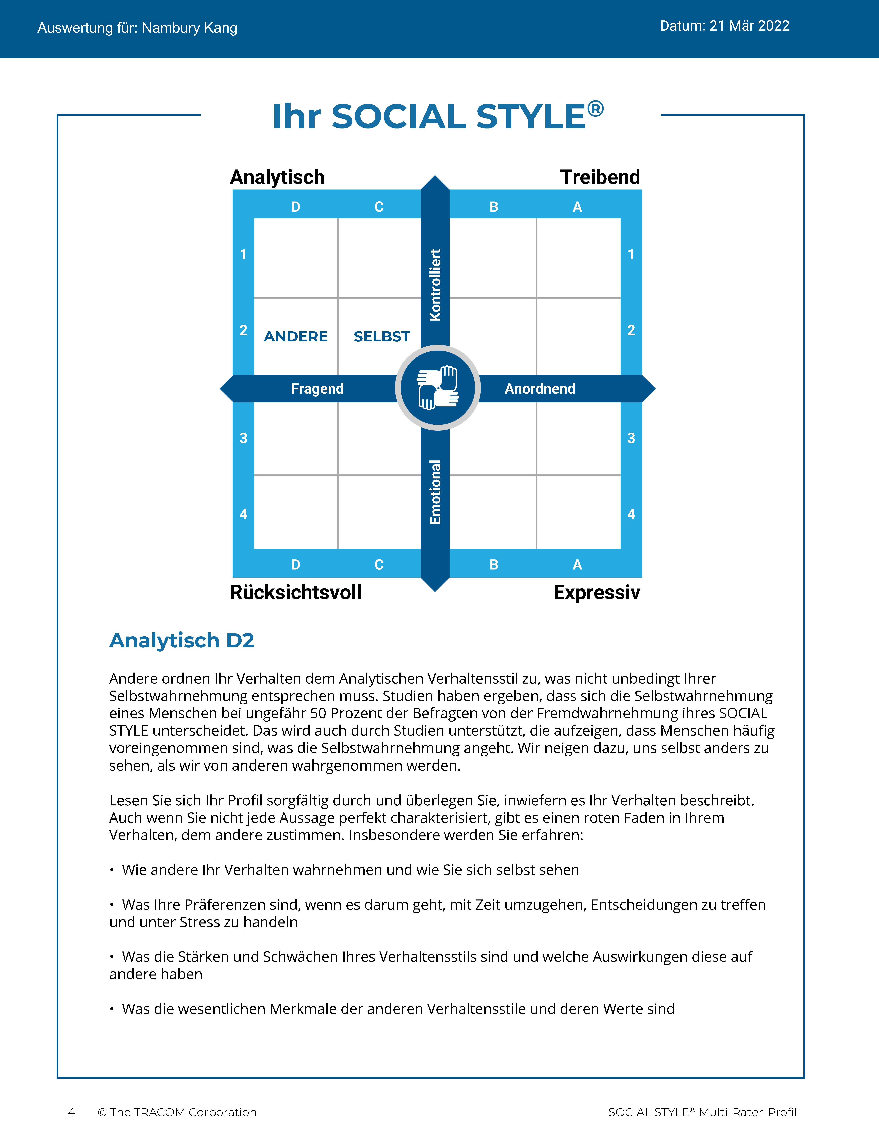
© The TRACOM Corporation. Alle Rechte vorbehalten.
49
Notes:
Continue reviewing.

Slide 50
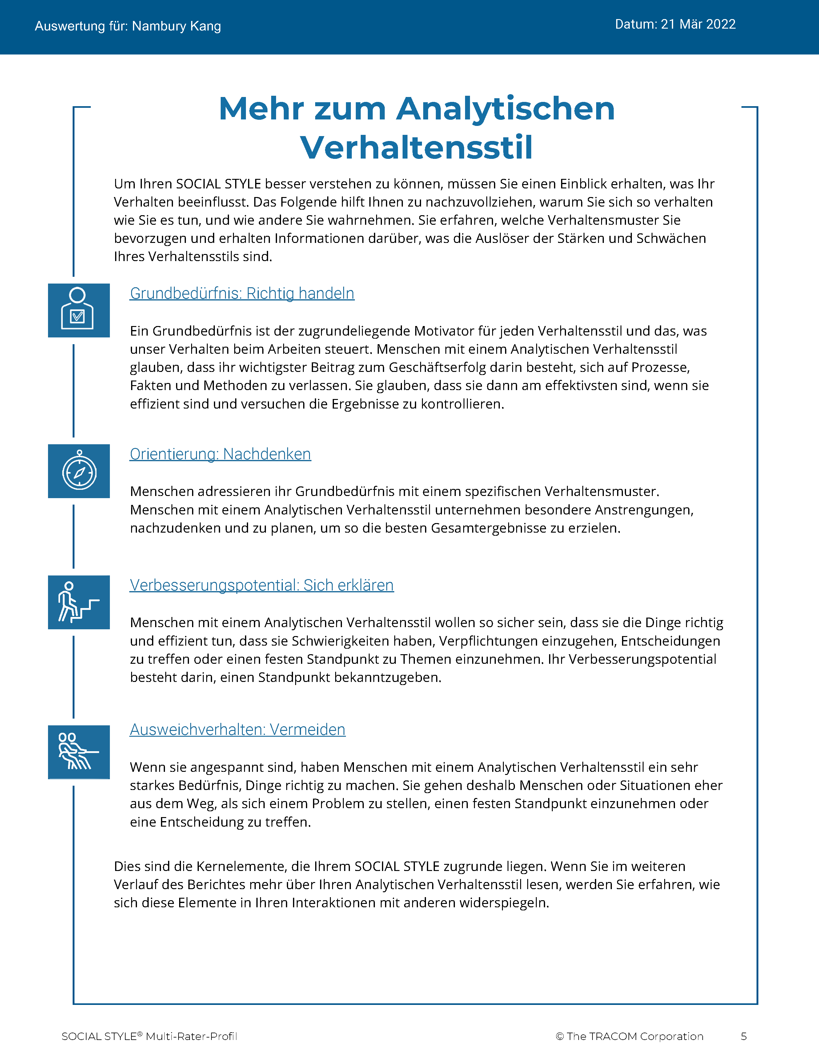
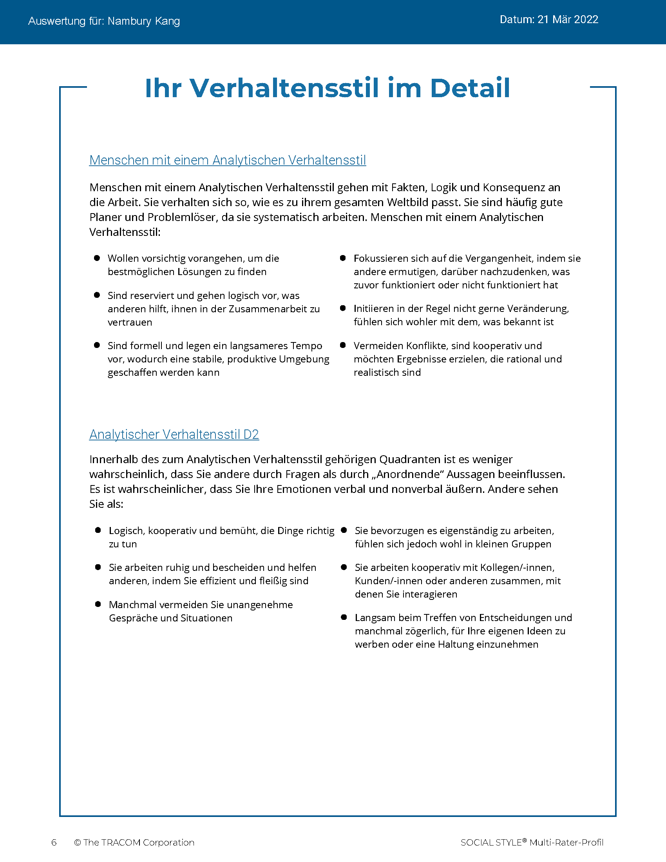
© The TRACOM Corporation. Alle Rechte vorbehalten.
50
Notes:
Continue reviewing.

Slide 51
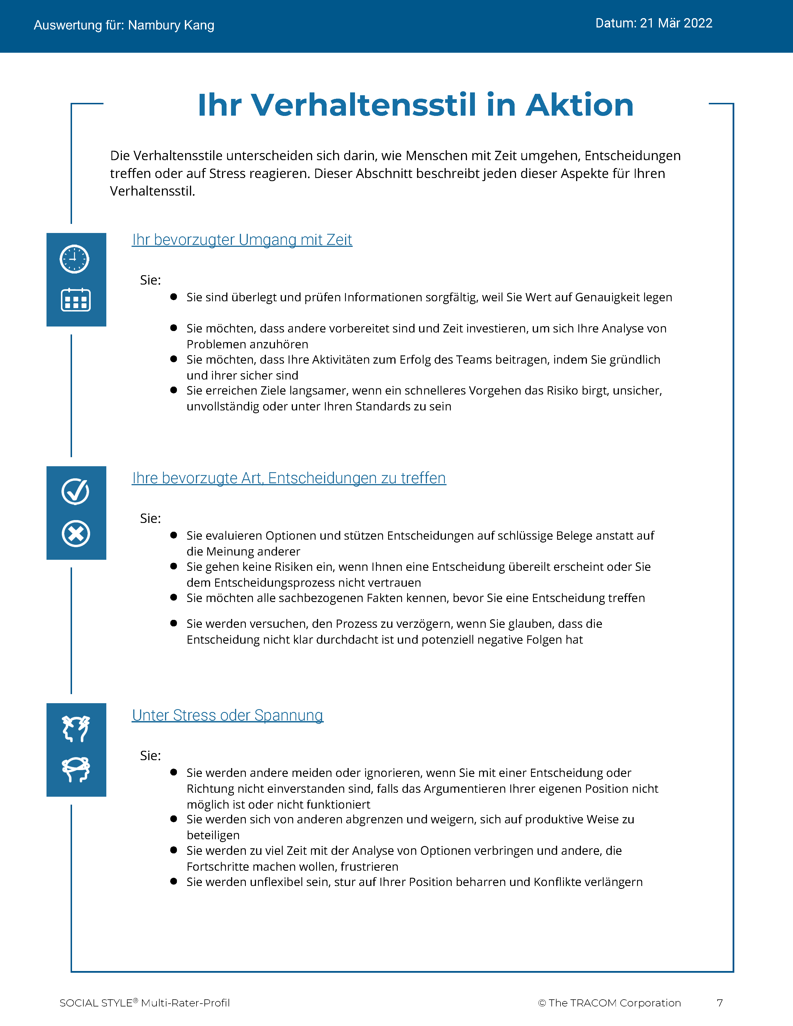
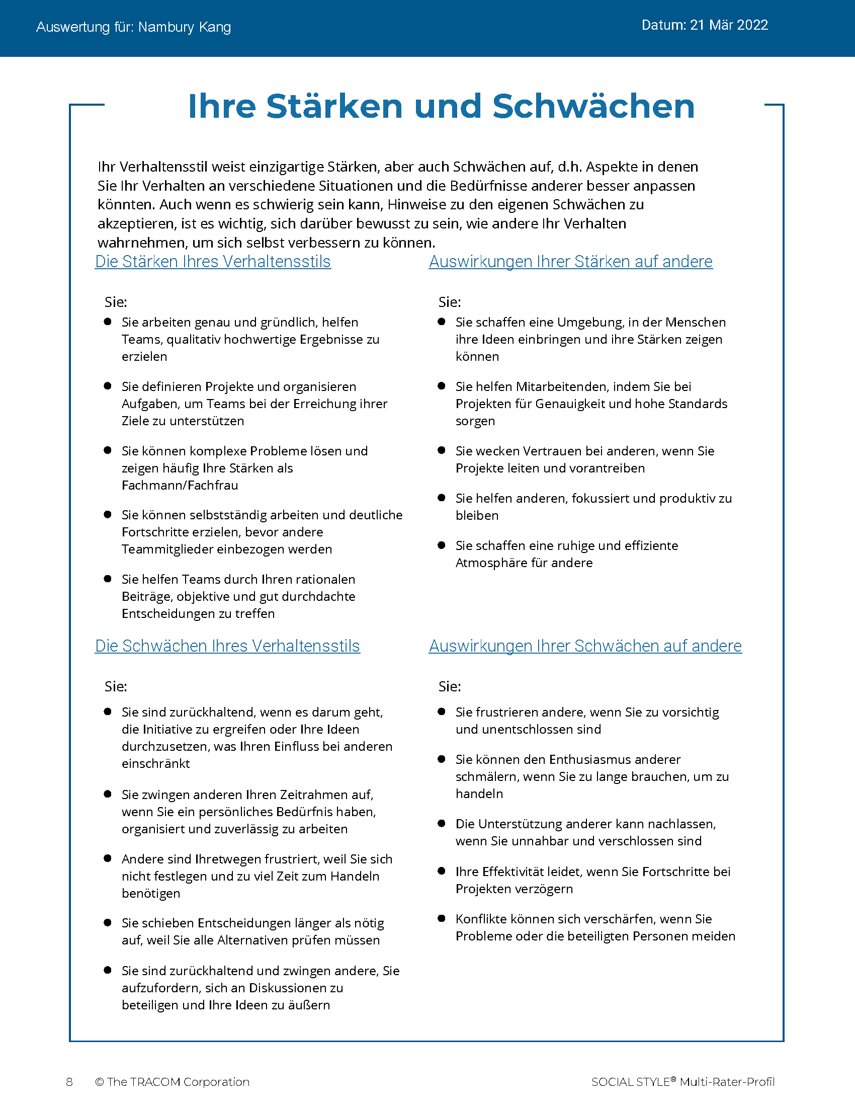
© The TRACOM Corporation. Alle Rechte vorbehalten.
51
Notes:
Continue reviewing.

Slide 52
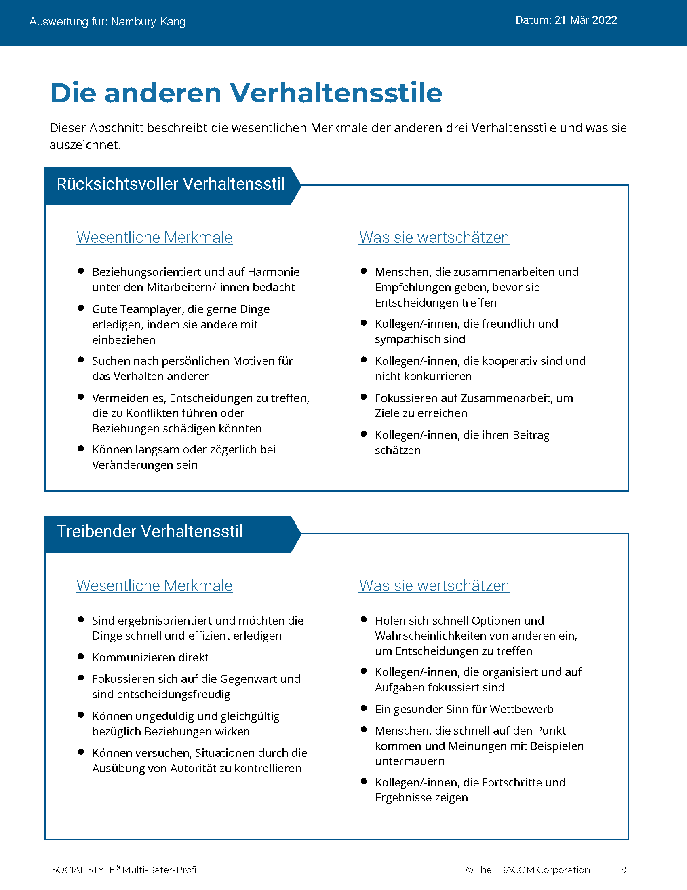
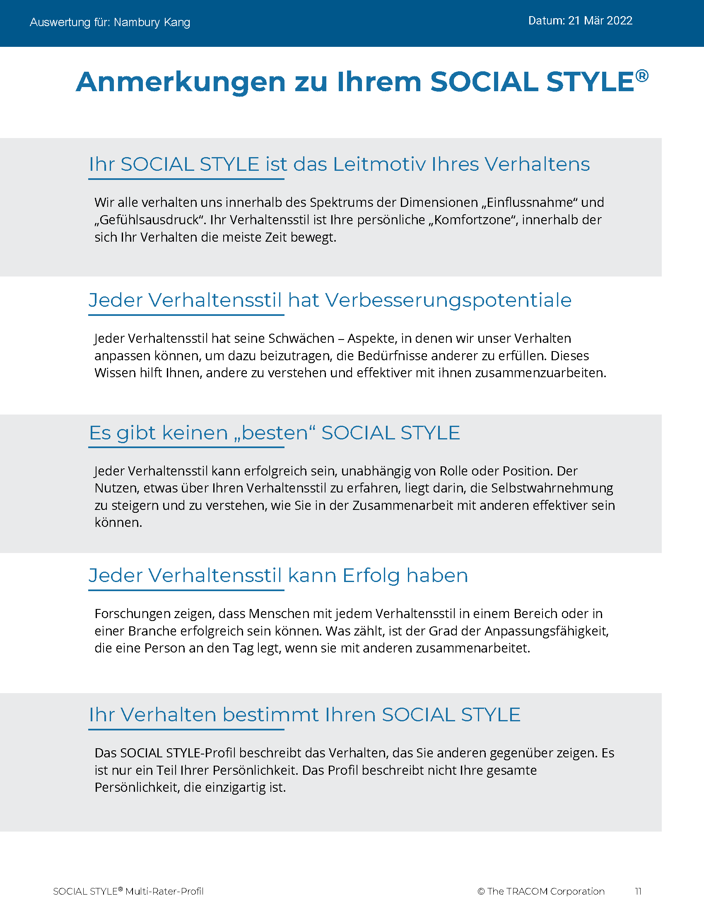
© The TRACOM Corporation. Alle Rechte vorbehalten.
52
Notes:
Continue reviewing.

Slide 53
Virtuelle Zustellung: So können Sie auf Ihr Profil zugreifen
Bei tracomlearning.com anmelden
Benutzernamen und Passwort eingeben
Bericht herunterladen
Notes:
OPTIONAL: FOR VIRTUAL DELIVERY ONLY.
USE THE NEXT TWO SLIDES IF LEARNERS DOWNLOAD THEIR PROFILES DURING THE SESSION.
20 Minutes

Slide 54
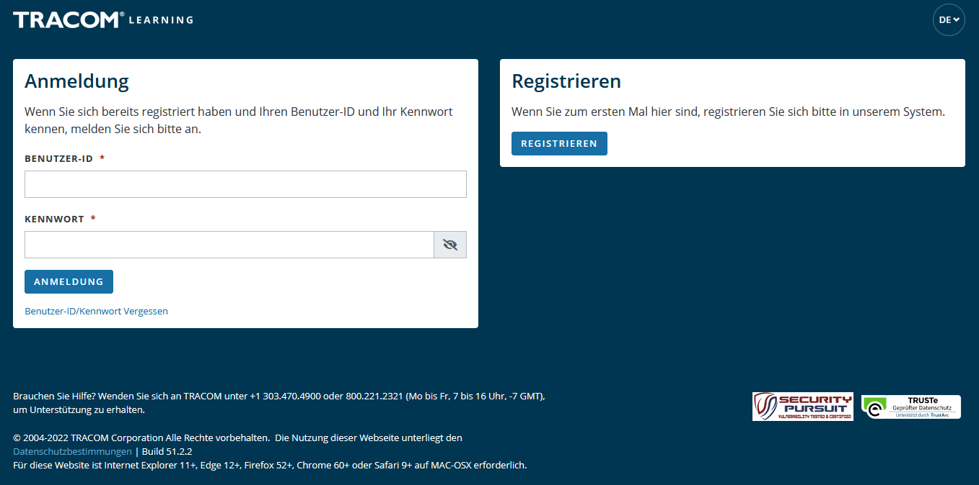
1. Gehen Sie zu tracomlearning.com
2. Geben Sie Ihren Benutzernamen und Ihr Passwort ein und melden Sie sich mit einem Klick auf „Login“ an
Notes:
SAY Login to tracomlearning.com. Use the same username and password as when you completed the assessment (survey).

Slide 55
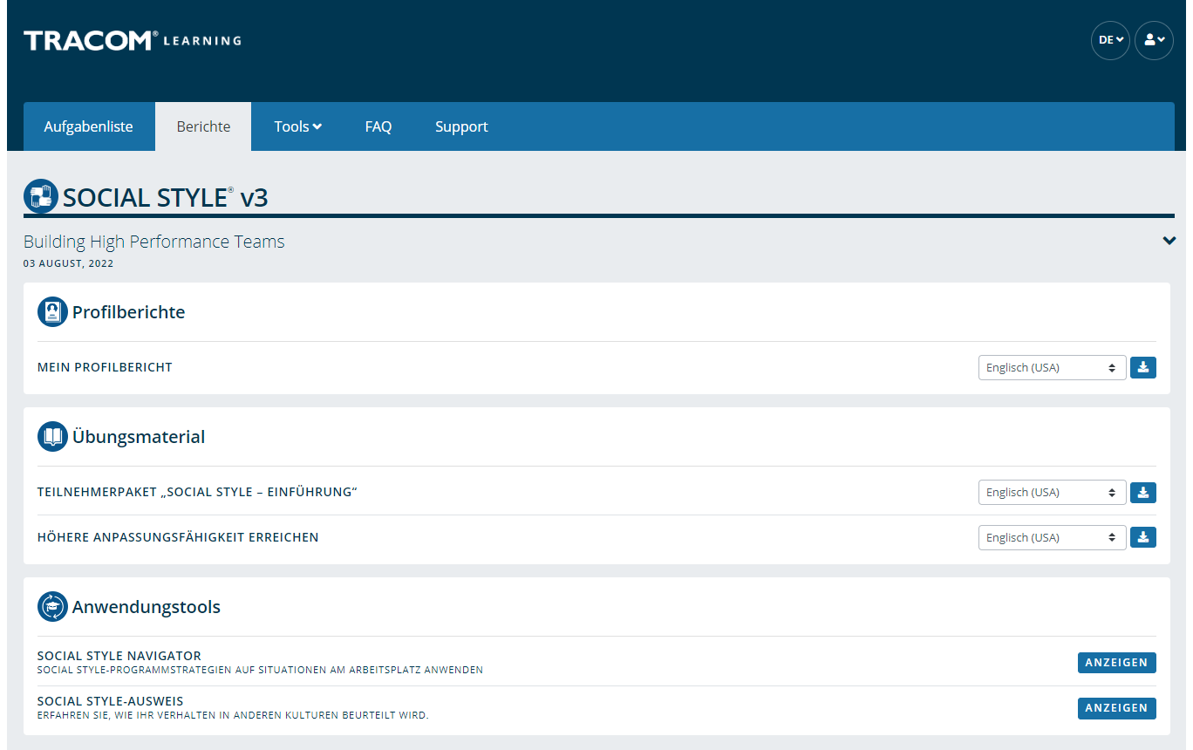
Laden Sie Ihr Profil herunter, indem Sie zum Abschnitt „Profilberichte“ (Profile Reports) navigieren und auf das „Download“-Symbol zum Herunterladen klicken
Notes:
SAY Your profile will be listed under “Profile Reports.” Click to download as a pdf.
Note: If the Learner selects the download button and the PDF does not open up (i.e., the screen just flashes), it is an indicator that their pop-up blockers are on. They need to allow pop-ups from tracomlearning.com and click the download button again. The profile report will open in a separate window. They can then save the profile report locally if they wish.

Slide 56
Kennen und kontrollieren Sie sich selbst
SOCIAL STYLE
Meine Stil-Verhaltensweisen, die Kunden dieses Stils frustrieren
Das kann ich tun, um die Verhaltensweise meines Stils zu kontrollieren
Treibend
Expressiv
Rücksichtsvoll
Analytisch
Notes:
10 Minutes (Workbook, page 29)
The purpose of this exercise is to help people begin to understand how some of their Style behavior can be challenging for customers and others. A later exercise will require learners to determine specific ways they can increase their Versatility towards people of other Styles.
SAY Each of us has behavior that frustrates others. Write down a brief list of your Style behaviors that frustrate customers of other Styles. Then, determine one specific thing you can do to control this behavior. Use the insights you discovered from your profiles to help.
ASK for volunteers to provide a sample of responses and write them on a flipchart. If delivering virtually, learners can chat some of their responses as a way of engaging the group.
SAY Next you will learn more about your own Versatility.

Slide 57
Techniken zur Stilbeobachtung
Ziehen Sie keine voreiligen Schlüsse
Bleiben Sie objektiv
Trennen Sie Stil-Verhalten von der Rolle oder Position einer Person
Ein moderates Maß an Stress kann den Stil eines Menschen deutlicher zeigen
Aus dem Weg gehen (Beobachter sein)
1
2
3
4
5
Notes:
5 Minutes (Workbook, page 29)
SAY The more accurately we are able to observe our customers’ Styles, the better we will be able to adapt our own behavior and “Do something for others” to increase Versatility.
DESCRIBE the best practices:
Don’t jump to conclusions about someone’s Style
Be an objective observer
Separate Style behavior from someone’s role or position
A moderate amount of stress can clarify someone’s Style
Get out of the way (be an observer)
ASK if there are any questions.

Slide 58
Anpassungsfähigkeit
Notes:
1 Minute
SAY You now have a good understanding of Style. What you learned from your profile is going to be useful during the next section, where we learn about Versatility and how to adjust to the Style needs of others.

Slide 59
Anpassungsfähigkeit bedeutet, wie gut Sie sich an die Stil-Bedürfnisse anderer anpassen
Notes:
2 Minutes (Workbook, page 30)
SAY Versatility is a measure of your consistency in adjusting to the Style needs of others.
At the beginning of the program, we reviewed some statistics on Versatility. Research has found that Style and Versatility significantly help salespeople’s performance.
Versatility is completely within your control, so it is your choice to be versatile with others. You can be highly versatile with one group and show low Versatility with another group. It depends on the circumstances and how much you value your interpersonal effectiveness with each group.
It is completely independent of SOCIAL STYLE: Any Style can show Versatility and be successful.
Versatility is NOT the same as likeability. A person can be well liked but not have high Versatility. The opposite can also be true. Versatility helps you develop better working relationships, but it is separate from your personal likeability.

Slide 60
Vier Quellen der Anpassungsfähigkeit
Die angemessene Verwendung von
Image
Präsentation
Kompetenz
Feedback
Führt zu
Höhere Anpassungsfähigkeit
Notes:
6 Minutes (Workbook, page 31)
Image remains a part of the Versatility model because it’s important for building relationships. Describe Versatility in a timeline:
SAY You show Versatility in four areas.
Image – When you first meet a new person at work, you form an impression about this person based on what you see, consciously or not. Essentially Image is a first impression: Are you dressed appropriately for the situation, for the work culture, for the client, and so on?
Note that Image is not measured as part of your Profile. This is because:
Image is difficult to observe in virtual environments. We can’t observe very well how people are dressed, and because there is a wide variety of dress codes, even within companies and teams, it is less relevant to measure Image in this way.
Raters don’t always like answering questions about people’s Image without understanding the context of how Image is explained in training.
Image is still important for many people and companies, which is why it’s part of the model. However, you won’t receive a measure of your Image.
Presentation – When a person communicates in meetings or other public venues, you’ll notice how clear they are at helping people understand their points. Do they use clear language? Are their examples effective? Do they take others’ Styles into account?
Competence – Over time, you’ll observe this person in a variety of situations. Are they reliable and do they persevere during difficult times? Are they flexible when change happens? Are they optimistic most of the time? Do they show creativity?
Feedback – Finally, this is the most interpersonal part of Versatility. Are they a good listener? Do they show empathy for others’ situations? Do they meet the needs of other people’s Styles? Do they develop good relationships with others?

Slide 61
Anpassungsfähigkeit in Aktion
Was hat jede Person getan, um anpassungsfähig zu handeln?
Wie haben sich die Personen im Einzelnen verhalten?
Kyle
Lana
AJ
Abby
Notes:
12 Minutes (Workbook, page 32)
SAY We are now going to revisit our video characters in a continuation of their earlier meeting.
ASK participants to take notes in their participant workbooks on page 32 as they watch the video:
What did each person do to act with Versatility?
What were their specific behaviors?
PLAY the video, Part 2.
CONDUCT a debrief of the video, soliciting participants’ responses to the above questions.

Slide 62
Anpassungsfähigkeitsprofil
Notes:
1 Minute
SAY Now you will learn about the Versatility Profile and will review your profile. There is a lot of information about Versatility—not only how you’re perceived, but also simple strategies to adjust your behavior and increase Versatility.
This profile is a resource for you. You will use it for the Versatility exercises during the rest of the program.

Slide 63
Anpassungsfähigkeit
Ein Maß für Ihre Konsequenz bei der Anpassung an die Stil-Bedürfnisse der anderen
W | Nicht konsistent | X | Einigermaßen konsistent | Y | In der Regel konsistent | Z | Sehr konsistent
Notes:
2 Minutes
SAY We measure Versatility on a scale ranging from W to Z. These are normed quartiles, just like Assertiveness and Responsiveness.
When you aren’t consistent in your behavior, you’re usually focusing on your own Style needs. When you consistently show Versatility, you’re focusing on meeting others’ Style needs.
Your profile will show your results on this scale, ranging from W (not consistent) to Z (very consistent).

Slide 64
Die Bedeutung der Anpassungsfähigkeitspositionen
 | 1 | 2 | 3 | 4 | 5
 | Stimme überhaupt nicht zu | Stimme nicht zu | Stimme teilweise zu teilweise nicht zu | Stimme zu | Stimme voll und ganz zu
1. Geht mit einer positiven Einstellung an neue Situationen heran. | ◯ | ◯ | ◯ | ◯ | ◯
2. Baut gute Beziehungen zu seinen Kolleginnen und Kollegen auf. | ◯ | ◯ | ◯ | ◯ | ◯
3. Präsentiert seine Ideen wirkungsvoll vor Gruppen. | ◯ | ◯ | ◯ | ◯ | ◯
W | X Y | Z
Konsistenz
Notes:
3 Minutes
Before delivering Versatility profiles, explain the meaning of the positions.
SAY Before reviewing your results in more detail, let’s put your results into context. This graph shows several sample items that measure Versatility.
You and your raters (if multi-rater) responded to these items using the scale ranging from ‘strongly disagree’ to ‘strongly agree’. TRACOM assigns values to each of these scale points: 1 to 5.
When rating Versatility, most people respond at the higher end of the rating scale. This makes sense since most people have at least some abilities in these areas. This means that the cutoff for achieving Z Versatility is very high, approximately 4.5 or higher.
Similarly, to score either an X or Y requires scores between 3.5 and 4.5. These are approximate values used for purposes of explanation.
Importantly, if you receive a W in any area of Versatility, this DOES NOT mean that your raters (if multi-rater) or yourself evaluated you at the low end of the rating scale. On the contrary, almost nobody scores at the lowest end – 1 or 2. For people with a W result, most of their ratings fluctuate between 2 and 4, resulting in an average score of slightly less than 3.5.
So, putting this into context, a W rating means that you are not showing as much consistency in these behaviors as you could. With effort and more consistency, your evaluation would improve.
Set the context:
W does not mean that you lack ability.
It doesn’t mean that your raters (if Multi-rater) evaluated you at the lowest end of the rating scale.
It doesn’t mean they don’t like you or don’t think you’re effective (if multi-rater)
It does mean that you’re not highly consistent in your behavior; you do these things some of the time but could do them more often.
It does mean that your raters (if multi-rater) evaluated you between ‘disagree’ and ‘agree’, on average.
Note that these cutoff values (3.5 and 4.5) are only for demonstration – they aren’t the exact values in TRACOM’s norms, but they are close.
Giving the context is critical because it helps to ease people’s automatic reactions to the profile.
Then:
Help people focus on just one area to improve. This increases chances of success.
What is ‘low hanging fruit?’ Something they can improve quickly.

Slide 65
Allgemeine Anpassungsfähigkeit
Ihre Konsistenz bei Verhaltensweisen in Bezug auf Anpassungsfähigkeit
W | Nicht konsistent | X | Einigermaßen konsistent | Y | In der Regel konsistent | Z | Sehr konsistent
 |  | ANDERE |  | SELBST
Notes:
2 Minutes
SAY Overall Versatility is a combination of your results in three areas: Presentation, Competence, and Feedback.
The “Others” position is the average of your raters’ evaluations. The “Self” position is where you evaluated yourself.
Like Assertiveness and Responsiveness, Versatility is normed in quartiles: W, X, Y, and Z.
Versatility is all about consistency of behavior.
A lower Versatility score does NOT mean you lack ability or that you never demonstrate these abilities.
What it DOES mean is that you aren’t showing consistency in your behavior.
By making small changes to your behavior and acting with more consistency, you can increase your Versatility. (Recall that the difference in values between W and Z are small but meaningful.)

Slide 66
Ausführlichere Informationen zur Anpassungsfähigkeit
Präsentation: X
W | Nicht konsistent | X | Einigermaßen konsistent | Y | In der Regel konsistent | Z | Sehr konsistent
 |  | ANDERE |  |  |  | SELBST
Ihre Konsistenz bei Verhaltensweisen in Bezug auf Anpassungsfähigkeit
Kompetenz: Y
W | Nicht konsistent | X | Einigermaßen konsistent | Y | In der Regel konsistent | Z | Sehr konsistent
 |  |  |  | ANDERE |  | SELBST
Feedback: X
W | Nicht konsistent | X | Einigermaßen konsistent | Y | In der Regel konsistent | Z | Sehr konsistent
 |  | ANDERE |  | SELBST
Notes:
2 Minutes
Each source of Versatility is explained the same as Overall Versatility – it is a measure of consistency of behavior.
Remember that Image is not measured because:
Image is difficult to observe in virtual environments. We can’t see very well how people are dressed, and because there is a wide variety of dress codes, even within companies and teams, it is less relevant to measure Image in this way.
Raters don’t always like answering questions about people’s Image without understanding the context of how Image is explained in training.
Image is still important for many people and companies, which is why it’s part of the Model. However, you won’t receive a measure of your Image.
Presentation – When a person communicates in meetings or other public venues, you’ll notice how clear they are at helping people understand their points. Do they use clear language? Are their examples effective? Do they take others’ Styles into account?
Competence – Over time, you’ll observe this person in a variety of situations. Are they reliable and do they persevere during difficult times? Are they flexible when change happens? Are they optimistic most of the time? Do they show creativity?
Feedback – Finally, this is the most interpersonal part of Versatility. Are they a good listener? Do they show empathy for others’ situations? Do they meet the needs of other people’s Styles? Do they develop good relationships with others?

Slide 67
© The TRACOM Corporation. Alle Rechte vorbehalten.
67
Notes:
20 Minutes
Review the Profile pages so participants understand the layout of the Profile. After you’ve reviewed the profile, distribute individuals’ profiles.
PROVIDE ample time for participants to read and absorb their reports. Do not continue until it is evident that all participants have finished reading their reports.
ASK if there are any questions, surprises, or concerns.
ASK If your self-perception results were different, what might have caused the difference in views?
NOTE: It is recommended that you take a break here and make yourself available for one-on-one conversations as participants may have questions or concerns they do not want to discuss with the entire class.

Slide 68
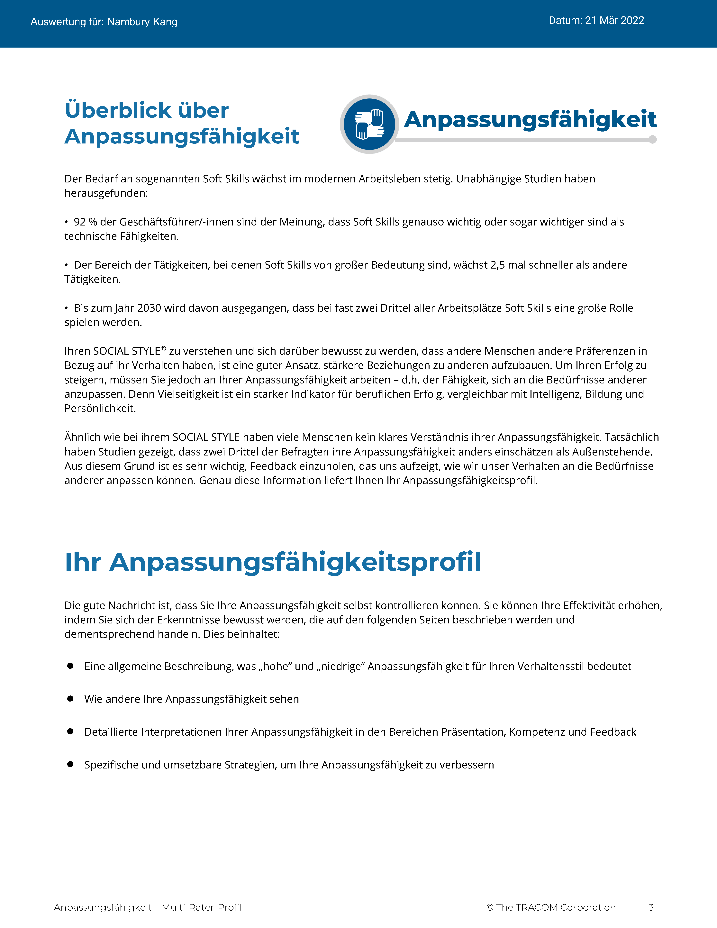
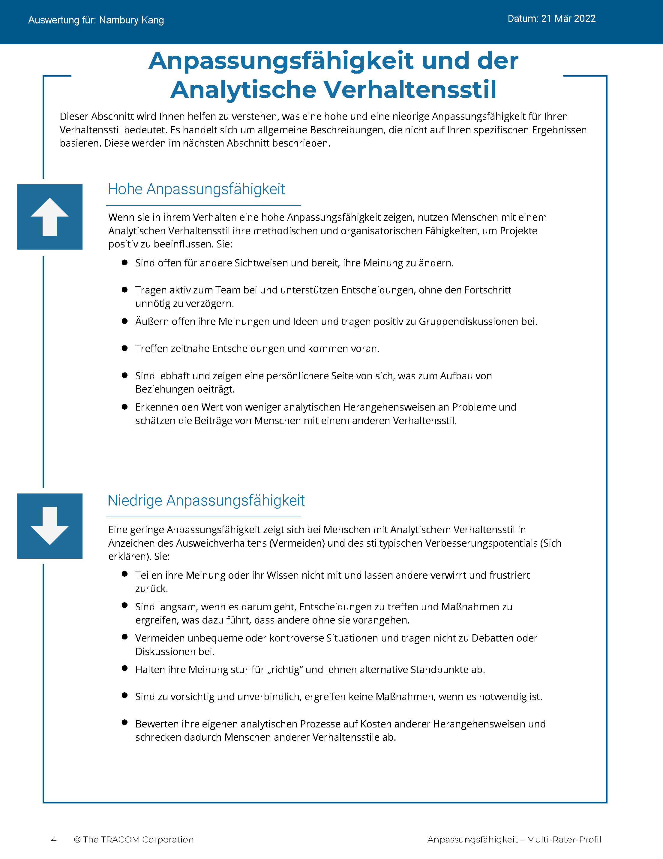
© The TRACOM Corporation. Alle Rechte vorbehalten.
68
Notes:
Continue reviewing.

Slide 69
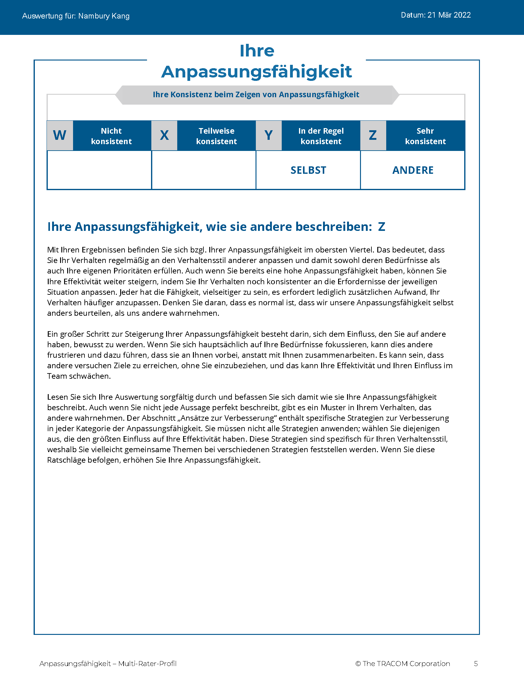
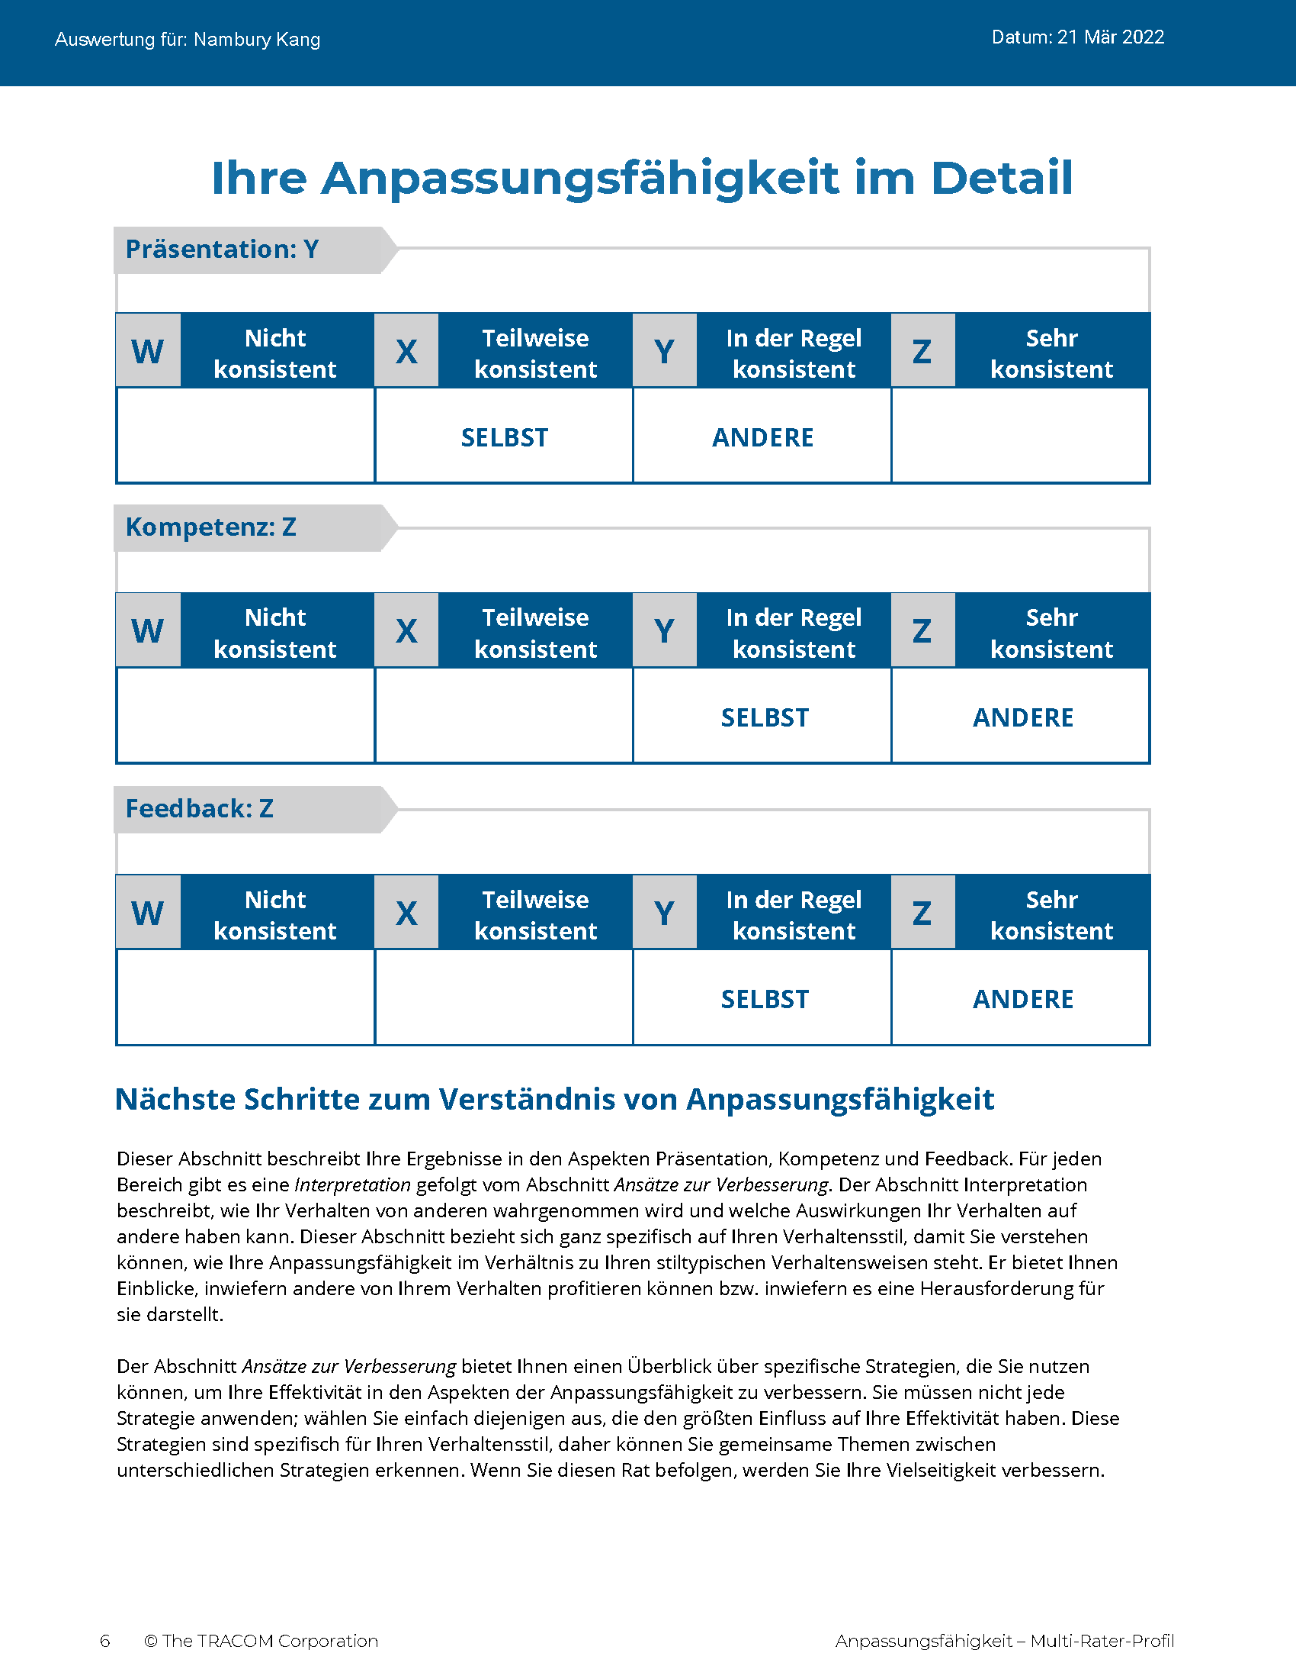
© The TRACOM Corporation. Alle Rechte vorbehalten.
69
Notes:
Continue reviewing.

Slide 70
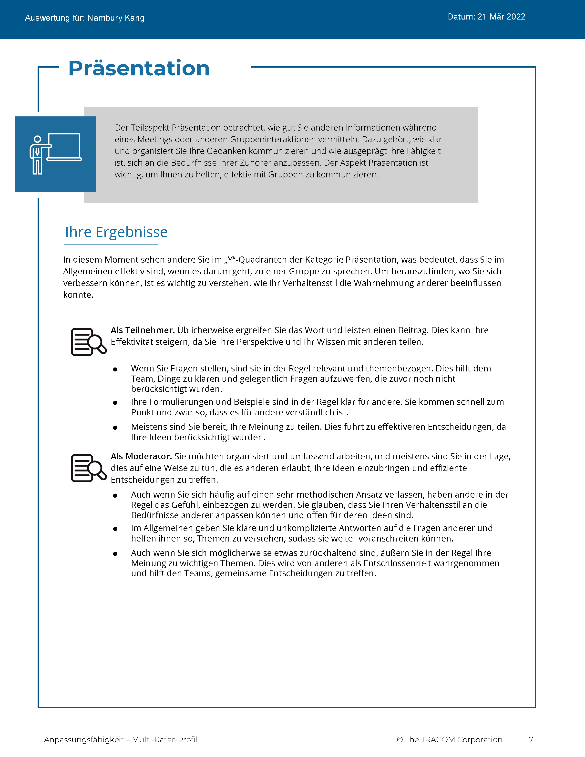
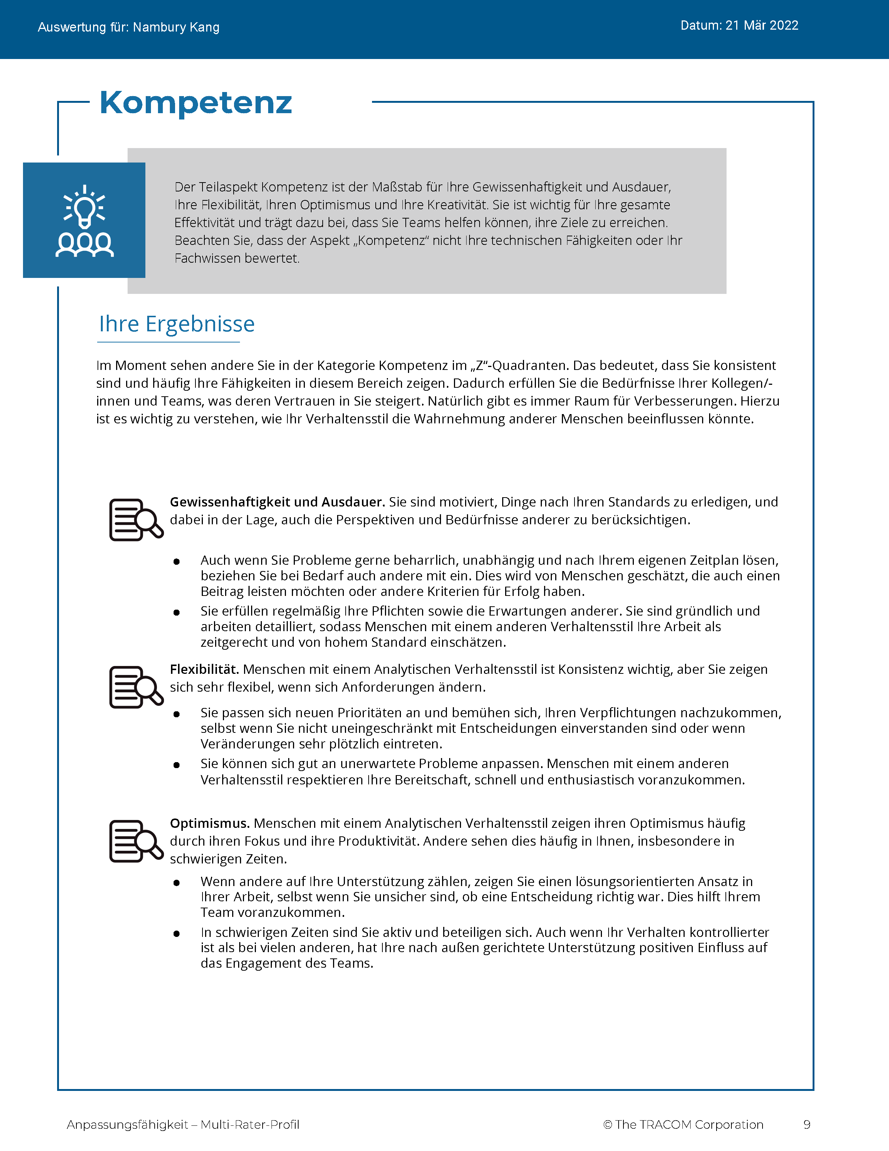
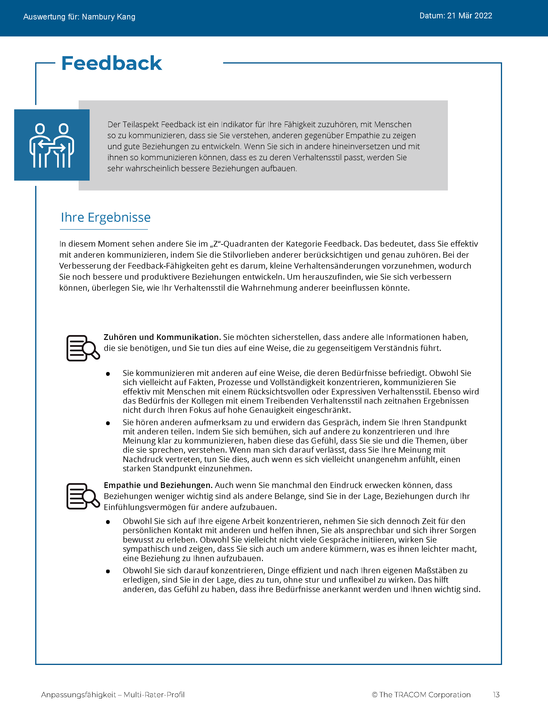
© The TRACOM Corporation. Alle Rechte vorbehalten.
70
Notes:
Continue reviewing.

Slide 71
Schritte zur Steigerung der zwischenmenschlichen Effektivität
Etwas für andere tun
Sich selbst kontrollieren
Erkennen Sie Ihren Einfluss auf andere
Steuern Sie Ihr eigenes Verhalten
Beobachten Sie andere objektiv
Helfen Sie, die Stil-Bedürfnisse anderer zu erfüllen
Sich selbst kennen
Andere kennen
Notes:
5 Minutes (Workbook, page 33)
SAY At the beginning of the program, we talked about the four steps for increasing interpersonal effectiveness. Now that you’ve reviewed your Versatility profiles, let’s review these again as we think about ways to adjust behavior to increase Versatility.
REVIEW the four steps for increasing interpersonal effectiveness:
1. Know Yourself by recognizing the impact your Style has on others.
2. Control Yourself by managing your own Style behavior and being tolerant of others’ Styles.
3. Know Others by observing them more objectively.
4. Do Something For Others by helping them meet their Style needs. This eases their tension and opens the door for them to act with Versatility towards you.
SAY To finish the program, we’re going to focus on Doing Something for Others. You’re going to create an action plan to increase Versatility with your customers. First, we’ll review some strategies for showing Versatility towards each Style. This will give you important information for creating your action plan.

Slide 72
Vorbereitungen auf Besprechungen
Kontrolliert
Analytisch
TUN
Tagesordnung im Voraus teilen
Überprüfen, ob die Details der Besprechung ausreichend sind
Gut vorbereitet sein
VERMEIDEN
Viel Gesprächsstoff erwarten
Fokus auf persönliche Beziehungen legen
Beiträge der Person abtun
Treibend
TUN
Erwartete Ergebnisse angeben
Zustimmung zur Tagesordnung einholen
Der Person erlauben, Einzelheiten des Treffens zu kontrollieren
VERMEIDEN
Spät anfangen
Unorganisiert sein
Entscheidungen unnötig blockieren
Fragend
Anordnend
Rücksichtsvoll
TUN
Die Tagesordnung mitgestalten
Frühzeitig kommen, um Kontakte zu pflegen
Mit eingeschalteter Kamera und Mikrofon eintreten
VERMEIDEN
Interesse unterstellen, weil die Person einem Treffen zugestimmt hat
Bei der Kommunikation direkt zur Aufgabe springen
Andere ohne vorherige Information einbeziehen
Expressiv
TUN
Nach der Meinung der Person zur Tagesordnung fragen
Sofort Anerkennung für die Person ausdrücken
Spaß haben
VERMEIDEN
Zu viele Details im Voraus bereitstellen
Vergangenes im Detail rekapitulieren
Zu straffe Strukturierung der Besprechung
Emotional
Notes:
6 Minutes (Workbook, page 34)
SAY Part of showing Versatility is recognizing customers’ needs and preparing ahead of time. Here are some meeting strategies for each Style.
CLICK TO REVEAL THE TEXT IN EACH QUADRANT.
REVIEW the do’s and don’ts when preparing for meetings.

Slide 73
Maßgeschneiderte Botschaften
Kontrolliert
Analytisch
Das haben wir bisher gemacht, basierend auf den Informationen…
Wir nehmen Folgendes an...
Das sind die Risiken, die wir sehen...
Auf dieser Grundlage empfehlen wir...
Treibend
Wir werden die Ergebnisse erzielen, die Sie sich wünschen.
Wir haben ein erfahrenes „A“-Team.
Unser Team wird für Sie schnelle Erfolge erzielen.
Wir können sofort beginnen.
Fragend
Anordnend
Rücksichtsvoll
Hier erfahren Sie, was gleich bleibt und was sich ändert.
Wir haben das schon viele Male so durchgeführt.
Hier ist eine Liste von Referenzen, die Sie anrufen können.
Zusammenarbeit ist uns äußerst wichtig.
Expressiv
Wir freuen uns darauf, Sie bei der Umsetzung Ihrer Vision zu unterstützen!
Wenn das alles abgeschlossen ist, werden Sie weltweit führend sein!
Das wird für Sie und Ihr Unternehmen ein großer Schritt nach vorn sein!
Die leitenden Angestellten stehen voll dahinter!
Emotional
Notes:
6 Minutes (Workbook, page 35)
SAY Most of us fall into the habit of communicating with people in ways that are comfortable for us, without thinking of the needs of the customer. This is often because we’re rushed and send out quick emails. Communicating in Style-specific ways is very important for meeting your customers’ needs. Here are some simple strategies for tailoring your messages to each Style.
CLICK TO REVEAL THE TEXT IN EACH QUADRANT.
REVIEW the techniques for tailoring messages to each Style.

Slide 74
Mit Anpassungsfähigkeit Vertrauen gewinnen
Kontrolliert
Analytisch
Beweisen Sie Ihre Fähigkeiten
Zeigen Sie die Logik hinter den Vorschlägen
Konzentrieren Sie sich auf Qualität
Bereiten Sie sich vor und informieren Sie sich vorab über das Unternehmen der Person
Kommunizieren Sie die Vor- und Nachteile
Lassen Sie die persönliche Beziehung im Laufe der Zeit entstehen, drängen Sie die Person nicht
Treibend
Zeigen Sie Vertrauen in Ihre Fähigkeiten
Informieren Sie die Person, wenn Forderungen nicht erfüllt werden können
Seien Sie offen
Halten Sie mit dem schnellen Tempo mit
Vermitteln Sie, dass Sie die gewünschten Ergebnisse verstehen
Gehen Sie effizient mit der Zeit dieser Person um
Fragend
Anordnend
Rücksichtsvoll
Gegebenenfalls persönliche Informationen weitergeben
Seien Sie authentisch und aufrichtig
Zeigen Sie Ihr Engagement, der Person zu helfen
Zeigen Sie Einfühlungsvermögen in die Bedürfnisse der Person
Vermeiden Sie unnötigen Druck
Merken Sie sich die Namen der wichtigsten Beziehungen
Expressiv
Gehen Sie ungezwungen und offen heran
Verstecken Sie nicht unnötig Ihre Gefühle
Vermeiden Sie es, die Person herauszufordern oder mit ihr zu konkurrieren
Zeigen Sie Begeisterung für die Ideen und Erkenntnisse dieser Person
Schenken Sie dieser Person Ihre ungeteilte Aufmerksamkeit
Sprechen Sie auch über nicht-berufliche Themen
Emotional
Notes:
8 Minutes (Workbook, page 36)
ASK Given a customer’s Style need, what are some ways to earn trust?
FACILITATE a discussion of each Style before revealing the text.
ASK What are some ways to earn trust from people of each Style? Think about their Style needs—what do they value from salespeople?
CLICK TO REVEAL THE TEXT IN EACH QUADRANT.

Slide 75
Aktionsplan zur Anpassungsfähigkeit
Entwickeln Sie einen Aktionsplan zur Steigerung Ihrer Anpassungsfähigkeit bei den Kunden.
Anweisungen
Berücksichtigen Sie den Stil des Kunden, den Sie identifiziert haben.
Wie steht Ihr Stil einer besseren Beziehung im Wege? (Denken Sie an Ihre Stil-Wachstumsmaßnahmen)
Welche Maßnahmen werden Sie ergreifen, um die Anpassungsfähigkeit bei diesem Kunden zu erhöhen?
Diskutieren Sie Ihren Plan in Ihren Arbeitsgruppen und holen Sie sich Feedback von der Gruppe.
75
Notes:
30 Minutes (Workbook, page 37)
SAY Use the insights you’ve learned and create a specific plan for yourself. Writing down your intentions is a proven way of making sure you actually do something. Decide on just one or two things you can do differently.
Remember your Style growth actions, since managing your own Style behavior is an important part of being versatile.
REVIEW the Style growth actions:
Driving: to listen
Expressive: to check
Amiable: to initiate
Analytical: to declare
SAY When you’ve finished this, we will put you in small breakout groups to share your insights and give feedback to one another.
CREATE breakout groups of 2 to 3 people.

Slide 76
Anpassungsfähigkeit virtuell beobachten
Notes:
10 Minutes (whole section on Observing Versatility Virtually)
SAY Briefly, before we finish—remember those text messages we reviewed earlier? Let’s bring Versatility into those conversations.

Slide 77
Ich wollte nachfragen, ob Sie sich bereits das Video über unsere neuesten technischen Verbesserungen ansehen konnten. Was meinen Sie dazu?
Notes:
SAY We had four responses to this message. Let’s look at how the person who sent this message might respond to each of these individuals. Is the person showing Versatility in each message?

Slide 78
Hallo! Es kommen zahlreiche Veränderungen schnell auf uns zu. Mein Team muss hinsichtlich der neuen Funktionen geschult werden. Können Sie uns dabei helfen?
Es sieht nach einer Menge Veränderungen aus, aber diese Upgrades werden Ihrem Team helfen, besser zusammenzuarbeiten. Ich arbeite einen Plan für die Schulung Ihres eams aus und stehe Ihnen zur Verfügung, falls Probleme auftauchen. Ich bin für Sie und das Team da!
Notes:
SAY This message came from the Amiable Style customer.
Click to reveal.
SAY And here is the response. What do you think? Is the salesperson showing Versatility toward the Amiable Style person? What would you add or change to the response?
NOTE: The salesperson is making an effort to meet the person’s Style needs by reassuring them about the changes. The salesperson offers to help the customer by developing a training plan, then reassures them that they will be supported.

Slide 79
Das ist aufregend! Ich habe einen kurzen Blick darauf geworfen, und die neuen Funktionen sehen großartig aus!
Ich rufe Sie nächste Woche an!
Ja, die Upgrades sollten ziemlich gut funktionieren. Wir sprechen uns später.
Notes:
SAY This message came from the Expressive Style person.
Click to reveal.
SAY And here is the response. What do you think? Is the salesperson showing Versatility toward the Expressive Style customer?
Is the response focused on their own needs, or the Expressive Style person’s needs? What would be a more effective response?
NOTE: The salesperson is diminishing the customer’s enthusiasm. A more effective response would be to reflect the enthusiasm by reiterating how great the new upgrades are and how excited the salesperson is about the changes, then offer to set up a call with the customer.

Slide 80
Meiner Meinung nach werden uns die neuen Upgrades helfen, effizienter zu sein und einiges an Aufwand zu sparen. Bevor wir jedoch die neue Version anpassen, müssen wir eine Schulung für mein Team planen. Gibt es bei Ihnen dafür einen vorhandenen Prozess?
Wir haben die Upgrades getestet und sie zeigen eine deutliche Leistungssteigerung. Ich werde Ihnen diese Daten zusammen mit einem Schulungsplan und den verfügbaren Terminen zusenden. Lassen Sie mich wissen, wie ich sonst noch helfen kann.
Notes:
SAY This message came from the Analytical Style customer.
Click to reveal.
SAY And here is the response. What do you think? Is the salesperson showing Versatility toward the Analytical Style person? What would you add or change to the response?
NOTE: The salesperson is making an effort to meet the customer’s Analytical Style needs by recognizing their need to prepare ahead of time by getting training. The salesperson offers to send more detailed information about the upgrades as an effort to give the customer more information and alleviate any remaining concerns. They also open the conversation to more input by offering to help in any other way.

Slide 81
Sieht gut aus. Ich rufe Sie an, wenn ich zur Umsetzung bereit bin.
OK.
Notes:
SAY This message came from the Driving Style customer.
Click to reveal.
SAY And here is the response. What do you think? Is the salesperson showing Versatility toward the Driving Style customer?
Is the response focused on their own needs, or the Driving Style person’s needs? What would be a more effective response?
NOTE: Though Driving Style people appreciate brevity, the salesperson is dismissive and is missing important elements of the customer’s Style. The salesperson should recognize that the customer probably hasn’t reviewed the upgrades in detail. The salesperson should state that they are there to help move forward, and also offer options to meet with the customer to discuss the changes and listen to their input.

Slide 82
Nächste Schritte
Üben Sie Anpassungsfähigkeit! Halten Sie Ihren Aktionsplan griffbereit, falls Sie nachschlagen möchten.
Der SOCIAL STYLE-Navigator bietet Ratschläge für viele Verkaufssituationen und zusätzliche Ressourcen.
Mit dem SOCIAL STYLE-Reisepass können Sie sehen, wie Sie sich in einem anderen Land profilieren würden.
Notes:
5 Minutes (Workbook, page 38)
SHARE key “takeaways” with the class:
The key to more effective performance is to practice what you’ve learned. Keep your Versatility Action Plan nearby as a reminder. As you begin to experience positive results, this will reinforce your commitment to practice Versatility.
There are additional resources that will help you. TRACOM’s SOCIAL STYLE Navigator contains advice for working with customers in a variety of situations, such as giving presentations, advancing the sale, and having difficult conversations. You can access this resource by logging in at tracomlearning.com.
NOTE the following slides describe SOCIAL STYLE Navigator in more detail.

Slide 83
SOCIAL STYLE-Navigator®
SOCIAL STYLE-Schätzer Eine kurze Umfrage, die den Stil der anderen einschätzt
SOCIAL STYLE-Ratgeber
Vorbereitung auf Besprechungen, Verhandlungen, Präsentationen
Stil und Anpassungsfähigkeit – beste Praktiken für viele Situationen
eLearning-Module Anwendung von Stilkonzepten auf Teams, Konfliktmanagement und Coaching
SOCIAL STYLE-Navigator® ist ein eingetragenes Warenzeichen der TRACOM Corporation.
Notes:
1 Minute
SAY You now have free and unlimited access to SOCIAL STYLE Navigator, the on-demand micro-learning tool that helps you apply Style and Versatility.
SOCIAL STYLE Navigator includes:
SOCIAL STYLE Estimator
The Estimator survey provides users with an interactive tool that evaluates observable behavior in others to determine their Style and helps you plan ahead for successful interactions.
SOCIAL STYLE Advisor
Use Advisor topics to prepare “just-in-time” for meetings, negotiations or sales presentations with advice on navigating Style and Versatility best practices to maximize high-performing relationships.
eLearning modules
Continue your learning journey via micro-learning that reinforces ways to apply SOCIAL STYLE and Versatility to Working in Teams, Coaching and Managing Conflict.

Slide 84
Zugang zum SOCIAL STYLE-Navigator®
Erhältlich über tracomlearning.com
Notes:
1 Minute
SAY Available through www.tracomlearning.com
Enter your username and password for free, unlimited access to SOCIAL STYLE Navigator®

Slide 85
Notes:
Optional demonstration, time permitting

Slide 86
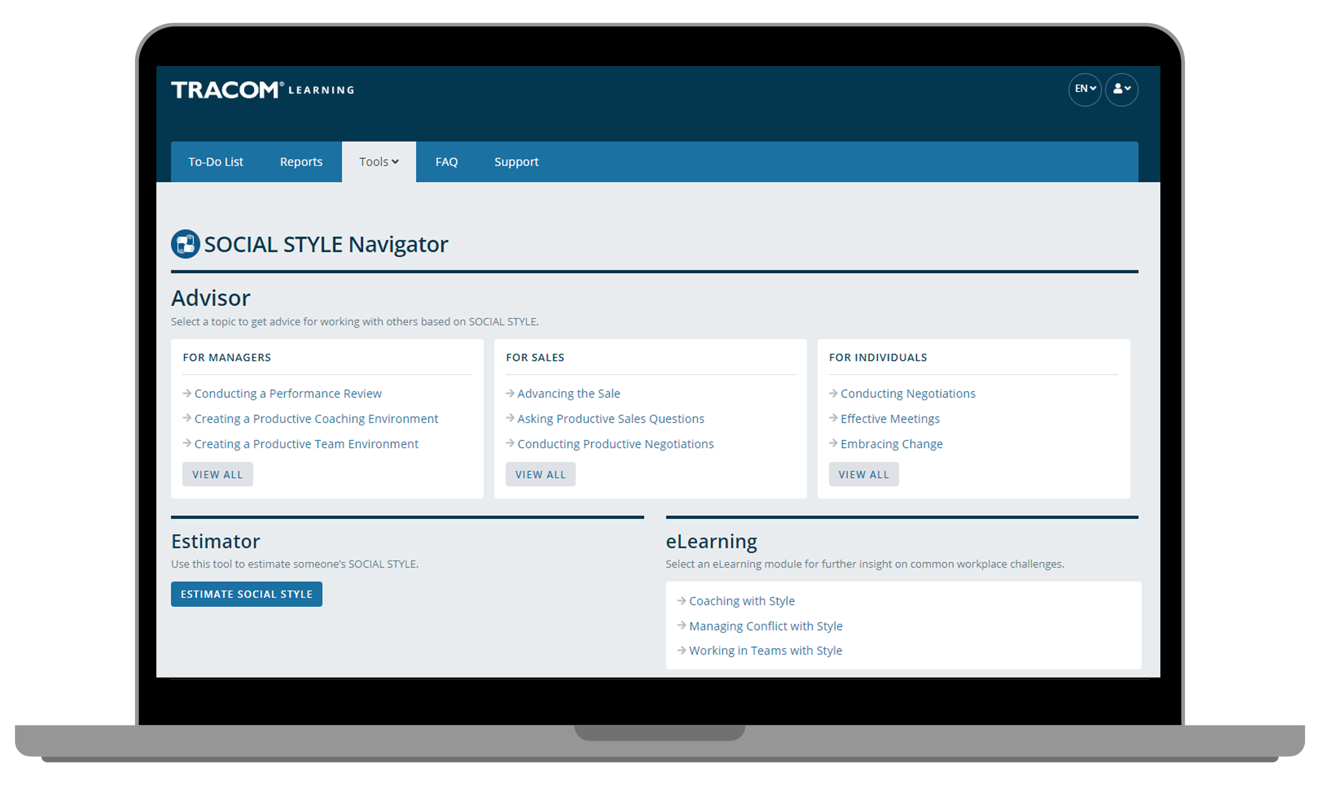
Notes:
Optional demonstration, time permitting

Slide 87
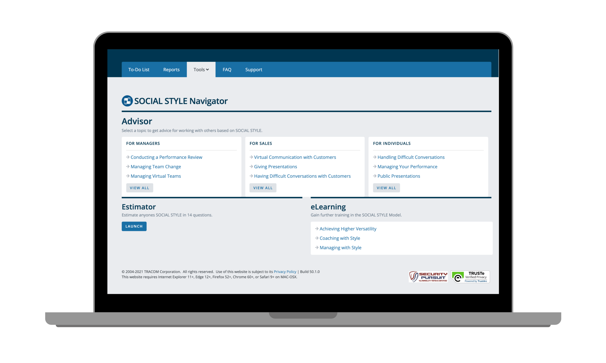
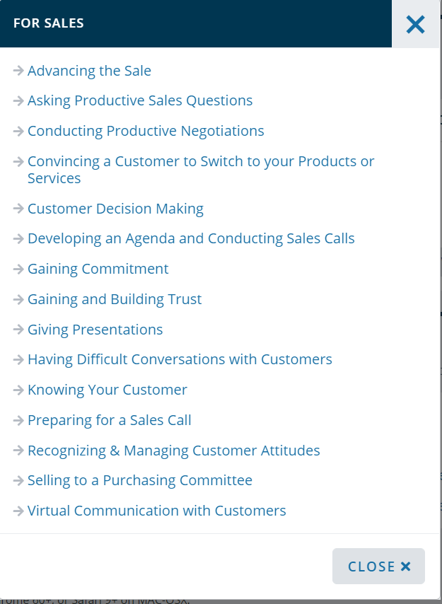
Notes:
Optional demonstration, time permitting

Slide 88
Notes:
Optional demonstration, time permitting

Slide 89
Notes:
Optional demonstration, time permitting

Slide 90
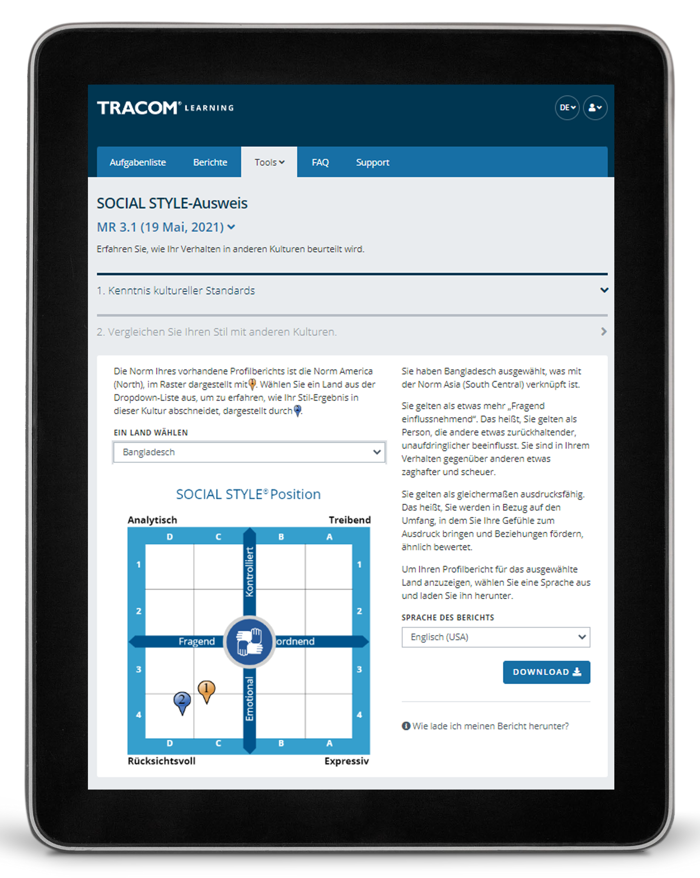
SOCIAL STYLE-Reisepass
Notes:
Optional demonstration, time permitting
The SOCIAL STYLE Passport allows you to see how you would profile in another country. It’s also available at tracomlearning.com.

Slide 91
91
Notes:
THANK participants and conclude the session.

