Slide 1
Vente axée sur les Résultats™
© The TRACOM Corporation. Tous droits réservés.
Notes:
2 Minutes
WELCOME participants to the session and REVIEW key points about TRACOM’s SOCIAL STYLE Model:
One of the most widely used and highly regarded behavioral models in use today.
Will help you develop insight about your behavioral strengths and weaknesses, and your customers’ behavioral preferences.
Originally developed in the 1960s by psychologists David Merrill and Roger Reid.
Used worldwide by millions of people.
PROGRAM BENEFITS
SAY Working successfully with customers depends on developing good relationships. You can do this by understanding your own Style and, more importantly, other people’s Styles. This allows you to practice Versatility by adjusting your behavior to meet other people’s Style preferences. Research shows that people who consistently show Versatility are more effective in their jobs than people who don’t show Versatility.

Slide 2
Étapes pour accroître l’efficacité interpersonnelle
Faire quelque chose pour les autres
Se contrôler
Reconnaître votre impact sur les autres
Gérez votre propre comportement
Observer objectivement les autres
Aider à répondre aux besoins des autres en matière de Style
Se connaître soi-même
Connaître les autres
Notes:
5 Minutes (Workbook, page 2)
SAY This program will bring you on a journey. The ultimate goal is to work more effectively with your customers and others. We’ll get there through a process that starts with understanding yourself and how your behavior affects your productivity and relationships. We refer to these as “know yourself” and “control yourself.”
Most importantly though, you’ll begin to focus on understanding others and their preferences for getting work done. This is called “know others.” With this understanding of others’ behavioral styles, you’ll begin to practice your Versatility, which is “do something for others.”
We’ll talk more about these four steps later, but as we progress through the program, you’ll see how they are applied.
By the end of the program, you’ll have insight into your own Style and behavior, and the Style of at least one of your customers. You’ll build on this knowledge to develop more effective ways of working with your customers through practicing Versatility.

Slide 3
Ce que vous apprendrez
Comment prédire le comportement des clients.
Ce qui cause du stress aux clients.
Comment reconnaître et satisfaire leurs besoins.
Comment préparer les réunions et adapter la communication.
Comment gagner la confiance des clients.
Notes:
2 Minutes
SAY Ultimately, this course will help you have more success with your customers. In particular, you’re going to learn specific strategies:
How to predict your customers’ behavior, and an understanding of why they behave that way.
What causes customers to become stressed, and how your own behavior can contribute to this.
How to recognize their needs and meet those needs.
How to prepare for meetings and tailor your communication to different customers.
Ultimately, how to earn their trust.

Slide 4
STYLE SOCIAL ET ADAPTABILITÉ
UN ÉLÉMENT CLÉ DE LA PERFORMANCE COMMERCIALE
À la suite de la formation sur le STYLE SOCIAL et à l’Adaptabilité, les professionnels de la vente déclarent que :
92 %
87 %
58 %
ont développé davantage de
ont augmenté leur capacité à
ont
CONCLU DES VENTES QU’ILS N’AURAIENT PEUT-ÊTRE PAS RÉALISÉES AUTREMENT
RELATIONS POSITIVES AVEC LES CLIENTS
INFLUENCER OU PERSUADER LES CLIENTS
Plus l’Adaptabilité augmente, plus les performances professionnelles augmentent.
Notes:
2 MINUTES (Workbook, page 4)
SAY In the first part of the program, you’ll learn about Style. This will help you understand your customers and how they prefer to interact with you.
The second part of the program focuses on Versatility, which is how well you meet others’ Style needs.
Versatility is the application of SOCIAL STYLE—when you understand your customers’ Style needs, you can help them meet those needs. This helps them feel more valued and sets the stage for them to have a better relationship with you. If you consistently show Versatility, you can be more effective.
You can read the stats on this slide. Research has found that salespeople who practice SOCIAL STYLE and Versatility have more success.

Slide 5
Présentations
Nom
Fonction
Client anonyme : ce qui est le plus frustrant
Notes:
10 Minutes
Have participants introduce themselves by revealing the topics listed on the slide.
ASK participants to think of one customer they have a difficult relationship with, and briefly describe their main frustration(s) with this person WITHOUT NAMING THE PERSON.
If Group is too large for verbal introductions, do this through chat.
TIP: You might want to record participants’ “What is Most Frustrating” on a flip chart (or virtual white board). The purpose of the session is to learn how to improve these relationships.
Make sure you have a Profile for each participant who completed the online Questionnaire by the deadline.
DO NOT pass out the Profiles at this time.
If you are delivering a virtual program, options and instructions for downloading profiles are given later in this guide.

Slide 6
Le Style en action
Observations
Opinions
Kyle
Lana
AJ
Abby
Notes:
15 Minutes (Workbook, page 5)
INTRODUCE the video: Four individuals participate in a meeting to discuss a product that is missing a client’s expectations.
ASK participants to write down their observations and opinions of each character on page 5 of the Participant Workbook.
PLAY Part 1.
DEBRIEF the video by asking participants to briefly share their thoughts on the characters. Many of the participants’ comments will be subjective observations.

Slide 7
Mon client : premières impressions
Considérez le client que vous avez identifié précédemment. Donnez-lui un nom fictif et notez :
Les premières impressions que vous avez eues de cette personne (lors de vos premières interactions)
Notes:
5 Minutes (Workbook, page 6)
SAY Think about the customer you identified during our “Introduction” exercise.
SAY Give your customer a fictional name and then write down:
First impressions you had of that person (from your first interactions).
DEBRIEF the exercise by asking participants to briefly share the information about their customer.
SAY The information you shared is typical about how we feel about and react to others. Some information is objective and observable—and some of it is subjective (how we feel about them). Today, we’re going to show you a more objective and reliable way to understand behavior; then based on this, find ways to work more effectively and with less frustration.

Slide 8
Dimensions du comportement
Assertivité et réactivité
Notes:
SAY We’re going to talk about behavior and how to accurately observe people’s behavior.

Slide 9
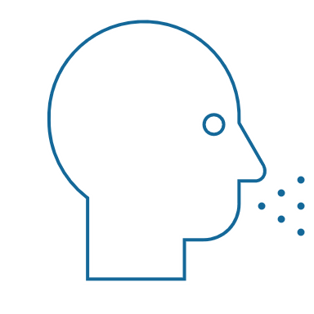
Comportements observables et personnalité
Comportement
Vos paroles (verbal) et vos actions (non verbal)
STYLE SOCIAL® Un schéma particulier d’actions que les autres personnes peuvent observer et accepter pour décrire le comportement de quelqu’un
Comportement observable
Dire / Faire
Personnalité
Comportement interpersonnel
Vos paroles et vos actions quand vous entrez en relation avec les autres personnes
Personnalité
Tout ce qui représente une personne : ses idées, ses valeurs, ses espoirs et ses rêves
Notes:
4 Minutes (Workbook, page 7)
SAY Behavior and personality are not the same things. Observable behavior is like the crust of a pie. Personality is like the inside and outside of the pie.
ASK What makes up personality?
CONDUCT a quick facilitated discussion to solicit participants’ responses. They should say things such as:
Values, hopes, attitudes, beliefs.
Things that are not necessarily observable.
These internal qualities are more subjective in nature.
SAY Style is like the crust, because it’s on the outside and observable. By observing behavior, we can find ways to define and discuss what we see. Then, we can begin to understand how this behavior affects ourselves and others.

Slide 10
Dire & Faire Comportement
Traits
Honnête
Intelligent
Arrogant
Motivé
Égocentrique
Sincère
Critique
Comportement observable
Silencieux
Rythme plus lent
Expressions du visage mieux contrôlées
Voix moins modulée
Peu de contact visuel
Posture décontractée
Se penche en arrière
Bruyant
Rythme plus rapide
Expressions du visage plus animées
Voix plus modulée
Davantage de contact visuel
Posture rigide Se penche en avant
Jugements
Je l’aime bien
Il m’agace
Elle m’intéresse
Il m’irrite
Je me méfie d’elle
Je le déteste
Je lui fais confiance
DIRE
FAIRE
Notes:
5 Minutes (Workbook, page 8)
SAY When we first meet people, we often form immediate impressions, even after just a few seconds. This is subconscious (below our level of awareness) and happens immediately.
DESCRIBE
Traits Column: What we think we know about a person, based on interactions; subjective opinions.
Judgments Column: Our reactions to others; conclusions or evaluations we make, based on our subjective opinions.
Observable Behavior Column: Things others “Say and Do”; more objective and observable behaviors.
SAY Traits and Judgments are most subjective in nature and contain positive or negative descriptions.
Observable Behavior is objective and contains no positive or negative value.
Observable Behavior is an important tool for assessing others’ Styles. By focusing on Observable Behavior, you gain objectivity, which is critical for understanding people’s Styles.

Slide 11
Assertivité et réactivité
Notes:
SAY We measure observable behavior on two dimensions: Assertiveness and Responsiveness

Slide 12
Assertivité
La mesure dans laquelle nous « demandons » ou « affirmons » lorsque nous interagissons avec les autres
Plus de demande
Demande avec un peu d’affirmation
Affirmation avec un peu de demande
Plus d’affirmation
Notes:
2 Minutes (Workbook, page 9)
SAY To become more effective with others, we follow a behavioral model. There are two dimensions of behavior that define SOCIAL STYLE: Assertiveness and Responsiveness.
Assertiveness is the degree to which we ask or tell when interacting with others. The two anchors for Assertiveness are Ask on the left side of the continuum and Tell on the right side of the continuum.
Assertiveness is a measurement of how we try to influence others to take action. If you are more “Tell” Assertive, you state your opinions directly. You tend to declare your viewpoints and try to direct the actions of others.
For example, if you want to have lunch with someone, you might say, “Let’s have lunch today!”
If you are more “Ask” Assertive, you tend to be more cautious and reserved about sharing your opinions. You attempt to influence others in a more quiet, low-key, questioning manner.
For example, if you want to have lunch with someone, you might say, “Would you like to have lunch with me today?”

Slide 13
Comportements d’assertivité
DIRE | Comportements verbaux
Plus lent
Rythme de la parole
Plus rapide
Moins
Quantité de discours
Plus
Plus silencieux
Volume de la parole
Plus fort
DEMANDE
AFFIRME
Détendue
Utilisation des mains
Directive
S’appuie au dossier du siège
Posture du corps
Se penche en avant
Moins direct
Contact visuel
Plus direct
FAIRE | Comportements non verbaux
Notes:
3 Minutes (Workbook, page 10)
SAY The Assertiveness scale helps predict a person’s behavior because it represents a “theme” or typical pattern. There are verbal and non-verbal clues to indicate a person’s Assertiveness.
ASK participants for examples of verbal and non-verbal clues for Ask-Assertive and Tell-Assertive individuals.
DESCRIBE the verbal and non-verbal indicators of Assertiveness:
Verbal: Ask-Assertive individuals use a slower pace, less quantity (fewer words), and quieter volume. Tell-Assertive individuals use a faster pace, talk more, and a louder volume.
Non-Verbal: Ask-Assertive individuals show relaxed hands and gestures, lean back, and use less direct eye contact. Tell-Assertive individuals have a directive use of hands, lean forward, and use more direct eye contact.

Slide 14
Assertivité
Indices verbaux
Indices non verbaux
Kyle
Lana
AJ
Abby
Notes:
10 Minutes (Workbook, page 11)
PLAY the same Video Part 1, again, now that participants have been introduced to Assertiveness.
ASK them to observe verbal and non-verbal “Say and Do” behaviors and record their observations on page 11 of their Participant Workbook.
DISCUSS video characters related to Assertiveness.
ASK participants to share some subjective “Say and Do” verbal and non-verbal behaviors of each of the team members. Think about speech characteristics such as pace, quantity, and volume for verbal behaviors and use of hands, posture, and eye contact for non-verbal behaviors.
ASK What is different about your observations from the first time you saw the video? (Answer: They are much more objective.) This contrasts with the subjective observations participants made earlier.
ASK Based on your understanding of the Assertiveness dimension, where do you think each of the characters falls on the Assertiveness continuum?
SAY Assertiveness is neither positive nor negative; it is neutral. There is no good or bad place on the Assertiveness scale. Your level of Assertiveness only becomes positive or negative when used appropriately or inappropriately.

Slide 15
Client : observations sur l’assertivité
DIRE | Comportements verbaux
Plus lent
Rythme de la parole
Plus rapide
Moins
Quantité de discours
Plus
Plus silencieux
Volume de la parole
Plus fort
DEMANDE
AFFIRME
Détendue
Utilisation des mains
Directive
S’appuie au dossier du siège
Posture du corps
Se penche en avant
Moins direct
Contact visuel
Plus direct
FAIRE | Comportements non verbaux
Notes:
10 Minutes (Workbook, page 12)
SAY Using the customer that you identified earlier, think about, and then write down, that person’s Assertiveness behaviors. Include the person’s verbal and non-verbal behaviors. Think about their speech characteristics such as pace, quantity, and volume for verbal behaviors and use of hands, posture, and eye contact for non-verbal behaviors.
DEBRIEF the exercise by asking participants to briefly share the information about their customer’s Ask or Tell Assertive behaviors.
RECORD their information on a virtual white board or flip chart.
ASK What is different about your observations from the first time you described this person?
Answer: They are much more objective. This contrasts with the subjective observations participants made earlier.
ASK Based on your understanding of the Assertiveness dimension, where do you think your customer falls on the Assertiveness continuum?
EMPHASIZE that Assertiveness is neither positive nor negative; it is neutral. There is no good or bad place on the Assertiveness scale.

Slide 16
Réactivité
Plus de contrôle
Contrôle avec un peu de démonstration
La mesure dans laquelle nous contrôlons ou affichons nos émotions lorsque nous interagissons avec d’autres personnes
Démonstration avec un peu de contrôle
Plus de démonstration
Notes:
2 Minutes (Workbook, page 13)
SAY Responsiveness is the degree to which people tend to control (don’t outwardly display emotions) or emote (outwardly display emotions).
The two descriptive anchors for the Responsiveness scale are Controls on the top of the continuum and Emotes on the bottom of the continuum.
Responsiveness is also the extent to which you react to emotional appeals or displays.
If you control your emotions, you usually don’t react to emotional appeals and are more likely to focus on ideas, data, and tasks. You are less likely to share your feelings publicly.
If you are more emoting, you share and display your emotions with others. You are more likely to respond to emotional appeals and displays from others.

Slide 17
Comportements de réactivité
DIRE | Comportements verbaux
FAIRE | Comportements non verbaux
Contrôle
Moins d’inflexion
Tâche
Faits/Données
Moins
Rigide
Contrôlée
Émotion dans la voix
Sujets du discours
Forme des descriptifs
Utilisation des mains
Posture du corps
Expression faciale
Plus d’inflexion
Personnes
Opinions/Histoires
Plus
Décontractée
Animée
Montre
Notes:
3 Minutes (Workbook, page 14)
SAY The Responsiveness scale, like the Assertiveness scale, helps us to predict a person’s behavior because it is a “theme” or typical pattern.
ASK participants for their opinions on the verbal and non-verbal clues of Control- and Emote-oriented individuals.
DESCRIBE the verbal and non-verbal clues to responsive behavior as noted on the slide.
SAY Responsiveness is neither a positive nor a negative quality; it is neutral.
Assertiveness and Responsiveness do not affect each other — they are independent of each other.

Slide 18
Réactivité
Indices verbaux
Indices non verbaux
Kyle
Lana
AJ
Abby
Notes:
10 Minutes (Workbook, page 15)
REPLAY Video Part 1 again, now that participants have been introduced to Responsiveness.
ASK participants to observe verbal and non-verbal Say/Do behaviors.
SAY Think about verbal clues such as vocal emotion, subjects, and what each team member describes. What did you observe? For non-verbal clues, think about use of hands, posture, and facial expressions.
ASK Based on your understanding of Responsiveness, where do you think each of the characters falls on the Responsiveness scale?
SAY The Assertiveness and Responsiveness dimensions assess behavior, not personality or intelligence, and they are independent of each other.

Slide 19
Client(e) : observations sur la réactivité
DIRE | Comportements verbaux
FAIRE | Comportements non verbaux
Contrôle
Moins d’inflexion
Tâche
Faits/Données
Moins
Rigide
Contrôlée
Émotion dans la voix
Sujets du discours
Forme des descriptifs
Utilisation des mains
Posture du corps
Expression faciale
Plus d’inflexion
Personnes
Opinions/Histoires
Plus
Décontractée
Animée
Montre
Notes:
10 Minutes (Workbook, page 16)
SAY Using the customer that you identified earlier, think about, and then write down, that person’s Responsiveness behaviors. Include their verbal and non-verbal behaviors. Think about speech characteristics such as emotion in their voice, subjects of speech, forms of descriptors, and non-verbal behaviors such as use of hands, body posture, and use of facial expressions.
DEBRIEF the exercise by asking participants to briefly share the information about their customer’s Control or Emote Responsiveness Behaviors.
RECORD their information on a virtual white board or flip chart.
ASK What is different about your observations from the first time you described this person?
Answer: They are much more objective. This difference contrasts with the subjective observations participants made earlier.
ASK Based on your understanding of the Responsiveness Dimension, where do you think your customer falls on the Responsiveness continuum?

Slide 20
Le modèle STYLE SOCIAL™
Notes:
SAY Now that you understand Assertiveness and Responsiveness, we’ll see how they form the SOCIAL STYLE Model.

Slide 21
Le modèle STYLE SOCIALTM
Contrôle
Demande assertive plus contrôlé
Style Analytique
Affirmation assertive plus contrôlé
Style Déterminé
Demande
Affirme
Demande assertive plus de démonstration
Style Sociable
Affirmation assertive plus de démonstration
Style Expressif
Montre
Notes:
4 Minutes (Workbook, page 17)
CLICK TO REVEAL EACH QUADRANT
SAY By combining Assertiveness and Responsiveness, the four SOCIAL STYLEs are formed.
No individual will display one Style exclusively; but, in a short time, you can determine the patterns that define a person’s Style. Once you know a person’s Style, you can adjust your behavior to develop a more effective relationship.

Slide 22
Le modèle STYLE SOCIAL
Contrôle
Analytique
Sérieux
Exigeant
Logique
Indécis
Déterminé
Indépendant
Formel
Pratique
Dominant
Demande
Affirme
Sociable
Solidaire
Fiable
Ouvert
Flexible
Expressif
Énergique
Animé
Aventureux
Impulsif
Montre
Notes:
5 Minutes (Workbook, page 18)
CLICK TO SPEAK ABOUT EACH QUADRANT (text becomes darker)
Review the summaries for each Style. Note that each Style contains positive descriptors and one negative descriptor. This illustrates the significance of perception. A Driving Style person might see themselves as Independent, Formal, and Practical, while others might perceive the same behavior as Dominating.
Solicit questions/ comments.
KEY POINTS:
Style descriptions are generalizations about each Style.
People with the same Style exhibit similar behaviors, but are still individuals.
Perceptions can vary. What you see as strengths in yourself, others might view negatively.

Slide 23
Quel Style est en action ?
Quel est le Style de chaque Personnage ?
Kyle
Lana
AJ
Abby
Notes:
3 Minutes (Workbook, page 19)
REFERENCE the video characters from earlier exercises.
ASK What do you think the SOCIAL STYLE of each video character is?
DISCUSS the behaviors of the characters and how those are indicative of their Styles.
IMPORTANT: Do not advance the slide until you’ve discussed the behavior of each character. The next slide reveals each character’s Style.

Slide 24
STYLE SOCIAL
Contrôle
Analytique
Déterminé
Lana
Kyle
Demande
Affirme
Sociable
Expressif
AJ
Abby
Montre
Notes:
2 Minutes (Workbook, page 19)
Kyle – Driving
Lana – Analytical
AJ – Amiable
Abby – Expressive
DISCUSS the behaviors of the characters and how those are indicative of their Styles.

Slide 25
STYLE SOCIAL du client
Contrôle
Demande assertive plus contrôlé
Style Analytique
Affirmation assertive plus contrôlé
Style Déterminé
Demande
Affirme
Demande assertive plus de démonstration
Style Sociable
Affirmation assertive plus de démonstration
Style Expressif
Montre
Notes:
5 Minutes (Workbook, page 20)
SAY Using the customer that you identified earlier, determine their Style. This is only a preliminary estimate. As we continue through the program, you might re-estimate the person’s Style.
DEBRIEF the exercise by asking participants to share their customer’s Style, and how this behavioral assessment relates to their initial impressions of the person (which may have been more subjective).
RECORD their information on a virtual white board or flip chart.
SAY You will use their Style as a framework for developing more effective interactions with this person.

Slide 26
Besoin, Orientation et Action de Croissance
Besoin
L’objectif de chaque Style
Orientation Le comportement courant utilisé pour satisfaire le besoin
Action de croissance
Comportement qui est rarement utilisé par chaque Style. Utiliser ce comportement plus souvent augmenterait l’efficacité de ce Style
Notes:
2 Minutes (Workbook, page 21)
SAY Remember that the Style descriptions are generalizations about each Style. While people with the same Style generally exhibit similar characteristics, each person is still unique.
SAY Each Style has a Need, an Orientation, and a Growth Action. By recognizing these things about each Style, we can understand their motivations and what drives their behavior.
DEFINE:
Need – The goal of each Style.
Orientation – The common behavior used to achieve the need.
Growth Action – Behavior that is rarely used by each Style. Using this behavior more often would increase this Style’s effectiveness.
SAY Understanding the need, orientation, and growth action of each Style will help you better relate to others’ Styles and enhance your effectiveness with them.

Slide 27
STYLE SOCIAL Caractéristiques principales
Contrôle
Analytique
Besoin de : avoir raison
Orientation : automatique
Action de croissance : déclarer
Déterminé
Besoin de : résultats
Orientation : action
Action de croissance : écouter
Demande
Affirme
Sociable
Besoin de : sécurité personnelle
Orientation : relations
Action de croissance : initier
Expressif
Besoin de : valorisation
Orientation : spontanéité
Action de croissance : vérifier
Montre
Notes:
6 Minutes (Workbook, page 21)
CLICK TO REVEAL THE TEXT IN EACH QUADRANT.
REVIEW each Style.
ASK How do need, orientation, and growth action manifest themselves in the video characters? Specifically, how does each team member’s behavior show their need, orientation, and growth action?

Slide 28
Comportements de STYLE SOCIAL
Contrôle
Analytique
Rythme plutôt lent
Fait des efforts pour s’organiser
Moins d’intérêt pour les relations
Travaille dans les délais chronologiques
Agit avec prudence
Évite l’implication personnelle
Déterminé
Rythme plutôt rapide
Souhaite donner le rythme
Moins d’intérêt pour les relations
Travaille dans les délais actuels
Dirige les actions des autres
Évite l’inaction
Demande
Affirme
Sociable
Rythme plutôt lent
Fait des efforts pour établir des relations
Moins d’intérêt pour effectuer des changements
Travaille dans les délais actuels
Fait preuve de solidarité
Évite les conflits
Expressif
Rythme plutôt rapide
Fait des efforts pour s’impliquer
Moins d’intérêt pour les routines
Travaille dans les délais à venir
Agit impulsivement
Évite l’isolement
Montre
Notes:
5 Minutes (Workbook, page 22)
CLICK TO SPEAK ABOUT EACH QUADRANT
DESCRIBE the typical behaviors of the four SOCIAL STYLEs. These behaviors are related to the Style needs, orientations, and growth actions.

Slide 29
Comportements des clients
Contrôle
Analytique
Moins social, plus professionnel
Un contact visuel moins direct
Écoute attentivement avant de présenter ses opinions
Pose des questions sur les détails
Peut éviter d’exprimer une opinion ou de prendre une décision
Déterminé
Moins social, plus professionnel
Un contact visuel plus direct
Direct avec opinions
Peut poser des questions difficiles
Peut se désengager ou essayer de prendre le contrôle
Demande
Affirme
Sociable
Sympathique et accessible
Hochement de tête et autres signes d’encouragement
Parle moins que les autres
Pose des questions sur les impacts sur les personnes
Peut acquiescer aux décisions du groupe
Expressif
Sociable et abordable au début de la rencontre
Parle plus que les autres
Peut s’écarter de l’ordre du jour et parler de divers sujets
Direct avec opinions
Peut affronter les autres personnes
Montre
Notes:
4 Minutes (Workbook, page 23)
CLICK TO REVEAL THE TEXT IN EACH QUADRANT.
REVIEW the customer behaviors. These behaviors are typical Style-related behaviors specific to working with customers.
ENCOURAGE participants to share stories about their customers.

Slide 30
Tension du client
Contrôle
Analytique
Manque de concentration et d’organisation
Pressions pour obtenir une vente rapide
Concentration sur des généralités sans tenir compte des détails
Trop de changements sans tenir compte des conséquences
Déterminé
Manque de structure et de résultats clairs
Ne reçoit pas de possibilités d’exprimer ses opinions
Aucune solution de fond
Des progrès lents
Qu’est-ce qui cause du stress à chaque Style ?
Demande
Affirme
Sociable
Trop de formalité et de concentration sur les tâches
Manque de collaboration pour trouver des solutions
Concentration sur la vente plutôt que sur la relation à long terme.
Trop de changements, trop rapidement
Expressif
N’est pas reconnu pour ses contributions
Trop de détails
Trop de structure sans conversation libre
Pas assez d’attention portée aux possibilités futures
Montre
Notes:
6 Minutes (Workbook, page 24)
ASK Given a customer’s Style need and typical behaviors, what will cause stress for them?
FACILITATE a discussion of each Style before revealing the text.
CLICK TO REVEAL THE TEXT IN EACH QUADRANT.
The Driving Style need is results, so what’s going to raise their tension in a sales meeting?
Lack of focus; disorganization; not being allowed to state their opinions; no bottom-line solutions; progress is too slow.
Expressive Style stressors:
Not being recognized; too many details; too much structure without free-flowing conversation; not enough focus on future possibilities.
Amiable Style stressors:
Too much formality; lack of collaboration towards solutions; focus on the sale instead of on long-term relationship; too much change too quickly.
Analytical Style stressors:
Lack of structure and clear outcomes; pushiness to achieve quick sale; focus on generalities without considering details; too much change without considering consequences.
ENCOURAGE participants to share stories about their customers.

Slide 31
Comportement de sauvegarde
Contrôle
Analytique
ÉVITE : Se retire pour réduire la tension personnelle
Déterminé
AUTOCRATIQUE : Prend les choses en main pour réduire les tensions personnelles
Comportement exagéré utilisé pour réduire la tension
Demande
Affirme
Sociable
ACQUIESCE : S’incline pour réduire la tension personnelle
Expressif
ATTAQUE : Affronte les autres personnes pour réduire la tension personnelle
Montre
Notes:
5 Minutes (Workbook, page 25)
CLICK TO REVEAL THE TEXT IN EACH QUADRANT.
SAY When customers are feeling stressed, their behavior can be categorized: each Style falls into a type of extreme backup behavior to try and reduce tension.
DESCRIBE each Style’s backup behavior. Remember, each Style’s goal is to get their Style need met.
ASK What are some common ways that each Style might show their backup behavior?
Driving: Will get frustrated by slow progress or barriers and try to take control of the situation.
Expressive: Will get upset if they aren’t given opportunities to express themselves or show their contributions, and might verbally confront others.
Amiable: If they feel that a relationship is being threatened, they will stay quiet and acquiesce instead of firmly stating their opinions.
Analytical: If they feel that things are moving too fast without taking into account important details, they will withdraw and refuse to contribute.
SAY Next we’ll talk about some specific strategies for working with customers.

Slide 32
Répondre aux besoins des clients
Contrôle
Analytique
Preuves et informations : partagez avec eux
Transparence : ils veulent voir et comprendre vos processus
Pour être compris : montrez que vous comprenez leurs problèmes
Du temps pour réfléchir : ne faites pas pression pour obtenir des décisions rapides
Déterminé
Résultats : livrez comme convenu et rapidement, si possible
Compétence : montrez les capacités de votre équipe
Franchise : soyez franc et professionnel
Efficacité : respectez leur temps et mettez-vous rapidement au travail
Demande
Affirme
Sociable
La socialisation : prenez le temps d’apprendre à les connaître
La sécurité : essayez de minimiser les risques pour eux
Engagement et consensus : impliquez les autres dans les décisions pour obtenir leur approbation
Rassurez-les : faites-leur savoir que des projets similaires ont déjà réussi
Expressif
Soutien : aidez à concrétiser leurs visions
Approbation : n’entrez pas en concurrence avec eux pour la reconnaissance
Respect et importance : ils aiment l’attention, surtout celle des dirigeants
Voix : donnez-leur le temps de s’exprimer, même si cela ne concerne pas l’objet de la réunion
Montre
Notes:
8 Minutes (Workbook, page 26)
ASK With these backup behaviors in mind, and understanding what causes stress for each Style, what are some ways to meet your customers’ needs? Start with the Driving Style, what ideas do you have?
CLICK TO REVEAL THE TEXT IN EACH QUADRANT.
REVIEW the needs and strategies to meet each Style’s needs and facilitate discussion of each Style.
ENCOURAGE participants to share stories about their customers.

Slide 33
Observer le Style virtuellement
Notes:
10 Minutes (whole section on Observing Style Virtually)
SAY Working with customers and trying to sell remotely has its own unique challenges. You can still use Style to your advantage. Let’s briefly see how people of different Styles might communicate using text messages.

Slide 34
Je reviens vers vous pour savoir si vous avez eu l’occasion de voir la vidéo que j’ai envoyée sur nos dernières mises à niveau technologiques.
Qu’en pensez-vous ?
Notes:
The following five slides are examples of “observable” behavior in text messages.
SAY By observing the behaviors of others, even through simple communication like texting, we can TRY to determine how people prefer to communicate and prefer to be communicated with.
Review example slides:
There is a lot of change happening at our organization, so I sent this text to four of my customers. Then I waited for their responses.

Slide 35
Je reviens vers vous pour savoir si vous avez eu l’occasion de voir la vidéo que j’ai envoyée sur nos dernières mises à niveau technologiques.
Qu’en pensez-vous ?
Bonjour ! Il y a beaucoup de changements qui arrivent rapidement.
Mon équipe aura besoin d’une formation sur les nouvelles fonctionnalités. Pouvez-vous nous aider ?
Notes:
SAY Here is the first response from a customer.

Slide 36
Je reviens vers vous pour savoir si vous avez eu l’occasion de voir la vidéo que j’ai envoyée sur nos dernières mises à niveau technologiques.
Qu’en pensez-vous ?
C’est excitant ! J’ai jeté un coup d’œil rapide et les nouvelles fonctionnalités semblent fantastiques !
Je vous appelle la semaine prochaine !
Notes:
SAY This is the second response from another customer.

Slide 37
Je reviens vers vous pour savoir si vous avez eu l’occasion de voir la vidéo que j’ai envoyée sur nos dernières mises à niveau technologiques.
Qu’en pensez-vous ?
Je pense que les nouvelles mises à jour nous aideront à être plus efficaces et à économiser des efforts. Cependant, avant d’adapter la nouvelle version, nous devons prévoir la formation de mon équipe. Avez-vous mis en place un processus à cet effet ?
Notes:
SAY Here’s the response from a third customer.

Slide 38
Je reviens vers vous pour savoir si vous avez eu l’occasion de voir la vidéo que j’ai envoyée sur nos dernières mises à niveau technologiques.
Qu’en pensez-vous ?
Ça a l’air bien. Je vous appellerai quand je serai prêt pour la mise en œuvre.
Notes:
SAY And finally, this response from a fourth customer.
Keep these texts in mind as we’ll be revisiting them later.

Slide 39
Nommez ce Style !
Je reviens vers vous pour savoir si vous avez eu l’occasion de voir la vidéo que j’ai envoyée sur nos dernières mises à niveau technologiques.
Qu’en pensez-vous ?
Notes:
SAY This is the text I first sent out. How about the responses I received? Knowing what you know so far about STYLE SOCIAL, can you guess which Style each response is from?

Slide 40
Contrôle
Demande assertive plus contrôlé
Style Analytique
Affirmation assertive plus contrôlé
Style Déterminé
Bonjour ! Il y a beaucoup de changements qui arrivent rapidement. Mon équipe aura besoin d’une formation sur les nouvelles fonctionnalités. Pouvez-vous nous aider ?
Demande
Affirme
Demande assertive plus de démonstration
Style Sociable
Affirmation assertive plus de démonstration
Style Expressif
Montre
Notes:
SAY Which Style might this person be?
AMIABLE
SAY This person is personable (“Hi!”) and concerned that things are moving fast. They are showing concern for the team’s ability to adapt the new technology, and they specifically ask for help. It indicates Ask Assertiveness and Emote Responsiveness.

Slide 41
Contrôle
Demande assertive plus contrôlé
Style Analytique
Affirmation assertive plus contrôlé
Style Déterminé
C’est excitant ! J’ai jeté un coup d’œil rapide et les nouvelles fonctionnalités semblent fantastiques !
Je vous appelle la semaine prochaine !
Demande
Affirme
Demande assertive plus de démonstration
Style Sociable
Affirmation assertive plus de démonstration
Style Expressif
Montre
Notes:
ASK How about this one—what Style?
EXPRESSIVE
SAY This person uses a lot of exclamation marks to show enthusiasm and wants to interact. They also mention “I took a quick look,” indicating they didn’t pay close attention to the video or details. It indicates Tell Assertiveness and Emote Responsiveness.

Slide 42
Contrôle
Demande assertive plus contrôlé
Style Analytique
Affirmation assertive plus contrôlé
Style Déterminé
Je pense que les nouvelles mises à jour nous aideront à être plus efficaces et à économiser des efforts. Cependant, avant d’adapter la nouvelle version, nous devons prévoir la formation de mon équipe. Avez-vous mis en place un processus à cet effet ?
Demande
Affirme
Demande assertive plus de démonstration
Style Sociable
Affirmation assertive plus de démonstration
Style Expressif
Montre
Notes:
ASK Which Style might this person be?
ANALYTICAL
SAY This person likes things to be efficient but is hesitant to adapt the new technology until the team is trained and ready. They also ask a clarifying question – “Do you have a process in place for this?” It indicates Ask Assertiveness and Control Responsiveness.

Slide 43
Contrôle
Demande assertive plus contrôlé
Style Analytique
Affirmation assertive plus contrôlé
Style Déterminé
Ça a l’air bien. Je vous appellerai quand je serai prêt pour la mise en œuvre.
Demande
Affirme
Demande assertive plus de démonstration
Style Sociable
Affirmation assertive plus de démonstration
Style Expressif
Montre
Notes:
ASK And finally, what Style might this be?
DRIVING
SAY This person is being direct and brief. They also communicate that they will initiate contact when they’re ready (“Don’t call me, I’ll call you.”). It indicates Tell Assertiveness and Control Responsiveness.

Slide 44
Points clés
Le Style n’est pas la personnalité.
Se réfère uniquement au comportement observable.
Le comportement est un continuum, pas un « soit/soit »
Les gens se comportent selon un seul Style la plupart du temps.
Il n’y a pas de « meilleur » Style.
Notes:
2 Minutes (Workbook, page 28)
REVIEW the key points.
Style is not personality.
Style refers only to observable behavior.
Behavior is a continuum, not an “either/or.”
People behave with one Style most of the time.
There is no “best” Style.

Slide 45
Profil du STYLE SOCIAL
Notes:
SAY Now that you’re familiar with the Model, each of you will review your own SOCIAL STYLE Profile.

Slide 46
Assertivité
La mesure dans laquelle une personne a tendance à demander ou à affirmer.
D
C
B
A
Plus de demande
Demande avec un peu d’affirmation
Affirmation avec un peu de demande
Plus d’affirmation
Plus de demande assertive que 75 % de la population
Plus de demande assertive que 50 % de la population
Plus d’affirmation assertive que 50 % de la population
Plus d’affirmation assertive que 75 % de la population
Notes:
2 Minutes
SAY Before you read your SOCIAL STYLE Profile, let me describe how your results are determined. The dimensions of behavior are normed. This means that Assertiveness is reported in quartiles.
Review the information on the slide concerning percentiles of people in each of the four quartiles.

Slide 47
Réactivité
1
Plus de contrôle
Plus réactif au contrôle que 75 % de la population
2
Contrôle avec un peu de démonstration
Plus réactif au contrôle que 50 % de la population
La mesure dans laquelle une personne a tendance à contrôler ou à afficher ses émotions.
3
Démonstration avec un peu de contrôle
Plus réactif à la démonstration que 50 % de la population
4
Plus de démonstration
Plus réactif à la démonstration que 75 % de la population
Notes:
2 Minutes
SAY In the same way, Responsiveness is reported in quartiles.
Review the information on the slide concerning percentiles of people in each of the four quartiles.

Slide 48
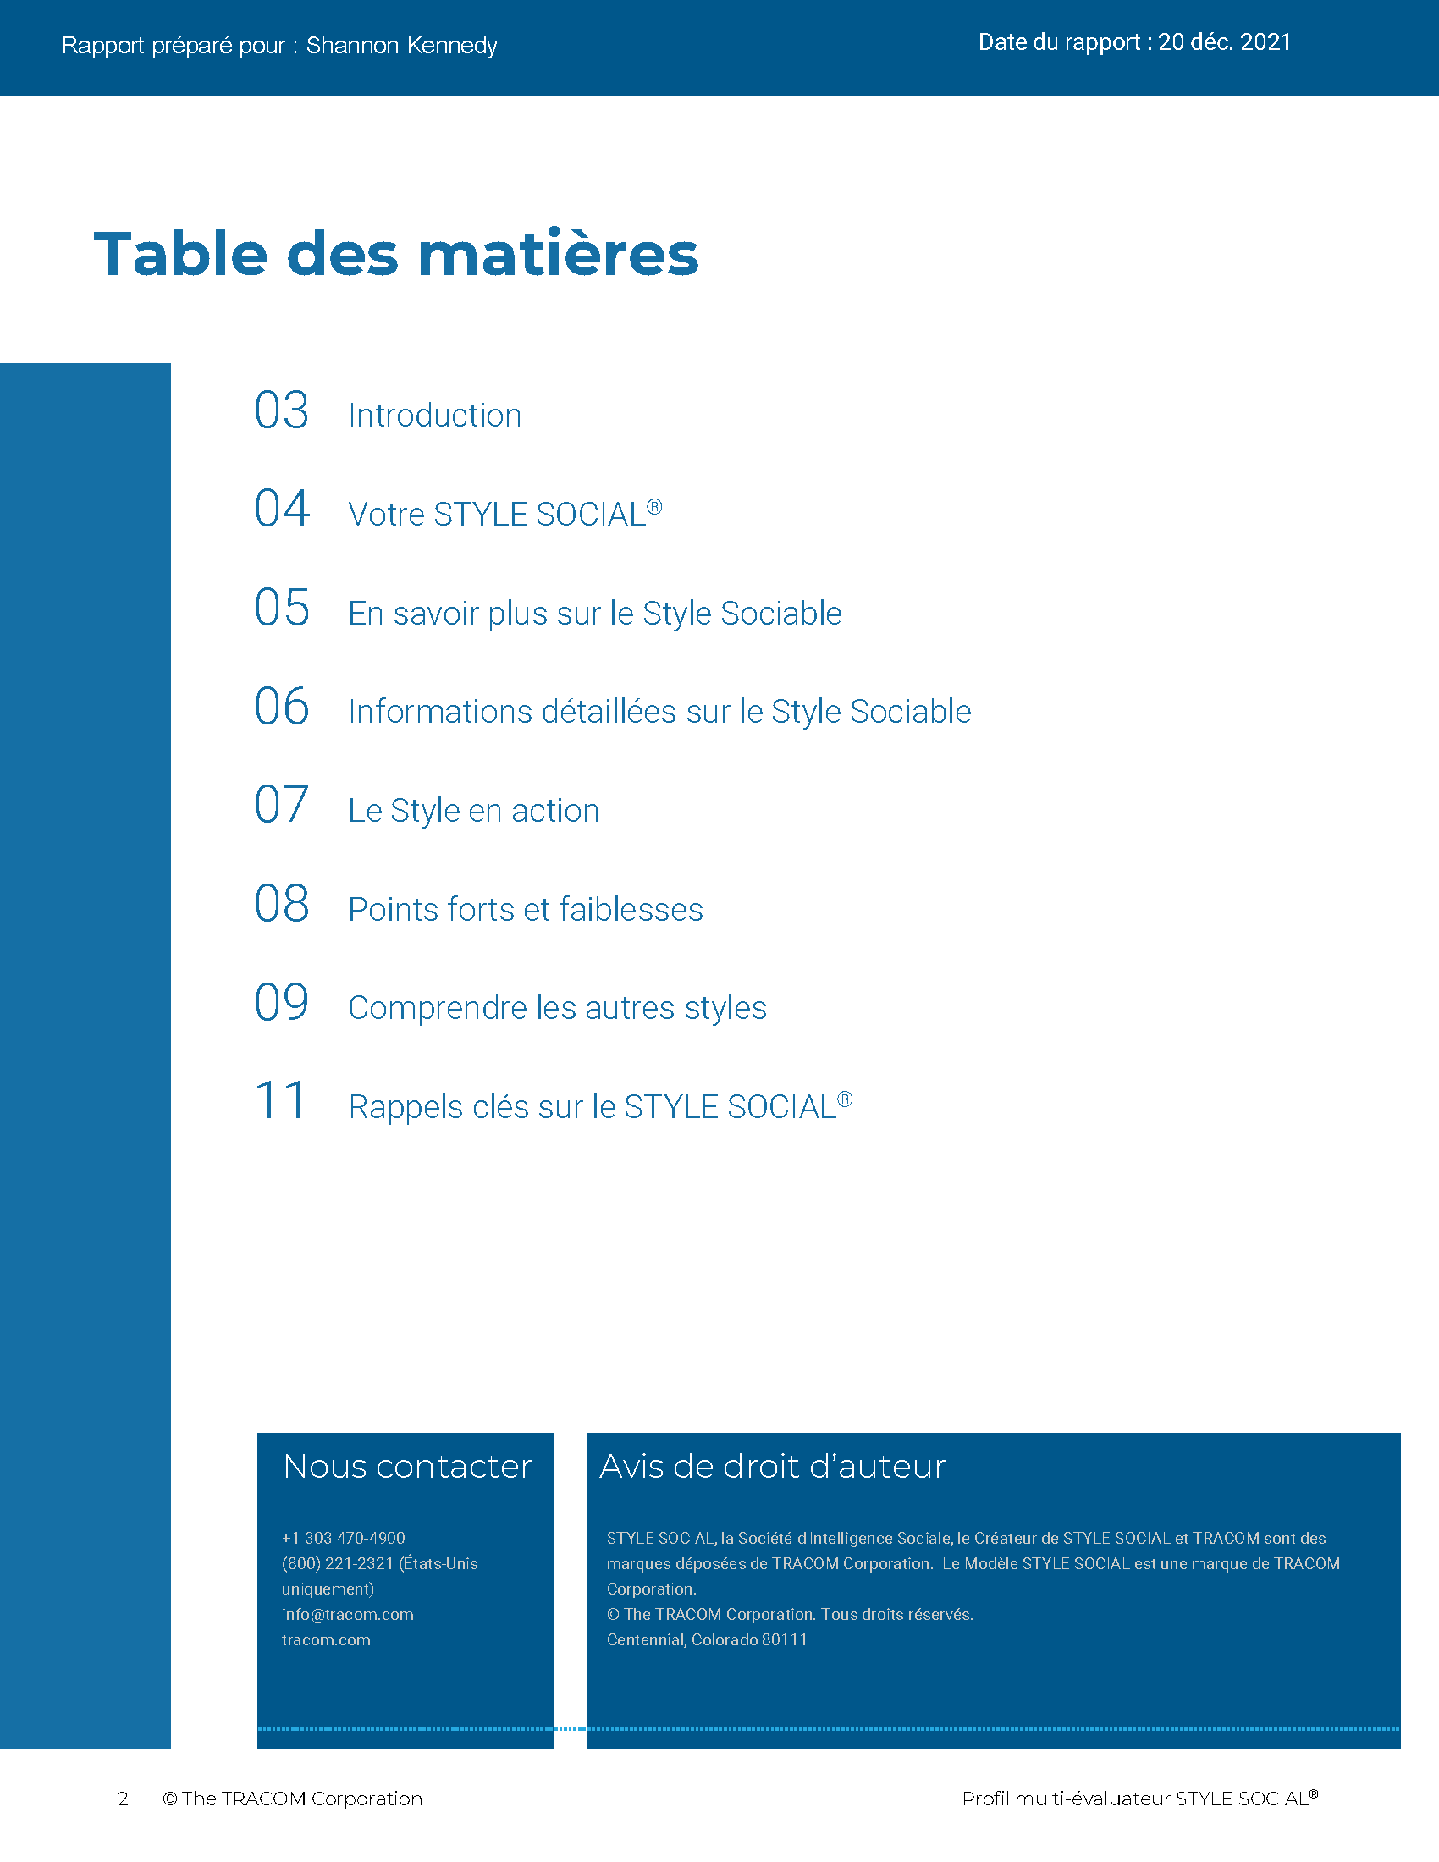
© The TRACOM Corporation. Tous droits réservés.
48
Notes:
20 Minutes
REVIEW the Profile pages on the following slides so participants understand the layout of the profile. After you’ve reviewed the slides, distribute individuals’ profiles.
If delivering a virtual program, participants will have already received their profiles. Note that you are only covering the SOCIAL STYLE section of the profile; the Versatility profile will be reviewed later.
PROVIDE ample time for participants to read and absorb their profiles. Do not continue until it is evident that all participants have finished reading their profiles.
ASK if there are any questions, surprises, or concerns.
ASK If your self-perception results were different, what might have caused the difference in views?
EXPLAIN TRACOM’s research shows that over 50% of the time, people see themselves differently from how others see them. Reiterate that there is no “best Style” and all Styles can be successful salespeople. Offer to be available during the break to answer individual questions or concerns.
NOTE: It is recommended that you take a break here and make yourself available for one-on-one conversations as participants may have questions or concerns they do not want to discuss publicly.

Slide 49
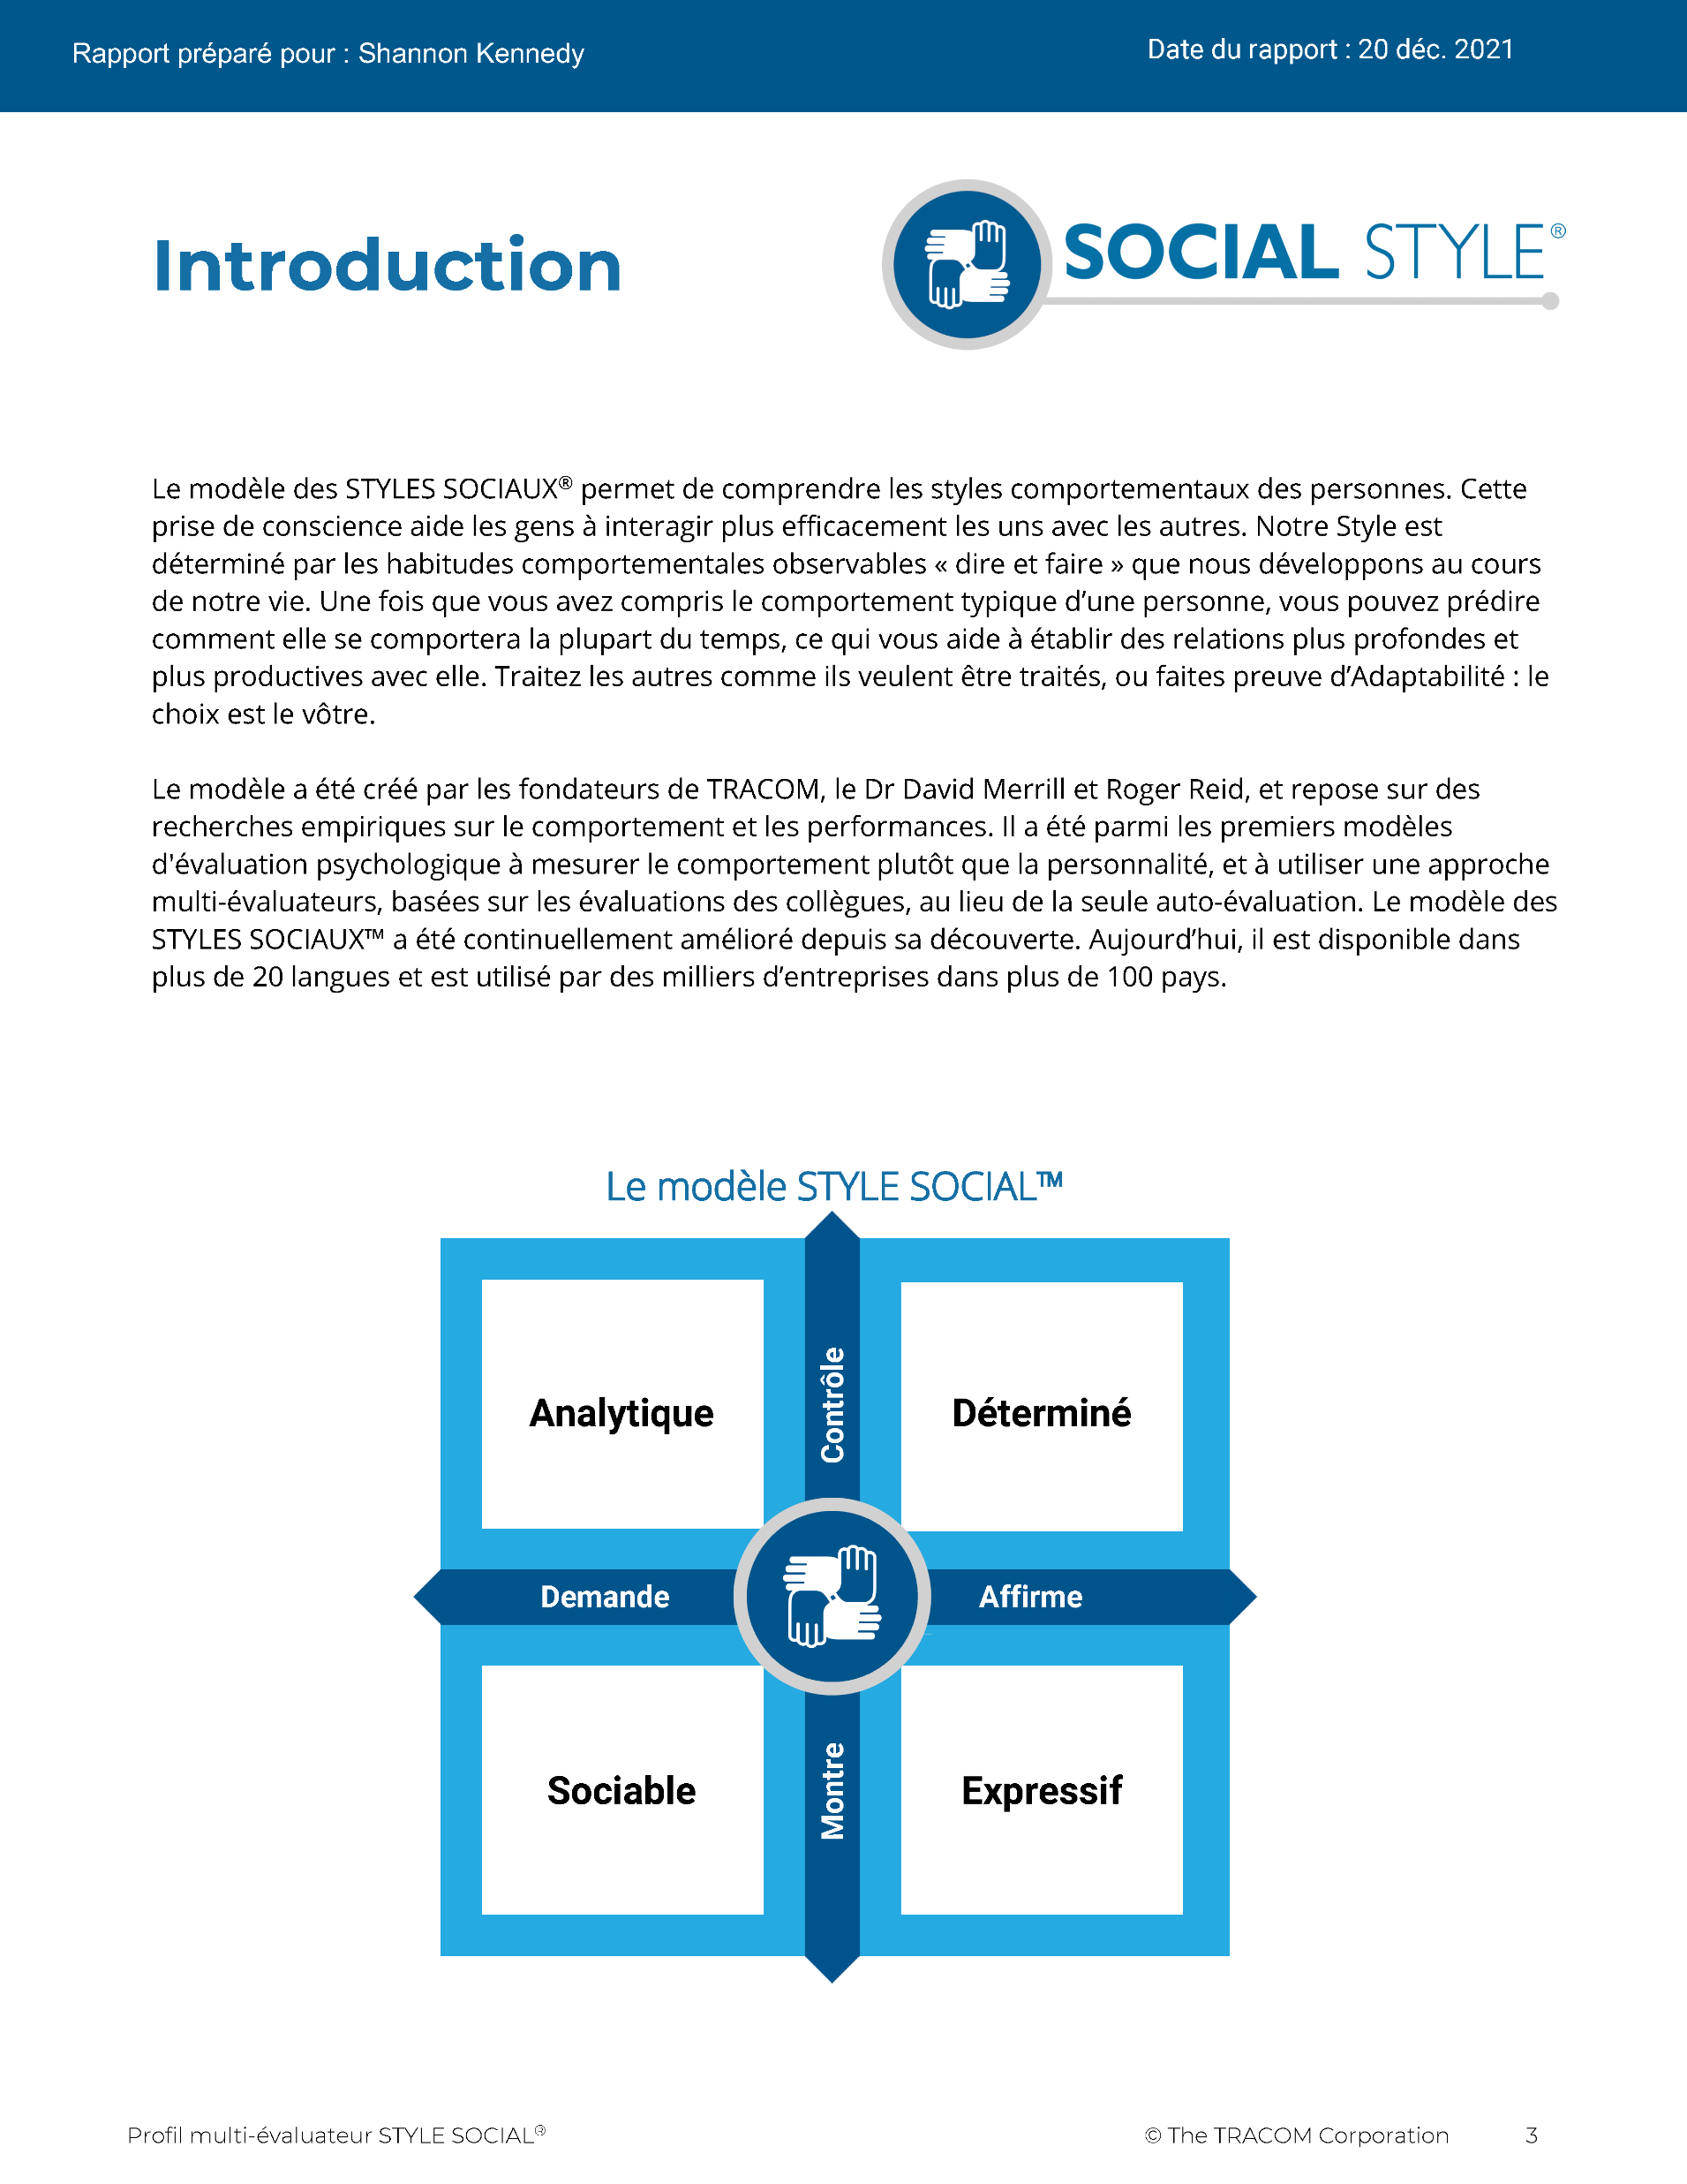
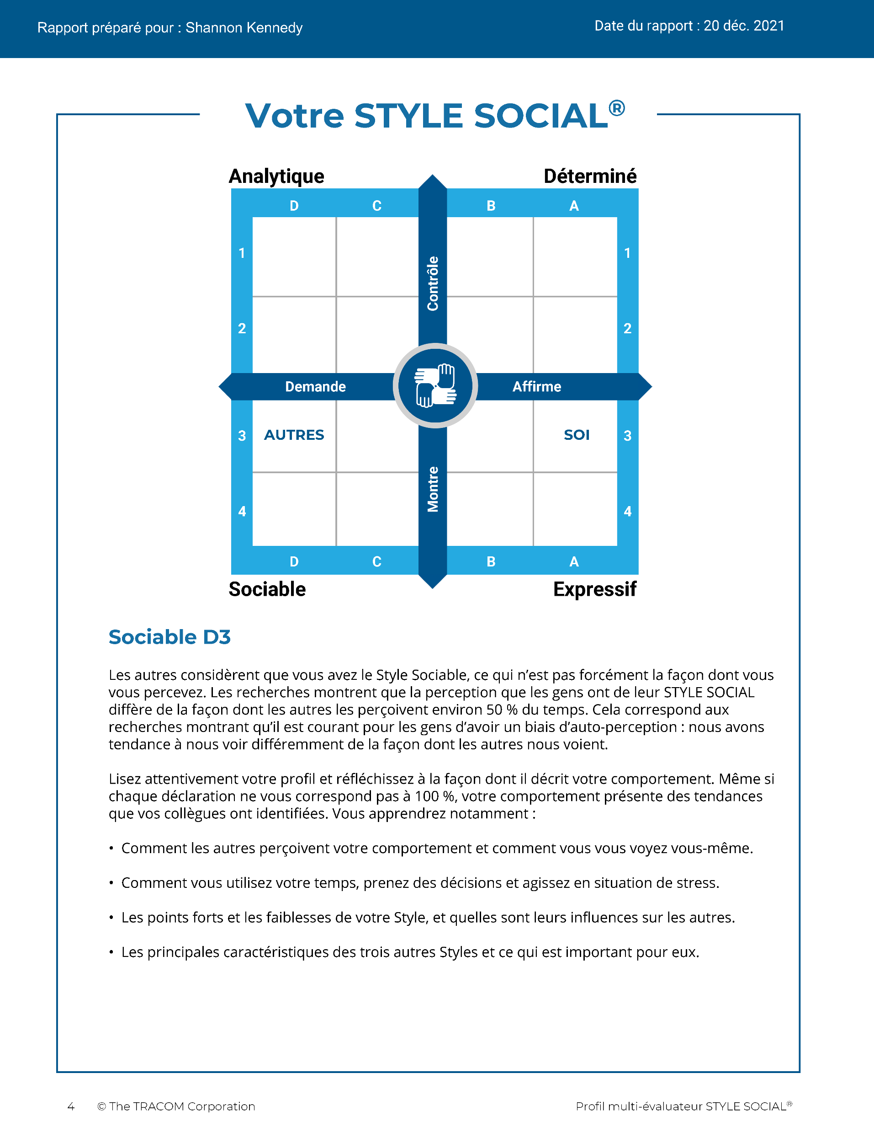
© The TRACOM Corporation. Tous droits réservés.
49
Notes:
Continue reviewing.

Slide 50
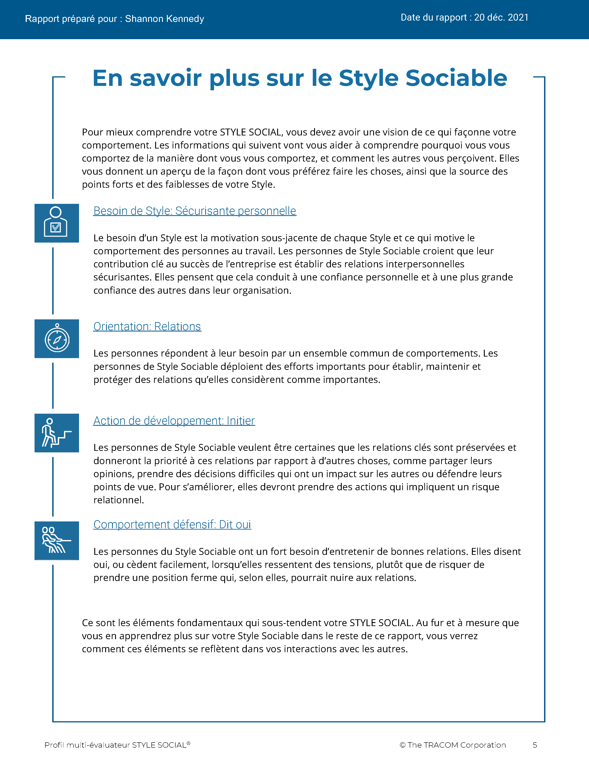
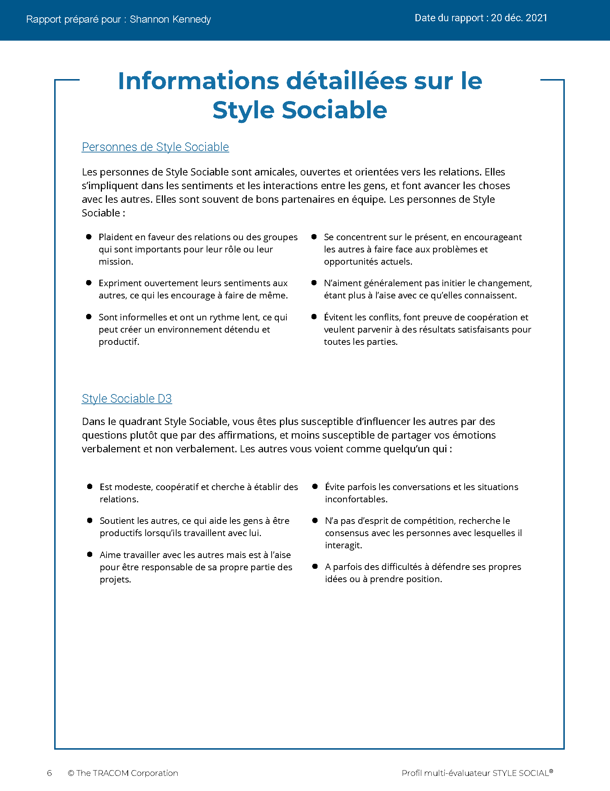
© The TRACOM Corporation. Tous droits réservés.
50
Notes:
Continue reviewing.

Slide 51
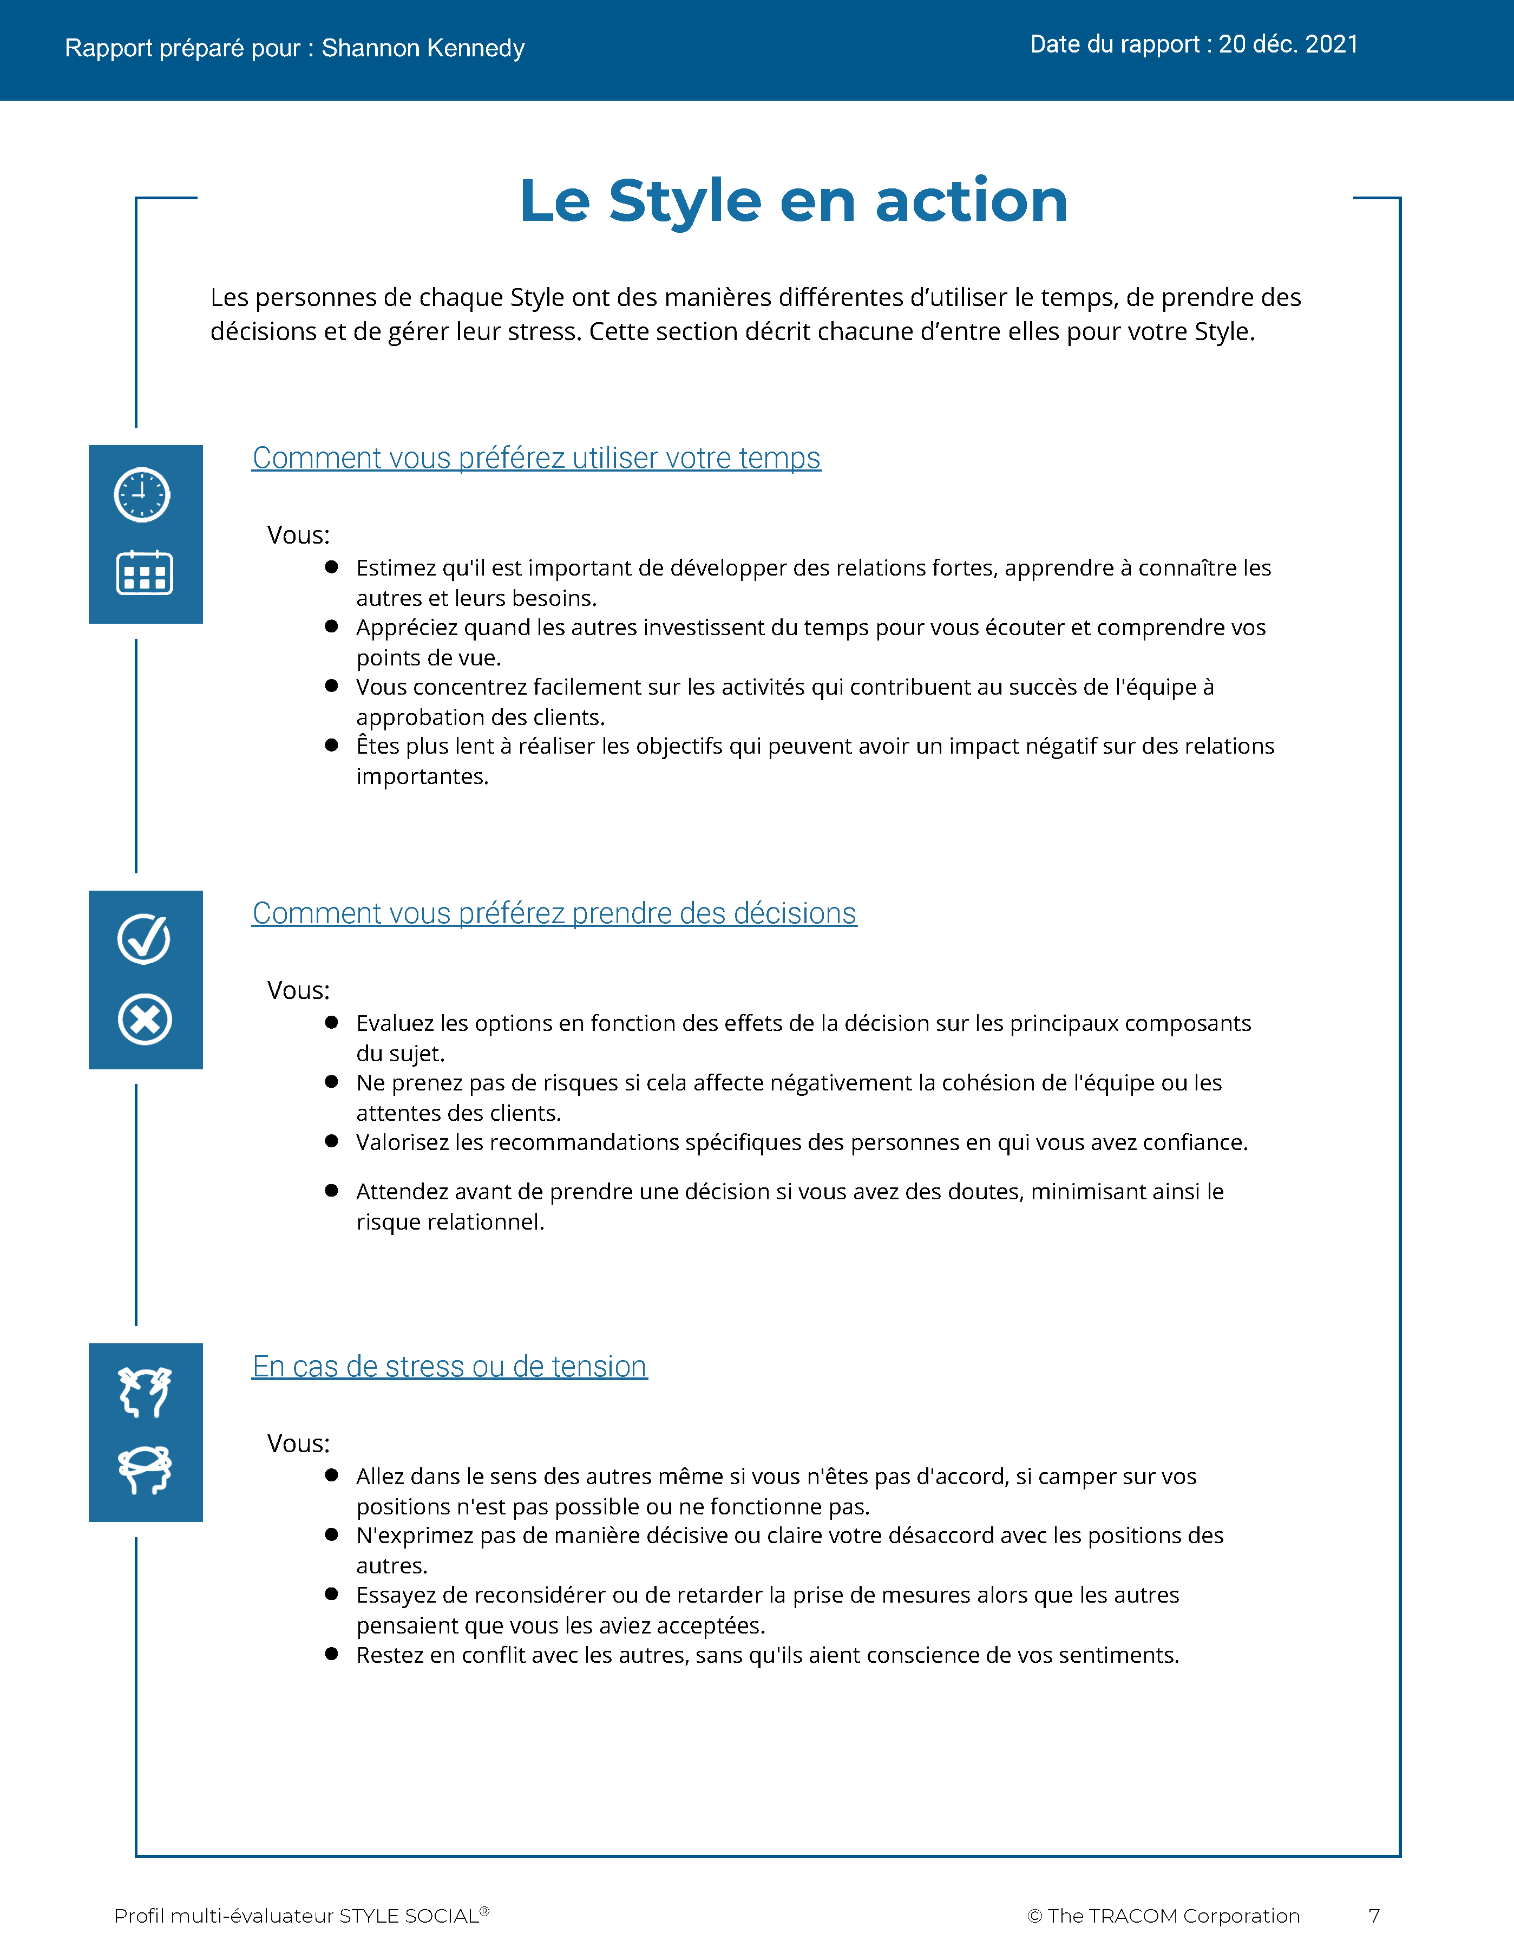
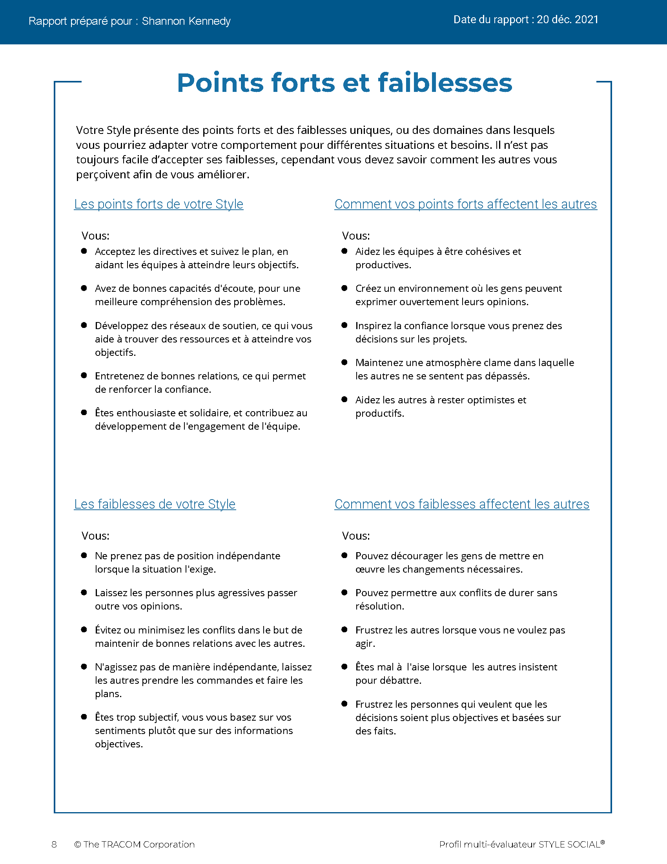
© The TRACOM Corporation. Tous droits réservés.
51
Notes:
Continue reviewing.

Slide 52
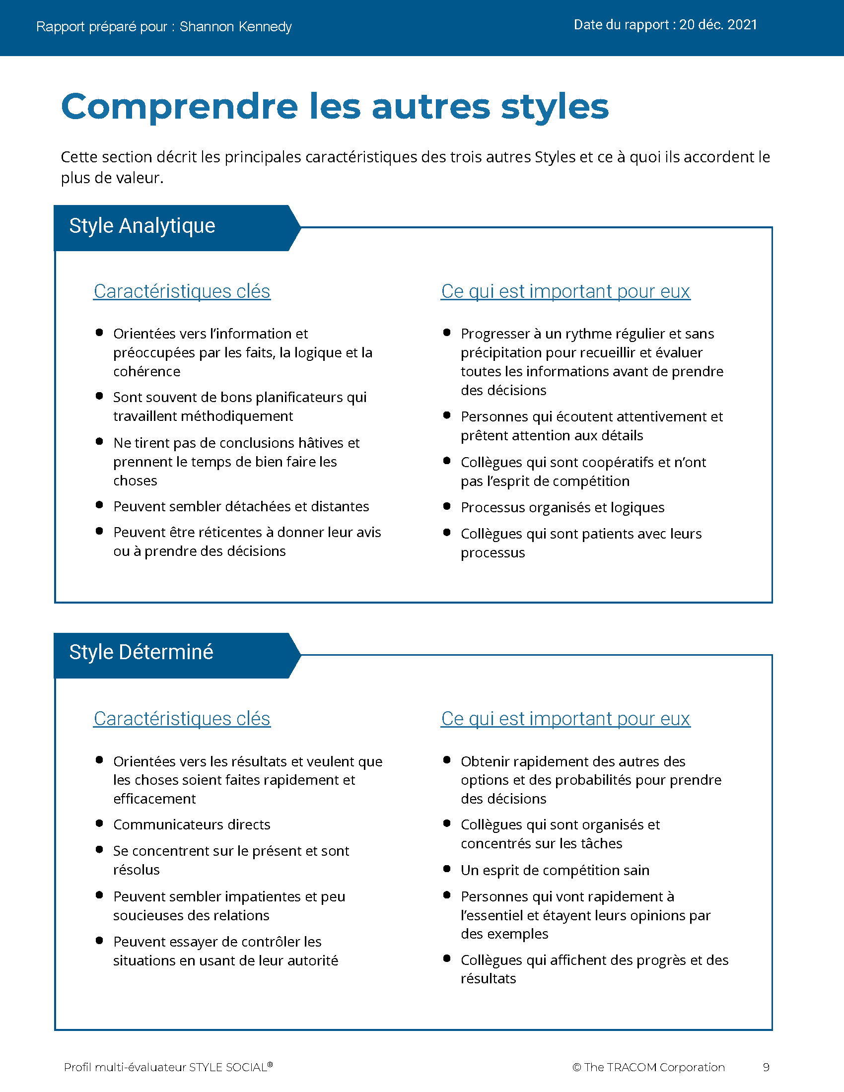
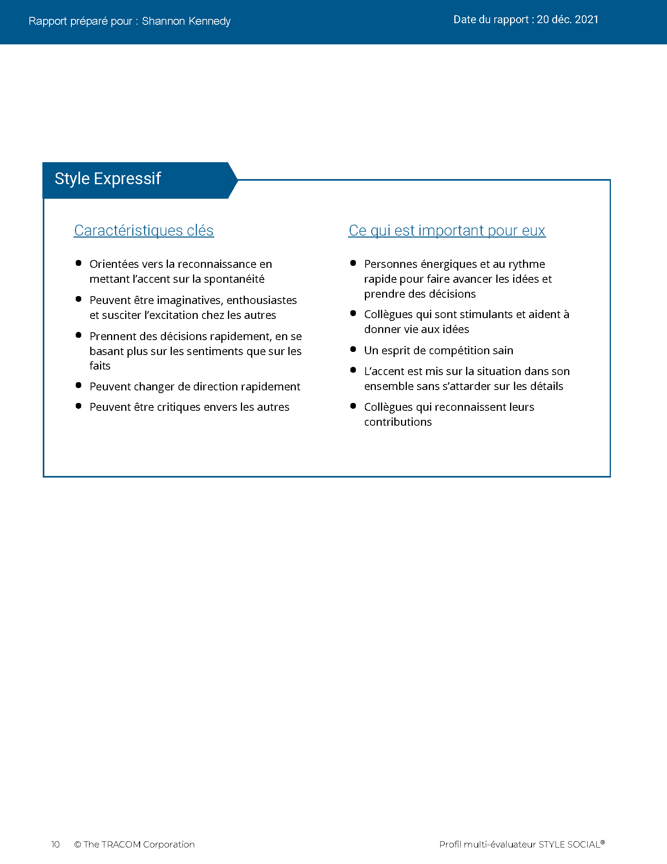
© The TRACOM Corporation. Tous droits réservés.
52
Notes:
Continue reviewing.

Slide 53
Livraison virtuelle : Comment accéder à votre profil
Connectez-vous à tracomlearning.com
Saisissez le nom d’utilisateur et le mot de passe
Téléchargez votre rapport
Notes:
OPTIONAL: FOR VIRTUAL DELIVERY ONLY.
USE THE NEXT TWO SLIDES IF LEARNERS DOWNLOAD THEIR PROFILES DURING THE SESSION.
20 Minutes

Slide 54
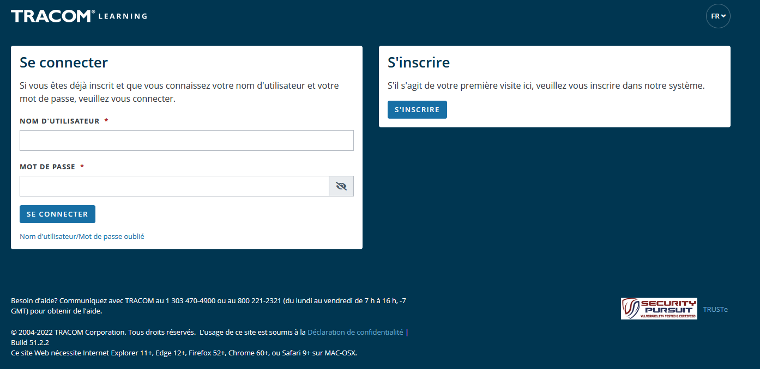
1. Aller sur tracomlearning.com
2. Saisissez votre nom d’utilisateur et votre mot de passe, puis appuyez sur « Login »
Notes:
SAY Login to tracomlearning.com. Use the same username and password as when you completed the assessment (survey).

Slide 55
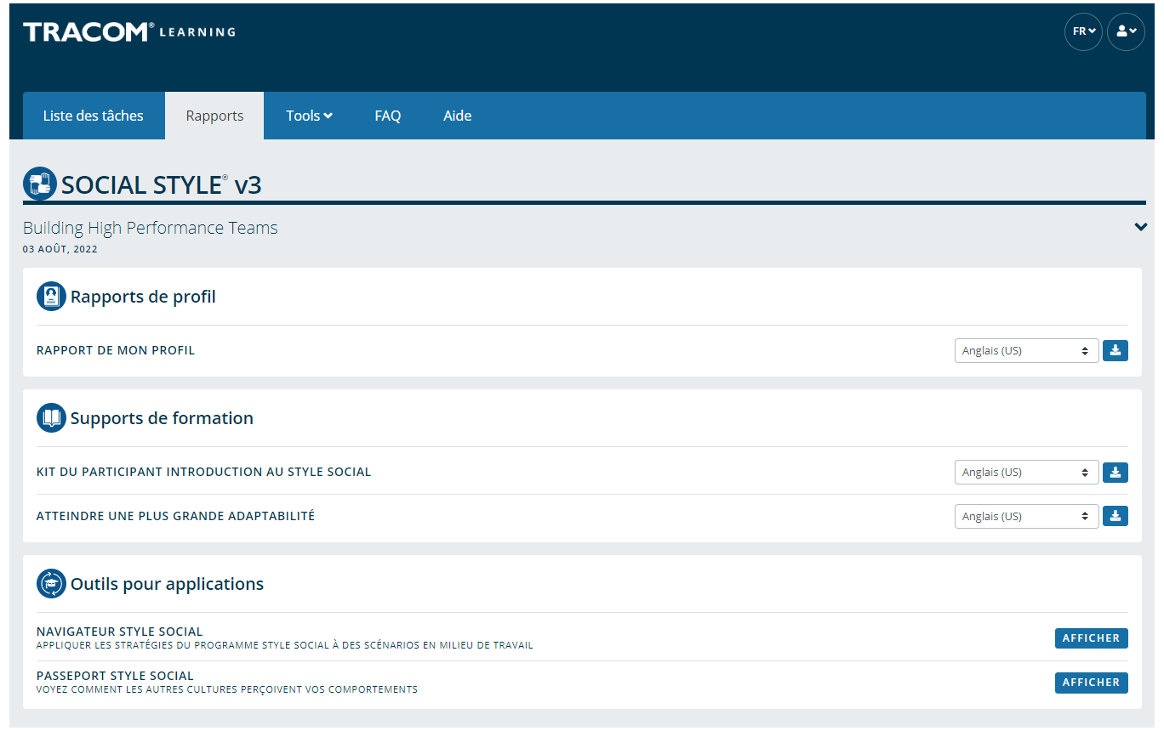
Téléchargez votre profil en accédant à la section « Profile Reports » et en cliquant sur l’icône « Download »
Notes:
SAY Your profile will be listed under “Profile Reports.” Click to download as a pdf.
Note: If the Learner selects the download button and the PDF does not open up (i.e., the screen just flashes), it is an indicator that their pop-up blockers are on. They need to allow pop-ups from tracomlearning.com and click the download button again. The profile report will open in a separate window. They can then save the profile report locally if they wish.

Slide 56
Se connaître et se contrôler
STYLE SOCIAL
Les comportements de Mon Style qui frustrent les clients de ce Style
Une chose que je peux faire pour contrôler le comportement lié à mon Style
Déterminé
Expressif
Sociable
Analytique
Notes:
10 Minutes (Workbook, page 29)
The purpose of this exercise is to help people begin to understand how some of their Style behavior can be challenging for customers and others. A later exercise will require learners to determine specific ways they can increase their Versatility towards people of other Styles.
SAY Each of us has behavior that frustrates others. Write down a brief list of your Style behaviors that frustrate customers of other Styles. Then, determine one specific thing you can do to control this behavior. Use the insights you discovered from your profiles to help.
ASK for volunteers to provide a sample of responses and write them on a flipchart. If delivering virtually, learners can chat some of their responses as a way of engaging the group.
SAY Next you will learn more about your own Versatility.

Slide 57
Techniques d’observation du Style
Ne tirez pas de conclusions hâtives
Restez objectif
Séparez le comportement de Style de la fonction ou de la position de quelqu’un
Une quantité modérée de stress peut clarifier le Style d’une personne
N’intervenez pas (soyez un observateur)
1
2
3
4
5
Notes:
5 Minutes (Workbook, page 29)
SAY The more accurately we are able to observe our customers’ Styles, the better we will be able to adapt our own behavior and “Do something for others” to increase Versatility.
DESCRIBE the best practices:
Don’t jump to conclusions about someone’s Style
Be an objective observer
Separate Style behavior from someone’s role or position
A moderate amount of stress can clarify someone’s Style
Get out of the way (be an observer)
ASK if there are any questions.

Slide 58
Adaptabilité
Notes:
1 Minute
SAY You now have a good understanding of Style. What you learned from your profile is going to be useful during the next section, where we learn about Versatility and how to adjust to the Style needs of others.

Slide 59
L’Adaptabilité est la façon dont vous vous adaptez aux besoins des autres en matière de Style
Notes:
2 Minutes (Workbook, page 30)
SAY Versatility is a measure of your consistency in adjusting to the Style needs of others.
At the beginning of the program, we reviewed some statistics on Versatility. Research has found that Style and Versatility significantly help salespeople’s performance.
Versatility is completely within your control, so it is your choice to be versatile with others. You can be highly versatile with one group and show low Versatility with another group. It depends on the circumstances and how much you value your interpersonal effectiveness with each group.
It is completely independent of SOCIAL STYLE: Any Style can show Versatility and be successful.
Versatility is NOT the same as likeability. A person can be well liked but not have high Versatility. The opposite can also be true. Versatility helps you develop better working relationships, but it is separate from your personal likeability.

Slide 60
Quatre sources d’Adaptabilité
L’utilisation appropriée de
Image
Présentation
Compétence
Feedback
Conduit à
Meilleure Adaptabilité
Notes:
6 Minutes (Workbook, page 31)
Image remains a part of the Versatility model because it’s important for building relationships. Describe Versatility in a timeline:
SAY You show Versatility in four areas.
Image – When you first meet a new person at work, you form an impression about this person based on what you see, consciously or not. Essentially Image is a first impression: Are you dressed appropriately for the situation, for the work culture, for the client, and so on?
Note that Image is not measured as part of your Profile. This is because:
Image is difficult to observe in virtual environments. We can’t observe very well how people are dressed, and because there is a wide variety of dress codes, even within companies and teams, it is less relevant to measure Image in this way.
Raters don’t always like answering questions about people’s Image without understanding the context of how Image is explained in training.
Image is still important for many people and companies, which is why it’s part of the model. However, you won’t receive a measure of your Image.
Presentation – When a person communicates in meetings or other public venues, you’ll notice how clear they are at helping people understand their points. Do they use clear language? Are their examples effective? Do they take others’ Styles into account?
Competence – Over time, you’ll observe this person in a variety of situations. Are they reliable and do they persevere during difficult times? Are they flexible when change happens? Are they optimistic most of the time? Do they show creativity?
Feedback – Finally, this is the most interpersonal part of Versatility. Are they a good listener? Do they show empathy for others’ situations? Do they meet the needs of other people’s Styles? Do they develop good relationships with others?

Slide 61
L’Adaptabilité en action
Qu’est-ce que chaque personne a fait pour agir avec Adaptabilité ?
Quel a été son comportement spécifique ?
Kyle
Lana
AJ
Abby
Notes:
12 Minutes (Workbook, page 32)
SAY We are now going to revisit our video characters in a continuation of their earlier meeting.
ASK participants to take notes in their participant workbooks on page 32 as they watch the video:
What did each person do to act with Versatility?
What were their specific behaviors?
PLAY the video, Part 2.
CONDUCT a debrief of the video, soliciting participants’ responses to the above questions.

Slide 62
Profil d’Adaptabilité
Notes:
1 Minute
SAY Now you will learn about the Versatility Profile and will review your profile. There is a lot of information about Versatility—not only how you’re perceived, but also simple strategies to adjust your behavior and increase Versatility.
This profile is a resource for you. You will use it for the Versatility exercises during the rest of the program.

Slide 63
Adaptabilité
Une mesure de votre constance à vous adapter aux besoins des autres en matière de Style
W | Non constant | X | Assez constant | Y | Habituellement constant | Z | Très constant
Notes:
2 Minutes
SAY We measure Versatility on a scale ranging from W to Z. These are normed quartiles, just like Assertiveness and Responsiveness.
When you aren’t consistent in your behavior, you’re usually focusing on your own Style needs. When you consistently show Versatility, you’re focusing on meeting others’ Style needs.
Your profile will show your results on this scale, ranging from W (not consistent) to Z (very consistent).

Slide 64
La signification des positions d’Adaptabilité
 | 1 | 2 | 3 | 4 | 5
 | Pas du tout d’accord | Pas d’accord | Partiellement d’accord Partiellement en désaccord | D’accord | Tout à fait d’accord
1. Aborde les nouvelles situations avec une attitude positive. | ◯ | ◯ | ◯ | ◯ | ◯
2. Établit de bonnes relations avec ses collègues. | ◯ | ◯ | ◯ | ◯ | ◯
3. Présente efficacement ses idées à des groupes. | ◯ | ◯ | ◯ | ◯ | ◯
W | X Y | Z
Constance
Notes:
3 Minutes
Before delivering Versatility profiles, explain the meaning of the positions.
SAY Before reviewing your results in more detail, let’s put your results into context. This graph shows several sample items that measure Versatility.
You and your raters (if multi-rater) responded to these items using the scale ranging from ’strongly disagree’ to ’strongly agree’. TRACOM assigns values to each of these scale points: 1 to 5.
When rating Versatility, most people respond at the higher end of the rating scale. This makes sense since most people have at least some abilities in these areas. This means that the cutoff for achieving Z Versatility is very high, approximately 4.5 or higher.
Similarly, to score either an X or Y requires scores between 3.5 and 4.5. These are approximate values used for purposes of explanation.
Importantly, if you receive a W in any area of Versatility, this DOES NOT mean that your raters (if multi-rater) or yourself evaluated you at the low end of the rating scale. On the contrary, almost nobody scores at the lowest end – 1 or 2. For people with a W result, most of their ratings fluctuate between 2 and 4, resulting in an average score of slightly less than 3.5.
So, putting this into context, a W rating means that you are not showing as much consistency in these behaviors as you could. With effort and more consistency, your evaluation would improve.
Set the context:
W does not mean that you lack ability.
It doesn’t mean that your raters (if Multi-rater) evaluated you at the lowest end of the rating scale.
It doesn’t mean they don’t like you or don’t think you’re effective (if multi-rater)
It does mean that you’re not highly consistent in your behavior; you do these things some of the time but could do them more often.
It does mean that your raters (if multi-rater) evaluated you between ’disagree’ and ’agree’, on average.
Note that these cutoff values (3.5 and 4.5) are only for demonstration – they aren’t the exact values in TRACOM’s norms, but they are close.
Giving the context is critical because it helps to ease people’s automatic reactions to the profile.
Then:
Help people focus on just one area to improve. This increases chances of success.
What is ’low hanging fruit?’ Something they can improve quickly.

Slide 65
Adaptabilité globale
Votre constance dans votre comportement d’Adaptabilité
W | Non constant | X | Assez constant | Y | Habituellement constant | Z | Très constant
 |  | AUTRES |  | SOI
Notes:
2 Minutes
SAY Overall Versatility is a combination of your results in three areas: Presentation, Competence, and Feedback.
The “Others” position is the average of your raters’ evaluations. The “Self” position is where you evaluated yourself.
Like Assertiveness and Responsiveness, Versatility is normed in quartiles: W, X, Y, and Z.
Versatility is all about consistency of behavior.
A lower Versatility score does NOT mean you lack ability or that you never demonstrate these abilities.
What it DOES mean is that you aren’t showing consistency in your behavior.
By making small changes to your behavior and acting with more consistency, you can increase your Versatility. (Recall that the difference in values between W and Z are small but meaningful.)

Slide 66
L’Adaptabilité en détail
Présentation : X
W | Non constant | X | Assez constant | Y | Habituellement constant | Z | Très constant
 |  | AUTRES |  |  |  | SOI
Votre constance dans votre comportement d’Adaptabilité
Compétence : Y
W | Non constant | X | Assez constant | Y | Habituellement constant | Z | Très constant
 |  |  |  | AUTRES |  | SOI
Feedback : X
W | Non constant | X | Assez constant | Y | Habituellement constant | Z | Très constant
 |  | AUTRES |  | SOI
Notes:
2 Minutes
Each source of Versatility is explained the same as Overall Versatility – it is a measure of consistency of behavior.
Remember that Image is not measured because:
Image is difficult to observe in virtual environments. We can’t see very well how people are dressed, and because there is a wide variety of dress codes, even within companies and teams, it is less relevant to measure Image in this way.
Raters don’t always like answering questions about people’s Image without understanding the context of how Image is explained in training.
Image is still important for many people and companies, which is why it’s part of the Model. However, you won’t receive a measure of your Image.
Presentation – When a person communicates in meetings or other public venues, you’ll notice how clear they are at helping people understand their points. Do they use clear language? Are their examples effective? Do they take others’ Styles into account?
Competence – Over time, you’ll observe this person in a variety of situations. Are they reliable and do they persevere during difficult times? Are they flexible when change happens? Are they optimistic most of the time? Do they show creativity?
Feedback – Finally, this is the most interpersonal part of Versatility. Are they a good listener? Do they show empathy for others’ situations? Do they meet the needs of other people’s Styles? Do they develop good relationships with others?

Slide 67
© The TRACOM Corporation. Tous droits réservés.
67
Notes:
20 Minutes
Review the Profile pages so participants understand the layout of the Profile. After you’ve reviewed the profile, distribute individuals’ profiles.
PROVIDE ample time for participants to read and absorb their reports. Do not continue until it is evident that all participants have finished reading their reports.
ASK if there are any questions, surprises, or concerns.
ASK If your self-perception results were different, what might have caused the difference in views?
NOTE: It is recommended that you take a break here and make yourself available for one-on-one conversations as participants may have questions or concerns they do not want to discuss with the entire class.

Slide 68
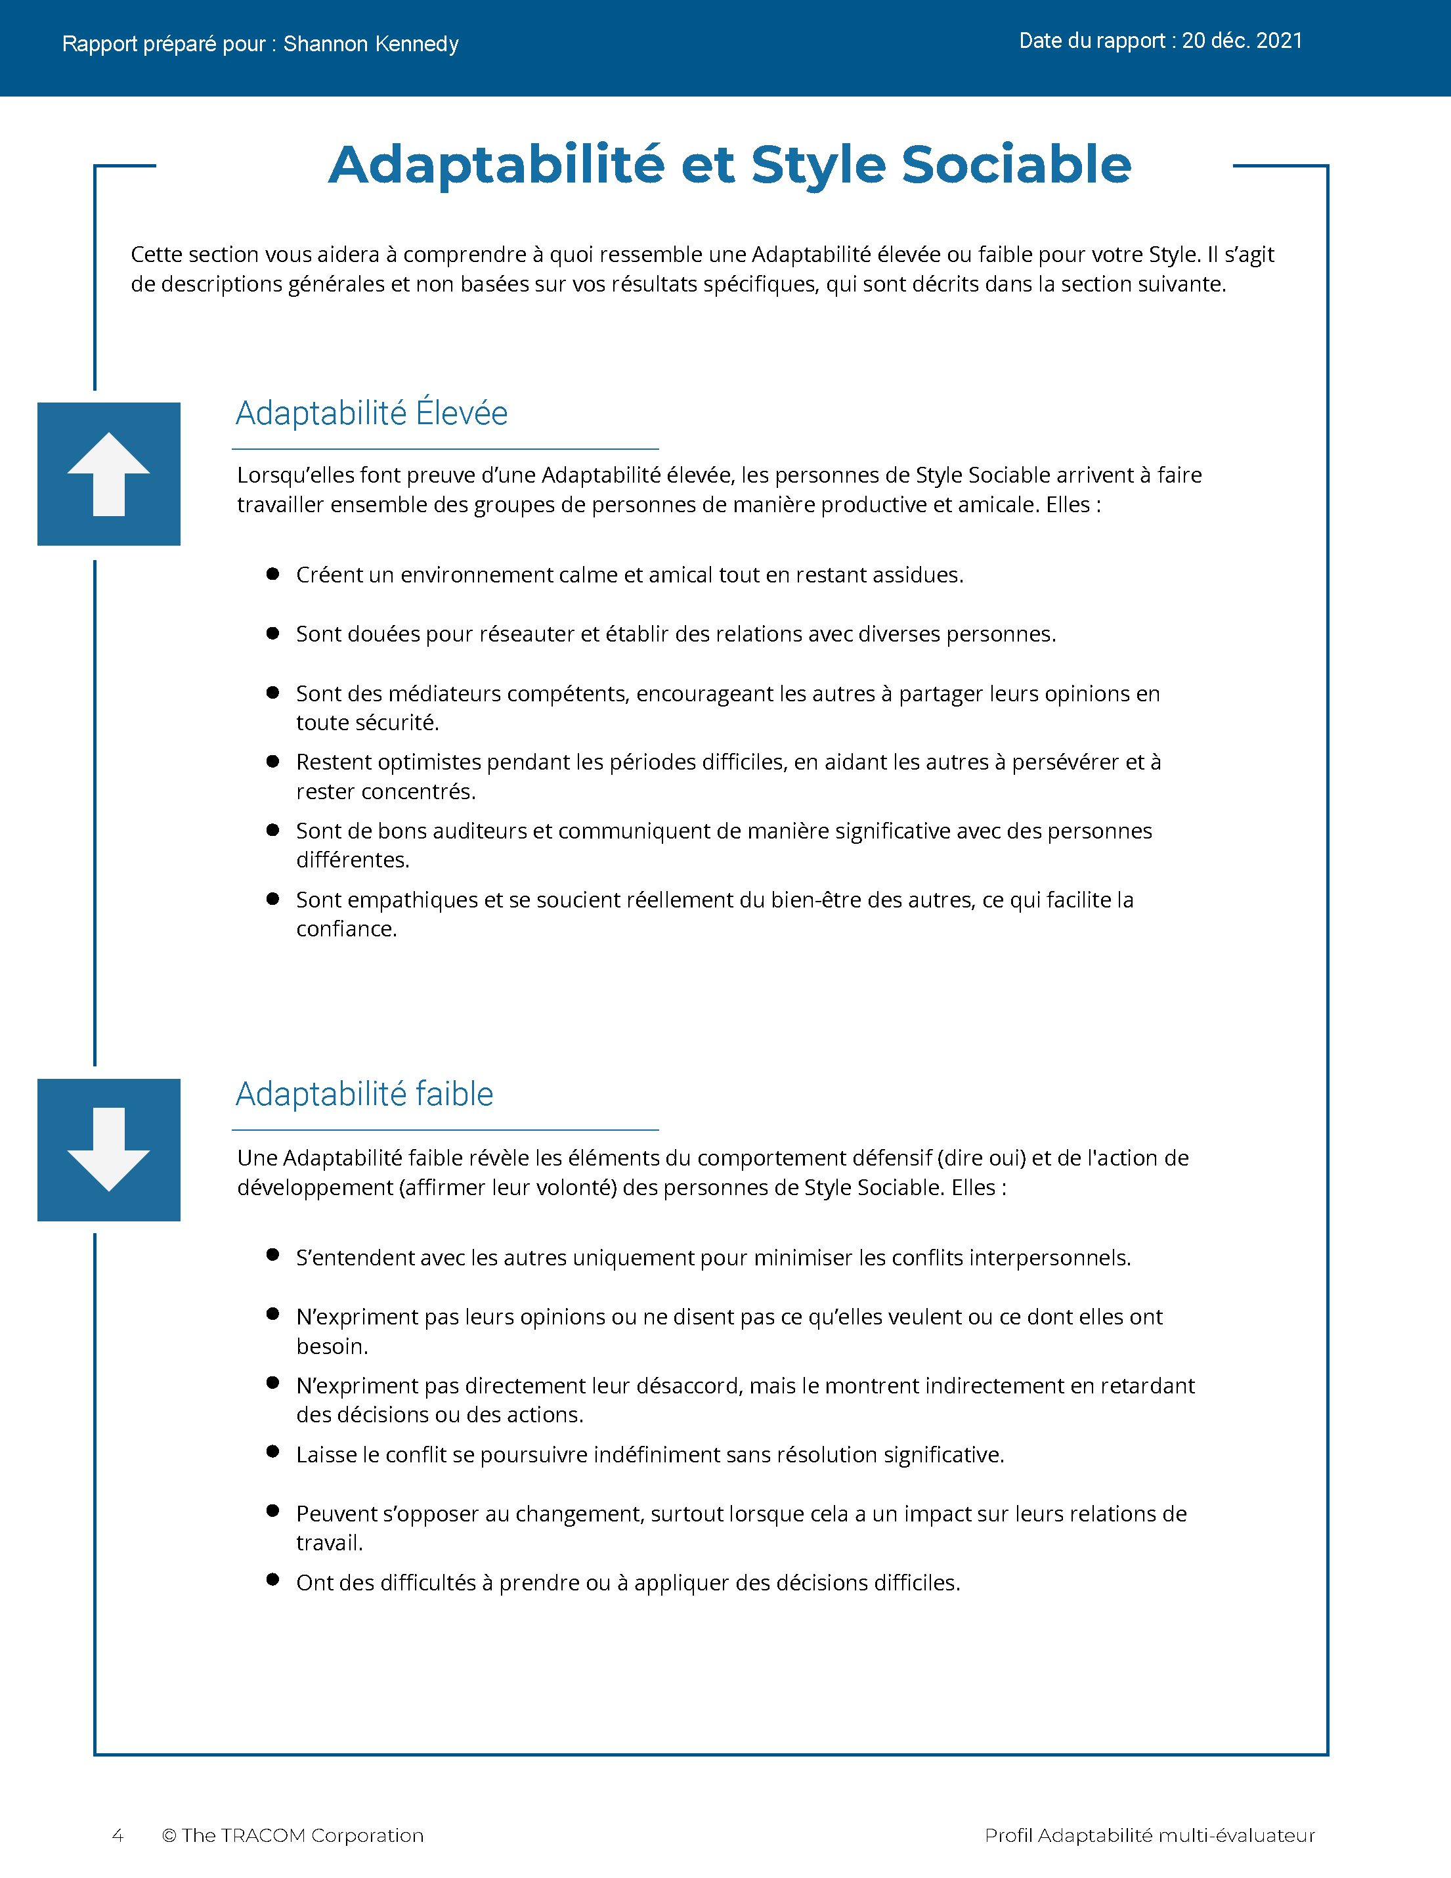
© The TRACOM Corporation. Tous droits réservés.
68
Notes:
Continue reviewing.

Slide 69
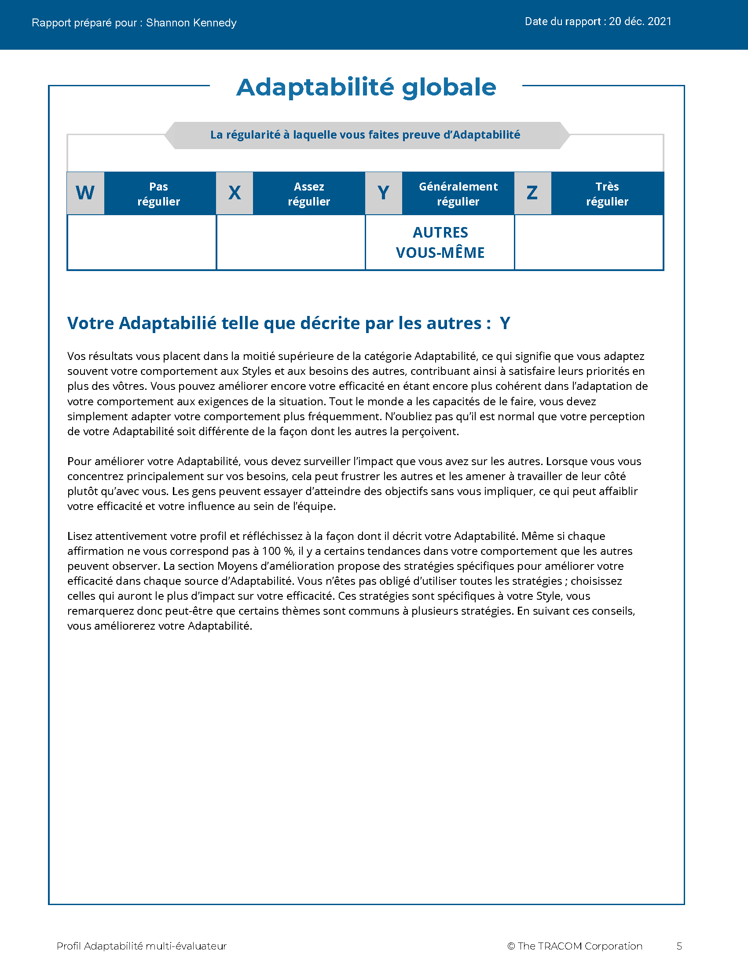
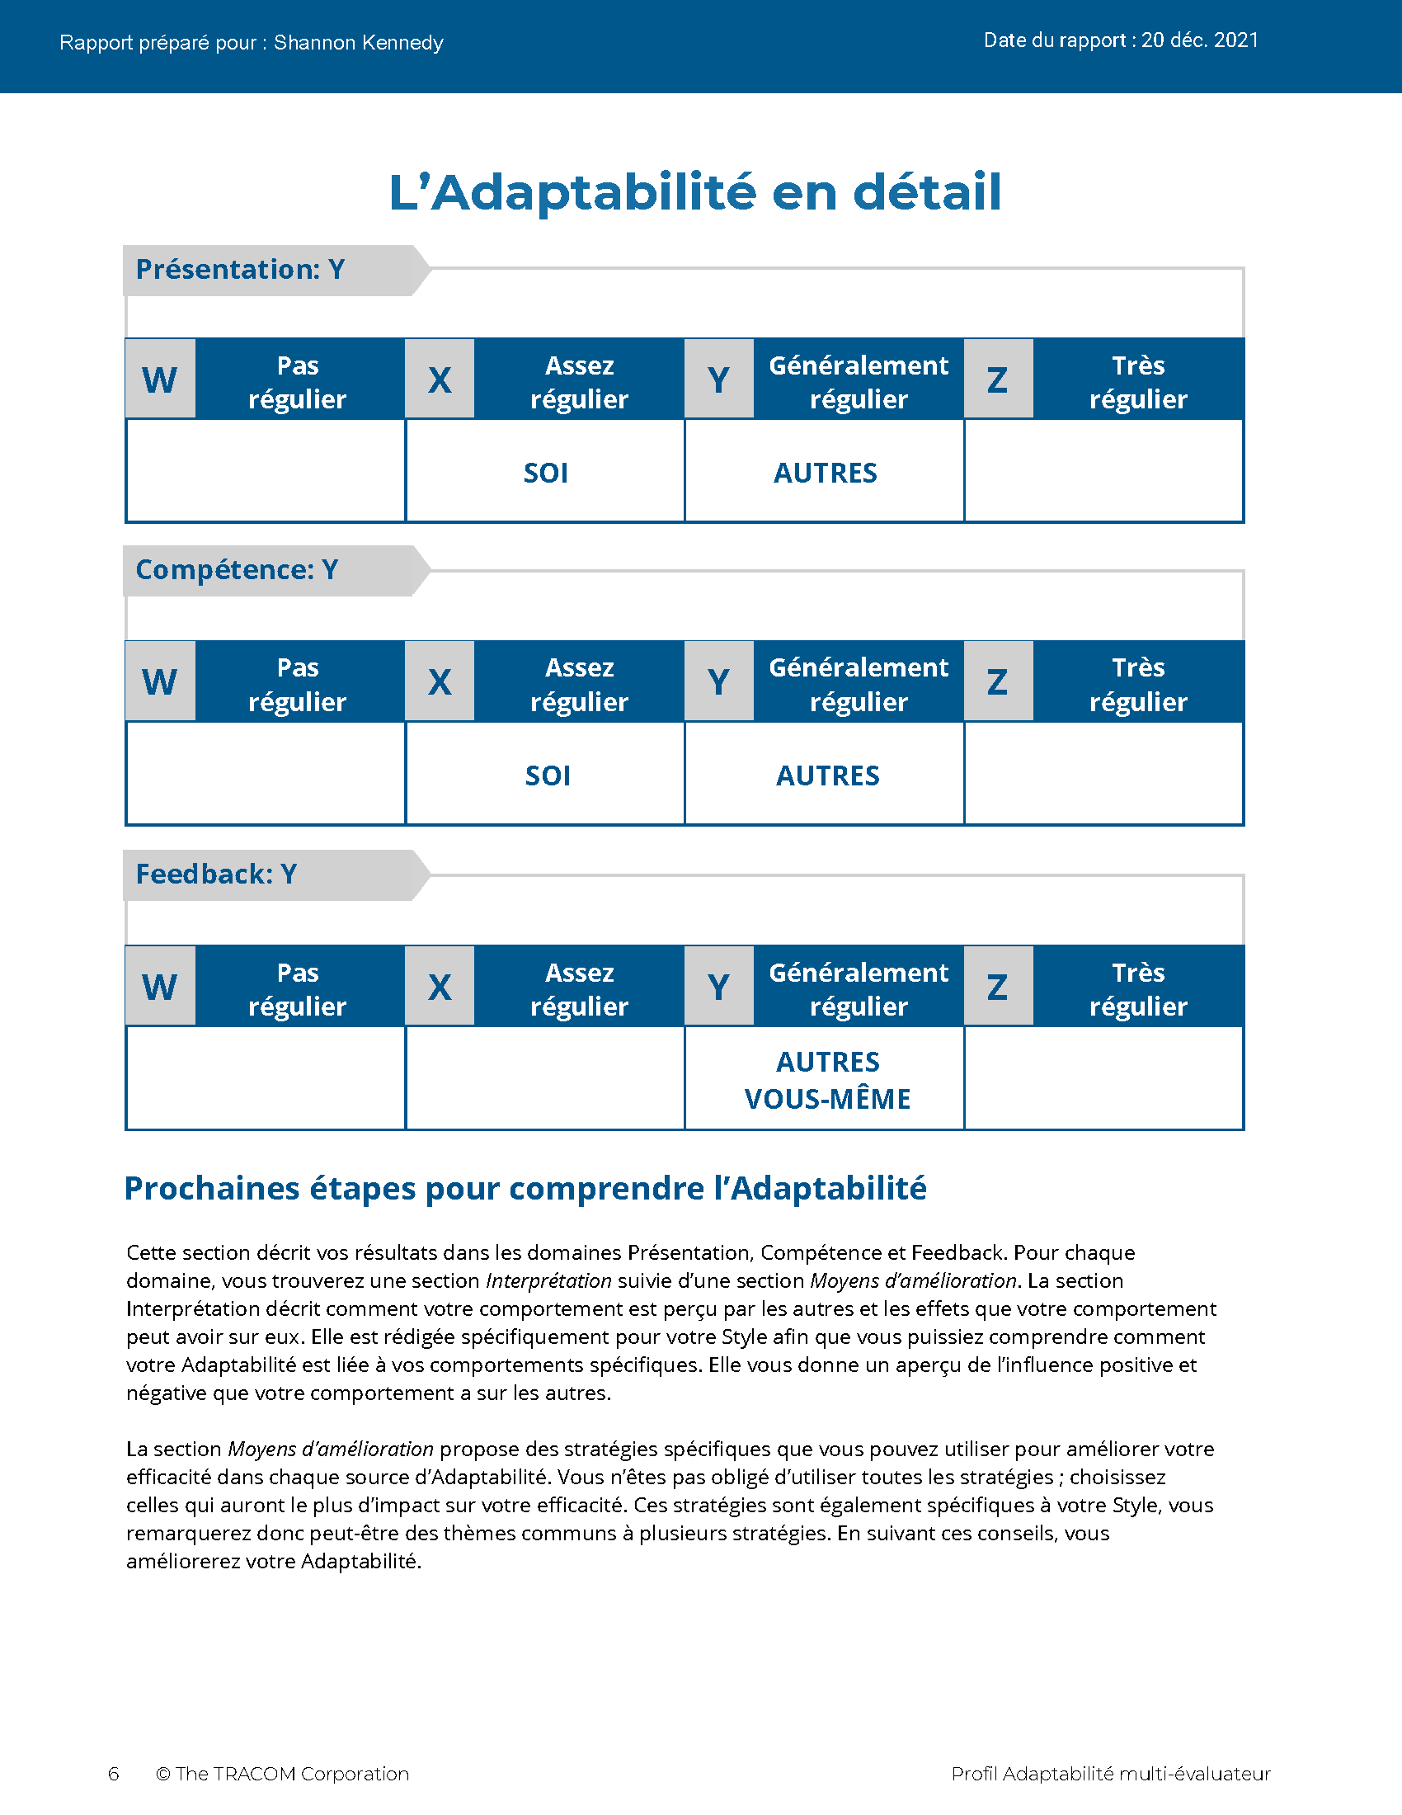
© The TRACOM Corporation. Tous droits réservés.
69
Notes:
Continue reviewing.

Slide 70
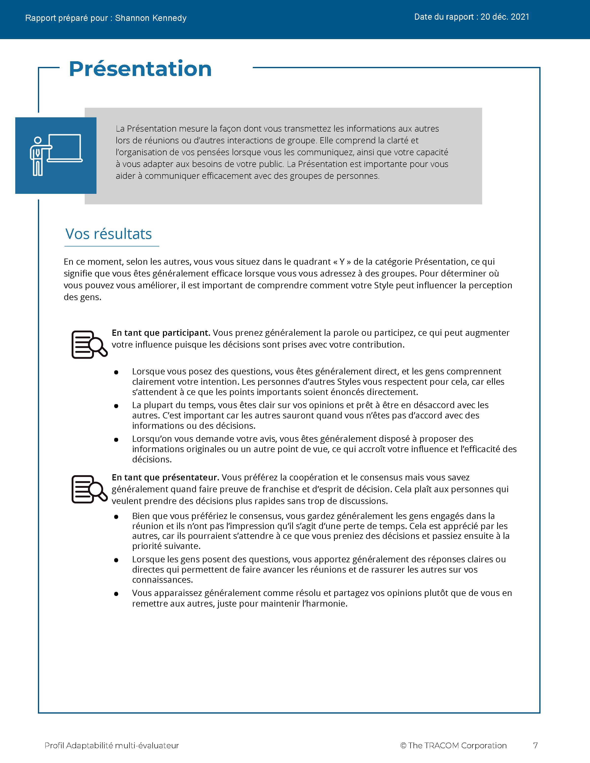
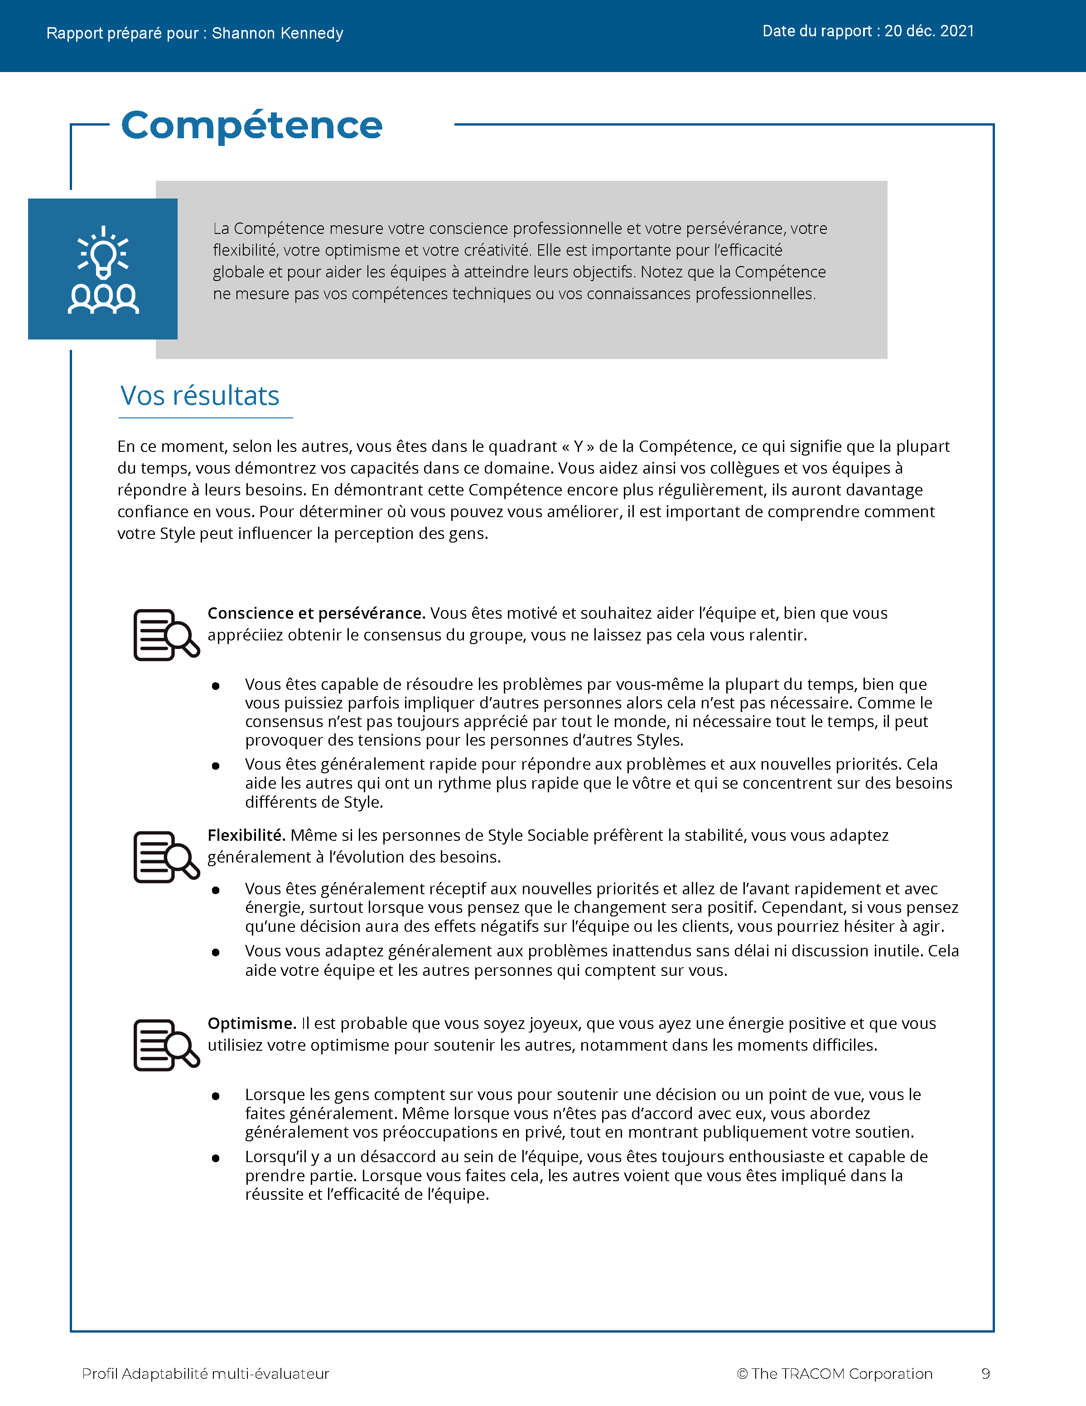
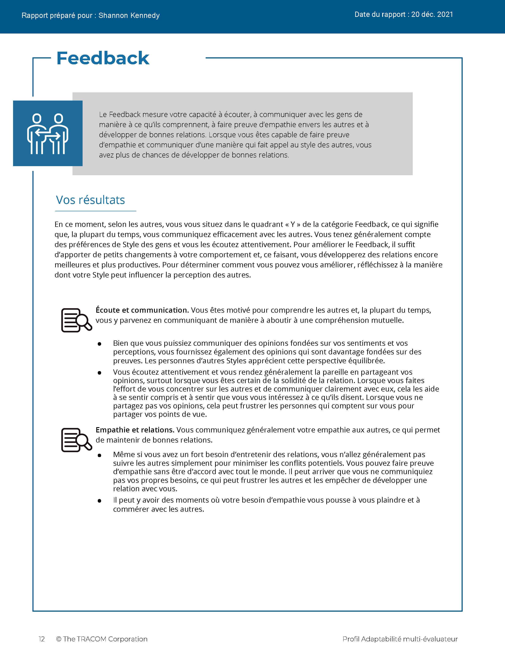
© The TRACOM Corporation. Tous droits réservés.
70
Notes:
Continue reviewing.

Slide 71
Étapes pour accroître l’efficacité interpersonnelle
Faire quelque chose pour les autres
Se contrôler
Reconnaître votre impact sur les autres
Gérez votre propre comportement
Observer objectivement les autres
Aider à répondre aux besoins des autres en matière de Style
Se connaître soi-même
Connaître les autres
Notes:
5 Minutes (Workbook, page 33)
SAY At the beginning of the program, we talked about the four steps for increasing interpersonal effectiveness. Now that you’ve reviewed your Versatility profiles, let’s review these again as we think about ways to adjust behavior to increase Versatility.
REVIEW the four steps for increasing interpersonal effectiveness:
1. Know Yourself by recognizing the impact your Style has on others.
2. Control Yourself by managing your own Style behavior and being tolerant of others’ Styles.
3. Know Others by observing them more objectively.
4. Do Something For Others by helping them meet their Style needs. This eases their tension and opens the door for them to act with Versatility towards you.
SAY To finish the program, we’re going to focus on Doing Something for Others. You’re going to create an action plan to increase Versatility with your customers. First, we’ll review some strategies for showing Versatility towards each Style. This will give you important information for creating your action plan.

Slide 72
Préparer les réunions
Contrôle
Analytique
FAIRE
Partagez l’ordre du jour à l’avance
Vérifiez que les détails de la réunion sont suffisants
Soyez bien préparés
NE PAS FAIRE
S’attendre à beaucoup de conversations
Se concentrer sur les relations personnelles
Ne pas tenir compte de leur contribution
Déterminé
FAIRE
Indiquez les résultats attendus
Obtenez leur approbation de l’ordre du jour
Permettez-leur de contrôler les détails de la réunion
NE PAS FAIRE
Commencer tard
Être désorganisé
Bloquer inutilement les décisions
Demande
Affirme
Sociable
FAIRE
Créez ensemble l’ordre du jour
Soyez le premier à socialiser
Entrez avec la caméra et le micro activés
NE PAS FAIRE
Supposer que les personnes sont intéressées parce qu’elles ont accepté la rencontre
Passer directement au travail dans les communications
Impliquer d’autres personnes sans les informer au préalable
Expressif
FAIRE
Demandez-leur leur avis sur l’ordre du jour
Accueillez-les immédiatement
Amusez-vous
NE PAS FAIRE
Fournir trop de détails à l’avance
Récapituler le passé en détail
Structurer la réunion de manière trop stricte
Montre
Notes:
6 Minutes (Workbook, page 34)
SAY Part of showing Versatility is recognizing customers’ needs and preparing ahead of time. Here are some meeting strategies for each Style.
CLICK TO REVEAL THE TEXT IN EACH QUADRANT.
REVIEW the do’s and don’ts when preparing for meetings.

Slide 73
Adaptation des messages
Contrôle
Analytique
Voici ce que nous avons fait jusqu’à présent, sur la base des informations...
Nous émettons ces hypothèses...
Voici les risques que nous voyons...
Sur cette base, nous recommandons...
Déterminé
Nous produirons les résultats que vous recherchez.
Nous disposons d’une équipe de spécialistes expérimentés.
Notre équipe produira des gains rapides pour vous.
Nous pouvons commencer immédiatement.
Demande
Affirme
Sociable
Voici ce qui restera inchangé et ce qui changera.
Nous l’avons déjà fait à plusieurs reprises.
Voici une liste de personnes de référence que vous pouvez appeler.
Nous nous engageons à travailler en collaboration.
Expressif
Nous sommes ravis de vous aider à concrétiser votre vision !
Vous serez le leader mondial lorsque ce projet sera terminé !
Ce sera un grand pas en avant pour vous et votre organisation !
Les cadres supérieurs soutiennent totalement ce processus !
Montre
Notes:
6 Minutes (Workbook, page 35)
SAY Most of us fall into the habit of communicating with people in ways that are comfortable for us, without thinking of the needs of the customer. This is often because we’re rushed and send out quick emails. Communicating in Style-specific ways is very important for meeting your customers’ needs. Here are some simple strategies for tailoring your messages to each Style.
CLICK TO REVEAL THE TEXT IN EACH QUADRANT.
REVIEW the techniques for tailoring messages to each Style.

Slide 74
Utiliser l’Adaptabilité pour gagner la confiance
Contrôle
Analytique
Prouvez que vous êtes capable
Montrez la logique des propositions
Concentrez-vous sur la qualité
Préparez-vous à l’avance et connaissez leur organisation
Communiquez les avantages et les inconvénients
Laissez la relation personnelle se développer ; ne soyez pas insistant
Déterminé
Montrez que vous avez confiance en vos capacités
Informez-les si les exigences ne peuvent être satisfaites
Soyez franc
Suivez le rythme rapide
Communiquez votre compréhension des résultats qu’ils souhaitent obtenir
Soyez efficace avec le temps dont ils disposent
Demande
Affirme
Sociable
Partagez des informations personnelles, selon le cas
Soyez authentique et sincère
Montrez votre engagement à les aider
Faites preuve d’empathie à l’égard de leurs besoins
Évitez toute pression inutile
Souvenez-vous du nom de leurs principales relations
Expressif
Adoptez une approche décontractée et ouverte
Ne dissimulez pas inutilement vos sentiments
Évitez de les mettre à l’épreuve ou d’être en compétition avec eux
Montrez de l’enthousiasme pour leurs idées et leurs points de vue
Accordez-leur toute votre attention
Parler de sujets non professionnels
Montre
Notes:
8 Minutes (Workbook, page 36)
ASK Given a customer’s Style need, what are some ways to earn trust?
FACILITATE a discussion of each Style before revealing the text.
ASK What are some ways to earn trust from people of each Style? Think about their Style needs—what do they value from salespeople?
CLICK TO REVEAL THE TEXT IN EACH QUADRANT.

Slide 75
Plan d’action en faveur de l’Adaptabilité
Élaborez un plan d’action pour accroître votre Adaptabilité auprès des clients.
Instructions
Considérez le Style du client que vous avez identifié.
Comment votre Style peut-il faire obstacle à une meilleure relation ? (Pensez à l’action de croissance relative à votre Style)
Quelles actions allez-vous entreprendre pour augmenter l’Adaptabilité avec ce client ?
Dans vos groupes de discussion, discutez de votre plan et obtenez le feedback du groupe.
75
Notes:
30 Minutes (Workbook, page 37)
SAY Use the insights you’ve learned and create a specific plan for yourself. Writing down your intentions is a proven way of making sure you actually do something. Decide on just one or two things you can do differently.
Remember your Style growth actions, since managing your own Style behavior is an important part of being versatile.
REVIEW the Style growth actions:
Driving: to listen
Expressive: to check
Amiable: to initiate
Analytical: to declare
SAY When you’ve finished this, we will put you in small breakout groups to share your insights and give feedback to one another.
CREATE breakout groups of 2 to 3 people.

Slide 76
Observer l’Adaptabilité virtuellement
Notes:
10 Minutes (whole section on Observing Versatility Virtually)
SAY Briefly, before we finish—remember those text messages we reviewed earlier? Let’s bring Versatility into those conversations.

Slide 77
Je reviens vers vous pour savoir si vous avez eu l’occasion de voir la vidéo que j’ai envoyée sur nos dernières mises à niveau technologiques. Qu’en pensez-vous ?
Notes:
SAY We had four responses to this message. Let’s look at how the person who sent this message might respond to each of these individuals. Is the person showing Versatility in each message?

Slide 78
Bonjour ! Il y a beaucoup de changements qui arrivent rapidement. Mon équipe aura besoin d’une formation sur les nouvelles fonctionnalités. Pouvez-vous nous aider ?
On dirait que cela fait beaucoup de changements, mais ces mises à niveau aideront votre équipe à mieux collaborer. Je travaillerai sur un plan de formation de votre équipe et je serai disponible en cas de problème. Je suis là pour vous et pour l’équipe !
Notes:
SAY This message came from the Amiable Style customer.
Click to reveal.
SAY And here is the response. What do you think? Is the salesperson showing Versatility toward the Amiable Style person? What would you add or change to the response?
NOTE: The salesperson is making an effort to meet the person’s Style needs by reassuring them about the changes. The salesperson offers to help the customer by developing a training plan, then reassures them that they will be supported.

Slide 79
C’est excitant ! J’ai jeté un coup d’œil rapide et les nouvelles fonctionnalités semblent fantastiques !
Je vous appelle la semaine prochaine !
Ouais, les mises à jour devraient fonctionner assez bien. On se parle plus tard.
Notes:
SAY This message came from the Expressive Style person.
Click to reveal.
SAY And here is the response. What do you think? Is the salesperson showing Versatility toward the Expressive Style customer?
Is the response focused on their own needs, or the Expressive Style person’s needs? What would be a more effective response?
NOTE: The salesperson is diminishing the customer’s enthusiasm. A more effective response would be to reflect the enthusiasm by reiterating how great the new upgrades are and how excited the salesperson is about the changes, then offer to set up a call with the customer.

Slide 80
Je pense que les nouvelles mises à jour nous aideront à être plus efficaces et à économiser des efforts. Cependant, avant d’adapter la nouvelle version, nous devons prévoir la formation de mon équipe. Avez-vous mis en place un processus à cet effet ?
Nous avons testé les mises à niveau et elles montrent une amélioration significative des performances. Je vous enverrai ces données, ainsi qu’un programme de formation et les dates disponibles. Faites-moi savoir si je peux vous aider d’une quelconque autre manière.
Notes:
SAY This message came from the Analytical Style customer.
Click to reveal.
SAY And here is the response. What do you think? Is the salesperson showing Versatility toward the Analytical Style person? What would you add or change to the response?
NOTE: The salesperson is making an effort to meet the customer’s Analytical Style needs by recognizing their need to prepare ahead of time by getting training. The salesperson offers to send more detailed information about the upgrades as an effort to give the customer more information and alleviate any remaining concerns. They also open the conversation to more input by offering to help in any other way.

Slide 81
Ça a l’air bien. Je vous appellerai quand je serai prêt pour la mise en œuvre.
OK.
Notes:
SAY This message came from the Driving Style customer.
Click to reveal.
SAY And here is the response. What do you think? Is the salesperson showing Versatility toward the Driving Style customer?
Is the response focused on their own needs, or the Driving Style person’s needs? What would be a more effective response?
NOTE: Though Driving Style people appreciate brevity, the salesperson is dismissive and is missing important elements of the customer’s Style. The salesperson should recognize that the customer probably hasn’t reviewed the upgrades in detail. The salesperson should state that they are there to help move forward, and also offer options to meet with the customer to discuss the changes and listen to their input.

Slide 82
Étapes suivantes
Pratiquez l’Adaptabilité ! Conservez votre plan d’action à proximité pour pouvoir le consulter.
Le Navigateur de STYLE SOCIAL propose des conseils sur de nombreuses situations de vente, ainsi que des ressources supplémentaires.
Le Passeport de STYLE SOCIAL vous permet de voir quel serait votre profil dans un autre pays.
Notes:
5 Minutes (Workbook, page 38)
SHARE key “takeaways” with the class:
The key to more effective performance is to practice what you’ve learned. Keep your Versatility Action Plan nearby as a reminder. As you begin to experience positive results, this will reinforce your commitment to practice Versatility.
There are additional resources that will help you. TRACOM’s SOCIAL STYLE Navigator contains advice for working with customers in a variety of situations, such as giving presentations, advancing the sale, and having difficult conversations. You can access this resource by logging in at tracomlearning.com.
NOTE the following slides describe SOCIAL STYLE Navigator in more detail.

Slide 83
Navigateur de STYLE SOCIAL®
Estimateur de STYLE SOCIAL Une brève enquête qui permet d’estimer le Style des autres
Conseiller de STYLE SOCIAL
Préparation des réunions, des négociations, des présentations
Meilleures pratiques de Style et Adaptabilité pour de nombreuses situations
Modules d’eLearning Appliquez les concepts de Style aux équipes, à la gestion des conflits et au coaching
Navigateur de STYLE SOCIAL® est une marque déposée de la TRACOM Corporation
Notes:
1 Minute
SAY You now have free and unlimited access to SOCIAL STYLE Navigator, the on-demand micro-learning tool that helps you apply Style and Versatility.
SOCIAL STYLE Navigator includes:
SOCIAL STYLE Estimator
The Estimator survey provides users with an interactive tool that evaluates observable behavior in others to determine their Style and helps you plan ahead for successful interactions.
SOCIAL STYLE Advisor
Use Advisor topics to prepare “just-in-time” for meetings, negotiations or sales presentations with advice on navigating Style and Versatility best practices to maximize high-performing relationships.
eLearning modules
Continue your learning journey via micro-learning that reinforces ways to apply SOCIAL STYLE and Versatility to Working in Teams, Coaching and Managing Conflict.

Slide 84
Accès au Navigateur de STYLE SOCIAL®
Disponible sur tracomlearning.com
Notes:
1 Minute
SAY Available through www.tracomlearning.com
Enter your username and password for free, unlimited access to SOCIAL STYLE Navigator®

Slide 85
© The TRACOM Corporation. Tous droits réservés.
Notes:
Optional demonstration, time permitting

Slide 86
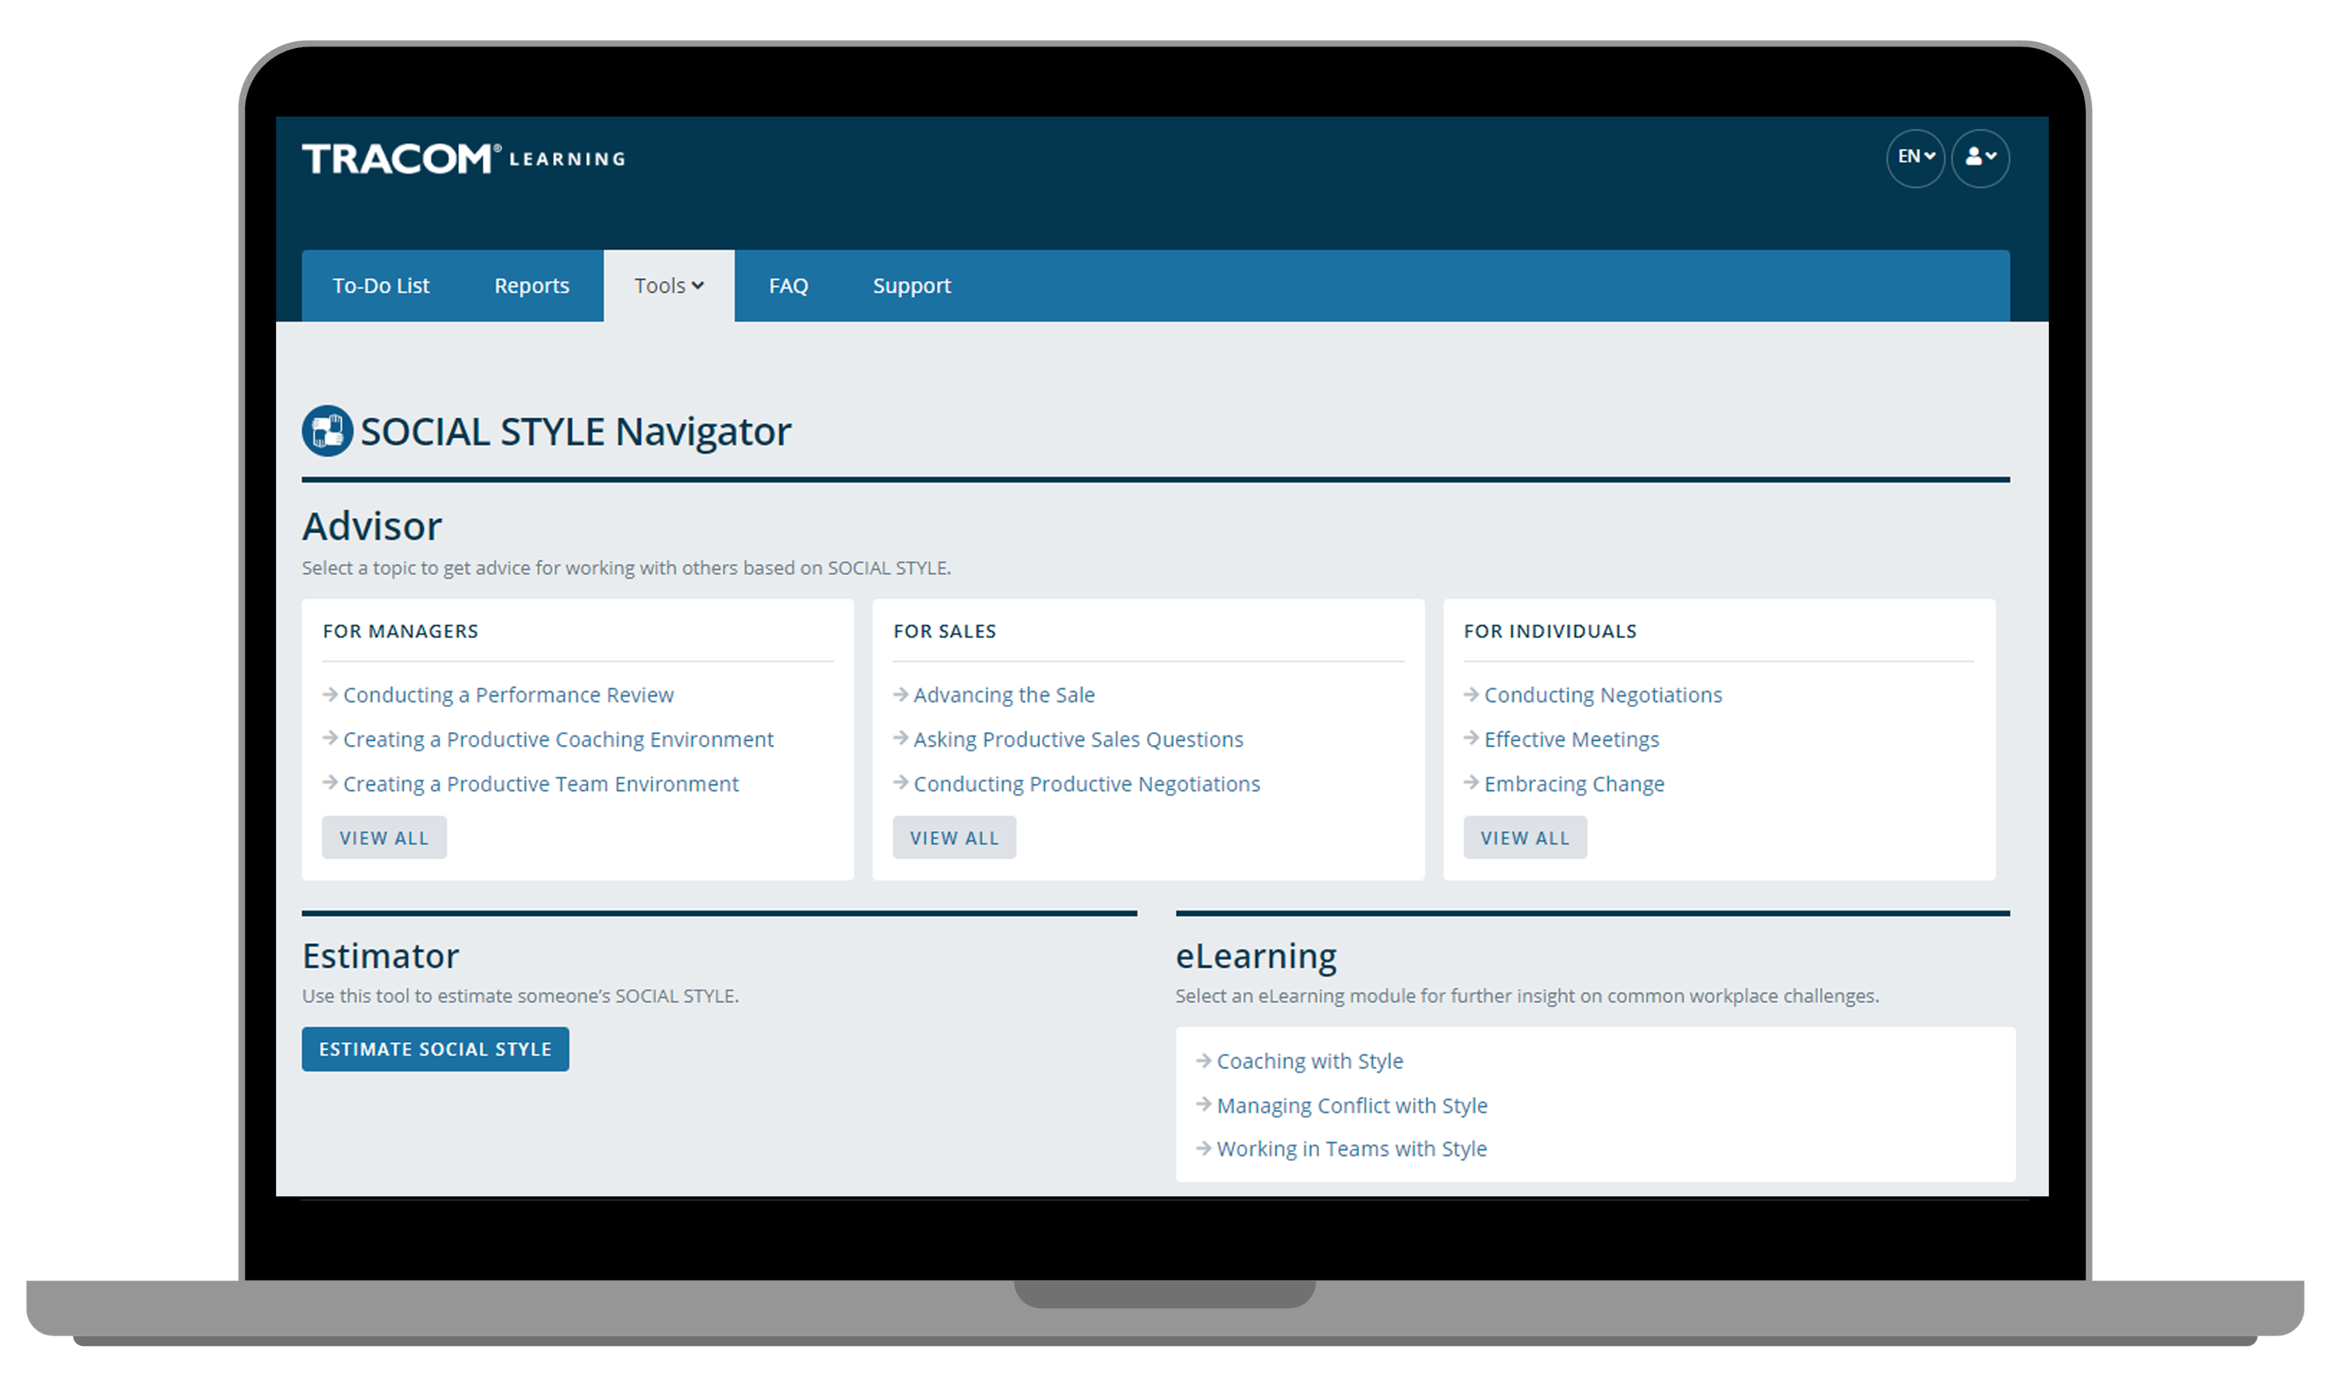
Notes:
Optional demonstration, time permitting

Slide 87
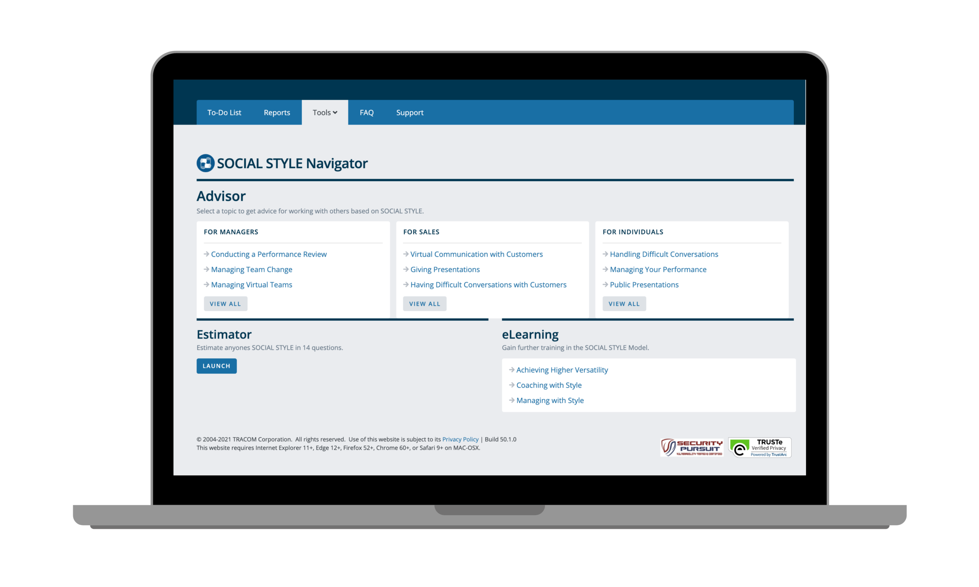
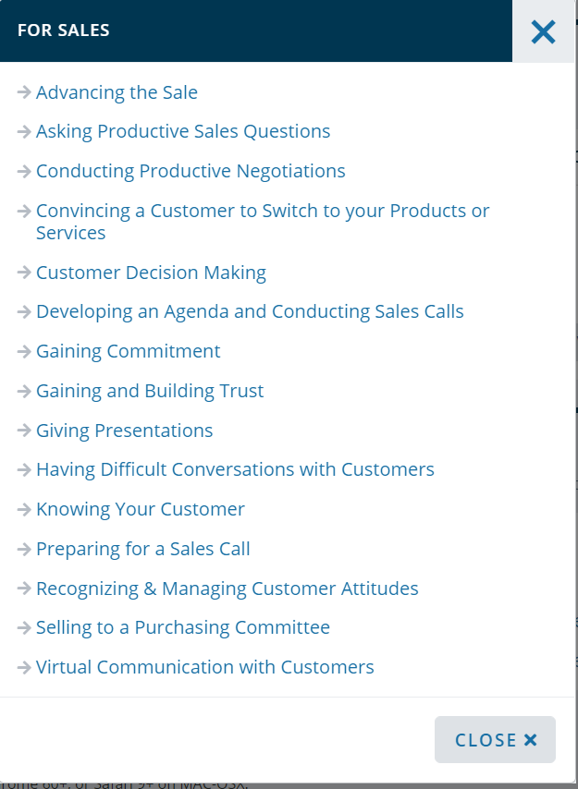
Notes:
Optional demonstration, time permitting

Slide 88
Notes:
Optional demonstration, time permitting

Slide 89
Notes:
Optional demonstration, time permitting

Slide 90
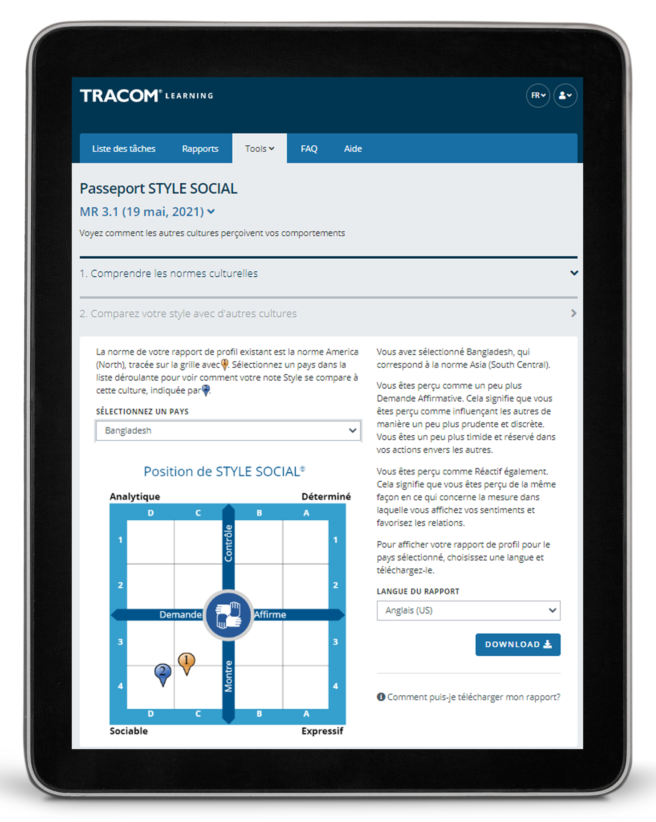
Passeport de STYLE SOCIAL
Notes:
Optional demonstration, time permitting
The SOCIAL STYLE Passport allows you to see how you would profile in another country. It’s also available at tracomlearning.com.

Slide 91
91
Notes:
THANK participants and conclude the session.

