Slide 1
为结果而销售™
Notes:
2 Minutes
WELCOME participants to the session and REVIEW key points about TRACOM’s SOCIAL STYLE Model:
One of the most widely used and highly regarded behavioral models in use today.
Will help you develop insight about your behavioral strengths and weaknesses, and your customers’ behavioral preferences.
Originally developed in the 1960s by psychologists David Merrill and Roger Reid.
Used worldwide by millions of people.
PROGRAM BENEFITS
SAY Working successfully with customers depends on developing good relationships. You can do this by understanding your own Style and, more importantly, other people’s Styles. This allows you to practice Versatility by adjusting your behavior to meet other people’s Style preferences. Research shows that people who consistently show Versatility are more effective in their jobs than people who don’t show Versatility.

Slide 2
提高人际效能的步骤
为他人做点事情
控制自己
认识到你对他人的影响
管理自己的行为
客观地观察他人
帮助满足他人的风格需求
了解自己
了解他人
Notes:
5 Minutes (Workbook, page 2)
SAY This program will bring you on a journey. The ultimate goal is to work more effectively with your customers and others. We’ll get there through a process that starts with understanding yourself and how your behavior affects your productivity and relationships. We refer to these as “know yourself” and “control yourself.”
Most importantly though, you’ll begin to focus on understanding others and their preferences for getting work done. This is called “know others.” With this understanding of others’ behavioral styles, you’ll begin to practice your Versatility, which is “do something for others.”
We’ll talk more about these four steps later, but as we progress through the program, you’ll see how they are applied.
By the end of the program, you’ll have insight into your own Style and behavior, and the Style of at least one of your customers. You’ll build on this knowledge to develop more effective ways of working with your customers through practicing Versatility.

Slide 3
你将学到什么
如何预测客户的行为。
什么事情会给客户带来压力?
如何认识和满足他们的需求。
如何为会议和沟通做准备。
如果赢得客户的信任。
Notes:
2 Minutes
SAY Ultimately, this course will help you have more success with your customers. In particular, you’re going to learn specific strategies:
How to predict your customers’ behavior, and an understanding of why they behave that way.
What causes customers to become stressed, and how your own behavior can contribute to this.
How to recognize their needs and meet those needs.
How to prepare for meetings and tailor your communication to different customers.
Ultimately, how to earn their trust.

Slide 4
待人处事风格和变通能力
销售业绩的要素
待人处事风格和变通能力培训后，销售专业人员报告:
92%
87%
58%
建立了更为
提高了自己
报告自己
积极的客户关系
影响或说服客户的能力
完成了原本可能无法完成的销售
变通能力提高，工作绩效也会提升。
Notes:
2 MINUTES (Workbook, page 4)
SAY In the first part of the program, you’ll learn about Style. This will help you understand your customers and how they prefer to interact with you.
The second part of the program focuses on Versatility, which is how well you meet others’ Style needs.
Versatility is the application of SOCIAL STYLE—when you understand your customers’ Style needs, you can help them meet those needs. This helps them feel more valued and sets the stage for them to have a better relationship with you. If you consistently show Versatility, you can be more effective.
You can read the stats on this slide. Research has found that salespeople who practice SOCIAL STYLE and Versatility have more success.

Slide 5
介绍
姓名
岗位职责
匿名的客户 – 最令人沮丧的是什么
Notes:
10 Minutes
Have participants introduce themselves by revealing the topics listed on the slide.
ASK participants to think of one customer they have a difficult relationship with, and briefly describe their main frustration(s) with this person WITHOUT NAMING THE PERSON.
If Group is too large for verbal introductions, do this through chat.
TIP: You might want to record participants’ “What is Most Frustrating” on a flip chart (or virtual white board). The purpose of the session is to learn how to improve these relationships.
Make sure you have a Profile for each participant who completed the online Questionnaire by the deadline.
DO NOT pass out the Profiles at this time.
If you are delivering a virtual program, options and instructions for downloading profiles are given later in this guide.

Slide 6
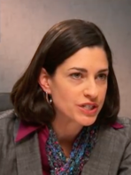
措施中的风格
观察
观点
Kyle
Lana
AJ
Abby
Notes:
15 Minutes (Workbook, page 5)
INTRODUCE the video: Four individuals participate in a meeting to discuss a product that is missing a client’s expectations.
ASK participants to write down their observations and opinions of each character on page 5 of the Participant Workbook.
PLAY Part 1.
DEBRIEF the video by asking participants to briefly share their thoughts on the characters. Many of the participants’ comments will be subjective observations.

Slide 7
我的客户 – 第一印象
思考您之前确定的客户。给他们虚构一个名字并写下来:
你对那个人的第一印象（从第一次接触开始）
Notes:
5 Minutes (Workbook, page 6)
SAY Think about the customer you identified during our “Introduction” exercise.
SAY Give your customer a fictional name and then write down:
First impressions you had of that person (from your first interactions).
DEBRIEF the exercise by asking participants to briefly share the information about their customer.
SAY The information you shared is typical about how we feel about and react to others. Some information is objective and observable—and some of it is subjective (how we feel about them). Today, we’re going to show you a more objective and reliable way to understand behavior; then based on this, find ways to work more effectively and with less frustration.

Slide 8
行为的维度
自主性和响应性
Notes:
SAY We’re going to talk about behavior and how to accurately observe people’s behavior.

Slide 9
可观察的行为和个性
行为
你说什么（言语），做什么（非言语）
待人处事风格® 用来描述某个人行为的、他人可以观察到并达成共识的行为模式
观察到的行为
说的/做的
个性
人际行为
在与他人互动时，你的所言与所为
个性
一个人的一切: 他的思想、价值观、希望和梦想
Notes:
4 Minutes (Workbook, page 7)
SAY Behavior and personality are not the same things. Observable behavior is like the crust of a pie. Personality is like the inside and outside of the pie.
ASK What makes up personality?
CONDUCT a quick facilitated discussion to solicit participants’ responses. They should say things such as:
Values, hopes, attitudes, beliefs.
Things that are not necessarily observable.
These internal qualities are more subjective in nature.
SAY Style is like the crust, because it’s on the outside and observable. By observing behavior, we can find ways to define and discuss what we see. Then, we can begin to understand how this behavior affects ourselves and others.

Slide 10
说的和做的行为
特质
诚实
睿智
傲慢
斗志昂扬
以自我为中心
真诚
挑剔
观察到的行为
安静
节奏较慢
面部表情控制
音调变化较小
眼神接触较少
姿势随意
身体后倾
吵闹
节奏较快
面部表情活跃
音调变化较大
眼神接触较多
姿势僵硬
身体前倾
判断
我喜欢他
我讨厌他
我对她感兴趣
我对他恼火
我不信任她
我恨他
我相信他
说的
做的
Notes:
5 Minutes (Workbook, page 8)
SAY When we first meet people, we often form immediate impressions, even after just a few seconds. This is subconscious (below our level of awareness) and happens immediately.
DESCRIBE
Traits Column: What we think we know about a person, based on interactions; subjective opinions.
Judgments Column: Our reactions to others; conclusions or evaluations we make, based on our subjective opinions.
Observable Behavior Column: Things others “Say and Do”; more objective and observable behaviors.
SAY Traits and Judgments are most subjective in nature and contain positive or negative descriptions.
Observable Behavior is objective and contains no positive or negative value.
Observable Behavior is an important tool for assessing others’ Styles. By focusing on Observable Behavior, you gain objectivity, which is critical for understanding people’s Styles.

Slide 11
自主性和响应性
Notes:
SAY We measure observable behavior on two dimensions: Assertiveness and Responsiveness

Slide 12
自主性
在与他人互动时，我们“征询意见”或“表达意见”的程度
更多 征询意见
征询 中带少许 表达
表达 中带少许 征询
更多 表达意见
Notes:
2 Minutes (Workbook, page 9)
SAY To become more effective with others, we follow a behavioral model. There are two dimensions of behavior that define SOCIAL STYLE: Assertiveness and Responsiveness.
Assertiveness is the degree to which we ask or tell when interacting with others. The two anchors for Assertiveness are Ask on the left side of the continuum and Tell on the right side of the continuum.
Assertiveness is a measurement of how we try to influence others to take action. If you are more “Tell” Assertive, you state your opinions directly. You tend to declare your viewpoints and try to direct the actions of others.
For example, if you want to have lunch with someone, you might say, “Let’s have lunch today!”
If you are more “Ask” Assertive, you tend to be more cautious and reserved about sharing your opinions. You attempt to influence others in a more quiet, low-key, questioning manner.
For example, if you want to have lunch with someone, you might say, “Would you like to have lunch with me today? ”

Slide 13
自主性行为
说的 | 言语行为
较慢
语速
较快
较少
说话数量
较多
较安静
说话音量
较吵闹
征询意见
表达意见
放松
手部动作
指令性
身体后倾
身体姿势
身体前倾
不太直接
目光接触
较为直接
做的 | 非言语行为
Notes:
3 Minutes (Workbook, page 10)
SAY The Assertiveness scale helps predict a person’s behavior because it represents a “theme” or typical pattern. There are verbal and non-verbal clues to indicate a person’s Assertiveness.
ASK participants for examples of verbal and non-verbal clues for Ask-Assertive and Tell-Assertive individuals.
DESCRIBE the verbal and non-verbal indicators of Assertiveness:
Verbal: Ask-Assertive individuals use a slower pace, less quantity (fewer words), and quieter volume. Tell-Assertive individuals use a faster pace, talk more, and a louder volume.
Non-Verbal: Ask-Assertive individuals show relaxed hands and gestures, lean back, and use less direct eye contact. Tell-Assertive individuals have a directive use of hands, lean forward, and use more direct eye contact.

Slide 14
自主性
言语线索
非言语线索
Kyle
Lana
AJ
Abby
Notes:
10 Minutes (Workbook, page 11)
PLAY the same Video Part 1, again, now that participants have been introduced to Assertiveness.
ASK them to observe verbal and non-verbal “Say and Do” behaviors and record their observations on page 11 of their Participant Workbook.
DISCUSS video characters related to Assertiveness.
ASK participants to share some subjective “Say and Do” verbal and non-verbal behaviors of each of the team members. Think about speech characteristics such as pace, quantity, and volume for verbal behaviors and use of hands, posture, and eye contact for non-verbal behaviors.
ASK What is different about your observations from the first time you saw the video? (Answer: They are much more objective.) This contrasts with the subjective observations participants made earlier.
ASK Based on your understanding of the Assertiveness dimension, where do you think each of the characters falls on the Assertiveness continuum?
SAY Assertiveness is neither positive nor negative; it is neutral. There is no good or bad place on the Assertiveness scale. Your level of Assertiveness only becomes positive or negative when used appropriately or inappropriately.

Slide 15
客户: 自主性观察
说的 | 言语行为
较慢
语速
较快
较少
说话数量
较多
较安静
说话音量
较吵闹
征询意见
表达意见
放松
手部动作
指令性
身体后倾
身体姿势
身体前倾
不太直接
目光接触
较为直接
做的 | 非言语行为
Notes:
10 Minutes (Workbook, page 12)
SAY Using the customer that you identified earlier, think about, and then write down, that person’s Assertiveness behaviors. Include the person’s verbal and non-verbal behaviors. Think about their speech characteristics such as pace, quantity, and volume for verbal behaviors and use of hands, posture, and eye contact for non-verbal behaviors.
DEBRIEF the exercise by asking participants to briefly share the information about their customer’s Ask or Tell Assertive behaviors.
RECORD their information on a virtual white board or flip chart.
ASK What is different about your observations from the first time you described this person?
Answer: They are much more objective. This contrasts with the subjective observations participants made earlier.
ASK Based on your understanding of the Assertiveness dimension, where do you think your customer falls on the Assertiveness continuum?
EMPHASIZE that Assertiveness is neither positive nor negative; it is neutral. There is no good or bad place on the Assertiveness scale.

Slide 16
响应性
较为 控制 情绪
控制 中带少许 流露
在与他人互动时，我们控制或流露情绪的程度
流露 中带少许 控制
较为 流露 情绪
Notes:
2 Minutes (Workbook, page 13)
SAY Responsiveness is the degree to which people tend to control (don’t outwardly display emotions) or emote (outwardly display emotions).
The two descriptive anchors for the Responsiveness scale are Controls on the top of the continuum and Emotes on the bottom of the continuum.
Responsiveness is also the extent to which you react to emotional appeals or displays.
If you control your emotions, you usually don’t react to emotional appeals and are more likely to focus on ideas, data, and tasks. You are less likely to share your feelings publicly.
If you are more emoting, you share and display your emotions with others. You are more likely to respond to emotional appeals and displays from others.

Slide 17
响应性行为
说的 | 言语行为
做的 | 非言语行为
控制情绪
音调变化较小
任务
事实/数据
较少
僵硬
控制
声音中 的情绪
说话的主题
描述性统 计的形式
手部动作
身体姿势
面部表情
音调变化较大
人
观点/故事
较多
随意
活跃
流露情绪
Notes:
3 Minutes (Workbook, page 14)
SAY The Responsiveness scale, like the Assertiveness scale, helps us to predict a person’s behavior because it is a “theme” or typical pattern.
ASK participants for their opinions on the verbal and non-verbal clues of Control- and Emote-oriented individuals.
DESCRIBE the verbal and non-verbal clues to responsive behavior as noted on the slide.
SAY Responsiveness is neither a positive nor a negative quality; it is neutral.
Assertiveness and Responsiveness do not affect each other — they are independent of each other.

Slide 18
响应性
言语线索
非言语线索
Kyle
Lana
AJ
Abby
Notes:
10 Minutes (Workbook, page 15)
REPLAY Video Part 1 again, now that participants have been introduced to Responsiveness.
ASK participants to observe verbal and non-verbal Say/Do behaviors.
SAY Think about verbal clues such as vocal emotion, subjects, and what each team member describes. What did you observe? For non-verbal clues, think about use of hands, posture, and facial expressions.
ASK Based on your understanding of Responsiveness, where do you think each of the characters falls on the Responsiveness scale?
SAY The Assertiveness and Responsiveness dimensions assess behavior, not personality or intelligence, and they are independent of each other.

Slide 19
客户: 响应性观察
说的 | 言语行为
做的 | 非言语行为
控制情绪
音调变化较小
任务
事实/数据
较少
僵硬
控制
声音中 的情绪
说话的主题
描述性统计 的形式
手部动作
身体姿势
面部表情
音调变化较大
人
观点/故事
较多
随意
活跃
流露情绪
Notes:
10 Minutes (Workbook, page 16)
SAY Using the customer that you identified earlier, think about, and then write down, that person’s Responsiveness behaviors. Include their verbal and non-verbal behaviors. Think about speech characteristics such as emotion in their voice, subjects of speech, forms of descriptors, and non-verbal behaviors such as use of hands, body posture, and use of facial expressions.
DEBRIEF the exercise by asking participants to briefly share the information about their customer’s Control or Emote Responsiveness Behaviors.
RECORD their information on a virtual white board or flip chart.
ASK What is different about your observations from the first time you described this person?
Answer: They are much more objective. This difference contrasts with the subjective observations participants made earlier.
ASK Based on your understanding of the Responsiveness Dimension, where do you think your customer falls on the Responsiveness continuum?

Slide 20
待人处事风格模型™
Notes:
SAY Now that you understand Assertiveness and Responsiveness, we’ll see how they form the SOCIAL STYLE Model.

Slide 21
待人处事风格模型TM
控制情绪
征询意见自主性 较为控制情绪
分析型风格
表达意见自主性 较为控制情绪
进取型风格
征询意见
表达意见
征询意见自主性 较为流露情绪
亲切型风格
表达意见自主性 较为流露情绪
表达型风格
流露情绪
Notes:
4 Minutes (Workbook, page 17)
CLICK TO REVEAL EACH QUADRANT
SAY By combining Assertiveness and Responsiveness, the four SOCIAL STYLEs are formed.
No individual will display one Style exclusively; but, in a short time, you can determine the patterns that define a person’s Style. Once you know a person’s Style, you can adjust your behavior to develop a more effective relationship.

Slide 22
待人处事风格模型
控制情绪
分析型
严肃
严厉
注重逻辑
瞻前顾后
进取型
独立自主
合乎礼仪
务实
专横
征询意见
表达意见
亲切型
乐于支持
可靠
坦率
圆滑
表达型
有魄力
活跃
有冒险精神
易冲动
流露情绪
Notes:
5 Minutes (Workbook, page 18)
CLICK TO SPEAK ABOUT EACH QUADRANT (text becomes darker)
Review the summaries for each Style. Note that each Style contains positive descriptors and one negative descriptor. This illustrates the significance of perception. A Driving Style person might see themselves as Independent, Formal, and Practical, while others might perceive the same behavior as Dominating.
Solicit questions/ comments.
KEY POINTS:
Style descriptions are generalizations about each Style.
People with the same Style exhibit similar behaviors, but are still individuals.
Perceptions can vary. What you see as strengths in yourself, others might view negatively.

Slide 23
动作中是什么风格?
每个人物是什么风格?
Kyle
Lana
AJ
Abby
Notes:
3 Minutes (Workbook, page 19)
REFERENCE the video characters from earlier exercises.
ASK What do you think the SOCIAL STYLE of each video character is?
DISCUSS the behaviors of the characters and how those are indicative of their Styles.
IMPORTANT: Do not advance the slide until you’ve discussed the behavior of each character. The next slide reveals each character’s Style.

Slide 24
待人处事风格
控制情绪
分析型
进取型
Lana
Kyle
征询意见
表达意见
亲切型
表达型
AJ
Abby
流露情绪
Notes:
2 Minutes (Workbook, page 19)
Kyle – Driving
Lana – Analytical
AJ – Amiable
Abby – Expressive
DISCUSS the behaviors of the characters and how those are indicative of their Styles.

Slide 25
客户的待人处事风格
控制情绪
征询意见自主性 较为控制情绪
分析型风格
表达意见自主性 较为控制情绪
进取型风格
征询意见
表达意见
征询意见自主性 较为流露情绪
亲切型风格
表达意见自主性 较为流露情绪
表达型风格
流露情绪
Notes:
5 Minutes (Workbook, page 20)
SAY Using the customer that you identified earlier, determine their Style. This is only a preliminary estimate. As we continue through the program, you might re-estimate the person’s Style.
DEBRIEF the exercise by asking participants to share their customer’s Style, and how this behavioral assessment relates to their initial impressions of the person (which may have been more subjective).
RECORD their information on a virtual white board or flip chart.
SAY You will use their Style as a framework for developing more effective interactions with this person.

Slide 26
需求、倾向和发展措施
需求
每种风格的目标
倾向 为实现需求所采取的常见行为
发展措施
每种风格很少采取的行为。采取这种行为的频率提高会增加这一风格的效能
Notes:
2 Minutes (Workbook, page 21)
SAY Remember that the Style descriptions are generalizations about each Style. While people with the same Style generally exhibit similar characteristics, each person is still unique.
SAY Each Style has a Need, an Orientation, and a Growth Action. By recognizing these things about each Style, we can understand their motivations and what drives their behavior.
DEFINE:
Need – The goal of each Style.
Orientation – The common behavior used to achieve the need.
Growth Action – Behavior that is rarely used by each Style. Using this behavior more often would increase this Style’s effectiveness.
SAY Understanding the need, orientation, and growth action of each Style will help you better relate to others’ Styles and enhance your effectiveness with them.

Slide 27
待人处事风格 关键特征
控制情绪
分析型
需求: 正确
倾向: 思考
发展措施: 发表意见
进取型
需求: 成绩
倾向: 措施
发展措施: 倾听
征询意见
表达意见
亲切型
需求: 个人安全
倾向: 关系
发展措施: 发起
表达型
需求: 个人认可
倾向: 自发性
发展措施: 检查
流露情绪
Notes:
6 Minutes (Workbook, page 21)
CLICK TO REVEAL THE TEXT IN EACH QUADRANT.
REVIEW each Style.
ASK How do need, orientation, and growth action manifest themselves in the video characters? Specifically, how does each team member’s behavior show their need, orientation, and growth action?

Slide 28
待人处事风格行为
控制情绪
分析型
节奏较慢
努力组织
较少关注关系
注重历史时间段
行为谨慎
避免个人参与
进取型
节奏较快
希望掌握节奏
较少关注关系
注重当前时间段
指导他人的行为
避免不作为
征询意见
表达意见
亲切型
节奏较慢
努力联系
较少关注影响变化
注重当前时间段
展现支持行为
避免冲突
表达型
节奏较快
努力参与
较少关注常规
注重未来时间段
冲动行事
避免孤立
流露情绪
Notes:
5 Minutes (Workbook, page 22)
CLICK TO SPEAK ABOUT EACH QUADRANT
DESCRIBE the typical behaviors of the four SOCIAL STYLEs. These behaviors are related to the Style needs, orientations, and growth actions.

Slide 29
客户行为
控制情绪
分析型
较少社交，更注重事务
直接眼神接触较少
在提出意见前认真倾听
询问细节
可能避免陈述意见或做决定
进取型
较少社交，更注重事务
直接眼神接触较多
直接表达意见
可能会询问挑战性的问题
可能会脱离团队或试图掌控
征询意见
表达意见
亲切型
友好且平易近人
点头和其他鼓励信号
说话比其他人少
询问关于对人们影响的问题
可能默许小组的决定
表达型
在会议一开始善于社交且平易近人
说话比其他人多
可能偏离议程，谈论不同的话题
直接表达意见
可能会对抗
流露情绪
Notes:
4 Minutes (Workbook, page 23)
CLICK TO REVEAL THE TEXT IN EACH QUADRANT.
REVIEW the customer behaviors. These behaviors are typical Style-related behaviors specific to working with customers.
ENCOURAGE participants to share stories about their customers.

Slide 30
客户压力
控制情绪
分析型
缺少重点和组织性
急于实现快速销售
注重共性而不考虑细节
变化太多而不考虑后果
进取型
缺乏结构和明确的结果
没有机会陈述自己的观点
没有底线解决方案
进展缓慢
每个风格的压力来源是什么?
征询意见
表达意见
亲切型
太拘泥于形式和注重任务
在解决方案上缺乏合作
专注于销售而不是长期关系。
变化太多太快
表达型
贡献不获认可
细节太多
结构太多，没有自由的交谈
不够关注未来的可能性
流露情绪
Notes:
6 Minutes (Workbook, page 24)
ASK Given a customer’s Style need and typical behaviors, what will cause stress for them?
FACILITATE a discussion of each Style before revealing the text.
CLICK TO REVEAL THE TEXT IN EACH QUADRANT.
The Driving Style need is results, so what’s going to raise their tension in a sales meeting?
Lack of focus; disorganization; not being allowed to state their opinions; no bottom-line solutions; progress is too slow.
Expressive Style stressors:
Not being recognized; too many details; too much structure without free-flowing conversation; not enough focus on future possibilities.
Amiable Style stressors:
Too much formality; lack of collaboration towards solutions; focus on the sale instead of on long-term relationship; too much change too quickly.
Analytical Style stressors:
Lack of structure and clear outcomes; pushiness to achieve quick sale; focus on generalities without considering details; too much change without considering consequences.
ENCOURAGE participants to share stories about their customers.

Slide 31
备份行为
控制情绪
分析型
避免: 为减少个人压力而沉默寡言
进取型
专横: 为减少个人 压力而掌管
为了减少压力的夸张行为
征询意见
表达意见
亲切型
默许: 为减少个人压力而迎合赞同
表达型
攻击: 为减少个人压力而对抗
流露情绪
Notes:
5 Minutes (Workbook, page 25)
CLICK TO REVEAL THE TEXT IN EACH QUADRANT.
SAY When customers are feeling stressed, their behavior can be categorized: each Style falls into a type of extreme backup behavior to try and reduce tension.
DESCRIBE each Style’s backup behavior. Remember, each Style’s goal is to get their Style need met.
ASK What are some common ways that each Style might show their backup behavior?
Driving: Will get frustrated by slow progress or barriers and try to take control of the situation.
Expressive: Will get upset if they aren’t given opportunities to express themselves or show their contributions, and might verbally confront others.
Amiable: If they feel that a relationship is being threatened, they will stay quiet and acquiesce instead of firmly stating their opinions.
Analytical: If they feel that things are moving too fast without taking into account important details, they will withdraw and refuse to contribute.
SAY Next we’ll talk about some specific strategies for working with customers.

Slide 32
满足客户需求
控制情绪
分析型
证据和信息: 跟他们分享
透明度: 他们希望看到并了解你的工作流程
获得理解: 表现出你理解他们的 问题
思考的时间: 不要急于做出决定
进取型
结果: 如有可能，尽快按约定交付
才能: 展示你团队的能力
坦诚: 直率和专业
效率: 尊重他们的时间，尽快投入工作
征询意见
表达意见
亲切型
社交: 花时间了解他们
安全: 为他们将尽量减少风险
参与和共识: 让他人参与决策以获得认可
保证: 让他们知道类似项目以前曾获得成功
表达型
支持: 帮助实现他们的愿景
认可: 不要和他们争夺表彰
尊重和重视: 他们喜欢关注，尤其是来自领导的关注
发言权: 给他们说话的机会，即使不是专门出于开会的目的
流露情绪
Notes:
8 Minutes (Workbook, page 26)
ASK With these backup behaviors in mind, and understanding what causes stress for each Style, what are some ways to meet your customers’ needs? Start with the Driving Style, what ideas do you have?
CLICK TO REVEAL THE TEXT IN EACH QUADRANT.
REVIEW the needs and strategies to meet each Style’s needs and facilitate discussion of each Style.
ENCOURAGE participants to share stories about their customers.

Slide 33
无形中观察风格
Notes:
10 Minutes (whole section on Observing Style Virtually)
SAY Working with customers and trying to sell remotely has its own unique challenges. You can still use Style to your advantage. Let’s briefly see how people of different Styles might communicate using text messages.

Slide 34
看看你是否有机会查看我发的 关于最新技术升级的视频。
你怎么看?
Notes:
The following five slides are examples of “observable” behavior in text messages.
SAY By observing the behaviors of others, even through simple communication like texting, we can TRY to determine how people prefer to communicate and prefer to be communicated with.
Review example slides:
There is a lot of change happening at our organization, so I sent this text to four of my customers. Then I waited for their responses.

Slide 35
看看你是否有机会查看我发的 关于最新技术升级的视频。
你怎么看?
Hi！很快就会发生很多变化。
我的团队需要接受关于新功 能的培训。你能帮帮我们吗?
Notes:
SAY Here is the first response from a customer.

Slide 36
看看你是否有机会查看我发的 关于最新技术升级的视频。
你怎么看?
真让人兴奋！我匆匆看了下， 新功能似乎很不错！
我下周打给你！
Notes:
SAY This is the second response from another customer.

Slide 37
看看你是否有机会查看我发的 关于最新技术升级的视频。
你怎么看?
我认为新的升级将帮助我们变 得更有效率，节省一些精力。 但在我们采用新版本之前， 我们需要计划对我的团队进行培训。 你有没有这方面的相应流程?
Notes:
SAY Here’s the response from a third customer.

Slide 38
看看你是否有机会查看我发的 关于最新技术升级的视频。
你怎么看?
看上去不错。 准备好实施时我会打给你。
Notes:
SAY And finally, this response from a fourth customer.
Keep these texts in mind as we’ll be revisiting them later.

Slide 39
说出这个风格的名称！
看看你是否有机会查看我发的 关于最新技术升级的视频。
你怎么看?
Notes:
SAY This is the text I first sent out. How about the responses I received? Knowing what you know so far about SOCIAL STYLE, can you guess which Style each response is from?

Slide 40
控制情绪
征询意见自主性 较为控制情绪
分析型风格
表达意见自主性 较为控制情绪
进取型风格
Hi！很快就会发生很多变化。 我的团队需要接受关于新功 能的培训。你能帮帮我们吗?
征询意见
表达意见
征询意见自主性 较为流露情绪
亲切型风格
表达意见自主性 较为流露情绪
表达型风格
流露情绪
Notes:
SAY Which Style might this person be?
AMIABLE
SAY This person is personable (“Hi!”) and concerned that things are moving fast. They are showing concern for the team’s ability to adapt the new technology, and they specifically ask for help. It indicates Ask Assertiveness and Emote Responsiveness.

Slide 41
控制情绪
征询意见自主性 较为控制情绪
分析型风格
表达意见自主性 较为控制情绪
进取型风格
真让人兴奋！我匆匆看了下， 新功能似乎很不错！
我下周打给你！
征询意见
表达意见
征询意见自主性 较为流露情绪
亲切型风格
表达意见自主性 较为流露情绪
表达型风格
流露情绪
Notes:
ASK How about this one—what Style?
EXPRESSIVE
SAY This person uses a lot of exclamation marks to show enthusiasm and wants to interact. They also mention “I took a quick look,” indicating they didn’t pay close attention to the video or details. It indicates Tell Assertiveness and Emote Responsiveness.

Slide 42
控制情绪
征询意见自主性 较为控制情绪
分析型风格
表达意见自主性 较为控制情绪
进取型风格
我认为新的升级将帮助我们变 得更有效率，节省一些精力。 但在我们采用新版本之前， 我们需要计划对我的团队进行培训。 你有没有这方面的相应流程?
征询意见
表达意见
征询意见自主性 较为流露情绪
亲切型风格
表达意见自主性 较为流露情绪
表达型风格
流露情绪
Notes:
ASK Which Style might this person be?
ANALYTICAL
SAY This person likes things to be efficient but is hesitant to adapt the new technology until the team is trained and ready. They also ask a clarifying question – “Do you have a process in place for this? ” It indicates Ask Assertiveness and Control Responsiveness.

Slide 43
控制情绪
征询意见自主性 较为控制情绪
分析型风格
表达意见自主性 较为控制情绪
进取型风格
看上去不错。 准备好实施时我会打给你。
征询意见
表达意见
征询意见自主性 较为流露情绪
亲切型风格
表达意见自主性 较为流露情绪
表达型风格
流露情绪
Notes:
ASK And finally, what Style might this be?
DRIVING
SAY This person is being direct and brief. They also communicate that they will initiate contact when they’re ready (“Don’t call me, I’ll call you.”). It indicates Tell Assertiveness and Control Responsiveness.

Slide 44
要点
风格并非个性。
只是指可观察的行为。
行为是一个“统一体”，不是“非此即彼”。
一个人在大部分时间里会表现出一种行为风格。
并没有“最好的”风格。
Notes:
2 Minutes (Workbook, page 28)
REVIEW the key points.
Style is not personality.
Style refers only to observable behavior.
Behavior is a continuum, not an “either/or.”
People behave with one Style most of the time.
There is no “best” Style.

Slide 45
待人处事风格档案
Notes:
SAY Now that you’re familiar with the Model, each of you will review your own SOCIAL STYLE Profile.

Slide 46
自主性
一个人更倾向于征询还是表达意见的程度。
D
C
B
A
更多 征询意见
征询 中带少许 表达
表达 中带少许 征询
更多 表达意见
比 75% 的人更具征询意见自主性
比 50% 的人更具征询意见自主性
比 50% 的人更具表达意见自主性
比 75% 的人更具表达意见自主性
Notes:
2 Minutes
SAY Before you read your SOCIAL STYLE Profile, let me describe how your results are determined. The dimensions of behavior are normed. This means that Assertiveness is reported in quartiles.
Review the information on the slide concerning percentiles of people in each of the four quartiles.

Slide 47
响应性
1
较为 控制 情绪
比 75% 的人更具控制情绪响应性
2
控制 中带少许 流露
比 50% 的人更具控制情绪响应性
一个人更倾向于控制还是流露情绪的程度。
3
流露 中带少许 控制
比 50% 的人更具流露情绪响应性
4
较为 流露 情绪
比 75% 的人更具流露情绪响应性
Notes:
2 Minutes
SAY In the same way, Responsiveness is reported in quartiles.
Review the information on the slide concerning percentiles of people in each of the four quartiles.

Slide 48
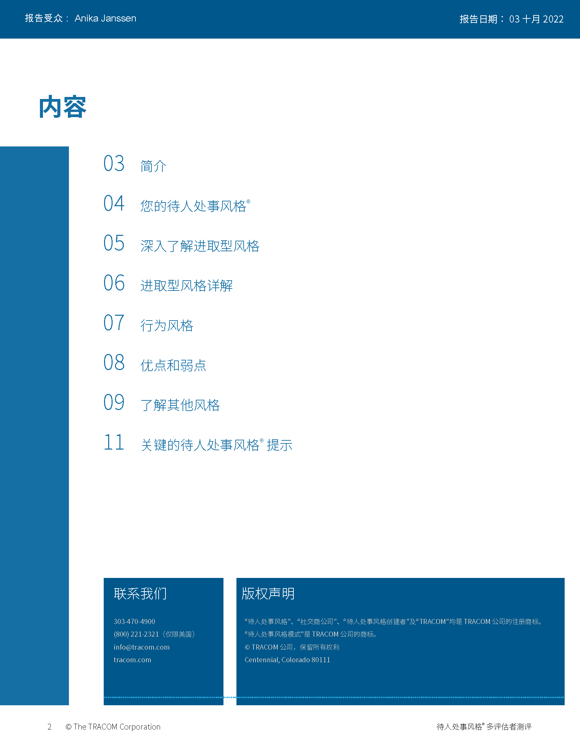
© TRACOM 公司。保留所有权利。
48
Notes:
20 Minutes
REVIEW the Profile pages on the following slides so participants understand the layout of the profile. After you’ve reviewed the slides, distribute individuals’ profiles.
If delivering a virtual program, participants will have already received their profiles. Note that you are only covering the SOCIAL STYLE section of the profile; the Versatility profile will be reviewed later.
PROVIDE ample time for participants to read and absorb their profiles. Do not continue until it is evident that all participants have finished reading their profiles.
ASK if there are any questions, surprises, or concerns.
ASK If your self-perception results were different, what might have caused the difference in views?
EXPLAIN TRACOM’s research shows that over 50% of the time, people see themselves differently from how others see them. Reiterate that there is no “best Style” and all Styles can be successful salespeople. Offer to be available during the break to answer individual questions or concerns.
NOTE: It is recommended that you take a break here and make yourself available for one-on-one conversations as participants may have questions or concerns they do not want to discuss publicly.

Slide 49
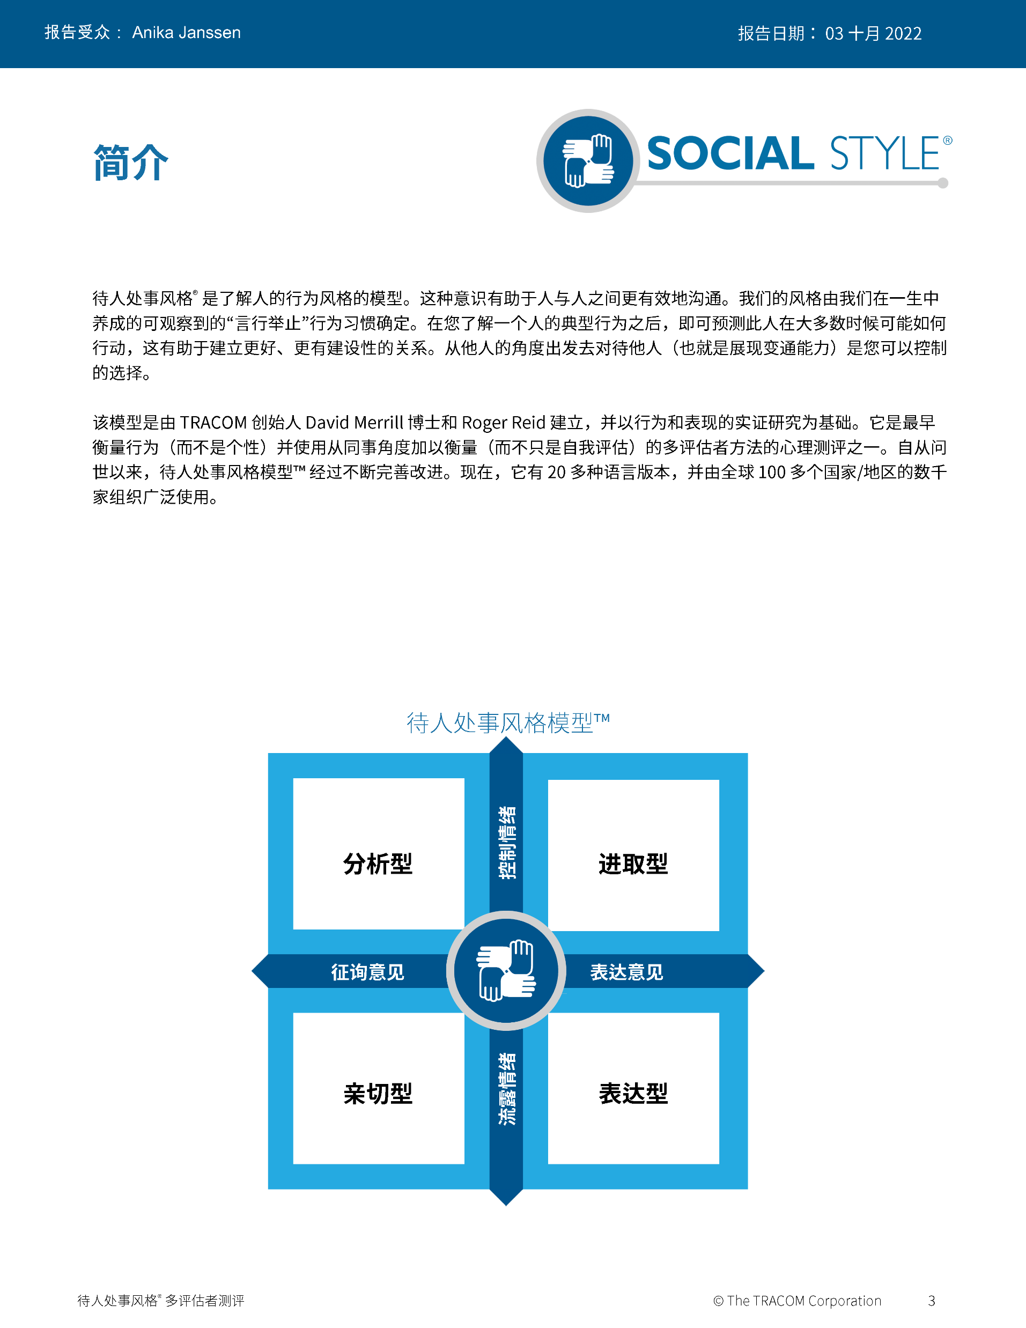
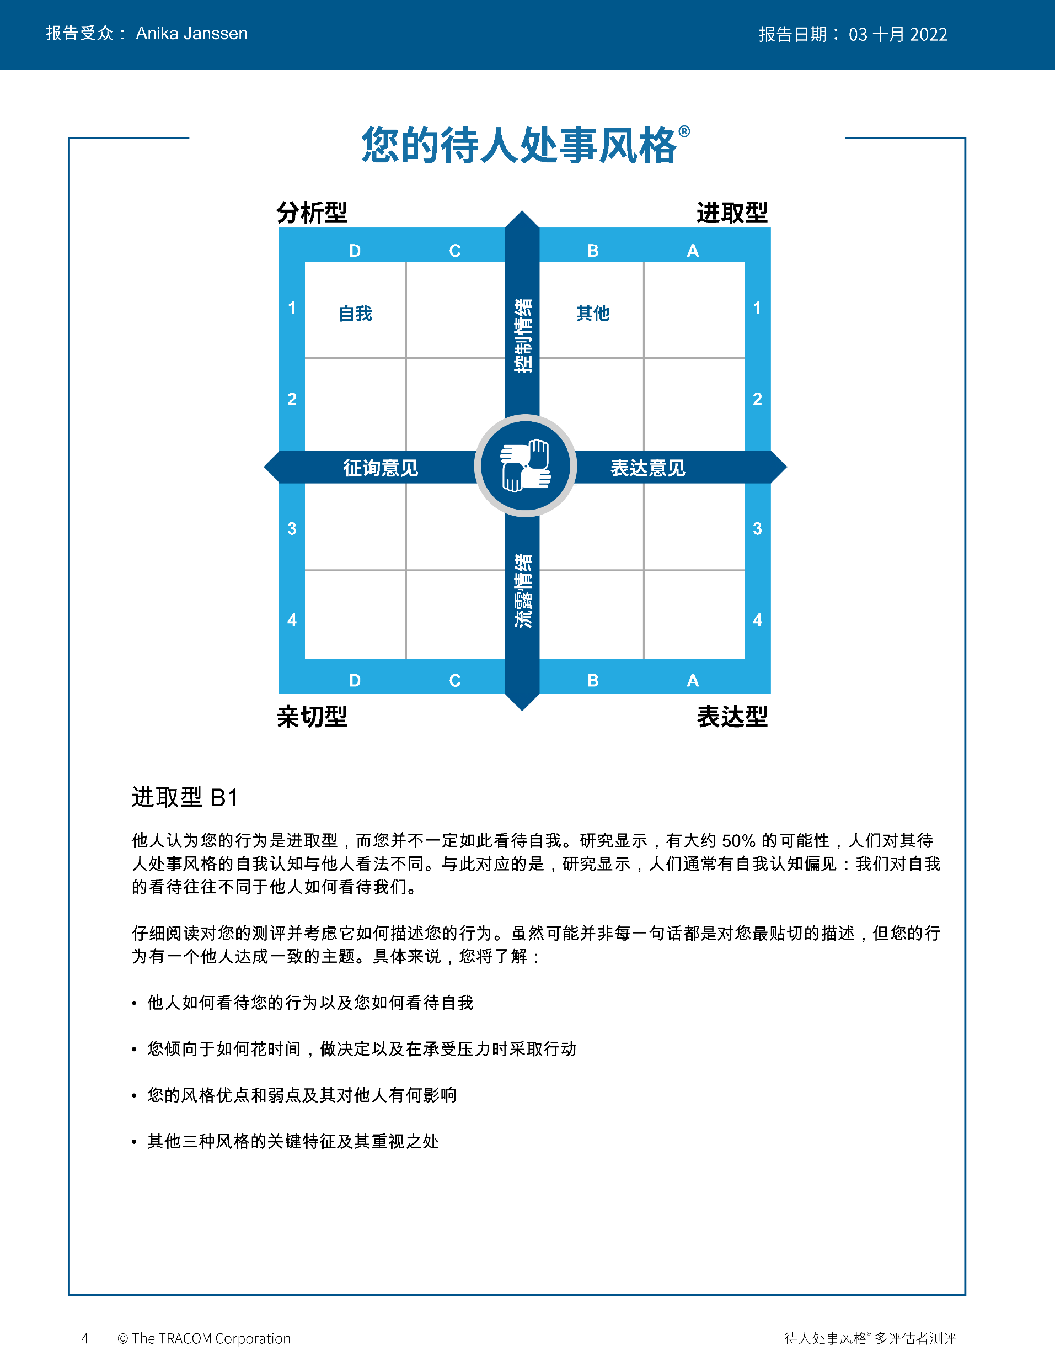
© TRACOM 公司。保留所有权利。
49
Notes:
Continue reviewing.

Slide 50
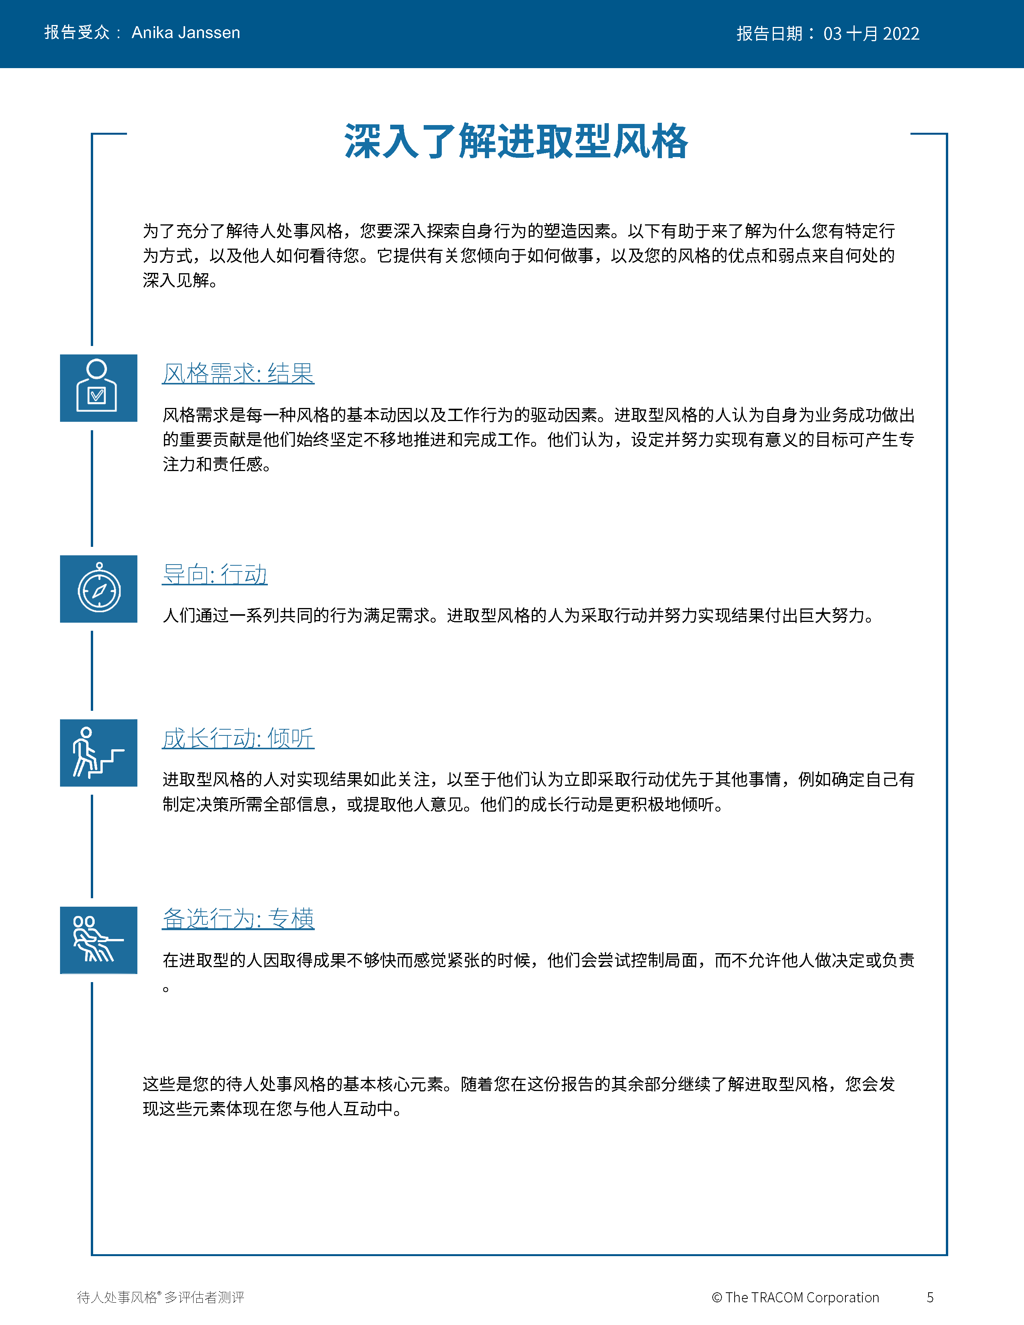
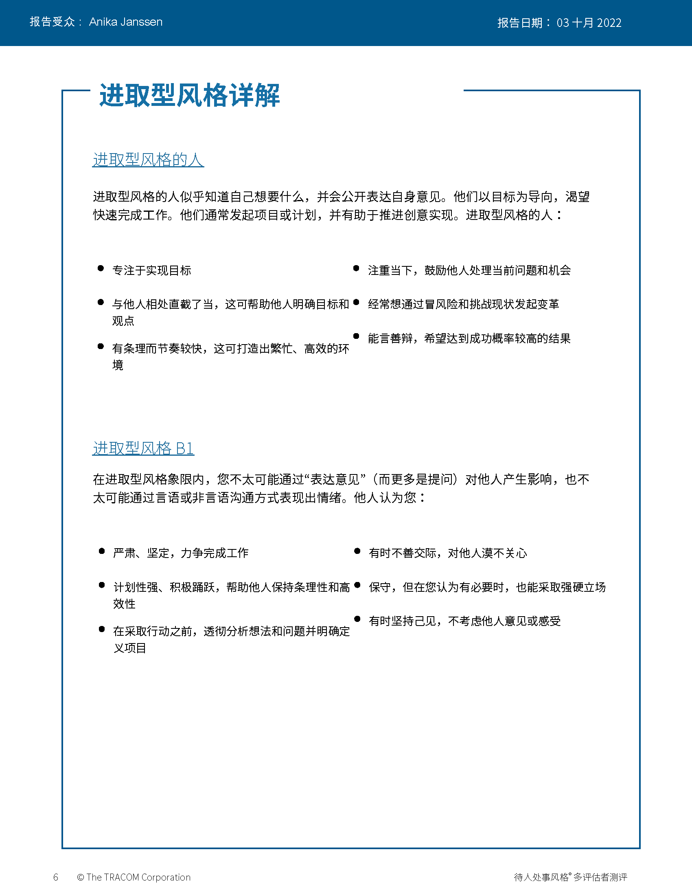
© TRACOM 公司。保留所有权利。
50
Notes:
Continue reviewing.

Slide 51
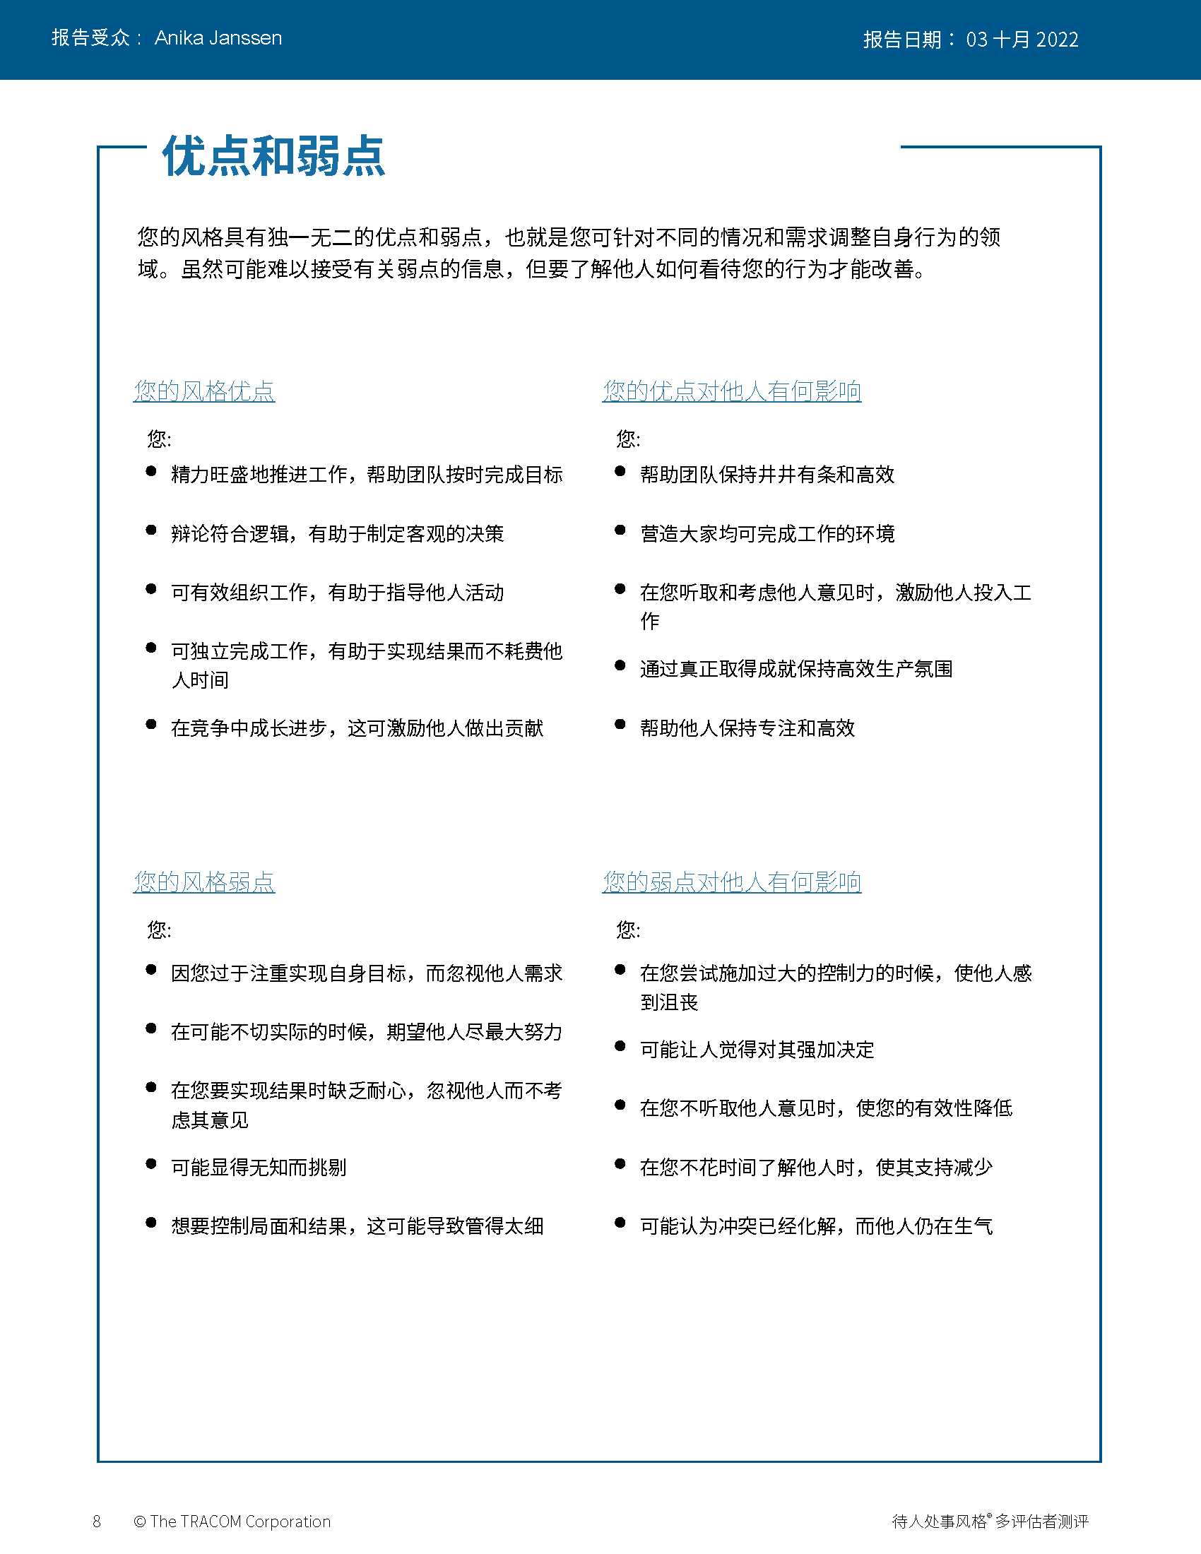
© TRACOM 公司。保留所有权利。
51
Notes:
Continue reviewing.

Slide 52
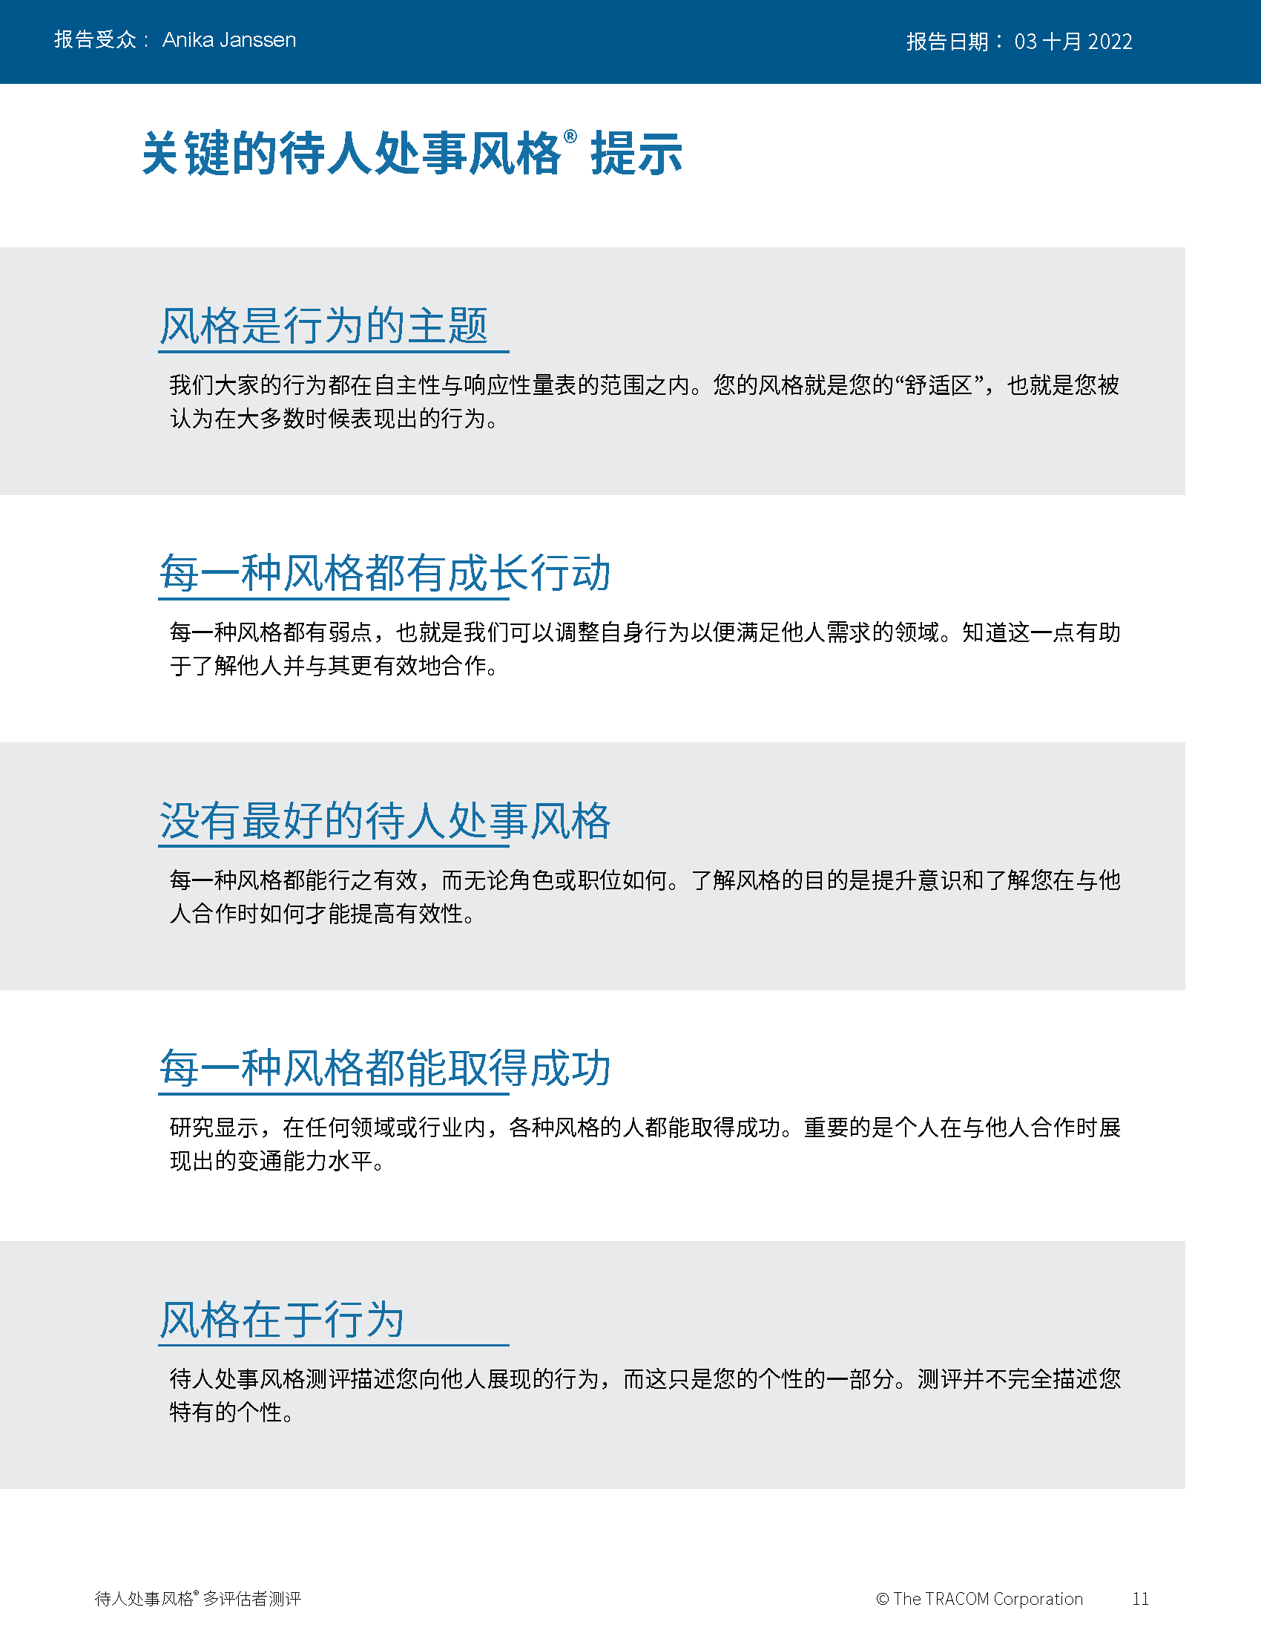
© TRACOM 公司。保留所有权利。
52
Notes:
Continue reviewing.

Slide 53
虚拟交付: 如何访问你的档案
登录 tracomlearning.com
输入用户名和密码
下载你的报告
Notes:
OPTIONAL: FOR VIRTUAL DELIVERY ONLY.
USE THE NEXT TWO SLIDES IF LEARNERS DOWNLOAD THEIR PROFILES DURING THE SESSION.
20 Minutes

Slide 54
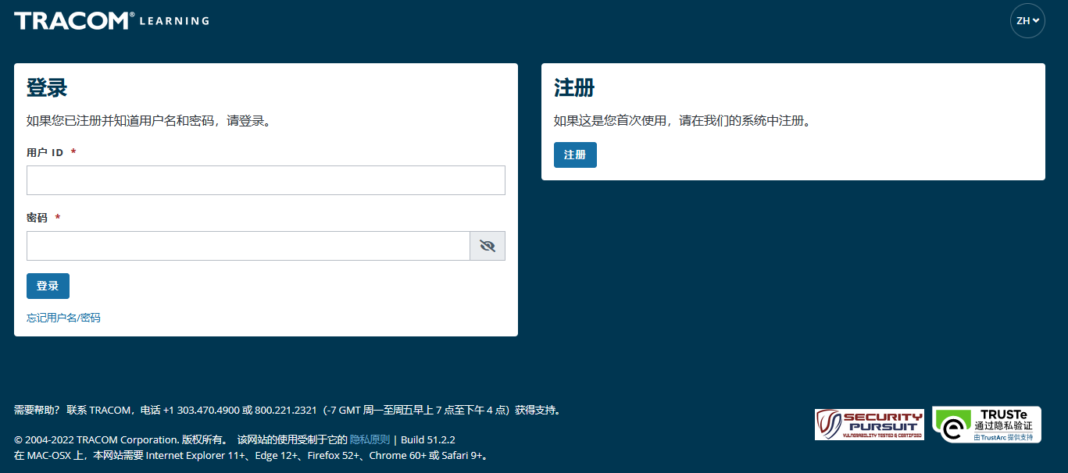
1. 转到 tracomlearning.com
2. 输入你的用户名和密码，再按“登录”
Notes:
SAY Login to tracomlearning.com. Use the same username and password as when you completed the assessment (survey).

Slide 55
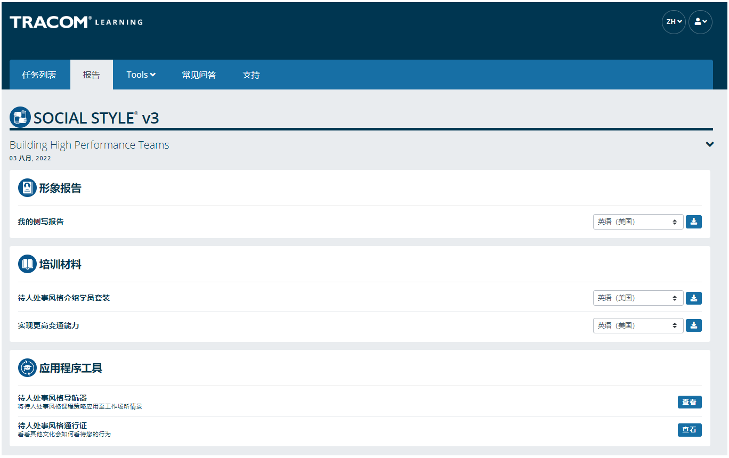
导航到“档案报告”部分再单击“下载”图标可以下载你的档案。
Notes:
SAY Your profile will be listed under “Profile Reports.” Click to download as a pdf.
Note: If the Learner selects the download button and the PDF does not open up (i.e., the screen just flashes), it is an indicator that their pop-up blockers are on. They need to allow pop-ups from tracomlearning.com and click the download button again. The profile report will open in a separate window. They can then save the profile report locally if they wish.

Slide 56
了解和控制你自己
待人处事风格
会让这一风格的客户感到沮丧的我的风格行为
能做哪一件事来控制我的风格行为
进取型
表达型
亲切型
分析型
Notes:
10 Minutes (Workbook, page 29)
The purpose of this exercise is to help people begin to understand how some of their Style behavior can be challenging for customers and others. A later exercise will require learners to determine specific ways they can increase their Versatility towards people of other Styles.
SAY Each of us has behavior that frustrates others. Write down a brief list of your Style behaviors that frustrate customers of other Styles. Then, determine one specific thing you can do to control this behavior. Use the insights you discovered from your profiles to help.
ASK for volunteers to provide a sample of responses and write them on a flipchart. If delivering virtually, learners can chat some of their responses as a way of engaging the group.
SAY Next you will learn more about your own Versatility.

Slide 57
观察风格的技巧
不要过早下结论
保持客观
将风格行为和一个人的角色和职位区别开
适度的压力可以明确一个人的风格
不要挡道（做一个观察者）
1
2
3
4
5
Notes:
5 Minutes (Workbook, page 29)
SAY The more accurately we are able to observe our customers’ Styles, the better we will be able to adapt our own behavior and “Do something for others” to increase Versatility.
DESCRIBE the best practices:
Don’t jump to conclusions about someone’s Style
Be an objective observer
Separate Style behavior from someone’s role or position
A moderate amount of stress can clarify someone’s Style
Get out of the way (be an observer)
ASK if there are any questions.

Slide 58
变通能力
Notes:
1 Minute
SAY You now have a good understanding of Style. What you learned from your profile is going to be useful during the next section, where we learn about Versatility and how to adjust to the Style needs of others.

Slide 59
变通能力是指你如何很好地适应他人的风格需求
Notes:
2 Minutes (Workbook, page 30)
SAY Versatility is a measure of your consistency in adjusting to the Style needs of others.
At the beginning of the program, we reviewed some statistics on Versatility. Research has found that Style and Versatility significantly help salespeople’s performance.
Versatility is completely within your control, so it is your choice to be versatile with others. You can be highly versatile with one group and show low Versatility with another group. It depends on the circumstances and how much you value your interpersonal effectiveness with each group.
It is completely independent of SOCIAL STYLE: Any Style can show Versatility and be successful.
Versatility is NOT the same as likeability. A person can be well liked but not have high Versatility. The opposite can also be true. Versatility helps you develop better working relationships, but it is separate from your personal likeability.

Slide 60
变通能力的四个来源
合理运用
形象
表达
才能
反馈
实现
变通能力更强
Notes:
6 Minutes (Workbook, page 31)
Image remains a part of the Versatility model because it’s important for building relationships. Describe Versatility in a timeline:
SAY You show Versatility in four areas.
Image – When you first meet a new person at work, you form an impression about this person based on what you see, consciously or not. Essentially Image is a first impression: Are you dressed appropriately for the situation, for the work culture, for the client, and so on?
Note that Image is not measured as part of your Profile. This is because:
Image is difficult to observe in virtual environments. We can’t observe very well how people are dressed, and because there is a wide variety of dress codes, even within companies and teams, it is less relevant to measure Image in this way.
Raters don’t always like answering questions about people’s Image without understanding the context of how Image is explained in training.
Image is still important for many people and companies, which is why it’s part of the model. However, you won’t receive a measure of your Image.
Presentation – When a person communicates in meetings or other public venues, you’ll notice how clear they are at helping people understand their points. Do they use clear language? Are their examples effective? Do they take others’ Styles into account?
Competence – Over time, you’ll observe this person in a variety of situations. Are they reliable and do they persevere during difficult times? Are they flexible when change happens? Are they optimistic most of the time? Do they show creativity?
Feedback – Finally, this is the most interpersonal part of Versatility. Are they a good listener? Do they show empathy for others’ situations? Do they meet the needs of other people’s Styles? Do they develop good relationships with others?

Slide 61
措施中的变通能力
每个人都做了什么来实践变通能力?
他们有什么具体行为?
Kyle
Lana
AJ
Abby
Notes:
12 Minutes (Workbook, page 32)
SAY We are now going to revisit our video characters in a continuation of their earlier meeting.
ASK participants to take notes in their participant workbooks on page 32 as they watch the video:
What did each person do to act with Versatility?
What were their specific behaviors?
PLAY the video, Part 2.
CONDUCT a debrief of the video, soliciting participants’ responses to the above questions.

Slide 62
变通能力档案
Notes:
1 Minute
SAY Now you will learn about the Versatility Profile and will review your profile. There is a lot of information about Versatility—not only how you’re perceived, but also simple strategies to adjust your behavior and increase Versatility.
This profile is a resource for you. You will use it for the Versatility exercises during the rest of the program.

Slide 63
变通能力
衡量你在适应他人风格需求方面的稳定性
W | 不稳定 | X | 比较稳定 | Y | 通常稳定 | Z | 非常稳定
Notes:
2 Minutes
SAY We measure Versatility on a scale ranging from W to Z. These are normed quartiles, just like Assertiveness and Responsiveness.
When you aren’t consistent in your behavior, you’re usually focusing on your own Style needs. When you consistently show Versatility, you’re focusing on meeting others’ Style needs.
Your profile will show your results on this scale, ranging from W (not consistent) to Z (very consistent).

Slide 64
变通能力定位的意义
 | 1 | 2 | 3 | 4 | 5
 | 非常不同意 | 不同意 | 部分同意 部分不同意 | 同意 | 非常同意
1. 以积极的态度面对新情况。 | ◯ | ◯ | ◯ | ◯ | ◯
2. 与同事建立良好的关系。 | ◯ | ◯ | ◯ | ◯ | ◯
3. 有效地向团体表达意见。 | ◯ | ◯ | ◯ | ◯ | ◯
W | X Y | Z
稳定性
Notes:
3 Minutes
Before delivering Versatility profiles, explain the meaning of the positions.
SAY Before reviewing your results in more detail, let’s put your results into context. This graph shows several sample items that measure Versatility.
You and your raters (if multi-rater) responded to these items using the scale ranging from ‘strongly disagree’ to ‘strongly agree’. TRACOM assigns values to each of these scale points: 1 to 5.
When rating Versatility, most people respond at the higher end of the rating scale. This makes sense since most people have at least some abilities in these areas. This means that the cutoff for achieving Z Versatility is very high, approximately 4.5 or higher.
Similarly, to score either an X or Y requires scores between 3.5 and 4.5. These are approximate values used for purposes of explanation.
Importantly, if you receive a W in any area of Versatility, this DOES NOT mean that your raters (if multi-rater) or yourself evaluated you at the low end of the rating scale. On the contrary, almost nobody scores at the lowest end – 1 or 2. For people with a W result, most of their ratings fluctuate between 2 and 4, resulting in an average score of slightly less than 3.5.
So, putting this into context, a W rating means that you are not showing as much consistency in these behaviors as you could. With effort and more consistency, your evaluation would improve.
Set the context:
W does not mean that you lack ability.
It doesn’t mean that your raters (if Multi-rater) evaluated you at the lowest end of the rating scale.
It doesn’t mean they don’t like you or don’t think you’re effective (if multi-rater)
It does mean that you’re not highly consistent in your behavior; you do these things some of the time but could do them more often.
It does mean that your raters (if multi-rater) evaluated you between ‘disagree’ and ‘agree’, on average.
Note that these cutoff values (3.5 and 4.5) are only for demonstration – they aren’t the exact values in TRACOM’s norms, but they are close.
Giving the context is critical because it helps to ease people’s automatic reactions to the profile.
Then:
Help people focus on just one area to improve. This increases chances of success.
What is ‘low hanging fruit? ’ Something they can improve quickly.

Slide 65
总体变通能力
你在行为中展现变通能力的稳定性
W | 不稳定 | X | 比较稳定 | Y | 通常稳定 | Z | 非常稳定
 |  | 他人 |  | 自己
Notes:
2 Minutes
SAY Overall Versatility is a combination of your results in three areas: Presentation, Competence, and Feedback.
The “Others” position is the average of your raters’ evaluations. The “Self” position is where you evaluated yourself.
Like Assertiveness and Responsiveness, Versatility is normed in quartiles: W, X, Y, and Z.
Versatility is all about consistency of behavior.
A lower Versatility score does NOT mean you lack ability or that you never demonstrate these abilities.
What it DOES mean is that you aren’t showing consistency in your behavior.
By making small changes to your behavior and acting with more consistency, you can increase your Versatility. (Recall that the difference in values between W and Z are small but meaningful.)

Slide 66
变通能力具体情况
表达: X
W | 不稳定 | X | 比较稳定 | Y | 通常稳定 | Z | 非常稳定
 |  | 他人 |  |  |  | 自己
你在行为中展现变通能力的稳定性
才能: Y
W | 不稳定 | X | 比较稳定 | Y | 通常稳定 | Z | 非常稳定
 |  |  |  | 他人 |  | 自己
反馈: X
W | 不稳定 | X | 比较稳定 | Y | 通常稳定 | Z | 非常稳定
 |  | 他人 |  | 自己
Notes:
2 Minutes
Each source of Versatility is explained the same as Overall Versatility – it is a measure of consistency of behavior.
Remember that Image is not measured because:
Image is difficult to observe in virtual environments. We can’t see very well how people are dressed, and because there is a wide variety of dress codes, even within companies and teams, it is less relevant to measure Image in this way.
Raters don’t always like answering questions about people’s Image without understanding the context of how Image is explained in training.
Image is still important for many people and companies, which is why it’s part of the Model. However, you won’t receive a measure of your Image.
Presentation – When a person communicates in meetings or other public venues, you’ll notice how clear they are at helping people understand their points. Do they use clear language? Are their examples effective? Do they take others’ Styles into account?
Competence – Over time, you’ll observe this person in a variety of situations. Are they reliable and do they persevere during difficult times? Are they flexible when change happens? Are they optimistic most of the time? Do they show creativity?
Feedback – Finally, this is the most interpersonal part of Versatility. Are they a good listener? Do they show empathy for others’ situations? Do they meet the needs of other people’s Styles? Do they develop good relationships with others?

Slide 67
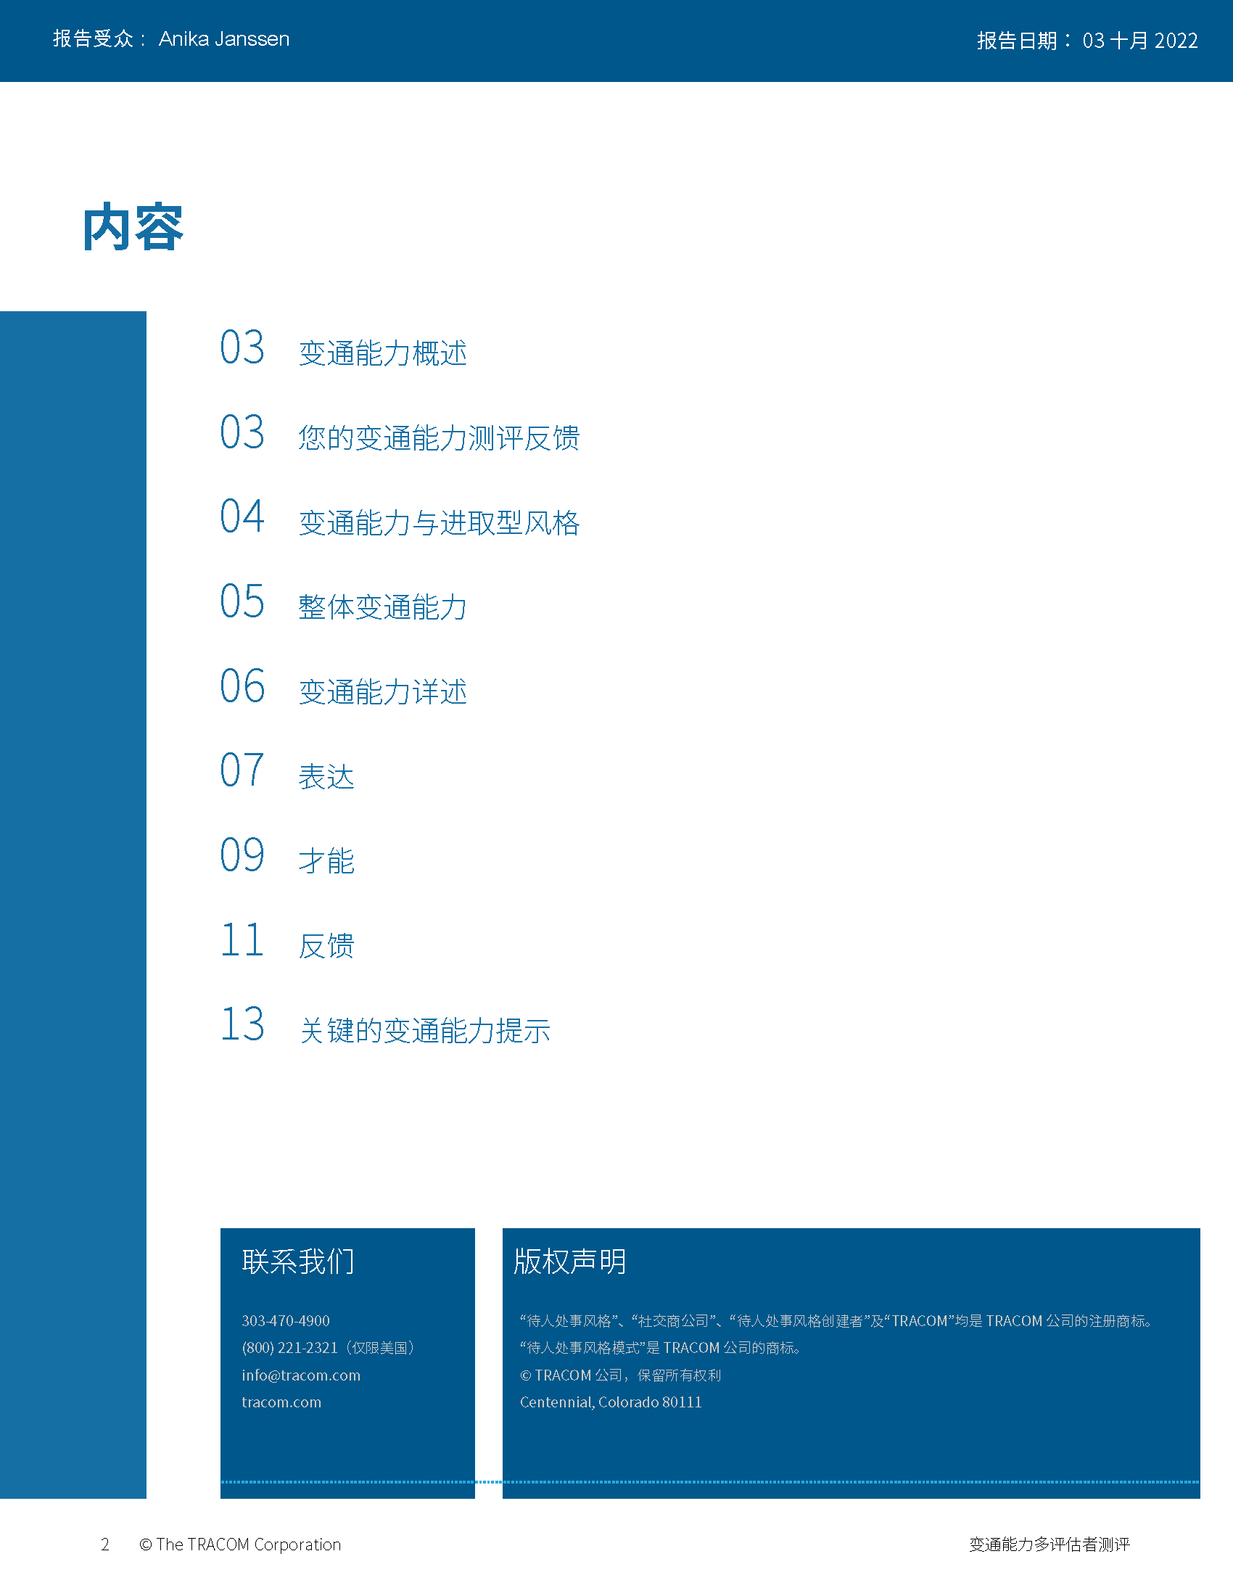
© TRACOM 公司。保留所有权利。
67
Notes:
20 Minutes
Review the Profile pages so participants understand the layout of the Profile. After you’ve reviewed the profile, distribute individuals’ profiles.
PROVIDE ample time for participants to read and absorb their reports. Do not continue until it is evident that all participants have finished reading their reports.
ASK if there are any questions, surprises, or concerns.
ASK If your self-perception results were different, what might have caused the difference in views?
NOTE: It is recommended that you take a break here and make yourself available for one-on-one conversations as participants may have questions or concerns they do not want to discuss with the entire class.

Slide 68
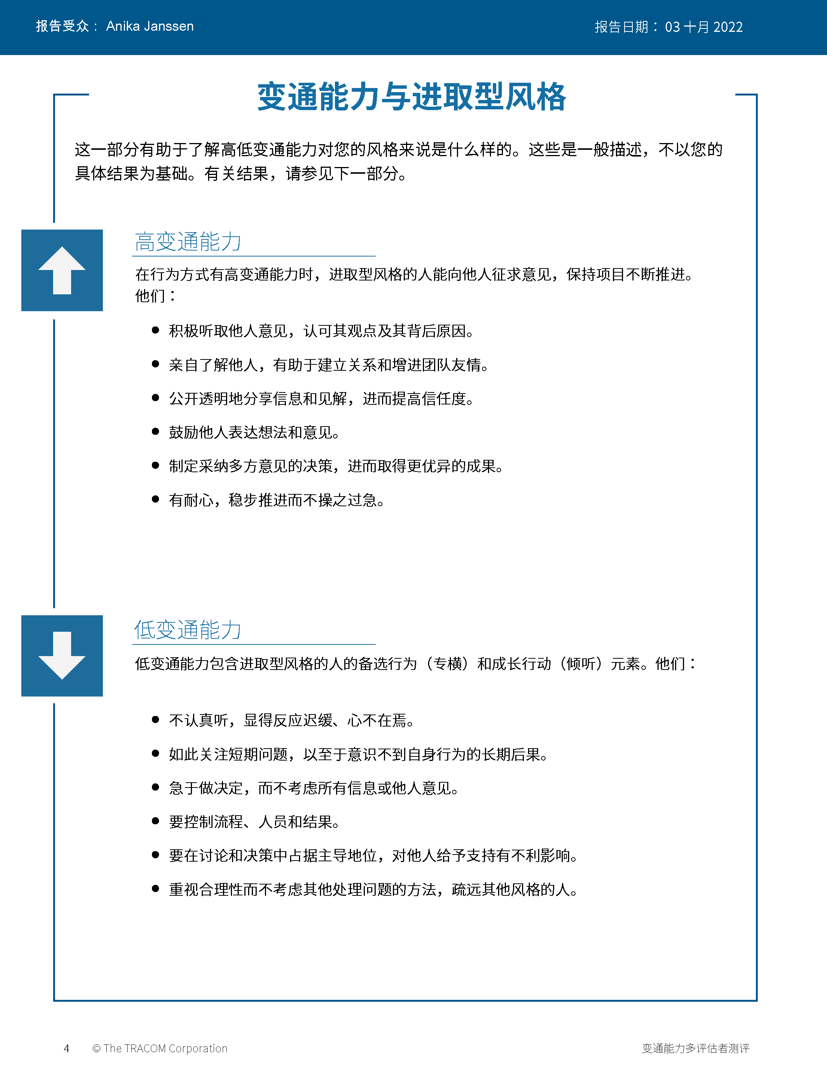
© TRACOM 公司。保留所有权利。
68
Notes:
Continue reviewing.

Slide 69
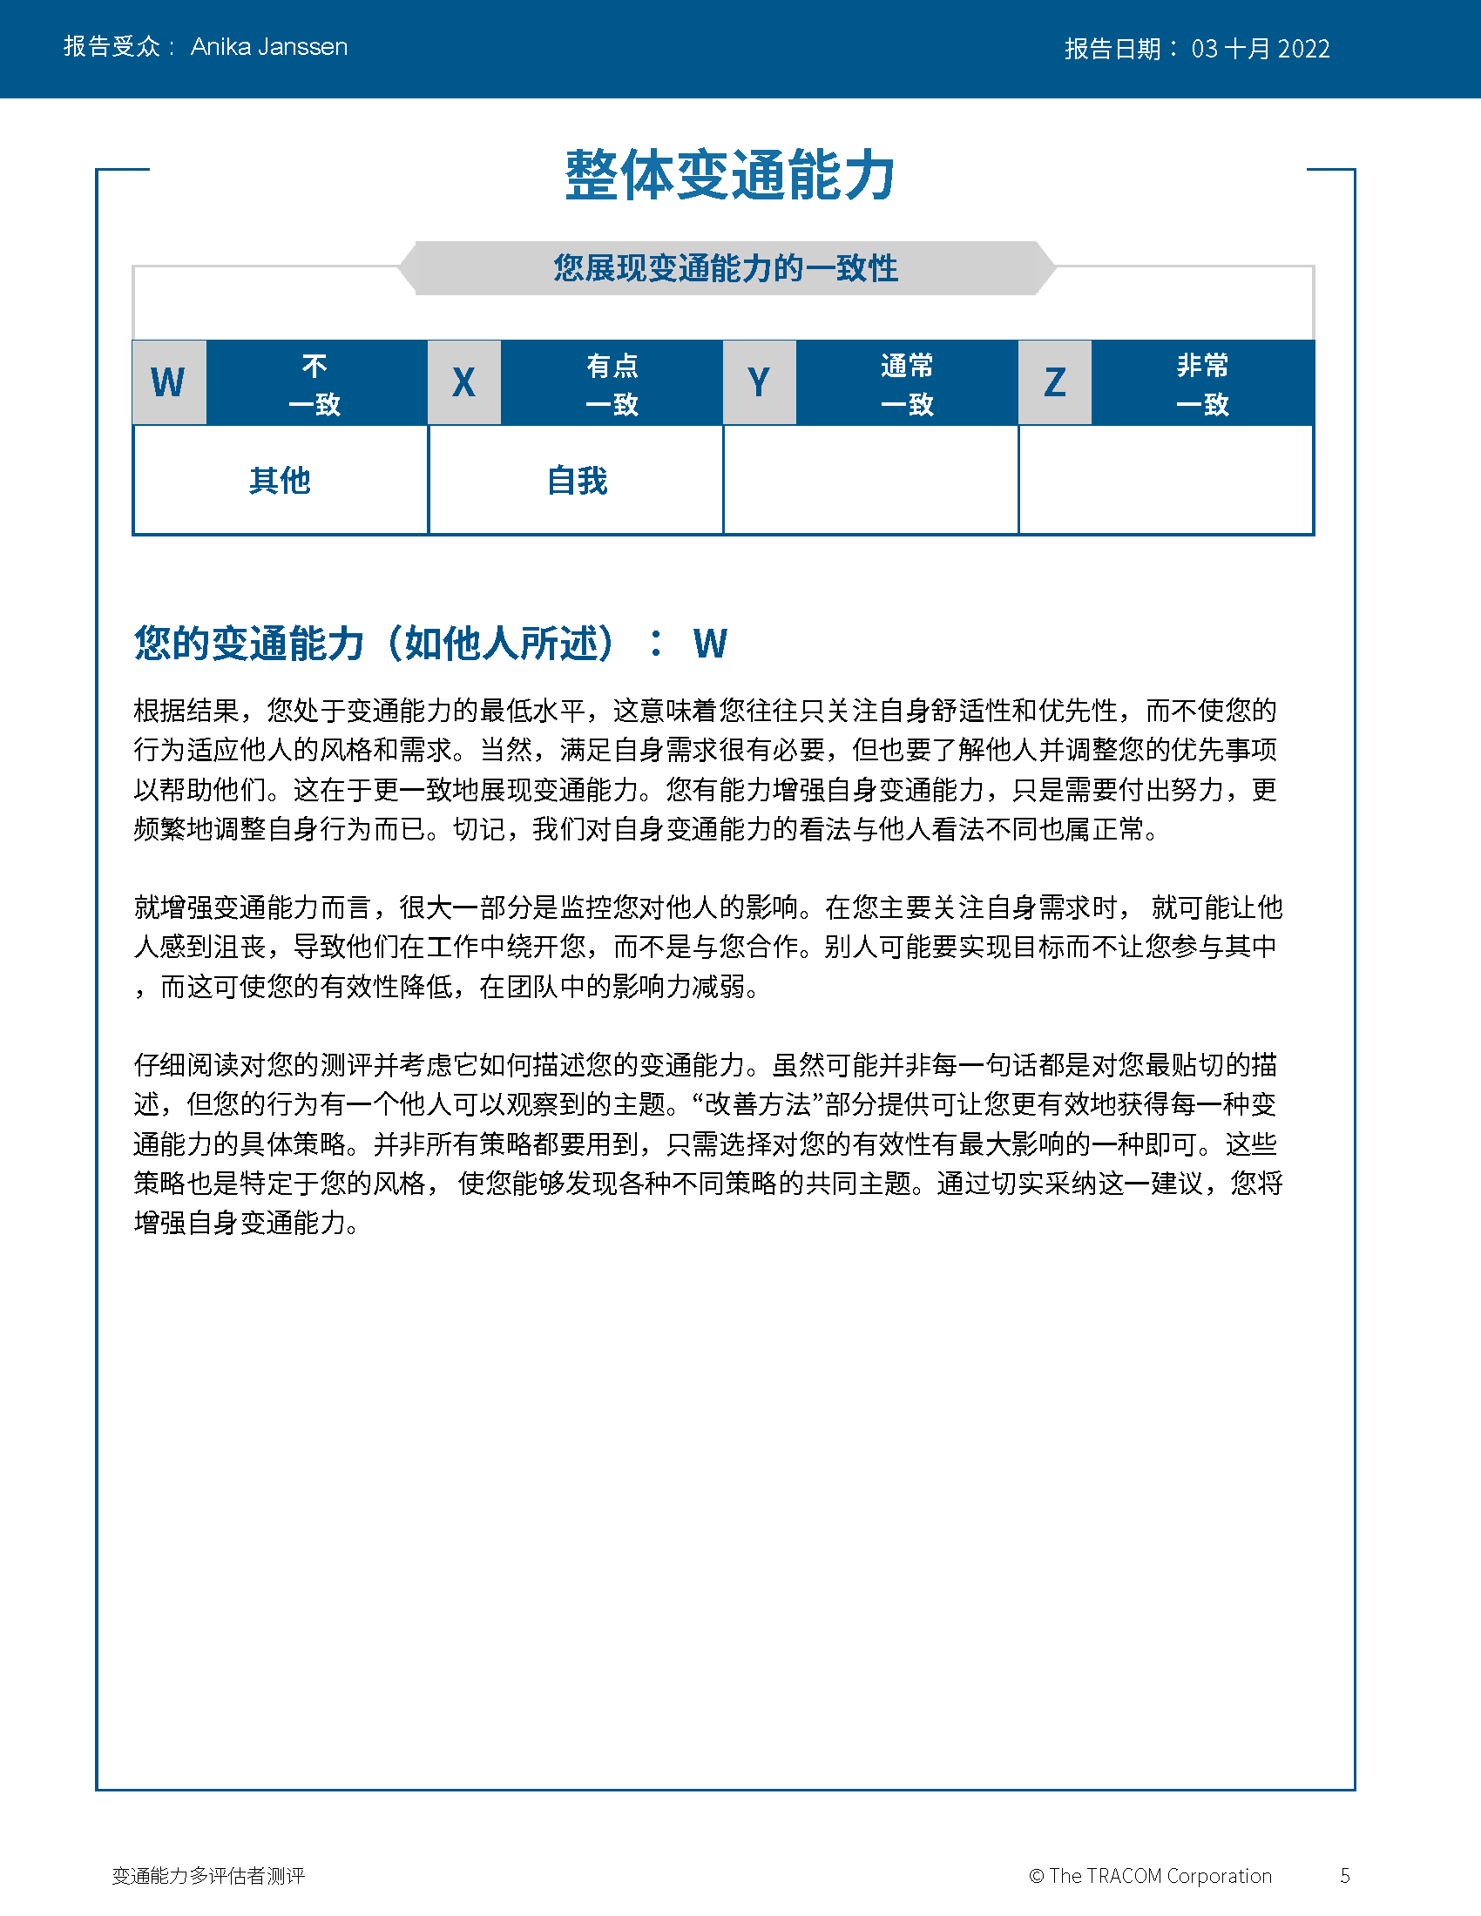
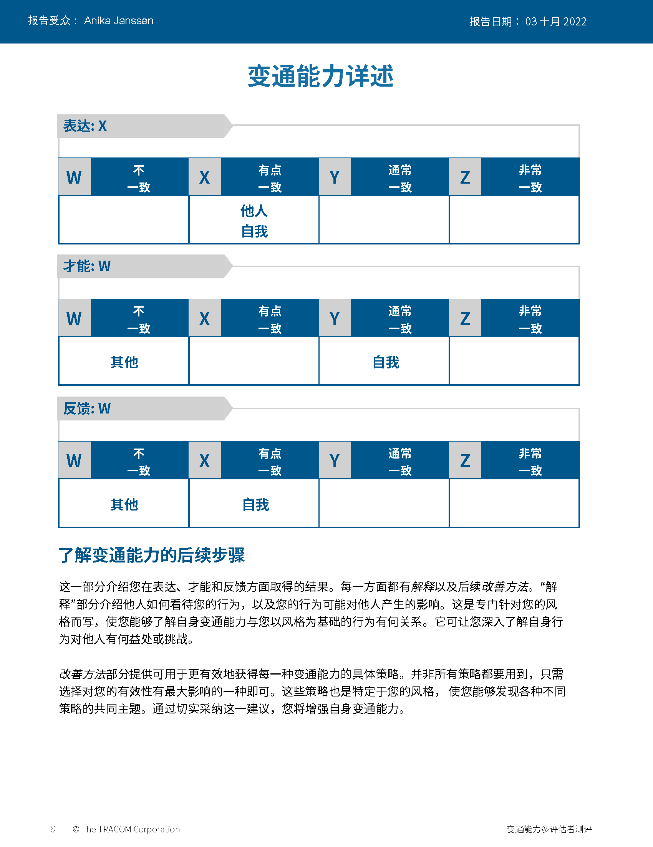
© TRACOM 公司。保留所有权利。
69
Notes:
Continue reviewing.

Slide 70
© TRACOM 公司。保留所有权利。
70
Notes:
Continue reviewing.

Slide 71
提高人际效能的步骤
为他人做点事情
控制自己
认识到你对他人的影响
管理自己的行为
客观地观察他人
帮助满足他人的风格需求
了解自己
了解他人
Notes:
5 Minutes (Workbook, page 33)
SAY At the beginning of the program, we talked about the four steps for increasing interpersonal effectiveness. Now that you’ve reviewed your Versatility profiles, let’s review these again as we think about ways to adjust behavior to increase Versatility.
REVIEW the four steps for increasing interpersonal effectiveness:
1. Know Yourself by recognizing the impact your Style has on others.
2. Control Yourself by managing your own Style behavior and being tolerant of others’ Styles.
3. Know Others by observing them more objectively.
4. Do Something For Others by helping them meet their Style needs. This eases their tension and opens the door for them to act with Versatility towards you.
SAY To finish the program, we’re going to focus on Doing Something for Others. You’re going to create an action plan to increase Versatility with your customers. First, we’ll review some strategies for showing Versatility towards each Style. This will give you important information for creating your action plan.

Slide 72
为会议做准备
控制情绪
分析型
要
提前分享议程
确认会议细节是否足够
做好准备
不要
期待有很多对话
注重人际关系
对他们的意见不屑一顾
进取型
要
陈述预期成果
获得他们对议程的同意
允许他们控制会议详情
不要
开始太晚
杂乱无章
不必要地阻塞决策
征询意见
表达意见
亲切型
要
共同创建议程
提前进行社交
入场时打开相机和麦克风
不要
因为他们同意见面而假装有兴趣
在沟通中直奔任务主题
在不让他们事先知道的情况下让他们参与进来
表达型
要
询问他们对议程的意见
立即认可他们
乐在其中
不要
提前提供太多细节
详细回顾过去
会议安排得过于紧凑
流露情绪
Notes:
6 Minutes (Workbook, page 34)
SAY Part of showing Versatility is recognizing customers’ needs and preparing ahead of time. Here are some meeting strategies for each Style.
CLICK TO REVEAL THE TEXT IN EACH QUADRANT.
REVIEW the do’s and don’ts when preparing for meetings.

Slide 73
量身定制消息
控制情绪
分析型
以下是我们目前根据这些信息所 做的…
我们做了这些假设…
我们预测到这些风险…
根据这一点，我们建议…
进取型
我们将实现您所期望的结果。
我们有经验丰富的一流团队。
我们的团队将快速致胜。
我们可以马上开始。
征询意见
表达意见
亲切型
这里是会保持不变的事情以及会变化的事情。
我们之前已经这么做过很多次了。
这里有一份你可以打电话的推荐人名单。
我们保证通力合作。
表达型
我们很高兴能帮助您实现您的愿景！
当这一切完成时，你将成为全球的领导者！
这将是你和你的组织向前的一个重大飞跃！
高管们是真真正正幕后英雄！
流露情绪
Notes:
6 Minutes (Workbook, page 35)
SAY Most of us fall into the habit of communicating with people in ways that are comfortable for us, without thinking of the needs of the customer. This is often because we’re rushed and send out quick emails. Communicating in Style-specific ways is very important for meeting your customers’ needs. Here are some simple strategies for tailoring your messages to each Style.
CLICK TO REVEAL THE TEXT IN EACH QUADRANT.
REVIEW the techniques for tailoring messages to each Style.

Slide 74
运用变通能力获取信任
控制情绪
分析型
证明你有能力
展示提案背后的逻辑
注重质量
提前做好准备，了解他们的组织
沟通优点和缺点
允许培养个人关系，而不要操之过急
进取型
对自己的能力表现出信心
如果要求不能满足，通知他们
坦诚
跟上快节奏
表达你对他们期望结果的理解
有效利用他们的时间
征询意见
表达意见
亲切型
在适当的情况下分享个人信息
真诚待人
展示你帮助他们的决心
对他们的需求感同身受
避免不必要的压力
记住他们之间关键关系的名称
表达型
保持随意和开放的态度
不可不必要地隐藏你的感觉
避免挑战或与他们竞争
对他们的想法和见解表现出热情
全心全意地关注他们
聊些与工作无关的话题
流露情绪
Notes:
8 Minutes (Workbook, page 36)
ASK Given a customer’s Style need, what are some ways to earn trust?
FACILITATE a discussion of each Style before revealing the text.
ASK What are some ways to earn trust from people of each Style? Think about their Style needs—what do they value from salespeople?
CLICK TO REVEAL THE TEXT IN EACH QUADRANT.

Slide 75
变通能力行动计划
制定一项行动计划来提高你与客户相处的变通能力。
指导
思考您所确定的客户的风格。
你的风格是如何妨碍一段更好的关系的? （思考你的风格发展措施）
您将采取什么措施来提高与该客户相处的变通能力?
在你的分组中，讨论你的计划并获得小组的反馈。
75
Notes:
30 Minutes (Workbook, page 37)
SAY Use the insights you’ve learned and create a specific plan for yourself. Writing down your intentions is a proven way of making sure you actually do something. Decide on just one or two things you can do differently.
Remember your Style growth actions, since managing your own Style behavior is an important part of being versatile.
REVIEW the Style growth actions:
Driving: to listen
Expressive: to check
Amiable: to initiate
Analytical: to declare
SAY When you’ve finished this, we will put you in small breakout groups to share your insights and give feedback to one another.
CREATE breakout groups of 2 to 3 people.

Slide 76
无形中观察变通能力
Notes:
10 Minutes (whole section on Observing Versatility Virtually)
SAY Briefly, before we finish—remember those text messages we reviewed earlier? Let’s bring Versatility into those conversations.

Slide 77
看看你是否有机会查看我发的关于 最新技术升级的视频。你怎么看?
Notes:
SAY We had four responses to this message. Let’s look at how the person who sent this message might respond to each of these individuals. Is the person showing Versatility in each message?

Slide 78
Hi！很快就会发生很多变化。 我的团队需要接受关于新功能的培训。 你能帮帮我们吗?
看起来有很多变化，但是这些升级将帮 助你的团队更好地协作。我将为你的团队 制定一个计划，以防发生任何问题。 我为你和你的团队而来！
Notes:
SAY This message came from the Amiable Style customer.
Click to reveal.
SAY And here is the response. What do you think? Is the salesperson showing Versatility toward the Amiable Style person? What would you add or change to the response?
NOTE: The salesperson is making an effort to meet the person’s Style needs by reassuring them about the changes. The salesperson offers to help the customer by developing a training plan, then reassures them that they will be supported.

Slide 79
真让人兴奋！我匆匆看了下， 新功能似乎很不错！
我下周打给你！
是啊，升级应该没问题。以后再聊。
Notes:
SAY This message came from the Expressive Style person.
Click to reveal.
SAY And here is the response. What do you think? Is the salesperson showing Versatility toward the Expressive Style customer?
Is the response focused on their own needs, or the Expressive Style person’s needs? What would be a more effective response?
NOTE: The salesperson is diminishing the customer’s enthusiasm. A more effective response would be to reflect the enthusiasm by reiterating how great the new upgrades are and how excited the salesperson is about the changes, then offer to set up a call with the customer.

Slide 80
我认为新的升级将帮助我们变得更有效率， 节省一些精力。但在我们采用新版本之前， 我们需要计划对我的团队进行培训。 你有没有这方面的相应流程?
我们已经对升级进行了测试，证明它 们的性能有显著改进。我会把这些数据 连同培训日程和可用日期一起发给你。 还有什么别的需要帮忙，记得告诉我。
Notes:
SAY This message came from the Analytical Style customer.
Click to reveal.
SAY And here is the response. What do you think? Is the salesperson showing Versatility toward the Analytical Style person? What would you add or change to the response?
NOTE: The salesperson is making an effort to meet the customer’s Analytical Style needs by recognizing their need to prepare ahead of time by getting training. The salesperson offers to send more detailed information about the upgrades as an effort to give the customer more information and alleviate any remaining concerns. They also open the conversation to more input by offering to help in any other way.

Slide 81
看上去不错。 准备好实施时我会打给你。
OK。
Notes:
SAY This message came from the Driving Style customer.
Click to reveal.
SAY And here is the response. What do you think? Is the salesperson showing Versatility toward the Driving Style customer?
Is the response focused on their own needs, or the Driving Style person’s needs? What would be a more effective response?
NOTE: Though Driving Style people appreciate brevity, the salesperson is dismissive and is missing important elements of the customer’s Style. The salesperson should recognize that the customer probably hasn’t reviewed the upgrades in detail. The salesperson should state that they are there to help move forward, and also offer options to meet with the customer to discuss the changes and listen to their input.

Slide 82
后续步骤
实践变通能力 请将你的行动计划放在身边方便参考。
待人处事风格导航器建议了许多销售情况以及更多资源。
待人处事风格护照允许你了解在别的国家会怎样做侧写。
Notes:
5 Minutes (Workbook, page 38)
SHARE key “takeaways” with the class:
The key to more effective performance is to practice what you’ve learned. Keep your Versatility Action Plan nearby as a reminder. As you begin to experience positive results, this will reinforce your commitment to practice Versatility.
There are additional resources that will help you. TRACOM’s SOCIAL STYLE Navigator contains advice for working with customers in a variety of situations, such as giving presentations, advancing the sale, and having difficult conversations. You can access this resource by logging in at tracomlearning.com.
NOTE the following slides describe SOCIAL STYLE Navigator in more detail.

Slide 83
待人处事风格导航器®
待人处事风格评估器 评估他人风格的简短调查
待人处事风格顾问
为会议、谈判、陈述做准备
多种情况下的风格和变通能力最佳实践
网上学习模块 将风格概念应用于团队，管理冲突和指导
待人处事风格导航器® 是 TRACOM 公司的注册商标
Notes:
1 Minute
SAY You now have free and unlimited access to SOCIAL STYLE Navigator, the on-demand micro-learning tool that helps you apply Style and Versatility.
SOCIAL STYLE Navigator includes:
SOCIAL STYLE Estimator
The Estimator survey provides users with an interactive tool that evaluates observable behavior in others to determine their Style and helps you plan ahead for successful interactions.
SOCIAL STYLE Advisor
Use Advisor topics to prepare “just-in-time” for meetings, negotiations or sales presentations with advice on navigating Style and Versatility best practices to maximize high-performing relationships.
eLearning modules
Continue your learning journey via micro-learning that reinforces ways to apply SOCIAL STYLE and Versatility to Working in Teams, Coaching and Managing Conflict.

Slide 84
待人处事风格 导航器®访问权限
可访问 tracomlearning.com 获得
Notes:
1 Minute
SAY Available through www.tracomlearning.com
Enter your username and password for free, unlimited access to SOCIAL STYLE Navigator®

Slide 85
Notes:
Optional demonstration, time permitting

Slide 86
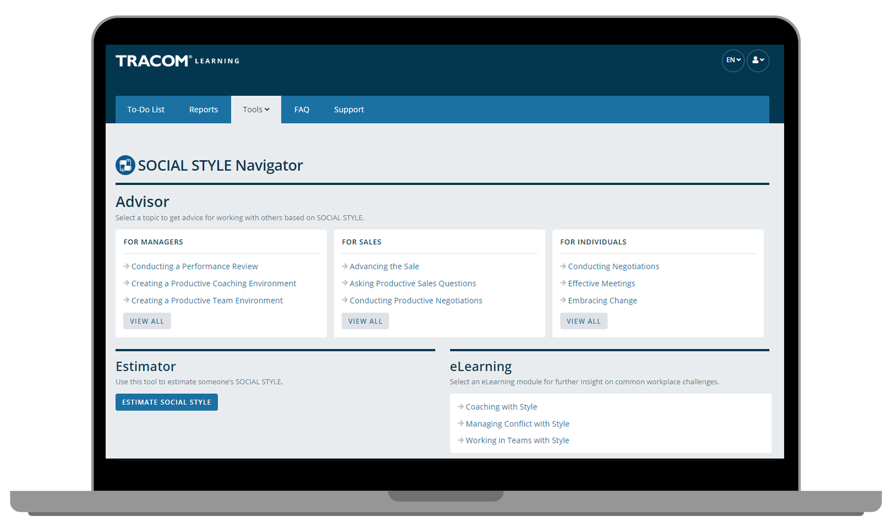
Notes:
Optional demonstration, time permitting

Slide 87
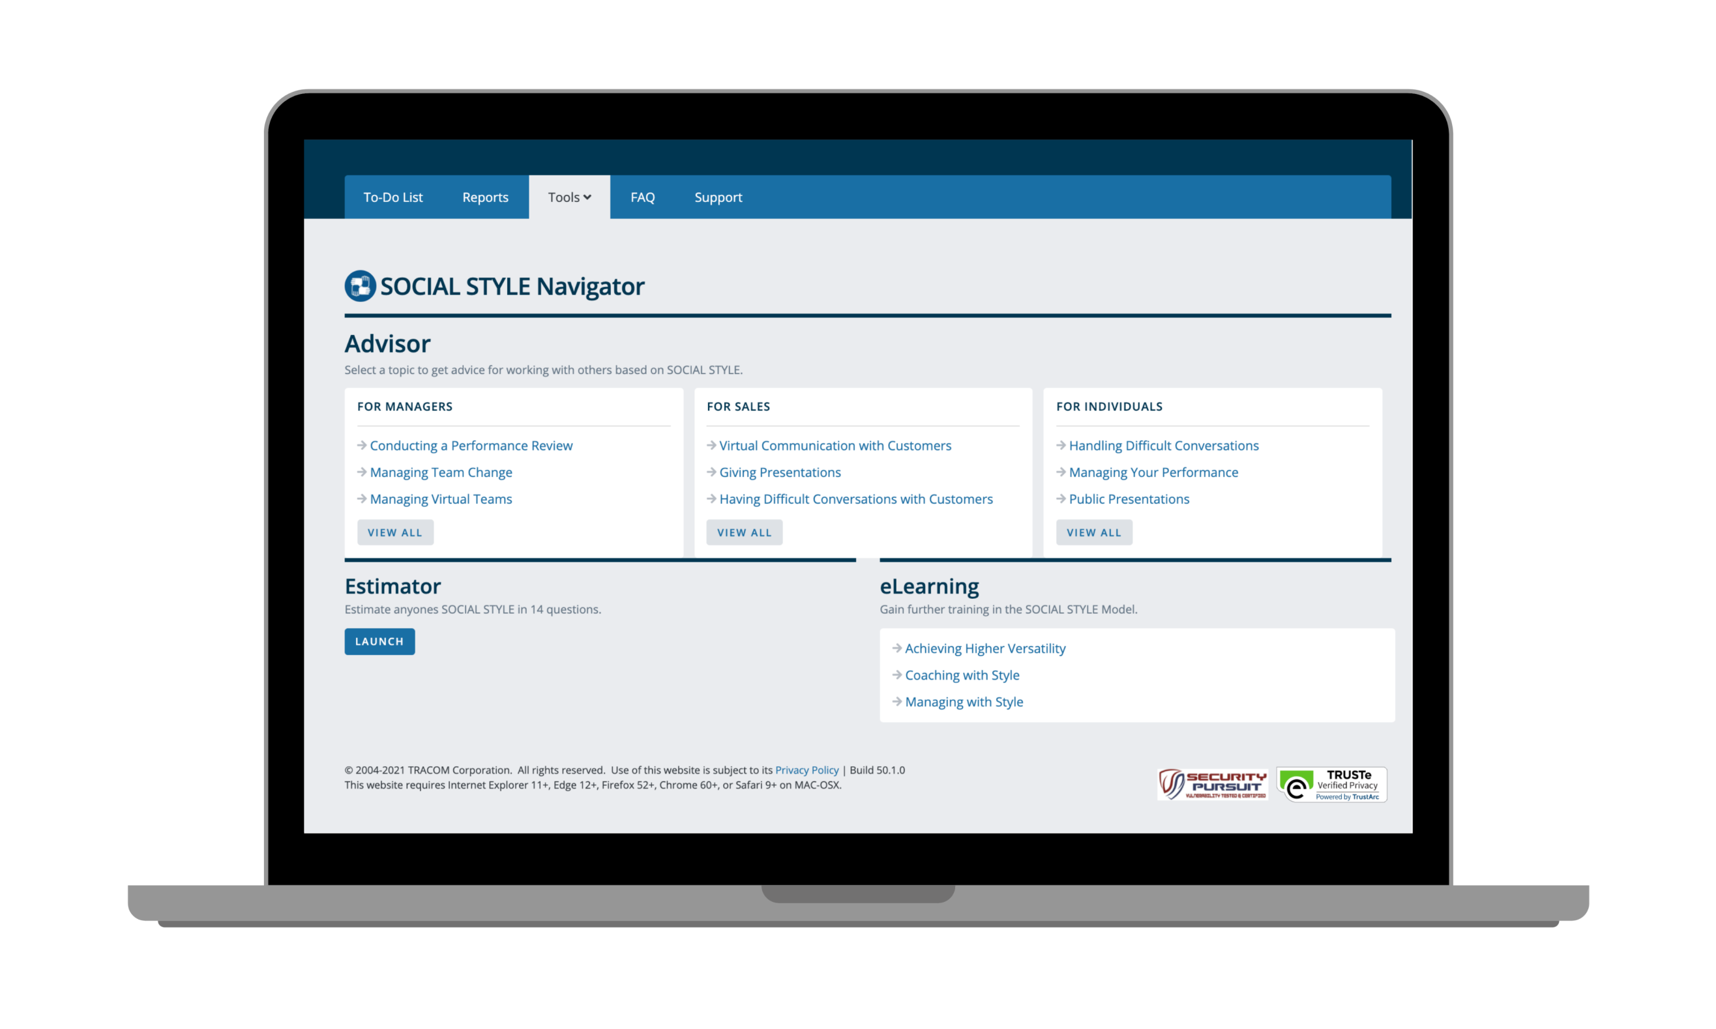
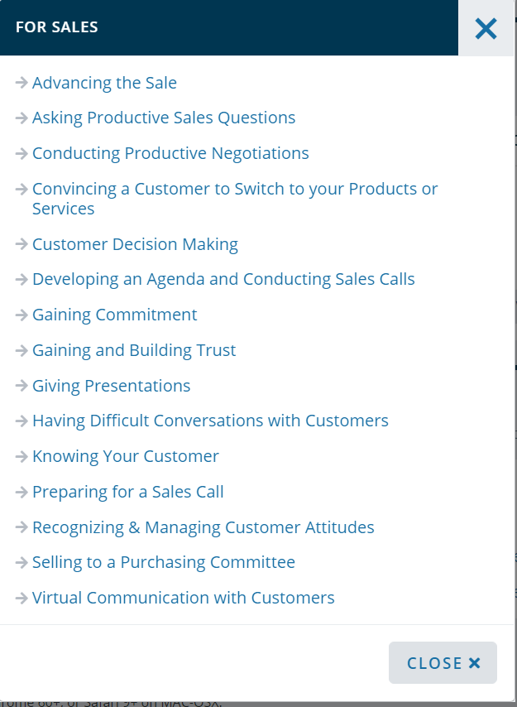
Notes:
Optional demonstration, time permitting

Slide 88
Notes:
Optional demonstration, time permitting

Slide 89
Notes:
Optional demonstration, time permitting

Slide 90
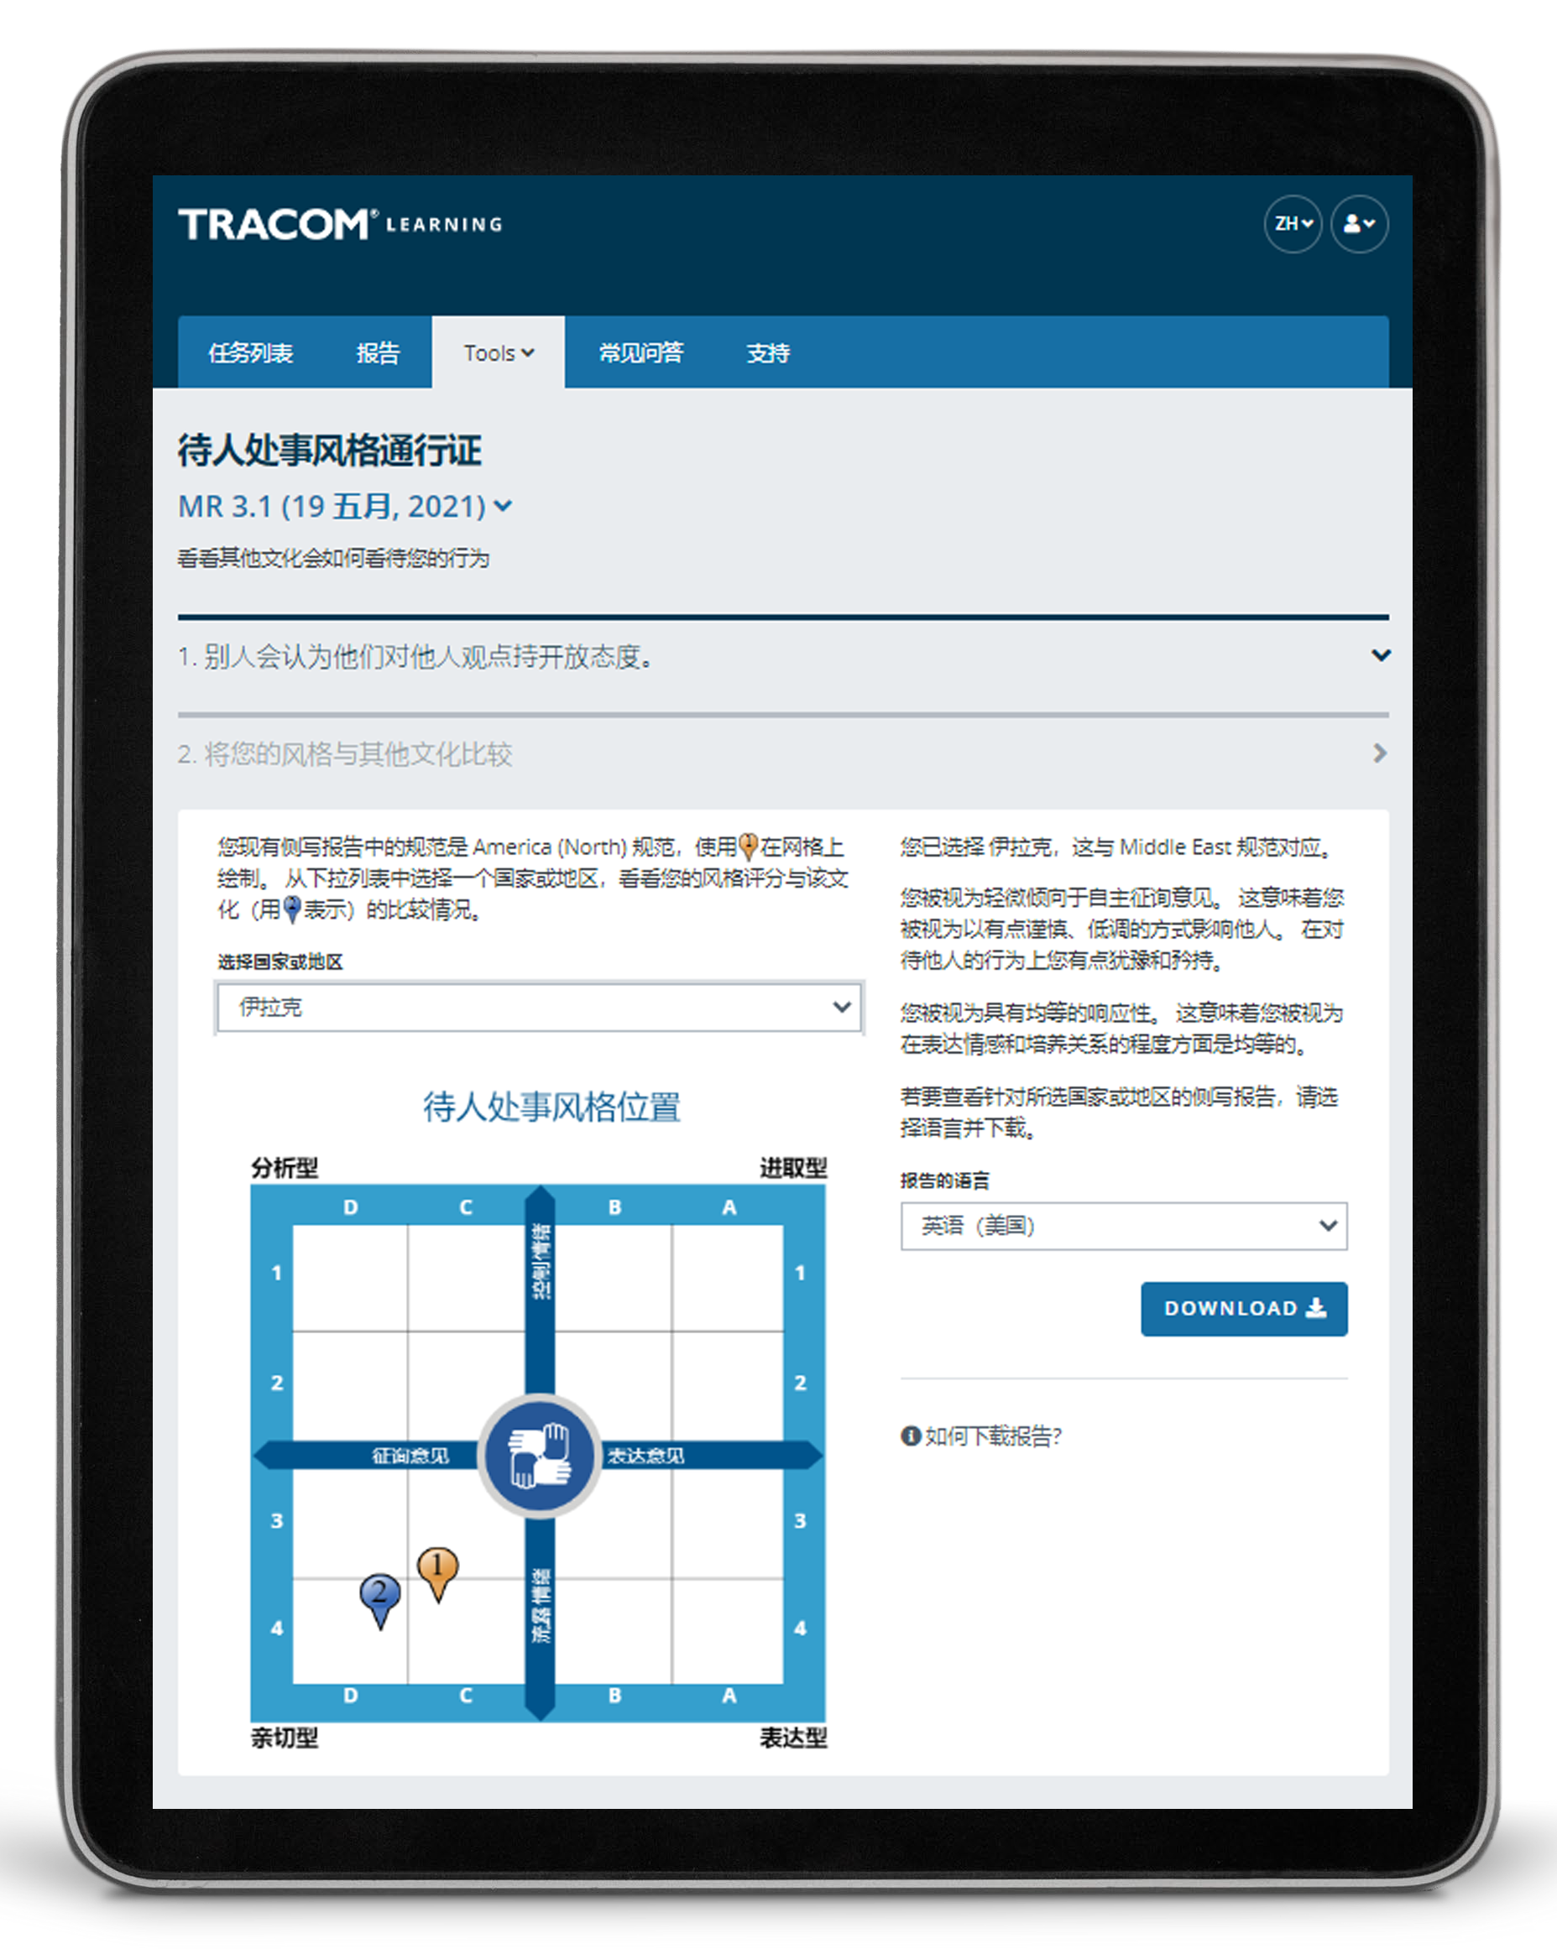
待人处事风格护照
Notes:
Optional demonstration, time permitting
The SOCIAL STYLE Passport allows you to see how you would profile in another country. It’s also available at tracomlearning.com.

Slide 91
91
Notes:
THANK participants and conclude the session.

