Slide 1

Mejorar la eficacia de las ventas con versatilidad™
Versión 4.0
Notes:
5 MINUTES (Workbook, pages 1-3)
WELCOME participants and provide a brief overview of the session.
ASK participants to turn to Pages 1, 2 and 3 in the Participant Workbook to follow along.
Stress the importance of active participation.
Briefly review the history of SOCIAL STYLE.
Cite the proven effectiveness of increased Versatility on page 3 in the Participant Workbook.
Explain what SOCIAL STYLE is all about. Say something like, “Did you ever notice that customers have certain patterns of behavior: some are animated and loud, some treat you like a friend from the start, others are all business? SOCIAL STYLE gives you a way of identifying a customer’s pattern of behavior, and of interacting with them in ways that will help you to increase your effectiveness in your selling process.”
Ask participants to think about their past customers. Ask, “Besides, ‘they bought from me,’ what made your good customers good? And, what made the difficult ones difficult to sell to?” Use the participants' responses to identify issues that will be addressed in this training.
<<Copy and paste this table to
notes pages on which you want
participants to be able to take
notes

Slide 2
Objetivos de aprendizaje
Comprender El modelo ESTILO SOCIAL Model™.
Determinar su ESTILO SOCIAL completando un cuestionario de autopercepción.
Comprender mejor su comportamiento y cómo los clientes ven a las personas con su Estilo.
Aumentar su versatilidad para ser más efectivo con los clientes.
Notes:
15 MINUTES TOTAL
5 MINUTES
Going through this session you will:
• Gain an understanding of the SOCIAL STYLE Model.
• Determine your SOCIAL STYLE by completing a self-perception questionnaire.
• Increase your understanding of your behavior and how Customers view people with your Style.
• Increase your Versatility to become more effective with Customers.
SAY I want to emphasize the last point, number 4. While you’ll learn a lot about yourself, the goal of this program is to learn about your customers and how you can adjust your behavior to work more effectively with them. Versatility is about adjusting your behavior to help others meet their Style needs. When you do this, you increase your effectiveness and also make it easier for others to show Versatility toward you.
If your participants completed the Online Self-Perception assessment:
Make sure you have a profile for each participant who completed the assessment.
DO NOT pass out the profiles at this time.
VIRTUAL: Participants should already have their profiles available.
10 MINUTES
If you are using the Paper profile:
SAY It’s critical that individuals understand their own behavior and how it affects others. So we’re going to do an exercise that will give you insights about yourself. You’re each going to complete a self-assessment of your SOCIAL STYLE. With that knowledge as a foundation, we’ll then look at how you can work more effectively with others.
1. DISTRIBUTE questionnaires.
2. ASK participants to complete the SOCIAL STYLE and Versatility Questionnaires.
3. DO NOT ask participants to score their questionnaires at this time.
VIRTUAL PROGRAM
If delivering virtually, you will not be able to use paper questionnaires and will need to prepare ahead of time to deliver online profiles. Arrange to have a notification sent to learners so they can download their profiles prior to the session.

Slide 3
ESTILO SOCIAL Y VERSATILIDAD
UN ELEMENTO CLAVE DEL RENDIMIENTO DE LAS VENTAS
Como resultado de la capacitación sobre ESTILO SOCIAL y versatilidad, los profesionales de ventas informan lo siguiente:
92 %
87 %
58 %
desarrolló más
aumentó su capacidad para
informó que
RELACIONES POSITIVAS CON LOS CLIENTES
CERRÓ VENTAS QUE DE OTRO MODO NO HABRÍA REALIZADO
INFLUIR O PERSUADIR A LOS CLIENTES
A medida que aumenta la versatilidad, también lo hace el desempeño en el trabajo.
Notes:
2 MINUTES
SAY In the first part of the program, you’ll learn about Style. This will help you understand your customers and how they prefer to interact with you.
The second part of the program focuses on Versatility, which is how well you meet others’ Style needs.
Versatility is the application of SOCIAL STYLE—when you understand your customers’ Style needs, you can help them meet those needs. This helps them feel more valued and sets the stage for them to have a better relationship with you. If you consistently show Versatility, you can be more effective.
You can read the stats on this slide. Research has found that SOCIAL STYLE and Versatility is a strong predictor of successful sales performance.

Slide 4
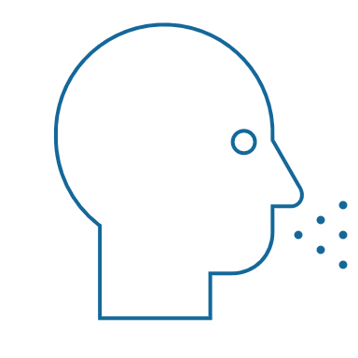
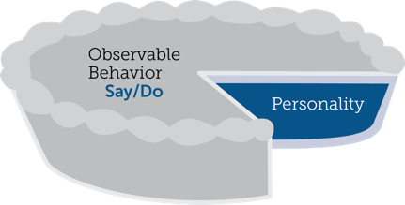

Comportamientos observables frente a personalidad
Comportamiento
Lo que dice (verbal) y hace (no verbal)
ESTILO SOCIAL®
Un patrón de acciones que otros pueden observar y acordar para describir el comportamiento de una persona
Comportamiento observable
Decir/Hacer
Personalidad
Comportamiento interpersonal
Lo que dice y hace cuando interactúa con otras personas
Personalidad
Todo lo que es una persona: sus ideas, valores, esperanzas y sueños
Notes:
4 MINUTES (Workbook, page 5)
ASK participants to turn to page 5 of the Participant Workbook to follow along.
SAY Behavior and personality are not the same things. Observable behavior is like the crust of a pie. Personality is like the inside and outside of the pie.
ASK What makes up personality?
CONDUCT a quick facilitated discussion to solicit participants’ responses. They should say things such as:
Values, hopes, attitudes, beliefs.
Things that are not necessarily observable.
These internal qualities are more subjective in nature.
SAY Style is like the crust, because it’s on the outside and observable. By observing behavior, we can find ways to define and discuss what we see. Then, we can begin to understand how this behavior affects ourselves and others.

Slide 5
Comportamientos de decir y hacer
Rasgos
Honesto
Inteligente
Arrogante
Motivado
Egocéntrico
Sincero
Crítico
Comportamiento observable
Tranquilo
Ritmo más lento
Rostro controlado
Voz menos inflexible
Contacto visual reducido
Postura casual
Se inclina hacia atrás
Ruidoso
Ritmo más rápido
Rostro animado
Voz más inflexible
Contacto visual en exceso
Postura rígida
Se inclina hacia adelante
Juicios
Me gusta
Él me molesta
Ella me interesa
Él me irrita
No confío en ella
Lo odio
Confío en él
DECIR
HACER
Notes:
4 MINUTES (Workbook, pages 6-7)
ASK participants to turn to pages 6 and 7 of the Participant Workbook to follow along.
SAY When we first meet people we often form immediate impressions, even after just a few seconds. This is sub-conscious (below our awareness) and happens immediately.
DESCRIBE
Traits Column: What we think we know about a person, based on interactions; subjective opinions.
Judgments Column: Our reactions to others; conclusions or evaluations we make, based on our subjective opinions.
Observable Behavior Column: Things others “Say and Do”; more objective and observable behaviors.
SAY Traits and Judgments are most subjective in nature and contain positive or negative descriptions.
Observable Behavior is objective and contains no positive or negative value.
Observable Behavior is an important tool for assessing others’ Styles. By focusing on Observable Behavior, you gain objectivity, which is critical for understanding people’s Styles.

Slide 6
Firmeza y reacción
Notes:
SAY We measure observable behavior on two dimensions: Assertiveness and Responsiveness

Slide 7
Firmeza
El grado en el que “preguntamos” o “decimos” cuando interactuamos con otros
Mayor tendencia a preguntar
Tendencia a preguntar con algo de decir
Tendencia a decir con algo de preguntar
Mayor tendencia a decir
Notes:
4 MINUTES (Workbook, pages 8-9)
ASK participants to turn to pages 8 and 9 of the Participant Workbook.
SAY To become more effective with others, we follow a behavioral model. There are two dimensions of behavior that define SOCIAL STYLE: Assertiveness and Responsiveness.
Assertiveness is the degree to which we ask or tell when interacting with others. The two anchors for Assertiveness are Ask on the left side of the continuum and Tell on the right side of the continuum.
Assertiveness is a measurement of how we try to influence others to take action. If you are more “Tell” Assertive, you state your opinions directly. You tend to declare your viewpoints and try to direct the actions of others.
For example, if you want to have lunch with someone, you might say, “Let’s have lunch today!”
If you are more “Ask” Assertive, you tend to be more cautious and reserved about sharing your opinions. You attempt to influence others in a more quiet, low-key, questioning manner.
For example, if you want to have lunch with someone, you might say, “Would you like to have lunch with me today?”

Slide 8
Comportamientos de firmeza
DECIR | Comportamientos verbales
Más lento
Ritmo del discurso
Más rápido
Menos
Cantidad de discurso
Más
Más silencioso
Volumen de voz
Más fuerte
PREGUNTA
DICE
Relajado
Uso de las manos
Directivo
Se inclina hacia atrás
Postura corporal
Se inclina hacia adelante
Menos directo
Contacto visual
Más directo
HACER | Comportamientos no verbales
Notes:
3 MINUTES
SAY The Assertiveness scale helps predict a person’s behavior because it represents a “theme” or typical pattern. There are verbal and non-verbal clues to indicate a person’s Assertiveness.
DESCRIBE the verbal and non-verbal indicators of Assertiveness:
Verbal: Ask-Assertive individuals use a slower pace, less quantity (fewer words), and quieter volume. Tell-Assertive individuals use a faster pace, talk more, and a louder volume.
Non-Verbal: Ask-Assertive individuals show relaxed hands and gestures, lean back, and use less direct eye contact. Tell-Assertive individuals have a directive use of hands, lean forward, and use more direct eye contact.
Optional Exercise: Do You Ask or Tell?
ASK participants to chat whether they see themselves as more asking or more telling, and to give examples of why they see themselves this way.
In-person activity:
1. ASK participants to go toward either the left side or right side of the room to indicate whether they see themselves as “more asking” (left) or “more telling” (right).
2. ASK participants to introduce themselves to people around them and to share examples of what they feel makes them more asking or more telling.
3. ASK participants to validate their self-assessment based on whether they asked questions or made statements during their discussions. (Ask Assertive individuals will tend to ask more questions; Tell Assertive individuals will tend to make more statements).
4. ASK if anyone feels as though they might have gone to the wrong place.

Slide 9
Reacción
Mayor tendencia a controlar
Tendencia a controlar con algo de emocionar
El grado en el que controlamos o mostramos emociones cuando interactuamos con otros.
Tendencia a emocionar con algo de controlar
Mayor tendencia a emocionar
Notes:
4 MINUTES (Workbook, pages 10-11)
ASK Participants to turn to pages 10 and 11 of the Participant Workbook.
SAY Responsiveness is the degree to which people tend to control (don’t outwardly display emotions) or emote (outwardly display emotions).
The two anchors are Controls on the top of the continuum and Emotes on the bottom of the continuum.
Responsiveness is also the extent to which you react to emotional appeals or displays.
If you control your emotions, you usually don’t react to emotional appeals and are more likely to focus on ideas, data, and tasks. You are less likely to share your feelings publicly.
If you are more emoting, you share and display your emotions with others. You are more likely to respond to emotional appeals and displays from others.

Slide 10
Comportamientos de reacción
DECIR | Comportamientos verbales
HACER | Comportamientos no verbales
Controla
Menos inflexión
Tarea
Hechos/Datos
Menos
Rígido
Controlado
Emoción en la voz
Sujetos de discurso
Forma de los descriptivos
Uso de las manos
Postura corporal
Expresión facial
Más Inflexión
Personas
Opiniones/Historias
Más
Casual
Animado
Emociona
Notes:
3 MINUTES
SAY The Responsiveness scale, like the Assertiveness scale, helps us to predict a person’s behavior because it is a “theme” or typical pattern.
DESCRIBE the verbal and non-verbal clues to responsive behavior as noted on the slide.
SAY Responsiveness is neither a positive nor a negative quality; it is neutral.
Assertiveness and Responsiveness do not affect each other — they are independent of each other.
Optional Exercise: Do You Control or Emote?
ASK participants to chat whether they see themselves as more controlling or more emoting, and to give examples of why they see themselves this way.
In-person activity:
1. ASK participants to go toward the front of the room if they feel they are “more controlling” of their emotions or to the rear of the room if they feel that they are “more emoting” (display their emotions).
2. ASK participants to validate their self-assessments. Typically, “more emoting” individuals will be talking with one another more than the “less emoting” ones.
3. ASK if anyone feels as though they went to the wrong place.

Slide 11
El modelo
ESTILO SOCIAL ModelTM
Controla
Firme al preguntar
Más controlado
Estilo
Analítico
Firme al decir
Más controlado
Estilo Motivador
Pregunta
Dice
Firme al preguntar
Más emotivo
Estilo
Amable
Firme al decir
Más emotivo
Estilo
Expresivo
Emociona
Notes:
4 MINUTES (Workbook, page 12)
ASK participants to turn to page 12 of the Participant Workbook.
EXPLAIN how the SOCIAL STYLE Model is built by combining the Assertiveness and Responsiveness scales and how that forms the four SOCIAL STYLEs.
CLICK TO REVEAL EACH QUADRANT
SAY By combining Assertiveness and Responsiveness, the four SOCIAL STYLEs are formed.
No individual will display one Style exclusively; but, over time, you can determine a person’s Style. Once you know a person’s Style, you can adjust your behavior to develop a more effective relationship.
Note that there is no good or bad Style; each can be equally effective.

Slide 12
Perfil en línea de autopercepción de ESTILO SOCIAL
Notes:
If using the online profile, use the following slides.
Note that if delivering virtually, participants will need to have received their profiles prior to the program.
Check the Session Status Report and Composite Report to understand which participants have completed their profiles, and the breakdown of Style within your program.
FACILITATOR NOTE: By completing on online profile, Learners will immediately have free, unlimited access to SOCIAL STYLE Navigator through tracomlearning.com to help extend their learning beyond the classroom. See Slide #45 for details.

Slide 13

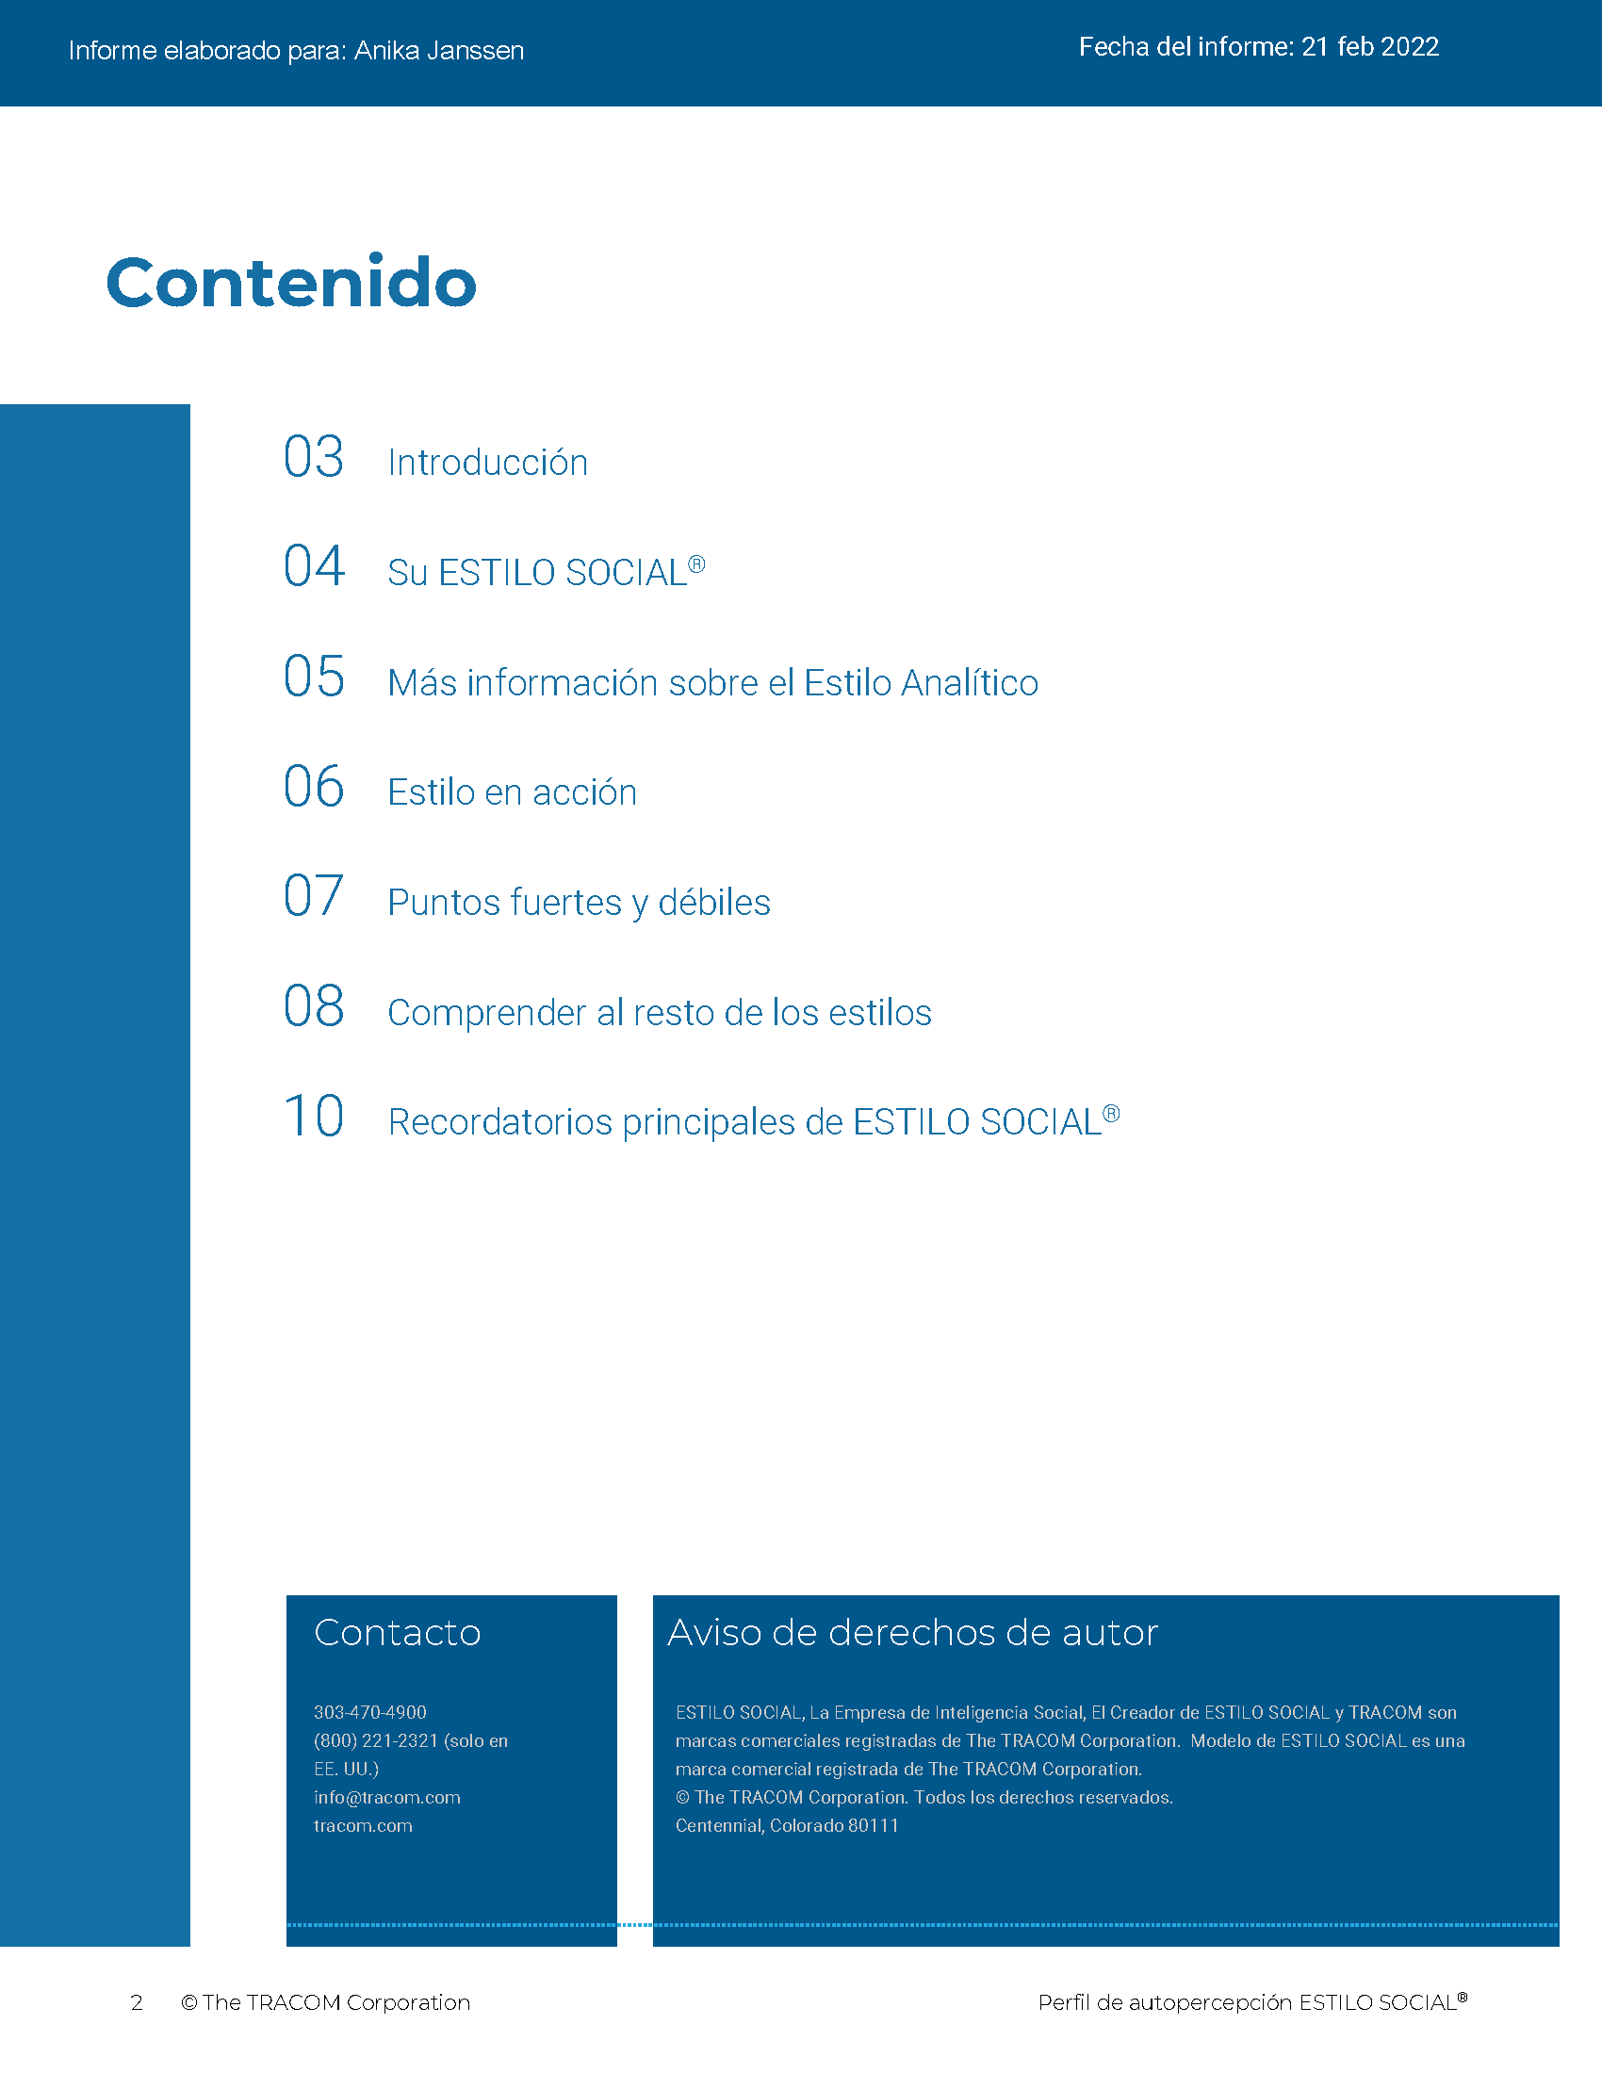
© The TRACOM Corporation. Todos los derechos reservados.
13
Notes:
15 MINUTES (5 MINUTES if Virtual Program)
Purpose
The purpose of this exercise is to help participants learn more about their SOCIAL STYLE and to encourage them to think about how they can adjust their behavior to be more effective.
Materials Needed
SOCIAL STYLE profile
Virtual Directions:
ASK participants to chat their Style along with one adjustment to their behavior they can make to enhance their effectiveness with others.
In-Person Directions:
ASK participants to read their Style profile and begin to determine ways they can adjust their behavior to meet others’ Style needs. (They will continue this exercise when they read their Versatility profiles).
ASK participants to share what they learned about their Style and how they can adjust their behavior.

Slide 14
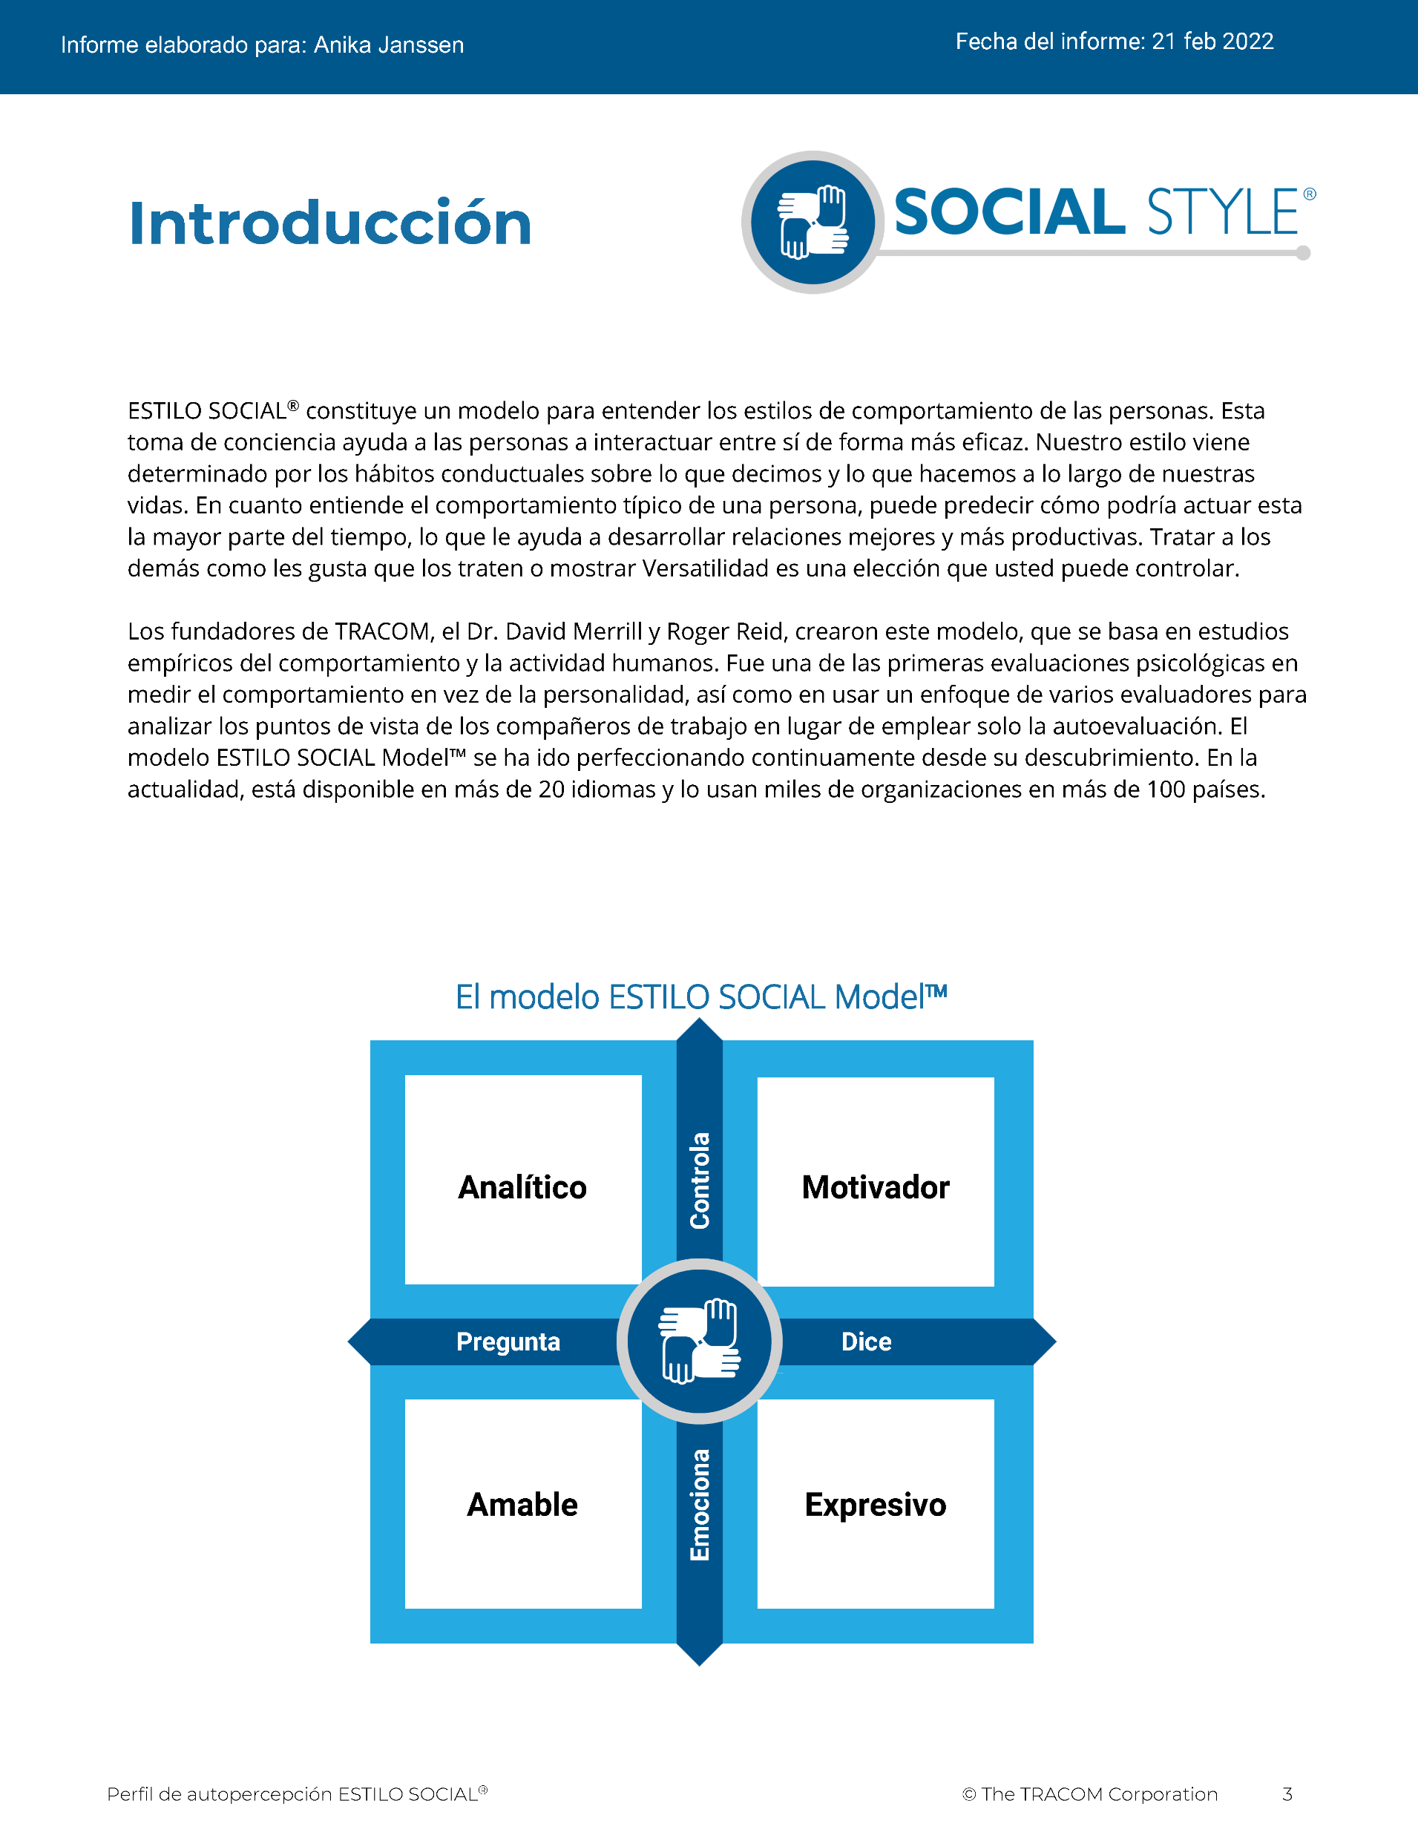
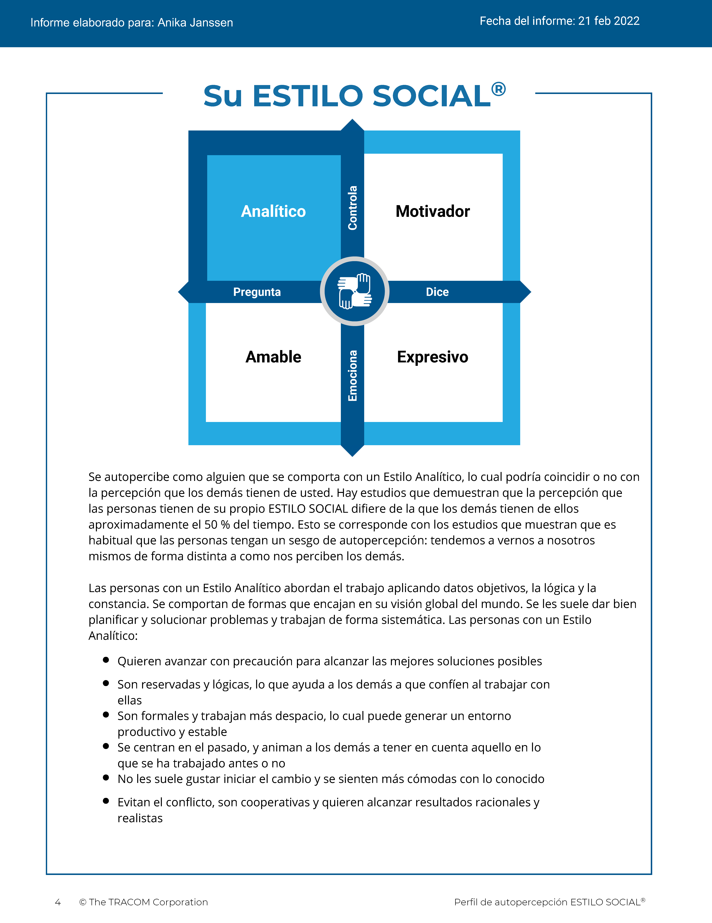
© The TRACOM Corporation. Todos los derechos reservados.
14
Notes:
These slides show pages of the SOCIAL STYLE profile and can be displayed to assist with conversation during the exercise debrief.

Slide 15
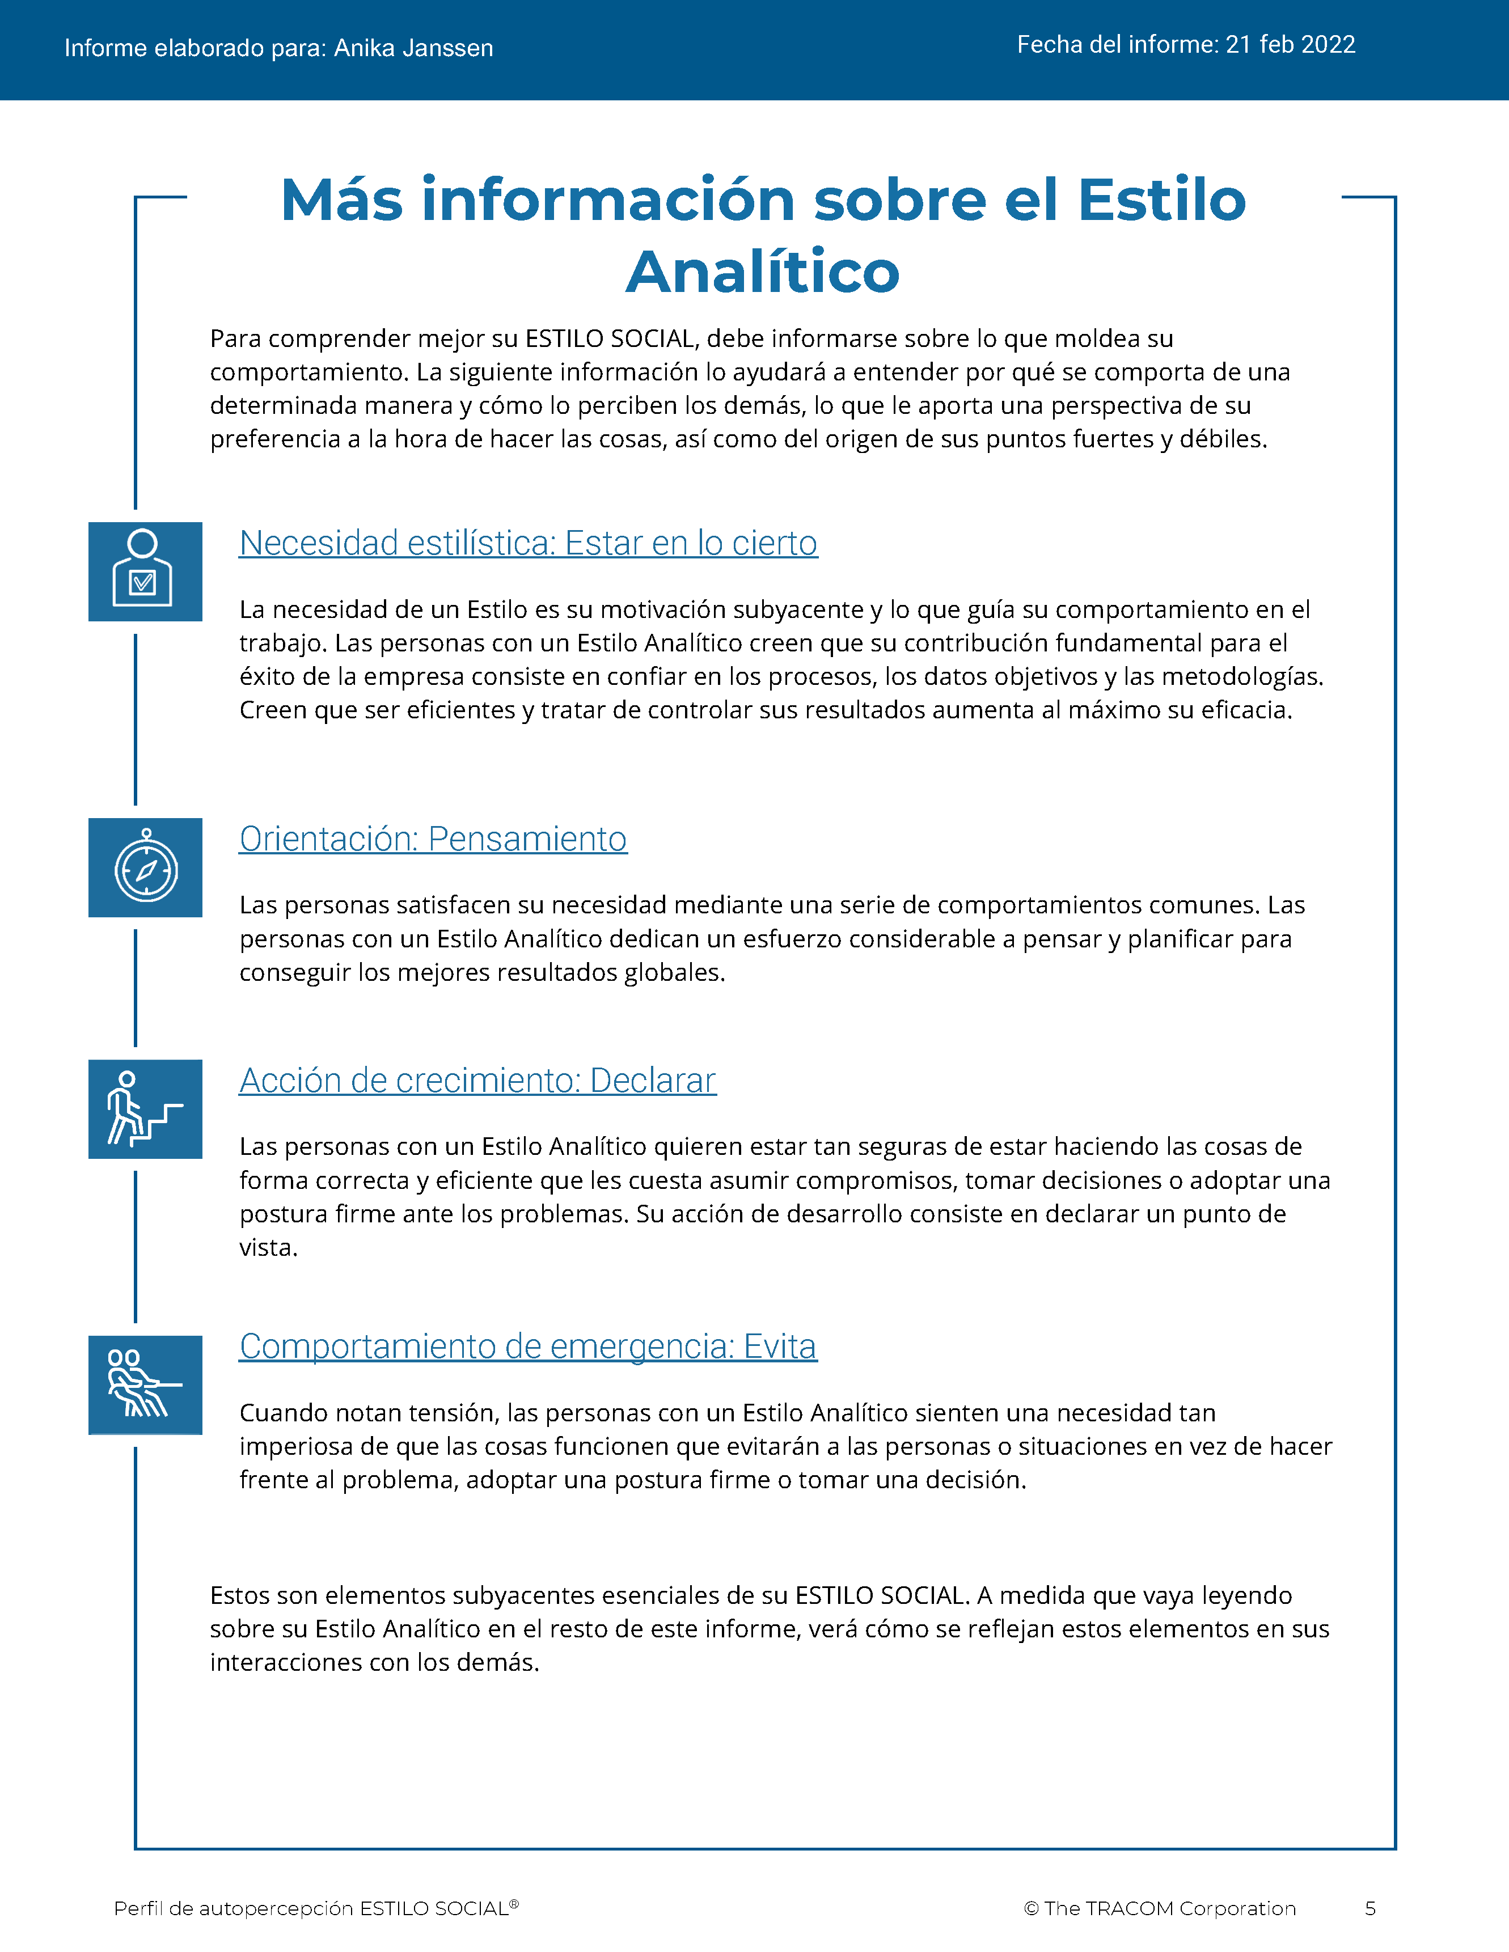
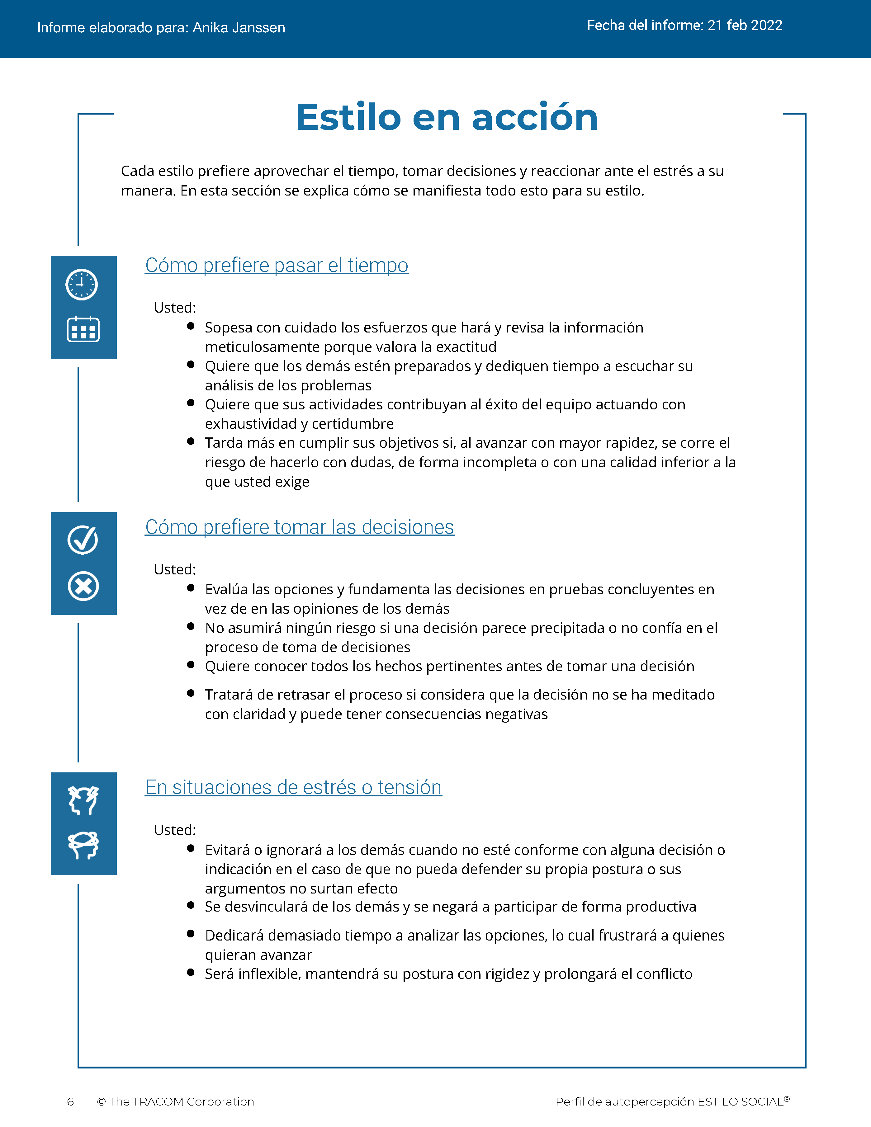
© The TRACOM Corporation. Todos los derechos reservados.
15
Notes:
These slides show pages of the SOCIAL STYLE profile and can be displayed to assist with conversation during the exercise debrief.

Slide 16
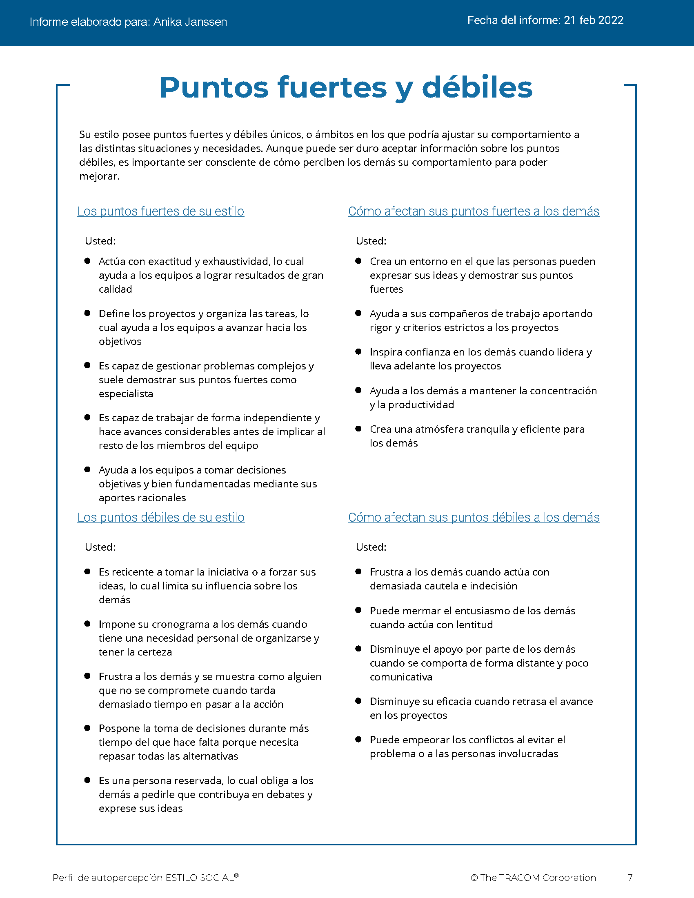
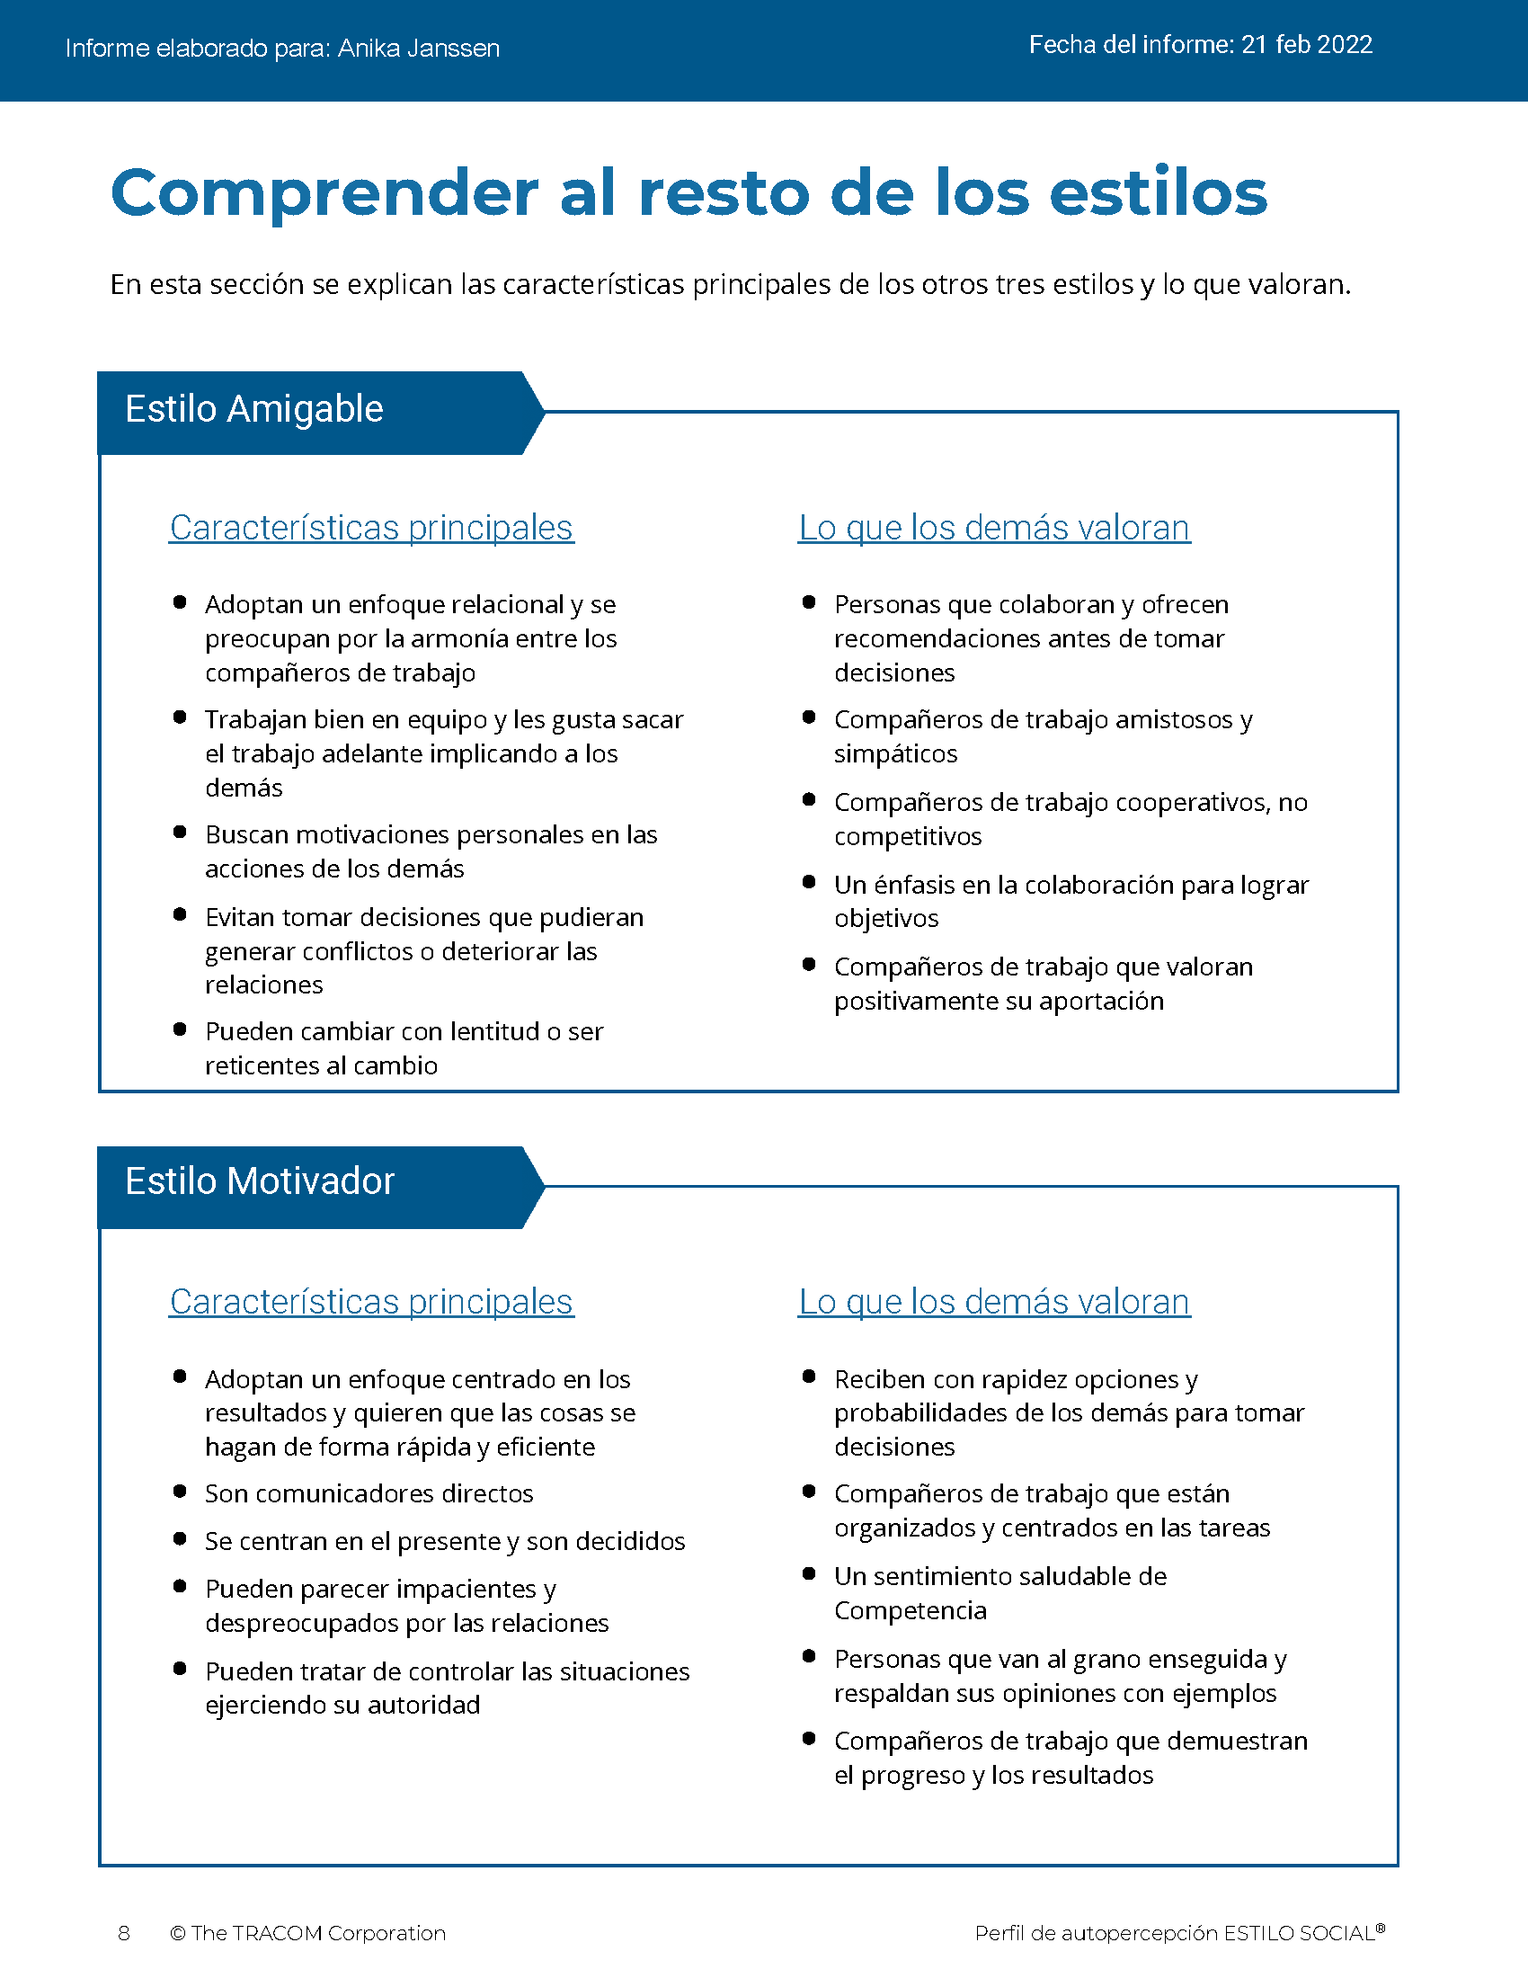
© The TRACOM Corporation. Todos los derechos reservados.
16
Notes:
These slides show pages of the SOCIAL STYLE profile and can be displayed to assist with conversation during the exercise debrief.

Slide 17
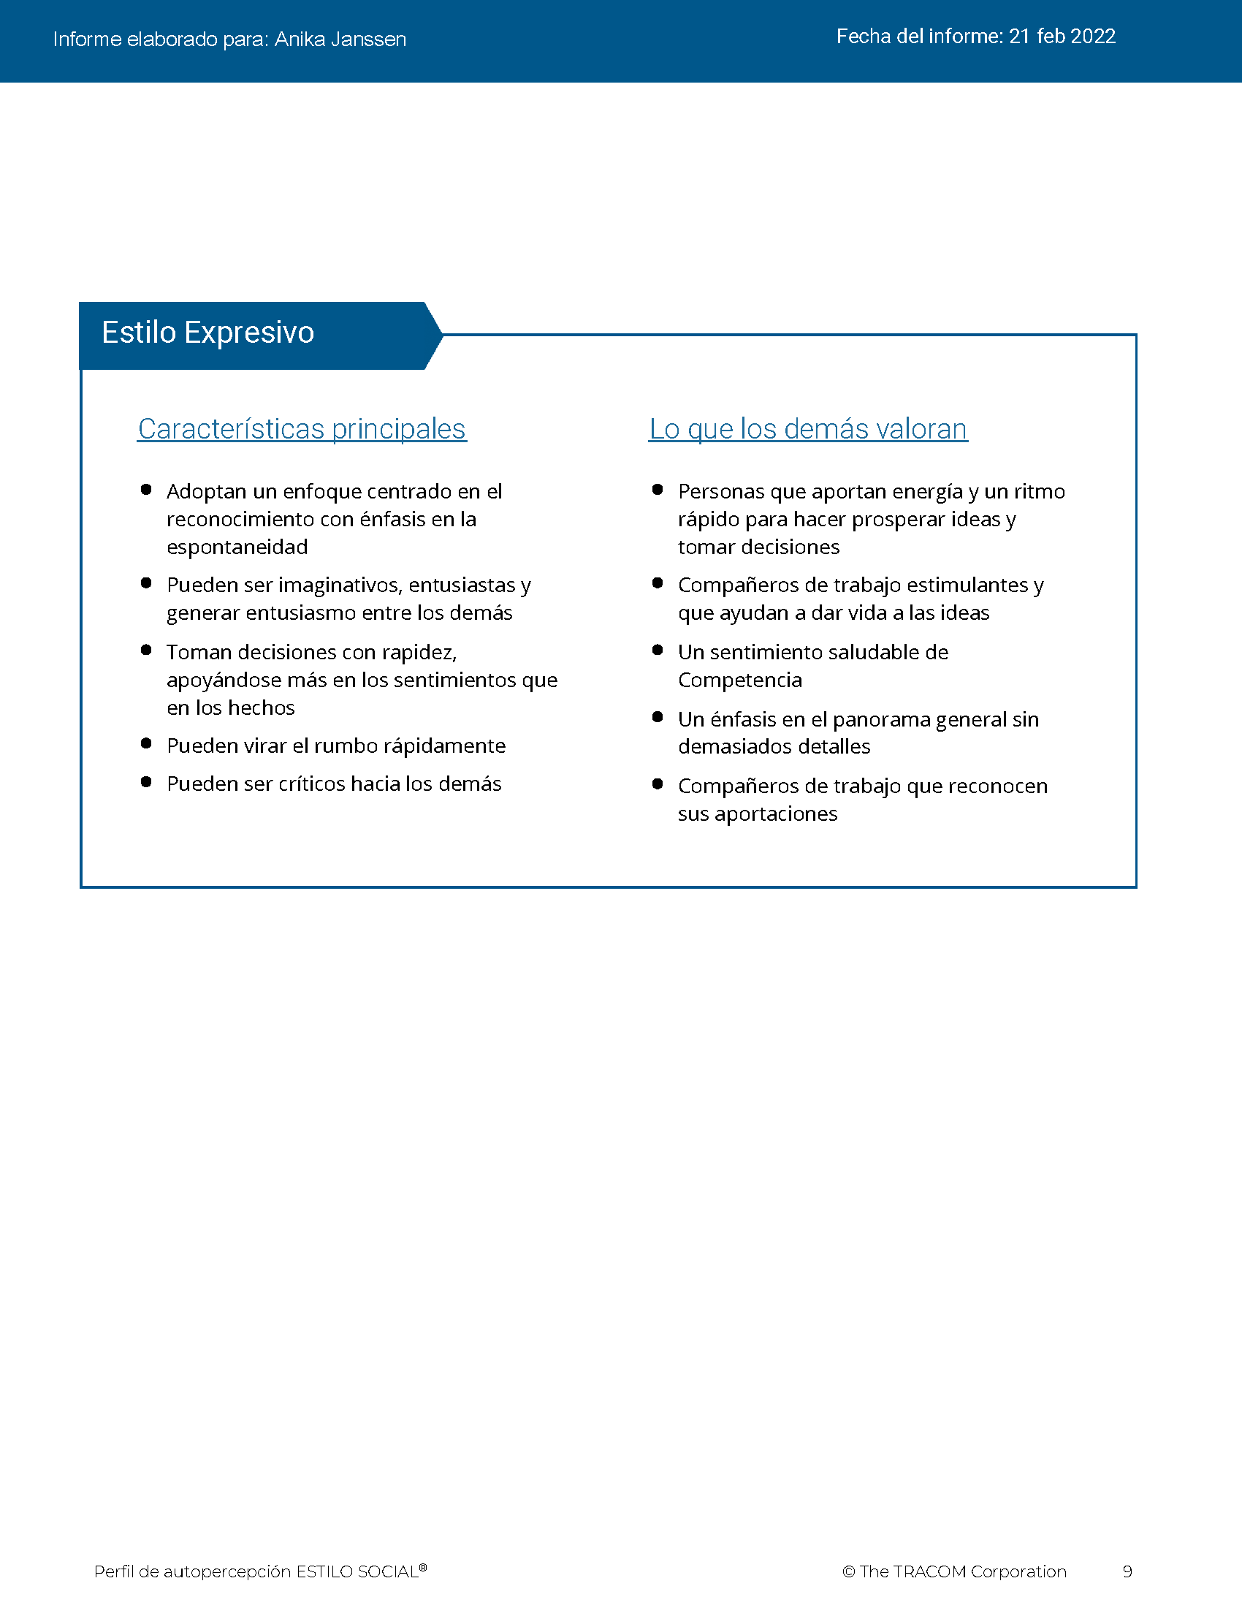
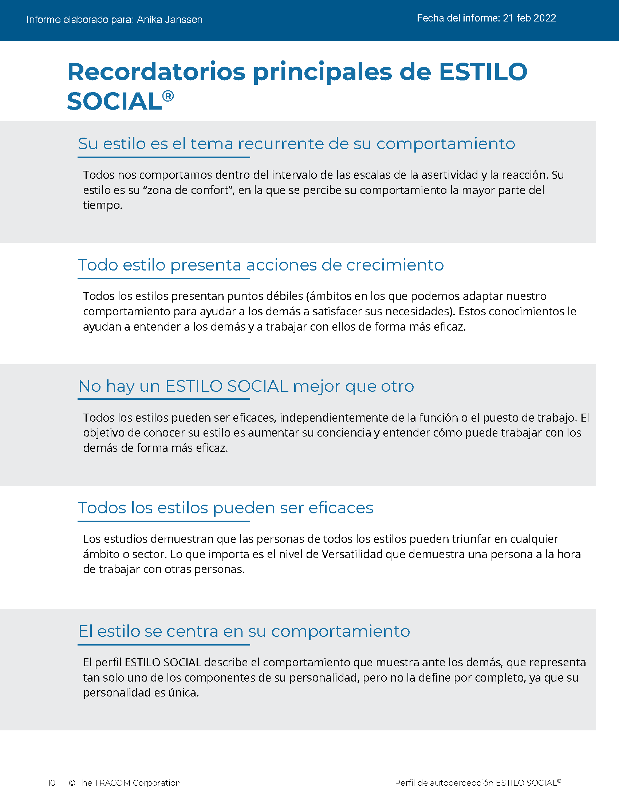
© The TRACOM Corporation. Todos los derechos reservados.
17
Notes:
These slides show pages of the SOCIAL STYLE profile and can be displayed to assist with conversation during the exercise debrief.

Slide 18
Perfil impreso de autopercepción de ESTILO SOCIAL
Notes:
If using the paper profile, use the following slides.
FACILITATOR NOTE: To extend their learning beyond the classroom, participants who complete the Paper Survey can register for free, unlimited access to SOCIAL STYLE Navigator. See Slide #46 for details.

Slide 19
Autopercepción de su SOCIAL STYLE
EJEMPLO:
C
Abra la perforación
Transfiera la respuesta a cada pregunta
Sume los totales de las columnas
Trace su ESTILO SOCIAL
Analítico
Motivador
P
D
Amable
Expresivo
E
¡Su autopercepción puede diferir de las opiniones de los demás!
Notes:
10 MINUTES – PAPER PROFILE ONLY
If your participants completed the Online Profile:
DO NOT DISPLAY this slide.
FOLLOW INSTRUCTIONS in “Online Profile” section.
If your participants are using the Paper Assessment:
SAY Now, it’s time to score the SOCIAL STYLE questionnaire that you completed earlier. Score your questionnaire following the instructions on the slide.
ASK participants to plot their Assertiveness (A, T) score and Responsiveness (C, E) score as shown on the slide.
SAY The SOCIAL STYLE Self-Perception Profile reflects how you see yourself. Keep in mind that others may see you differently. TRACOM’s research indicates that about 50% of those who complete the Self-Perception Questionnaire differ in their perceptions from their reference group who complete a Multi-Rater Profile about them.
Leader Tip: You may get asked the question, “If the research indicates 50% of people see themselves differently, then what value does it have?”
Answer: The format of this course did not allow us to use the multi-rater profile. The reason we gave you a profile is that you can start to realize that others might see you differently than you see yourself. Even though receiving a multi-rater profile would give you more insight into how others perceive your behavior, this session is still useful and practical. By following the suggestions in this session you will be able to observe other people’s behavior to determine their SOCIAL STYLE. Then you can adjust your behavior to work more effectively with them.

Slide 20
Lea sobre su Estilo
Controla
Estilo Analítico
Página 16
Estilo Motivador
Página 13
Pregunta
Dice
Estilo Amable
Página 15
Estilo Expresivo
Página 14
Emociona
Notes:
15 MINUTES – PAPER PROFILE ONLY
Purpose
The purpose of this exercise is to allow participants to learn more about their SOCIAL STYLE and begin thinking about how they can use their Styles to be more effective salespeople.
Materials Needed
Flip chart
Visual: "Read About Your Style“
Directions
1. ASK participants to read about their Styles in the Participant Workbook.
2. ASK participants to identify their top three perceived strengths and weaknesses as salespeople.
3. ASK if anyone has any questions about their SOCIAL STYLE regarding (a) strengths of their Style and (b) things they need to work on.
4. ASK participants to share what they learned. Draw SOCIAL STYLE quadrants on the flip chart and record their answers for all to see and consider.

Slide 21



Acción de necesidad, orientación y crecimiento
Necesidad
El objetivo de cada Estilo
Orientación
El comportamiento común utilizado para lograr la necesidad
Acción de crecimiento
Comportamiento que rara vez utiliza cada Estilo. Usar este comportamiento con más frecuencia aumentaría la eficacia de este Estilo
Notes:
2 MINUTES (Workbook, page 18)
ASK participants to turn to page 18 of the Participant Workbook.
SAY Each Style has a Need, an Orientation, and a Growth Action.
DEFINE:
Need – The goal of each Style.
Orientation – The common behavior used to achieve the need.
Growth Action – Behavior that is rarely used by each Style. Using this behavior more often would increase this Style’s effectiveness.
SAY Understanding the Need, Orientation, and Growth Action of each Style will help you better relate to others’ Styles and enhance your effectiveness with them.

Slide 22
Características clave de
ESTILO SOCIAL
Controla
Analítico
Necesidad: Tener razón
Orientación: Pensamiento
Acción de crecimiento: Declarar
Motivador
Necesidad: Resultados
Orientación: Acción
Acción de crecimiento: Escuchar
Pregunta
Dice
Amable
Necesidad: Seguridad personal
Orientación: Relaciones
Acción de crecimiento: Iniciar
Expresivo
Necesidad: Aprobación personal
Orientación: Espontaneidad
Acción de crecimiento: Verificar
Emociona
Notes:
4 MINUTES
CLICK TO REVEAL THE TEXT IN EACH QUADRANT.
Correlate Assertiveness and Responsiveness behaviors to Style Need and Orientation:
Have participants think about how Style Need and Orientation directly correlate to the Assertiveness and Responsiveness behaviors that were discussed earlier. For example, the Analytical Style's need for time to think is consistent with getting things done at a slower-pace, being more interested in facts, and displaying less emotion.
In the diagonally opposite corner, the Expressive Style’s need for approval and Orientation toward spontaneity is consistent with being louder and using more hand gestures.
Ask participants to point out correlations they see between the Driving Style’s Need and Orientation and the Assertiveness and Responsiveness behaviors …same question regarding the Amiable Style.
Leader Tip: The key characteristics of Style are only a convenient way of summarizing basic Style characteristics. The descriptions of key characteristics are generalizations of behavior that fit most characteristics of each Style. They do not perfectly describe any single individual.

Slide 23
Tensión y productividad
Alta
Tensión baja
Productividad baja
Tensión y productividad adecuadas
Tensión alta
Productividad baja
Tensión: una fuerza que estimula la actividad
Productividad
Baja
Baja
Alta
Tensión
Notes:
5 Minutes (Workbook, page 20)
ASK participants to turn to page 20 of the Participant Workbook.
SAY Tension is a force that stimulates activity, and it has an effect on behavior. Managing tension during the sales process is important to ensure that the customer is feeling motivated enough to proceed with the buying process but not so tense that negative emotions grow and get in the way.
DESCRIBE the Tension Productivity Model.
SAY Tension exists in every relationship. Managing it productively is the key. Low tension, the sale stalls; appropriate levels of tension, the sale proceeds; high tension, the sale comes to a stop as the customer goes into Backup Behavior (more on this in the next section).
Sometimes tension cannot be turned into productive effort, so it is misdirected and released in random or harmful ways. When tension is too great, we want to reduce it. This is called Backup Behavior.
Leader Tip: Clearly define Tension. Tension can occur in both positive and negative forms. A certain degree of tension is positive and can be productive. Don’t overemphasize or focus solely on the negative forms of tension.

Slide 24
Comportamiento defensivo
Controla
Analítico
EVITA: Se retira para reducir la tensión personal.
Motivador
AUTOCRÁTICO: Se encarga de reducir la tensión personal.
Comportamiento exagerado utilizado para reducir la tensión
Pregunta
Dice
Amable
CONSIENTE: Acompaña para reducir la tensión personal.
Expresivo
ATACA: Confronta para reducir la tensión personal
Emociona
Notes:
4 MINUTES (Workbook, page 21)
ASK participants to turn to page 21 of the Participant Workbook.
SAY Backup Behavior occurs when people are frustrated in trying to get their Style need met. Backup Behavior is an exaggerated form of Style-related behavior used by a person to reduce tension within the relationships that caused the tension.
To increase your effectiveness, recognize when you are affected by tension.
Recognizing the Backup Behavior for each Style can also help you to deal effectively with others who are experiencing tension and behaving in Style-bound ways.
REVIEW the Backup Behavior for each Style.

Slide 25
Controlar el comportamiento defensivo
Controla
Analítico - Evita
Destaque el valor de sus datos y aportes y pídales que comparen su información con sus requisitos de forma objetiva y no emocional
Motivador - Autocrático
Declare firmemente su compromiso con los objetivos y muestre cómo puede ayudarlos a lograr los resultados que se comprometieron a alcanzar
Comportamiento exagerado utilizado para reducir la tensión
Pregunta
Dice
Amable - Consiente
Tranquilícelos para que se sientan seguros de volver a involucrarse; anímelos a que den su opinión
Expresivo - Ataca
Permita que se “desahoguen” y reconozcan sus contribuciones, al tiempo que orienta la conversación hacia acciones que los beneficiarán a ellos y al equipo
Emociona
Notes:
4 MINUTES
DESCRIBE some simple strategies for managing individuals who are using their backup behavior as shown on the slide.
Leader Tip: Backup Behavior is always self-serving. Reinforce the notion that Backup Behavior is selfish and never results in positive outcomes. There is nothing that is mutually productive in this form of behavior.

Slide 26
Relaciones potencialmente tóxicas
Controla
Analítico
Ritmo más lento
Se centra en los detalles
Enfoque serio y formal
Motivador
Ritmo más rápido
Se centra en el objetivo
Enfoque serio y formal
Pregunta
Dice
Amable
Ritmo más lento
Se centra en la relación
Enfoque casual e informal
Expresivo
Ritmo más rápido
Se centra en las generalidades
Enfoque casual e informal
Emociona
Notes:
5 Minutes (Workbook, pages 22-23)
CLICK TO REVEAL THE TEXT IN EACH QUADRANT.
ASK participants to turn to pages 22 and 23 of the Participant Workbook.
SAY toxic relationships can occur when you and your customer interact in “Style-bound” ways: You both act according to your own Style Need and Orientation and make little or no attempt to accommodate the Style of the other person. A Toxic Relationship can jeopardize or, more likely, kill the sale!
Relationships that are diagonal to each other often have the potential to be toxic because they are the most opposite in their behavioral preferences (Driving vs. Amiable and Analytical vs. Expressive). However, toxic relationships can develop for any Style combination, including people of the same Style.

Slide 27
Recordatorios clave
No hay un “mejor” Estilo.
El Estilo no es la personalidad.
Su Estilo es un tema en su comportamiento.
Su Estilo tiene acciones de crecimiento.
Su desafío: Tomar la iniciativa para establecer y desarrollar relaciones efectivas con sus clientes.
Notes:
2 MINUTES
REVIEW what has been covered so far, discussing Key Reminders as presented on the slide.

Slide 28
Versatilidad

Slide 29
La versatilidad es lo bien que se adapta a las necesidades de Estilo de los demás
Notes:
2 MINUTES
SAY Versatility is a measure of your consistency in adjusting to the Style needs of others.
At the beginning of the program, we reviewed some statistics on Versatility. Research has found that Versatility is a strong predictor of successful job performance. People who consistently show Versatility are more effective in their job performance than people who are inconsistent in their Versatility.
Salespeople who have been through SOCIAL STYLE and Versatility training have rated the experience as having a significant impact on their performance in key areas.
Versatility is completely within your control, so it is your choice to be versatile with others. You can be highly versatile with one group and show low Versatility with another group. It depends on the circumstances and how much you value your interpersonal effectiveness with each group.
It is completely independent of SOCIAL STYLE: Any Style can show Versatility and be successful.
Versatility is NOT the same as likeability. A person can be well liked but not have high Versatility. The opposite can also be true. Versatility helps you develop better working relationships, but it is separate from your personal likeability.

Slide 30
Versatilidad
Una medida de su consistencia para adaptarse a las necesidades de Estilo de los demás
W | No consistente | X | Algo consistente | Y | Generalmente consistente | Z | Muy consistente
Baja
Media
Alta
Notes:
3 Minutes (Workbook, page 24)
ASK participants to turn to page 24 of their Participant Workbook.
Online Profile Only:
SAY We measure Versatility on a scale ranging from W to Z. These are normed quartiles, just like Assertiveness and Responsiveness.
When you aren’t consistent in your behavior, you’re usually focusing on your own Style needs. When you consistently show Versatility, you’re focusing on meeting others’ Style needs.
Your profile will show your results on this scale, ranging from W (not consistent) to Z (very consistent).
Paper Questionnaires Only:
Will measure High, Medium or Low
Click to show next graphic
Your workbooks might show a graphic similar to this, with low, medium, and high. This is just another way of explaining Versatility. Just remember, the key point is that Versatility is under your control, and the more consistently you behave with Versatility the more effective you will be.

Slide 31
Cuatro fuentes de versatilidad
El uso apropiado de
Imagen
Presentación
Competencia
Opinión
genera
Mayor versatilidad
Notes:
5 MINUTES (Workbook, pages 25-28)
ASK participants to turn to pages 25 through 28 in the Participant Workbook.
Image remains a part of the Versatility model because it’s important for building relationships. Describe Versatility in a timeline:
SAY You show Versatility in four areas. Let me describe these as a timeline.
Image – When you first meet a new person at work, you form an impression about this person based on what you see, consciously or not. Essentially Image is a first impression: Are you dressed appropriately for the situation, for the work culture, for the client, and so on?
ONLINE PROFILE: Note that Image is not measured as part of your Profile. This is because:
Image is difficult to observe in virtual environments. We can’t observe very well how people are dressed, and because there are a wide variety of dress codes, even within companies and teams, it is less relevant to measure Image in this way.
Raters don’t always like answering questions about people’s Image without understanding the context of how Image is explained in training.
Image is still important for many people and companies, which is why it’s part of the model. However, you won’t receive a measure of your Image.
Presentation – When that person communicates in meetings or other public venues, you’ll notice how clear they are at helping people understand their points. Do they use clear language? Are their examples effective? Do they take others’ Styles into account?
Competence – Over time, you’ll observe this person in a variety of situations. Are they reliable and do they persevere during difficult times? Are they flexible when change happens? Are they optimistic most of the time? Do they show creativity?
Feedback – Finally, this is the most interpersonal part of Versatility. Are they a good listener? Do they show empathy for others’ situations? Do they meet the needs of other people’s Styles? Do they develop good relationships with others?

Slide 32
Perfil en línea de autopercepción de versatilidad
Notes:
If using the online profile, use the following slides.
Note that if delivering virtually, participants will need to have received their profiles prior to the program.
Check the Session Status Report and Composite Report to understand which participants have completed their profiles, and the breakdown of Versatility within your program.

Slide 33
Versatilidad general
Su consistencia para mostrar versatilidad
W | No consistente | X | Algo consistente | Y | Generalmente consistente | Z | Muy consistente
 |  | OTROS |  | UNO MISMO
Notes:
5 MINUTES
THIS SLIDE ONLY USED WITH ONLINE PROFILE.
SAY We measure Versatility on a scale ranging from W to Z. These are normed quartiles, just like Assertiveness and Responsiveness.
When you are not consistent in your behavior, you’re usually focusing on your own Style needs. When you consistently show Versatility, you’re focusing on meeting others’ Style needs, which reduces their tension. When you are consistent, the more effective you will be.
Your profile will show your results on this scale, ranging from W (not consistent) to Z (very consistent).
Versatility is all about consistency of behavior. A lower Versatility score does NOT mean you lack ability or that you never demonstrate these abilities. What it DOES mean is that you aren’t showing consistency in your behavior.
By making small changes to your behavior and acting with more consistency, you can increase your Versatility. (Recall that the difference in values between W and Z are small but meaningful.)

Slide 34
El significado de las posiciones de versatilidad
 | 1 | 2 | 3 | 4 | 5
 | Totalmente en desacuerdo | En desacuerdo | Parcialmente de acuerdo Parcialmente en desacuerdo | De acuerdo | Totalmente de acuerdo
1. Aborda situaciones nuevas con una perspectiva positiva. | ◯ | ◯ | ◯ | ◯ | ◯
2. Establece buenas relaciones con los compañeros de trabajo. | ◯ | ◯ | ◯ | ◯ | ◯
3. Presenta ideas de manera efectiva a los grupos. | ◯ | ◯ | ◯ | ◯ | ◯
W | X Y | Z
Consistencia
Notes:
3 MINUTES
THIS SLIDE ONLY USED WITH ONLINE PROFILE.
Before delivering Versatility profiles, explain the meaning of the positions.
SAY Before reviewing your results in more detail, let’s put your results into context. This graph shows several sample items that measure Versatility.
You responded to these items using the scale ranging from ‘strongly disagree’ to ‘strongly agree’. TRACOM assigns values to each of these scale points: 1 to 5.
When rating Versatility, most people respond at the higher end of the rating scale. This makes sense since most people have at least some abilities in these areas. This means that the cutoff for achieving Z Versatility is very high, approximately 4.5 or higher.
Similarly, to score either an X or Y requires scores between 3.5 and 4.5. These are approximate values used for purposes of explanation.
Importantly, if you receive a W in any area of Versatility, this DOES NOT mean that you evaluated yourself at the low end of the rating scale. On the contrary, almost nobody scores at the lowest end – 1 or 2. For people with a W result, most of their ratings fluctuate between 2 and 4, resulting in an average score of slightly less than 3.5.
So, putting this into context, a W rating means that you are not showing as much consistency in these behaviors as you could. With effort and more consistency, your evaluation would improve.
Set the context:
W does not mean that you lack ability.
It doesn’t mean that you evaluated yourself at the lowest end of the rating scale.
It does mean that you’re not highly consistent in your behavior; you do these things some of the time but could do them more often.
It does mean that you evaluated yourself between ‘disagree’ and ‘agree’, on average.
Note that these cutoff values (3.5 and 4.5) are only for demonstration – they aren’t the exact values in TRACOM’s norms, but they are close.
Giving the context is critical because it helps to ease people’s automatic reactions to the profile.
Then:
Help people focus on just one area to improve. This increases chances of success.
What is ‘low hanging fruit?’ Something they can improve quickly.

Slide 35


© The TRACOM Corporation. Todos los derechos reservados.
35
Notes:
15 MINUTES (5 MINUTES if Virtual Program)
Purpose
The purpose of this exercise is to help participants develop an action plan for showing Versatility more consistently.
Materials Needed
Versatility profile
Virtual Directions:
ASK participants to chat one way they can adjust their behavior to be more consistent in their Versatility. Encourage them to choose just one or two concrete steps they can take, based on the strategies they read about in their profiles.
In-Person Directions:
DISTRIBUTE the Versatility profiles.
ASK participants to read their profiles and consider ways they can adjust their behavior to be more consistent in their Versatility. Encourage them to choose just one or two concrete steps they can take, based on the strategies they read about in their profiles.
VIRTUAL DELIVERY: If delivering virtually, learners will have downloaded their profiles earlier.

Slide 36
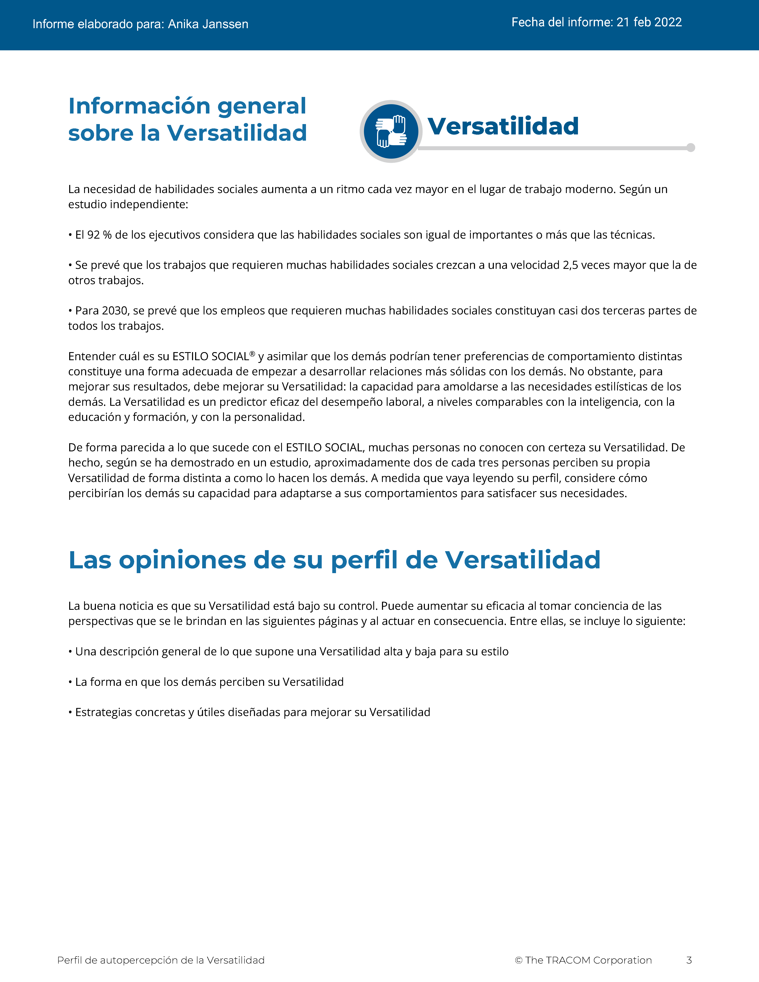
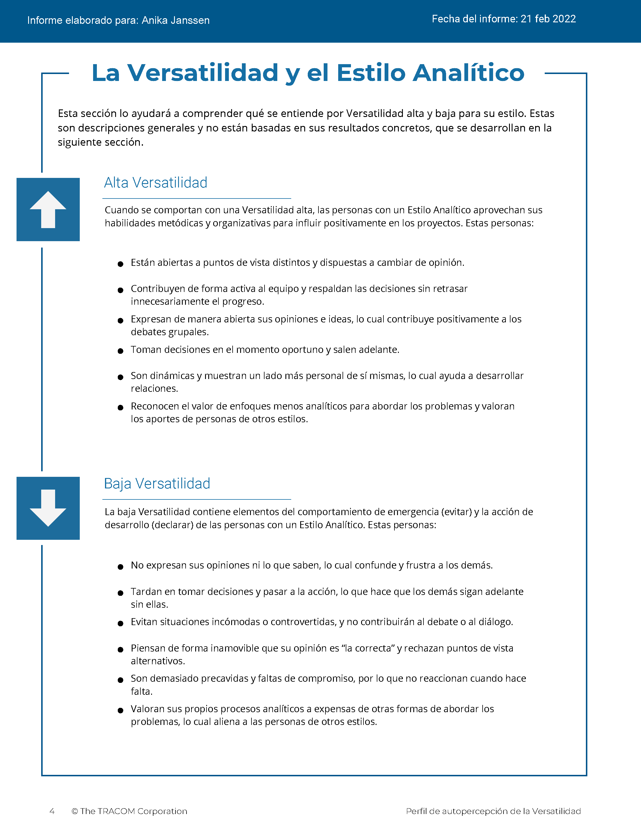
© The TRACOM Corporation. Todos los derechos reservados.
36
Notes:
These slides show pages of the Versatility profile and can be displayed to assist with conversation during the exercise debrief.

Slide 37
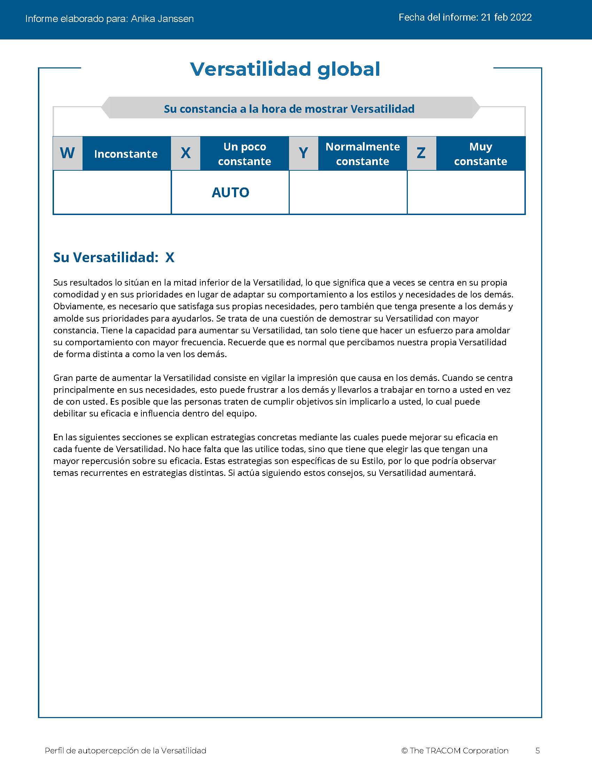
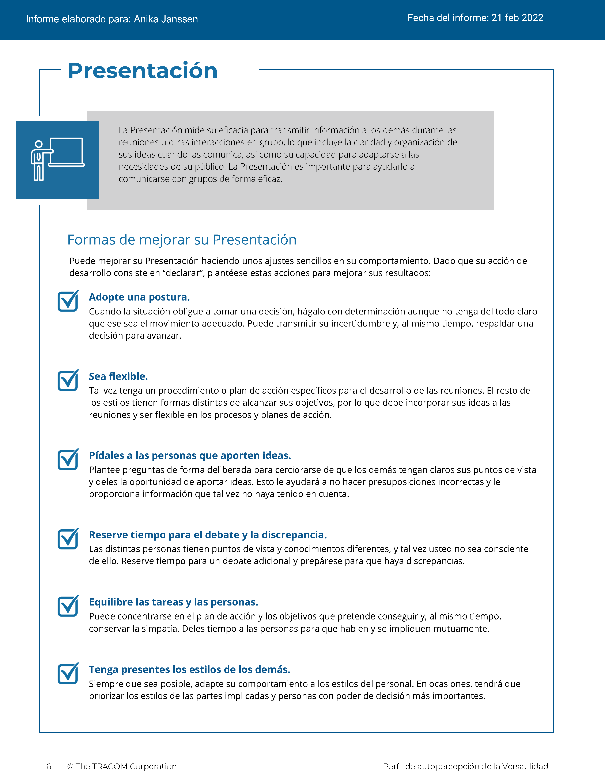
© The TRACOM Corporation. Todos los derechos reservados.
37
Notes:
These slides show pages of the Versatility profile and can be displayed to assist with conversation during the exercise debrief.

Slide 38
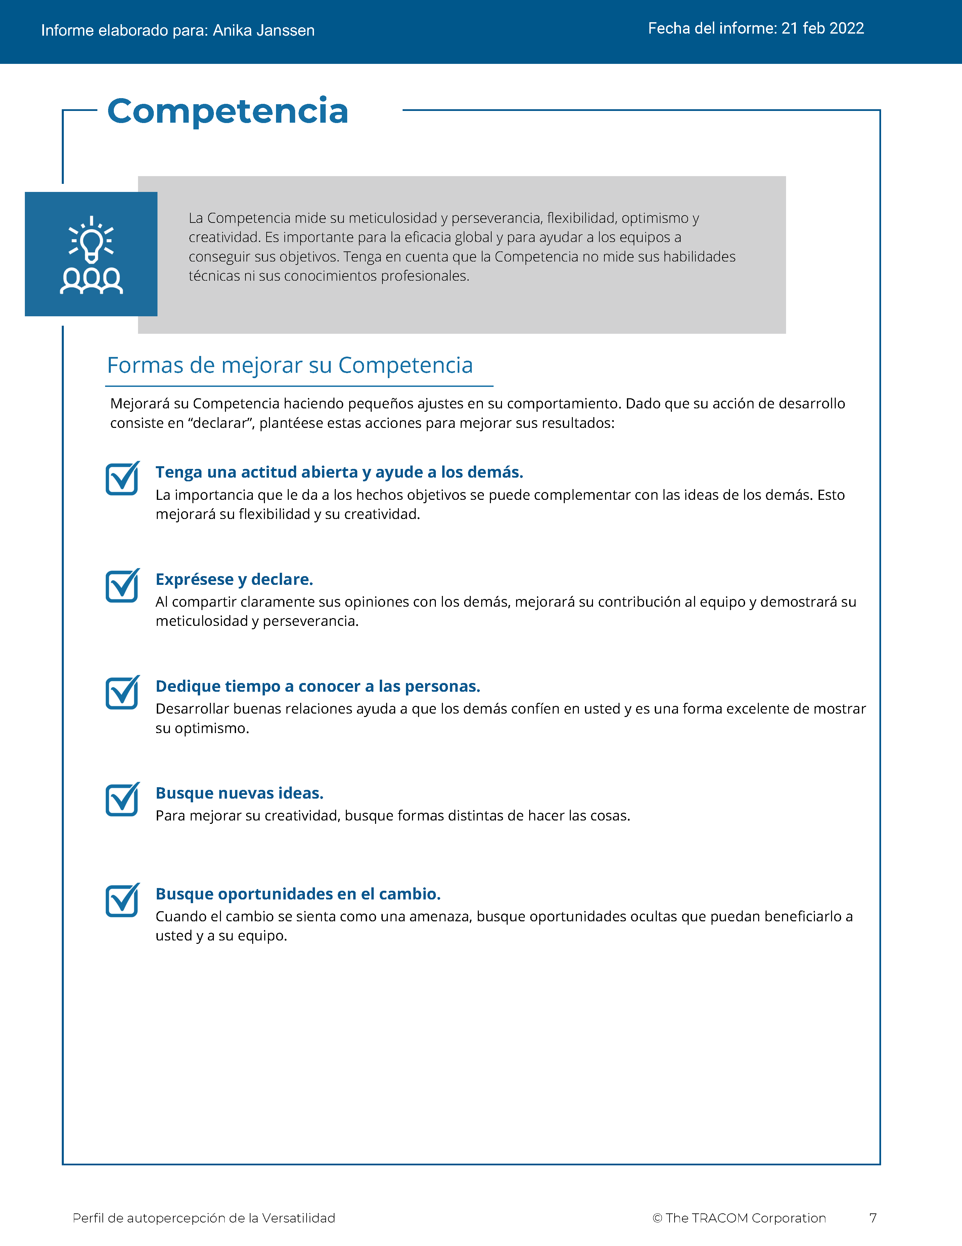
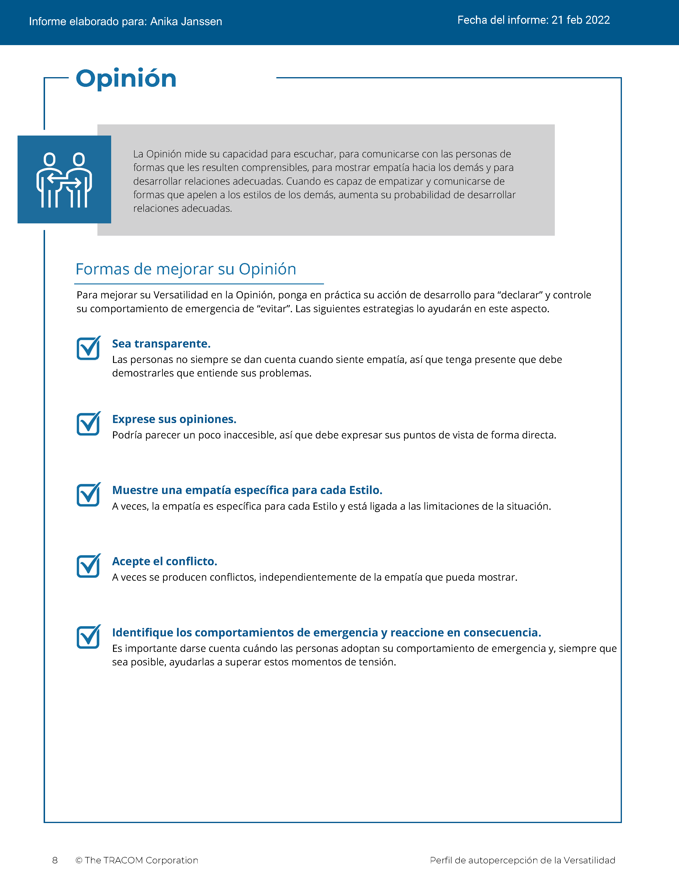
© The TRACOM Corporation. Todos los derechos reservados.
38
Notes:
These slides show pages of the Versatility profile and can be displayed to assist with conversation during the exercise debrief.

Slide 39
Perfil impreso de versatilidad
Notes:
If using the paper profile, use the following slides.

Slide 40
Versatilidad
Una medida de la eficacia interpersonal cuando se trabaja con otros.
Comportamiento visto como centrado en…
Baja
Media
Alta
Mi tensión
La tensión de los demás
Notes:
2 MINUTES
THIS SLIDE IS USED ONLY WITH THE PAPER PROFILE.
SAY while identifying your SOCIAL STYLE can help you understand your behavioral preferences, by itself, knowing your Style doesn’t necessarily help you be more effective. As I’ve said, there is no good or bad Style. What is important is how you adjust your behavior when working with others. That’s where Versatility comes in.
Versatility is your ability to adjust your behavior to meet others’ Style preferences in the areas of Image, Presentation, Competence, and Feedback.
SAY When you are not consistent in your behavior, you’re usually focusing on your own tension and Style needs. When you consistently show Versatility, you’re focusing on meeting others’ Style needs, which reduces their tension. When you are consistent, the more effective you will be.

Slide 41
Su autopercepción de versatilidad
Abra la perforación
Sume las marcas de verificación en la columna sombreada
Marque con un círculo la letra de su puntuación de versatilidad
EJEMPLO:
Si es 7 o menos = Baja (marque con un círculo la “B”)
Si es 8 - 14 = Media
(marque con un círculo la “M”)
Si es 15 - 21 = Alta
(marque con un círculo la “A”)
B | M | A
¡Su autopercepción puede diferir de las opiniones de los demás!
© The TRACOM Corporation. Todos los derechos reservados.
Notes:
8 MINUTES
THIS SLIDE ONLY USED WITH PAPER PROFILE.
1. ASK participants to score their Versatility Questionnaires following the instructions on the slide.
2. SAY before we discuss Versatility, I’d like you to score your Versatility Questionnaire.
After scoring is complete, ASK Is anyone surprised? Are there any questions or concerns?
The Versatility profile reflects how you see yourself. Keep in mind that others may see you differently.

Slide 42
Objetivos de aprendizaje
Comprender El modelo ESTILO SOCIAL Model™.
Determinar su ESTILO SOCIAL completando un cuestionario de autopercepción.
Comprender mejor su comportamiento y cómo los clientes ven a las personas con su Estilo.
Aumentar su versatilidad para ser más efectivo con los clientes.
Notes:
2 MINUTES
REVIEW the learning objectives.
ASK Did we meet them?
HIGHLIGHT key points learned.
EMPHASIZE importance of comparing self-perception data with multi-rater.

Slide 43
Próximos pasos y aprendizaje clave
Comparta su ESTILO SOCIAL con sus colegas y pídales su opinión.
Busque dos dimensiones de comportamiento: firmeza y reacción.
Actúe para satisfacer las necesidades de ESTILO SOCIAL de los clientes a medida que interactúa con ellos.
Prediga probables comportamientos futuros del Estilo de los clientes actuales y potenciales.
Notes:
2 MINUTES
As participants take their knowledge of Style back into the workplace, suggest that they do the following:
SHARE their Style with their colleagues and ask them for additional insights into how they can interact more effectively.
REMIND them that the most objective way to identify a customer’s Style is by looking for behavior along Assertiveness and Responsiveness.
Finally, UNDERSCORE that being able to predict the probable future Style behavior of others is a powerful tool for interpersonal success. Participants now have valuable information to use in developing themselves into more effective salespeople.

Slide 44
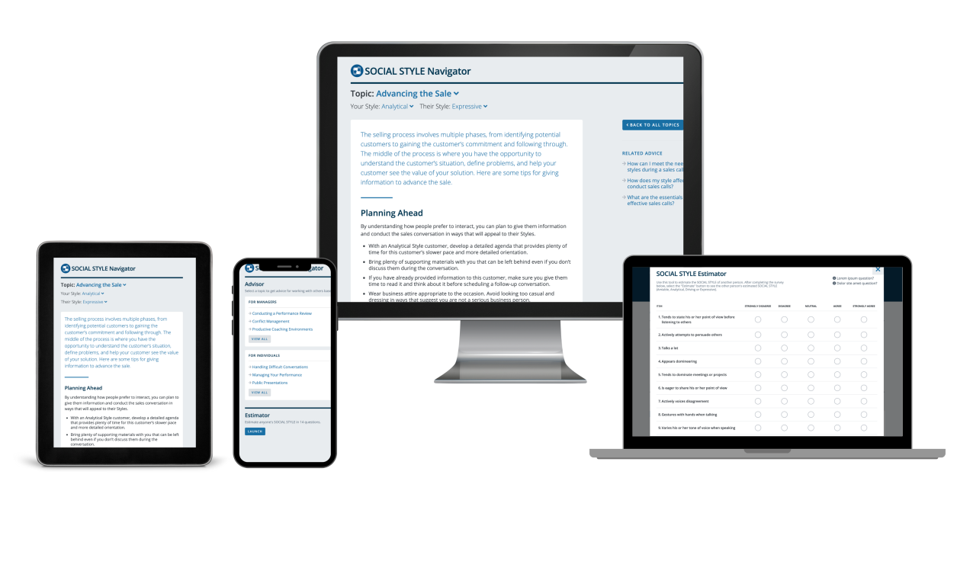
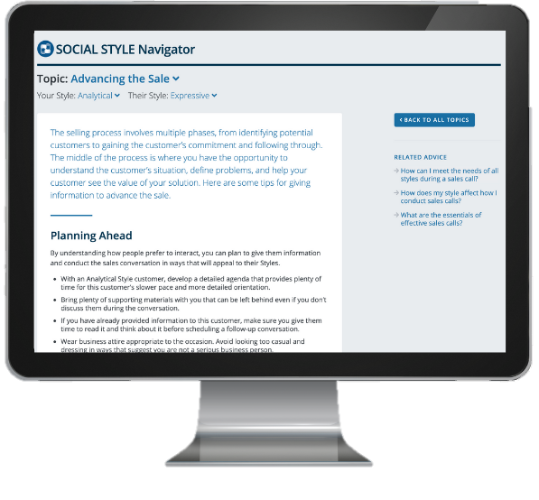
SOCIAL STYLE Navigator®
SOCIAL STYLE Estimator
Una breve encuesta que calcula el Estilo de los demás
SOCIAL STYLE Advisor
  Preparación para reuniones, negociaciones, presentaciones
  Mejores prácticas de Estilo y versatilidad para muchas situaciones
Módulos de aprendizaje electrónico
Aplicar conceptos de Estilo a los equipos, gestionar conflictos y entrenar
SOCIAL STYLE Navigator® es una marca registrada de TRACOM Corporation
Notes:
1 Minute
SAY You now have free and unlimited access to SOCIAL STYLE Navigator, the on-demand micro-learning tool that helps you apply Style and Versatility.
SOCIAL STYLE Navigator includes:
SOCIAL STYLE Estimator
The Estimator survey provides users with an interactive tool that evaluates observable behavior in others to determine their Style and helps you plan ahead for successful interactions.
SOCIAL STYLE Advisor
Use Advisor topics to prepare “just-in-time” for meetings, negotiations or sales presentations with advice on navigating Style and Versatility best practices to maximize high-performing relationships.
eLearning modules
Continue your learning journey via micro-learning that reinforces ways to apply SOCIAL STYLE and Versatility to Working in Teams, Coaching and Managing Conflict.

Slide 45
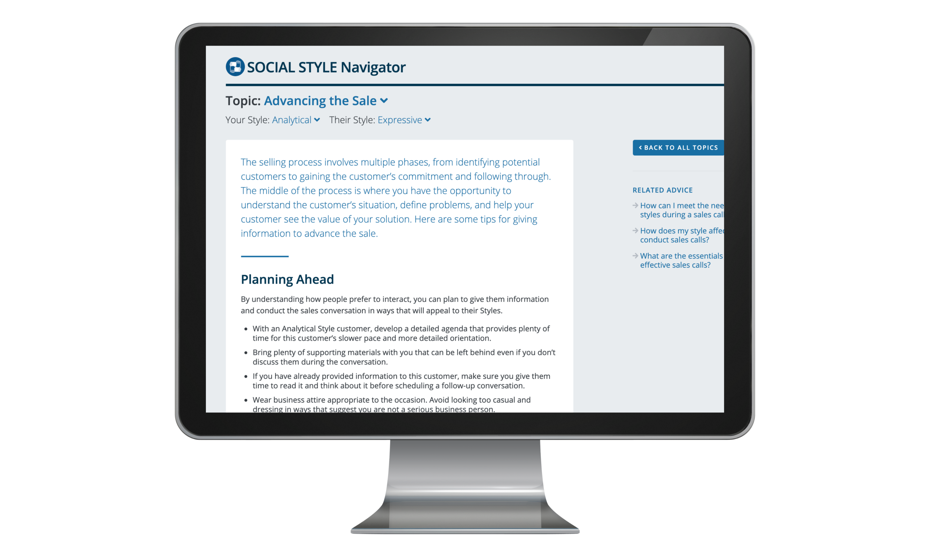
Acceso a SOCIAL STYLE
Navigator®
(solo perfiles en línea)
Disponible a través de tracomlearning.com
Inicie sesión con su nombre de usuario y contraseña para obtener acceso GRATUITO E ILIMITADO a SOCIAL STYLE Navigator
Notes:
1 Minute
THIS SLIDE FOR ONLINE PROFILES ONLY
SAY Available through www.tracomlearning.com
Enter your username and password for free, unlimited access to SOCIAL STYLE Navigator®

Slide 46

Acceso a SOCIAL STYLE
Navigator®
(solo perfiles impresos)
Vaya a
tracomlearning.com/registration-paper
Regístrese con su dirección de
correo electrónico y código de suscripción _____-_____
para obtener acceso GRATUITO E ILIMITADO a SOCIAL STYLE NAVIGATOR
Notes:
1 Minute
THIS SLIDE FOR PAPER SURVEYS ONLY
SAY Go to tracomlearning.com/registration-paper and register with your email address and subscription code ______-______ for free, unlimited access to SOCIAL STYLE Navigator®
IMPORTANT FACILITATOR NOTE REGARDING SUBSCRIPTION CODES:
Your subscription code can be found on the “ATTENTION” colored flyer included in your participant materials shipment. The code is formatted in two sets of 4 numbers separated by a hyphen (EXAMPLE: xxxx-xxxx). If you do not have the “ATTENTION” flyer included with your materials shipment, please contact TRACOM to receive your subscription code.

Slide 47
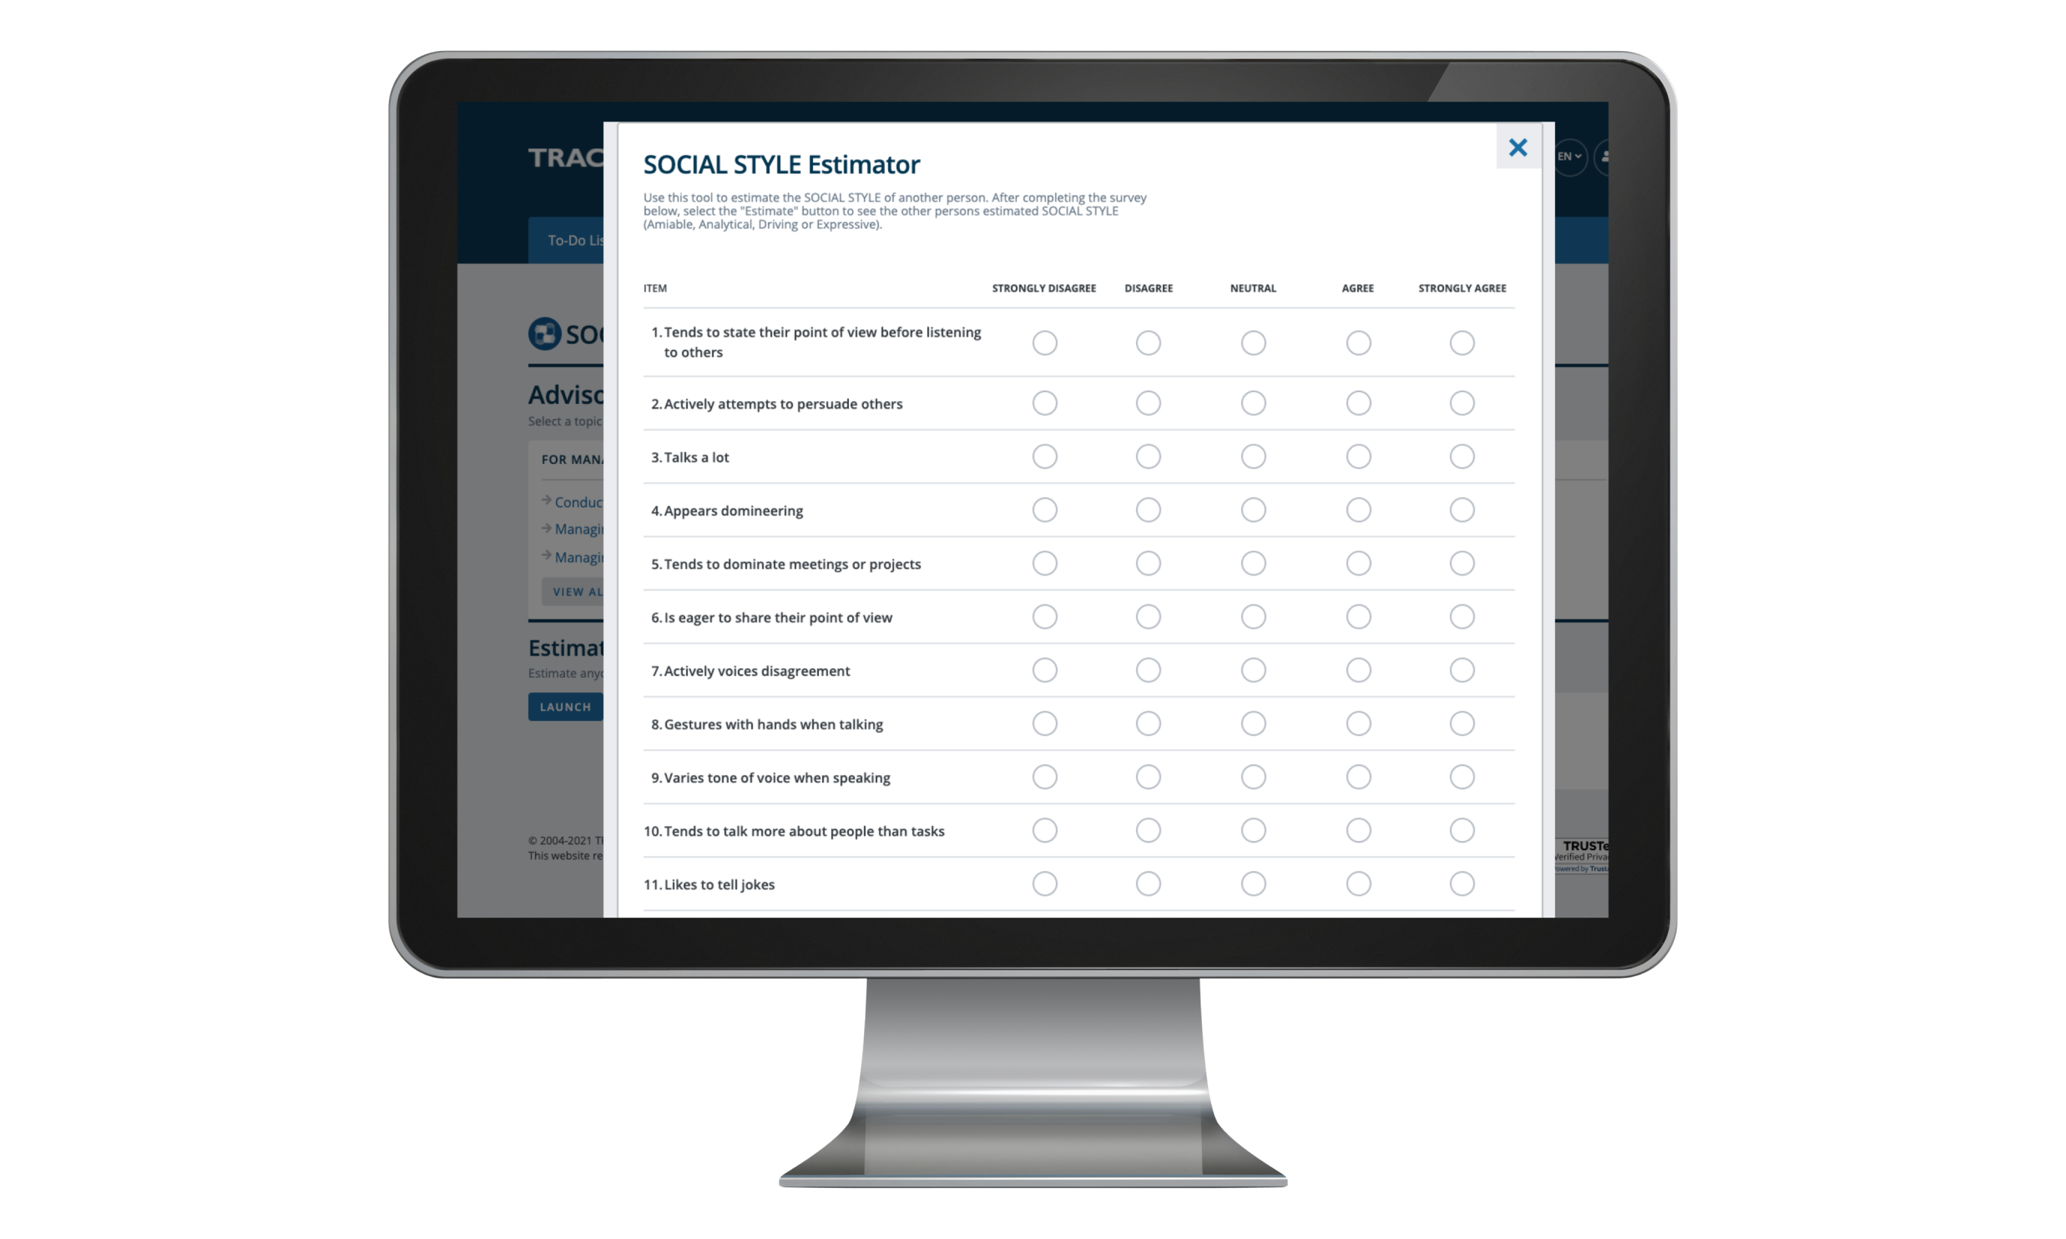
Notes:
Optional demonstration, time permitting

Slide 48
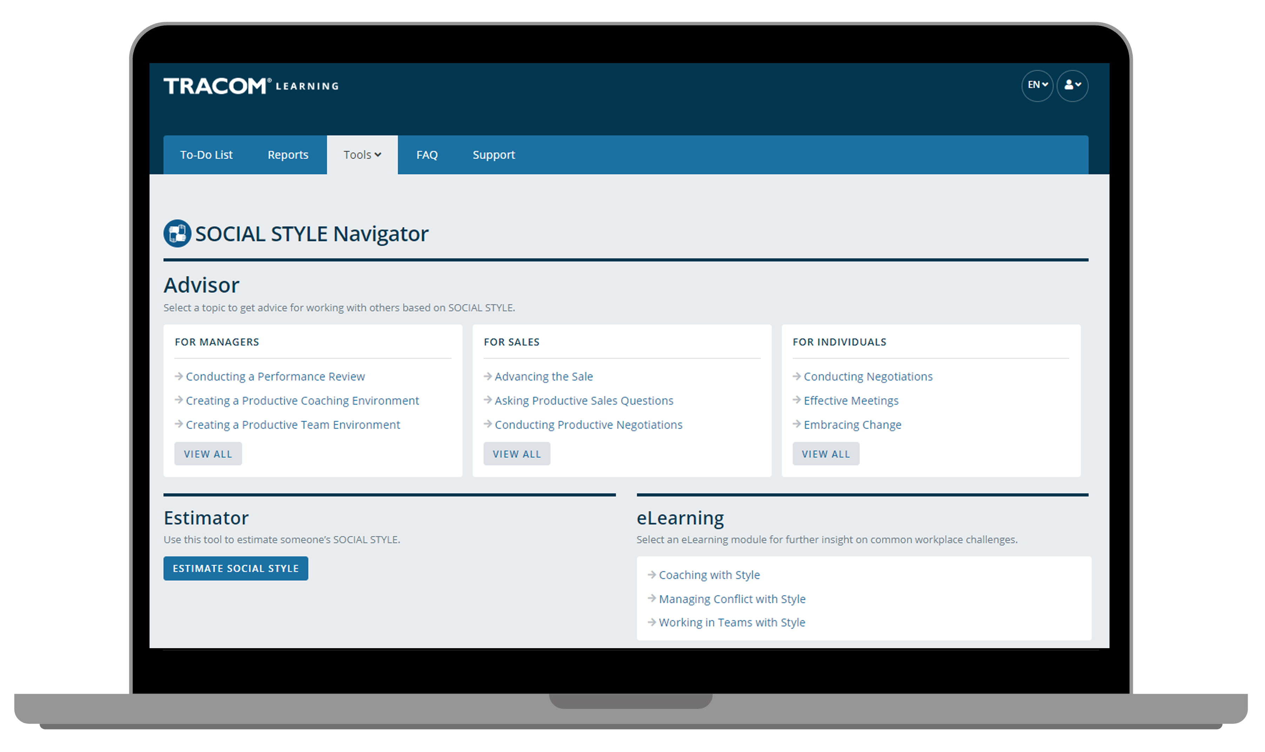
Notes:
Optional demonstration, time permitting

Slide 49
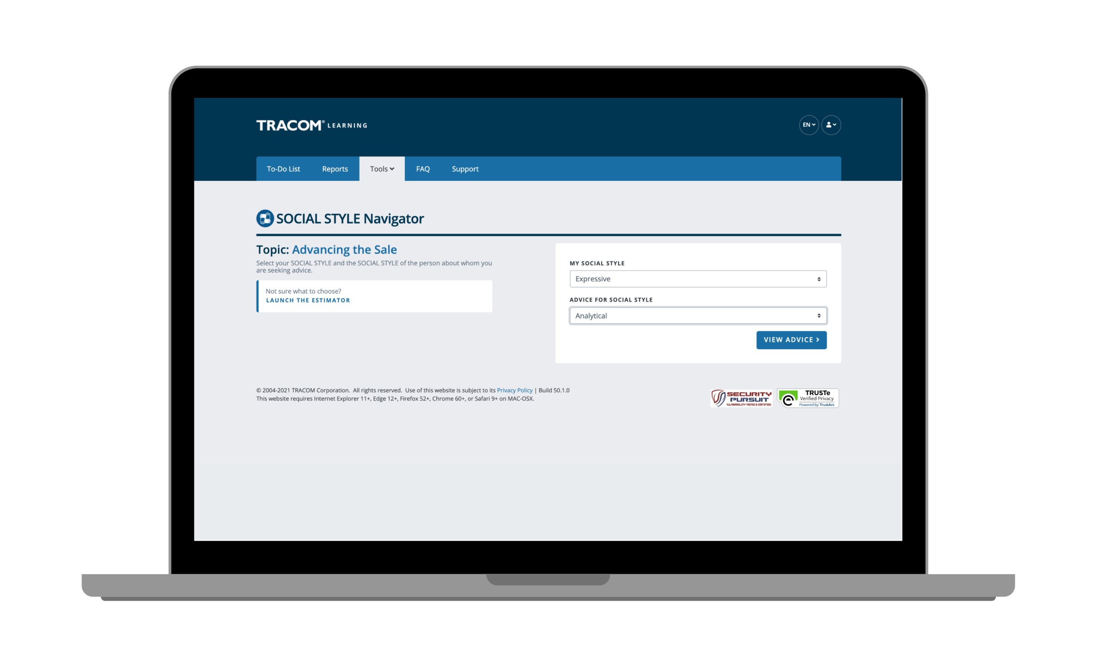
Notes:
Optional demonstration, time permitting

Slide 50
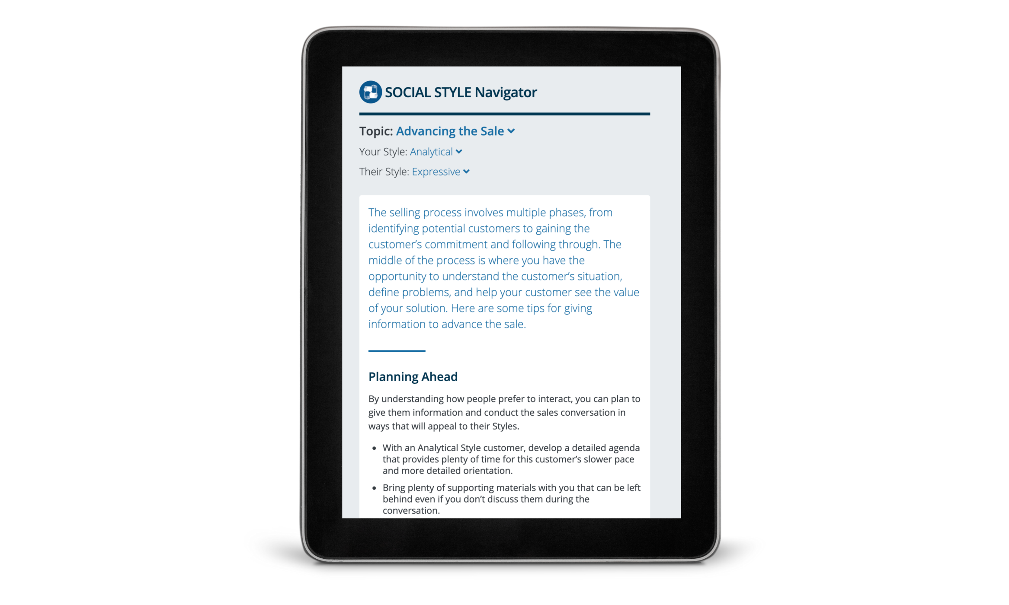
Notes:
Optional demonstration, time permitting

Slide 51
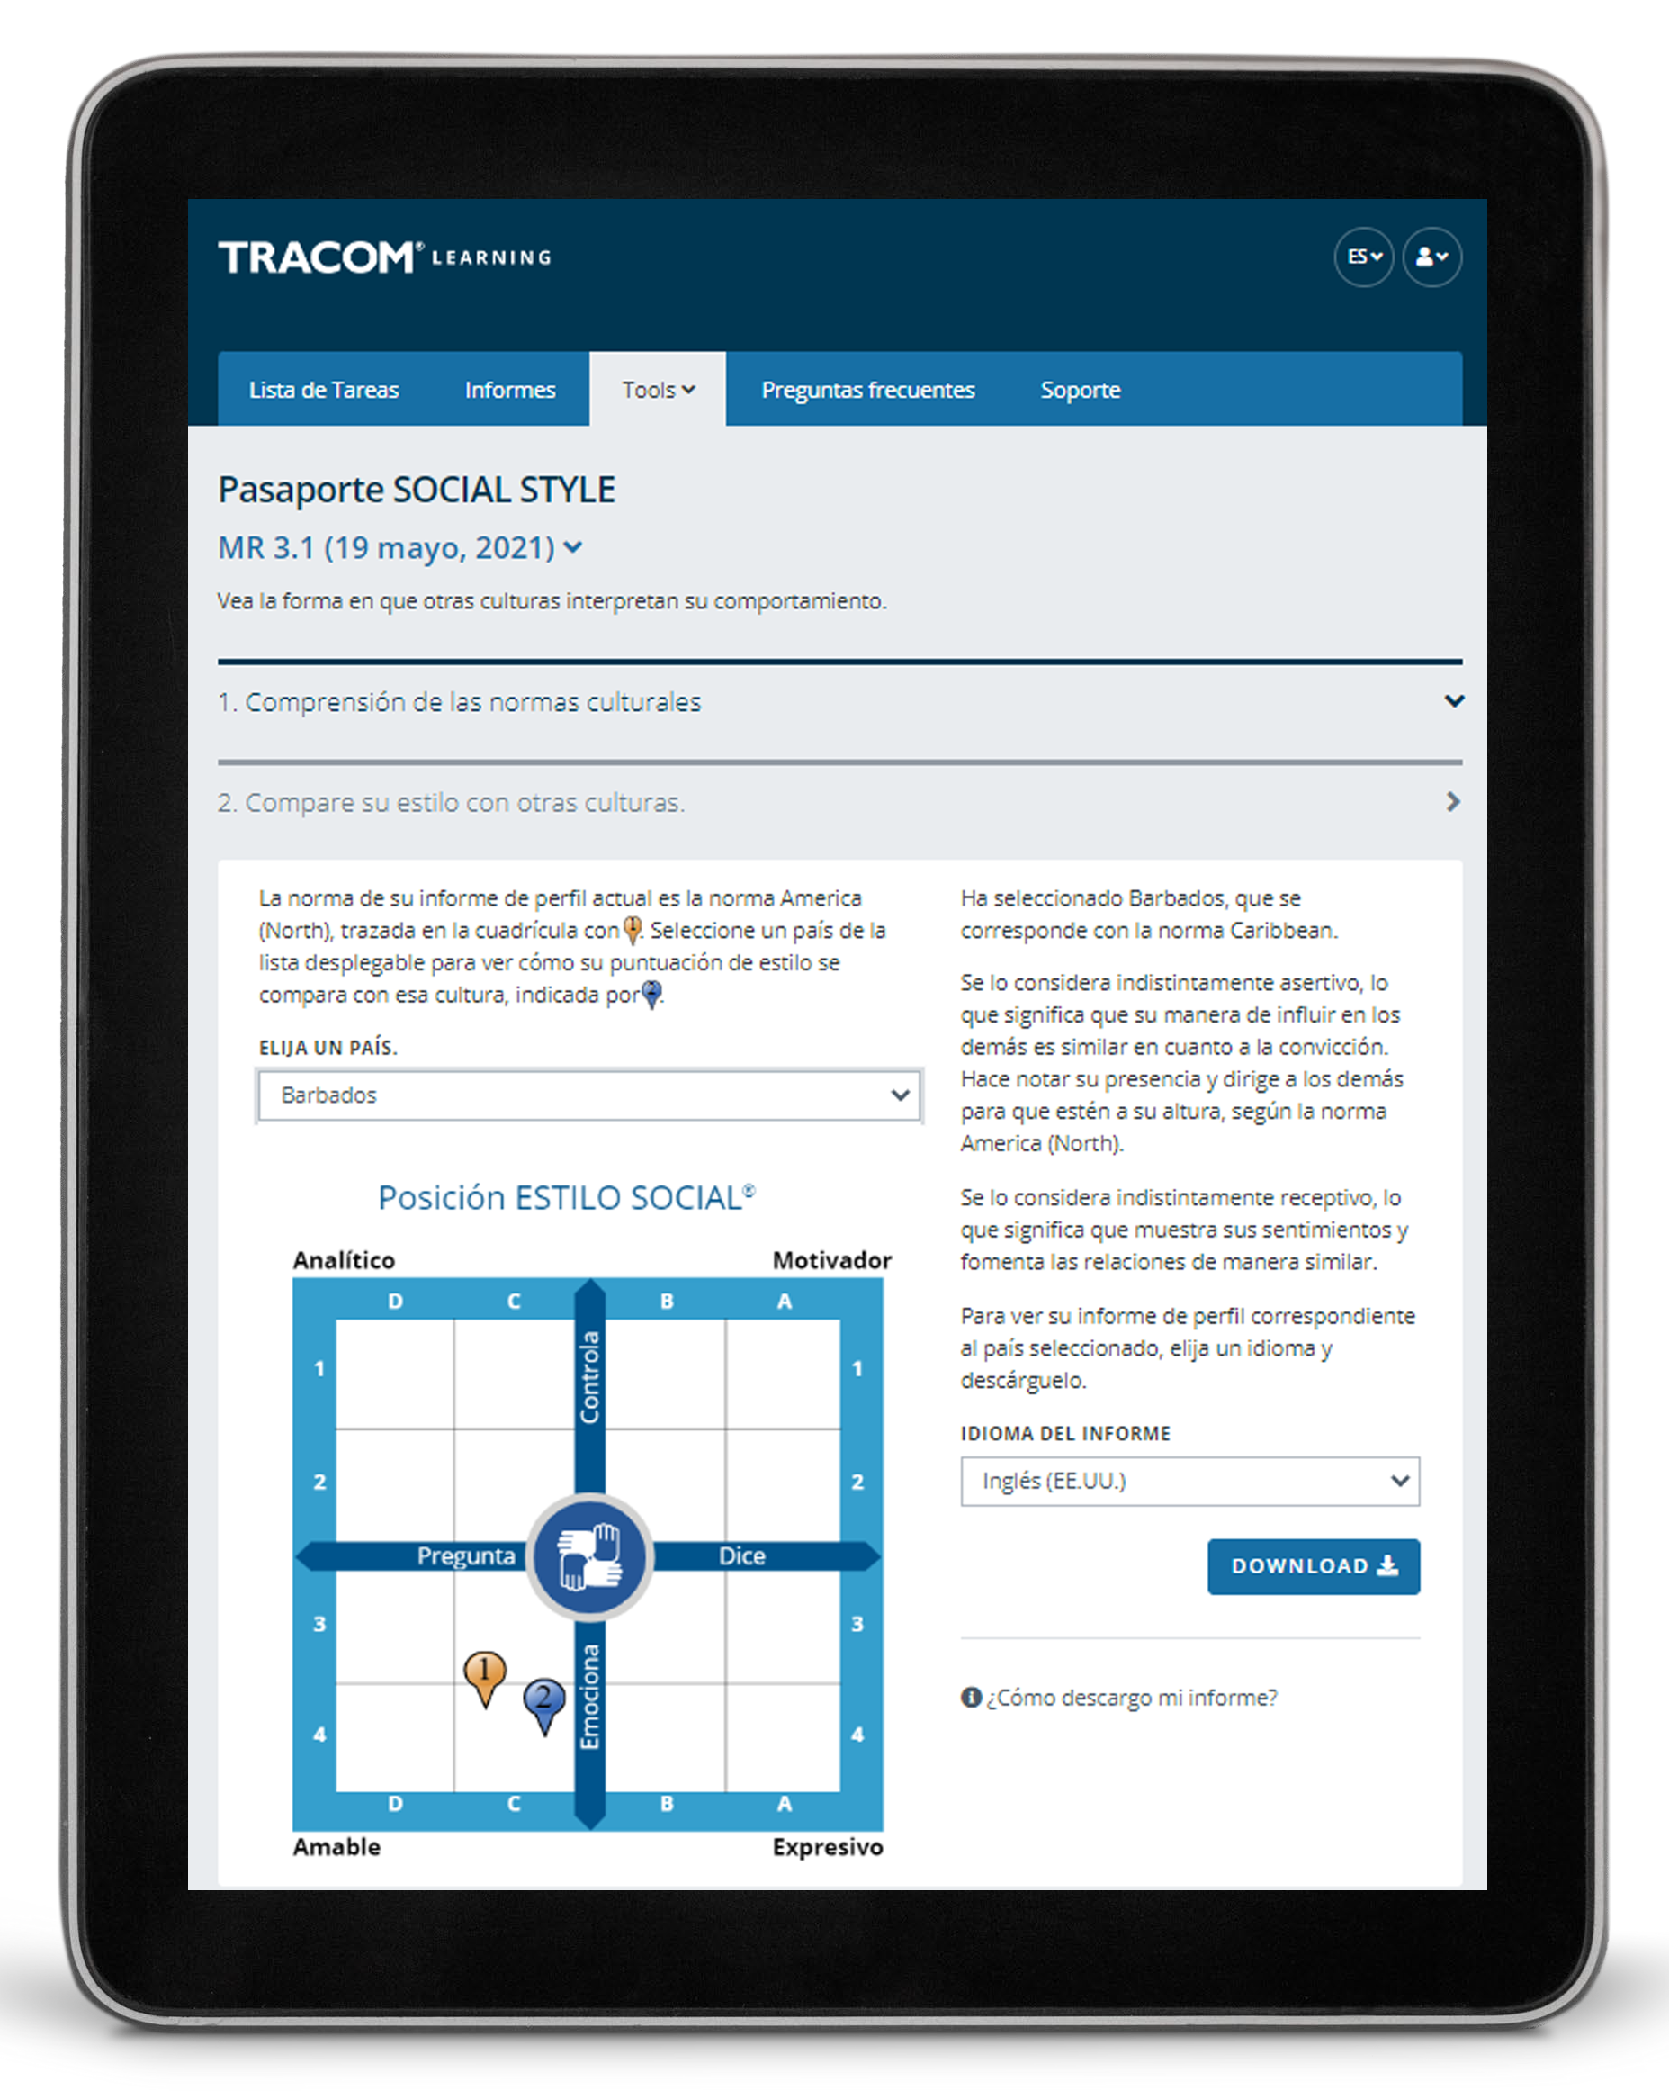
Pasaporte SOCIAL STYLE
Notes:
Optional demonstration, time permitting

Slide 52
52
Notes:
2 MINUTES
Thank you. Do you have final questions / feedback.

Slide 53
Ejercicios opcionales
Seleccione ejercicios opcionales según sus necesidades de capacitación y el tiempo disponible.
53
Notes:
You can draw upon the following exercises to enhance your session to best meet the needs of your participants.

Slide 54

Relaciones potencialmente tóxicas
Controla
Analítico
Ritmo más lento
Se centra en los detalles
Enfoque serio y formal
Motivador
Ritmo más rápido
Se centra en el objetivo
Enfoque serio y formal
Pregunta
Dice
Amable
Ritmo más lento
Se centra en la relación
Enfoque casual e informal
Expresivo
Ritmo más rápido
Se centra en las generalidades
Enfoque casual e informal
Emociona
Notes:
Potentially Toxic Relationships
Purpose
To determine if they have a toxic relationship with a customer.
Recommended Time
10 minutes
Materials Needed
None
Directions
ASK participants to turn to pages 21 through 23 of the Participant Workbook.
DESCRIBE the possibility of Toxic Relationships occurring when both the salesperson and the customer act in Style-bound ways.
SAY Toxic relationships can occur when you and your customer interact in “Style-bound ways.” That is, you both act according to Style Need and Orientation and make little or no attempt to accommodate the Style of the other person.
ASK participants to take a few moments to consider whether they have a toxic relationship with a customer.
ASK participants to write notes about ways they can resolve these relationships.
DEBRIEF the exercise by asking participants to share their insights.

Slide 55
Foro de Estilo
Objetivo: Darle la oportunidad de describir qué es lo que le crea tensión en la posición del ESTILO SOCIAL opuesto y desarrollar ideas sobre cómo ser más productivo con un cliente que tiene ese Estilo.
Instrucciones:
  En su grupo asignado, comente y desarrolle una lista de comportamientos que exhibe el ESTILO SOCIAL opuesto que crea tensión para usted.
  Comparta su lista con el grupo del Estilo opuesto.
  En su grupo, comente qué puede hacer para interactuar mejor con el Estilo opuesto.
  Comparta su información con el Estilo opuesto y con toda la clase.
55
Notes:
Style Forum
Purpose
The purpose of this exercise is to give participants an opportunity to describe what it is about the opposite SOCIAL STYLE position that creates tension for them when working with customers of that Style and to develop insights into how to be more productive with a person who has that Style.
Recommended Time
30 minutes
Materials needed
None
Directions
Break participants into groups by SOCIAL STYLE position with a maximum of six per group.
Give each group 10 minutes to discuss and develop a list of behaviors that the opposite SOCIAL STYLE position manifests to create tension that leads to unproductive relationships.
After each group has developed its list, ask the Amiable and Driving Styles to get together to share their lists. Ask the Expressive and Analytical Styles to do the same thing. Each Style should spend five to ten minutes sharing its list and answering clarifying questions. Caution the groups that this is not a time to get defensive.
After each group has heard the other’s list, the original groups should get together by themselves to discuss what they can do to interact better with the opposite Style (e.g., those with Expressive Styles would develop a list of what they could do to make the relationship more productive with Analytical Styles). As each group shares its list of what it could do better, the opposite Style group should provide feedback and suggestions as to how appropriate the lists are.
After all groups have shared their information with the opposite Style, the whole class discusses what has been learned.
At the conclusion of the exercise, each group should have valuable information as to how to behave more appropriately with the diagonally opposite Style. In addition, after the general class discussions, each Style should have valuable information for working with each of the other SOCIAL STYLE positions.

Slide 56
Foro de versatilidad
Objetivo: Darle la oportunidad de describir una relación desafiante y trabajar en grupo para identificar los pasos específicos que puede tomar para mostrar más versatilidad con ese cliente.
Instrucciones:
Divida en cuatro grupos de Estilo.
Una por una, cada persona hace lo siguiente:
  Describe a un cliente con el que tiene una relación difícil y trata de identificar su Estilo.
  Comparte lo que hace el cliente que los frustra.
  Como grupo, ayuden a la persona a identificar acciones específicas para mostrar más versatilidad a su cliente.
  Nombre un portavoz: ¿Hay algo único o revelador que quiera compartir con todo el grupo?
56
Notes:
Versatility Forum
Purpose
This exercise helps learners prepare to apply Versatility with a challenging relationship. Each Style group helps one another identify specific actions they can take to show more Versatility.
Recommended Time
30 minutes
Materials needed
Style and Versatility profiles, to help discover specific strategies for showing Versatility.
Directions
DIVIDE participants into Style groups and assign them to virtual breakout rooms (or separate areas of a physical space).
PROVIDE instructions on the slide.
SAY Nominate a spokesperson to represent your Style group. Take note of anything unique or insightful that you want to share with the whole group. We don’t want you to repeat everything that was said, only key takeaways.
CONDUCT the activity, carefully monitoring time and adding value as appropriate.
CLOSE the Versatility Forum by ASKING for questions and EMPHASIZING any key insights participants made.

Slide 57
SOCIAL STYLE Navigator
Objetivo: Utilizar Navigator para mejorar su eficacia.
Instrucciones
  Determine un cliente o situación (como reuniones) en la que desea mejorar su eficacia.
  Inicie sesión en tracomlearning.com y seleccione “SOCIAL STYLE Navigator” en la pestaña “Tools” (Herramientas).
  Use la herramienta “Estimator” para calcular el Estilo de la persona que identificó. Si hay varias personas involucradas, haga esto para cada persona u omita este paso por ahora.
  Examine la lista de temas en la pestaña “Advisor” para encontrar el área de asesoramiento relevante y haga clic en ella.
  Lea los consejos e imprima la página si es necesario para conservarla.
  Como grupo, comenten las ideas que aprendieron.
57
Notes:
SOCIAL STYLE Navigator
Purpose
To use SOCIAL STYLE Navigator to improve your effectiveness.
Recommended Time
30 minutes
Materials Needed
Login to tracomlearning.com
Directions
Determine a customer or situation (such as meetings) where you want to improve your effectiveness.
Login to tracomlearning.com and select SOCIAL STYLE Navigator from the Tools tab.
Use the “Estimator” to estimate the Style of the person you identified. If multiple people are involved, do this for each person or skip this step for now.
Examine the list of topics under the “Advisor” section to find the relevant advice area and click on it.
Read the advice and print the page if needed to keep with you.
As a group, discuss any insights that were learned.

Slide 58
Plan de acción de versatilidad
Objetivo: Desarrollar un plan de acción para aumentar su versatilidad.
Instrucciones:
Lea su perfil de versatilidad para comprender su comportamiento. (solo perfil en línea)
Revise las estrategias provistas en las tres secciones: Formas de mejorar la presentación, formas de mejorar la competencia y formas de mejorar la opinión. (solo perfil en línea)
Dentro de cada área, elija una o dos acciones específicas y escríbalas.
Júntese con otra persona (o grupo pequeño) y comente su plan.
58
Notes:
Versatility Action Plan
Purpose
To develop a specific action plan for increasing your Versatility.
Recommended Time
30 minutes
Materials Needed
Versatility Profile
Directions
Read your Versatility profile to understand your behavior.
Review the strategies provided in the three sections: Ways to Improve Presentation, Ways to Improve Competence, and Ways to Improve Feedback.
Within each area, decide on one or two specific actions that you will take, and write these down.
Pair up with another person (or small group) and discuss your plan.

Slide 59
Técnicas para observar el Estilo
No saque conclusiones precipitadas
Mantenga la objetividad
Separe el comportamiento de Estilo de la función o el puesto de alguien
Una cantidad moderada de estrés puede aclarar el Estilo de alguien
Hágase a un lado (sea un observador)
1
2
3
4
5
Notes:
Guidelines for Observing Style
Purpose
The purpose of this exercise is to familiarize participants with the six rules for identifying another person's SOCIAL STYLE.
Recommended Time:
10 minutes
Materials Needed
None
Directions
SAY The more accurately we are able to observe our colleagues’ Styles, the better we will be able to adapt our own behavior to earn greater Versatility.
ASK participants to take notes on ways of implementing the best practices.
DESCRIBE the best practices:
Don’t jump to conclusions
Remain objective
Separate Style behavior from someone’s role or position
A moderate amount of stress can clarify someone’s Style
Get out of the way (be an observer)
ASK if there are any questions.

Slide 60
Realizar mi acción de crecimiento
Objetivo: Identificar formas específicas en las que puede realizar su acción de crecimiento para mejorar su eficacia con los clientes.
Instrucciones:
  Calcule el Estilo de uno de sus clientes (usando “Style Estimator” dentro de SOCIAL STYLE Navigator si está disponible).
  Registre la necesidad de Estilo y la orientación de ese cliente.
  Identifique específicamente cómo puede realizar su acción de crecimiento con el cliente.
  Explique por qué realizar la acción de crecimiento que identificó será particularmente efectivo con este cliente.
60
Notes:
Taking My Growth Action
Purpose
To get participants to think about how taking their Growth Action (in specific ways) could help to enhance their effectiveness with a customer.
Recommended Time
20 minutes
Materials Needed
ISEV Participant Workbook
SOCIAL STYLE Navigator (“Style Estimator”)
Directions
1. Ask participants to estimate the Style of a customer. This can be done using the “Style Estimator” of the SOCIAL STYLE Navigator. If participants don’t have online access, they can refer to the graphic on page 12 of the Participant Workbook for help in determining the customer’s Style.
3. After about five minutes, ask for volunteers to identify their Style and, specifically, how they thought they could take their growth action with the customer.
4. Ask participants why taking the growth action they identified would be particularly effective with the Style of the customer they selected.
5. Provide feedback to participants based on the specifics of the action they identified.

Slide 61
Mejorar la eficacia de las ventas con versatilidad™
Versión 4.0
Notes:
<<Copy and paste this table to
notes pages on which you want
participants to be able to take
notes

