Slide 1

Améliorer l’efficacité des ventes avec Adaptabilité™
Version 4.0
Notes:
5 MINUTES (Workbook, pages 1-3)
WELCOME participants and provide a brief overview of the session.
ASK participants to turn to Pages 1, 2 and 3 in the Participant Workbook to follow along.
Stress the importance of active participation.
Briefly review the history of STYLE SOCIAL.
Cite the proven effectiveness of increased Versatility on page 3 in the Participant Workbook.
Explain what SOCIAL STYLE is all about. Say something like, “Did you ever notice that customers have certain patterns of behavior: some are animated and loud, some treat you like a friend from the start, others are all business? SOCIAL STYLE gives you a way of identifying a customer’s pattern of behavior, and of interacting with them in ways that will help you to increase your effectiveness in your selling process.”
Ask participants to think about their past customers. Ask, “Besides, ’they bought from me,’ what made your good customers good? And, what made the difficult ones difficult to sell to?” Use the participants’ responses to identify issues that will be addressed in this training.
<<Copy and paste this table to
notes pages on which you want
participants to be able to take
notes

Slide 2
Objectifs d’apprentissage
Obtenir une compréhension du le modèle STYLE SOCIAL™.
Déterminer votre STYLE SOCIAL en remplissant un questionnaire d’autoperception.
Mieux comprendre mieux votre comportement et comment les clients voient ceux qui partagent votre Style.
Augmenter votre Adaptabilité pour devenir plus efficace auprès des clients.
Notes:
15 MINUTES TOTAL
5 MINUTES
Going through this session you will:
• Gain an understanding of the SOCIAL STYLE Model.
• Determine your SOCIAL STYLE by completing a self-perception questionnaire.
• Increase your understanding of your behavior and how Customers view people with your Style.
• Increase your Versatility to become more effective with Customers.
SAY I want to emphasize the last point, number 4. While you’ll learn a lot about yourself, the goal of this program is to learn about your customers and how you can adjust your behavior to work more effectively with them. Versatility is about adjusting your behavior to help others meet their Style needs. When you do this, you increase your effectiveness and also make it easier for others to show Versatility toward you.
If your participants completed the Online Self-Perception assessment:
Make sure you have a profile for each participant who completed the assessment.
DO NOT pass out the profiles at this time.
VIRTUAL: Participants should already have their profiles available.
10 MINUTES
If you are using the Paper profile:
SAY It’s critical that individuals understand their own behavior and how it affects others. So we’re going to do an exercise that will give you insights about yourself. You’re each going to complete a self-assessment of your STYLE SOCIAL. With that knowledge as a foundation, we’ll then look at how you can work more effectively with others.
1. DISTRIBUTE questionnaires.
2. ASK participants to complete the SOCIAL STYLE and Versatility Questionnaires.
3. DO NOT ask participants to score their questionnaires at this time.
VIRTUAL PROGRAM
If delivering virtually, you will not be able to use paper questionnaires and will need to prepare ahead of time to deliver online profiles. Arrange to have a notification sent to learners so they can download their profiles prior to the session.

Slide 3
STYLE SOCIAL ET ADAPTABILITÉ
UN ÉLÉMENT CLÉ DE LA PERFORMANCE COMMERCIALE
À la suite de la formation sur le STYLE SOCIAL et à l’Adaptabilité, les professionnels de la vente déclarent que :
92 %
87 %
58 %
ont développé davantage de
ont augmenté leur capacité à
ont
CONCLU DES VENTES QU’ILS N’AURAIENT PEUT-ÊTRE PAS RÉALISÉES AUTREMENT
RELATIONS POSITIVES AVEC LES CLIENTS
INFLUENCER OU PERSUADER LES CLIENTS
Plus l’Adaptabilité augmente, plus les performances professionnelles augmentent.
Notes:
2 MINUTES
SAY In the first part of the program, you’ll learn about Style. This will help you understand your customers and how they prefer to interact with you.
The second part of the program focuses on Versatility, which is how well you meet others’ Style needs.
Versatility is the application of STYLE SOCIAL—when you understand your customers’ Style needs, you can help them meet those needs. This helps them feel more valued and sets the stage for them to have a better relationship with you. If you consistently show Versatility, you can be more effective.
You can read the stats on this slide. Research has found that SOCIAL STYLE and Versatility is a strong predictor of successful sales performance.

Slide 4

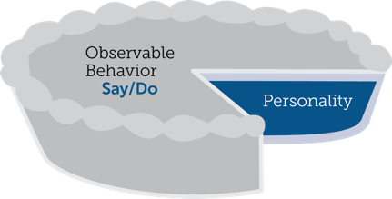

Comportements observables et personnalité
Comportement
Vos paroles (verbal) et vos actions (non verbal)
STYLE SOCIAL®
Un schéma particulier d’actions que les autres personnes peuvent observer et accepter pour décrire le comportement de quelqu’un
Comportement observable
Dire /
Faire
Personnalité
Comportement interpersonnel
Vos paroles et vos actions quand vous entrez en relation avec les autres personnes
Personnalité
Tout ce qui représente une personne : ses idées, ses valeurs, ses espoirs et ses rêves
Notes:
4 MINUTES (Workbook, page 5)
ASK participants to turn to page 5 of the Participant Workbook to follow along.
SAY Behavior and personality are not the same things. Observable behavior is like the crust of a pie. Personality is like the inside and outside of the pie.
ASK What makes up personality?
CONDUCT a quick facilitated discussion to solicit participants’ responses. They should say things such as:
Values, hopes, attitudes, beliefs.
Things that are not necessarily observable.
These internal qualities are more subjective in nature.
SAY Style is like the crust, because it’s on the outside and observable. By observing behavior, we can find ways to define and discuss what we see. Then, we can begin to understand how this behavior affects ourselves and others.

Slide 5
Dire & Faire Comportement
Traits
Honnête
Intelligent
Arrogant
Motivé
Égocentrique
Sincère
Critique
Comportement observable
Silencieux
Rythme plus lent
Expressions du visage mieux contrôlées
Voix moins modulée
Peu de contact visuel
Posture décontractée
Se penche en arrière
Bruyant
Rythme plus rapide
Expressions du visage plus animées
Voix plus modulée
Davantage de contact visuel
Posture rigide
Se penche en avant
Jugements
Je l’aime bien
Il m’agace
Elle m’intéresse
Il m’irrite
Je me méfie d’elle
Je le déteste
Je lui fais confiance
DIRE
FAIRE
Notes:
4 MINUTES (Workbook, pages 6-7)
ASK participants to turn to pages 6 and 7 of the Participant Workbook to follow along.
SAY When we first meet people we often form immediate impressions, even after just a few seconds. This is sub-conscious (below our awareness) and happens immediately.
DESCRIBE
Traits Column: What we think we know about a person, based on interactions; subjective opinions.
Judgments Column: Our reactions to others; conclusions or evaluations we make, based on our subjective opinions.
Observable Behavior Column: Things others “Say and Do”; more objective and observable behaviors.
SAY Traits and Judgments are most subjective in nature and contain positive or negative descriptions.
Observable Behavior is objective and contains no positive or negative value.
Observable Behavior is an important tool for assessing others’ Styles. By focusing on Observable Behavior, you gain objectivity, which is critical for understanding people’s Styles.

Slide 6
Assertivité et réactivité
Notes:
SAY We measure observable behavior on two dimensions: Assertiveness and Responsiveness

Slide 7
Assertivité
La mesure dans laquelle nous « demandons » ou « affirmons » lorsque nous interagissons avec les autres
Plus de demande
Demande
avec un peu d’affirmation
Affirmation avec un peu de demande
Plus d’affirmation
Notes:
4 MINUTES (Workbook, pages 8-9)
ASK participants to turn to pages 8 and 9 of the Participant Workbook.
SAY To become more effective with others, we follow a behavioral model. There are two dimensions of behavior that define SOCIAL STYLE: Assertiveness and Responsiveness.
Assertiveness is the degree to which we ask or tell when interacting with others. The two anchors for Assertiveness are Ask on the left side of the continuum and Tell on the right side of the continuum.
Assertiveness is a measurement of how we try to influence others to take action. If you are more “Tell” Assertive, you state your opinions directly. You tend to declare your viewpoints and try to direct the actions of others.
For example, if you want to have lunch with someone, you might say, “Let’s have lunch today!”
If you are more “Ask” Assertive, you tend to be more cautious and reserved about sharing your opinions. You attempt to influence others in a more quiet, low-key, questioning manner.
For example, if you want to have lunch with someone, you might say, “Would you like to have lunch with me today?”

Slide 8
Comportements d’assertivité
DIRE | Comportements verbaux
Plus lent
Rythme de la parole
Plus rapide
Moins
Quantité de discours
Plus
Plus silencieux
Volume de la parole
Plus fort
DEMANDE
AFFIRME
Détendue
Utilisation des mains
Directive
S’appuie au dossier du siège
Posture du corps
Se penche en avant
Moins direct
Contact visuel
Plus direct
FAIRE | Comportements non verbaux
Notes:
3 MINUTES
SAY The Assertiveness scale helps predict a person’s behavior because it represents a “theme” or typical pattern. There are verbal and non-verbal clues to indicate a person’s Assertiveness.
DESCRIBE the verbal and non-verbal indicators of Assertiveness:
Verbal: Ask-Assertive individuals use a slower pace, less quantity (fewer words), and quieter volume. Tell-Assertive individuals use a faster pace, talk more, and a louder volume.
Non-Verbal: Ask-Assertive individuals show relaxed hands and gestures, lean back, and use less direct eye contact. Tell-Assertive individuals have a directive use of hands, lean forward, and use more direct eye contact.
Optional Exercise: Do You Ask or Tell?
ASK participants to chat whether they see themselves as more asking or more telling, and to give examples of why they see themselves this way.
In-person activity:
1. ASK participants to go toward either the left side or right side of the room to indicate whether they see themselves as “more asking” (left) or “more telling” (right).
2. ASK participants to introduce themselves to people around them and to share examples of what they feel makes them more asking or more telling.
3. ASK participants to validate their self-assessment based on whether they asked questions or made statements during their discussions. (Ask Assertive individuals will tend to ask more questions; Tell Assertive individuals will tend to make more statements).
4. ASK if anyone feels as though they might have gone to the wrong place.

Slide 9
Réactivité
Plus de
contrôle
Contrôle
avec un peu de démonstration
La mesure dans laquelle nous contrôlons ou affichons nos émotions lorsque nous interagissons avec d’autres personnes
Démonstration avec un peu de contrôle
Plus de démonstration
Notes:
4 MINUTES (Workbook, pages 10-11)
ASK Participants to turn to pages 10 and 11 of the Participant Workbook.
SAY Responsiveness is the degree to which people tend to control (don’t outwardly display emotions) or emote (outwardly display emotions).
The two anchors are Controls on the top of the continuum and Emotes on the bottom of the continuum.
Responsiveness is also the extent to which you react to emotional appeals or displays.
If you control your emotions, you usually don’t react to emotional appeals and are more likely to focus on ideas, data, and tasks. You are less likely to share your feelings publicly.
If you are more emoting, you share and display your emotions with others. You are more likely to respond to emotional appeals and displays from others.

Slide 10
Comportements de réactivité
DIRE | Comportements verbaux
FAIRE | Comportements non verbaux
Contrôle
Moins d’inflexion
Tâche
Faits/Données
Moins
Rigide
Contrôlée
Émotion dans la voix
Sujets du discours
Forme des descriptifs
Utilisation des mains
Posture du corps
Expression faciale
Plus d’inflexion
Personnes
Opinions/Histoires
Plus
Décontractée
Animée
Montre
Notes:
3 MINUTES
SAY The Responsiveness scale, like the Assertiveness scale, helps us to predict a person’s behavior because it is a “theme” or typical pattern.
DESCRIBE the verbal and non-verbal clues to responsive behavior as noted on the slide.
SAY Responsiveness is neither a positive nor a negative quality; it is neutral.
Assertiveness and Responsiveness do not affect each other — they are independent of each other.
Optional Exercise: Do You Control or Emote?
ASK participants to chat whether they see themselves as more controlling or more emoting, and to give examples of why they see themselves this way.
In-person activity:
1. ASK participants to go toward the front of the room if they feel they are “more controlling” of their emotions or to the rear of the room if they feel that they are “more emoting” (display their emotions).
2. ASK participants to validate their self-assessments. Typically, “more emoting” individuals will be talking with one another more than the “less emoting” ones.
3. ASK if anyone feels as though they went to the wrong place.

Slide 11
Le modèle
STYLE SOCIALTM
Contrôle
Demande assertive
plus contrôlé
Style Analytique
Affirmation assertive
plus contrôlé
Style Déterminé
Demande
Affirme
Demande assertive
plus de démonstration
Style
Sociable
Affirmation assertive
plus de démonstration
Style Expressif
Montre
Notes:
4 MINUTES (Workbook, page 12)
ASK participants to turn to page 12 of the Participant Workbook.
EXPLAIN how the SOCIAL STYLE Model is built by combining the Assertiveness and Responsiveness scales and how that forms the four SOCIAL STYLEs.
CLICK TO REVEAL EACH QUADRANT
SAY By combining Assertiveness and Responsiveness, the four SOCIAL STYLEs are formed.
No individual will display one Style exclusively; but, over time, you can determine a person’s Style. Once you know a person’s Style, you can adjust your behavior to develop a more effective relationship.
Note that there is no good or bad Style; each can be equally effective.

Slide 12
Profil d’auto-perception du STYLE SOCIAL en ligne
Notes:
If using the online profile, use the following slides.
Note that if delivering virtually, participants will need to have received their profiles prior to the program.
Check the Session Status Report and Composite Report to understand which participants have completed their profiles, and the breakdown of Style within your program.
FACILITATOR NOTE: By completing on online profile, Learners will immediately have free, unlimited access to SOCIAL STYLE Navigator through tracomlearning.com to help extend their learning beyond the classroom. See Slide #45 for details.

Slide 13

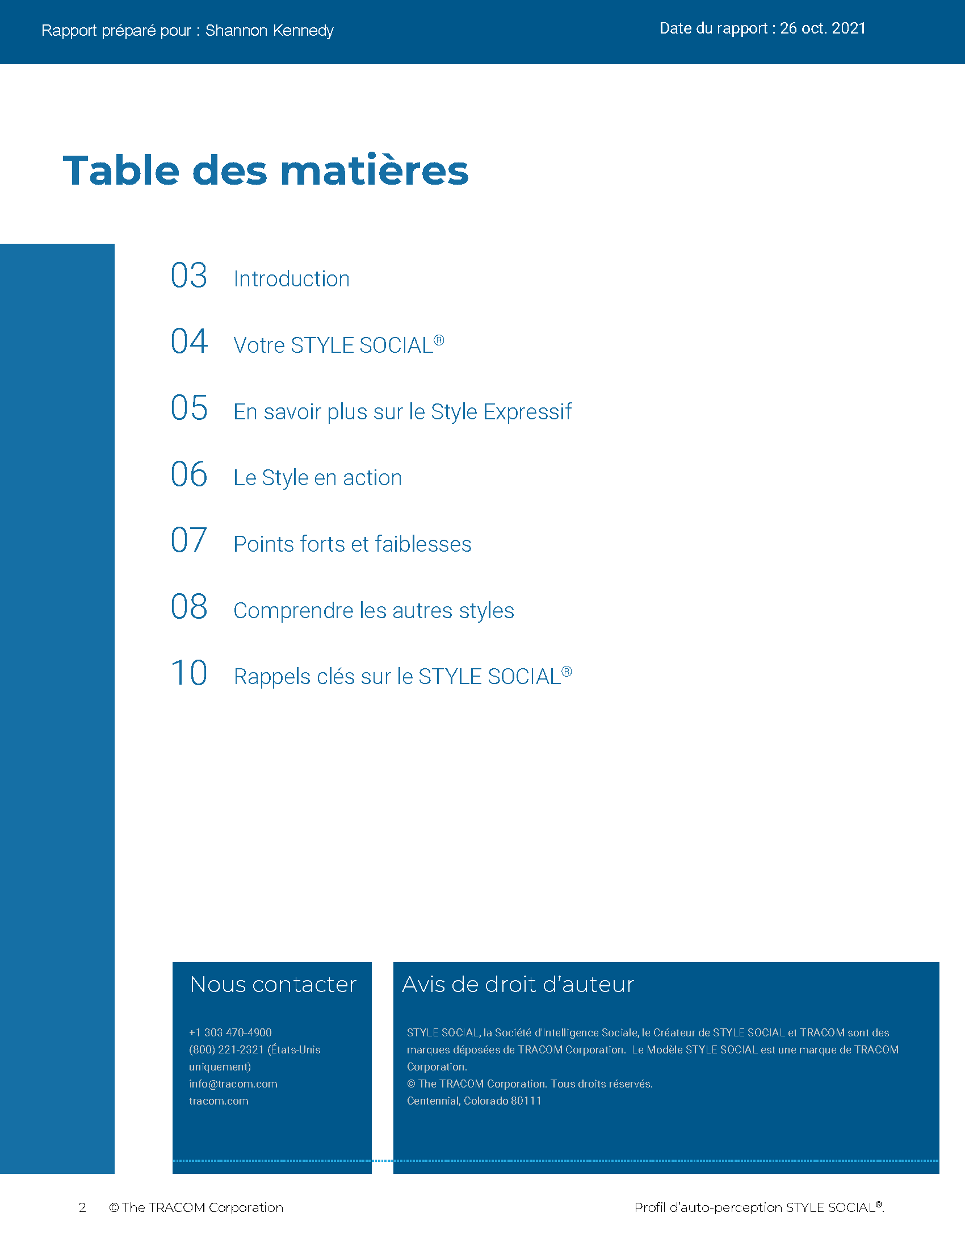
© The TRACOM Corporation. Tous droits réservés.
13
Notes:
15 MINUTES (5 MINUTES if Virtual Program)
Purpose
The purpose of this exercise is to help participants learn more about their SOCIAL STYLE and to encourage them to think about how they can adjust their behavior to be more effective.
Materials Needed
SOCIAL STYLE profile
Virtual Directions:
ASK participants to chat their Style along with one adjustment to their behavior they can make to enhance their effectiveness with others.
In-Person Directions:
ASK participants to read their Style profile and begin to determine ways they can adjust their behavior to meet others’ Style needs. (They will continue this exercise when they read their Versatility profiles).
ASK participants to share what they learned about their Style and how they can adjust their behavior.

Slide 14
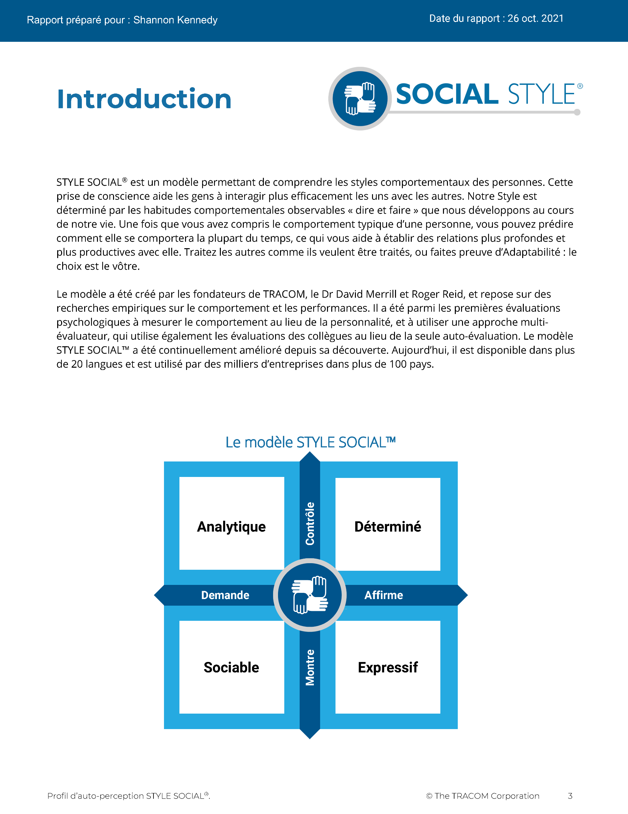
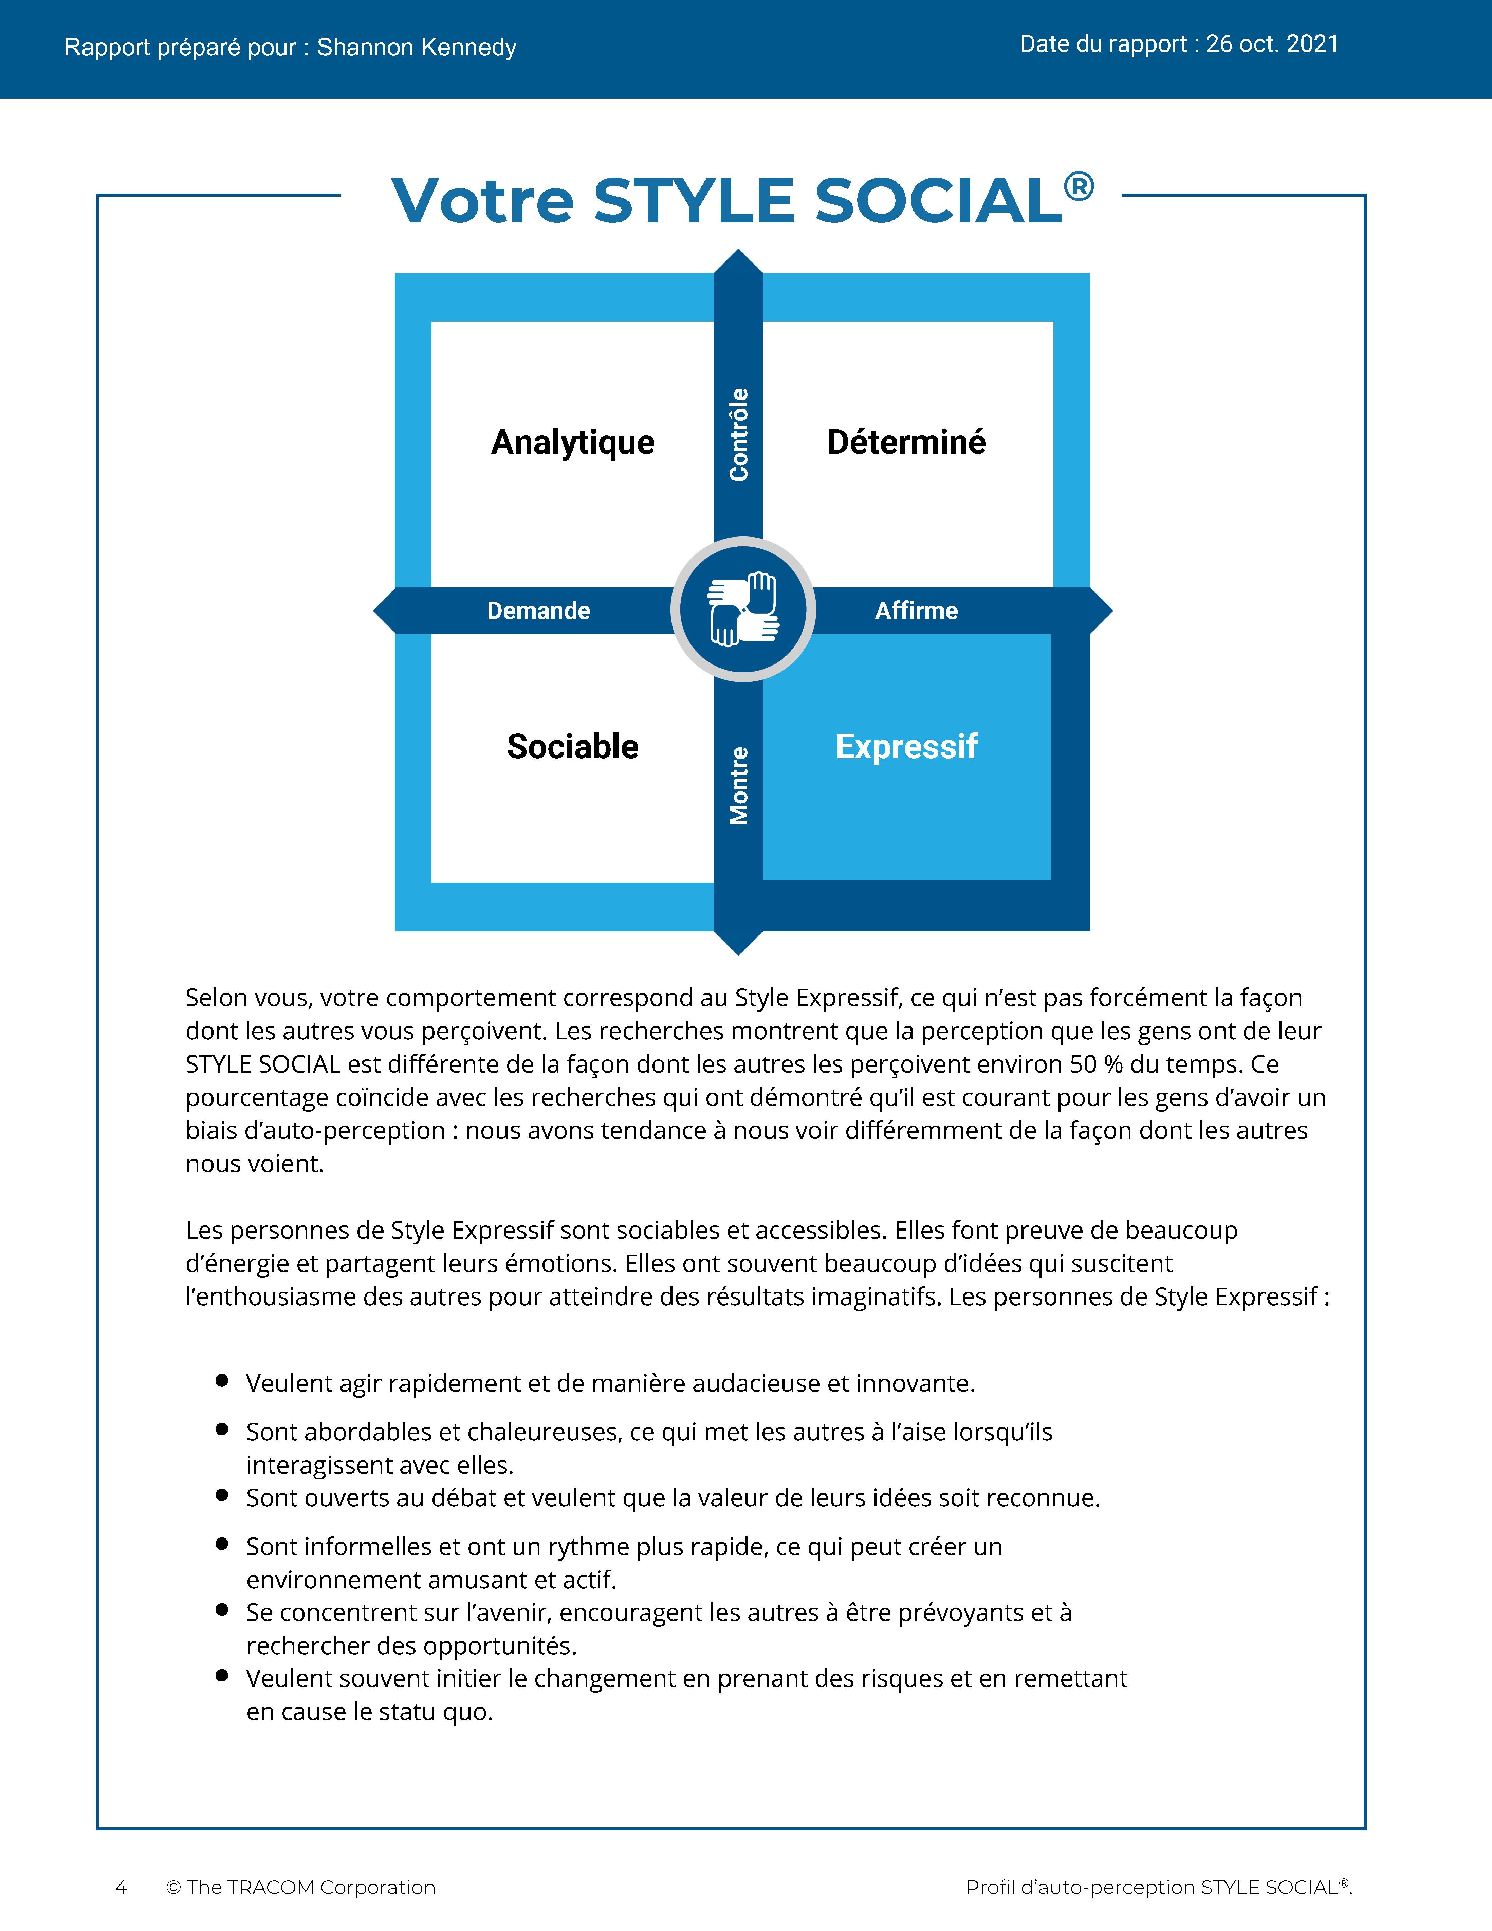
© The TRACOM Corporation. Tous droits réservés.
14
Notes:
These slides show pages of the SOCIAL STYLE profile and can be displayed to assist with conversation during the exercise debrief.

Slide 15
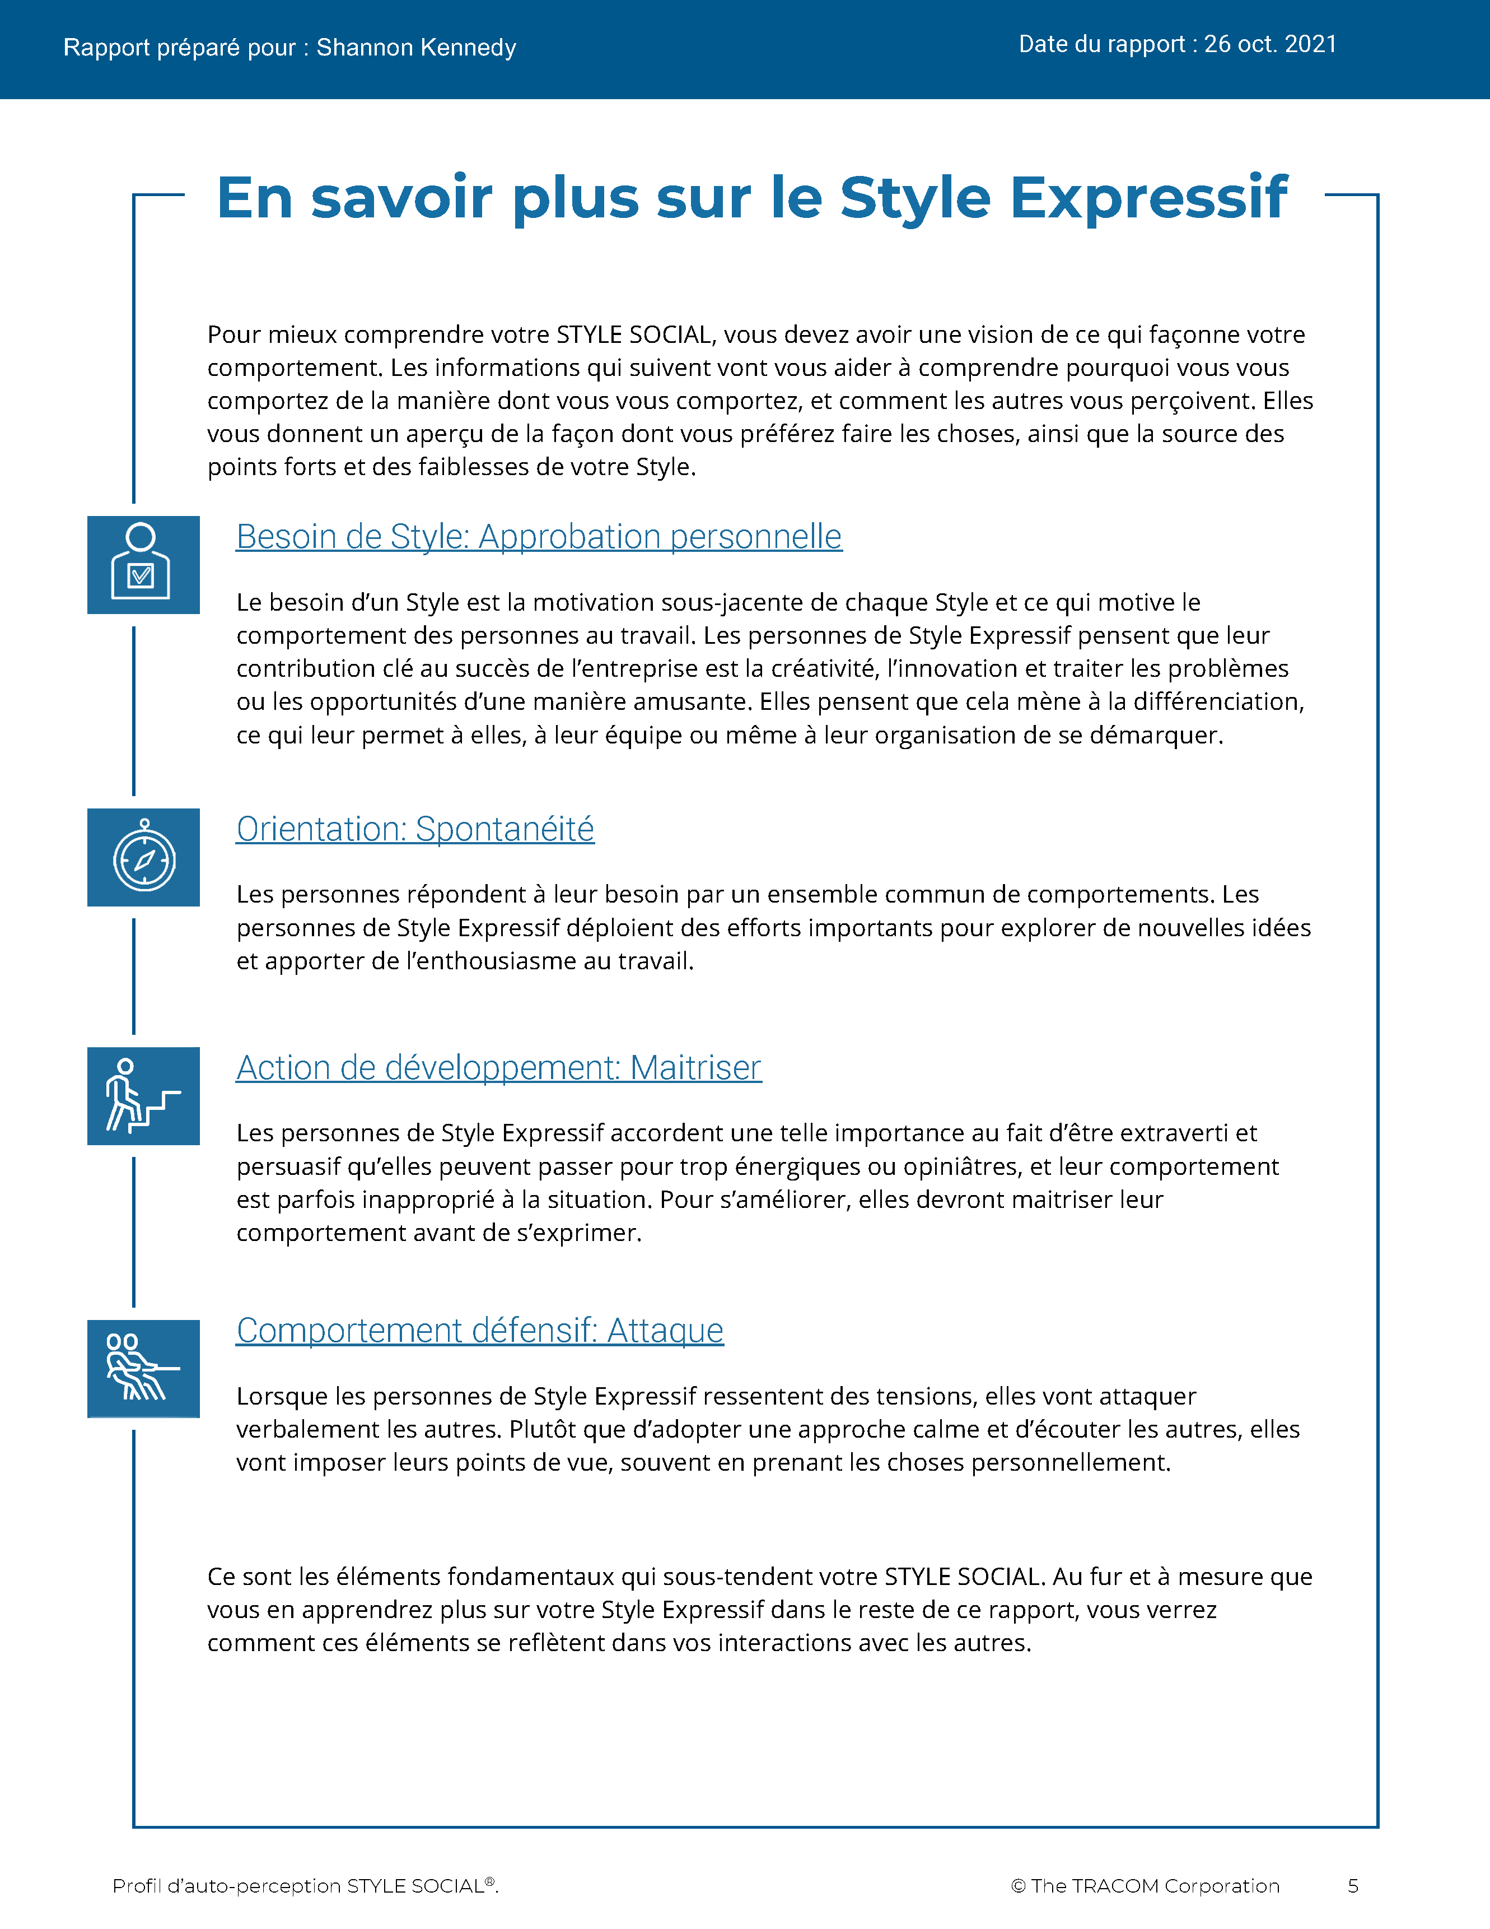
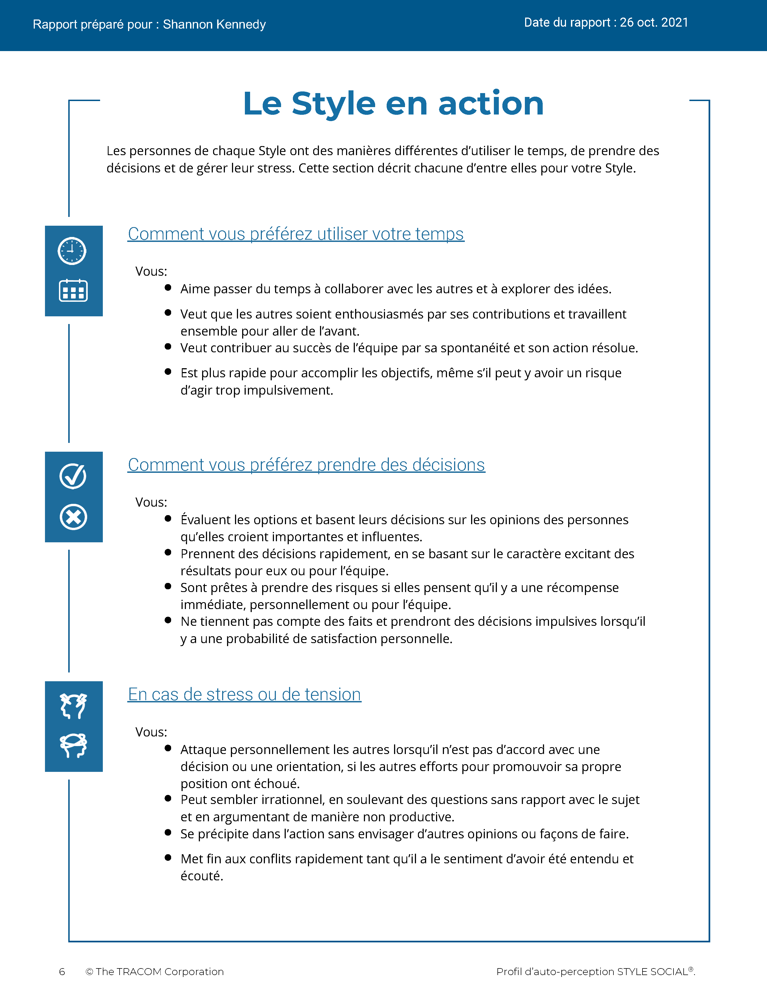
© The TRACOM Corporation. Tous droits réservés.
15
Notes:
These slides show pages of the SOCIAL STYLE profile and can be displayed to assist with conversation during the exercise debrief.

Slide 16
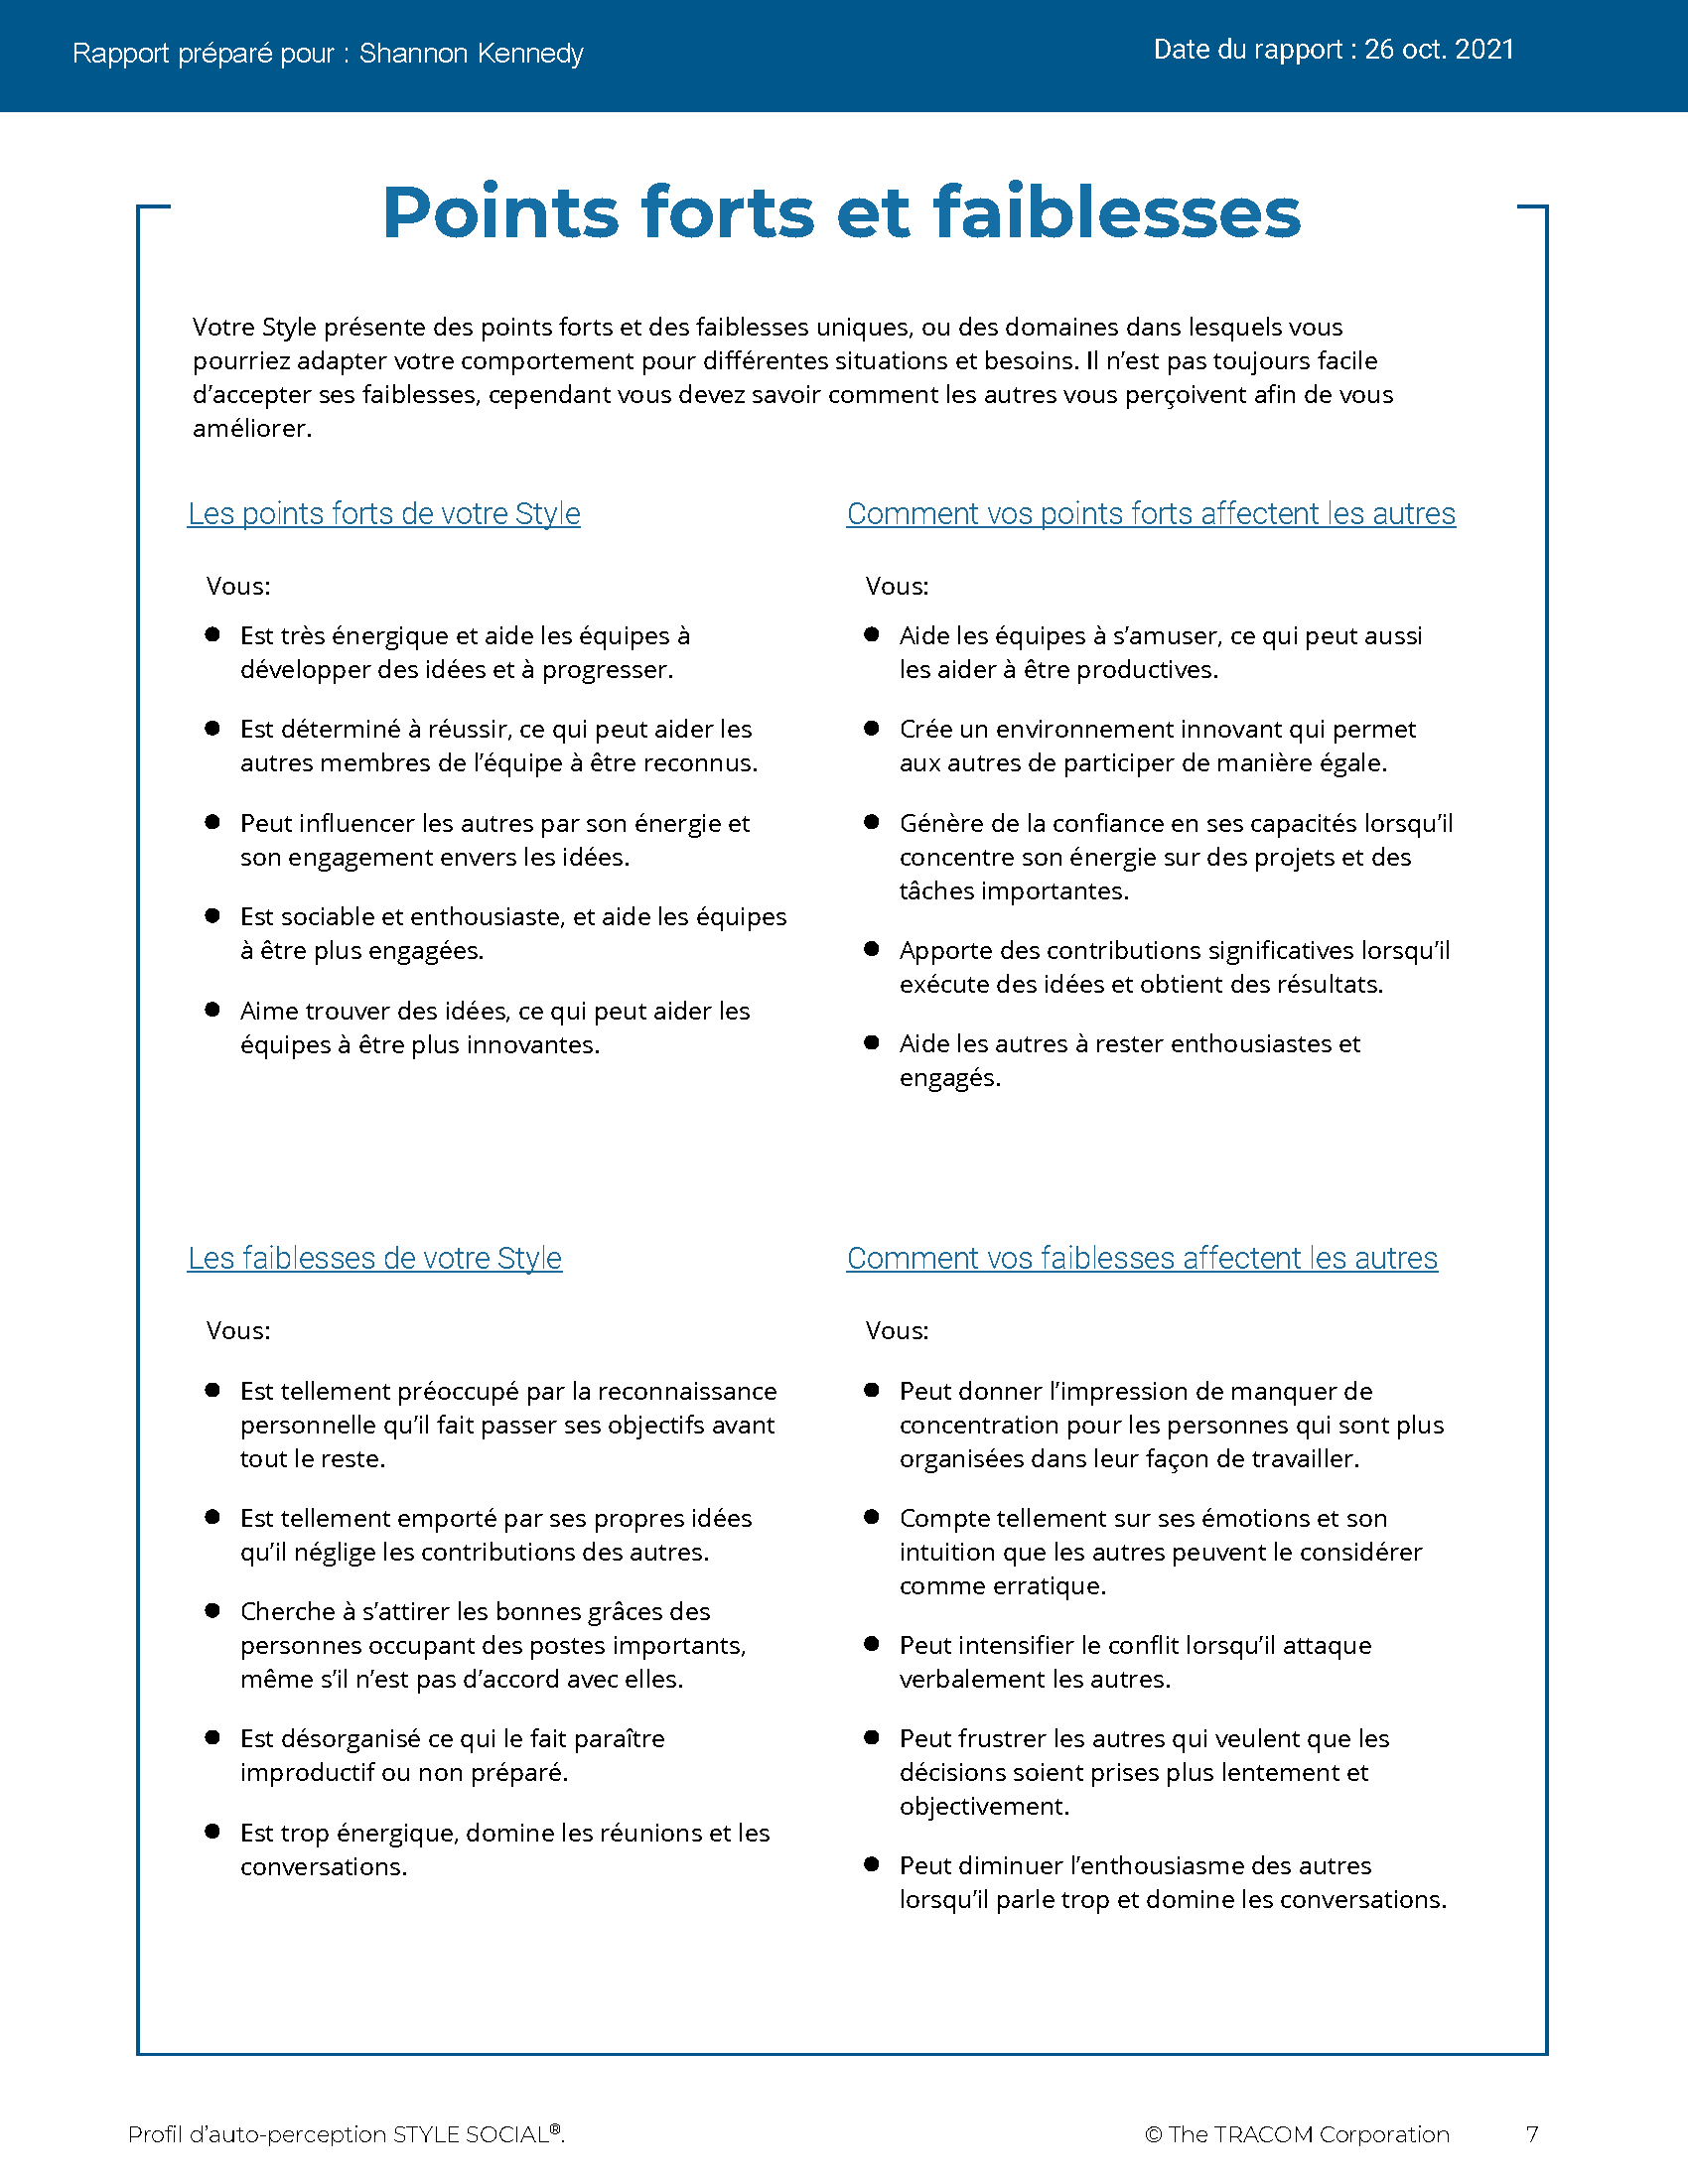
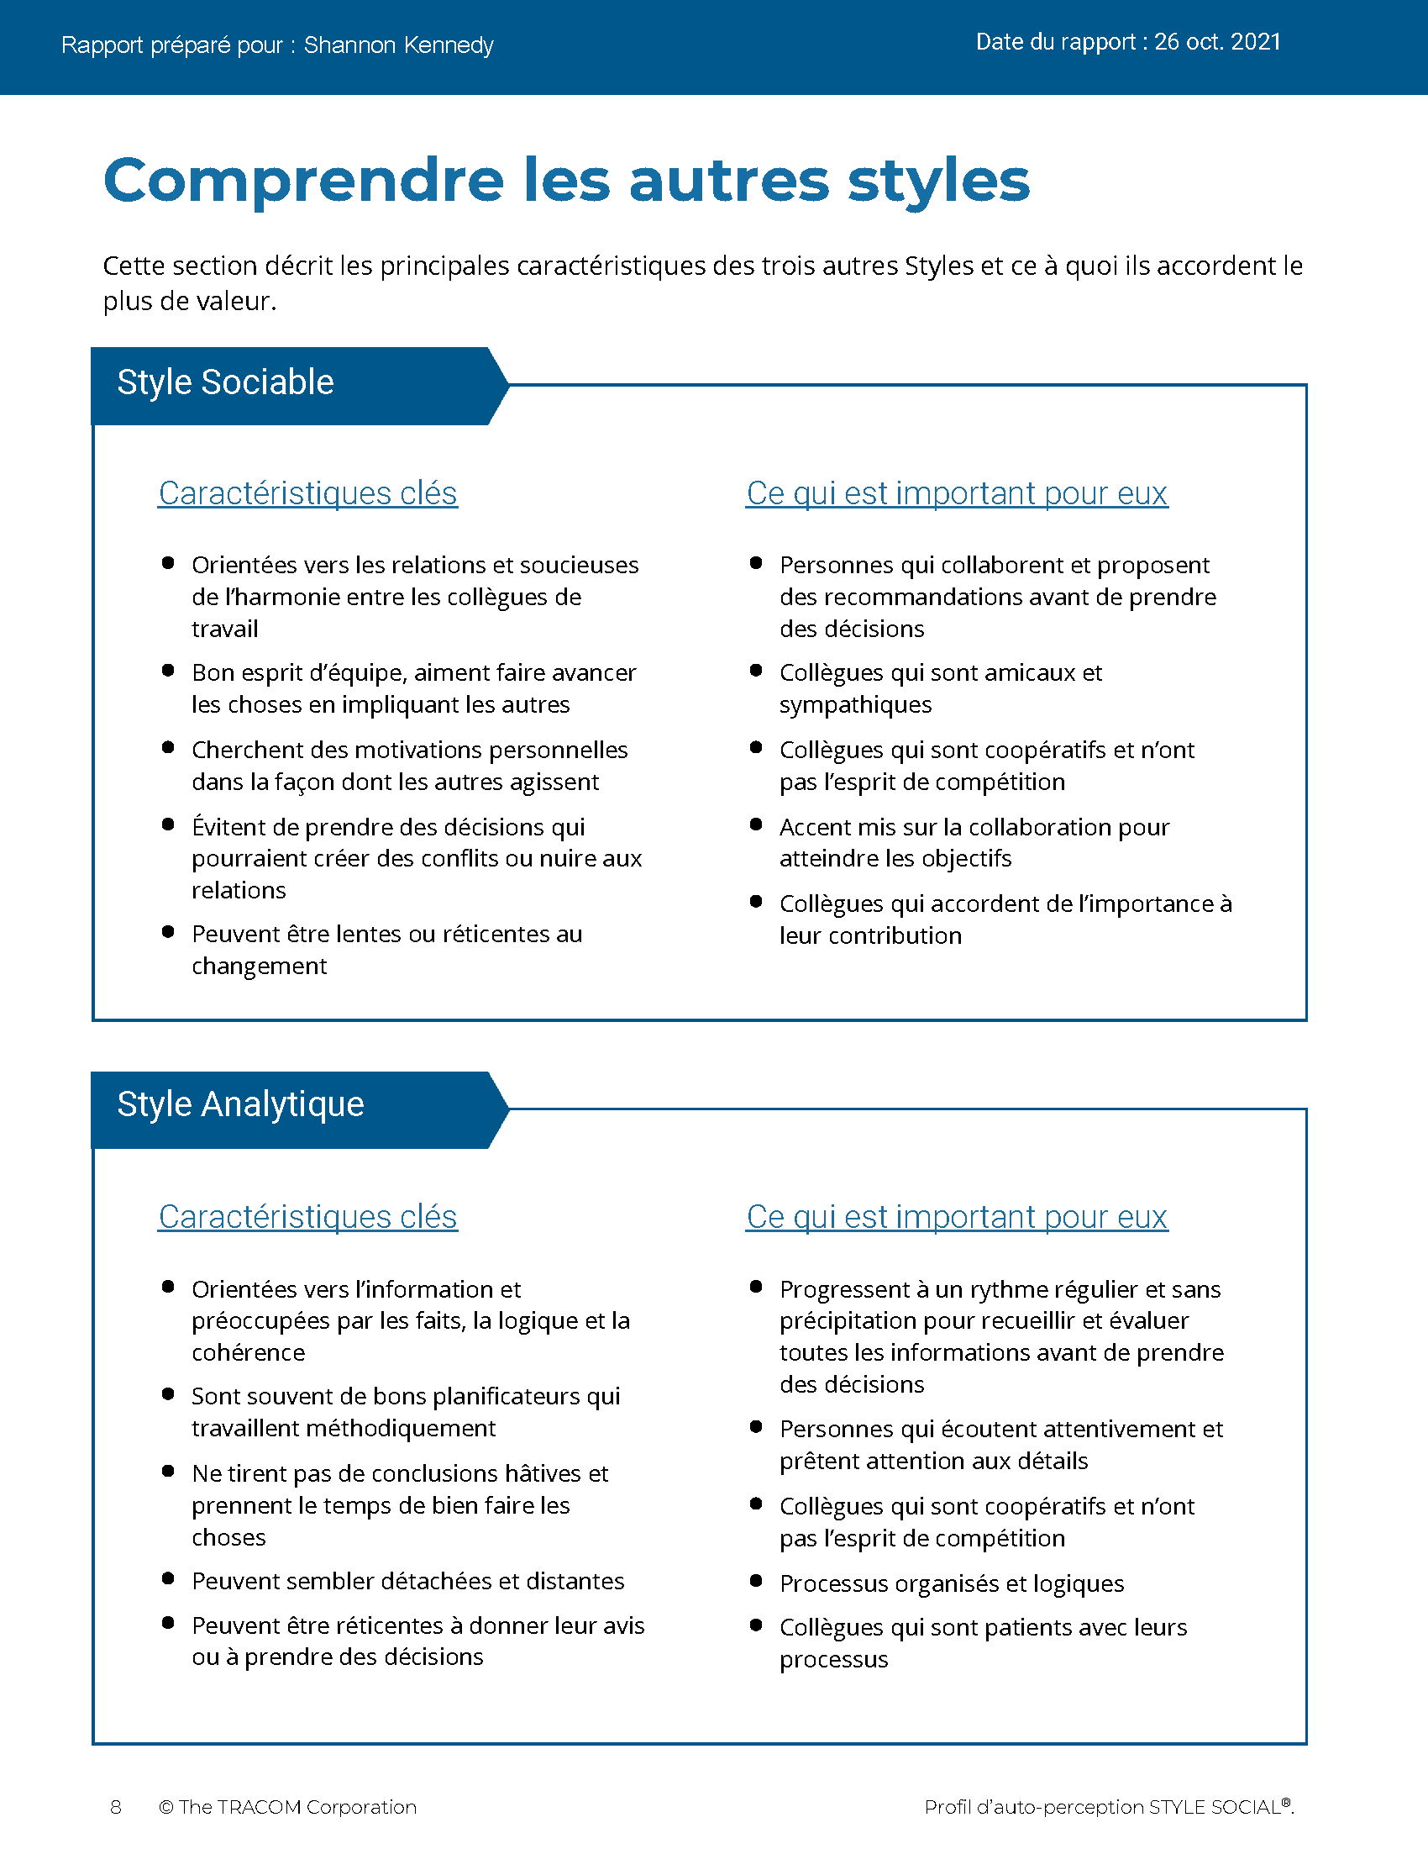
© The TRACOM Corporation. Tous droits réservés.
16
Notes:
These slides show pages of the SOCIAL STYLE profile and can be displayed to assist with conversation during the exercise debrief.

Slide 17
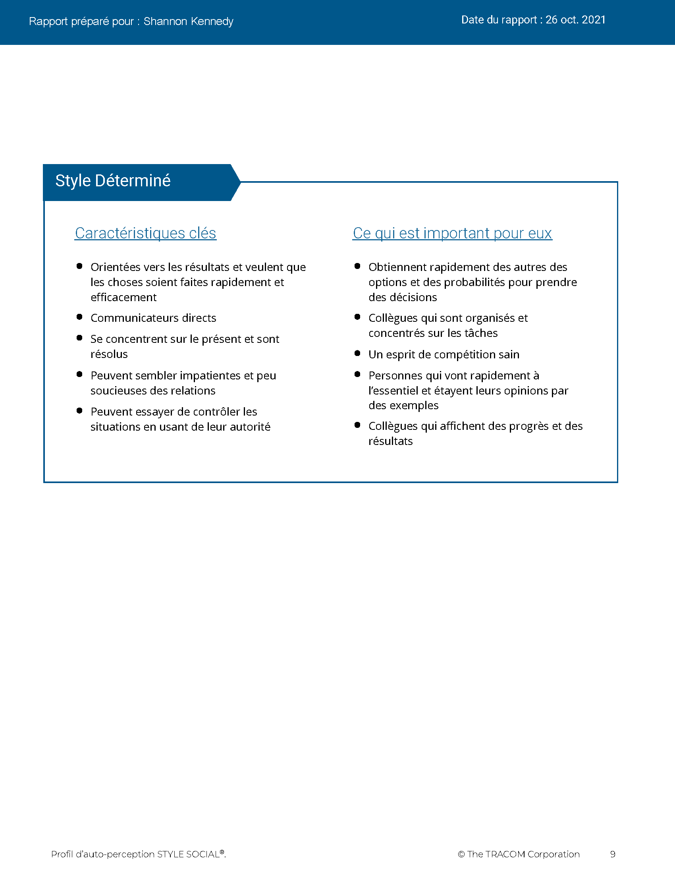
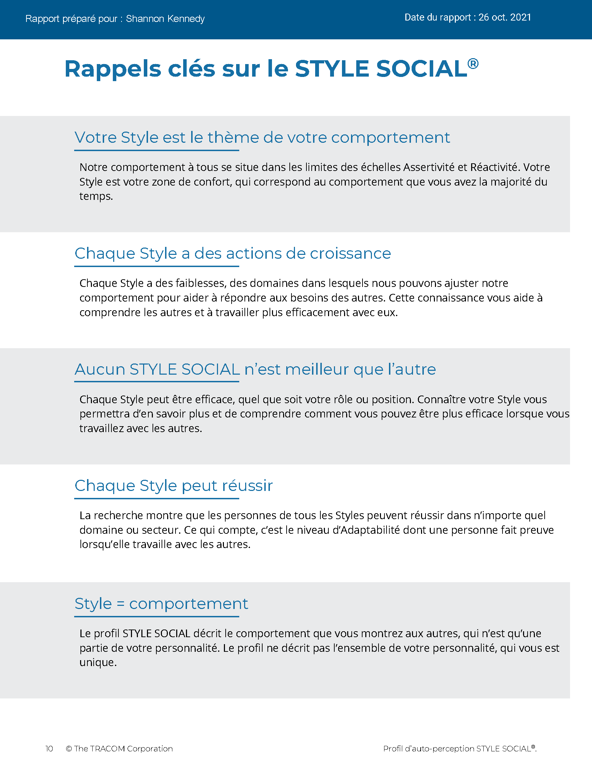
© The TRACOM Corporation. Tous droits réservés.
17
Notes:
These slides show pages of the SOCIAL STYLE profile and can be displayed to assist with conversation during the exercise debrief.

Slide 18
Profil papier d’auto-perception du STYLE SOCIAL
Notes:
If using the paper profile, use the following slides.
FACILITATOR NOTE: To extend their learning beyond the classroom, participants who complete the Paper Survey can register for free, unlimited access to SOCIAL STYLE Navigator. See Slide #46 for details.

Slide 19
Auto-perception de votre STYLE SOCIAL
EXEMPLE :
C
Découpez la partie perforée
Transférez la réponse à chaque question
Additionnez les totaux de colonnes
Faites le diagramme de votre STYLE SOCIAL
Analytique
Déterminé
D
A
Sociable
Expressif
M
Votre autoperception peut être différente de la façon dont les autres vous voient !
Notes:
10 MINUTES – PAPER PROFILE ONLY
If your participants completed the Online Profile:
DO NOT DISPLAY this slide.
FOLLOW INSTRUCTIONS in “Online Profile” section.
If your participants are using the Paper Assessment:
SAY Now, it’s time to score the SOCIAL STYLE questionnaire that you completed earlier. Score your questionnaire following the instructions on the slide.
ASK participants to plot their Assertiveness (A, T) score and Responsiveness (C, E) score as shown on the slide.
SAY The SOCIAL STYLE Self-Perception Profile reflects how you see yourself. Keep in mind that others may see you differently. TRACOM’s research indicates that about 50% of those who complete the Self-Perception Questionnaire differ in their perceptions from their reference group who complete a Multi-Rater Profile about them.
Leader Tip: You may get asked the question, “If the research indicates 50% of people see themselves differently, then what value does it have?”
Answer: The format of this course did not allow us to use the multi-rater profile. The reason we gave you a profile is that you can start to realize that others might see you differently than you see yourself. Even though receiving a multi-rater profile would give you more insight into how others perceive your behavior, this session is still useful and practical. By following the suggestions in this session you will be able to observe other people’s behavior to determine their STYLE SOCIAL. Then you can adjust your behavior to work more effectively with them.

Slide 20
Lisez sur votre Style
Contrôle
Style Analytique
Page 16
Style Déterminé
Page 13
Demande
Affirme
Style Sociable
Page 15
Style Expressif
Page 14
Montre
Notes:
15 MINUTES – PAPER PROFILE ONLY
Purpose
The purpose of this exercise is to allow participants to learn more about their SOCIAL STYLE and begin thinking about how they can use their Styles to be more effective salespeople.
Materials Needed
Flip chart
Visual: "Read About Your Style“
Directions
1. ASK participants to read about their Styles in the Participant Workbook.
2. ASK participants to identify their top three perceived strengths and weaknesses as salespeople.
3. ASK if anyone has any questions about their SOCIAL STYLE regarding (a) strengths of their Style and (b) things they need to work on.
4. ASK participants to share what they learned. Draw SOCIAL STYLE quadrants on the flip chart and record their answers for all to see and consider.

Slide 21



Besoin, Orientation et Action de Croissance
Besoin
L’objectif de chaque Style
Orientation
Le comportement courant utilisé pour satisfaire le besoin
Action de croissance
Comportement qui est rarement utilisé par chaque Style. Utiliser ce comportement plus souvent augmenterait l’efficacité de ce Style
Notes:
2 MINUTES (Workbook, page 18)
ASK participants to turn to page 18 of the Participant Workbook.
SAY Each Style has a Need, an Orientation, and a Growth Action.
DEFINE:
Need – The goal of each Style.
Orientation – The common behavior used to achieve the need.
Growth Action – Behavior that is rarely used by each Style. Using this behavior more often would increase this Style’s effectiveness.
SAY Understanding the Need, Orientation, and Growth Action of each Style will help you better relate to others’ Styles and enhance your effectiveness with them.

Slide 22
STYLE SOCIAL
Caractéristiques principales
Contrôle
Analytique
Besoin de : avoir raison
Orientation : automatique
Action de croissance : déclarer
Déterminé
Besoin de : résultats
Orientation : action
Action de croissance : écouter
Demande
Affirme
Sociable
Besoin de : sécurité personnelle
Orientation : relations
Action de croissance : initier
Expressif
Besoin de : valorisation
Orientation : spontanéité
Action de croissance : vérifier
Montre
Notes:
4 MINUTES
CLICK TO REVEAL THE TEXT IN EACH QUADRANT.
Correlate Assertiveness and Responsiveness behaviors to Style Need and Orientation:
Have participants think about how Style Need and Orientation directly correlate to the Assertiveness and Responsiveness behaviors that were discussed earlier. For example, the Analytical Style's need for time to think is consistent with getting things done at a slower-pace, being more interested in facts, and displaying less emotion.
In the diagonally opposite corner, the Expressive Style’s need for approval and Orientation toward spontaneity is consistent with being louder and using more hand gestures.
Ask participants to point out correlations they see between the Driving Style’s Need and Orientation and the Assertiveness and Responsiveness behaviors …same question regarding the Amiable Style.
Leader Tip: The key characteristics of Style are only a convenient way of summarizing basic Style characteristics. The descriptions of key characteristics are generalizations of behavior that fit most characteristics of each Style. They do not perfectly describe any single individual.

Slide 23
Tension et productivité
Élevé
Faible Tension
Faible Productivité
Approprié :
Tension et productivité
Élevé Tension
Faible Productivité
Tension - Une force qui stimule l’activité
Productivité
Faible
Faible
Élevé
Tension
Notes:
5 Minutes (Workbook, page 20)
ASK participants to turn to page 20 of the Participant Workbook.
SAY Tension is a force that stimulates activity, and it has an effect on behavior. Managing tension during the sales process is important to ensure that the customer is feeling motivated enough to proceed with the buying process but not so tense that negative emotions grow and get in the way.
DESCRIBE the Tension Productivity Model.
SAY Tension exists in every relationship. Managing it productively is the key. Low tension, the sale stalls; appropriate levels of tension, the sale proceeds; high tension, the sale comes to a stop as the customer goes into Backup Behavior (more on this in the next section).
Sometimes tension cannot be turned into productive effort, so it is misdirected and released in random or harmful ways. When tension is too great, we want to reduce it. This is called Backup Behavior.
Leader Tip: Clearly define Tension. Tension can occur in both positive and negative forms. A certain degree of tension is positive and can be productive. Don’t overemphasize or focus solely on the negative forms of tension.

Slide 24
Comportement de sauvegarde
Contrôle
Analytique
ÉVITE : Se retire pour réduire la tension personnelle
Déterminé
AUTOCRATIQUE : Prend les choses en main pour réduire les tensions personnelles
Comportement exagéré utilisé pour réduire la tension
Demande
Affirme
Sociable
ACQUIESCE : S’incline pour réduire la tension personnelle
Expressif
ATTAQUE : Affronte les autres personnes pour réduire la tension personnelle
Montre
Notes:
4 MINUTES (Workbook, page 21)
ASK participants to turn to page 21 of the Participant Workbook.
SAY Backup Behavior occurs when people are frustrated in trying to get their Style need met. Backup Behavior is an exaggerated form of Style-related behavior used by a person to reduce tension within the relationships that caused the tension.
To increase your effectiveness, recognize when you are affected by tension.
Recognizing the Backup Behavior for each Style can also help you to deal effectively with others who are experiencing tension and behaving in Style-bound ways.
REVIEW the Backup Behavior for each Style.

Slide 25
Gestion du comportement de sauvegarde
Contrôle
Analytique - Évite
Soulignez la valeur de leurs faits et de leur contribution et demandez-leur de comparer leurs informations avec vos exigences de manière objective et sans émotion
Déterminé - Autocratique
Déclarez fermement votre engagement envers les objectifs et montrez comment vous pouvez les aider à parvenir aux résultats qu’ils se sont engagés à atteindre
Comportement exagéré utilisé pour réduire la tension
Demande
Affirme
Sociable - Acquiesce
Rassurez-les pour qu’ils se sentent en sécurité en s’impliquant à nouveau ; encouragez-les à
donner leur avis
Expressif - Attaque
Permettez-leur de se défouler et reconnaissez leurs contributions, tout en orientant la conversation vers des actions qui leur seront bénéfiques, à eux et à l’équipe
Montre
Notes:
4 MINUTES
DESCRIBE some simple strategies for managing individuals who are using their backup behavior as shown on the slide.
Leader Tip: Backup Behavior is always self-serving. Reinforce the notion that Backup Behavior is selfish and never results in positive outcomes. There is nothing that is mutually productive in this form of behavior.

Slide 26
Relations potentiellement toxiques
Contrôle
Analytique
Rythme plutôt lent
Le souci du détail
Approche sérieuse et formelle
Déterminé
Rythme plutôt rapide
Concentration sur l’objectif
Approche sérieuse et formelle
Demande
Affirme
Sociable
Rythme plutôt lent
Concentration sur
les relations
Approche décontractée et informelle
Expressif
Rythme plutôt rapide
Concentration sur
les généralités
Approche décontractée et informelle
Montre
Notes:
5 Minutes (Workbook, pages 22-23)
CLICK TO REVEAL THE TEXT IN EACH QUADRANT.
ASK participants to turn to pages 22 and 23 of the Participant Workbook.
SAY toxic relationships can occur when you and your customer interact in “Style-bound” ways: You both act according to your own Style Need and Orientation and make little or no attempt to accommodate the Style of the other person. A Toxic Relationship can jeopardize or, more likely, kill the sale!
Relationships that are diagonal to each other often have the potential to be toxic because they are the most opposite in their behavioral preferences (Driving vs. Amiable and Analytical vs. Expressive). However, toxic relationships can develop for any Style combination, including people of the same Style.

Slide 27
Rappels clés
Il n’y a pas de « meilleur » Style.
Le Style n’est pas la personnalité.
Votre Style est un thème dans votre comportement.
Votre Style a des actions de croissance.
Votre défi : Prendre l’initiative d’établir et de construire des relations efficaces avec vos clients.
Notes:
2 MINUTES
REVIEW what has been covered so far, discussing Key Reminders as presented on the slide.

Slide 28
Adaptabilité

Slide 29
L’Adaptabilité est la façon dont vous vous adaptez aux besoins des autres en matière de Style
Notes:
2 MINUTES
SAY Versatility is a measure of your consistency in adjusting to the Style needs of others.
At the beginning of the program, we reviewed some statistics on Versatility. Research has found that Versatility is a strong predictor of successful job performance. People who consistently show Versatility are more effective in their job performance than people who are inconsistent in their Versatility.
Salespeople who have been through SOCIAL STYLE and Versatility training have rated the experience as having a significant impact on their performance in key areas.
Versatility is completely within your control, so it is your choice to be versatile with others. You can be highly versatile with one group and show low Versatility with another group. It depends on the circumstances and how much you value your interpersonal effectiveness with each group.
It is completely independent of SOCIAL STYLE: Any Style can show Versatility and be successful.
Versatility is NOT the same as likeability. A person can be well liked but not have high Versatility. The opposite can also be true. Versatility helps you develop better working relationships, but it is separate from your personal likeability.

Slide 30
Adaptabilité
Une mesure de votre constance à vous adapter aux besoins des autres en matière de Style
W | Non constant | X | Assez constant | Y | Habituellement constant | Z | Très constant
Faible
Moyenne
Élevée
Notes:
3 Minutes (Workbook, page 24)
ASK participants to turn to page 24 of their Participant Workbook.
Online Profile Only:
SAY We measure Versatility on a scale ranging from W to Z. These are normed quartiles, just like Assertiveness and Responsiveness.
When you aren’t consistent in your behavior, you’re usually focusing on your own Style needs. When you consistently show Versatility, you’re focusing on meeting others’ Style needs.
Your profile will show your results on this scale, ranging from W (not consistent) to Z (very consistent).
Paper Questionnaires Only:
Will measure High, Medium or Low
Click to show next graphic
Your workbooks might show a graphic similar to this, with low, medium, and high. This is just another way of explaining Versatility. Just remember, the key point is that Versatility is under your control, and the more consistently you behave with Versatility the more effective you will be.

Slide 31
Quatre sources d’Adaptabilité
L’utilisation appropriée de
Image
Présentation
Compétence
Feedback
Conduit à
Meilleure Adaptabilité
Notes:
5 MINUTES (Workbook, pages 25-28)
ASK participants to turn to pages 25 through 28 in the Participant Workbook.
Image remains a part of the Versatility model because it’s important for building relationships. Describe Versatility in a timeline:
SAY You show Versatility in four areas. Let me describe these as a timeline.
Image – When you first meet a new person at work, you form an impression about this person based on what you see, consciously or not. Essentially Image is a first impression: Are you dressed appropriately for the situation, for the work culture, for the client, and so on?
ONLINE PROFILE: Note that Image is not measured as part of your Profile. This is because:
Image is difficult to observe in virtual environments. We can’t observe very well how people are dressed, and because there are a wide variety of dress codes, even within companies and teams, it is less relevant to measure Image in this way.
Raters don’t always like answering questions about people’s Image without understanding the context of how Image is explained in training.
Image is still important for many people and companies, which is why it’s part of the model. However, you won’t receive a measure of your Image.
Presentation – When that person communicates in meetings or other public venues, you’ll notice how clear they are at helping people understand their points. Do they use clear language? Are their examples effective? Do they take others’ Styles into account?
Competence – Over time, you’ll observe this person in a variety of situations. Are they reliable and do they persevere during difficult times? Are they flexible when change happens? Are they optimistic most of the time? Do they show creativity?
Feedback – Finally, this is the most interpersonal part of Versatility. Are they a good listener? Do they show empathy for others’ situations? Do they meet the needs of other people’s Styles? Do they develop good relationships with others?

Slide 32
Profil d’auto-perception de l’Adaptabilité en ligne
Notes:
If using the online profile, use the following slides.
Note that if delivering virtually, participants will need to have received their profiles prior to the program.
Check the Session Status Report and Composite Report to understand which participants have completed their profiles, and the breakdown of Versatility within your program.

Slide 33
Adaptabilité globale
Votre constance dans l’affichage de votre Adaptabilité
W | Non constant | X | Assez constant | Y | Habituellement constant | Z | Très constant
 |  | AUTRES |  | SOI
Notes:
5 MINUTES
THIS SLIDE ONLY USED WITH ONLINE PROFILE.
SAY We measure Versatility on a scale ranging from W to Z. These are normed quartiles, just like Assertiveness and Responsiveness.
When you are not consistent in your behavior, you’re usually focusing on your own Style needs. When you consistently show Versatility, you’re focusing on meeting others’ Style needs, which reduces their tension. When you are consistent, the more effective you will be.
Your profile will show your results on this scale, ranging from W (not consistent) to Z (very consistent).
Versatility is all about consistency of behavior. A lower Versatility score does NOT mean you lack ability or that you never demonstrate these abilities. What it DOES mean is that you aren’t showing consistency in your behavior.
By making small changes to your behavior and acting with more consistency, you can increase your Versatility. (Recall that the difference in values between W and Z are small but meaningful.)

Slide 34
La signification des positions d’Adaptabilité
 | 1 | 2 | 3 | 4 | 5
 | Pas du tout d’accord | Pas d’accord | Partiellement d’accord Partiellement en désaccord | D’accord | Tout à fait d’accord
1. Aborde les nouvelles situations avec une attitude positive. | ◯ | ◯ | ◯ | ◯ | ◯
2. Établit de bonnes relations avec ses collègues. | ◯ | ◯ | ◯ | ◯ | ◯
3. Présente efficacement ses idées à des groupes. | ◯ | ◯ | ◯ | ◯ | ◯
W | X Y | Z
Constance
Notes:
3 MINUTES
THIS SLIDE ONLY USED WITH ONLINE PROFILE.
Before delivering Versatility profiles, explain the meaning of the positions.
SAY Before reviewing your results in more detail, let’s put your results into context. This graph shows several sample items that measure Versatility.
You responded to these items using the scale ranging from ‘strongly disagree’ to ‘strongly agree’. TRACOM assigns values to each of these scale points: 1 to 5.
When rating Versatility, most people respond at the higher end of the rating scale. This makes sense since most people have at least some abilities in these areas. This means that the cutoff for achieving Z Versatility is very high, approximately 4.5 or higher.
Similarly, to score either an X or Y requires scores between 3.5 and 4.5. These are approximate values used for purposes of explanation.
Importantly, if you receive a W in any area of Versatility, this DOES NOT mean that you evaluated yourself at the low end of the rating scale. On the contrary, almost nobody scores at the lowest end – 1 or 2. For people with a W result, most of their ratings fluctuate between 2 and 4, resulting in an average score of slightly less than 3.5.
So, putting this into context, a W rating means that you are not showing as much consistency in these behaviors as you could. With effort and more consistency, your evaluation would improve.
Set the context:
W does not mean that you lack ability.
It doesn’t mean that you evaluated yourself at the lowest end of the rating scale.
It does mean that you’re not highly consistent in your behavior; you do these things some of the time but could do them more often.
It does mean that you evaluated yourself between ‘disagree’ and ‘agree’, on average.
Note that these cutoff values (3.5 and 4.5) are only for demonstration – they aren’t the exact values in TRACOM’s norms, but they are close.
Giving the context is critical because it helps to ease people’s automatic reactions to the profile.
Then:
Help people focus on just one area to improve. This increases chances of success.
What is ‘low hanging fruit?’ Something they can improve quickly.

Slide 35

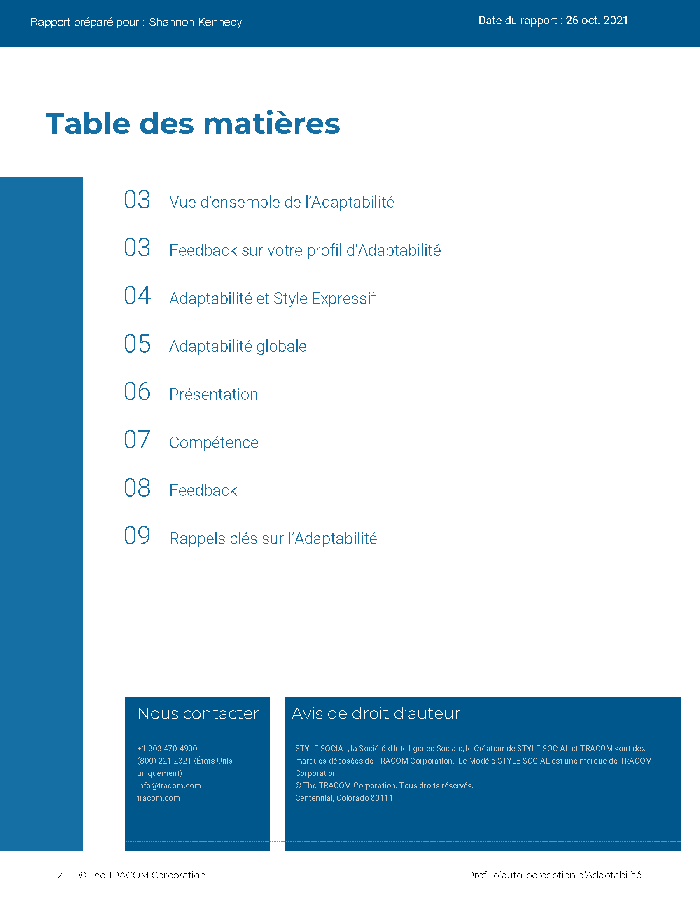
© The TRACOM Corporation. Tous droits réservés.
35
Notes:
15 MINUTES (5 MINUTES if Virtual Program)
Purpose
The purpose of this exercise is to help participants develop an action plan for showing Versatility more consistently.
Materials Needed
Versatility profile
Virtual Directions:
ASK participants to chat one way they can adjust their behavior to be more consistent in their Versatility. Encourage them to choose just one or two concrete steps they can take, based on the strategies they read about in their profiles.
In-Person Directions:
DISTRIBUTE the Versatility profiles.
ASK participants to read their profiles and consider ways they can adjust their behavior to be more consistent in their Versatility. Encourage them to choose just one or two concrete steps they can take, based on the strategies they read about in their profiles.
VIRTUAL DELIVERY: If delivering virtually, learners will have downloaded their profiles earlier.

Slide 36
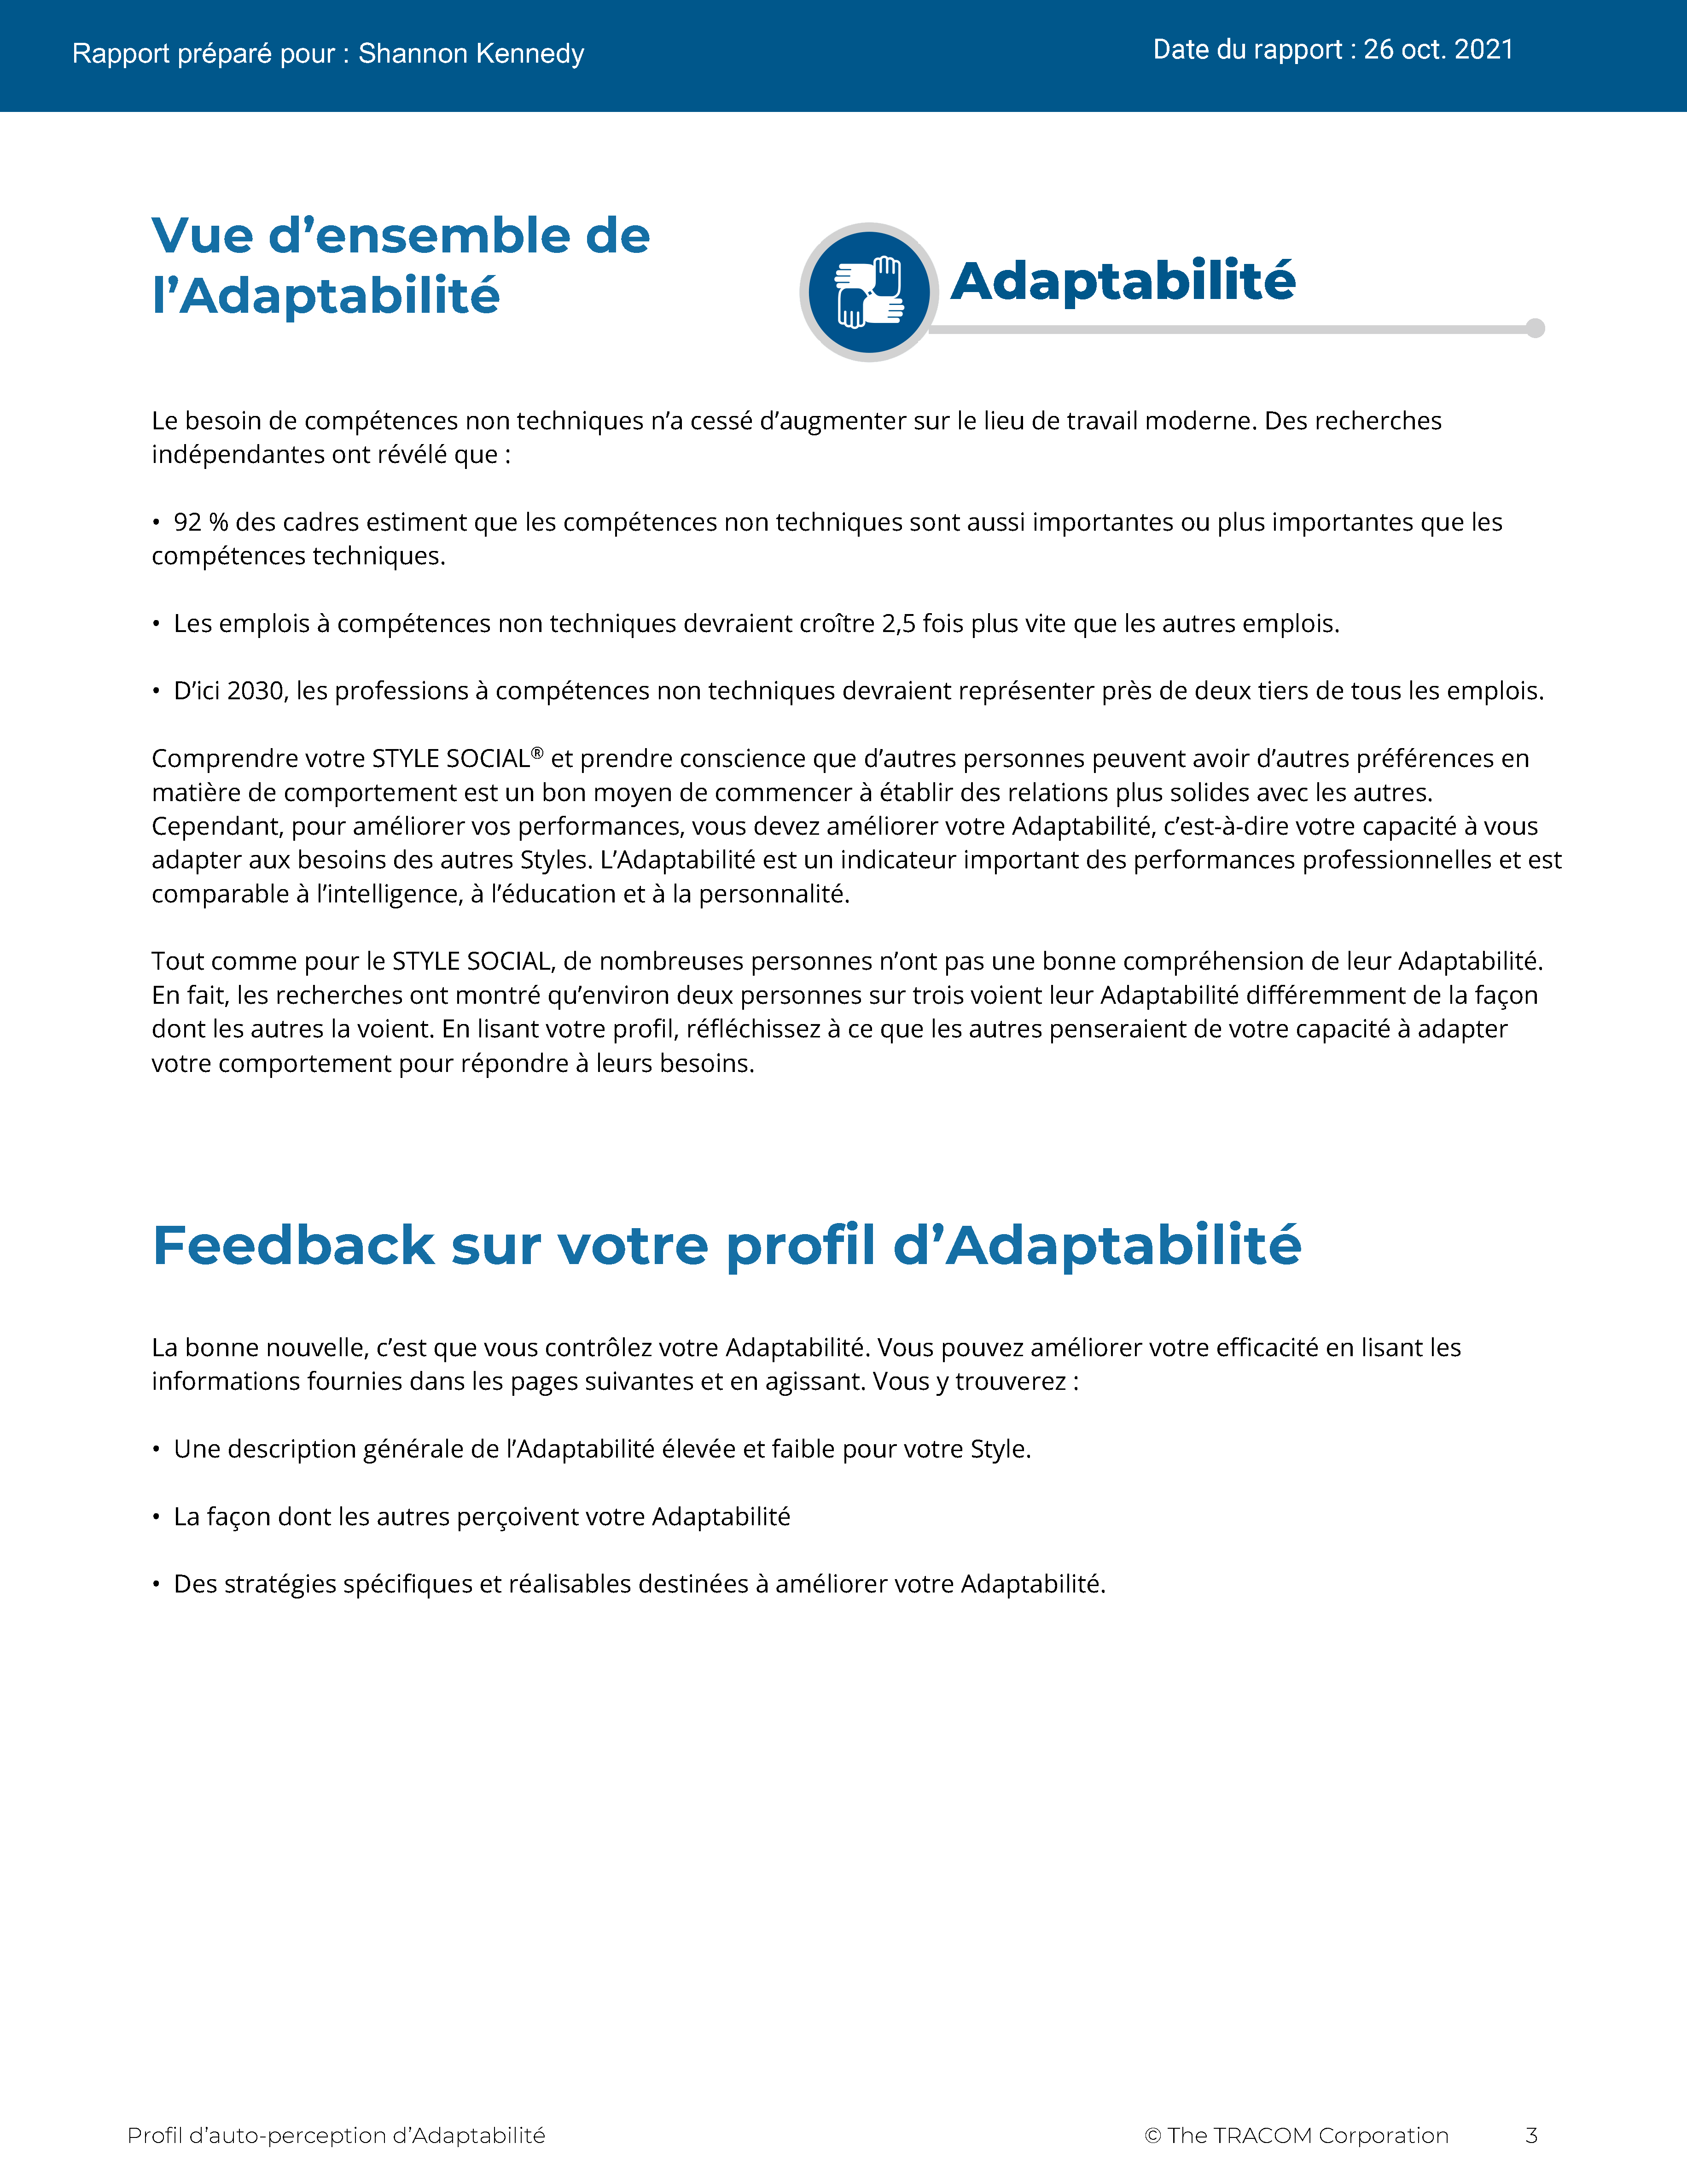
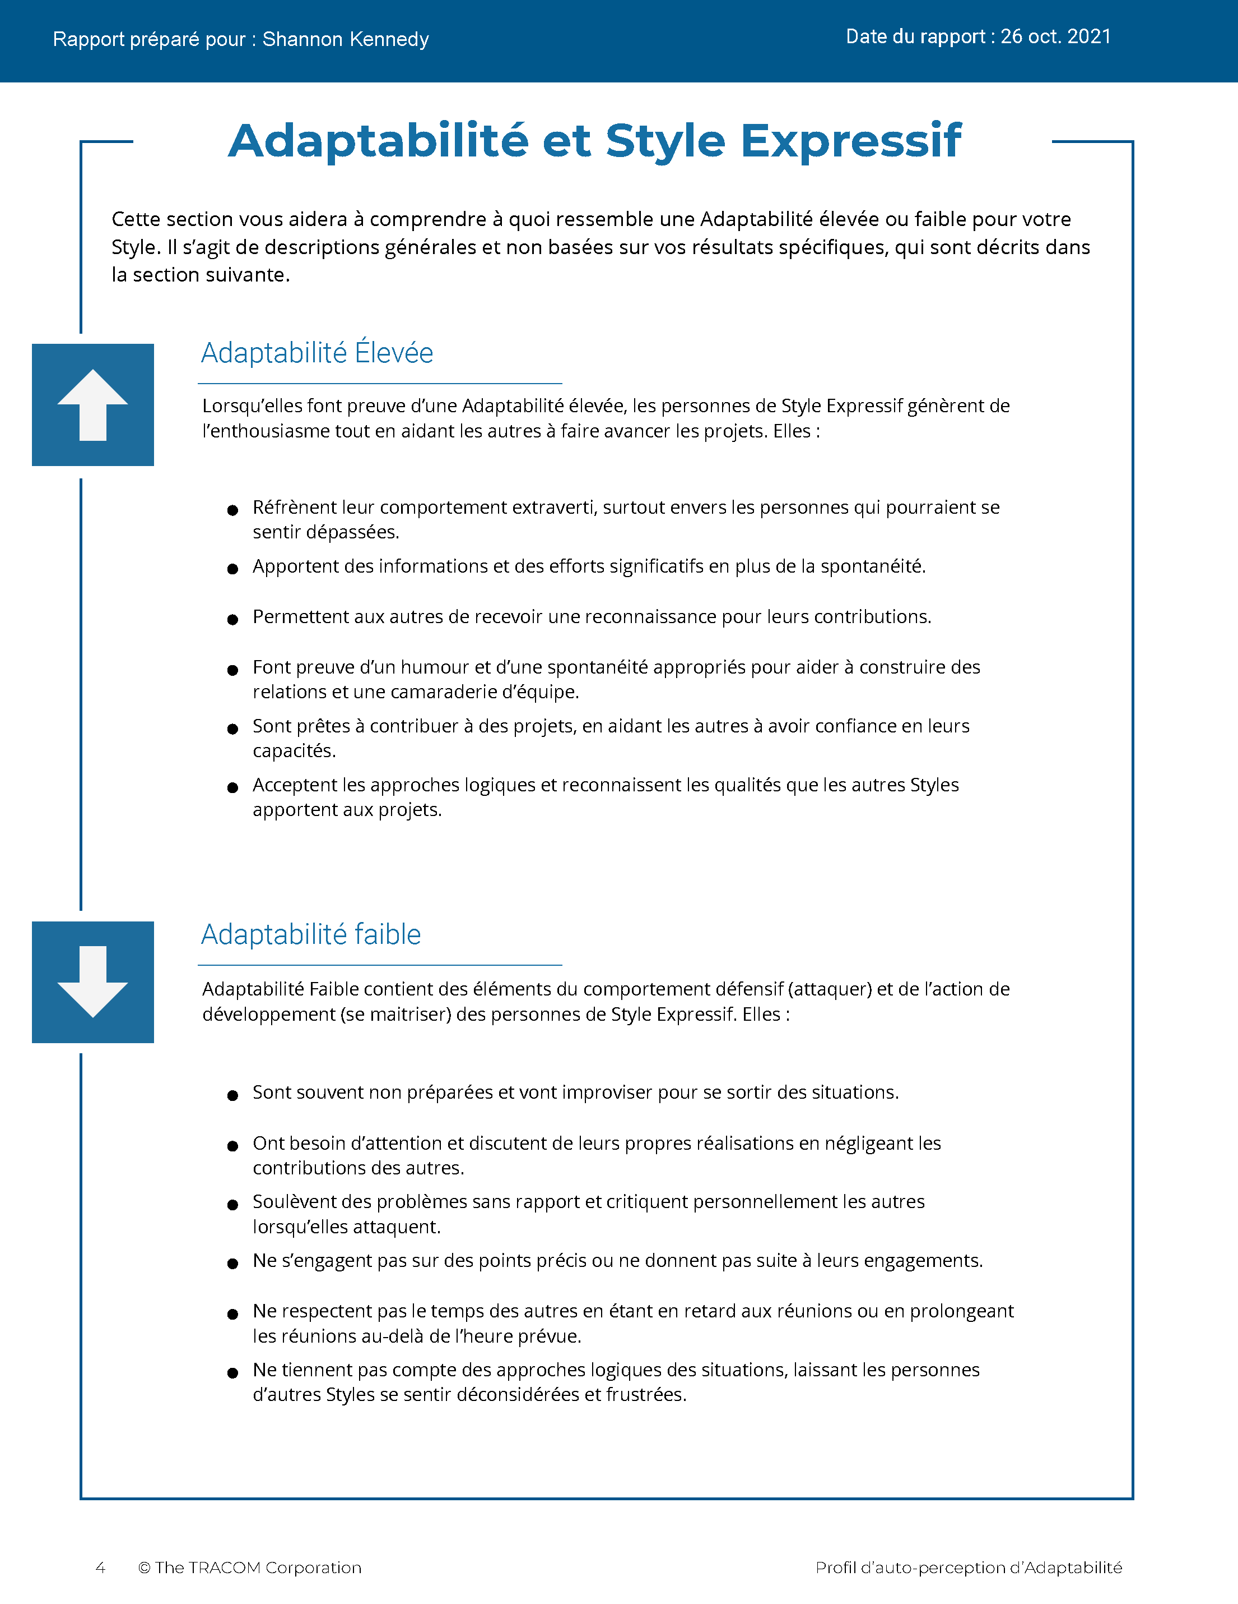
© The TRACOM Corporation. Tous droits réservés.
36
Notes:
These slides show pages of the Versatility profile and can be displayed to assist with conversation during the exercise debrief.

Slide 37
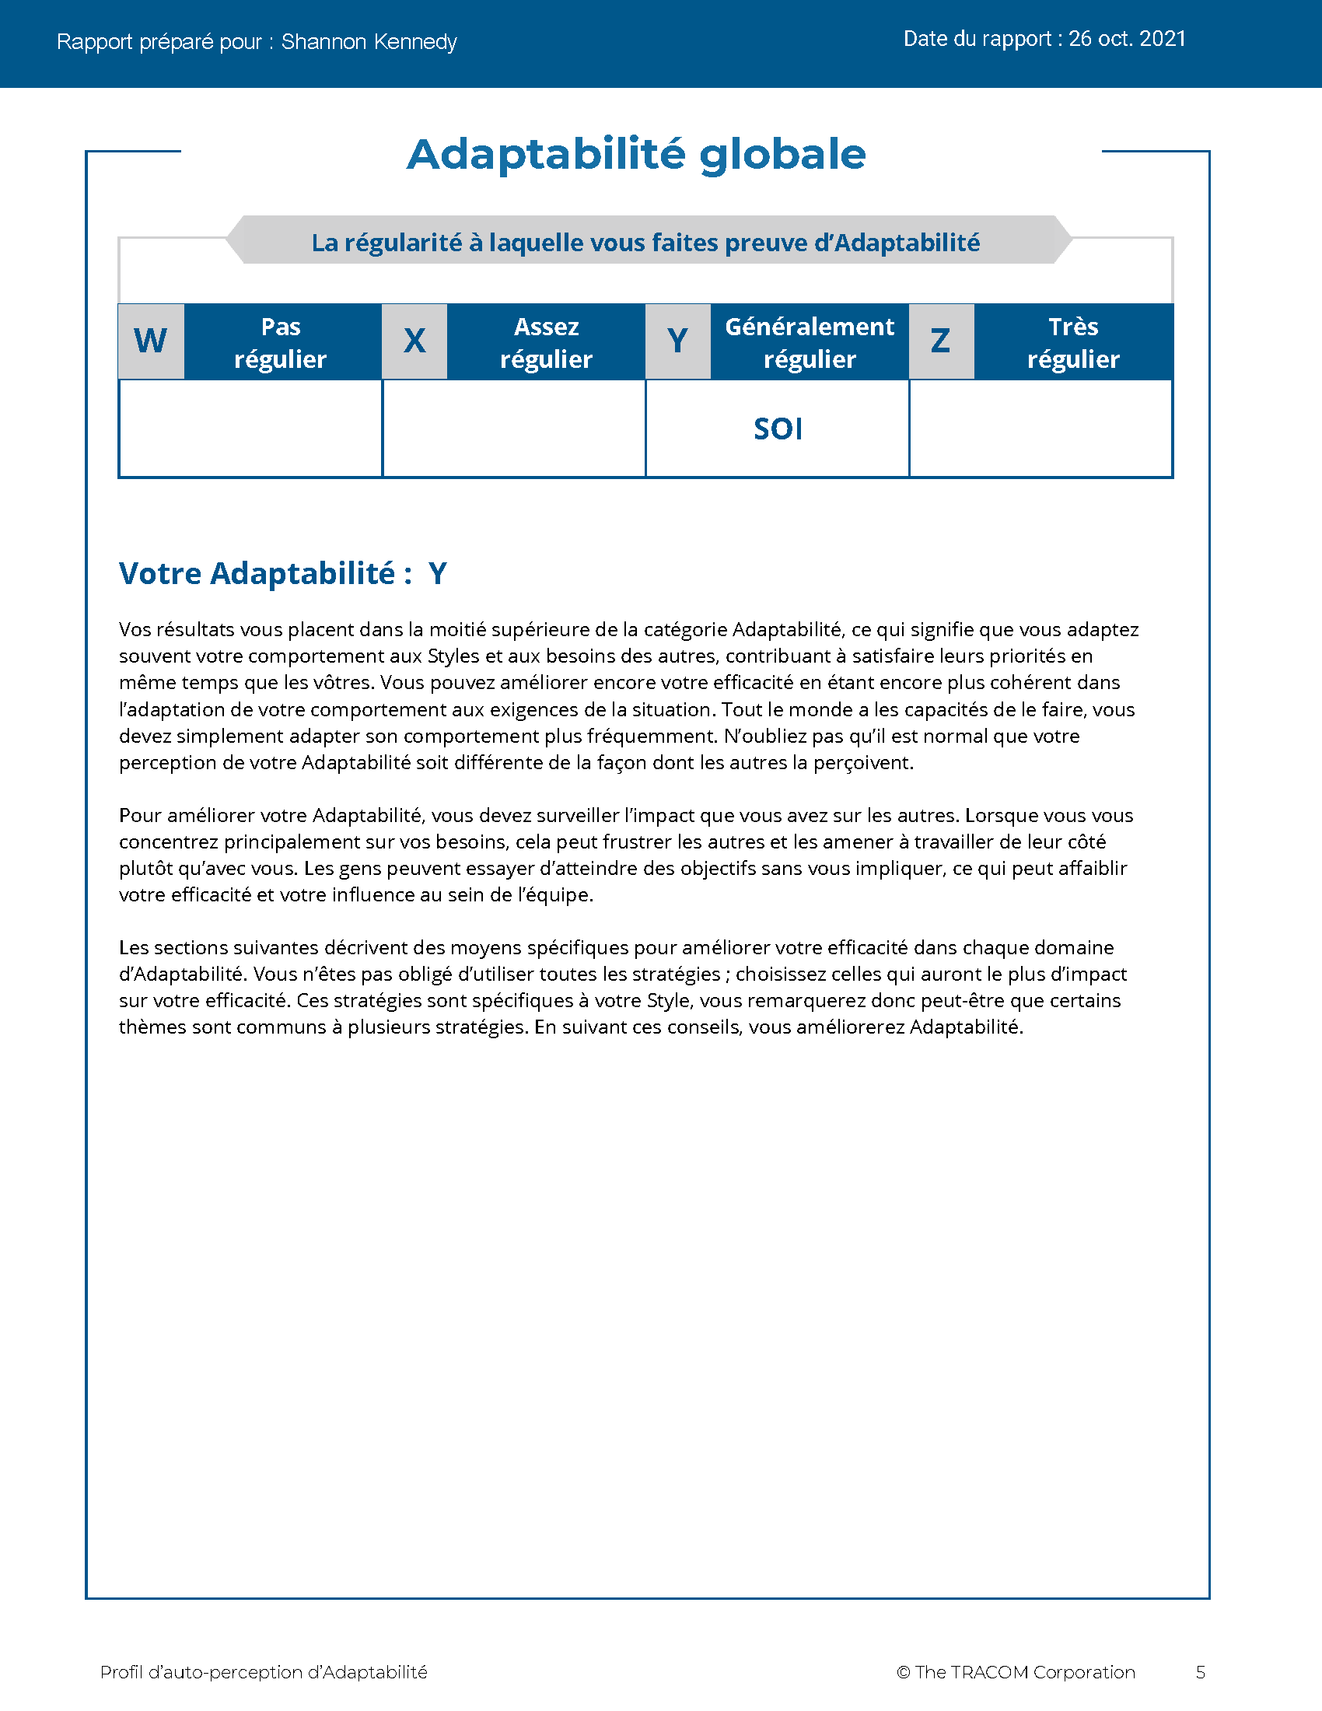
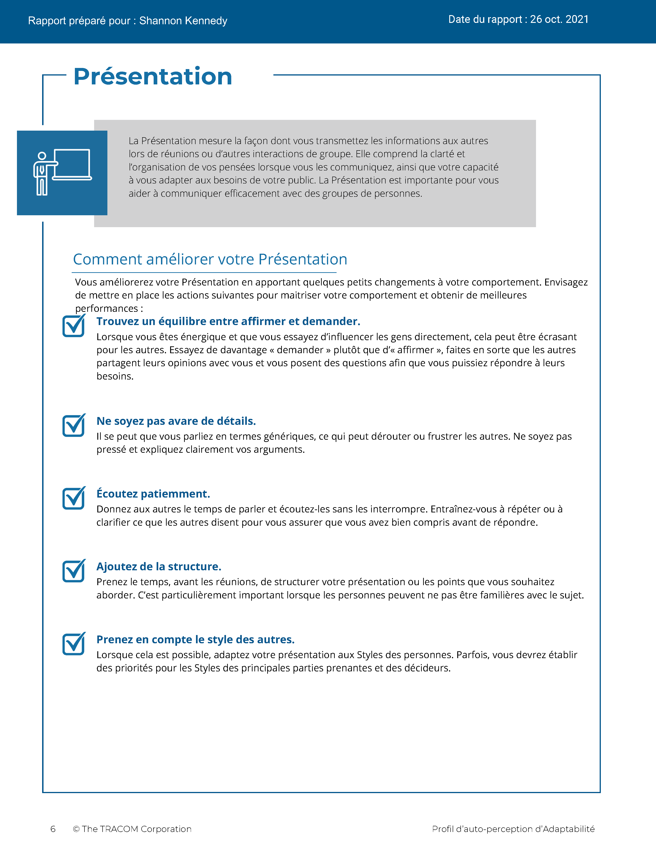
© The TRACOM Corporation. Tous droits réservés.
37
Notes:
These slides show pages of the Versatility profile and can be displayed to assist with conversation during the exercise debrief.

Slide 38
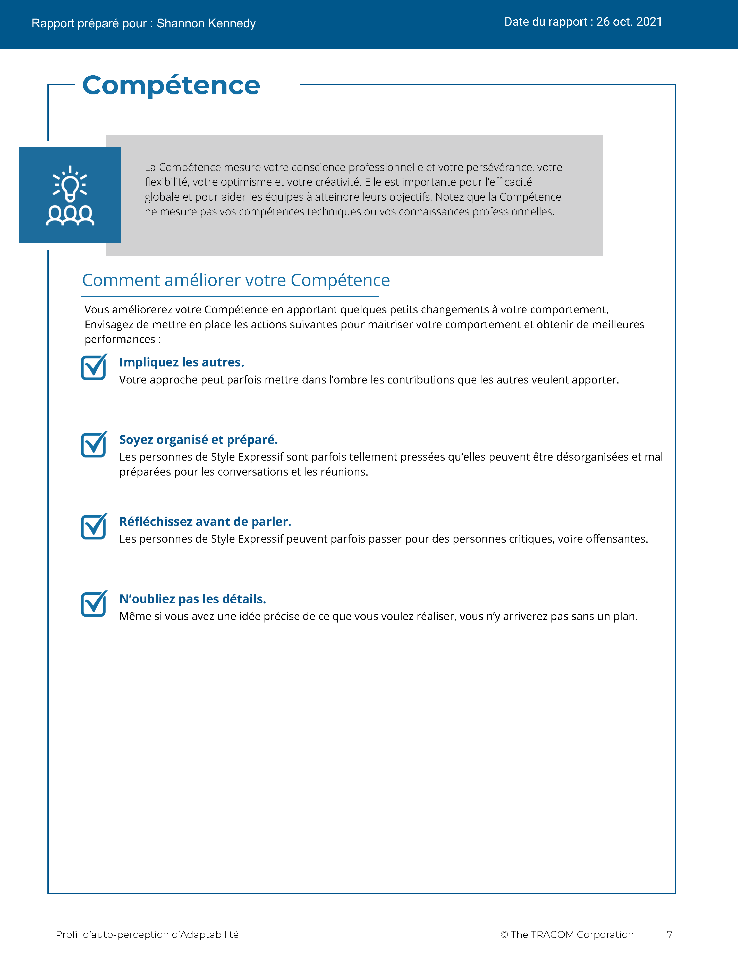
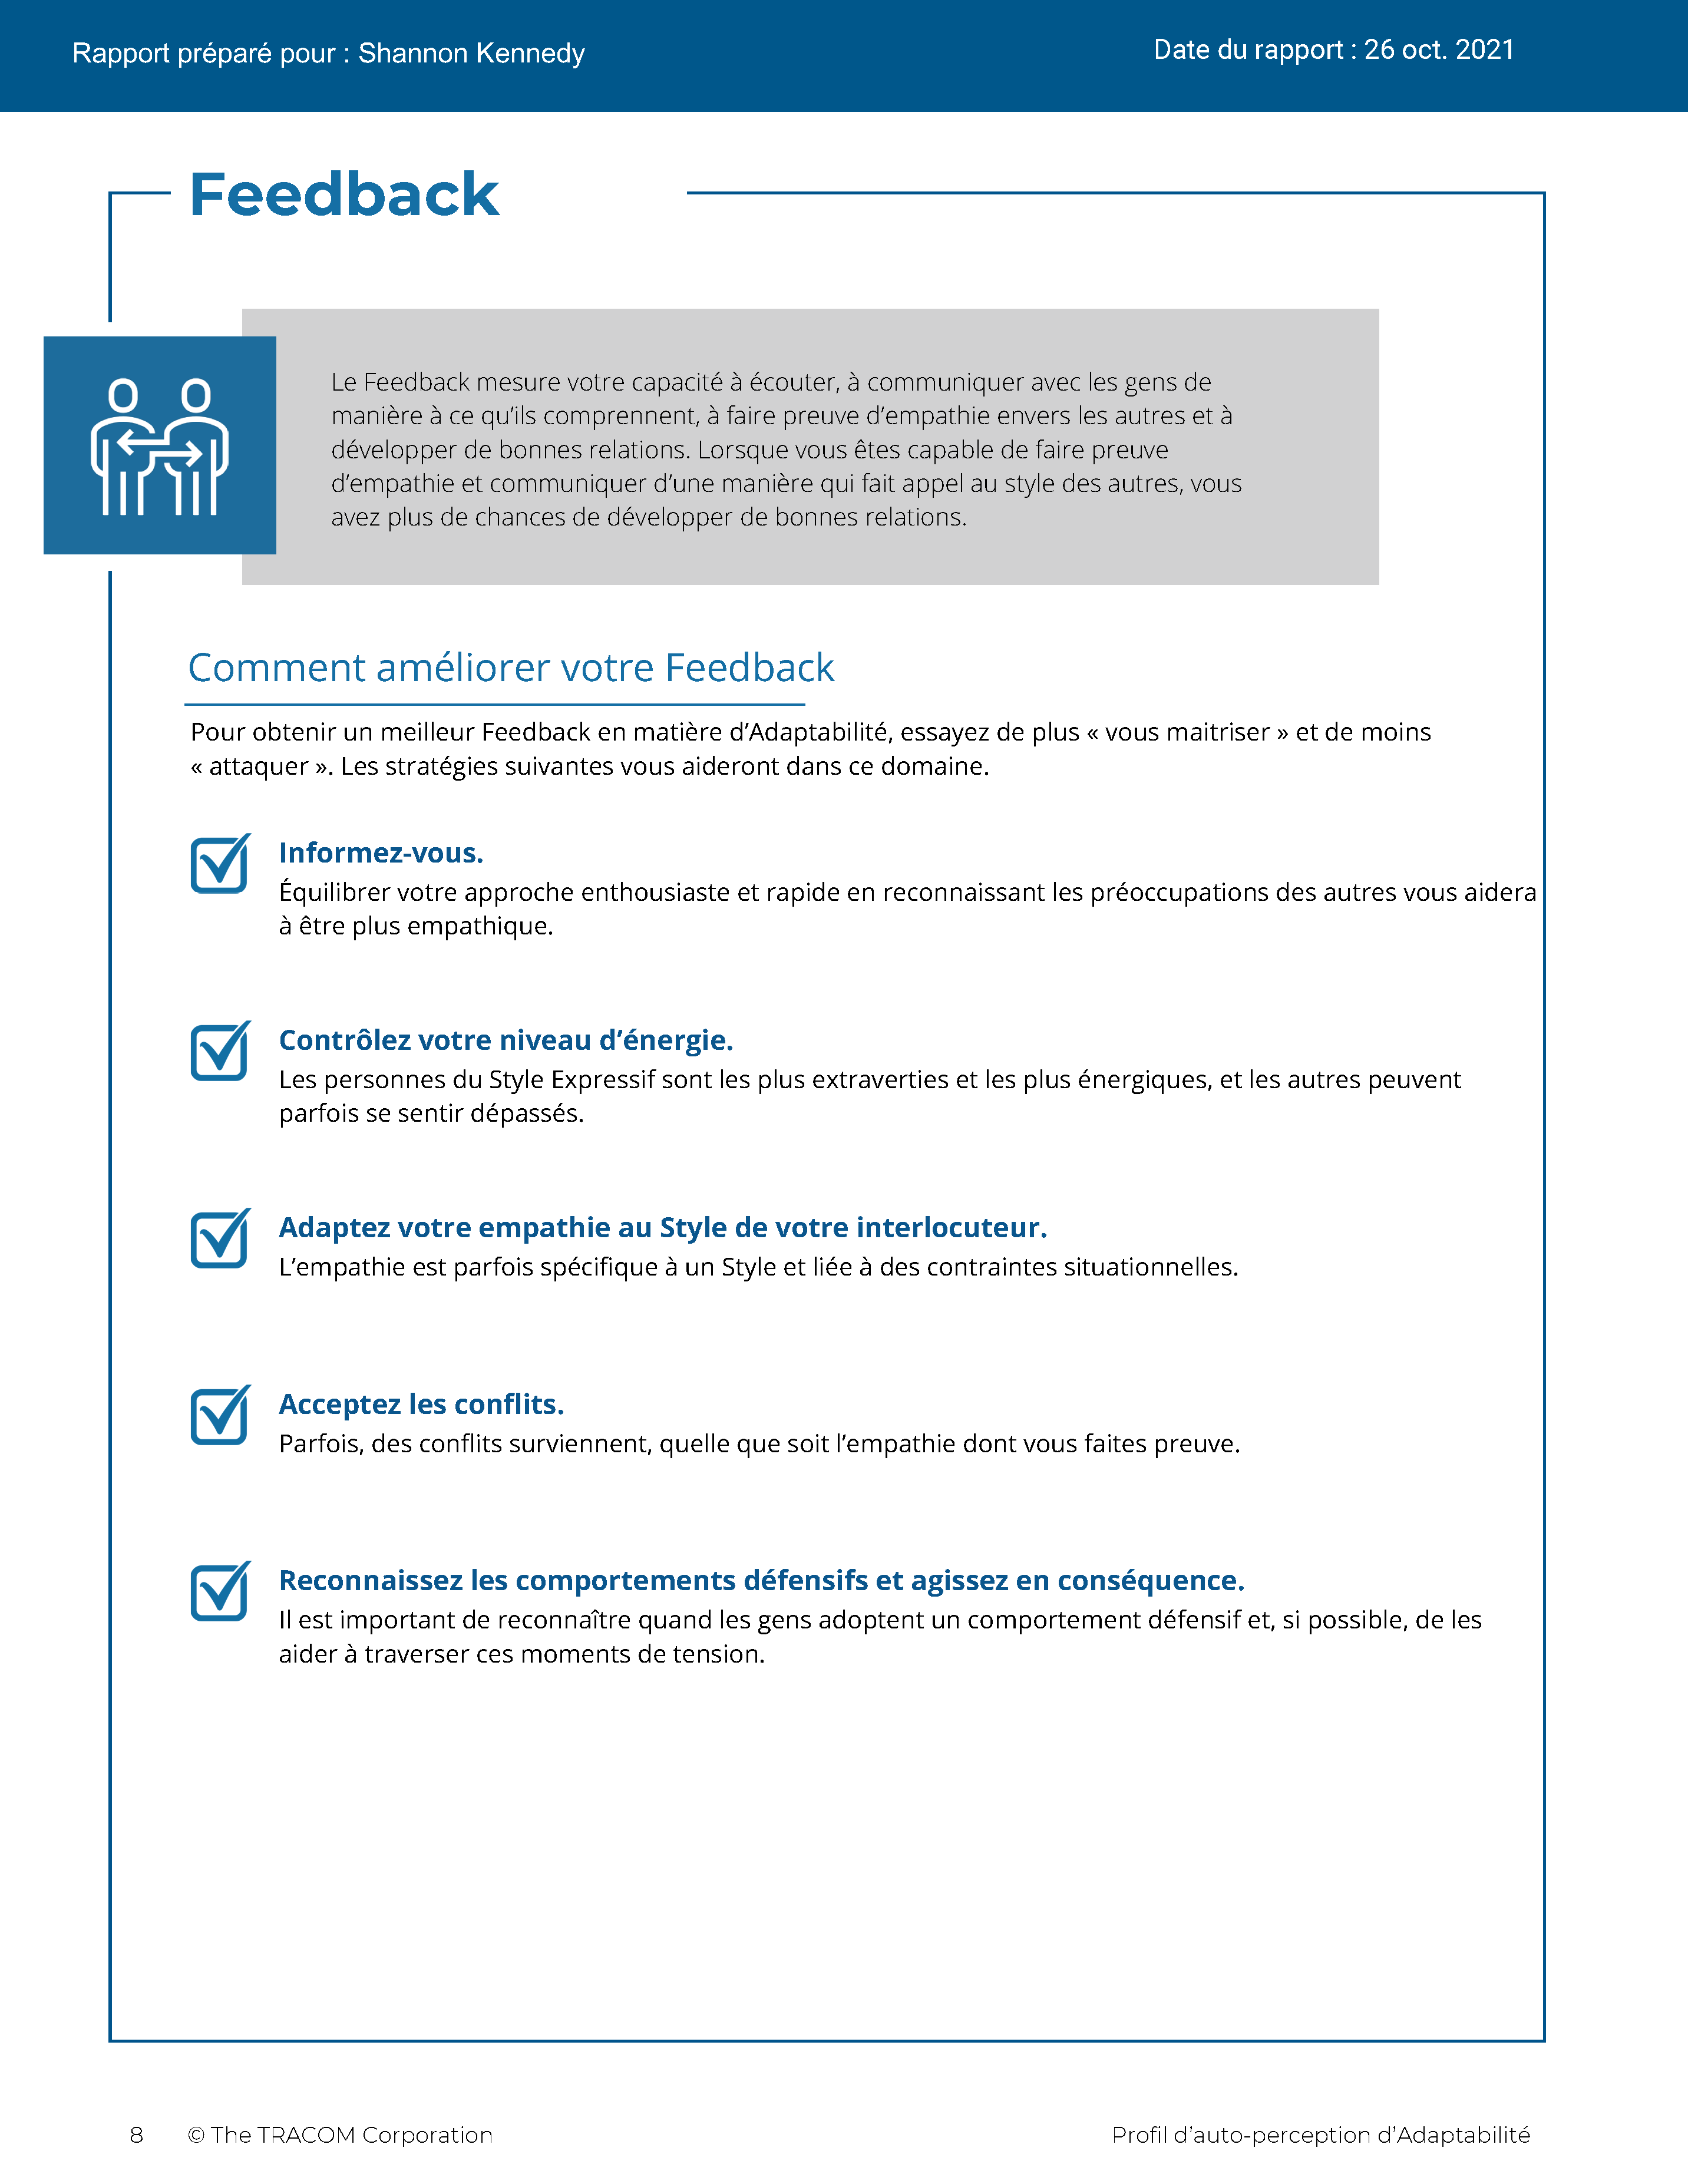
© The TRACOM Corporation. Tous droits réservés.
38
Notes:
These slides show pages of the Versatility profile and can be displayed to assist with conversation during the exercise debrief.

Slide 39
Profil papier d’Adaptabilité
Notes:
If using the paper assessment, use the following slides.

Slide 40
Adaptabilité
Une mesure de l’efficacité interpersonnelle lors du travail avec les autres
Comportement appréhendé comme étant axé sur...
Faible
Moyenne
Élevé
Tension
des autres personnes
Ma tension
Notes:
2 MINUTES
THIS SLIDE IS USED ONLY WITH THE PAPER PROFILE.
SAY while identifying your SOCIAL STYLE can help you understand your behavioral preferences, by itself, knowing your Style doesn’t necessarily help you be more effective. As I’ve said, there is no good or bad Style. What is important is how you adjust your behavior when working with others. That’s where Versatility comes in.
Versatility is your ability to adjust your behavior to meet others’ Style preferences in the areas of Image, Presentation, Competence, and Feedback.
SAY When you are not consistent in your behavior, you’re usually focusing on your own tension and Style needs. When you consistently show Versatility, you’re focusing on meeting others’ Style needs, which reduces their tension. When you are consistent, the more effective you will be.

Slide 41
Auto-perception de votre Adaptabilité
Découpez la partie perforée
Additionnez les coches dans la colonne grisée
Entourez la lettre de votre score d’Adaptabilité
EXEMPLE :
Si 7 ou moins = faible (entourez le « L »)
Si 8-14 = Moyenne (entourez le « M »)
Si 15-21 = Élevé (entourez le « H »)
L | M | H
Votre autoperception peut être différente de la façon dont les autres vous voient !
© The TRACOM Corporation. Tous droits réservés.
Notes:
8 MINUTES
THIS SLIDE ONLY USED WITH PAPER PROFILE.
1. ASK participants to score their Versatility Questionnaires following the instructions on the slide.
2. SAY before we discuss Versatility, I’d like you to score your Versatility Questionnaire.
After scoring is complete, ASK Is anyone surprised? Are there any questions or concerns?
The Versatility profile reflects how you see yourself. Keep in mind that others may see you differently.

Slide 42
Objectifs d’apprentissage
Obtenir une compréhension du le modèle STYLE SOCIAL™.
Déterminer votre STYLE SOCIAL en remplissant un questionnaire d’autoperception.
Mieux comprendre mieux votre comportement et comment les clients voient ceux qui partagent votre Style.
Augmenter votre Adaptabilité pour devenir plus efficace auprès des clients.
Notes:
2 MINUTES
REVIEW the learning objectives.
ASK Did we meet them?
HIGHLIGHT key points learned.
EMPHASIZE importance of comparing self-perception data with multi-rater.

Slide 43
Étapes suivantes et points essentiels à retenir
Communiquez votre STYLE SOCIAL à vos collègues et demandez-leur ce qu’ils en pensent.
Recherchez deux dimensions comportementales : assertivité et réactivité.
Prenez des mesures pour satisfaire les besoins du STYLE SOCIAL des clients lorsque vous interagissez avec eux.
Prédisez les comportements futurs probables des clients et des prospects en fonction de leur Style.
Notes:
2 MINUTES
As participants take their knowledge of Style back into the workplace, suggest that they do the following:
SHARE their Style with their colleagues and ask them for additional insights into how they can interact more effectively.
REMIND them that the most objective way to identify a customer’s Style is by looking for behavior along Assertiveness and Responsiveness.
Finally, UNDERSCORE that being able to predict the probable future Style behavior of others is a powerful tool for interpersonal success. Participants now have valuable information to use in developing themselves into more effective salespeople.

Slide 44
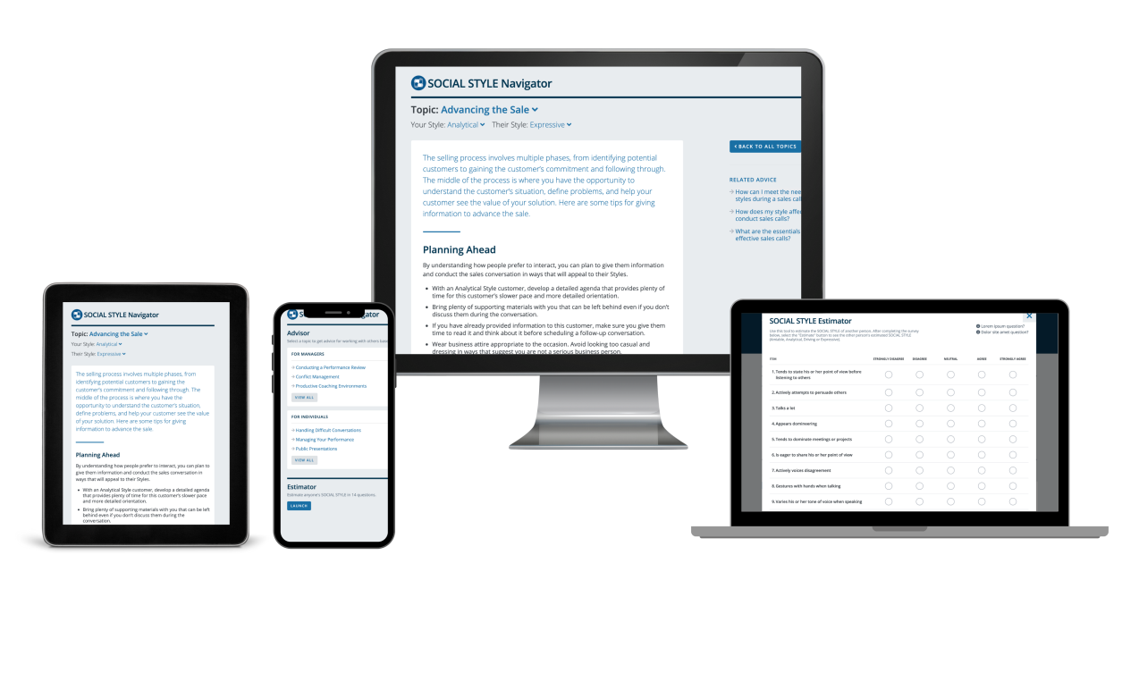
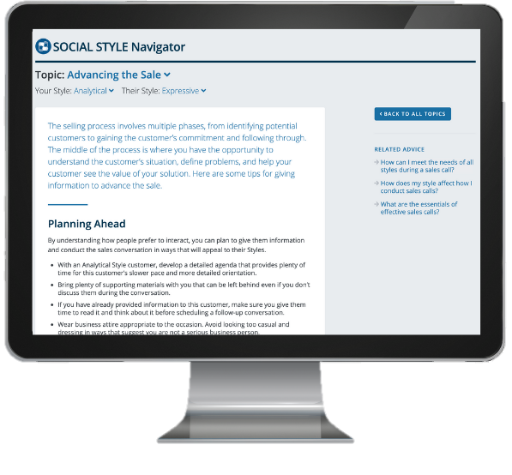
Navigateur de STYLE SOCIAL®
Estimateur de STYLE SOCIAL
Une brève enquête qui permet d’estimer le Style des autres
Conseiller de STYLE SOCIAL
  Préparation des réunions, des négociations, des présentations
  Meilleures pratiques de Style et Adaptabilité pour de nombreuses situations
Modules d’eLearning
Appliquez les concepts de Style aux équipes, à la gestion des conflits et au coaching
Navigateur de STYLE SOCIAL® est une marque déposée de la TRACOM Corporation
Notes:
1 Minute
SAY You now have free and unlimited access to SOCIAL STYLE Navigator, the on-demand micro-learning tool that helps you apply Style and Versatility.
SOCIAL STYLE Navigator includes:
SOCIAL STYLE Estimator
The Estimator survey provides users with an interactive tool that evaluates observable behavior in others to determine their Style and helps you plan ahead for successful interactions.
SOCIAL STYLE Advisor
Use Advisor topics to prepare “just-in-time” for meetings, negotiations or sales presentations with advice on navigating Style and Versatility best practices to maximize high-performing relationships.
eLearning modules
Continue your learning journey via micro-learning that reinforces ways to apply SOCIAL STYLE and Versatility to Working in Teams, Coaching and Managing Conflict.

Slide 45
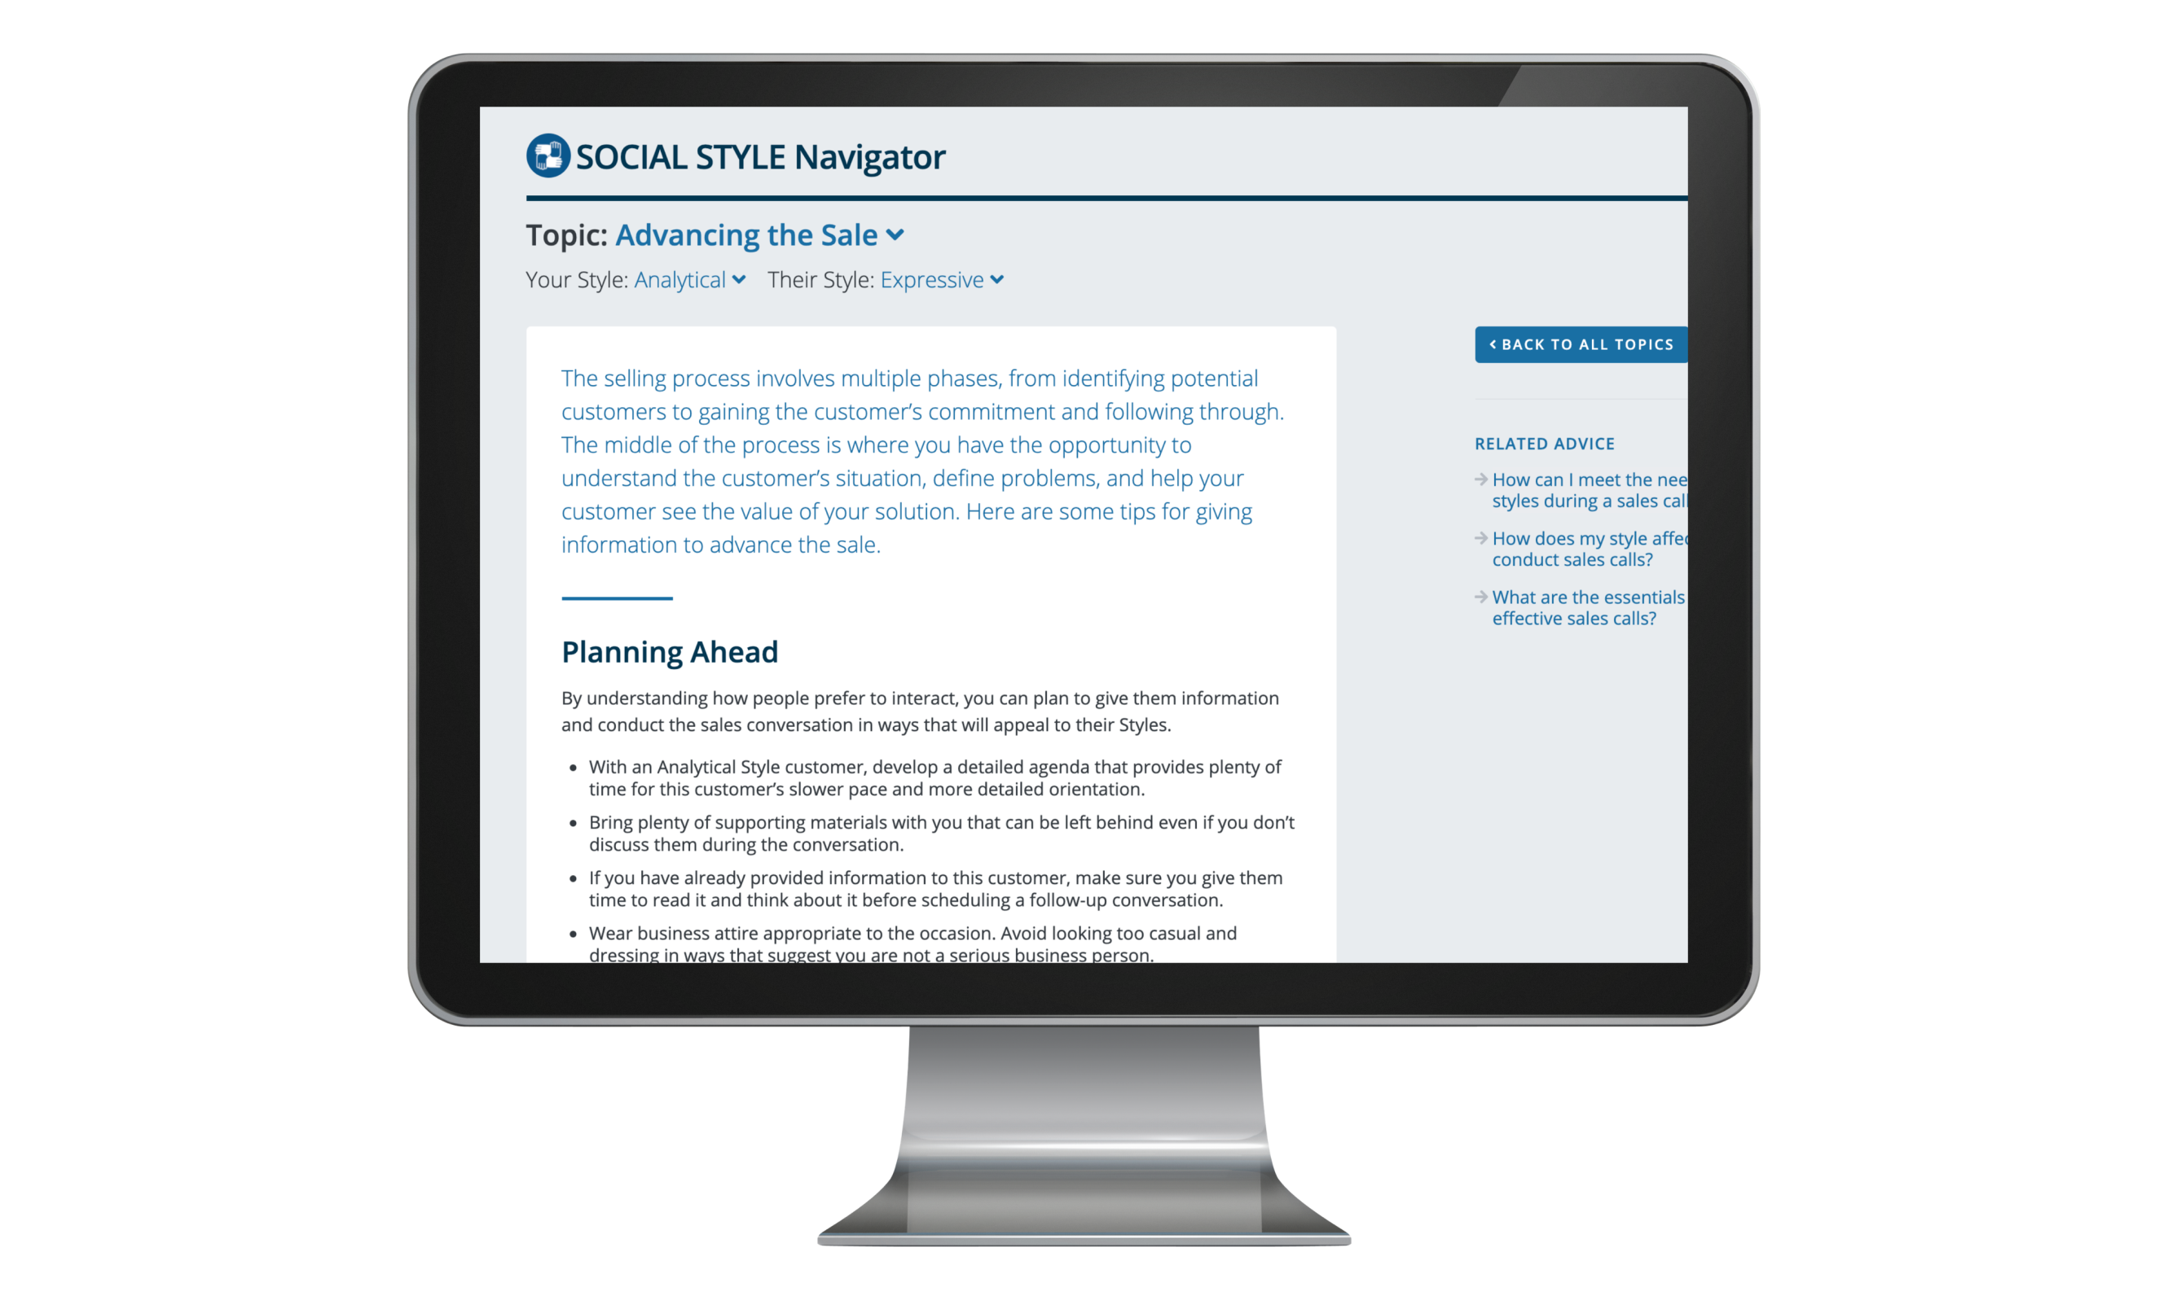
Accès au Navigateur de STYLE SOCIAL®
(profils en ligne uniquement)
Disponible sur tracomlearning.com
Connectez-vous à l’aide de votre nom d’utilisateur et de votre mot de passe TRACOM Learning pour obtenir un accès GRATUIT ET ILLIMITÉ au Navigateur de STYLE SOCIAL
Notes:
1 Minute
THIS SLIDE FOR ONLINE PROFILES ONLY
SAY Available through www.tracomlearning.com
Enter your username and password for free, unlimited access to SOCIAL STYLE Navigator®

Slide 46

Accès au Navigateur de STYLE SOCIAL®
(profils papier uniquement)
Rendez-vous sur :
tracomlearning.com/registration-paper
Inscrivez-vous avec votre adresse électronique et votre code d’abonnement _____-_____
pour un accès GRATUIT et ILLIMITÉ au Navigateur de STYLE SOCIAL
Notes:
1 Minute
THIS SLIDE FOR PAPER SURVEYS ONLY
SAY Go to tracomlearning.com/registration-paper and register with your email address and subscription code ______-______ for free, unlimited access to SOCIAL STYLE Navigator®
IMPORTANT FACILITATOR NOTE REGARDING SUBSCRIPTION CODES:
Your subscription code can be found on the “ATTENTION” colored flyer included in your participant materials shipment. The code is formatted in two sets of 4 numbers separated by a hyphen (EXAMPLE: xxxx-xxxx). If you do not have the “ATTENTION” flyer included with your materials shipment, please contact TRACOM to receive your subscription code.

Slide 47
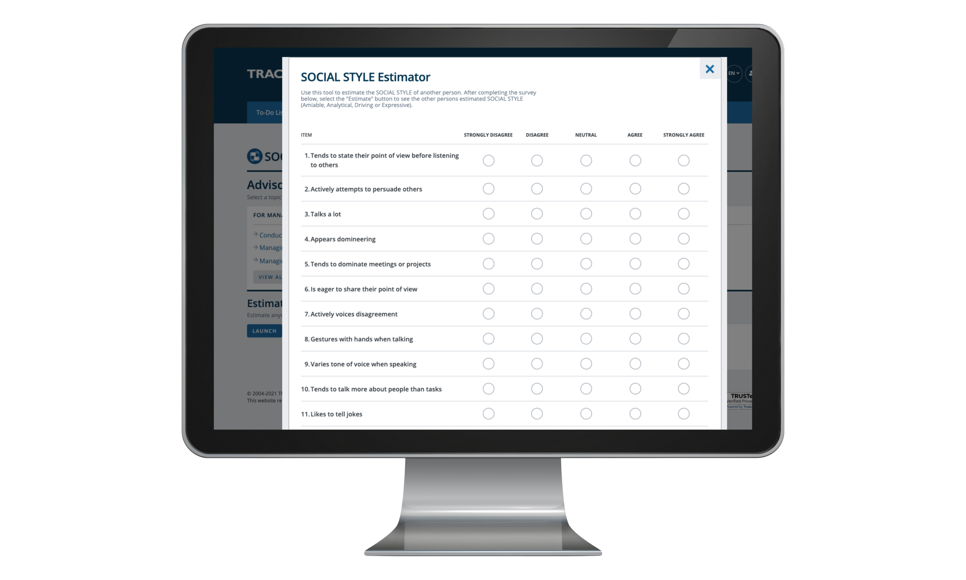
© The TRACOM Corporation. Tous droits réservés.
Notes:
Optional demonstration, time permitting

Slide 48
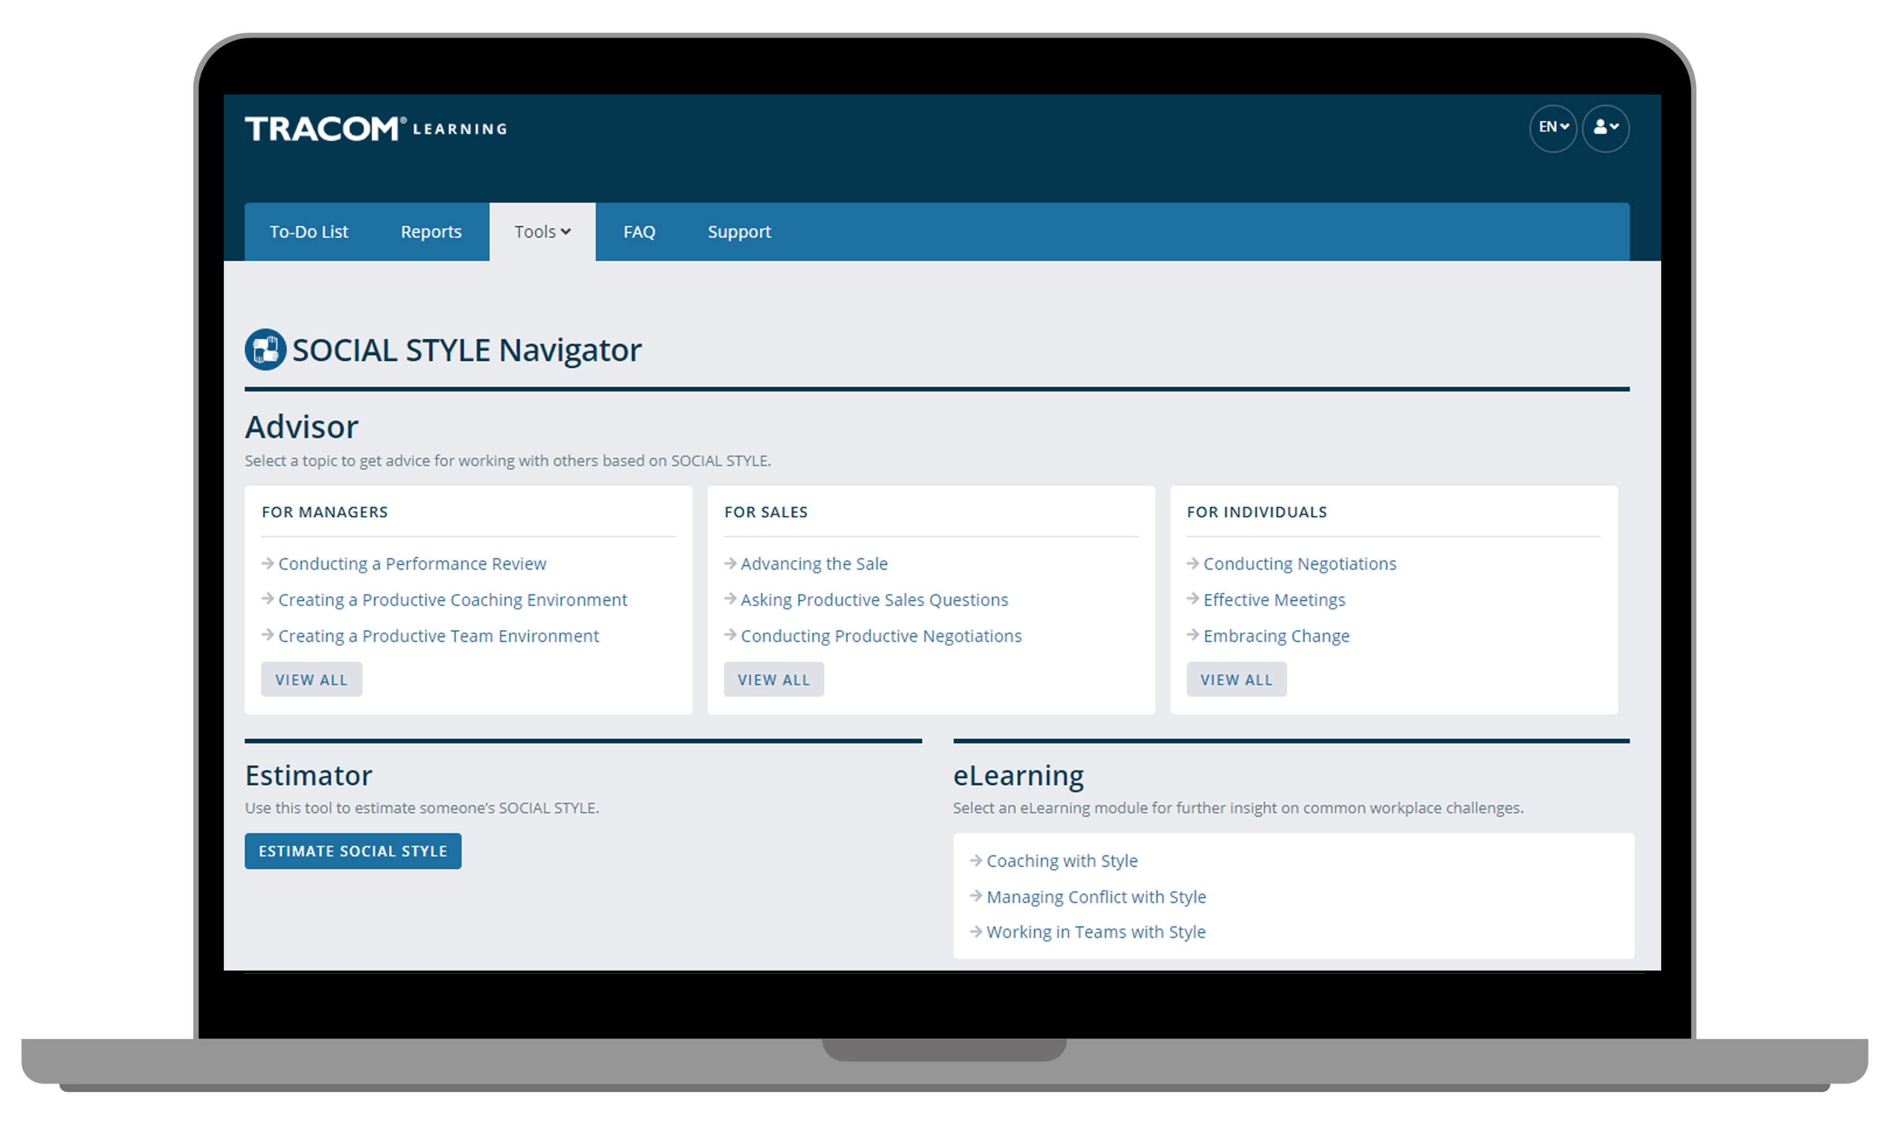
Notes:
Optional demonstration, time permitting

Slide 49
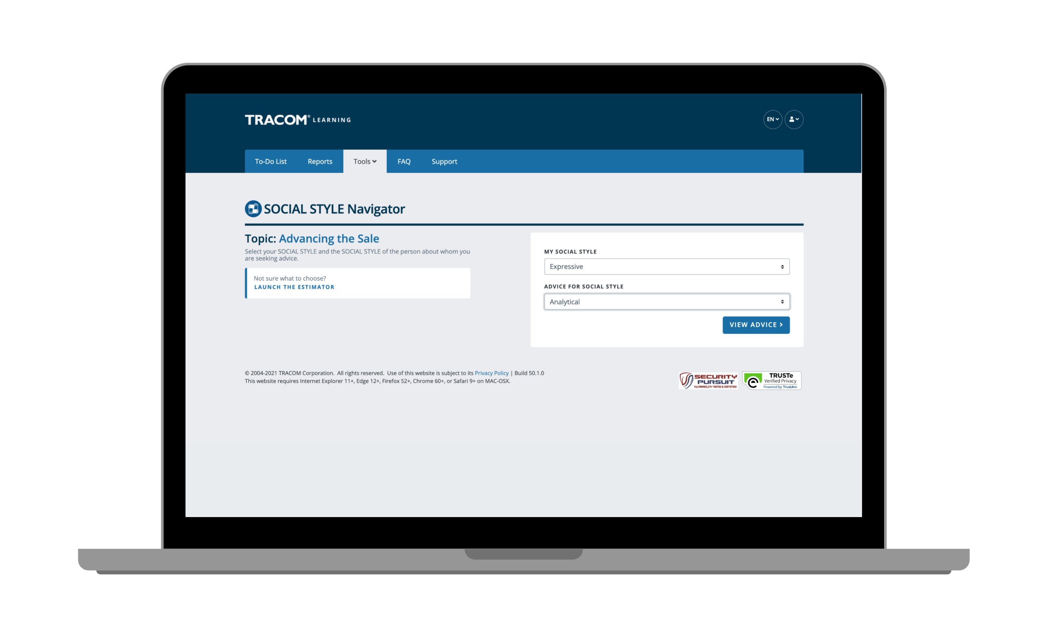
Notes:
Optional demonstration, time permitting

Slide 50
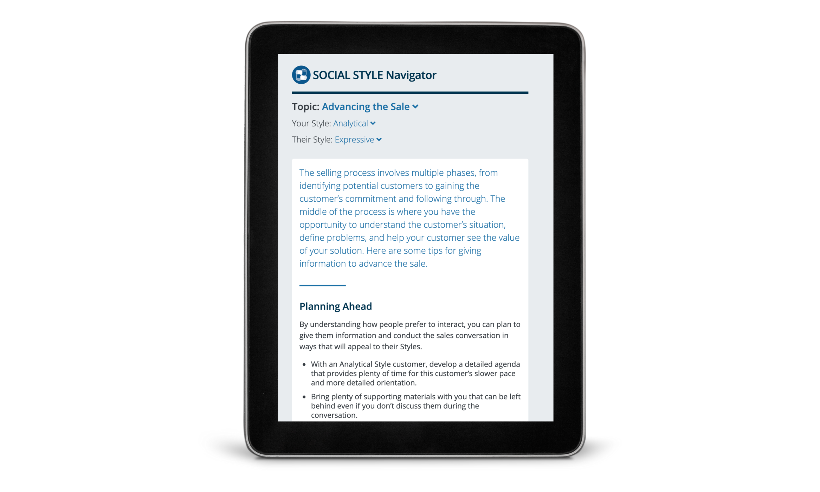
Notes:
Optional demonstration, time permitting

Slide 51
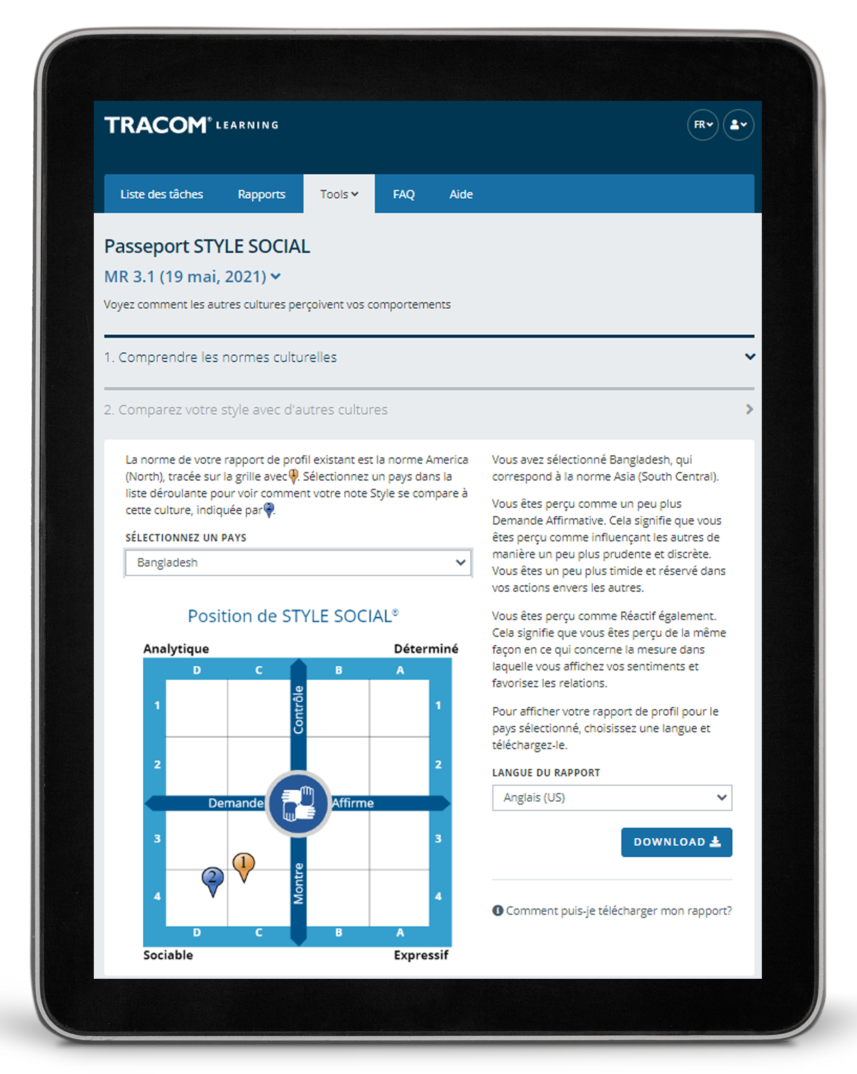
Passeport de STYLE SOCIAL
Notes:
Optional demonstration, time permitting

Slide 52
52
Notes:
2 MINUTES
Thank you. Do you have final questions / feedback.

Slide 53
Exercices facultatifs
Sélectionnez des exercices facultatifs en fonction de vos besoins en formation et du temps dont vous disposez.
53
Notes:
You can draw upon the following exercises to enhance your session to best meet the needs of your participants.

Slide 54

Relations potentiellement toxiques
Contrôle
Analytique
Rythme plutôt lent
Le souci du détail
Approche sérieuse et formelle
Déterminé
Rythme plutôt rapide
Concentration sur l’objectif
Approche sérieuse et formelle
Demande
Affirme
Sociable
Rythme plutôt lent
Concentration sur les relations
Approche décontractée et informelle
Expressif
Rythme plutôt rapide
Concentration sur les généralités
Approche décontractée et informelle
Montre
Notes:
Potentially Toxic Relationships
Purpose
To determine if they have a toxic relationship with a customer.
Recommended Time
10 minutes
Materials Needed
None
Directions
ASK participants to turn to pages 21 through 23 of the Participant Workbook.
DESCRIBE the possibility of Toxic Relationships occurring when both the salesperson and the customer act in Style-bound ways.
SAY Toxic relationships can occur when you and your customer interact in “Style-bound ways.” That is, you both act according to Style Need and Orientation and make little or no attempt to accommodate the Style of the other person.
ASK participants to take a few moments to consider whether they have a toxic relationship with a customer.
ASK participants to write notes about ways they can resolve these relationships.
DEBRIEF the exercise by asking participants to share their insights.

Slide 55
Forum sur le Style
But : Vous donner l’occasion de décrire ce qui, dans la position du STYLE SOCIAL opposé, suscite des tensions en vous et d’apprendre à être plus productif avec une personne dont c’est le Style.
Instructions :
  Dans votre groupe, discutez et établissez une liste des comportements présentés par le STYLE SOCIAL opposé qui suscitent des tensions en vous.
  Communiquez votre liste au groupe du Style opposé.
  Dans votre groupe, discutez de ce que vous pouvez faire pour avoir de meilleures relations avec le Style opposé.
  Communiquez vos informations au Style opposé et à la classe entière.
55
Notes:
Style Forum
Purpose
The purpose of this exercise is to give participants an opportunity to describe what it is about the opposite SOCIAL STYLE position that creates tension for them when working with customers of that Style and to develop insights into how to be more productive with a person who has that Style.
Recommended Time
30 minutes
Materials needed
None
Directions
Break participants into groups by SOCIAL STYLE position with a maximum of six per group.
Give each group 10 minutes to discuss and develop a list of behaviors that the opposite SOCIAL STYLE position manifests to create tension that leads to unproductive relationships.
After each group has developed its list, ask the Amiable and Driving Styles to get together to share their lists. Ask the Expressive and Analytical Styles to do the same thing. Each Style should spend five to ten minutes sharing its list and answering clarifying questions. Caution the groups that this is not a time to get defensive.
After each group has heard the other’s list, the original groups should get together by themselves to discuss what they can do to interact better with the opposite Style (e.g., those with Expressive Styles would develop a list of what they could do to make the relationship more productive with Analytical Styles). As each group shares its list of what it could do better, the opposite Style group should provide feedback and suggestions as to how appropriate the lists are.
After all groups have shared their information with the opposite Style, the whole class discusses what has been learned.
At the conclusion of the exercise, each group should have valuable information as to how to behave more appropriately with the diagonally opposite Style. In addition, after the general class discussions, each Style should have valuable information for working with each of the other SOCIAL STYLE positions.

Slide 56
Forum sur l’Adaptabilité
But : Vous donner l’occasion de décrire une relation difficile et de travailler en groupe pour identifier les mesures spécifiques que vous pouvez prendre pour faire preuve de plus d’Adaptabilité avec ce client.
Instructions :
Répartissez-vous en quatre groupes de Style.
Une à la fois, chaque personne :
  Décrit un client avec lequel elle a une relation difficile et essaie d’identifier son Style.
  Partage ce que le client fait qui la frustre.
  En groupe, aidez la personne à identifier des actions spécifiques pour faire preuve de plus d’Adaptabilité envers son client.
  Nommez un porte-parole : y a-t-il quelque chose d’unique ou de... révélateur que vous souhaitez partager avec l’ensemble du groupe ?
56
Notes:
Versatility Forum
Purpose
This exercise helps learners prepare to apply Versatility with a challenging relationship. Each Style group helps one another identify specific actions they can take to show more Versatility.
Recommended Time
30 minutes
Materials needed
Style and Versatility profiles, to help discover specific strategies for showing Versatility.
Directions
DIVIDE participants into Style groups and assign them to virtual breakout rooms (or separate areas of a physical space).
PROVIDE instructions on the slide.
SAY Nominate a spokesperson to represent your Style group. Take note of anything unique or insightful that you want to share with the whole group. We don’t want you to repeat everything that was said, only key takeaways.
CONDUCT the activity, carefully monitoring time and adding value as appropriate.
CLOSE the Versatility Forum by ASKING for questions and EMPHASIZING any key insights participants made.

Slide 57
Navigateur de STYLE SOCIAL
But : Utiliser le Navigateur afin d’améliorer votre efficacité.
Instructions
  Déterminez un client ou une situation (comme les réunions) pour lesquels vous souhaitez améliorer votre efficacité.
  Connectez-vous à tracomlearning.com et sélectionnez Navigateur de STYLE SOCIAL dans l’onglet Outils.
  Utilisez l’« Estimateur » pour estimer le Style de la personne que vous avez identifiée. Si plusieurs personnes sont concernées, faites-le pour chacune d’entre elles ou sautez cette étape pour le moment.
  Examinez la liste des sujets sous l’onglet « Conseiller » pour trouver la zone de conseil pertinente et cliquez sur celle-ci.
  Lisez les conseils et imprimez la page si nécessaire pour la garder avec vous.
  En groupe, discutez de tout ce que vous avez appris.
57
Notes:
SOCIAL STYLE Navigator
Purpose
To use SOCIAL STYLE Navigator to improve your effectiveness.
Recommended Time
30 minutes
Materials Needed
Login to tracomlearning.com
Directions
Determine a customer or situation (such as meetings) where you want to improve your effectiveness.
Login to tracomlearning.com and select SOCIAL STYLE Navigator from the Tools tab.
Use the “Estimator” to estimate the Style of the person you identified. If multiple people are involved, do this for each person or skip this step for now.
Examine the list of topics under the “Advisor” section to find the relevant advice area and click on it.
Read the advice and print the page if needed to keep with you.
As a group, discuss any insights that were learned.

Slide 58
Plan d’action en faveur de l’Adaptabilité
But : Développer un plan d’action pour accroître votre Adaptabilité.
Instructions :
Lisez votre profil d’Adaptabilité pour comprendre votre comportement (profil en ligne uniquement)
Passez en revue les stratégies fournies dans les trois sections : Comment améliorer la présentation, Comment améliorer la compétence, et Comment améliorer le feedback. (profil en ligne uniquement)
Dans chaque domaine, décidez d’une ou deux actions spécifiques que vous allez entreprendre, et notez-les.
Mettez-vous par deux avec une autre personne (ou en petit groupe) et discutez de votre plan.
58
Notes:
Versatility Action Plan
Purpose
To develop a specific action plan for increasing your Versatility.
Recommended Time
30 minutes
Materials Needed
Versatility Profile
Directions
Read your Versatility profile to understand your behavior.
Review the strategies provided in the three sections: Ways to Improve Presentation, Ways to Improve Competence, and Ways to Improve Feedback.
Within each area, decide on one or two specific actions that you will take, and write these down.
Pair up with another person (or small group) and discuss your plan.

Slide 59
Techniques d’observation du Style
Ne tirez pas de conclusions hâtives
Restez objectif
Séparez le comportement de Style de la fonction
ou de la position de quelqu’un
Une quantité modérée de stress peut clarifier le Style d’une personne
N’intervenez pas (soyez un observateur)
1
2
3
4
5
Notes:
Guidelines for Observing Style
Purpose
The purpose of this exercise is to familiarize participants with the six rules for identifying another person's SOCIAL STYLE.
Recommended Time:
10 minutes
Materials Needed
None
Directions
SAY The more accurately we are able to observe our colleagues’ Styles, the better we will be able to adapt our own behavior to earn greater Versatility.
ASK participants to take notes on ways of implementing the best practices.
DESCRIBE the best practices:
Don’t jump to conclusions
Remain objective
Separate Style behavior from someone’s role or position
A moderate amount of stress can clarify someone’s Style
Get out of the way (be an observer)
ASK if there are any questions.

Slide 60
Prendre mes mesures de croissance
But : Identifier les moyens spécifiques que vous pouvez mettre en œuvre pour votre action de croissance afin d’améliorer votre efficacité auprès des clients.
Instructions :
  Estimez le Style de l’un de vos clients (en utilisant « L’estimateur de Style » dans le Navigateur de STYLE SOCIAL, s’il est disponible).
  Enregistrez le besoin de Style et l’orientation du client.
  Identifiez précisément comment vous pouvez mener votre action de croissance avec ce client.
  Expliquez pourquoi l’action de croissance que vous avez identifiée sera particulièrement efficace pour ce client.
60
Notes:
Taking My Growth Action
Purpose
To get participants to think about how taking their Growth Action (in specific ways) could help to enhance their effectiveness with a customer.
Recommended Time
20 minutes
Materials Needed
ISEV Participant Workbook
SOCIAL STYLE Navigator (“Style Estimator”)
Directions
1. Ask participants to estimate the Style of a customer. This can be done using the “Style Estimator” of the SOCIAL STYLE Navigator. If participants don’t have online access, they can refer to the graphic on page 12 of the Participant Workbook for help in determining the customer’s Style.
3. After about five minutes, ask for volunteers to identify their Style and, specifically, how they thought they could take their growth action with the customer.
4. Ask participants why taking the growth action they identified would be particularly effective with the Style of the customer they selected.
5. Provide feedback to participants based on the specifics of the action they identified.

Slide 61
Améliorer l’efficacité des ventes avec Adaptabilité™
Version 4.0
Notes:
<<Copy and paste this table to
notes pages on which you want
participants to be able to take
notes

