Slide 1
Improving Sales Effectiveness with Versatility™
Version 4.0
Notes:
5 MINUTES (Workbook, pages 1-3)
WELCOME participants and provide a brief overview of the session.
ASK participants to turn to Pages 1, 2 and 3 in the Participant Workbook to follow along.
Stress the importance of active participation.
Briefly review the history of SOCIAL STYLE.
Cite the proven effectiveness of increased Versatility on page 3 in the Participant Workbook.
Explain what SOCIAL STYLE is all about. Say something like, “Did you ever notice that customers have certain patterns of behavior: some are animated and loud, some treat you like a friend from the start, others are all business? SOCIAL STYLE gives you a way of identifying a customer’s pattern of behavior, and of interacting with them in ways that will help you to increase your effectiveness in your selling process.”
Ask participants to think about their past customers. Ask, “Besides, ‘they bought from me,’ what made your good customers good? And, what made the difficult ones difficult to sell to?” Use the participants' responses to identify issues that will be addressed in this training.
<<Copy and paste this table to notes pages on which you want participants to be able to take notes

Slide 2
Learning Objectives
Gain an understanding of the SOCIAL STYLE Model™.
Determine your SOCIAL STYLE by completing a Self-Perception questionnaire.
Increase understanding of your behavior and how Customers view people with your Style.
Increase your Versatility to become more effective with Customers.
Notes:
15 MINUTES TOTAL
5 MINUTES
Going through this session you will:
• Gain an understanding of the SOCIAL STYLE Model.
• Determine your SOCIAL STYLE by completing a self-perception questionnaire.
• Increase your understanding of your behavior and how Customers view people with your Style.
• Increase your Versatility to become more effective with Customers.
SAY I want to emphasize the last point, number 4. While you’ll learn a lot about yourself, the goal of this program is to learn about your customers and how you can adjust your behavior to work more effectively with them. Versatility is about adjusting your behavior to help others meet their Style needs. When you do this, you increase your effectiveness and also make it easier for others to show Versatility toward you.
If your participants completed the Online Self-Perception assessment:
Make sure you have a profile for each participant who completed the assessment.
DO NOT pass out the profiles at this time.
VIRTUAL: Participants should already have their profiles available.
10 MINUTES
If you are using the Paper profile:
SAY It’s critical that individuals understand their own behavior and how it affects others. So we’re going to do an exercise that will give you insights about yourself. You’re each going to complete a self-assessment of your SOCIAL STYLE. With that knowledge as a foundation, we’ll then look at how you can work more effectively with others.
1. DISTRIBUTE questionnaires.
2. ASK participants to complete the SOCIAL STYLE and Versatility Questionnaires.
3. DO NOT ask participants to score their questionnaires at this time.
VIRTUAL PROGRAM
If delivering virtually, you will not be able to use paper questionnaires and will need to prepare ahead of time to deliver online profiles. Arrange to have a notification sent to learners so they can download their profiles prior to the session.

Slide 3
SOCIAL STYLE & VERSATILITY
A KEY ELEMENT OF SALES PERFORMANCE
As a result of SOCIAL STYLE and Versatility Training, sales professionals report that:
92%
87%
58%
developed more
increased their ability to
reported they
POSITIVE CUSTOMER
RELATIONSHIPS
INFLUENCE OR PERSUADE CUSTOMERS
CLOSED SALES THEY MIGHT OTHERWISE NOT HAVE
As Versatility increases, so does work performance.
Notes:
2 MINUTES
SAY In the first part of the program, you’ll learn about Style. This will help you understand your customers and how they prefer to interact with you.
The second part of the program focuses on Versatility, which is how well you meet others’ Style needs.
Versatility is the application of SOCIAL STYLE—when you understand your customers’ Style needs, you can help them meet those needs. This helps them feel more valued and sets the stage for them to have a better relationship with you. If you consistently show Versatility, you can be more effective.
You can read the stats on this slide. Research has found that SOCIAL STYLE and Versatility is a strong predictor of successful sales performance.

Slide 4
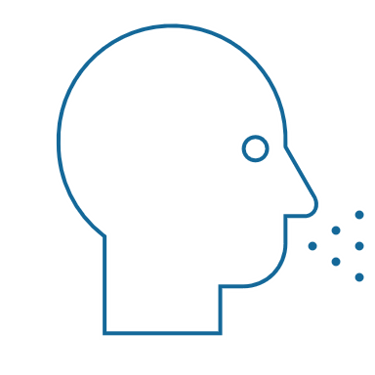
Observable Behaviors vs. Personality
Behavior
What you say (verbal) and do (non-verbal)
SOCIAL STYLE® A pattern of actions others can observe and agree on for describing one’s behavior
Observable behavior
Say / Do
Personality
Interpersonal behavior
What you say and do when interacting with other people
Personality
Everything a person is: their ideas, values, hopes and dreams
Notes:
4 MINUTES (Workbook, page 5)
ASK participants to turn to page 5 of the Participant Workbook to follow along.
SAY Behavior and personality are not the same things. Observable behavior is like the crust of a pie. Personality is like the inside and outside of the pie.
ASK What makes up personality?
CONDUCT a quick facilitated discussion to solicit participants’ responses. They should say things such as:
Values, hopes, attitudes, beliefs.
Things that are not necessarily observable.
These internal qualities are more subjective in nature.
SAY Style is like the crust, because it’s on the outside and observable. By observing behavior, we can find ways to define and discuss what we see. Then, we can begin to understand how this behavior affects ourselves and others.

Slide 5
Say & Do Behaviors
Traits
Honest
Intelligent
Arrogant
Motivated
Self-centered
Sincere
Critical
Observable Behavior
Quiet
Slower-paced
Facially controlled
Less-inflected voice
Less eye contact
Casual posture
Leans back
Loud
Faster-paced
Facially animated
More-inflected voice
More eye contact
Rigid posture
Leans forward
Judgments
I like him
He annoys me
She interests me
He irritates me
I distrust her
I hate him
I trust him
SAY
DO
Notes:
4 MINUTES (Workbook, pages 6-7)
ASK participants to turn to pages 6 and 7 of the Participant Workbook to follow along.
SAY When we first meet people we often form immediate impressions, even after just a few seconds. This is sub-conscious (below our awareness) and happens immediately.
DESCRIBE
Traits Column: What we think we know about a person, based on interactions; subjective opinions.
Judgments Column: Our reactions to others; conclusions or evaluations we make, based on our subjective opinions.
Observable Behavior Column: Things others “Say and Do”; more objective and observable behaviors.
SAY Traits and Judgments are most subjective in nature and contain positive or negative descriptions.
Observable Behavior is objective and contains no positive or negative value.
Observable Behavior is an important tool for assessing others’ Styles. By focusing on Observable Behavior, you gain objectivity, which is critical for understanding people’s Styles.

Slide 6
Assertiveness and Responsiveness
Notes:
SAY We measure observable behavior on two dimensions: Assertiveness and Responsiveness

Slide 7
Assertiveness
The degree to which we “ask” or “tell” when interacting with others
More Asking
Asking with some Telling
Telling with some Asking
More Telling
Notes:
4 MINUTES (Workbook, pages 8-9)
ASK participants to turn to pages 8 and 9 of the Participant Workbook.
SAY To become more effective with others, we follow a behavioral model. There are two dimensions of behavior that define SOCIAL STYLE: Assertiveness and Responsiveness.
Assertiveness is the degree to which we ask or tell when interacting with others. The two anchors for Assertiveness are Ask on the left side of the continuum and Tell on the right side of the continuum.
Assertiveness is a measurement of how we try to influence others to take action. If you are more “Tell” Assertive, you state your opinions directly. You tend to declare your viewpoints and try to direct the actions of others.
For example, if you want to have lunch with someone, you might say, “Let’s have lunch today!”
If you are more “Ask” Assertive, you tend to be more cautious and reserved about sharing your opinions. You attempt to influence others in a more quiet, low-key, questioning manner.
For example, if you want to have lunch with someone, you might say, “Would you like to have lunch with me today?”

Slide 8
Assertiveness Behaviors
SAY | Verbal Behaviors
Slower
Pace of Speech
Faster
Less
Quantity of Speech
More
Quieter
Volume of Speech
Louder
ASKS
TELLS
Relaxed
Use of Hands
Directive
Lean Back
Body Posture
Lean Forward
Less Direct
Eye Contact
More Direct
DO | Non-Verbal Behaviors
Notes:
3 MINUTES
SAY The Assertiveness scale helps predict a person’s behavior because it represents a “theme” or typical pattern. There are verbal and non-verbal clues to indicate a person’s Assertiveness.
DESCRIBE the verbal and non-verbal indicators of Assertiveness:
Verbal: Ask-Assertive individuals use a slower pace, less quantity (fewer words), and quieter volume. Tell-Assertive individuals use a faster pace, talk more, and a louder volume.
Non-Verbal: Ask-Assertive individuals show relaxed hands and gestures, lean back, and use less direct eye contact. Tell-Assertive individuals have a directive use of hands, lean forward, and use more direct eye contact.
Optional Exercise: Do You Ask or Tell?
ASK participants to chat whether they see themselves as more asking or more telling, and to give examples of why they see themselves this way.
In-person activity:
1. ASK participants to go toward either the left side or right side of the room to indicate whether they see themselves as “more asking” (left) or “more telling” (right).
2. ASK participants to introduce themselves to people around them and to share examples of what they feel makes them more asking or more telling.
3. ASK participants to validate their self-assessment based on whether they asked questions or made statements during their discussions. (Ask Assertive individuals will tend to ask more questions; Tell Assertive individuals will tend to make more statements).
4. ASK if anyone feels as though they might have gone to the wrong place.

Slide 9
Responsiveness
More Controlling
Controlling
with some Emoting
The degree to which we control or display emotions when interacting with others
Emoting
with some Controlling
More Emoting
Notes:
4 MINUTES (Workbook, pages 10-11)
ASK Participants to turn to pages 10 and 11 of the Participant Workbook.
SAY Responsiveness is the degree to which people tend to control (don’t outwardly display emotions) or emote (outwardly display emotions).
The two anchors are Controls on the top of the continuum and Emotes on the bottom of the continuum.
Responsiveness is also the extent to which you react to emotional appeals or displays.
If you control your emotions, you usually don’t react to emotional appeals and are more likely to focus on ideas, data, and tasks. You are less likely to share your feelings publicly.
If you are more emoting, you share and display your emotions with others. You are more likely to respond to emotional appeals and displays from others.

Slide 10
Responsiveness Behaviors
SAY | Verbal Behaviors
DO | Non-Verbal Behaviors
Controls
Less Inflection
Task
Facts / Data
Less
Rigid
Controlled
Emotion in Voice
Subjects of Speech
Form of Descriptives
Use of Hands
Body Posture
Facial Expression
More Inflection
People
Opinions / Stories
More
Casual
Animated
Emotes
Notes:
3 MINUTES
SAY The Responsiveness scale, like the Assertiveness scale, helps us to predict a person’s behavior because it is a “theme” or typical pattern.
DESCRIBE the verbal and non-verbal clues to responsive behavior as noted on the slide.
SAY Responsiveness is neither a positive nor a negative quality; it is neutral.
Assertiveness and Responsiveness do not affect each other — they are independent of each other.
Optional Exercise: Do You Control or Emote?
ASK participants to chat whether they see themselves as more controlling or more emoting, and to give examples of why they see themselves this way.
In-person activity:
1. ASK participants to go toward the front of the room if they feel they are “more controlling” of their emotions or to the rear of the room if they feel that they are “more emoting” (display their emotions).
2. ASK participants to validate their self-assessments. Typically, “more emoting” individuals will be talking with one another more than the “less emoting” ones.
3. ASK if anyone feels as though they went to the wrong place.

Slide 11
SOCIAL STYLE Model
Controls
Ask Assertive More Controlled
Analytical Style
Tell Assertive More Controlled
Driving Style
Asks
Tells
Ask Assertive More Emoting
Amiable Style
Tell Assertive More Emoting
Expressive Style
Emotes
Notes:
4 MINUTES (Workbook, page 12)
ASK participants to turn to page 12 of the Participant Workbook.
EXPLAIN how the SOCIAL STYLE Model is built by combining the Assertiveness and Responsiveness scales and how that forms the four SOCIAL STYLEs.
CLICK TO REVEAL EACH QUADRANT
SAY By combining Assertiveness and Responsiveness, the four SOCIAL STYLEs are formed.
No individual will display one Style exclusively; but, over time, you can determine a person’s Style. Once you know a person’s Style, you can adjust your behavior to develop a more effective relationship.
Note that there is no good or bad Style; each can be equally effective.

Slide 12
Online Profile
Notes:
If using the online profile, use the following slides.
Note that if delivering virtually, participants will need to have received their profiles prior to the program.
Check the Session Status Report and Composite Report to understand which participants have completed their profiles, and the breakdown of Style within your program.
FACILITATOR NOTE: By completing on online profile, Learners will immediately have free, unlimited access to SOCIAL STYLE Navigator through tracomlearning.com to help extend their learning beyond the classroom. See Slide #45 for details.

Slide 13
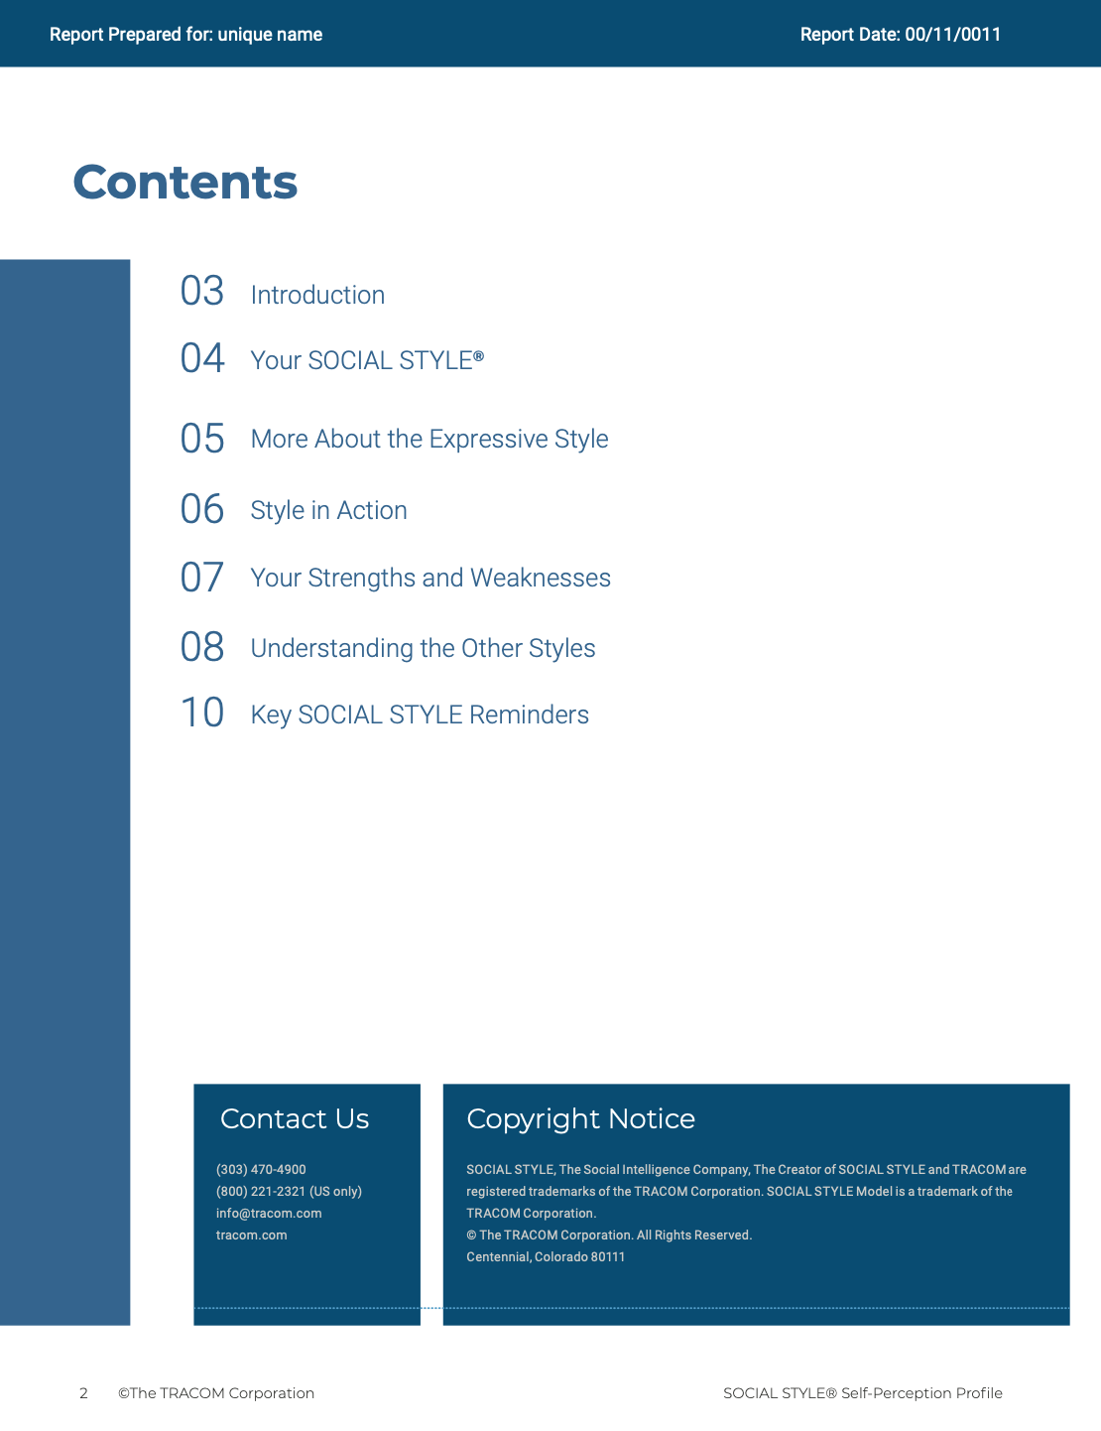
© The TRACOM Corporation. All Rights Reserved.
13
Notes:
15 MINUTES (5 MINUTES if Virtual Program)
Purpose
The purpose of this exercise is to help participants learn more about their SOCIAL STYLE and to encourage them to think about how they can adjust their behavior to be more effective.
Materials Needed
SOCIAL STYLE profile
Virtual Directions:
ASK participants to chat their Style along with one adjustment to their behavior they can make to enhance their effectiveness with customers and prospects.
In-Person Directions:
ASK participants to read their Style profile and begin to determine ways they can adjust their behavior to meet customers’ or prospects’ Style needs. (They will continue this exercise when they read their Versatility profiles).
ASK participants to share what they learned about their Style and how they can adjust their behavior.

Slide 14
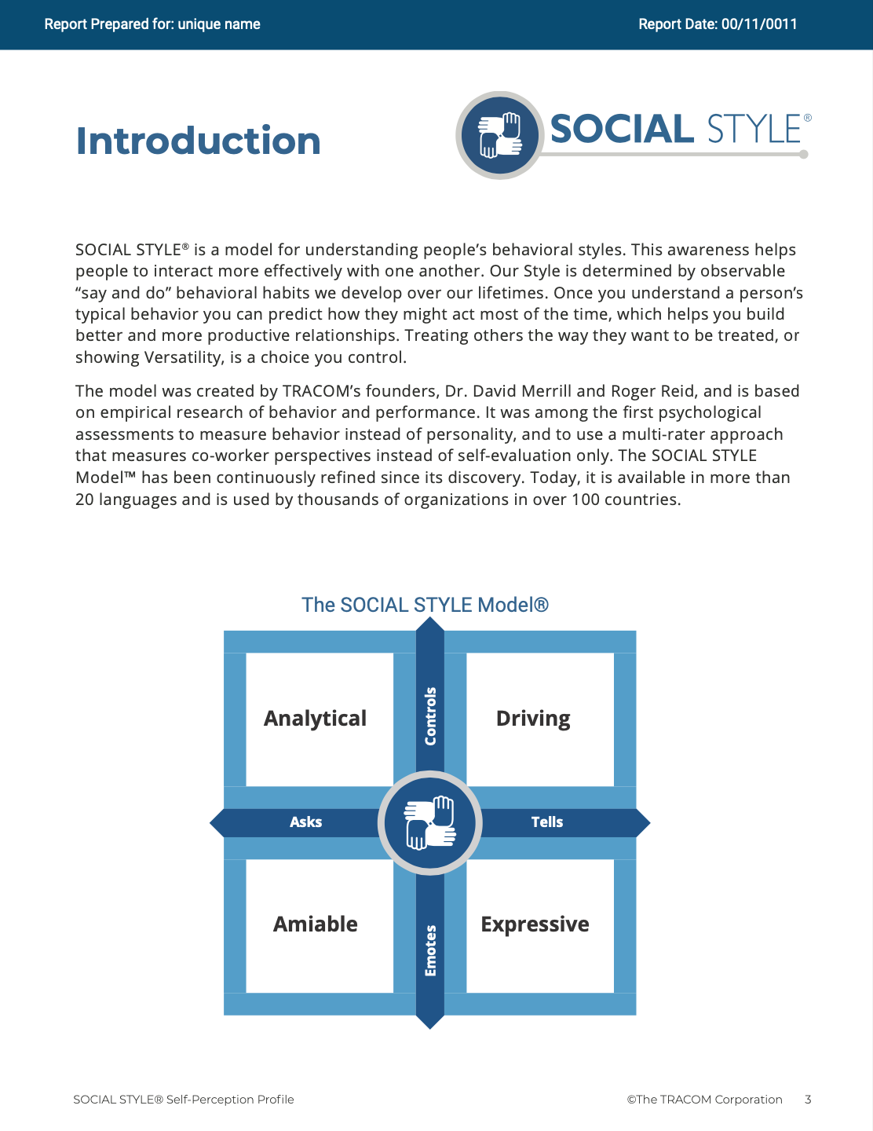
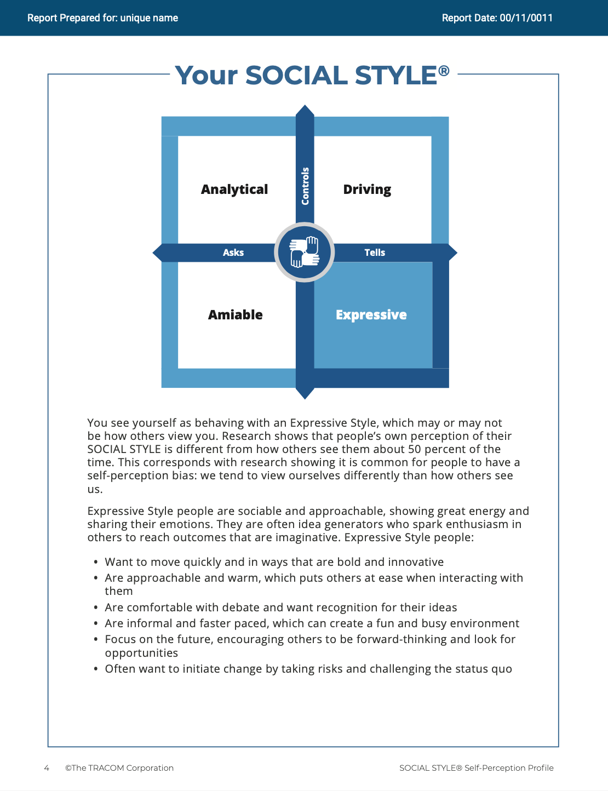
© The TRACOM Corporation. All Rights Reserved.
14
Notes:
These slides show pages of the SOCIAL STYLE profile and can be displayed to assist with conversation during the exercise debrief.

Slide 15
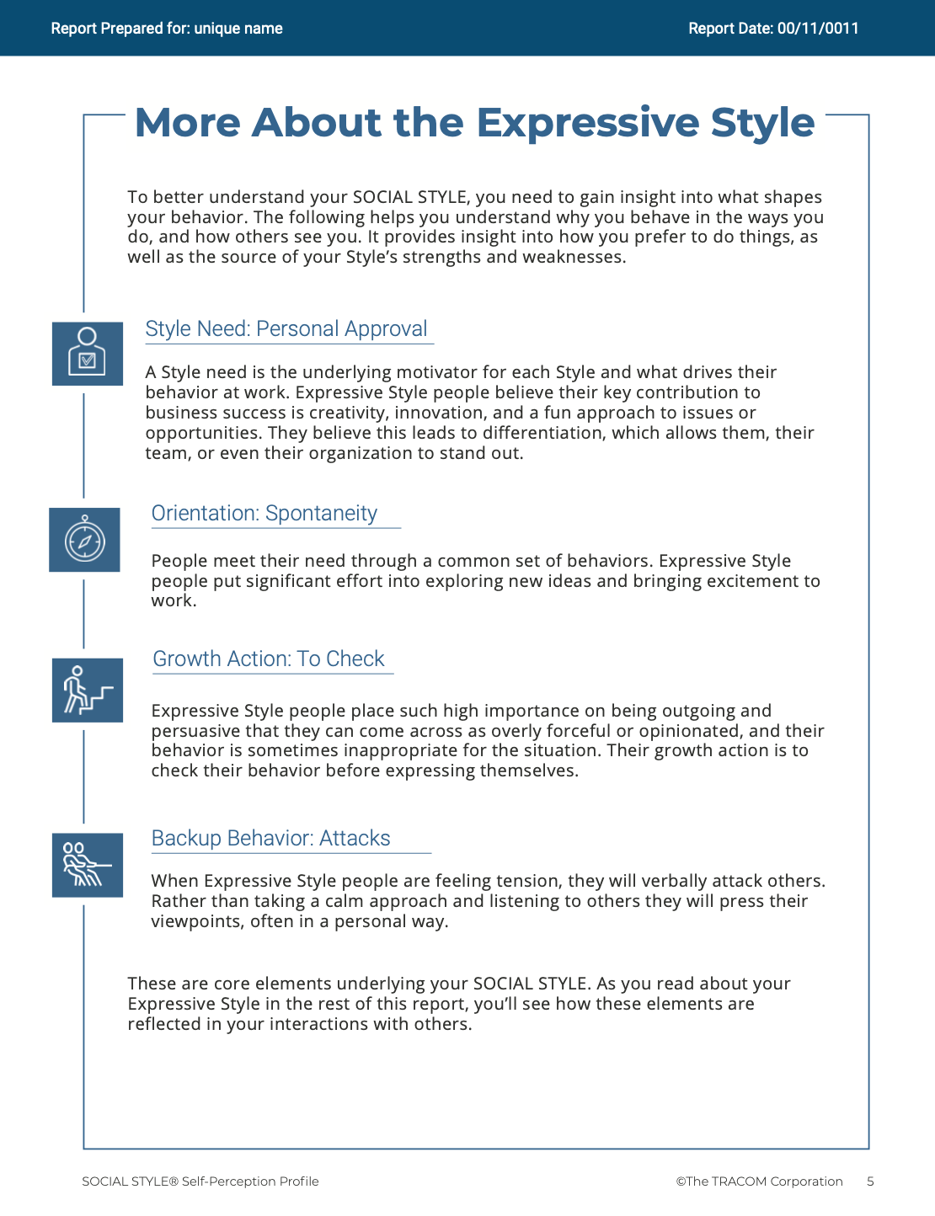
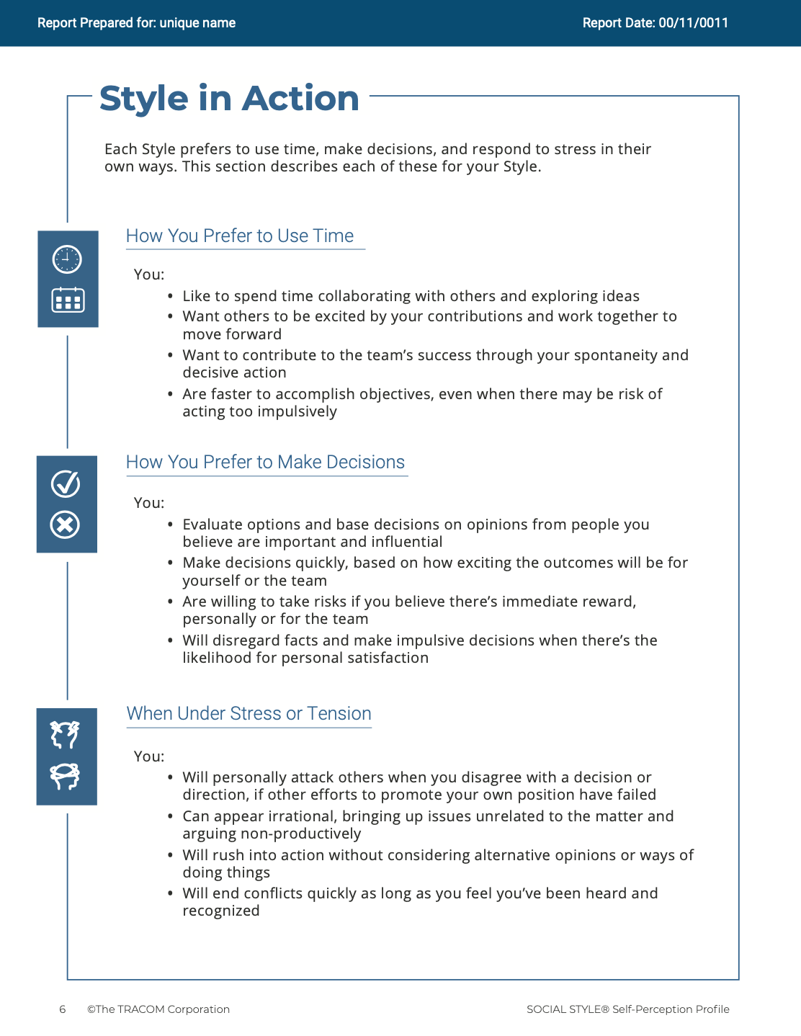
© The TRACOM Corporation. All Rights Reserved.
15
Notes:
These slides show pages of the SOCIAL STYLE profile and can be displayed to assist with conversation during the exercise debrief.

Slide 16
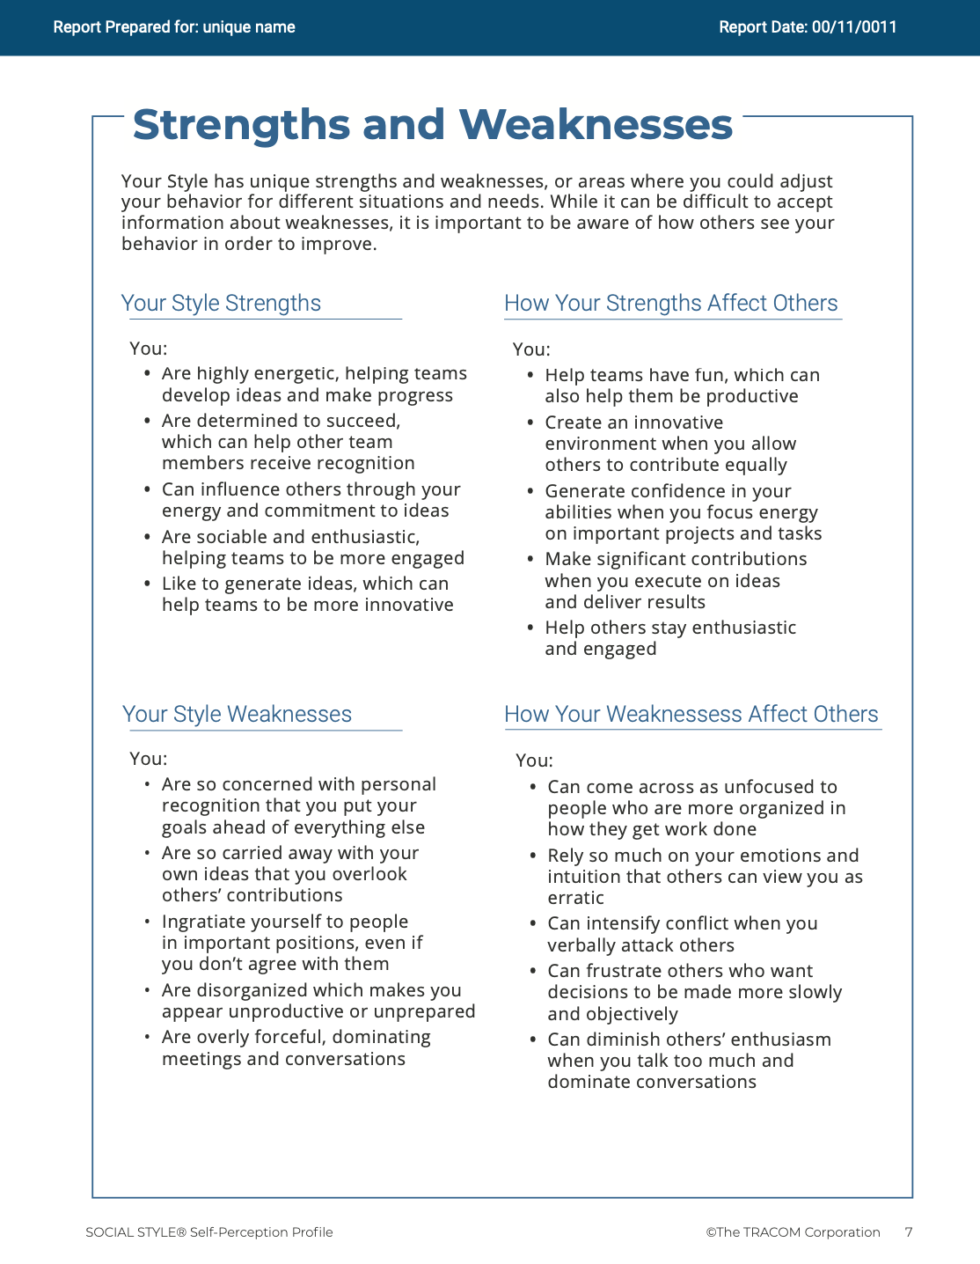
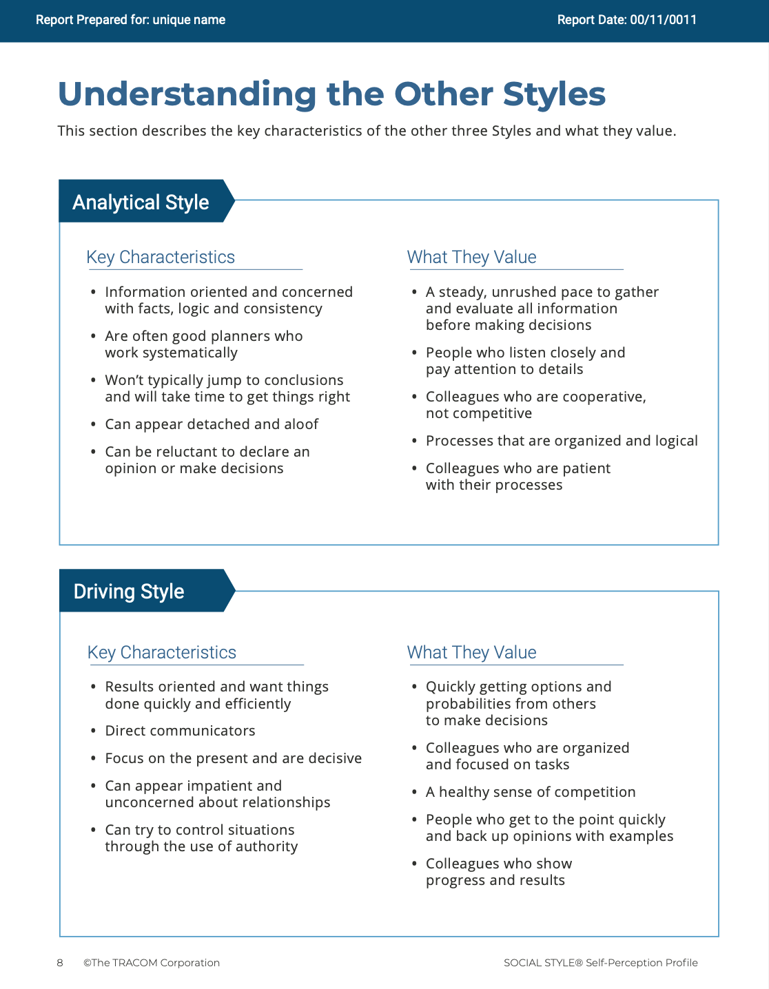
© The TRACOM Corporation. All Rights Reserved.
16
Notes:
These slides show pages of the SOCIAL STYLE profile and can be displayed to assist with conversation during the exercise debrief.

Slide 17
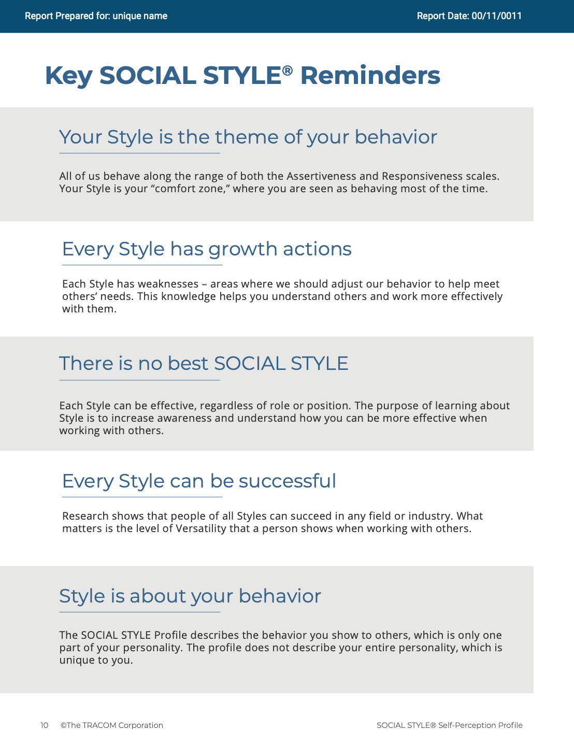
© The TRACOM Corporation. All Rights Reserved.
17
Notes:
These slides show pages of the SOCIAL STYLE profile and can be displayed to assist with conversation during the exercise debrief.

Slide 18
Paper Profile
Notes:
If using the paper profile, use the following slides.
FACILITATOR NOTE: To extend their learning beyond the classroom, participants who complete the Paper Survey can register for free, unlimited access to SOCIAL STYLE Navigator. See Slide #46 for details.

Slide 19
Your SOCIAL STYLE Self-Perception
EXAMPLE:
C
Tear open the perforation
Transfer response for each question
Add up column totals
Plot your SOCIAL STYLE
Analytical
Driving
A
T
Amiable
Expressive
E
Your self-perception may differ from others’ views!
Notes:
10 MINUTES – PAPER PROFILE ONLY
If your participants completed the Online Profile:
DO NOT DISPLAY this slide.
FOLLOW INSTRUCTIONS in “Online Profile” section.
If your participants are using the Paper Profile:
SAY now, it’s time to score the SOCIAL STYLE questionnaire that you completed earlier. Score your questionnaire following the instructions on this PowerPoint.
ASK participants to plot their Assertiveness (A, T) score and Responsiveness (C, E) score as shown on the PowerPoint.
SAY The SOCIAL STYLE Self-Perception Profile reflects how you see yourself. Keep in mind that others may see you differently. TRACOM’s research indicates that about 50% of those who complete Self-Perception Questionnaire differ in their perceptions from their reference group who complete a Multi-Rater Profile about them.
Leader Tip: You may get asked the question, “If the research indicates 50% of people see themselves differently, then what value does it have?”
Answer: The format of this course did not allow us to use the multi-rater profile. The reason we gave you a profile is that you can start to realize that others might see you differently than you see yourself. Even though receiving a multi-rater profile would give you more insight into how others perceive your behavior, this session is still useful and practical. By following the suggestions in this session, you will be able to observe other people’s behavior to determine their SOCIAL STYLE. Then you can adjust your behavior to work more effectively with them.

Slide 20
Read About Your Style
Controls
Analytical Style
Page 16
Driving Style
Page 13
Asks
Tells
Amiable Style
Page 15
Expressive Style
Page 14
Emotes
Notes:
15 MINUTES – PAPER PROFILE ONLY
Purpose
The purpose of this exercise is to allow participants to learn more about their SOCIAL STYLE and begin thinking about how they can use their Styles to be more effective salespeople.
Materials Needed
Flip chart
Visual: "Read About Your Style“
Directions
1. ASK participants to read about their Styles in the Participant Workbook.
2. ASK participants to identify their top three perceived strengths and weaknesses as salespeople.
3. ASK if anyone has any questions about their SOCIAL STYLE regarding (a) strengths of their Style and (b) things they need to work on.
4. ASK participants to share what they learned. Draw SOCIAL STYLE quadrants on the flip chart and record their answers for all to see and consider.

Slide 21
Need, Orientation, and Growth Action
Need
The goal of each Style
Orientation The common behavior used to achieve the need
Growth Action
Behavior that is rarely used by each Style. Using this behavior more often would increase this Style’s effectiveness
Notes:
2 MINUTES (Workbook, page 18)
ASK participants to turn to page 18 of the Participant Workbook.
SAY Each Style has a Need, an Orientation, and a Growth Action.
DEFINE:
Need – The goal of each Style.
Orientation – The common behavior used to achieve the need.
Growth Action – Behavior that is rarely used by each Style. Using this behavior more often would increase this Style’s effectiveness.
SAY Understanding the Need, Orientation, and Growth Action of each Style will help you better relate to others’ Styles and enhance your effectiveness with them.

Slide 22
SOCIAL STYLE Key Characteristics
Controls
Analytical
Need: To be right
Orientation: Thinking
Growth Action: To declare
Driving
Need: Results
Orientation: Action
Growth Action: To listen
Asks
Tells
Amiable
Need: Personal security
Orientation: Relationships
Growth Action: To initiate
Expressive
Need: Personal approval
Orientation: Spontaneity
Growth Action: To check
Emotes
Notes:
4 MINUTES
CLICK TO REVEAL THE TEXT IN EACH QUADRANT.
Correlate Assertiveness and Responsiveness behaviors to Style Need and Orientation:
Have participants think about how Style Need and Orientation directly correlate to the Assertiveness and Responsiveness behaviors that were discussed earlier. For example, the Analytical Style's need for time to think is consistent with getting things done at a slower-pace, being more interested in facts, and displaying less emotion.
In the diagonally opposite corner, the Expressive Style’s need for approval and Orientation toward spontaneity is consistent with being louder and using more hand gestures.
Ask participants to point out correlations they see between the Driving Style’s Need and Orientation and the Assertiveness and Responsiveness behaviors …same question regarding the Amiable Style.
Leader Tip: The key characteristics of Style are only a convenient way of summarizing basic Style characteristics. The descriptions of key characteristics are generalizations of behavior that fit most characteristics of each Style. They do not perfectly describe any single individual.

Slide 23
Tension and Productivity
High
Low Tension Low Productivity
Appropriate Tension And Productivity
High Tension Low Productivity
Tension—A force that stimulates activity
Productivity
Low
Low
High
Tension
Notes:
5 Minutes (Workbook, page 20)
ASK participants to turn to page 20 of the Participant Workbook.
SAY Tension is a force that stimulates activity, and it has an effect on behavior. Managing tension during the sales process is important to ensure that the customer is feeling motivated enough to proceed with the buying process but not so tense that negative emotions grow and get in the way.
DESCRIBE the Tension Productivity Model.
SAY Tension exists in every relationship. Managing it productively is the key. Low tension, the sale stalls; appropriate levels of tension, the sale proceeds; high tension, the sale comes to a stop as the customer goes into Backup Behavior (more on this in the next section).
Sometimes tension cannot be turned into productive effort, so it is misdirected and released in random or harmful ways. When tension is too great, we want to reduce it. This is called Backup Behavior.
Leader Tip: Clearly define Tension. Tension can occur in both positive and negative forms. A certain degree of tension is positive and can be productive. Don’t overemphasize or focus solely on the negative forms of tension.

Slide 24
Backup Behavior
Controls
Analytical
AVOIDS: Withdraws to reduce personal tension
Driving
AUTOCRATIC: Takes charge to reduce personal tension
Exaggerated behavior used to reduce tension
Asks
Tells
Amiable
ACQUIESCES: Goes along to reduce personal tension
Expressive
ATTACKS: Confronts to reduce personal tension
Emotes
Notes:
4 MINUTES (Workbook, page 21)
ASK participants to turn to page 21 of the Participant Workbook.
SAY Backup Behavior occurs when people are frustrated in trying to get their Style need met. Backup Behavior is an exaggerated form of Style-related behavior used by a person to reduce tension within the relationships that caused the tension.
To increase your effectiveness, recognize when you are affected by tension.
Recognizing the Backup Behavior for each Style can also help you to deal effectively with others who are experiencing tension and behaving in Style-bound ways.
REVIEW the Backup Behavior for each Style.

Slide 25
Managing Backup Behavior
Controls
Analytical
AVOIDS: Emphasize the value of their facts and input and ask to compare their information with your requirements objectively and unemotionally
Driving
AUTOCRATIC: Firmly state your commitment to the goals and show how you can help them achieve the results they are committed to reaching
Exaggerated behavior used to reduce tension
Asks
Tells
Amiable
ACQUIESCES: Reassure them to feel safe in becoming involved again; encourage them to offer their opinions
Expressive
ATTACKS: Allow them to “vent” and acknowledge their contributions, while moving the conversation toward actions that will benefit them and the team
Emotes
Notes:
4 MINUTES
DESCRIBE some simple strategies for managing individuals who are using their backup behavior as shown on the slide.
Leader Tip: Backup Behavior is always self-serving. Reinforce the notion that Backup Behavior is selfish and never results in positive outcomes. There is nothing that is mutually productive in this form of behavior.

Slide 26
Potentially Toxic Relationships
Controls
Analytical
Slower-paced
Focus on detail
Serious & formal approach
Driving
Faster-paced
Focus on goal
Serious & formal approach
Asks
Tells
Amiable
Slower-paced
Focus on relationship
Casual & informal approach
Expressive
Faster-paced
Focus on generalities
Casual & informal approach
Emotes
Notes:
5 Minutes (Workbook, pages 22-23)
CLICK TO REVEAL THE TEXT IN EACH QUADRANT.
ASK participants to turn to pages 22 and 23 of the Participant Workbook.
SAY toxic relationships can occur when you and your customer interact in “Style-bound” ways: You both act according to your own Style Need and Orientation and make little or no attempt to accommodate the Style of the other person. A Toxic Relationship can jeopardize or, more likely, kill the sale!
Relationships that are diagonal to each other often have the potential to be toxic because they are the most opposite in their behavioral preferences (Driving vs. Amiable and Analytical vs. Expressive). However, toxic relationships can develop for any Style combination, including people of the same Style.

Slide 27
Key Reminders
There is no “best” Style.
Style is not personality.
Your Style is a theme in your behavior.
Your Style has growth actions.
Your challenge: Take the initiative to establish and build effective relationships with your customers.
Notes:
2 MINUTES
REVIEW what has been covered so far, discussing Key Reminders as presented on the slide.

Slide 28
Versatility

Slide 29
Versatility is how well you adjust to the Style needs of others
Notes:
2 MINUTES
SAY Versatility is a measure of your consistency in adjusting to the Style needs of others.
At the beginning of the program, we reviewed some statistics on Versatility. Research has found that Versatility is a strong predictor of successful job performance. People who consistently show Versatility are more effective in their job performance than people who are inconsistent in their Versatility.
Salespeople who have been through SOCIAL STYLE and Versatility training have rated the experience as having a significant impact on their performance in key areas.
Versatility is completely within your control, so it is your choice to be versatile with others. You can be highly versatile with one group and show low Versatility with another group. It depends on the circumstances and how much you value your interpersonal effectiveness with each group.
It is completely independent of SOCIAL STYLE: Any Style can show Versatility and be successful.
Versatility is NOT the same as likeability. A person can be well liked but not have high Versatility. The opposite can also be true. Versatility helps you develop better working relationships, but it is separate from your personal likeability.

Slide 30
Versatility
A measure of your consistency in adjusting to the Style needs of others
W | Not Consistent | X | Somewhat Consistent | Y | Usually Consistent | Z | Very Consistent
Low
Medium
High
Notes:
3 Minutes (Workbook, page 24)
ASK participants to turn to page 24 of their Participant Workbook.
Online Profile Only:
SAY We measure Versatility on a scale ranging from W to Z. These are normed quartiles, just like Assertiveness and Responsiveness.
When you aren’t consistent in your behavior, you’re usually focusing on your own Style needs. When you consistently show Versatility, you’re focusing on meeting others’ Style needs.
Your profile will show your results on this scale, ranging from W (not consistent) to Z (very consistent).
Paper Questionnaires Only:
Will measure High, Medium or Low
Click to show next graphic
Your workbooks might show a graphic similar to this, with low, medium, and high. This is just another way of explaining Versatility. Just remember, the key point is that Versatility is under your control, and the more consistently you behave with Versatility the more effective you will be.

Slide 31
Four Sources of Versatility
The Appropriate Use of
Image
Presentation
Competence
Feedback
Leads to
Higher Versatility
Notes:
5 MINUTES (Workbook, pages 25-28)
ASK participants to turn to pages 25 through 28 in the Participant Workbook.
Image remains a part of the Versatility model because it’s important for building relationships. Describe Versatility in a timeline:
SAY You show Versatility in four areas. Let me describe these as a timeline.
Image – When you first meet a new person at work, you form an impression about this person based on what you see, consciously or not. Essentially Image is a first impression: Are you dressed appropriately for the situation, for the work culture, for the client, and so on?
ONLINE PROFILE: Note that Image is not measured as part of your Profile. This is because:
Image is difficult to observe in virtual environments. We can’t observe very well how people are dressed, and because there are a wide variety of dress codes, even within companies and teams, it is less relevant to measure Image in this way.
Raters don’t always like answering questions about people’s Image without understanding the context of how Image is explained in training.
Image is still important for many people and companies, which is why it’s part of the model. However, you won’t receive a measure of your Image.
Presentation – When that person communicates in meetings or other public venues, you’ll notice how clear they are at helping people understand their points. Do they use clear language? Are their examples effective? Do they take others’ Styles into account?
Competence – Over time, you’ll observe this person in a variety of situations. Are they reliable and do they persevere during difficult times? Are they flexible when change happens? Are they optimistic most of the time? Do they show creativity?
Feedback – Finally, this is the most interpersonal part of Versatility. Are they a good listener? Do they show empathy for others’ situations? Do they meet the needs of other people’s Styles? Do they develop good relationships with others?

Slide 32
Online Profile
Notes:
If using the online profile, use the following slides.
Note that if delivering virtually, participants will need to have received their profiles prior to the program.
Check the Session Status Report and Composite Report to understand which participants have completed their profiles, and the breakdown of Versatility within your program.

Slide 33
Overall Versatility
Your consistency in displaying Versatility
W | Not Consistent | X | Somewhat Consistent | Y | Usually Consistent | Z | Very Consistent
 |  | OTHERS |  | SELF
Notes:
5 MINUTES
THIS SLIDE ONLY USED WITH ONLINE PROFILE.
SAY We measure Versatility on a scale ranging from W to Z. These are normed quartiles, just like Assertiveness and Responsiveness.
When you are not consistent in your behavior, you’re usually focusing on your own Style needs. When you consistently show Versatility, you’re focusing on meeting others’ Style needs, which reduces their tension. When you are consistent, the more effective you will be.
Your profile will show your results on this scale, ranging from W (not consistent) to Z (very consistent).
Versatility is all about consistency of behavior. A lower Versatility score does NOT mean you lack ability or that you never demonstrate these abilities. What it DOES mean is that you aren’t showing consistency in your behavior.
By making small changes to your behavior and acting with more consistency, you can increase your Versatility. (Recall that the difference in values between W and Z are small but meaningful.)

Slide 34
The Meaning of Versatility Positions
 | 1 | 2 | 3 | 4 | 5
 | Strongly Disagree | Disagree | Partly Agree Partly Disagree | Agree | Strongly Agree
1. Approaches new situations with a positive outlook. | ◯ | ◯ | ◯ | ◯ | ◯
2. Builds good relationships with co-workers. | ◯ | ◯ | ◯ | ◯ | ◯
3. Effectively presents ideas to groups. | ◯ | ◯ | ◯ | ◯ | ◯
W | X Y | Z
Consistency
Notes:
3 MINUTES
THIS SLIDE ONLY USED WITH ONLINE PROFILE.
Before delivering Versatility profiles, explain the meaning of the positions.
SAY Before reviewing your results in more detail, let’s put your results into context. This graph shows several sample items that measure Versatility.
You responded to these items using the scale ranging from ‘strongly disagree’ to ‘strongly agree’. TRACOM assigns values to each of these scale points: 1 to 5.
When rating Versatility, most people respond at the higher end of the rating scale. This makes sense since most people have at least some abilities in these areas. This means that the cutoff for achieving Z Versatility is very high, approximately 4.5 or higher.
Similarly, to score either an X or Y requires scores between 3.5 and 4.5. These are approximate values used for purposes of explanation.
Importantly, if you receive a W in any area of Versatility, this DOES NOT mean that you evaluated yourself at the low end of the rating scale. On the contrary, almost nobody scores at the lowest end – 1 or 2. For people with a W result, most of their ratings fluctuate between 2 and 4, resulting in an average score of slightly less than 3.5.
So, putting this into context, a W rating means that you are not showing as much consistency in these behaviors as you could. With effort and more consistency, your evaluation would improve.
Set the context:
W does not mean that you lack ability.
It doesn’t mean that you evaluated yourself at the lowest end of the rating scale.
It does mean that you’re not highly consistent in your behavior; you do these things some of the time but could do them more often.
It does mean that you evaluated yourself between ‘disagree’ and ‘agree’, on average.
Note that these cutoff values (3.5 and 4.5) are only for demonstration – they aren’t the exact values in TRACOM’s norms, but they are close.
Giving the context is critical because it helps to ease people’s automatic reactions to the profile.
Then:
Help people focus on just one area to improve. This increases chances of success.
What is ‘low hanging fruit?’ Something they can improve quickly.

Slide 35
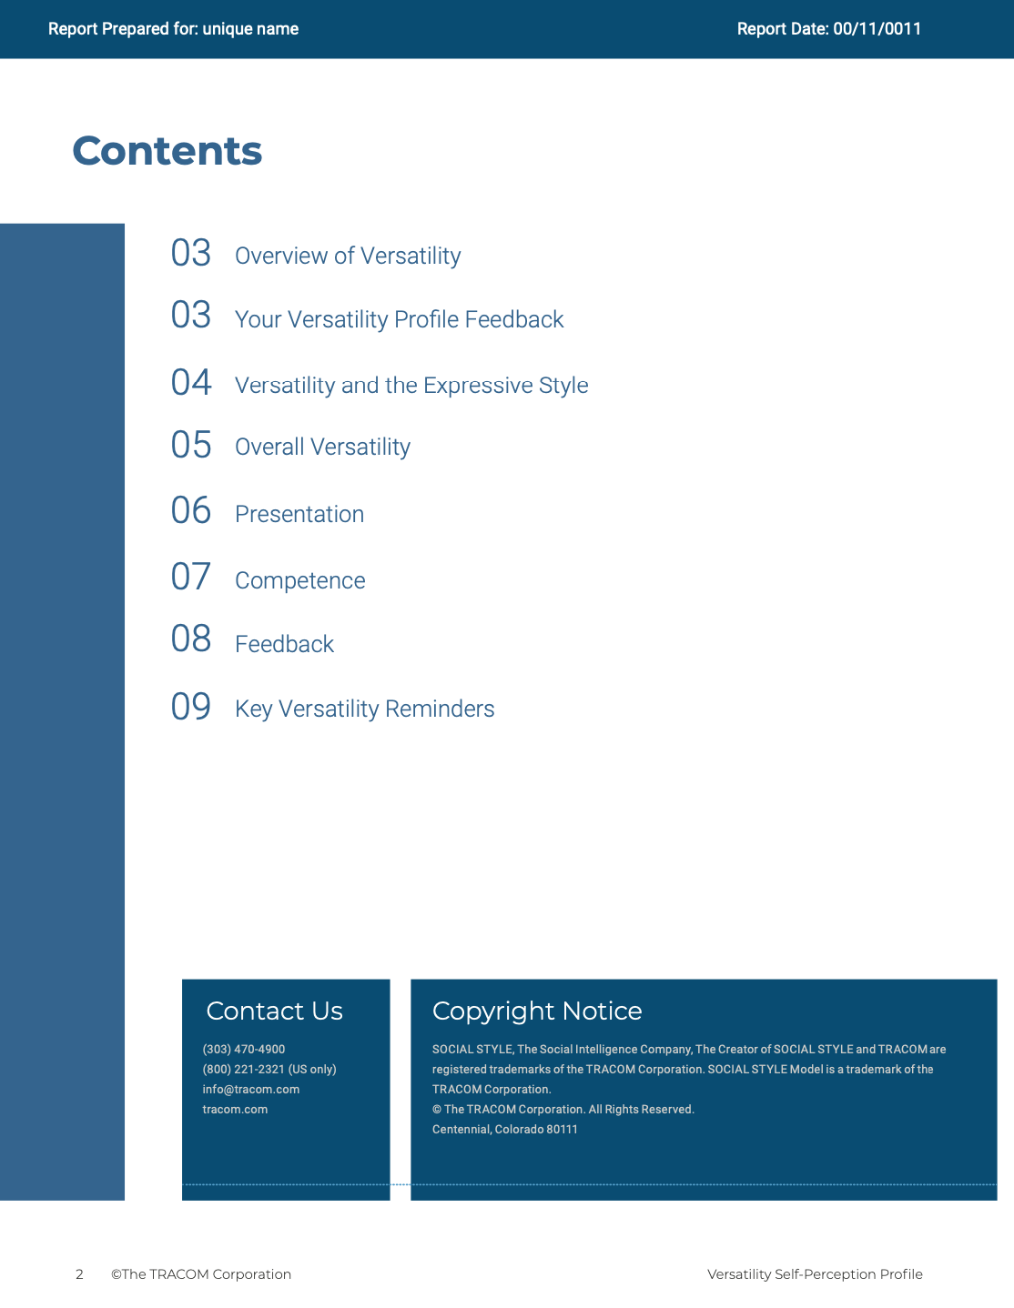
© The TRACOM Corporation. All Rights Reserved.
35
Notes:
15 MINUTES (5 MINUTES if Virtual Program)
Purpose
The purpose of this exercise is to help participants develop an action plan for showing Versatility more consistently.
Materials Needed
Versatility profile
Virtual Directions:
ASK participants to chat one way they can adjust their behavior to be more consistent in their Versatility. Encourage them to choose just one or two concrete steps they can take, based on the strategies they read about in their profiles.
In-Person Directions:
DISTRIBUTE the Versatility profiles.
ASK participants to read their profiles and consider ways they can adjust their behavior to be more consistent in their Versatility. Encourage them to choose just one or two concrete steps they can take, based on the strategies they read about in their profiles.
VIRTUAL DELIVERY: If delivering virtually, learners will have downloaded their profiles earlier.

Slide 36
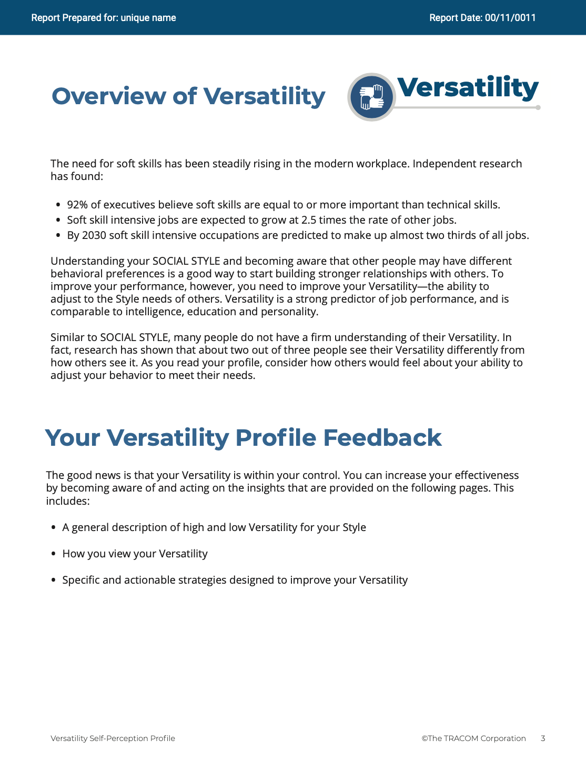
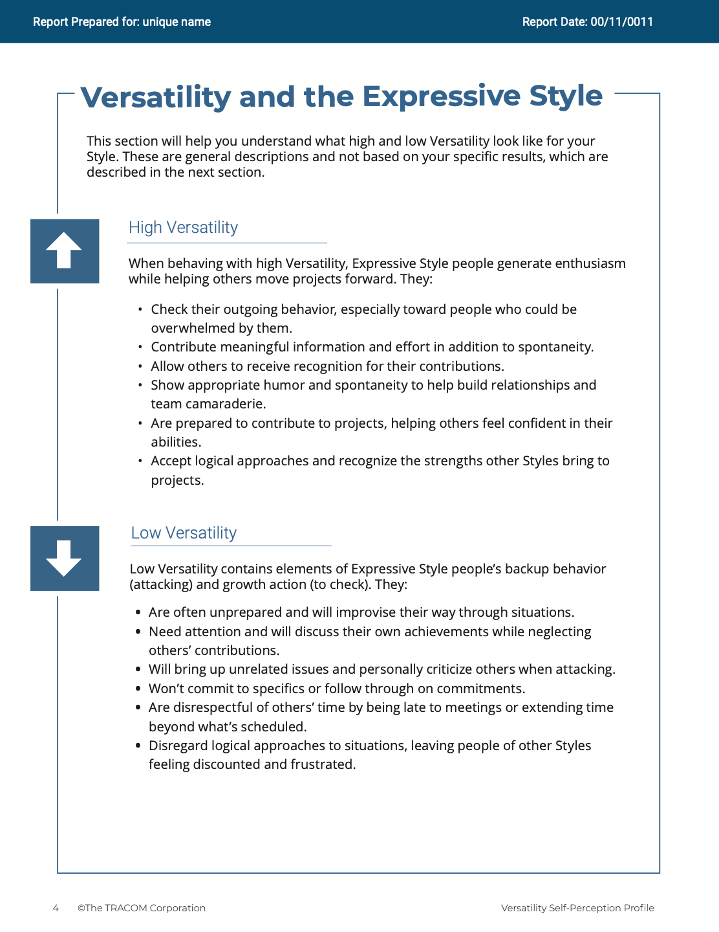
© The TRACOM Corporation. All Rights Reserved.
36
Notes:
These slides show pages of the Versatility profile and can be displayed to assist with conversation during the exercise debrief.

Slide 37
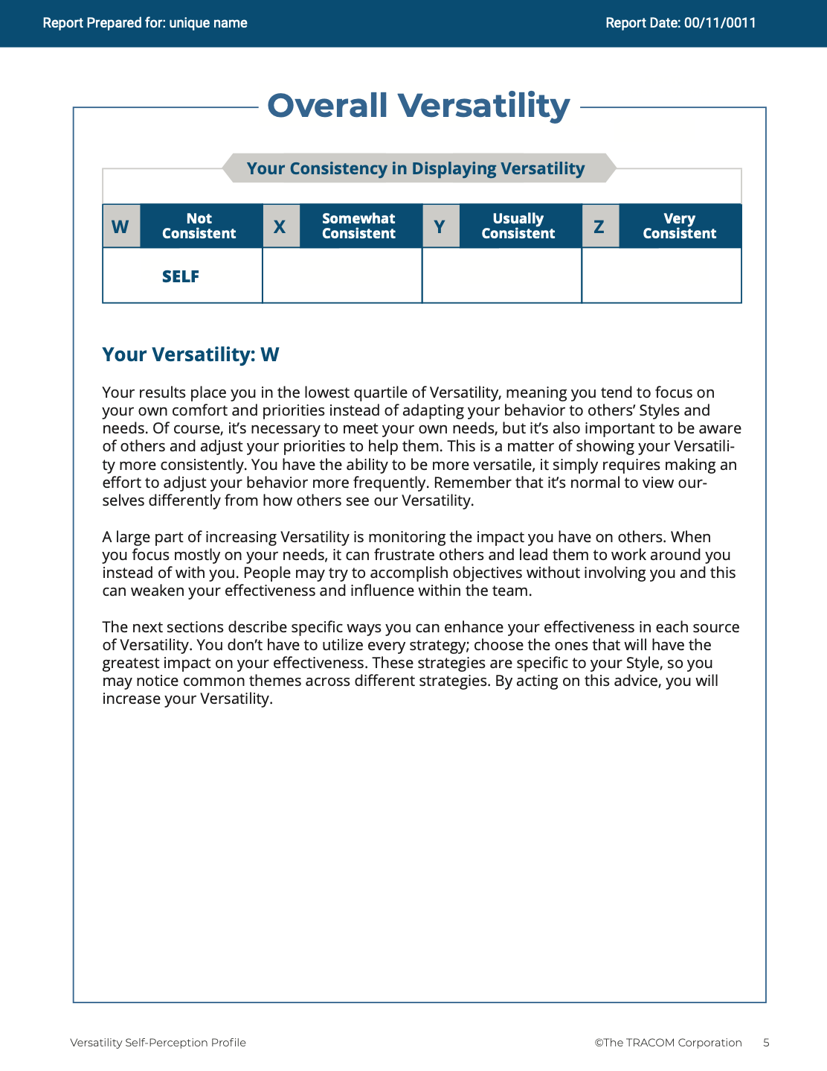
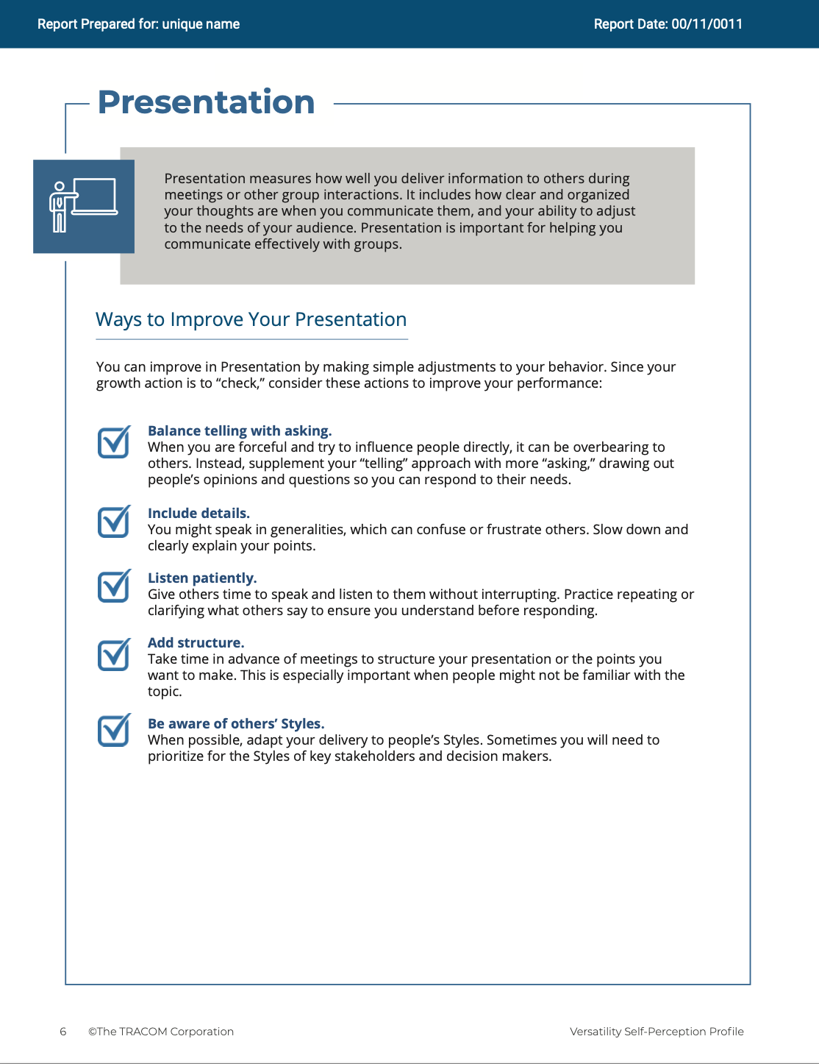
© The TRACOM Corporation. All Rights Reserved.
37
Notes:
These slides show pages of the Versatility profile and can be displayed to assist with conversation during the exercise debrief.

Slide 38
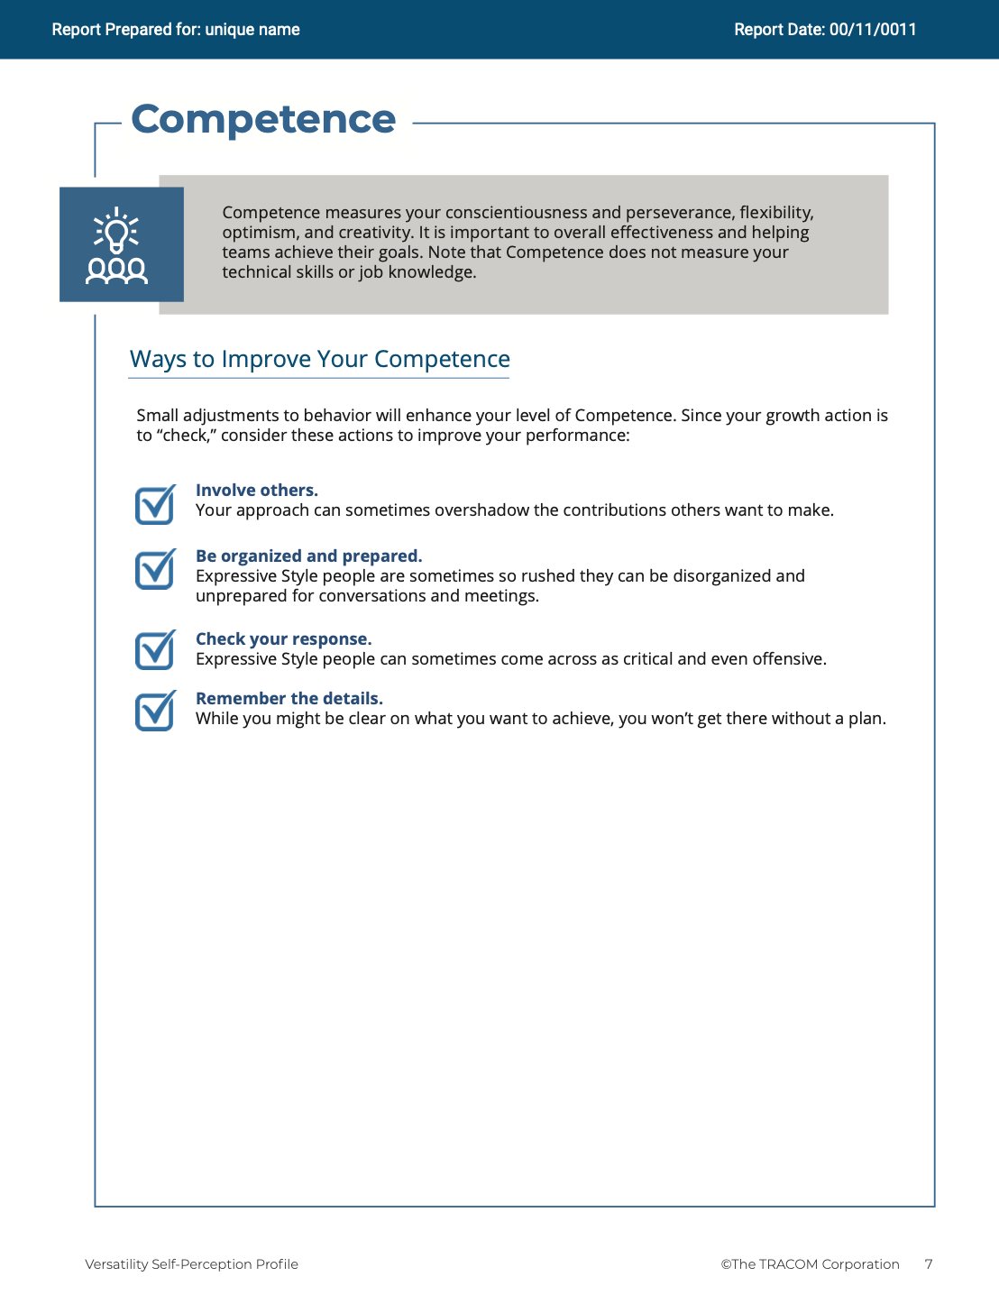
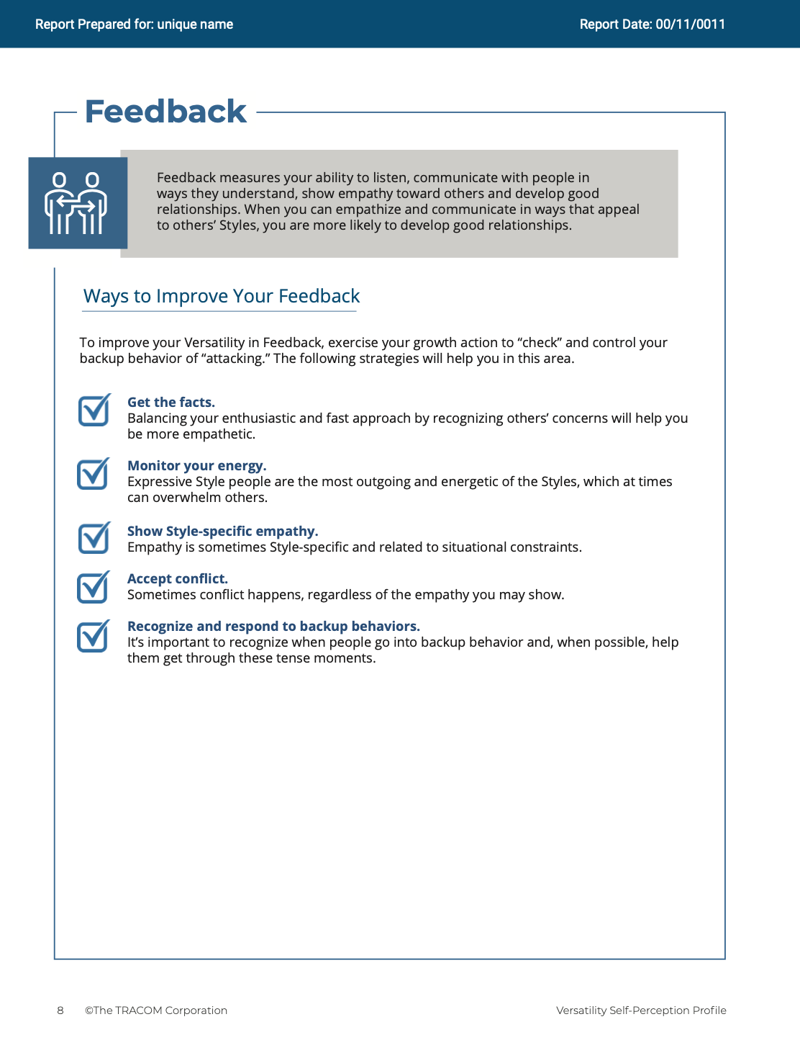
© The TRACOM Corporation. All Rights Reserved.
38
Notes:
These slides show pages of the Versatility profile and can be displayed to assist with conversation during the exercise debrief.

Slide 39
Paper Profile
Notes:
If using the paper profile, use the following slides.

Slide 40
Versatility
A measure of interpersonal effectiveness when working with others
Behavior seen as focusing on...
Low
Medium
High
My Tension
Others’ Tension
Notes:
2 MINUTES
THIS SLIDE ONLY USED WITH PAPER PROFILE.
SAY while identifying your SOCIAL STYLE can help you understand your behavioral preferences, by itself, knowing your Style doesn’t necessarily help you be more effective. As I’ve said, there is no good or bad Style. What is important is how you adjust your behavior when working with others. That’s where Versatility comes in.
Versatility is your ability to adjust your behavior to meet others’ Style preferences in the areas of Image, Presentation, Competence, and Feedback.
SAY When you are not consistent in your behavior, you’re usually focusing on your own tension and Style needs. When you consistently show Versatility, you’re focusing on meeting others’ Style needs, which reduces their tension. When you are consistent, the more effective you will be.

Slide 41
Your Versatility Self-Perception
Tear open the perforation
Add up the check marks in the shaded column
Circle the letter of your Versatility score
EXAMPLE:
If 7 or less = Low (circle the “L”)
If 8-14 = Medium (circle the “M”)
If 15-21 = High (circle the “H”)
L | M | H
Your self-perception may differ from others’ views!
© The TRACOM Corporation. All Rights Reserved.
Notes:
8 MINUTES
THIS SLIDE ONLY USED WITH PAPER PROFILE.
1. ASK participants to score their Versatility Questionnaires following the instructions on the PowerPoint.
2. SAY before we discuss Versatility, I’d like you to score your Versatility Questionnaire.
After scoring is complete, ASK Is anyone surprised? Are there any questions or concerns?
The Versatility profile reflects how you see yourself. Keep in mind that others may see you differently.

Slide 42
Learning Objectives
Gain an understanding of the SOCIAL STYLE Model.
Determine your SOCIAL STYLE by completing a Self-Perception questionnaire.
Increase understanding of your behavior and how Customers view people with your Style.
Increase your Versatility to become more effective with Customers.
Notes:
2 MINUTES
REVIEW the learning objectives.
ASK Did we meet them?
HIGHLIGHT key points learned.
EMPHASIZE importance of comparing self-perception data with multi-rater.

Slide 43
Next Steps and Key Learning
Share your SOCIAL STYLE with your colleagues and ask them for insights.
Look for two behavioral dimensions: Assertiveness and Responsiveness.
Take steps to meet customers’ SOCIAL STYLE needs as you interact with them.
Predict probable future Style behaviors of customers and prospects.
Notes:
2 MINUTES
As participants take their knowledge of Style back into the workplace, suggest that they do the following:
SHARE their Style with their colleagues and ask them for additional insights into how they can interact more effectively.
REMIND them that the most objective way to identify a customer’s Style is by looking for behavior along Assertiveness and Responsiveness.
Finally, UNDERSCORE that being able to predict the probable future Style behavior of others is a powerful tool for interpersonal success. Participants now have valuable information to use in developing themselves into more effective salespeople.

Slide 44
SOCIAL STYLE Navigator®
SOCIAL STYLE Estimator A brief survey that estimates the Style of others
SOCIAL STYLE Advisor
Prep for meetings, negotiations, presentations
Style & Versatility best practices for many situations
eLearning Modules Apply Style concepts to teams, managing conflict and coaching
SOCIAL STYLE Navigator® is a registered trademark of TRACOM Corporation
Notes:
1 Minute
SAY You now have free and unlimited access to SOCIAL STYLE Navigator, the on-demand micro-learning tool that helps you apply Style and Versatility.
SOCIAL STYLE Navigator includes:
SOCIAL STYLE Estimator
The Estimator survey provides users with an interactive tool that evaluates observable behavior in others to determine their Style and helps you plan ahead for successful interactions.
SOCIAL STYLE Advisor
Use Advisor topics to prepare “just-in-time” for meetings, negotiations or sales presentations with advice on navigating Style and Versatility best practices to maximize high-performing relationships.
eLearning modules
Continue your learning journey via micro-learning that reinforces ways to apply SOCIAL STYLE and Versatility to Working in Teams, Coaching and Managing Conflict.

Slide 45
SOCIAL STYLE Navigator® Access (online profiles only)
Available through tracomlearning.com
Log in with your Username and Password for FREE, UNLIMITED access to SOCIAL STYLE Navigator
Notes:
1 Minute
THIS SLIDE FOR ONLINE PROFILES ONLY
SAY Available through www.tracomlearning.com
Enter your username and password for free, unlimited access to SOCIAL STYLE Navigator®

Slide 46
SOCIAL STYLE Navigator® Access (paper profiles only)
Go to:
tracomlearning.com/registration-paper
Register with your email address and
Subscription Code _____-_____
for FREE, UNLIMITED access to SOCIAL STYLE NAVIGATOR
Notes:
1 Minute
THIS SLIDE FOR PAPER SURVEYS ONLY
SAY Go to tracomlearning.com/registration-paper and register with your email address and subscription code ______-______ for free, unlimited access to SOCIAL STYLE Navigator®
IMPORTANT FACILITATOR NOTE REGARDING SUBSCRIPTION CODES:
Your subscription code can be found on the “ATTENTION” colored flyer included in your participant materials shipment. The code is formatted in two sets of 4 numbers separated by a hyphen (EXAMPLE: xxxx-xxxx). If you do not have the “ATTENTION” flyer included with your materials shipment, please contact TRACOM to receive your subscription code.

Slide 47
Notes:
Optional demonstration, time permitting

Slide 48
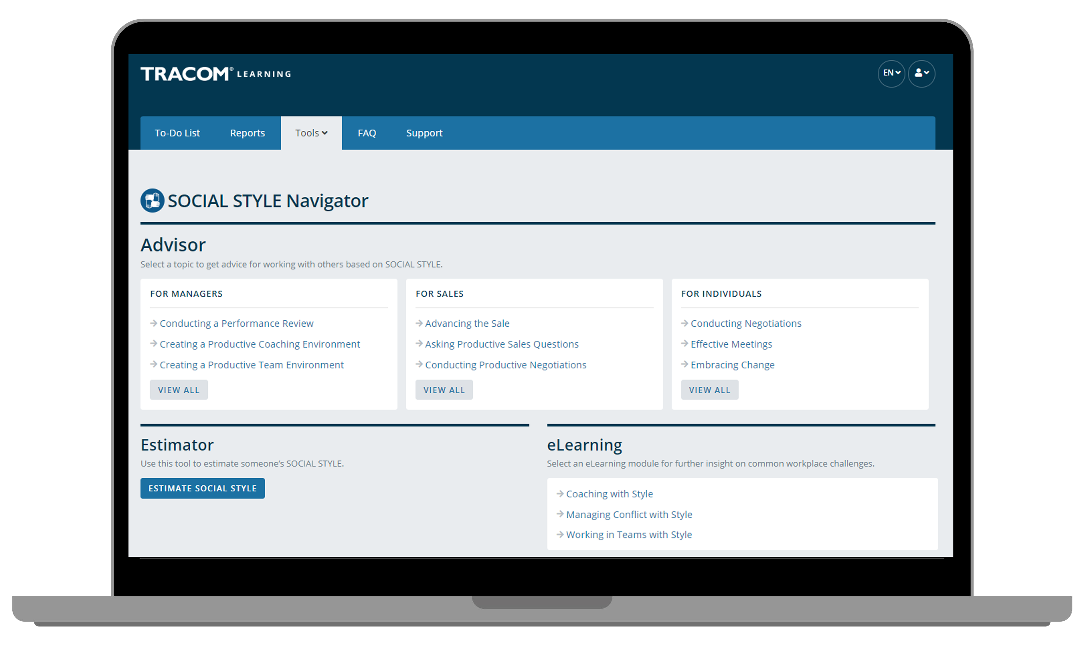
Notes:
Optional demonstration, time permitting

Slide 49
Notes:
Optional demonstration, time permitting

Slide 50
Notes:
Optional demonstration, time permitting

Slide 51
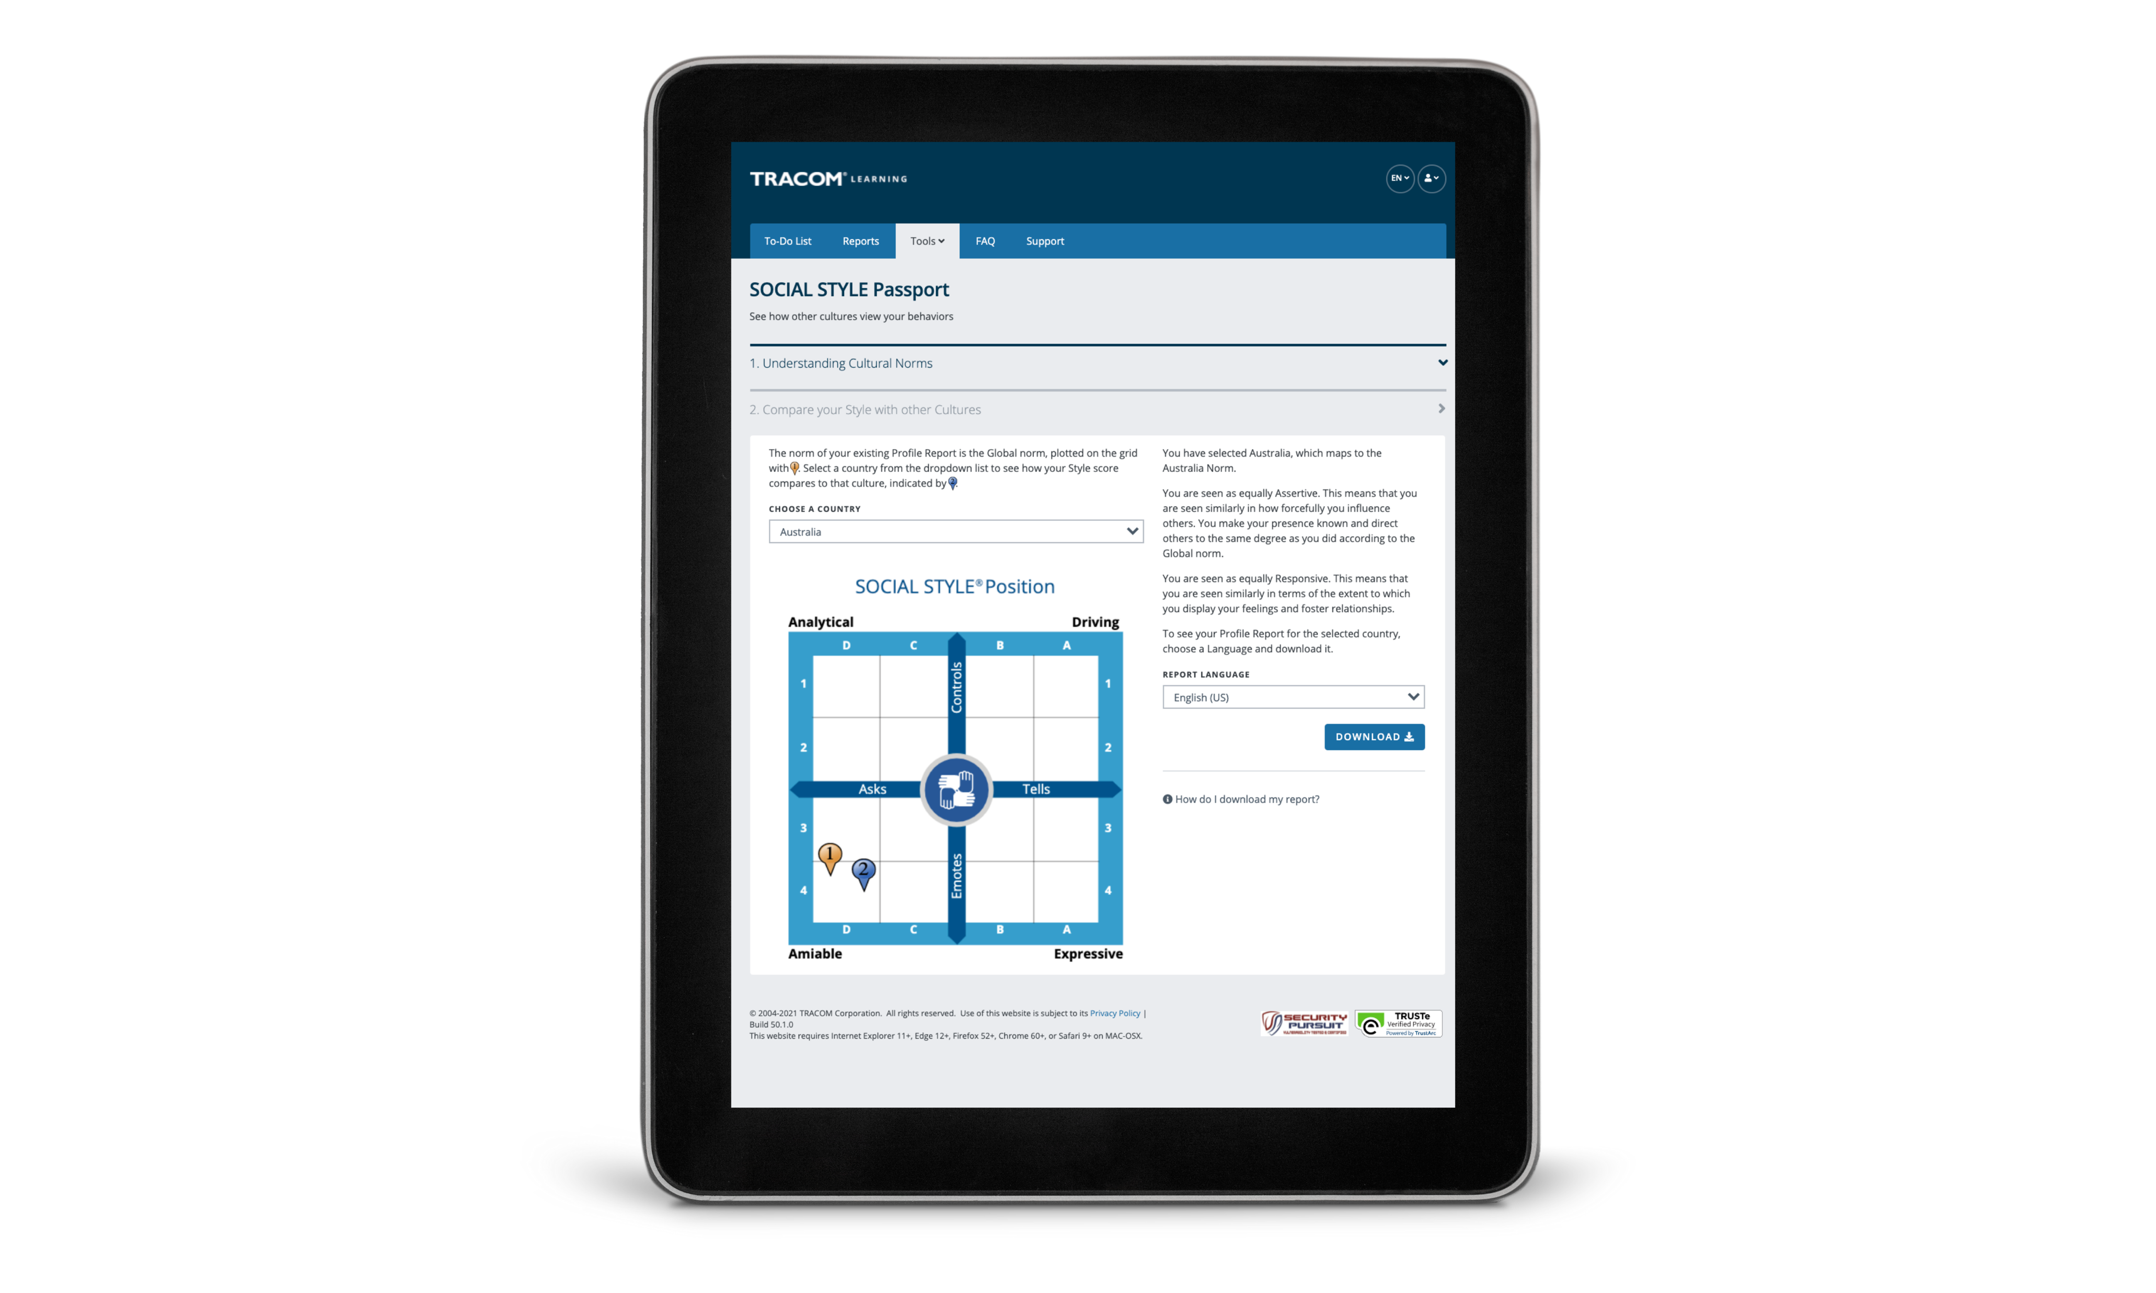
SOCIAL STYLE Passport
Notes:
Optional demonstration, time permitting

Slide 52
52
Notes:
2 MINUTES
Thank you. Do you have final questions / feedback.

Slide 53
Optional Exercises
Select optional exercises based on your needs and time available.
© The TRACOM Corporation. All Rights Reserved.
53
Notes:
You can draw upon the following exercises to enhance your session to best meet the needs of your participants.

Slide 54
Potentially Toxic Relationships
Controls
Analytical
Slower-paced
Focus on detail
Serious & formal approach
Driving
Faster-paced
Focus on goal
Serious & formal approach
Asks
Tells
Amiable
Slower-paced
Focus on relationship
Casual & informal approach
Expressive
Faster-paced
Focus on generalities
Casual & informal approach
Emotes
Notes:
Potentially Toxic Relationships
Purpose
To determine if they have a toxic relationship with a customer.
Recommended Time
10 minutes
Materials Needed
None
Directions
ASK participants to turn to pages 21 through 23 of the Participant Workbook.
DESCRIBE the possibility of Toxic Relationships occurring when both the salesperson and the customer act in Style-bound ways.
SAY Toxic relationships can occur when you and your customer interact in “Style-bound ways.” That is, you both act according to Style Need and Orientation and make little or no attempt to accommodate the Style of the other person.
ASK participants to take a few moments to consider whether they have a toxic relationship with a customer.
ASK participants to write notes about ways they can resolve these relationships.
DEBRIEF the exercise by asking participants to share their insights.

Slide 55
Style Forum
Purpose: To give you an opportunity to describe what it is about the opposite SOCIAL STYLE position that creates tension for you and to develop insights into how to be more productive with a customer who has that Style.
Directions:
In your assigned group, discuss and develop a list of behaviors that the opposite SOCIAL STYLE exhibits that creates tension for you.
Share your list with the group of the opposite Style.
In your group, discuss what you can do to interact better with the opposite Style.
Share your information with the opposite Style and the whole class.
55
Notes:
Style Forum
Purpose
The purpose of this exercise is to give participants an opportunity to describe what it is about the opposite SOCIAL STYLE position that creates tension for them when working with customers of that Style and to develop insights into how to be more productive with a person who has that Style.
Recommended Time
30 minutes
Materials needed
None
Directions
Break participants into groups by SOCIAL STYLE position with a maximum of six per group.
Give each group 10 minutes to discuss and develop a list of behaviors that the opposite SOCIAL STYLE position manifests to create tension that leads to unproductive relationships.
After each group has developed its list, ask the Amiable and Driving Styles to get together to share their lists. Ask the Expressive and Analytical Styles to do the same thing. Each Style should spend five to ten minutes sharing its list and answering clarifying questions. Caution the groups that this is not a time to get defensive.
After each group has heard the other’s list, the original groups should get together by themselves to discuss what they can do to interact better with the opposite Style (e.g., those with Expressive Styles would develop a list of what they could do to make the relationship more productive with Analytical Styles). As each group shares its list of what it could do better, the opposite Style group should provide feedback and suggestions as to how appropriate the lists are.
After all groups have shared their information with the opposite Style, the whole class discusses what has been learned.
At the conclusion of the exercise, each group should have valuable information as to how to behave more appropriately with the diagonally opposite Style. In addition, after the general class discussions, each Style should have valuable information for working with each of the other SOCIAL STYLE positions.

Slide 56
Versatility Forum
Purpose: To give you an opportunity to describe a challenging relationship and work as a group to identify specific steps you can take to show more Versatility with that customer.
Directions:
Divide into four Style groups.
One at a time, each person:
Describes a customer they have a difficult relationship with and tries to identify their Style.
Shares what the customer does that frustrates them.
As a group, help the person identify specific actions to show more Versatility to their customer.
Nominate a spokesperson: is there anything unique or insightful that you want to share with the whole group?
56
Notes:
Versatility Forum
Purpose
This exercise helps learners prepare to apply Versatility with a challenging relationship. Each Style group helps one another identify specific actions they can take to show more Versatility.
Recommended Time
30 minutes
Materials needed
Style and Versatility profiles, to help discover specific strategies for showing Versatility.
Directions
DIVIDE participants into Style groups and assign them to virtual breakout rooms (or separate areas of a physical space).
PROVIDE instructions on the slide.
SAY Nominate a spokesperson to represent your Style group. Take note of anything unique or insightful that you want to share with the whole group. We don’t want you to repeat everything that was said, only key takeaways.
CONDUCT the activity, carefully monitoring time and adding value as appropriate.
CLOSE the Versatility Forum by ASKING for questions and EMPHASIZING any key insights participants made.

Slide 57
SOCIAL STYLE Navigator
Purpose: To use Navigator to improve your effectiveness.
Directions
Determine a customer or situation (such as meetings) where you want to improve your effectiveness.
Login to tracomlearning.com and select SOCIAL STYLE Navigator from the Tools tab.
Use the “Estimator” to estimate the Style of the person you identified. If multiple people are involved, do this for each person or skip this step for now.
Examine the list of topics under the “Advisor” tab to find the relevant advice area and click on it.
Read the advice and print the page if needed to keep with you.
As a group, discuss any insights that were learned.
57
Notes:
SOCIAL STYLE Navigator
Purpose
To use SOCIAL STYLE Navigator to improve your effectiveness.
Recommended Time
30 minutes
Materials Needed
Login to tracomlearning.com
Directions
Determine a customer or situation (such as meetings) where you want to improve your effectiveness.
Login to tracomlearning.com and select SOCIAL STYLE Navigator from the Tools tab.
Use the “Estimator” to estimate the Style of the person you identified. If multiple people are involved, do this for each person or skip this step for now.
Examine the list of topics under the “Advisor” section to find the relevant advice area and click on it.
Read the advice and print the page if needed to keep with you.
As a group, discuss any insights that were learned.

Slide 58
Versatility Action Plan
Purpose: To develop an action plan for increasing your Versatility.
Directions
Read your Versatility profile to understand your behavior. (online profile only)
Review the strategies provided in the three sections: Ways to Improve Presentation, Ways to Improve Competence, and Ways to Improve Feedback. (online profile only)
Within each area, decide on one or two specific actions that you will take, and write these down.
Pair up with another person (or small group) and discuss your plan.
58
Notes:
Versatility Action Plan
Purpose
To develop a specific action plan for increasing your Versatility.
Recommended Time
30 minutes
Materials Needed
Versatility Profile
Directions
Read your Versatility profile to understand your behavior. (online profile only)
Review the strategies provided in the three sections: Ways to Improve Presentation, Ways to Improve Competence, and Ways to Improve Feedback. (online profile only)
Within each area, decide on one or two specific actions that you will take, and write these down.
Pair up with another person (or small group) and discuss your plan.

Slide 59
Guidelines for Observing Style
Don’t jump to conclusions
Remain objective
Separate Style behavior from someone’s role or position
A moderate amount of stress can clarify someone’s Style
Get out of the way (be an observer)
1
2
3
4
5
59
Notes:
Guidelines for Observing Style
Purpose
The purpose of this exercise is to familiarize participants with the six rules for identifying another person's SOCIAL STYLE.
Recommended Time:
10 minutes
Materials Needed
None
Directions
SAY The more accurately we are able to observe our colleagues’ Styles, the better we will be able to adapt our own behavior to earn greater Versatility.
ASK participants to take notes on ways of implementing the best practices.
DESCRIBE the best practices:
Don’t jump to conclusions
Remain objective
Separate Style behavior from someone’s role or position
A moderate amount of stress can clarify someone’s Style
Get out of the way (be an observer)
ASK if there are any questions.

Slide 60
Taking My Growth Action
Purpose: To identify specific ways you can take your Growth Action in order to enhance your effectiveness with customers.
Directions:
Estimate the Style of one of your customers (using the “Style Estimator” within SOCIAL STYLE Navigator, if available).
Record the Style Need and Orientation of the customer.
Identify specifically how you can take your Growth Action with the customer.
Tell why taking the Growth Action you identified will be particularly effective with this customer.
60
Notes:
Taking My Growth Action
Purpose
To get participants to think about how taking their Growth Action (in specific ways) could help to enhance their effectiveness with a customer.
Recommended Time
20 minutes
Materials Needed
ISEV Participant Workbook
SOCIAL STYLE Navigator (“Style Estimator”)
Directions
1. Ask participants to estimate the Style of a customer. This can be done using the “Style Estimator” of the SOCIAL STYLE Navigator. If participants don’t have online access, they can refer to the graphic on page 12 of the Participant Workbook for help in determining the customer’s Style.
3. After about five minutes, ask for volunteers to identify their Style and, specifically, how they thought they could take their growth action with the customer.
4. Ask participants why taking the growth action they identified would be particularly effective with the Style of the customer they selected.
5. Provide feedback to participants based on the specifics of the action they identified.

Slide 61
Improving Sales Effectiveness with Versatility™
61
Notes:
<<Copy and paste this table to notes pages on which you want participants to be able to take notes

