Slide 1
Mejorar la eficacia personal con Versatilidad
Versión 4.0
Notes:
3 MINUTES (Participant Workbook, pages 1 and 2)
WELCOME participants to the session and REVIEW key points about TRACOM’s SOCIAL STYLE Model:
One of the most widely-used and highly-regarded behavioral models in use today.
Will help you develop insight about your behavioral strengths and weaknesses, and your co-workers’ behavioral preferences.
Originally developed in the 1960s by psychologists David Merrill and Roger Reid.
Used worldwide by millions of people.
PROGRAM BENEFITS
SAY Working successfully with others depends on developing good relationships. You can do this by understanding your own Style and, more importantly, other people’s Styles. This allows you to practice Versatility, adjusting your behavior to meet other people’s Style preferences. Research shows that people who consistently show Versatility are more effective in their jobs than people who don’t show Versatility.
ASK participants to turn to Pages 1 and 2 in the workbook to follow along.
Cite the proven effectiveness of increased Versatility (e.g., Sales and Management studies on page 2 of the IPEV Participant Workbook).
<<Copy and paste this table to notes pages on which you want participants to be able to take notes

Slide 2
Objetivos de aprendizaje
Comprender El modelo SOCIAL STYLE Model™.
Descubrir el SOCIAL STYLE con una evaluación de percepción propia.
Comprender mejor su propio comportamiento y cómo los demás ven a las personas de su Estilo.
Mejorar el nivel de versatilidad para ser más eficaz con las demás personas.
Notes:
15 MINUTES TOTAL (Participant Workbook pages 1 and 2)
5 MINUTES
Going through this session you will:
• Gain an understanding of the SOCIAL STYLE Model.
• Estimate your SOCIAL STYLE by completing a self-perception assessment.
• Increase your understanding of your behavior and how others tend to view people with your Style.
• Increase your Versatility to become more effective with others.
SAY I want to emphasize the last point, number 4. While you’ll learn a lot about yourself, the goal of this program is to learn about the people you work with and how you can adjust your behavior to work more effectively with them. Versatility is about adjusting your behavior to help others meet their Style needs. When you do this, you increase your effectiveness and also make it easier for others to show Versatility toward you.
If your participants completed the Online Self-Perception assessment:
Make sure you have a profile for each participant who completed the assessment.
DO NOT pass out the profiles at this time.
VIRTUAL: Participants should already have their profiles available.
10 MINUTES
If you are using the Paper assessment:
SAY It’s critical that individuals understand their own behavior and how it affects others. So we’re going to do an exercise that will give you insights about yourself. You’re each going to complete a self-assessment of your SOCIAL STYLE. With that knowledge as a foundation, we’ll then look at how you can work more effectively with others.
1. DISTRIBUTE questionnaires.
2. ASK participants to complete the SOCIAL STYLE and Versatility Questionnaires.
3. DO NOT ask participants to score their questionnaires at this time.
VIRTUAL PROGRAM
If delivering virtually, you will not be able to use paper questionnaires and will need to prepare ahead of time to deliver online profiles. Arrange to have a notification sent to learners so they can download their profiles prior to the session.

Slide 3
SOCIAL STYLE Y VERSATILIDAD
UN ELEMENTO CLAVE DEL ÉXITO
Las opiniones de los participantes tras realizar la formación sobre SOCIAL STYLE y versatilidad fueron las siguientes:
El 88 %
El 74 %
El 71 %
dijo que serán
dijo que
dijo que
MÁS EFICACES AL TRABAJAR CON OTRAS PERSONAS
LAS SITUACIONES DE CONFLICTO MEJORARÁN
LAS RELACIONES LABORALES DIFÍCILES MEJORARÁN
La versatilidad aumenta al mismo ritmo que el rendimiento en el trabajo.
Notes:
2 Minutes
SAY In the first part of the program, you’ll learn about Style. This will help you understand your co-workers and how they prefer to get work done.
The second part of the program focuses on Versatility, which is how well you meet others’ Style needs.
Versatility is the application of SOCIAL STYLE—when you understand your co-workers’ Style needs, you can help them meet those needs. This helps them feel more valued and sets the stage for them to have a better relationship with you. If you consistently show Versatility, you can be more effective.
You can read the stats on this slide. Research has found that Versatility is a strong predictor of successful job performance. Individuals who consistently show Versatility are rated more effective in their job performance than those who are inconsistent in their Versatility.

Slide 4
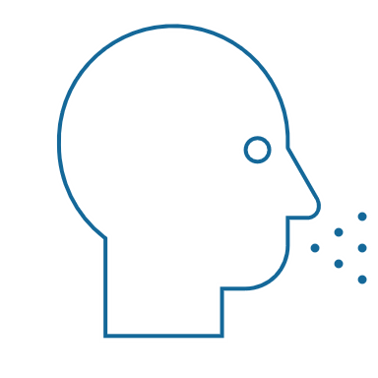
Comportamientos observables frente a personalidad
Comportamiento
Lo que se dice (verbal) y se hace (no verbal)
SOCIAL STYLE® Es un patrón de acciones que las otras personas observan y en el que coinciden para describir el comportamiento de uno mismo.
Comportamiento observable
Decir/Hacer
Personalidad
Comportamiento interpersonal
Lo que se dice y hace durante la interacción con otras personas
Personalidad
Todo lo que es una persona: sus ideas, valores, esperanzas y sueños
Notes:
4 MINUTES (Participant Workbook page 3)
ASK participants to turn to page 3 of the workbook to follow along.
SAY Behavior and personality are not the same things. Observable behavior is like the crust of a pie. Personality is like the inside and outside of the pie.
ASK What makes up personality?
CONDUCT a quick facilitated discussion to solicit participants’ responses. They should say things such as:
Values, hopes, attitudes, beliefs.
Things that are not necessarily observable.
These internal qualities are more subjective in nature.
SAY Style is like the crust, because it’s on the outside and observable. By observing behavior, we can find ways to define and discuss what we see. Then, we can begin to understand how this behavior affects ourselves and others.

Slide 5
Comportamientos “Decir y hacer”
Rasgos
Honesto
Inteligente
Arrogante
Motivado
Centrado
Sincero
Crítico
Comportamiento observable
Tranquilo
Más lento
Facialmente controlado
Más control sobre la expresividad facial
Menor contacto visual
Postura corporal relajada
Inclinación hacia atrás
Alborotador
Más rapido
Facialmente animado
Más animación en las expresiones faciales
Más contacto visual
Postura corporal rígida
Inclinación hacia adelante
Juicios
Me gusta
Me disgusta
Me interesa
Me irrita
Desconfío de ella
Lo odio
Confío en él
DECIR
HACER
Notes:
4 MINUTES (Participant Workbook page 4)
ASK participants to turn to page 4 of the workbook to follow along.
SAY When we first meet people, we often form immediate impressions, even after just a few seconds. This is sub-conscious (below our awareness) and happens immediately.
DESCRIBE
Traits Column: What we think we know about a person, based on interactions; subjective opinions.
Judgments Column: Our reactions to others; conclusions or evaluations we make, based on our subjective opinions.
Observable Behavior Column: Things others “Say and Do”; more objective and observable behaviors.
SAY Traits and Judgments are most subjective in nature and contain positive or negative descriptions.
Observable Behavior is objective and contains no positive or negative value.
Observable Behavior is an important tool for assessing others’ Styles. By focusing on Observable Behavior, you gain objectivity, which is critical for understanding people’s Styles.

Slide 6
La Asertividad y La Receptividad.
Notes:
SAY We measure observable behavior on two dimensions: Assertiveness and Responsiveness

Slide 7
La Asertividad
El grado en que “preguntamos” o “decimos” cuando interactuamos con otras personas
Más Preguntar
Preguntar con algo de Decir
Decir con algo de Preguntar
Más Decir
Notes:
4 MINUTES (Participant workbook page 5)
ASK participants to turn to page 5 of the workbook.
SAY To become more effective with others, we follow a behavioral model. There are two dimensions of behavior that define SOCIAL STYLE: Assertiveness and Responsiveness.
Assertiveness is the degree to which we ask or tell when interacting with others. The two anchors for Assertiveness are Ask on the left side of the continuum and Tell on the right side of the continuum.
Assertiveness is a measurement of how we try to influence others to take action. If you are more “Tell” Assertive, you state your opinions directly. You tend to declare your viewpoints and try to direct the actions of others.
For example, if you want to have lunch with someone, you might say, “Let’s have lunch today!”
If you are more “Ask” Assertive, you tend to be more cautious and reserved about sharing your opinions. You attempt to influence others in a more quiet, low-key, questioning manner.
For example, if you want to have lunch with someone, you might say, “Would you like to have lunch with me today?”

Slide 8
Comportamientos de la asertividad
DECIR | Comportamientos verbales
Más lento
Ritmo del discurso
Más rápido
Menos
Cantidad de discurso
Más
Más bajo
Volumen de voz
Más alto
PREGUNTA
DICE
Relajado
Uso de las manos
Autoritario
Inclinarse hacia atrás
Postura corporal
Inclinarse hacia adelante
Menos directo
Contacto visual
Mas directo
HACER | Comportamientos no verbales
Notes:
3 MINUTES (Participant Workbook page 5)
SAY The Assertiveness scale helps predict a person’s behavior because it represents a “theme” or typical pattern. There are verbal and non-verbal clues to indicate a person’s Assertiveness.
ASK participants for examples of verbal and non-verbal clues for Ask-Assertive and Tell-Assertive individuals.
DESCRIBE the verbal and non-verbal indicators of Assertiveness:
Verbal: Ask-Assertive individuals use a slower pace, less quantity (fewer words), and quieter volume. Tell-Assertive individuals use a faster pace, talk more, and a louder volume.
Non-Verbal: Ask-Assertive individuals show relaxed hands and gestures, lean back, and use less direct eye contact. Tell-Assertive individuals have a directive use of hands, lean forward, and use more direct eye contact.
Optional Exercise: Do You Ask or Tell?
Virtual activity:
ASK participants to chat whether they see themselves as more asking or more telling, and to give examples of why they see themselves this way.
In-person activity:
1. ASK participants to go toward either the left side or right side of the room to indicate whether they see themselves as “more asking” (left) or “more telling” (right).
2. ASK participants to introduce themselves to people around them and to share examples of what they feel makes them more asking or more telling.
3. ASK participants to validate their self-assessment based on whether they asked questions or made statements during their discussions. (Ask Assertive individuals will tend to ask more questions; Tell Assertive individuals will tend to make more statements).
4. ASK if anyone feels as though they might have gone to the wrong place.

Slide 9
La Receptividad
Más Controlar
Controla con algo de Demostrar emociones
El grado en que controlamos o mostramos emociones cuando interactuamos con otras personas.
Demuestra emociones con algo de Controlar
Más Demostrar emociones
Notes:
4 MINUTES (Participant Workbook page 5)
Participants stay on page 5 of the workbook.
SAY Responsiveness is the degree to which people tend to control (don’t outwardly display emotions) or emote (outwardly display emotions).
The two anchors are Controls on the top of the continuum and Emotes on the bottom of the continuum.
Responsiveness is also the extent to which you react to emotional appeals or displays.
If you control your emotions, you usually don’t react to emotional appeals and are more likely to focus on ideas, data, and tasks. You are less likely to share your feelings publicly.
If you are more emoting, you share and display your emotions with others. You are more likely to respond to emotional appeals and displays from others.

Slide 10
Comportamientos de La Receptividad
DECIR | Comportamientos verbales
HACER | Comportamientos no verbales
Controla
Menos modulación
La tarea
Hechos/Datos
Menos
Rígida
Controlada
Emoción en la voz
Asuntos del discurso
Formación de descriptivos
Uso de las manos
Postura corporal
Expresión facial
Más modulación
Las personas
Opiniones/ Historias
Más
Informal
Animada
Demuestra emociones
Notes:
3 MINUTES (Participant Workbook page 5)
SAY The Responsiveness scale, like the Assertiveness scale, helps us to predict a person’s behavior because it is a “theme” or typical pattern.
ASK participants for their opinions on the verbal and non-verbal clues of Control- and Emote-oriented individuals.
DESCRIBE the verbal and non-verbal clues to responsive behavior as noted on the slide.
SAY Responsiveness is neither a positive nor a negative quality; it is neutral.
Assertiveness and Responsiveness do not affect each other — they are independent of each other.
Optional Exercise: Do You Control or Emote?
Virtual activity:
ASK participants to chat whether they see themselves as more controlling or more emoting, and to give examples of why they see themselves this way.
In-person activity:
1. ASK participants to go toward the front of the room if they feel they are “more controlling” of their emotions or to the rear of the room if they feel that they are “more emoting” (display their emotions).
2. ASK participants to validate their self-assessments. Typically, “more emoting” individuals will be talking with one another more than the “less emoting” ones.
3. ASK if anyone feels as though they went to the wrong place.

Slide 11
El modelo SOCIAL STYLE ModelTM
Controla
Asertivo con preguntar Más control
Estilo Analítico
Asertivo con decir Más control
Estilo Motivador
Pregunta
Dice
Asertivo con preguntar Más demostrar emociones
Estilo
Afable
Asertivo con decir Más demostrar emociones
Estilo Expresivo
Demuestra emociones
Notes:
5 MINUTES (Participant Workbook page 6)
ASK participants to turn to page 6 of the workbook.
CLICK TO REVEAL EACH QUADRANT
SAY By combining Assertiveness and Responsiveness, the four SOCIAL STYLEs are formed.
No individual will display one Style exclusively; but, over time, you can determine a person’s Style. Once you know a person’s Style, you can adjust your behavior to develop a more effective relationship.
Leader Tip: Note that there is no good or bad Style; each can be equally effective.

Slide 12
Necesidad, orientación y acción de crecimiento
Necesidad
El objetivo de cada estilo
Orientación El comportamiento común que se utiliza para satisfacer la necesidad
Acción de crecimiento
Comportamiento que rara vez se utiliza en cada estilo. Usar este comportamiento con más frecuencia aumentaría la eficacia de este estilo
Notes:
2 MINUTES
SAY Remember that the Style descriptions are generalizations about each Style. While people with the same Style generally exhibit similar characteristics, each person is still unique.
SAY We’ve used some adjectives to describe the Styles. In addition, each Style has a Need, an Orientation, and a Growth Action.
DEFINE:
Need – The goal of each Style.
Orientation – The common behavior used to achieve the need.
Growth Action – Behavior that is rarely used by each Style. Using this behavior more often would increase this Style’s effectiveness.
SAY Understanding the Need, Orientation, and Growth Action of each Style will help you better relate to others’ Styles and enhance your effectiveness with them.

Slide 13
SOCIAL STYLE Características clave
Controla
Analítico
Necesidad: Estar en lo cierto
Orientación: Pensar
Acción de crecimiento: Expresar
Motivador
Necesidad: Resultados
Orientación: Acción
Acción de crecimiento: Escuchar
Pregunta
Dice
Afable
Necesidad: Seguridad personal
Orientación: Relaciones
Acción de crecimiento: Iniciar
Expresivo
Necesidad: Aprobación personal
Orientación: Espontaneidad
Acción de crecimiento: Comprobar
Demuestra emociones
Notes:
6 MINUTES
CLICK TO REVEAL THE TEXT IN EACH QUADRANT.
REVIEW each Style.

Slide 14
Perfil en línea sobre la percepción propia de SOCIAL STYLE
Notes:
If using the online profile, use the following slides.
Note that if delivering virtually, participants will need to have received their profiles prior to the program.
Check the Status Report and Composite Report to understand which participants have completed their profiles, and the breakdown of Style within your program.
FACILITATOR NOTE: By completing an online profile, Learners will immediately have free, unlimited access to SOCIAL STYLE Navigator through tracomlearning.com to help extend their learning beyond the classroom. See Slide #41 for details.

Slide 15
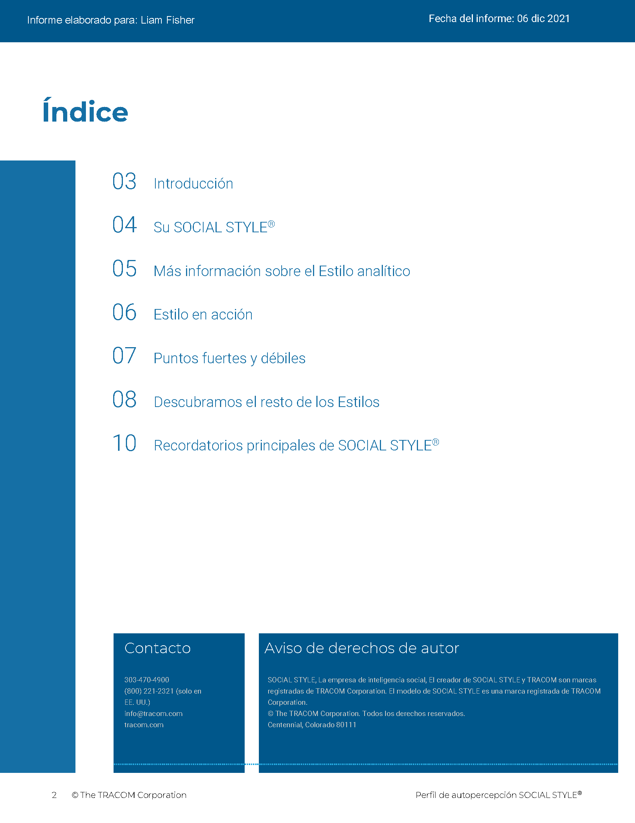
© The TRACOM Corporation. Todos los derechos reservados.
15
Notes:
15 MINUTES (5 MINUTES if Virtual Program)
Purpose
The purpose of this exercise is to help participants learn more about their SOCIAL STYLE and to encourage them to think about how they can adjust their behavior to be more effective.
Materials Needed
SOCIAL STYLE profile
Virtual Directions:
ASK participants to chat their Style along with one adjustment to their behavior they can make to enhance their effectiveness with others.
In-Person Directions:
ASK participants to read their Style profile and begin to determine ways they can adjust their behavior to meet others’ Style needs. (They will continue this exercise when they read their Versatility profiles).
ASK participants to share what they learned about their Style and how they can adjust their behavior.

Slide 16
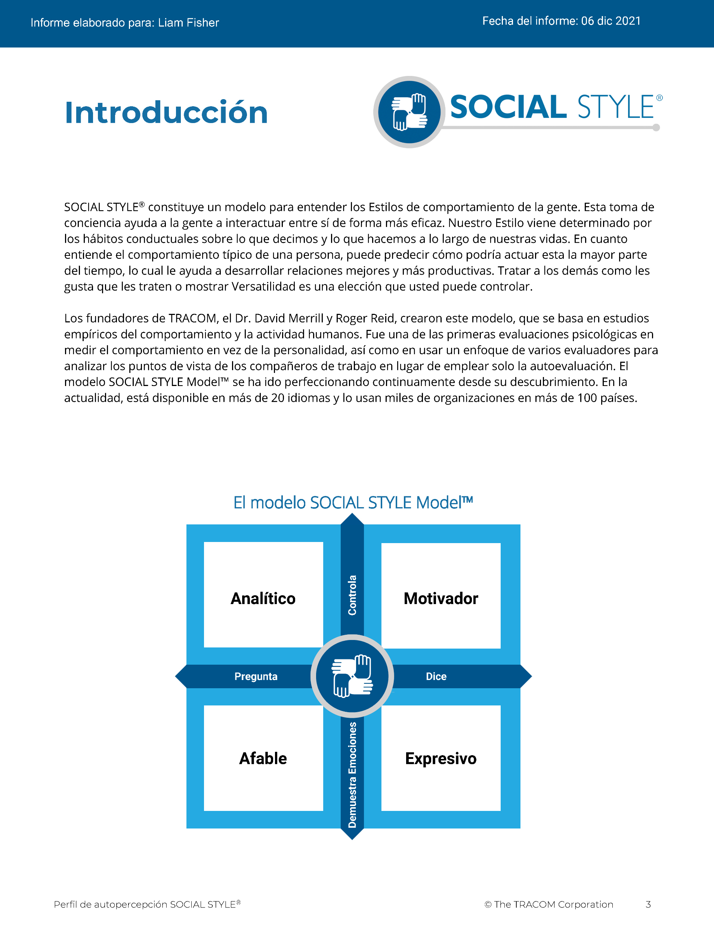
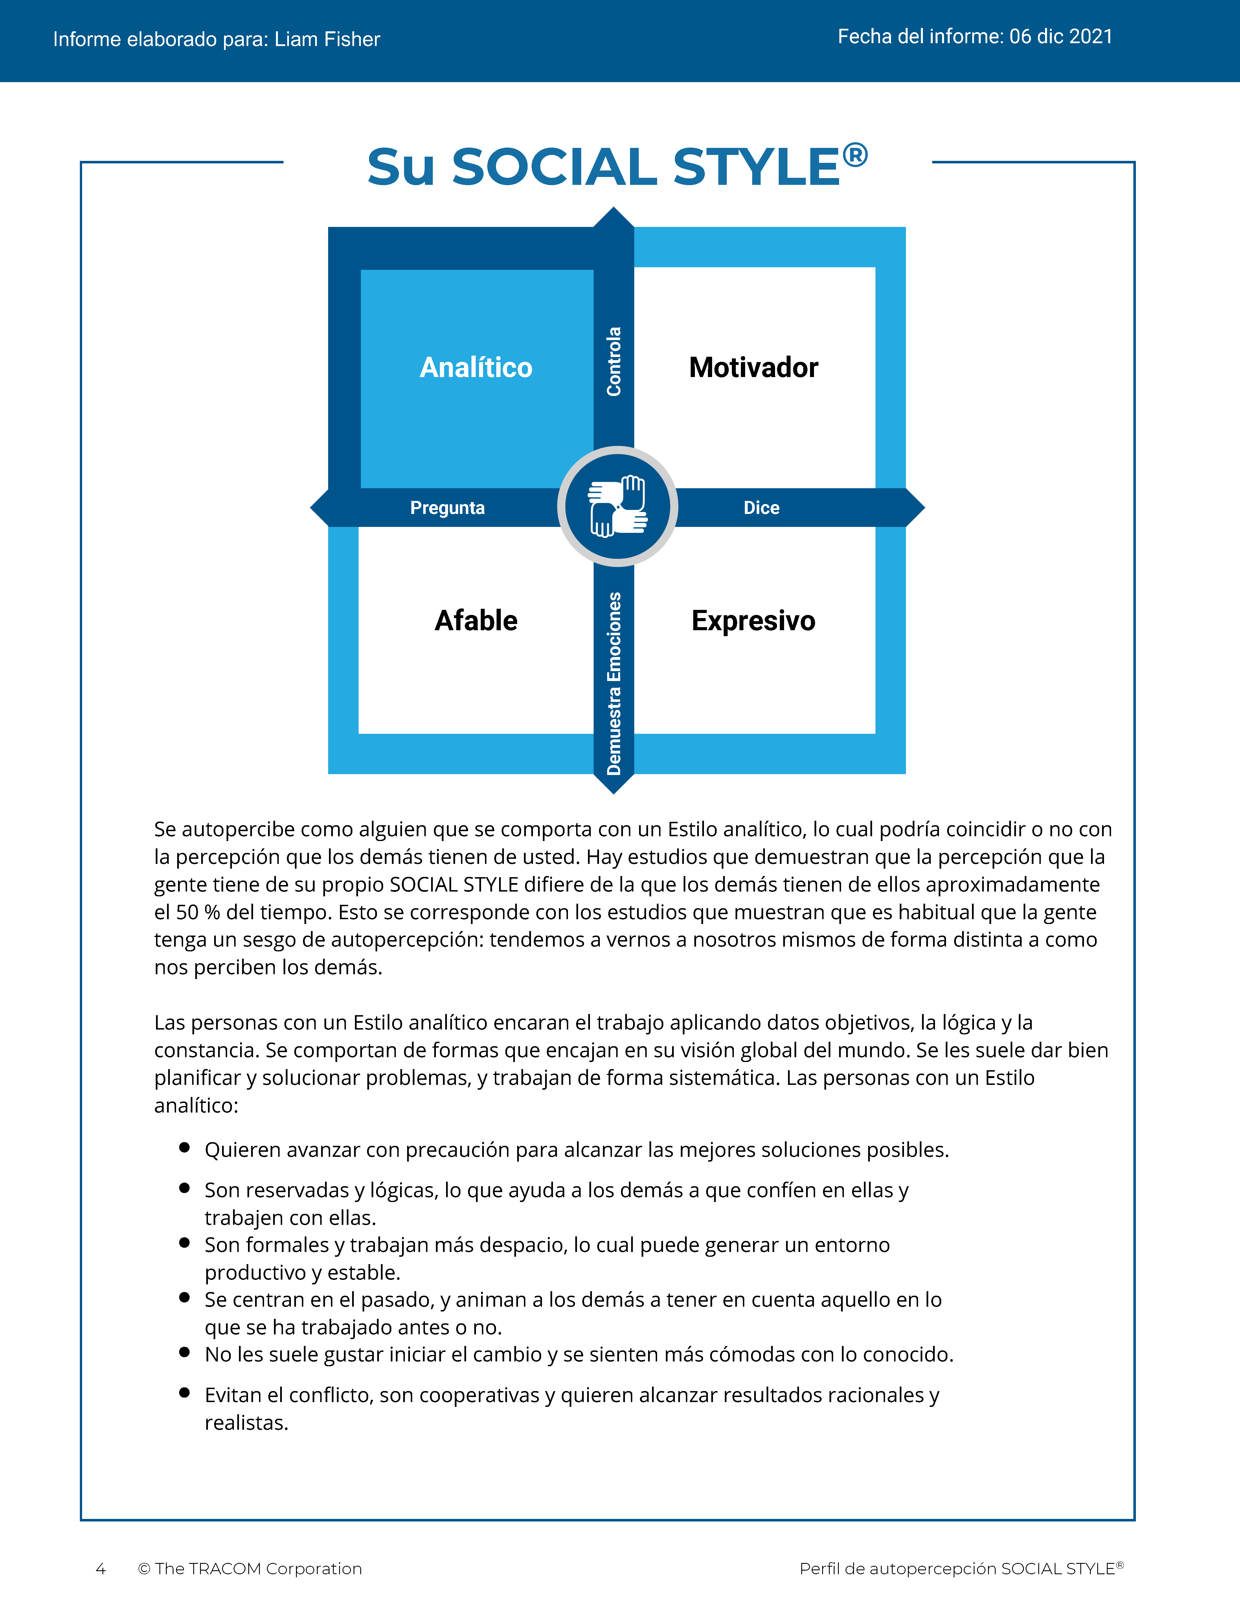
© The TRACOM Corporation. Todos los derechos reservados.
16
Notes:
These slides show pages of the SOCIAL STYLE profile and can be displayed to assist with conversation during the exercise debrief.

Slide 17
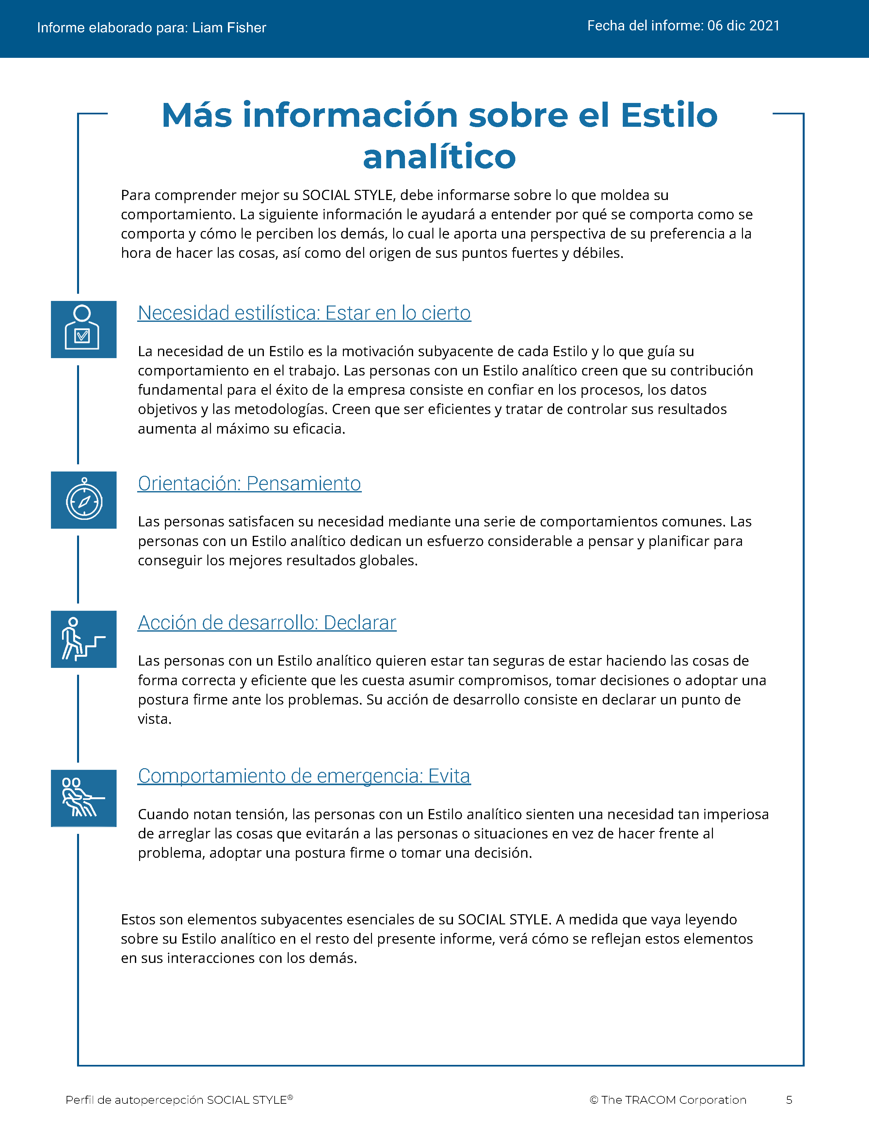
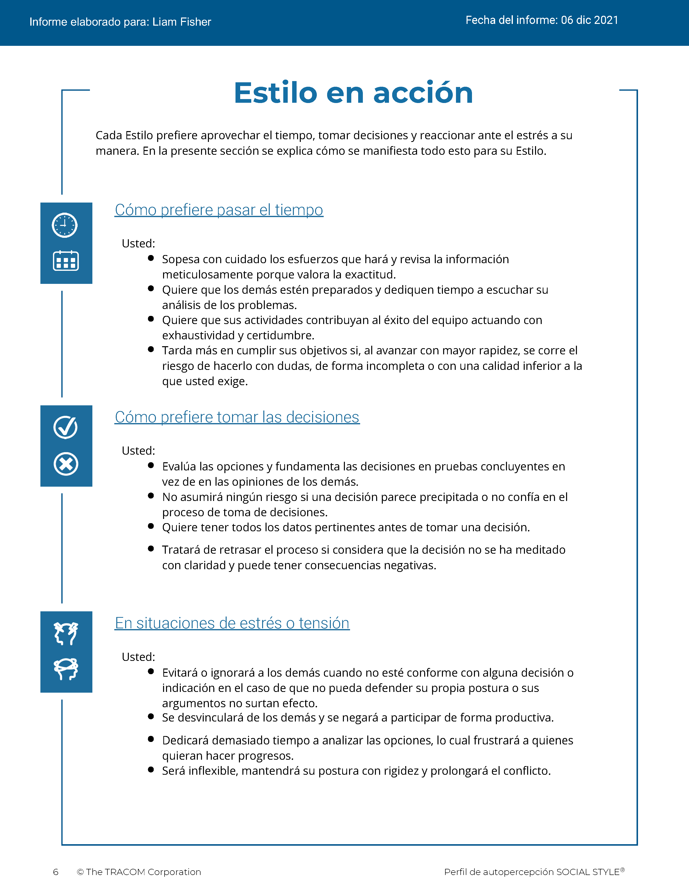
© The TRACOM Corporation. Todos los derechos reservados.
17
Notes:
These slides show pages of the SOCIAL STYLE profile and can be displayed to assist with conversation during the exercise debrief.

Slide 18
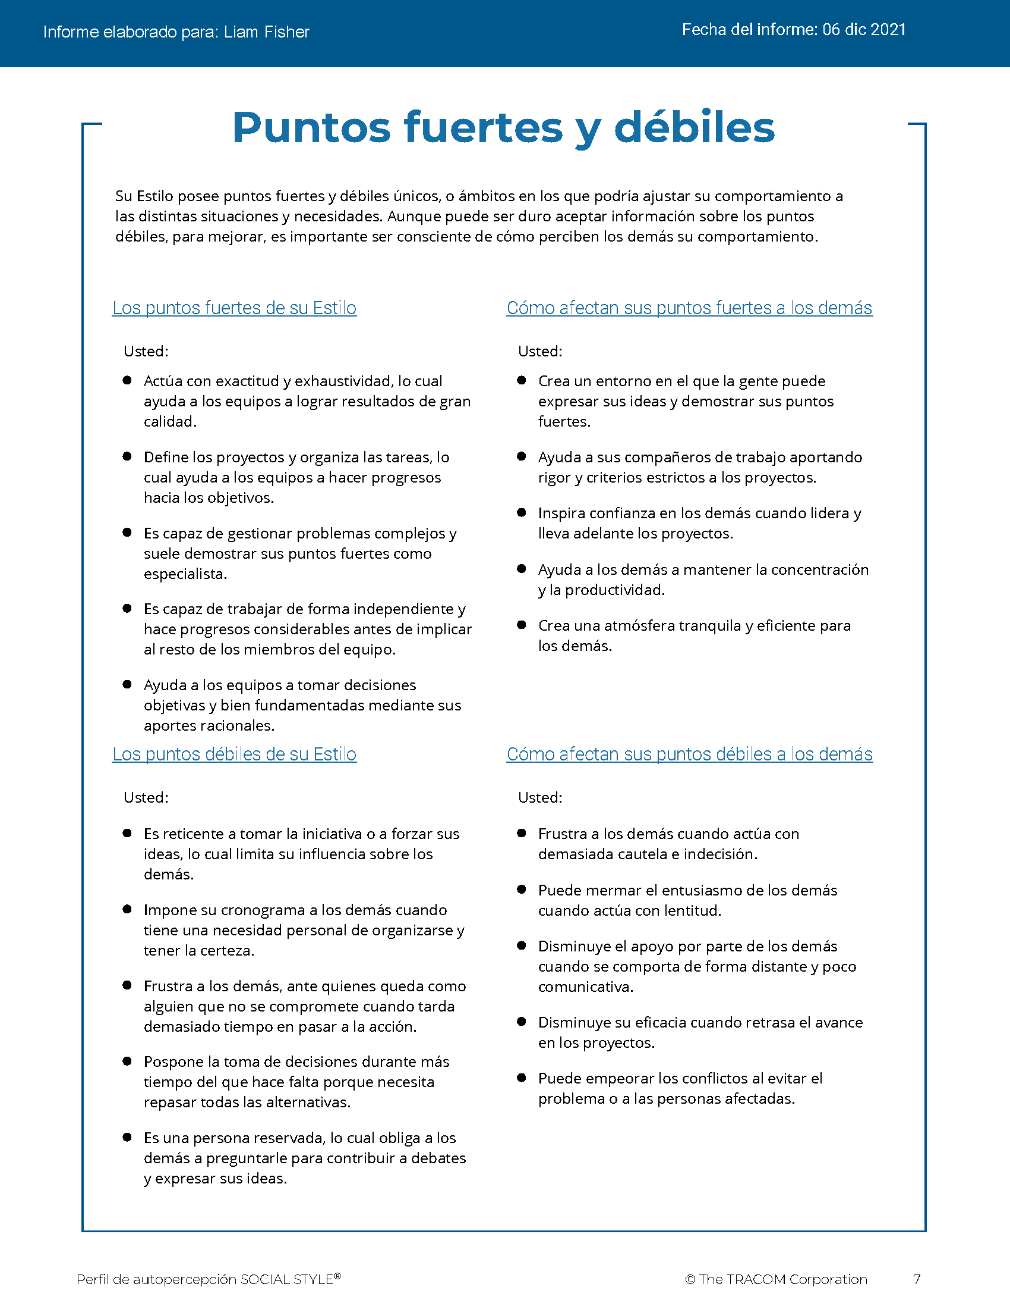
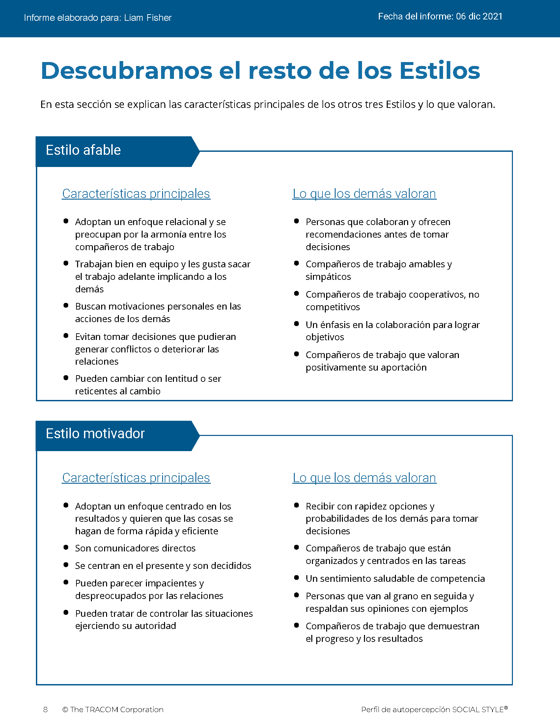
© The TRACOM Corporation. Todos los derechos reservados.
18
Notes:
These slides show pages of the SOCIAL STYLE profile and can be displayed to assist with conversation during the exercise debrief.

Slide 19
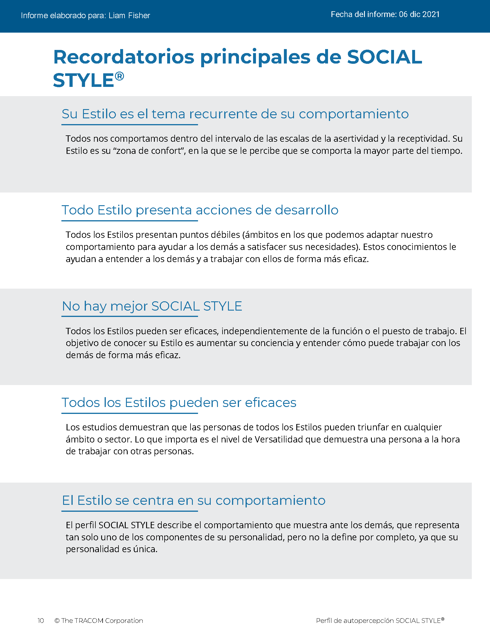
© The TRACOM Corporation. Todos los derechos reservados.
19
Notes:
These slides show pages of the SOCIAL STYLE profile and can be displayed to assist with conversation during the exercise debrief.

Slide 20
Perfil sobre la percepción propia de SOCIAL STYLE en formato físico
Notes:
If using the paper assessment, use the following slides.
FACILITATOR NOTE: To extend their learning beyond the classroom, participants who complete the Paper Survey can register for free, unlimited access to SOCIAL STYLE Navigator. See Slide #42 for details.

Slide 21
Su percepción propia de SOCIAL STYLE
EJEMPLO:
C
Abra las partes perforadas
Transfiera la respuesta para cada pregunta
Sume los totales de las columnas
Dibuje su SOCIAL STYLE
Analítico
Motivador
P
D
Afable
Expresivo
D
Es posible que su percepción propia sea diferente a lo que opinan los demás.
Notes:
10 MINUTES – PAPER PROFILE ONLY
If your participants completed the Online Profile:
DO NOT DISPLAY this slide.
FOLLOW INSTRUCTIONS in “Online Profile” section.
If your participants are using the Paper Assessment:
SAY Now, it’s time to score the SOCIAL STYLE questionnaire that you completed earlier. Score your questionnaire following the instructions on the slide.
ASK participants to plot their Assertiveness (A, T) score and Responsiveness (C, E) score as shown on the slide.
SAY The SOCIAL STYLE Self-Perception Profile reflects how you see yourself. Keep in mind that others may see you differently. TRACOM’s research indicates that about 50% of those who complete the Self-Perception Questionnaire differ in their perceptions from their reference group who complete a Multi-Rater Profile about them.
Leader Tip: You may get asked the question, “If the research indicates 50% of people see themselves differently, then what value does it have?”
Answer: The format of this course did not allow us to use the multi-rater profile. The reason we gave you a profile is that you can start to realize that others might see you differently than you see yourself. Even though receiving a multi-rater profile would give you more insight into how others perceive your behavior, this session is still useful and practical. By following the suggestions in this session you will be able to observe other people’s behavior to determine their SOCIAL STYLE. Then you can adjust your behavior to work more effectively with them.

Slide 22
Lea sobre su Estilo
Controla
Estilo Analítico
Páginas 14-15
Estilo Motivador
Páginas 8-9
Pregunta
Dice
Estilo Afable
Páginas 12-13
Estilo Expresivo
Páginas 10-11
Demuestra emociones
Notes:
15 MINUTES (Participant Workbook pages 8 to 15) – PAPER PROFILE ONLY
Purpose
The purpose of this exercise is to help participants learn more about their SOCIAL STYLE and to encourage them to think about how they can adjust their behavior to be more effective.
Materials Needed
Flip chart
Directions
ASK participants to read more about their Style in the workbook and to complete the two questions contained in each section. (10 minutes)
a. Driving Style, pages 8-9
b. Expressive Style, pages 10-11
c. Amiable Style, pages 12-13
d. Analytical Style, pages 14-15
ASK if anyone has any questions about their Style regarding (a) strengths of their Style and (b) things they need to work on.
ASK participants to share what they learned about their Style. Draw Style quadrants on the flip chart and record their answers for all to see and consider.

Slide 23
Recordatorios clave
No hay un Estilo “mejor”.
El Estilo no es la personalidad.
El Estilo es una característica del comportamiento.
El Estilo tiene acciones de crecimiento.
Su reto es: tomar la iniciativa para establecer y crear relaciones eficaces con los demás.
Notes:
5 MINUTES ( Participant Workbook page 16)
ASK participants to turn to page 16 in the workbook.
REVIEW what has been covered so far, discussing Key Reminders.

Slide 24
Versatilidad

Slide 25
Versatilidad es lo bien que uno se adapta a las necesidades del Estilo de los demás
Notes:
3 MINUTES
SAY Versatility is a measure of your consistency in adjusting to the Style needs of others.
At the beginning of the program, we reviewed some statistics on Versatility. Research has found that Versatility is a strong predictor of successful job performance. Individuals who consistently show Versatility are rated more effective in their job performance than those who are inconsistent in their Versatility.
Versatility is completely within your control, so it is your choice to be versatile with others. You can be highly versatile with one group and show low Versatility with another group. It depends on the circumstances and how much you value your interpersonal effectiveness with each group.
It is completely independent of SOCIAL STYLE: Any Style can show Versatility and be successful.
Versatility is NOT the same as likeability. A person can be well liked but not have high Versatility. The opposite can also be true. Versatility helps you develop better working relationships, but it is separate from your personal likeability.

Slide 26
Las cuatro fuentes de la versatilidad
El uso apropiado de
Imagen
Presentación
Competencia
Feedback
Genera una
mayor versatilidad
Notes:
5 MINUTES (Participant Workbook page 19)
ASK participants to turn to page 19 in the workbook.
Image remains a part of the Versatility model because it’s important for building relationships. Describe Versatility in a timeline:
SAY You show Versatility in four areas.
Image – When you first meet a new person at work, you form an impression about this person based on what you see, consciously or not. Essentially Image is a first impression: Are you dressed appropriately for the situation, for the work culture, for the client, and so on?
ONLINE PROFILE: Note that Image is not measured as part of your Profile. This is because:
Image is difficult to observe in virtual environments. We can’t observe very well how people are dressed, and because there are a wide variety of dress codes, even within companies and teams, it is less relevant to measure Image in this way.
People don’t always like answering questions about Image without understanding the context of how Image is explained in training.
Image is still important for many people and companies, which is why it’s part of the model. However, you won’t receive a measure of your Image.
Presentation – When a person communicates in meetings or other public venues, you’ll notice how clear they are at helping people understand their points. Do they use clear language? Are their examples effective? Do they take others’ Styles into account?
Competence – Over time, you’ll observe this person in a variety of situations. Are they reliable and do they persevere during difficult times? Are they flexible when change happens? Are they optimistic most of the time? Do they show creativity?
Feedback – Finally, this is the most interpersonal part of Versatility. Are they a good listener? Do they show empathy for others’ situations? Do they meet the needs of other people’s Styles? Do they develop good relationships with others?

Slide 27
Perfil en línea sobre la percepción propia en versatilidad
Notes:
If using the online profile, use the following slides.
Note that if delivering virtually, participants will need to have received their profiles prior to the program.
Check the Status Report and Composite Report to understand which participants have completed their profiles, and the breakdown of Versatility within your program.

Slide 28
Versatilidad general
La constancia con que muestra versatilidad
W | Nada constante | X | Algo constante | Y | Normalmente constante | Z | Muy constante
 |  | LOS DEMÁS |  | UNO MISMO
Notes:
5 MINUTES
THIS SLIDE IS USED ONLY WITH THE ONLINE PROFILE.
SAY We measure Versatility on a scale ranging from W to Z. These are normed quartiles, just like Assertiveness and Responsiveness.
When you are not consistent in your behavior, you’re usually focusing on your own Style needs. When you consistently show Versatility, you’re focusing on meeting others’ Style needs, which reduces their tension. When you are consistent, the more effective you will be.
Your profile will show your results on this scale, ranging from W (not consistent) to Z (very consistent).
Versatility is all about consistency of behavior. A lower Versatility score does NOT mean you lack ability or that you never demonstrate these abilities. What it DOES mean is that you aren’t showing consistency in your behavior.
By making small changes to your behavior and acting with more consistency, you can increase your Versatility. (The difference in values between W and Z are small but meaningful.)

Slide 29
El significado de cada posición en la versatilidad
 | 1 | 2 | 3 | 4 | 5
 | Totalmente en desacuerdo | En desacuerdo | Ni de acuerdo Ni en desacuerdo | De acuerdo | Totalmente de acuerdo
1. Afronta las situaciones nuevas con una perspectiva positiva. | ◯ | ◯ | ◯ | ◯ | ◯
2. Crea buenas relaciones con los compañeros de trabajo. | ◯ | ◯ | ◯ | ◯ | ◯
3. Presenta ideas de manera eficaz a los grupos. | ◯ | ◯ | ◯ | ◯ | ◯
W | X Y | Z
Constancia
Notes:
3 MINUTES
THIS SLIDE IS USED ONLY WITH THE ONLINE PROFILE.
Before delivering Versatility profiles, explain the meaning of the positions.
SAY Before reviewing your results in more detail, let’s put your results into context. This graph shows several sample items that measure Versatility.
You responded to these items using the scale ranging from ‘strongly disagree’ to ‘strongly agree’. TRACOM assigns values to each of these scale points: 1 to 5.
When rating Versatility, most people respond at the higher end of the rating scale. This makes sense since most people have at least some abilities in these areas. This means that the cutoff for achieving Z Versatility is very high, approximately 4.5 or higher.
Similarly, to score either an X or Y requires scores between 3.5 and 4.5. These are approximate values used for purposes of explanation.
Importantly, if you receive a W in Versatility, this DOES NOT mean that you evaluated yourself at the low end of the rating scale. On the contrary, almost nobody scores at the lowest end – 1 or 2. For people with a W result, most of their ratings fluctuate between 2 and 4, resulting in an average score of slightly less than 3.5.
So, putting this into context, a W rating means that you are not showing as much consistency in these behaviors as you could. With effort and more consistency, your evaluation would improve.
Set the context:
W does not mean that you lack ability.
It doesn’t mean that you evaluated yourself at the lowest end of the rating scale.
It does mean that you’re not highly consistent in your behavior; you do these things some of the time but could do them more often.
It does mean that you evaluated yourself between ‘disagree’ and ‘agree’, on average.
Note that these cutoff values (3.5 and 4.5) are only for demonstration – they aren’t the exact values in TRACOM’s norms, but they are close.
Giving the context is critical because it helps to ease people’s automatic reactions to the profile.
Help people focus on just one area to improve. This increases chances of success.
What is ‘low hanging fruit?’ Something they can improve quickly.

Slide 30
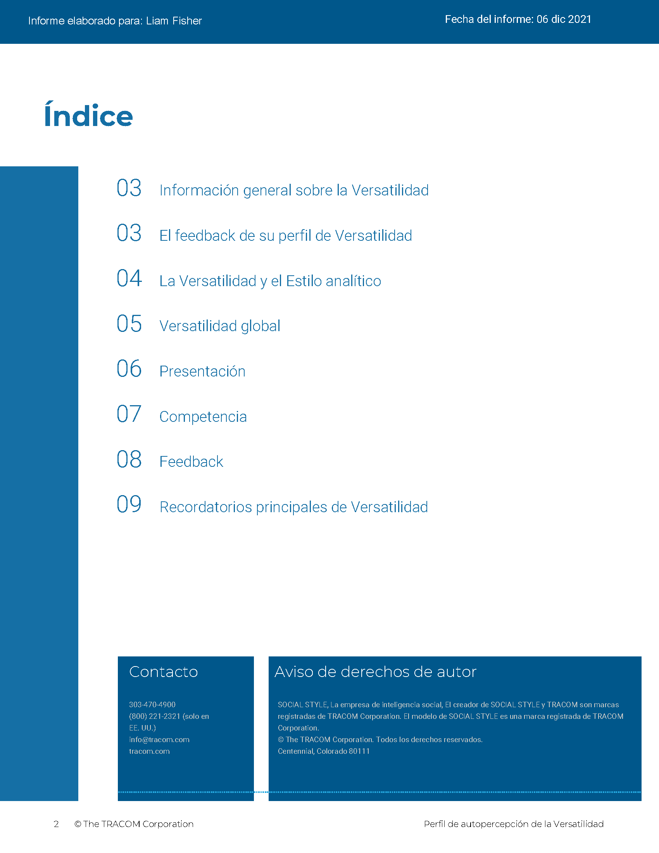
© The TRACOM Corporation. Todos los derechos reservados.
30
Notes:
15 MINUTES (5 MINUTES if Virtual Program)
Purpose
The purpose of this exercise is to help participants develop an action plan for showing Versatility more consistently.
Materials Needed
Versatility profile
Virtual Directions:
ASK participants to chat one way they can adjust their behavior to be more consistent in their Versatility. Encourage them to choose just one or two concrete steps they can take, based on the strategies they read about in their profiles.
In-Person Directions:
DISTRIBUTE the Versatility profiles.
ASK participants to read their profiles and consider ways they can adjust their behavior to be more consistent in their Versatility. Encourage them to choose just one or two concrete steps they can take, based on the strategies they read about in their profiles.
VIRTUAL DELIVERY: If delivering virtually, learners will have downloaded their profiles earlier.

Slide 31
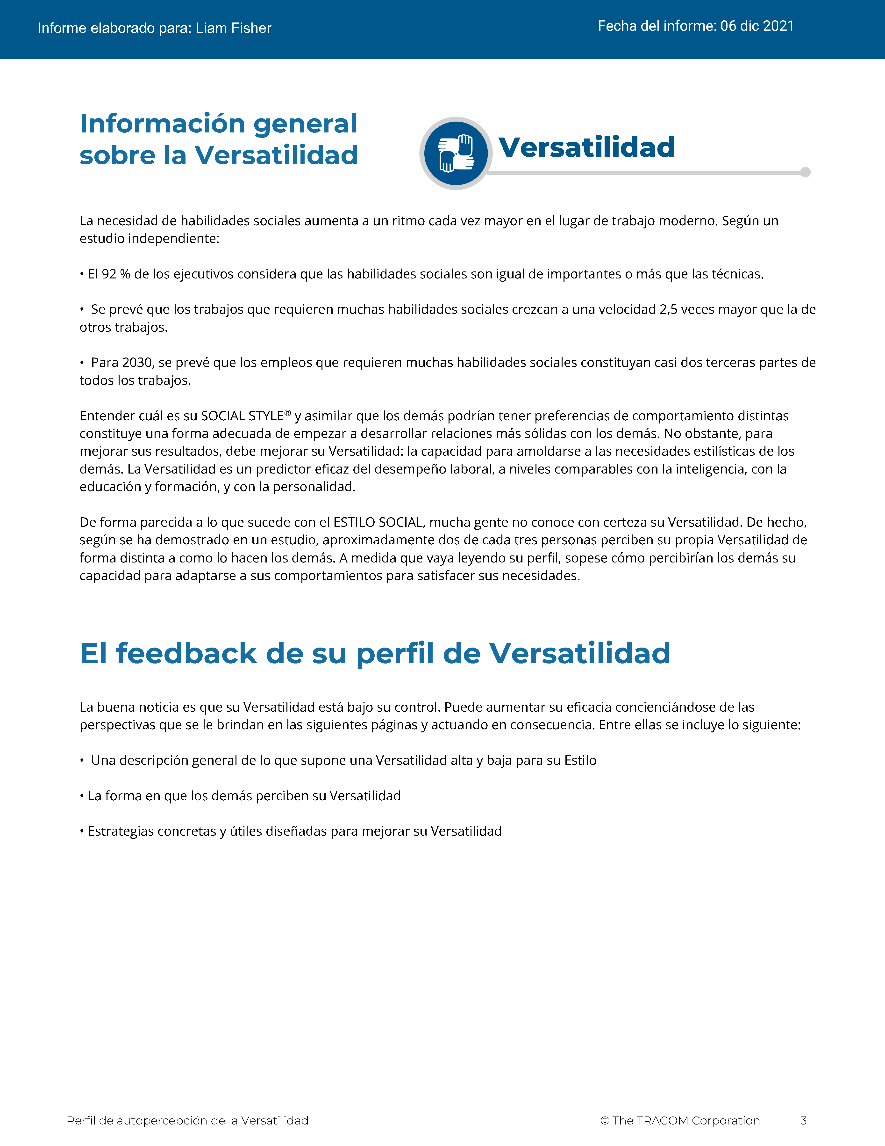
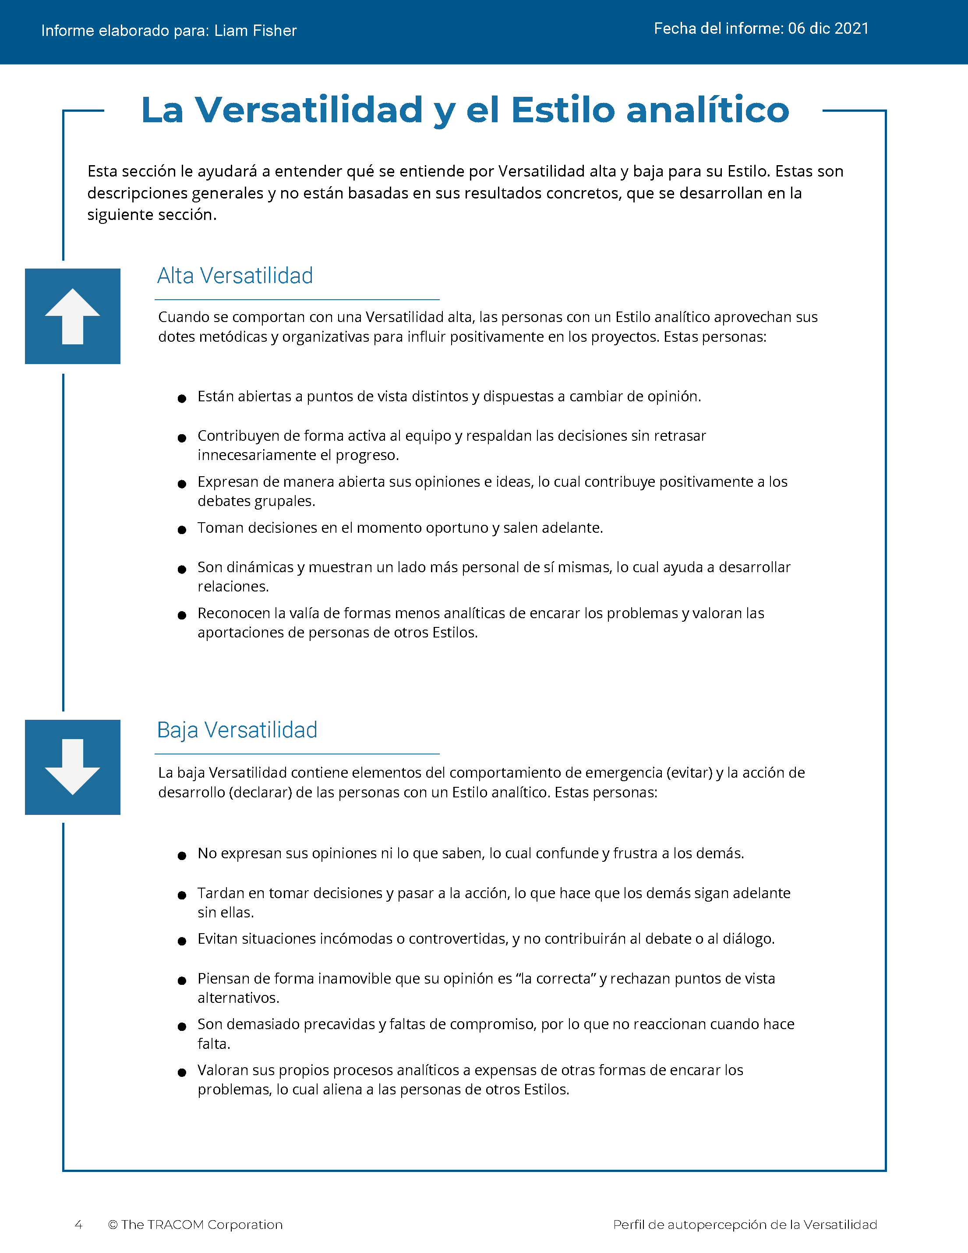
© The TRACOM Corporation. Todos los derechos reservados.
31
Notes:
These slides show pages of the Versatility profile and can be displayed to assist with conversation during the exercise debrief.

Slide 32
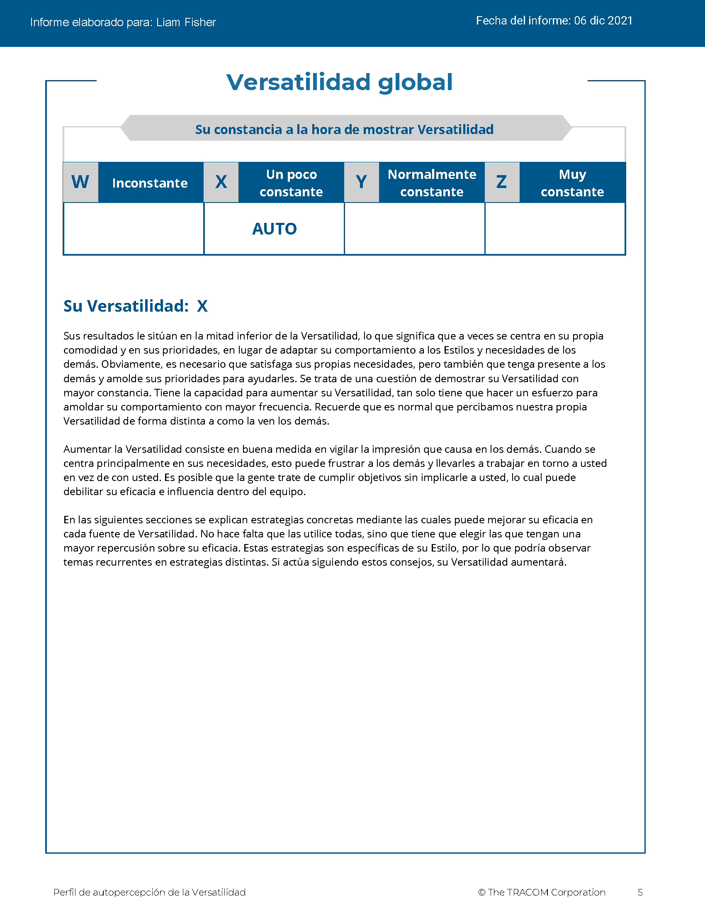
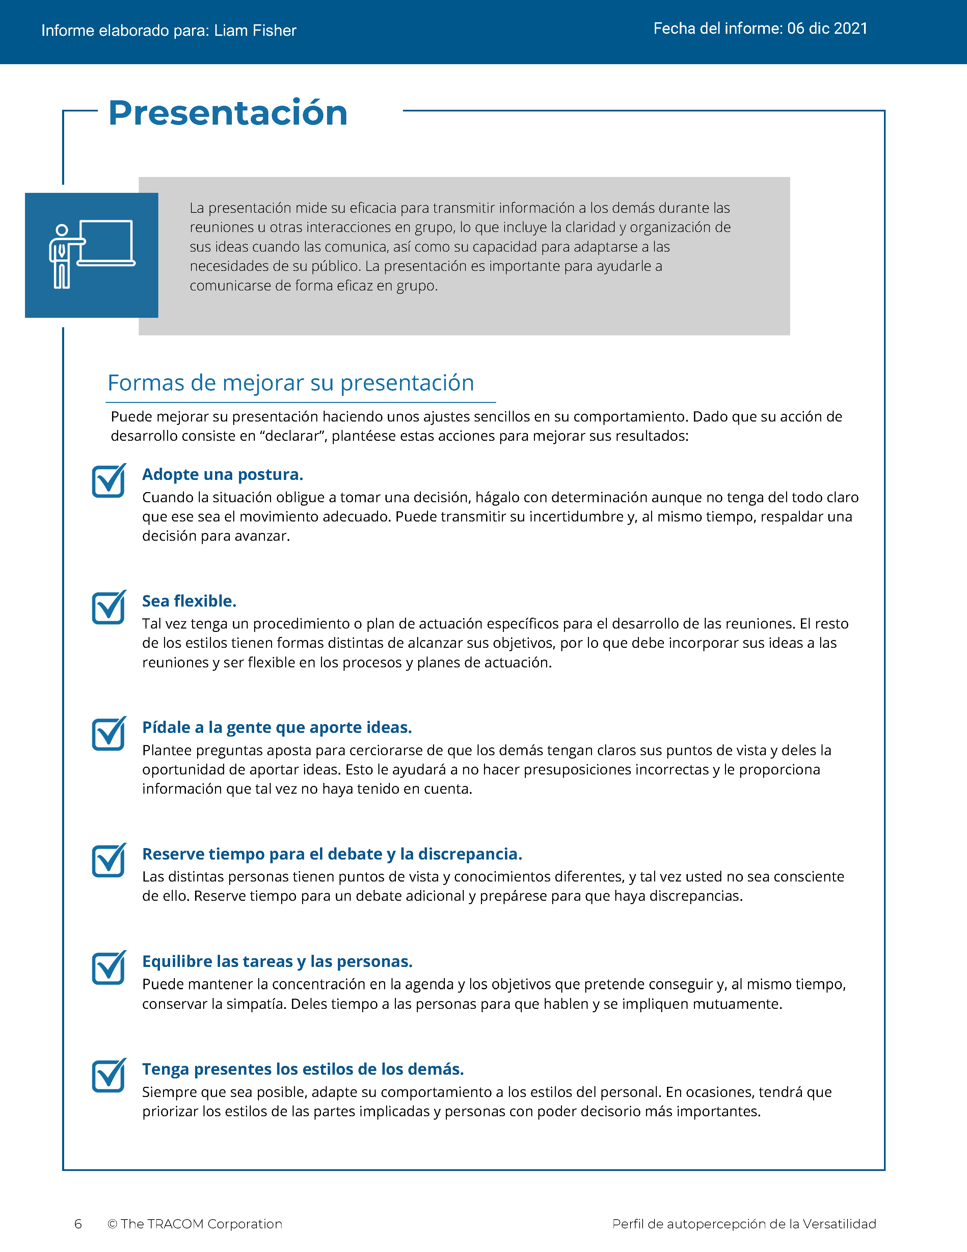
© The TRACOM Corporation. Todos los derechos reservados.
32
Notes:
These slides show pages of the Versatility profile and can be displayed to assist with conversation during the exercise debrief.

Slide 33
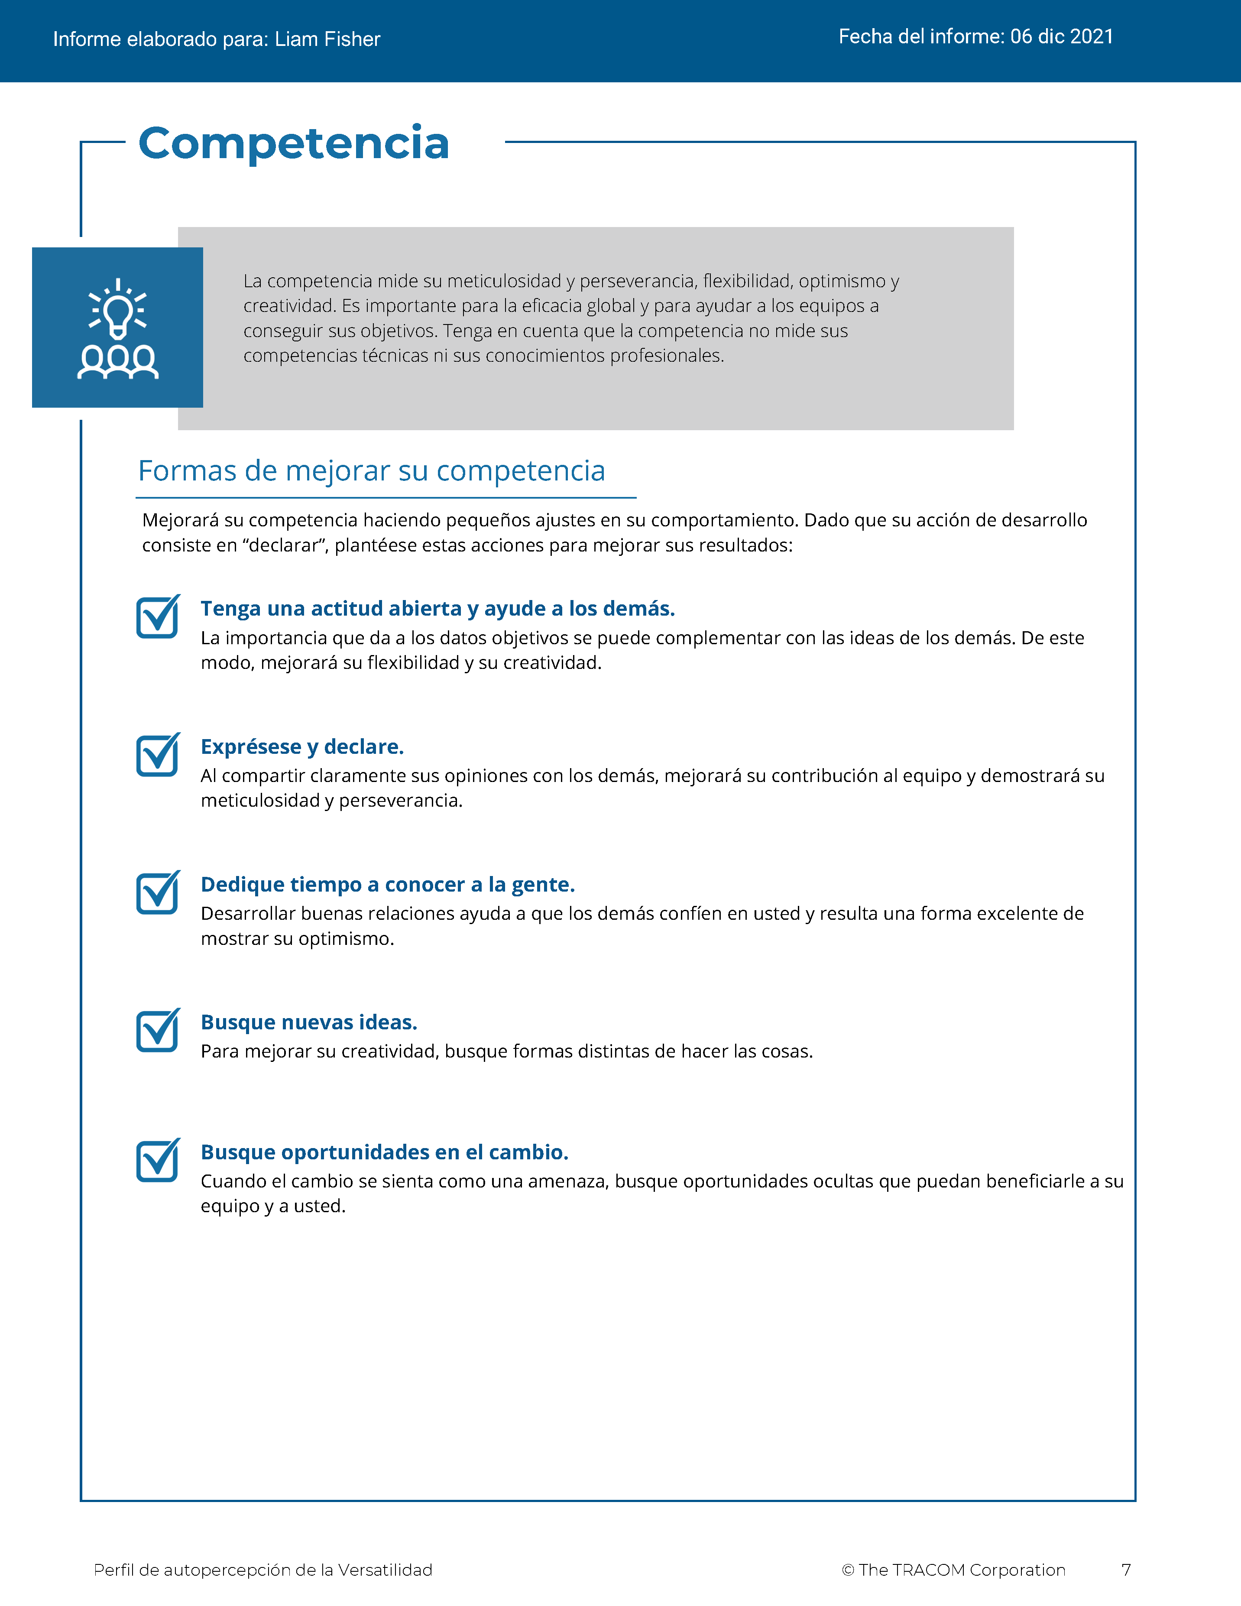
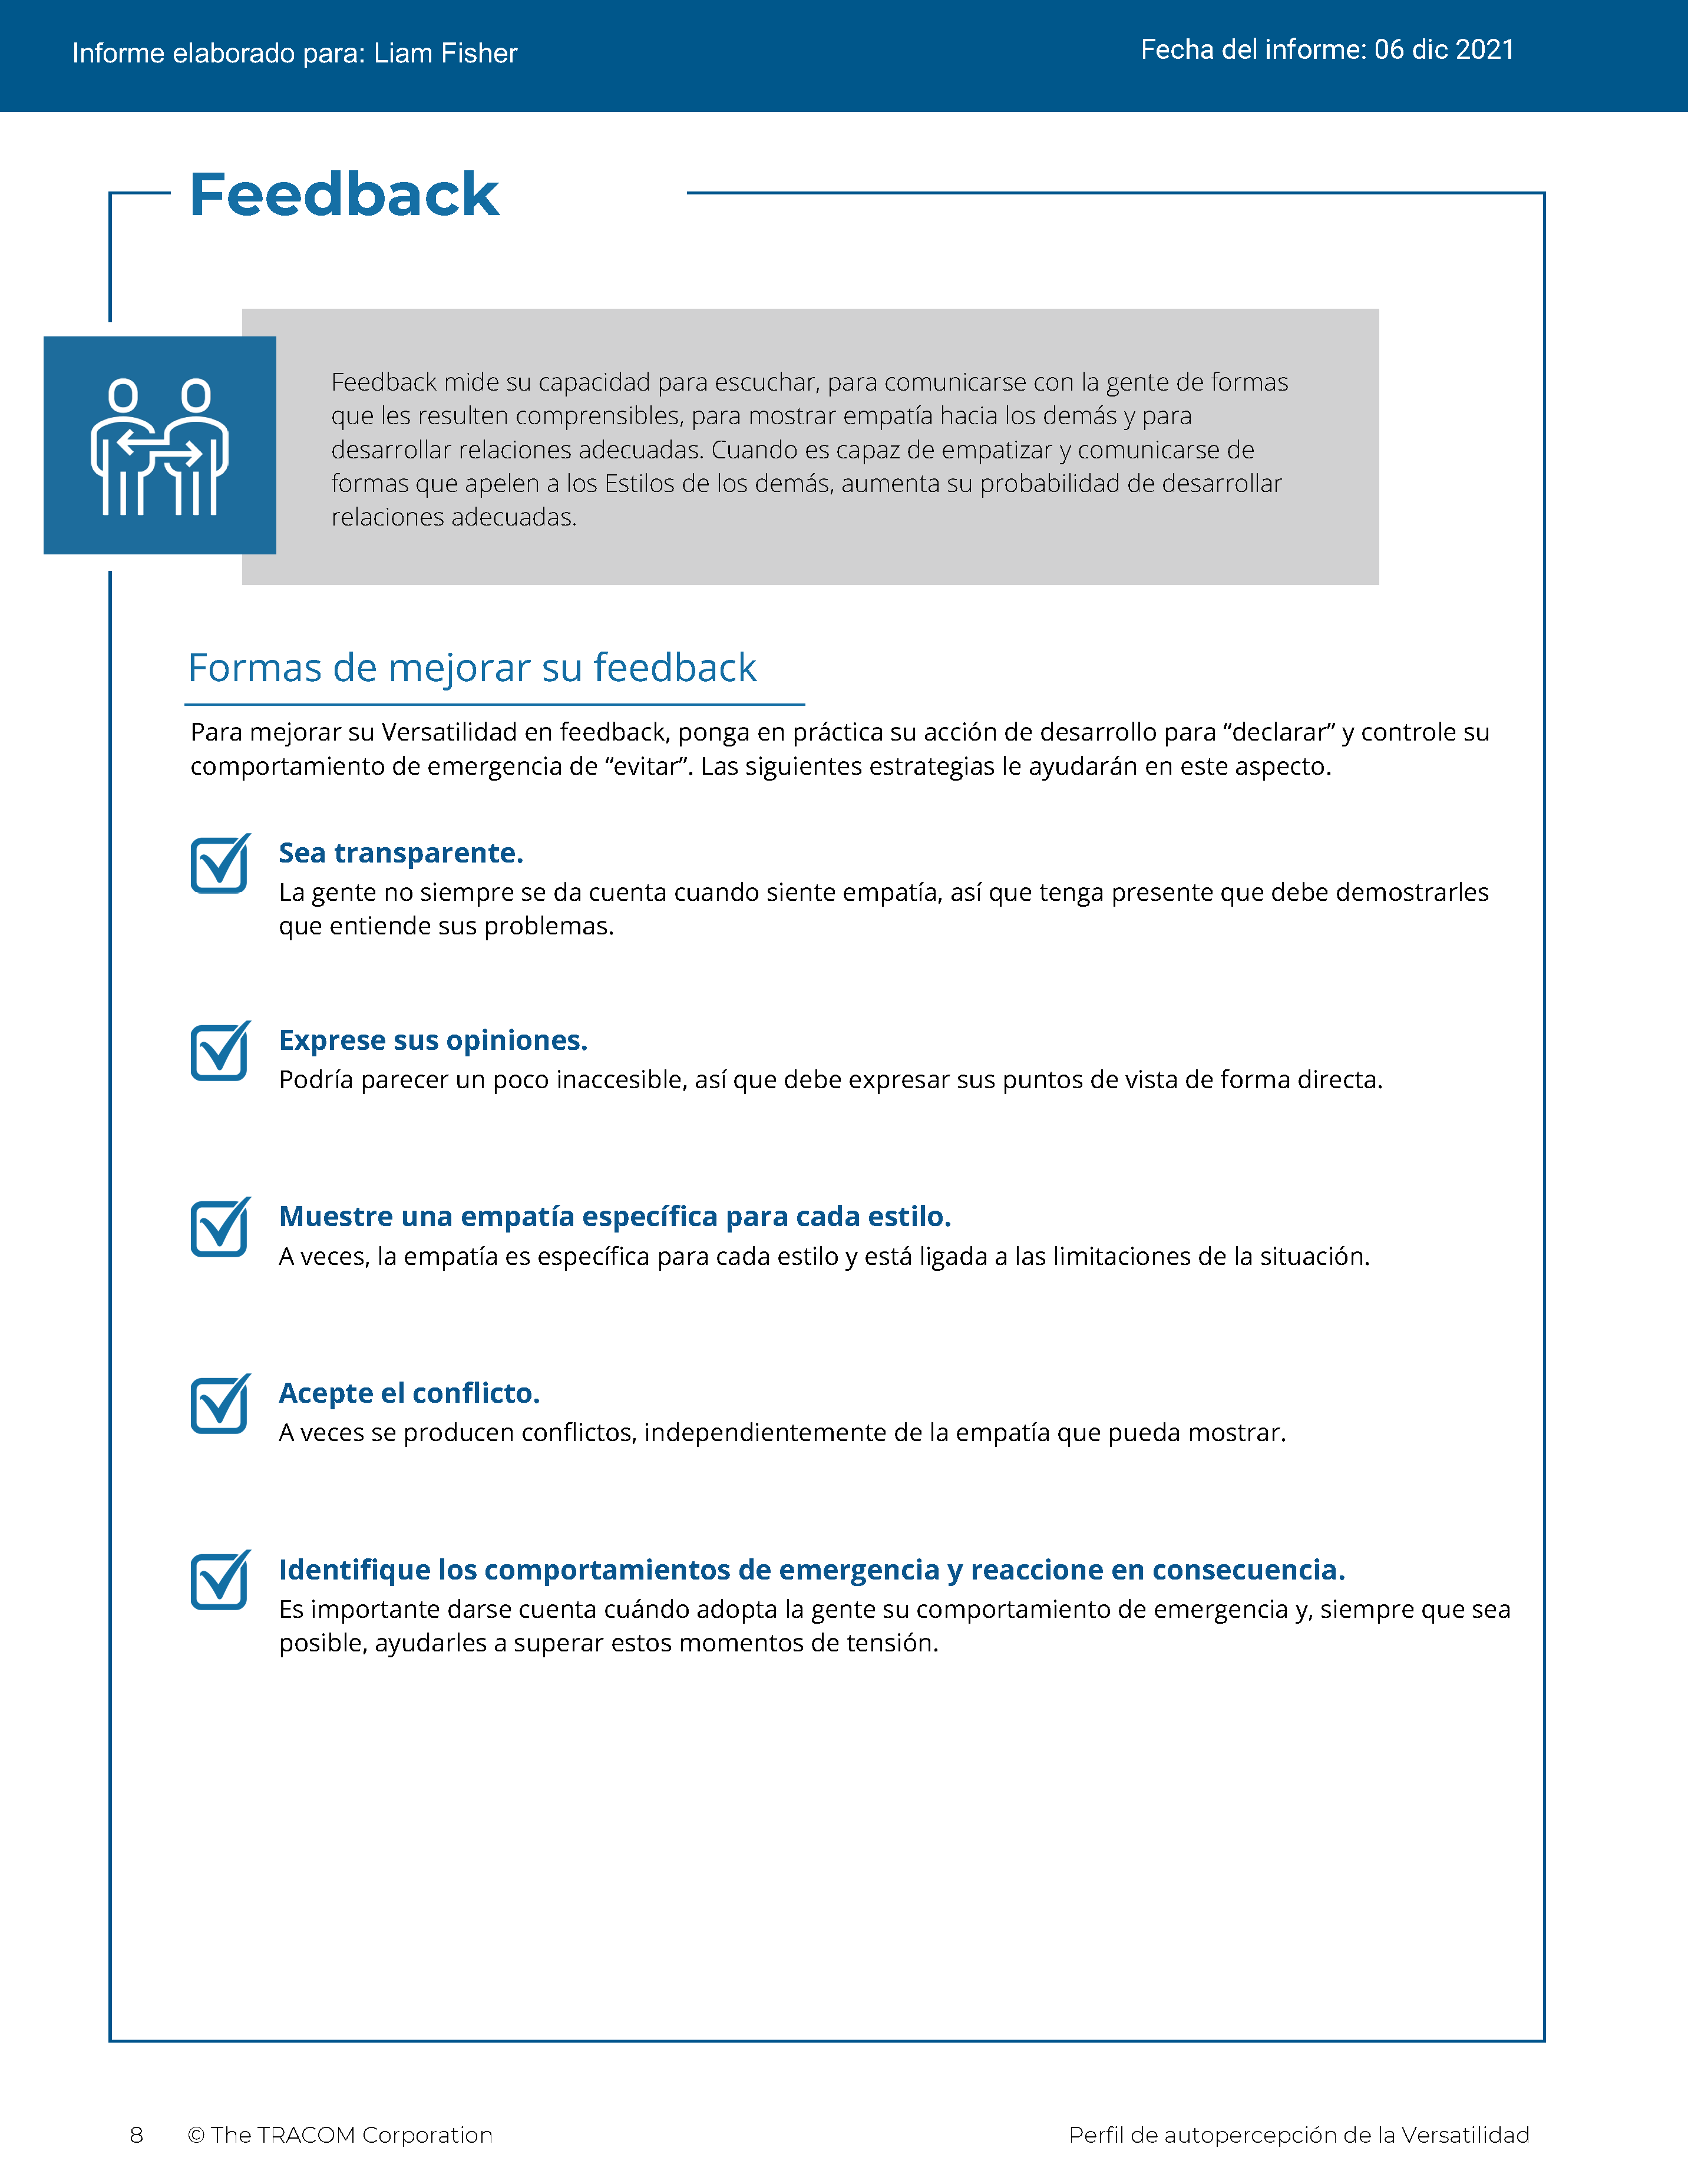
© The TRACOM Corporation. Todos los derechos reservados.
33
Notes:
These slides show pages of the Versatility profile and can be displayed to assist with conversation during the exercise debrief.

Slide 34
© The TRACOM Corporation. Todos los derechos reservados.
34
Notes:
These slides show pages of the Versatility profile and can be displayed to assist with conversation during the exercise debrief.

Slide 35
Perfil de versatilidad en formato físico
Notes:
If using the paper assessment, use the following slides.

Slide 36
Versatilidad
Es una medida de la eficacia interpersonal cuando se trabaja con otras personas
Se observa que el comportamiento se centra en...
Bajo
Medio
Alta
La tensión propia
La tensión ajena
Notes:
2 MINUTES
THIS SLIDE IS USED ONLY WITH THE PAPER PROFILE.
SAY while identifying your SOCIAL STYLE can help you understand your behavioral preferences, by itself, knowing your Style doesn’t necessarily help you be more effective. As I’ve said, there is no good or bad Style. What is important is how you adjust your behavior when working with others. That’s where Versatility comes in.
Versatility is your ability to adjust your behavior to meet others’ Style preferences in the areas of Image, Presentation, Competence, and Feedback.
SAY When you are not consistent in your behavior, you’re usually focusing on your own tension and Style needs. When you consistently show Versatility, you’re focusing on meeting others’ Style needs, which reduces their tension. When you are consistent, the more effective you will be.

Slide 37
Su percepción propia de versatilidad
Abra las partes perforadas
Sume las opciones marcadas en la columna sombreada
Rodee con un círculo la letra de su puntuación de versatilidad
EJEMPLO:
Si ha sumado 7 o menos = Bajo (rodee la “B”)
Si ha sumado entre 8 y 14 = Medio (rodee la “M”)
Si ha sumado entre 15 y 21 = Alta (rodee la “A”)
B | M | A
Es posible que su percepción propia sea diferente a lo que opinan los demás.
© The TRACOM Corporation. Todos los derechos reservados.
Notes:
8 MINUTES
THIS SLIDE ONLY USED WITH PAPER PROFILE.
1. ASK participants to score their Versatility Questionnaires following the instructions on the slide.
2. SAY before we discuss Versatility, I’d like you to score your Versatility Questionnaire.
After scoring is complete, ASK Is anyone surprised? Are there any questions or concerns?
The Versatility profile reflects how you see yourself. Keep in mind that others may see you differently.

Slide 38
Objetivos de aprendizaje
Comprender El modelo SOCIAL STYLE Model™.
Descubrir el SOCIAL STYLE con una evaluación de percepción propia.
Comprender mejor su propio comportamiento y cómo los demás ven a las personas de su estilo.
Mejorar el nivel de versatilidad para ser más eficaz con las demás personas.
Notes:
2 MINUTES
REVIEW the Session objectives.
ASK Did we meet them?
HIGHLIGHT key points learned.
EMPHASIZE importance of verifying self-perception data and, if possible, comparing it to multi-rater feedback.

Slide 39
Próximos pasos y aprendizaje clave
Diga cuál es su SOCIAL STYLE al resto de compañeros y pídales su opinión.
Trate de encontrar las dos dimensiones del comportamiento: La asertividad y la receptividad.
Trate de satisfacer las necesidades del SOCIAL STYLE de los demás cuando interactúe con ellos.
Prevea los comportamientos probables de Estilo de los demás en el futuro.
Notes:
3 MINUTES
As participants take their knowledge of Style back into the workplace, suggest that they do the following:
SHARE their Style with their colleagues and ask them for additional insights into how they can interact more effectively.
REMIND them that the most objective way to identify a colleague’s Style is by looking for behavior along Assertiveness and Responsiveness.
POINT OUT to participants that they can use the information in the workbook to help make their interactions with others more productive by following the guidelines for “Knowing Yourself, Controlling Yourself, Knowing Others, and Doing Something for Others.”
Finally, UNDERSCORE that being able to predict the probable future Style behavior of their colleagues is a powerful tool for interpersonal success. Participants now have valuable information to use in developing themselves into more effective individuals.

Slide 40
SOCIAL STYLE Navigator®
SOCIAL STYLE Estimator Una breve encuesta que estima el Estilo de las personas
SOCIAL STYLE Advisor
Preparación para reuniones, negociaciones y presentaciones.
Mejores prácticas de Estilo y versatilidad para muchas situaciones
Módulos de aprendizaje electrónico Se aplican los conceptos de Estilo a los equipos, para gestionar los conflictos y entrenamiento
SOCIAL STYLE Navigator® es una marca registrada de TRACOM Corporation
Notes:
1 Minute
SAY You now have free and unlimited access to SOCIAL STYLE Navigator, the on-demand micro-learning tool that helps you apply Style and Versatility.
SOCIAL STYLE Navigator includes:
SOCIAL STYLE Estimator
The Estimator survey provides users with an interactive tool that evaluates observable behavior in others to determine their Style and helps you plan ahead for successful interactions.
SOCIAL STYLE Advisor
Use Advisor topics to prepare “just-in-time” for meetings, negotiations or sales presentations with advice on navigating Style and Versatility best practices to maximize high-performing relationships.
eLearning modules
Continue your learning journey via micro-learning that reinforces ways to apply SOCIAL STYLE and Versatility to Working in Teams, Coaching, and Managing Conflict.

Slide 41
Acceso a SOCIAL STYLE Navigator® (solo perfiles en línea)
Disponible en tracomlearning.com
Inicie sesión con su nombre de usuario y contraseña para obtener acceso GRATUITO E ILIMITADO a SOCIAL STYLE Navigator
Notes:
1 Minute
THIS SLIDE FOR ONLINE PROFILES ONLY
SAY Available through www.tracomlearning.com
Enter your username and password for free, unlimited access to SOCIAL STYLE Navigator®

Slide 42
Acceso a SOCIAL STYLE Navigator® (solo perfiles en formato físico)
Vaya a:
tracomlearning.com/registration-paper
Regístrese con su dirección de correo electrónico y código de suscripción _____-_____
para obtener acceso GRATUITO E ILIMITADO a SOCIAL STYLE NAVIGATOR
Notes:
1 Minute
THIS SLIDE FOR PAPER SURVEYS ONLY
SAY Go to tracomlearning.com/registration-paper and register with your email address and subscription code ______-______ for free, unlimited access to SOCIAL STYLE Navigator®
IMPORTANT FACILITATOR NOTE REGARDING SUBSCRIPTION CODES:
Your subscription code can be found on the “ATTENTION” colored flyer included in your participant materials shipment. The code is formatted in two sets of 4 numbers separated by a hyphen (EXAMPLE: xxxx-xxxx). If you do not have the “ATTENTION” flyer included with your materials shipment, please contact TRACOM to receive your subscription code.

Slide 43
Notes:
Optional demonstration, time permitting

Slide 44
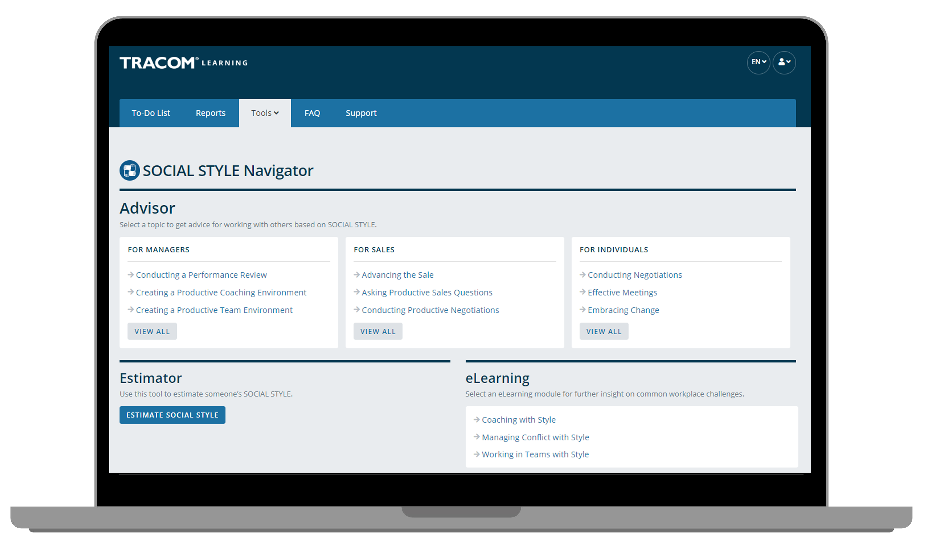
Notes:
Optional demonstration, time permitting

Slide 45
Notes:
Optional demonstration, time permitting

Slide 46
Notes:
Optional demonstration, time permitting

Slide 47
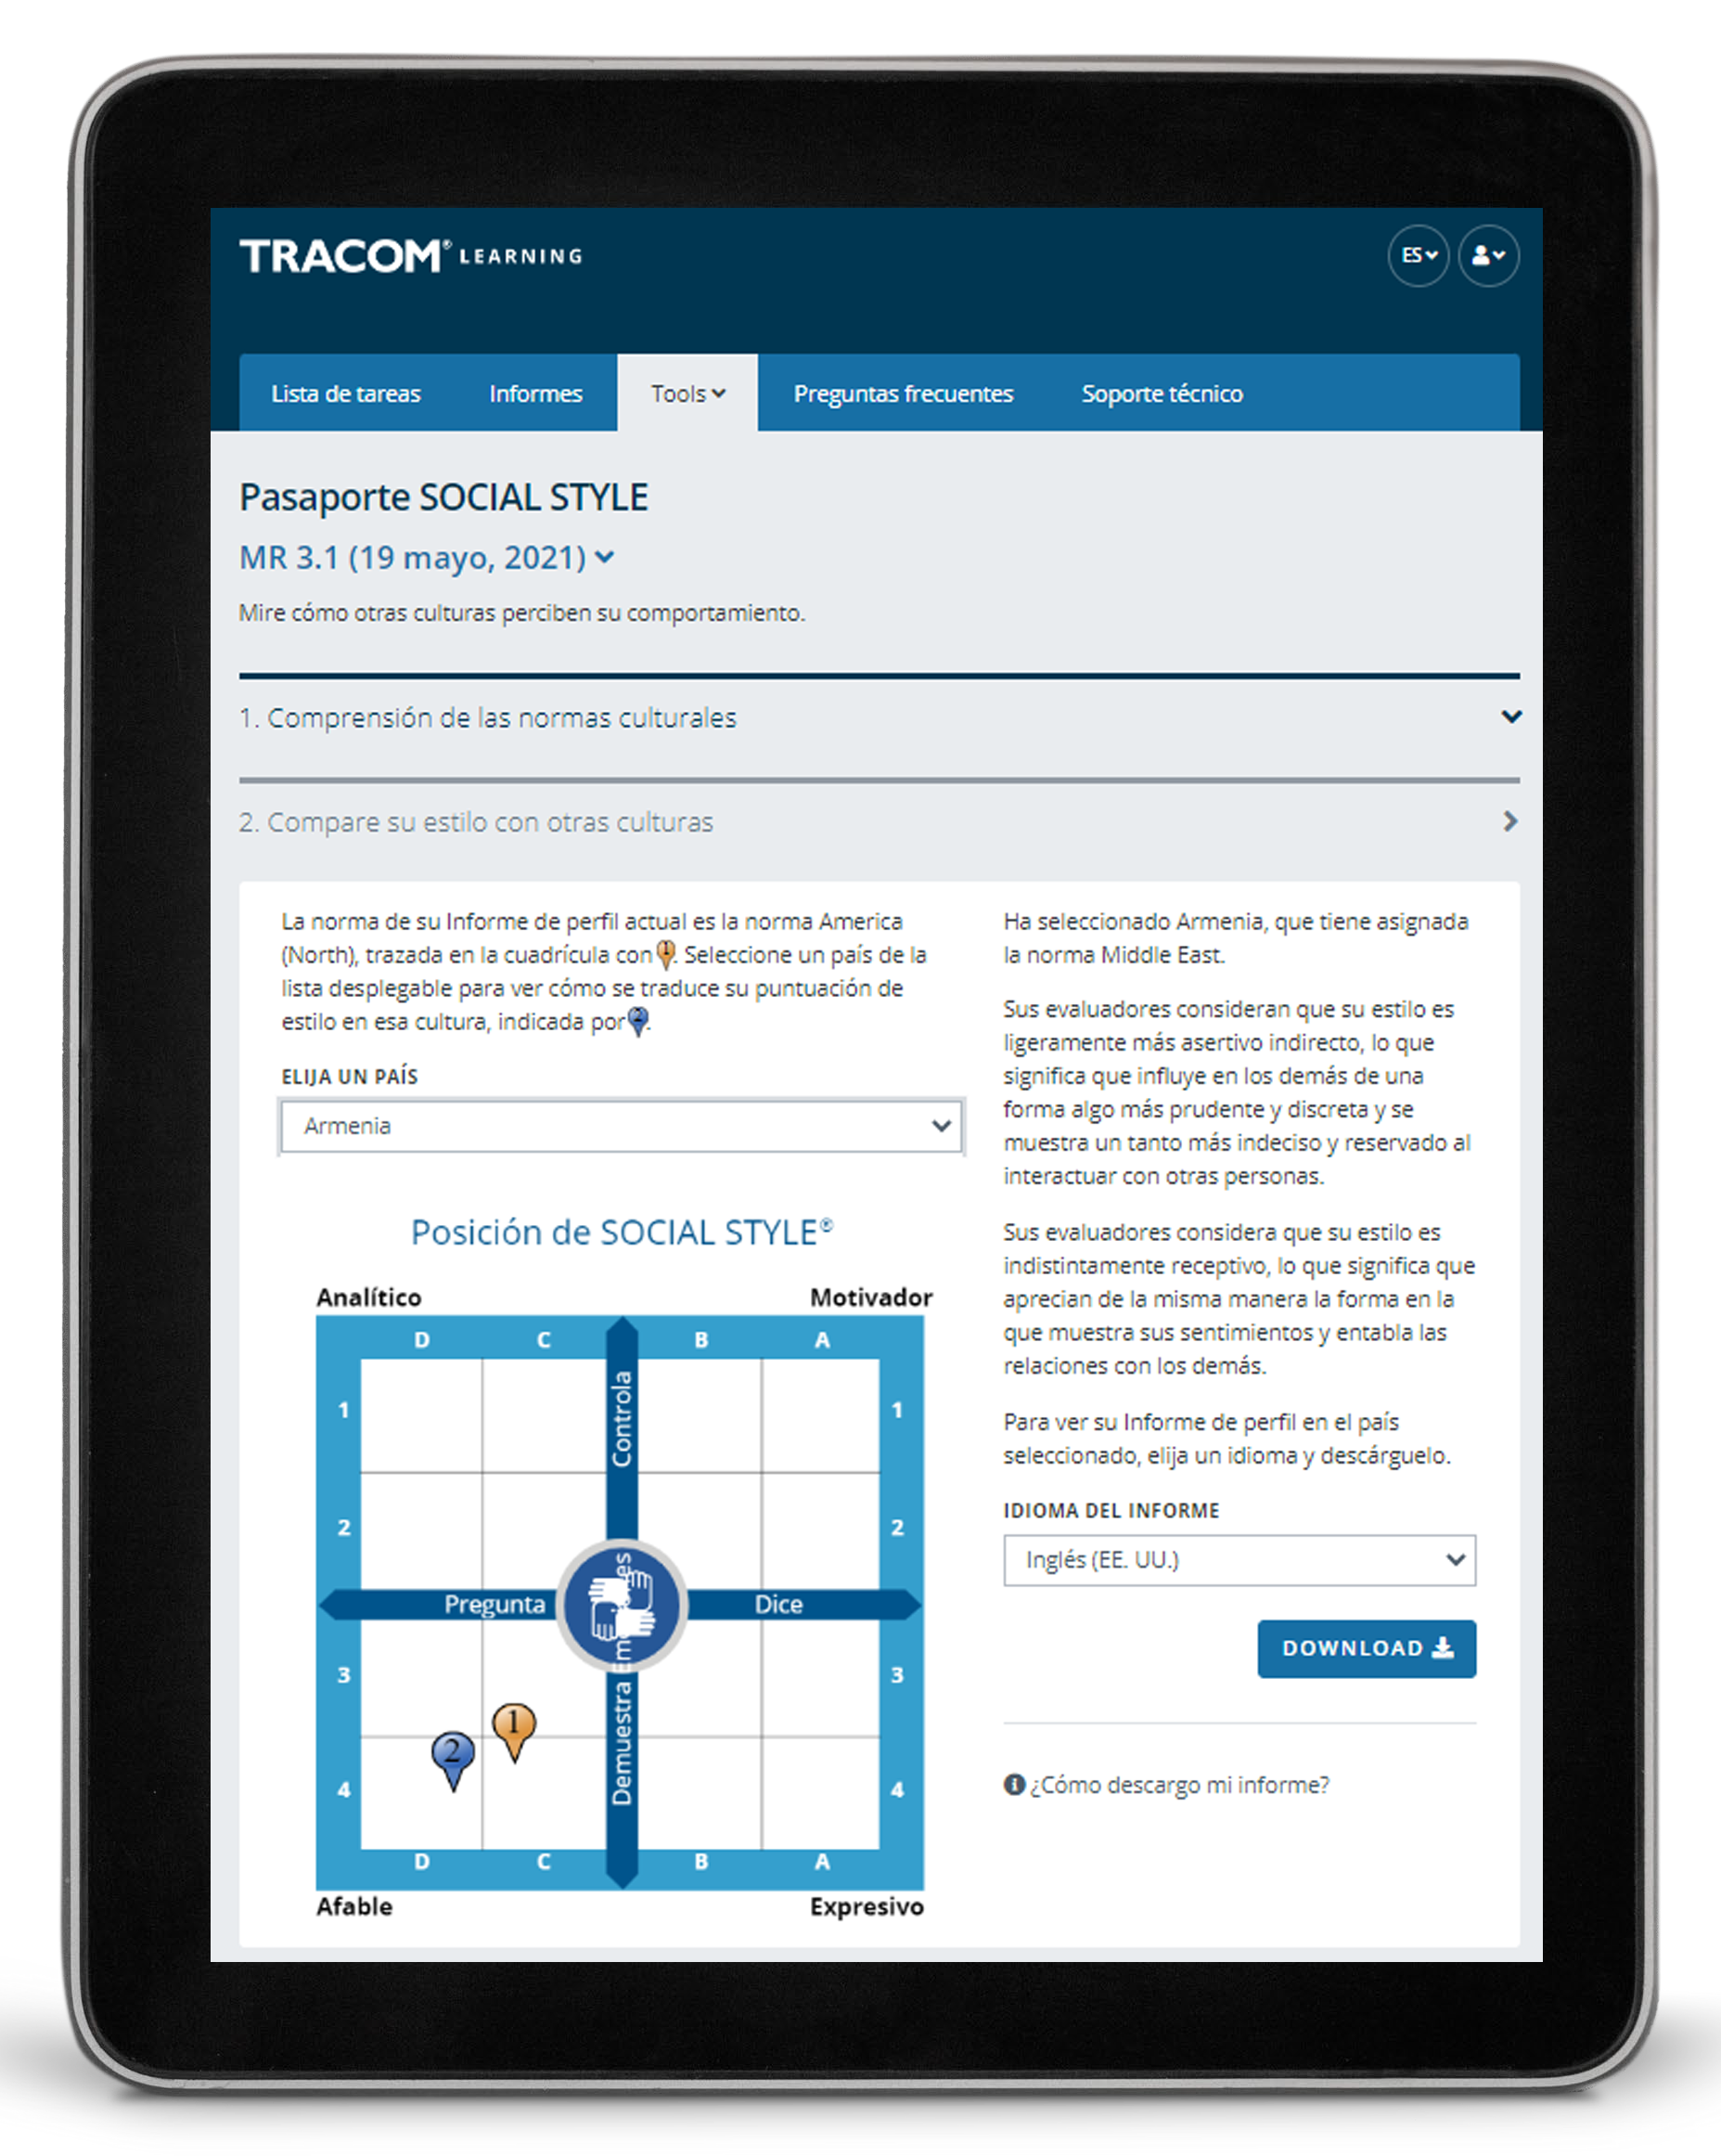
Pasaporte SOCIAL STYLE
Notes:
Optional demonstration, time permitting

Slide 48
48
Notes:
SAY Thank you. Do you have final questions?

Slide 49
Ejercicios opcionales
Seleccione los ejercicios opcionales según sus necesidades de formación y el tiempo disponible.
49
Notes:
You can use the following exercises to enhance the session to best meet the needs of your participants.

Slide 50
Técnicas para observar el Estilo
1
No saque conclusiones precipitadas
Manténgase objetivo
Separe el comportamiento de Estilo de la función o posición de la persona
Una cantidad moderada de estrés puede sacar a relucir el Estilo de las personas
Salga de la escena (sea un observador)
2
3
4
5
50
Notes:
Guidelines for Observing Style
Purpose
The purpose of this exercise is to familiarize participants with the rules for identifying another person's SOCIAL STYLE.
Recommended Time:
10 minutes
Materials Needed
None
Directions
SAY The more accurately we are able to observe our colleagues’ Styles, the better we will be able to adapt our own behavior to display greater Versatility.
ASK participants to take notes on ways of implementing the best practices.
DESCRIBE the best practices:
Don’t jump to conclusions
Remain objective
Separate Style behavior from someone’s role or position
A moderate amount of stress can clarify someone’s Style
Get out of the way (be an observer)
ASK if there are any questions.

Slide 51
Foro de estilo
Objetivo: Darle la oportunidad de describir qué es lo que crea tensión con usted de la posición opuesta de SOCIAL STYLE y elaborar ideas sobre cómo ser más productivo con personas con ese estilo.
Instrucciones:
En el grupo al que ha sido asignado, hable sobre esto y elabore una lista de comportamientos que exhibe el SOCIAL STYLE opuesto que crea tensión con usted.
Compartan su lista con el grupo del Estilo opuesto.
En su grupo, hable sobre qué se puede hacer para interactuar mejor con el Estilo opuesto.
Compartan su información con el Estilo opuesto y con toda la clase.
51
Notes:
Style Forum
Purpose
The purpose of this exercise is to give participants an opportunity to describe what it is about the opposite SOCIAL STYLE position that creates tension for them when working with people of that Style and to develop insights into how to be more productive with a person who has that Style.
Recommended Time
30 minutes
Materials needed
None
Directions
Break participants into groups by SOCIAL STYLE position with a maximum of six per group.
Give each group 10 minutes to discuss and develop a list of behaviors that the opposite SOCIAL STYLE position manifests to create tension that leads to unproductive relationships.
After each group has developed its list, ask the Amiable and Driving Styles to get together to share their lists. Ask the Expressive and Analytical Styles to do the same thing. Each Style should spend five to ten minutes sharing its list and answering clarifying questions. Caution the groups that this is not a time to get defensive.
After each group has heard the other’s list, the original groups should get together by themselves to discuss what they can do to interact better with the opposite Style (e.g., those with Expressive Styles would develop a list of what they could do to make the relationship more productive with Analytical Styles). As each group shares its list of what it could do better, the opposite Style group should provide feedback and suggestions as to how appropriate the lists are.
After all groups have shared their information with the opposite Style, the whole class discusses what has been learned.
At the conclusion of the exercise, each group should have valuable information as to how to behave more appropriately with the diagonally opposite Style. In addition, after the general class discussions, each Style should have valuable information for working with each of the other SOCIAL STYLE positions.

Slide 52
Foro de versatilidad
Objetivo: Darle la oportunidad de describir una relación difícil y trabajar en grupo para encontrar los pasos específicos que se pueden tomar para mostrar más versatilidad con esa persona.
Instrucciones:
Nos dividimos en cuatro grupos por estilo.
Por turnos, cada persona:
Describe a un compañero de trabajo con el que tiene una relación complicada y trata de identificar su estilo.
Comparte qué es lo que hace el compañero de trabajo que resulta frustrante.
El grupo ayuda a la persona a encontrar acciones específicas para mostrar más versatilidad con el compañero de trabajo.
Nombren a un portavoz: ¿Han descubierto algo único o importante que deseen compartir con todo el grupo?
52
Notes:
Versatility Forum
Purpose
This exercise helps learners prepare to apply Versatility with a challenging relationship. Each Style group helps one another identify specific actions they can take to show more Versatility.
Recommended Time
30 minutes
Materials needed
Style and Versatility profiles, to help discover specific strategies for showing Versatility.
Directions
DIVIDE participants into Style groups and assign them to virtual breakout rooms (or separate areas of a physical space).
PROVIDE instructions on the slide.
SAY Nominate a spokesperson to represent your Style group. Take note of anything unique or insightful that you want to share with the whole group. We don’t want you to repeat everything that was said, only key takeaways.
CONDUCT the activity, carefully monitoring time and adding value as appropriate.
CLOSE the Versatility Forum by ASKING for questions and EMPHASIZING any key insights participants made.

Slide 53
SOCIAL STYLE Navigator
Objetivo: Utilizar la herramienta Navigator para mejorar la eficacia.
Instrucciones:
Encuentre una persona o situación (como las reuniones de equipo) para la que desee mejorar su eficacia.
Inicie sesión en tracomlearning.com y seleccione SOCIAL STYLE Navigator en la pestaña “Tools” (Herramientas).
Utilice el “Estimator” (Estimador) para determinar el Estilo de la persona que ha identificado. Si se trata de varias personas, haga lo mismo para cada persona, también puede omitir este paso por el momento.
Examine la lista de temas en la sección “Advisor” (Asesor), encuentre el área de consejo que sea más adecuada y haga clic en ella.
Lea los consejos e imprima la página si es necesario para conservarla.
Se discuten en grupo las ideas que se han aprendido.
53
Notes:
SOCIAL STYLE Navigator
Purpose
To use SOCIAL STYLE Navigator to improve your effectiveness.
Recommended Time
30 minutes
Materials Needed
Login to tracomlearning.com and navigate to the Tools tab
Directions
Determine a person or situation (such as team meetings) where you want to improve your effectiveness.
Login to tracomlearning.com and select SOCIAL STYLE Navigator from the Tools tab.
Use the “Estimator” to estimate the Style of the person you identified. If multiple people are involved, do this for each person or skip this step for now.
Examine the list of topics under the “Advisor” tab to find the relevant advice area and click on it.
Read the advice and print the page if needed to keep with you.
As a group, discuss any insights that were learned.

Slide 54
Plan de acción de versatilidad
Objetivo: Elaborar un plan de acción para aumentar la versatilidad.
Instrucciones:
Lea su perfil de versatilidad para comprender su comportamiento (solo el perfil en línea)
Revise las estrategias que se proporcionan en las tres secciones: Formas de mejorar la presentación, formas de mejorar la competencia y formas de mejorar el feedback. (solo en el perfil en línea)
En cada área, escoja una o dos acciones específicas que va a realizar y anótelas.
Forme un pareja con otra persona (o haga un grupo pequeño) y hablen sobre su plan.
54
Notes:
Versatility Action Plan
Purpose
To develop a specific action plan for increasing your Versatility.
Recommended Time
30 minutes
Materials Needed
Versatility Profile
Directions
Read your Versatility profile to understand your behavior.
Review the strategies provided in the three sections: Ways to Improve Presentation, Ways to Improve Competence, and Ways to Improve Feedback.
Within each area, decide on one or two specific actions that you will take, and write these down.
Pair up with another person (or small group) and discuss your plan.

Slide 55
Mejorar la eficacia personal con Versatilidad
Versión 4.0
Notes:
<<Copy and paste this table to notes pages on which you want participants to be able to take notes

