Slide 1
対応性で他者への影響度を向上させるTM
バージョン4.0
Notes:
3 MINUTES (Participant Workbook, pages 1 and 2)
WELCOME participants to the session and REVIEW key points about TRACOM’s SOCIAL STYLE Model：
One of the most widely-used and highly-regarded behavioral models in use today.
Will help you develop insight about your behavioral strengths and weaknesses, and your co-workers’ behavioral preferences.
Originally developed in the 1960s by psychologists David Merrill and Roger Reid.
Used worldwide by millions of people.
PROGRAM BENEFITS
SAY Working successfully with others depends on developing good relationships. You can do this by understanding your own Style and, more importantly, other people’s Styles. This allows you to practice Versatility, adjusting your behavior to meet other people’s Style preferences. Research shows that people who consistently show Versatility are more effective in their jobs than people who don’t show Versatility.
ASK participants to turn to Pages 1 and 2 in the workbook to follow along.
Cite the proven effectiveness of increased Versatility (e.g., Sales and Management studies on page 2 of the IPEV Participant Workbook).
<<Copy and paste this table to notes pages on which you want participants to be able to take notes

Slide 2
学習目標
ソーシャル・スタイル™ モデルを理解する。
自己認識での評価を完了して、自分のソーシャル・スタイルを推定する。
自分の行動について、また自分と同じスタイルの人がほかの人からはどう見えるかについての理解を深める。
対応性を強化して対人効果を向上させる。
Notes:
15 MINUTES TOTAL (Participant Workbook pages 1 and 2)
5 MINUTES
Going through this session you will:
• Gain an understanding of the SOCIAL STYLE Model.
• Estimate your SOCIAL STYLE by completing a self-perception assessment.
• Increase your understanding of your behavior and how others tend to view people with your Style.
• Increase your Versatility to become more effective with others.
SAY I want to emphasize the last point, number 4. While you’ll learn a lot about yourself, the goal of this program is to learn about the people you work with and how you can adjust your behavior to work more effectively with them. Versatility is about adjusting your behavior to help others meet their Style needs. When you do this, you increase your effectiveness and also make it easier for others to show Versatility toward you.
If your participants completed the Online Self-Perception assessment:
Make sure you have a profile for each participant who completed the assessment.
DO NOT pass out the profiles at this time.
VIRTUAL：Participants should already have their profiles available.
10 MINUTES
If you are using the Paper assessment:
SAY It’s critical that individuals understand their own behavior and how it affects others. So we’re going to do an exercise that will give you insights about yourself. You’re each going to complete a self-assessment of your SOCIAL STYLE. With that knowledge as a foundation, we’ll then look at how you can work more effectively with others.
1. DISTRIBUTE questionnaires.
2. ASK participants to complete the SOCIAL STYLE and Versatility Questionnaires.
3. DO NOT ask participants to score their questionnaires at this time.
VIRTUAL PROGRAM
If delivering virtually, you will not be able to use paper questionnaires and will need to prepare ahead of time to deliver online profiles. Arrange to have a notification sent to learners so they can download their profiles prior to the session.

Slide 3
ソーシャル・スタイルと対応性
成功の重要な要素
ソーシャル・スタイルと対応性トレーニングの結果について、参加者は次のように報告しています。
88%
74%
71%
の自己評価では今後
の自己評価では今後
の自己評価では今後
ほかの人とより効果的に共同作業ができる
対立状況が改善する
仕事上の困難な関係が改善する
対応性が高まると、仕事のパフォーマンスも向上します。
Notes:
2 Minutes
SAY In the first part of the program, you’ll learn about Style. This will help you understand your co-workers and how they prefer to get work done.
The second part of the program focuses on Versatility, which is how well you meet others’ Style needs.
Versatility is the application of SOCIAL STYLE—when you understand your co-workers’ Style needs, you can help them meet those needs. This helps them feel more valued and sets the stage for them to have a better relationship with you. If you consistently show Versatility, you can be more effective.
You can read the stats on this slide. Research has found that Versatility is a strong predictor of successful job performance. Individuals who consistently show Versatility are rated more effective in their job performance than those who are inconsistent in their Versatility.

Slide 4
観察できる言動面の特徴と性格
行動
自分の発言（言語的）と 動作（非言語的）
ソーシャル・スタイル（SOCIAL STYLE®） ほかの人々が観察でき、 人によってその行動の説明に食い違いが生じないような アクションパターン
観察できる言動面の特徴
言/動
性格
対人行動
人とのやり取りでの言動
性格
その人のすべて。 考え、価値観、希望、夢など
Notes:
4 MINUTES (Participant Workbook page 3)
ASK participants to turn to page 3 of the workbook to follow along.
SAY Behavior and personality are not the same things. Observable behavior is like the crust of a pie. Personality is like the inside and outside of the pie.
ASK What makes up personality?
CONDUCT a quick facilitated discussion to solicit participants’ responses. They should say things such as:
Values, hopes, attitudes, beliefs.
Things that are not necessarily observable.
These internal qualities are more subjective in nature.
SAY Style is like the crust, because it’s on the outside and observable. By observing behavior, we can find ways to define and discuss what we see. Then, we can begin to understand how this behavior affects ourselves and others.

Slide 5
発言行動と動作行動
特徴
正直
知的
尊大
モチベーションが 高い
自己中心的
誠実
批判的
観察できる言動面の特徴
物静か
ペースが遅め
顔の表情に出にくい
抑揚の少ない声
あまり目を合わせない
自然体
後傾
にぎやか
ペースが速め
顔の表情が豊か
抑揚の目立つ声
よく目を合わせる
堅苦しい
前傾
判断
この人は好きだ
この人は気に障る
この人は興味深い
この人には いらだたされる
この人は 信じられない
この人は嫌いだ
この人は 信じられる
言
やる
Notes:
4 MINUTES (Participant Workbook page 4)
ASK participants to turn to page 4 of the workbook to follow along.
SAY When we first meet people, we often form immediate impressions, even after just a few seconds. This is sub-conscious (below our awareness) and happens immediately.
DESCRIBE
Traits Column: What we think we know about a person, based on interactions; subjective opinions.
Judgments Column: Our reactions to others; conclusions or evaluations we make, based on our subjective opinions.
Observable Behavior Column: Things others “Say and Do”; more objective and observable behaviors.
SAY Traits and Judgments are most subjective in nature and contain positive or negative descriptions.
Observable Behavior is objective and contains no positive or negative value.
Observable Behavior is an important tool for assessing others’ Styles. By focusing on Observable Behavior, you gain objectivity, which is critical for understanding people’s Styles.

Slide 6
自己主張度と感情表現度
Notes:
SAY We measure observable behavior on two dimensions：Assertiveness and Responsiveness

Slide 7
自己主張度
人とのやり取りで「意見を聞く」傾向、「意見を主張する」傾向の強さ
意見を 聞きがち
意見を聞く 一方で時には 意見を主張する
意見を主張する 一方で時には 意見を聞く
自分の意見を 主張しがち
Notes:
4 MINUTES (Participant workbook page 5)
ASK participants to turn to page 5 of the workbook.
SAY To become more effective with others, we follow a behavioral model. There are two dimensions of behavior that define SOCIAL STYLE: Assertiveness and Responsiveness.
Assertiveness is the degree to which we ask or tell when interacting with others. The two anchors for Assertiveness are Ask on the left side of the continuum and Tell on the right side of the continuum.
Assertiveness is a measurement of how we try to influence others to take action. If you are more “Tell” Assertive, you state your opinions directly. You tend to declare your viewpoints and try to direct the actions of others.
For example, if you want to have lunch with someone, you might say, “Let’s have lunch today!”
If you are more “Ask” Assertive, you tend to be more cautious and reserved about sharing your opinions. You attempt to influence others in a more quiet, low-key, questioning manner.
For example, if you want to have lunch with someone, you might say, “Would you like to have lunch with me today?”

Slide 8
行動における自己主張度
言 | 言語的行動
遅め
話すペース
速め
人より少ない
話す量
人より多い
人より小さい
話し声の音量
人より大きい
意見を聞く
意見を 主張する
リラックス
手ぶり
指図
後傾
身体の姿勢
前傾
少なめ
目の合わせ方
多め
動 | 非言語的行動
Notes:
3 MINUTES (Participant Workbook page 5)
SAY The Assertiveness scale helps predict a person’s behavior because it represents a “theme” or typical pattern. There are verbal and non-verbal clues to indicate a person’s Assertiveness.
ASK participants for examples of verbal and non-verbal clues for Ask-Assertive and Tell-Assertive individuals.
DESCRIBE the verbal and non-verbal indicators of Assertiveness:
Verbal: Ask-Assertive individuals use a slower pace, less quantity (fewer words), and quieter volume. Tell-Assertive individuals use a faster pace, talk more, and a louder volume.
Non-Verbal: Ask-Assertive individuals show relaxed hands and gestures, lean back, and use less direct eye contact. Tell-Assertive individuals have a directive use of hands, lean forward, and use more direct eye contact.
Optional Exercise: Do You Ask or Tell?
Virtual activity:
ASK participants to chat whether they see themselves as more asking or more telling, and to give examples of why they see themselves this way.
In-person activity:
1. ASK participants to go toward either the left side or right side of the room to indicate whether they see themselves as “more asking” (left) or “more telling” (right).
2. ASK participants to introduce themselves to people around them and to share examples of what they feel makes them more asking or more telling.
3. ASK participants to validate their self-assessment based on whether they asked questions or made statements during their discussions. (Ask Assertive individuals will tend to ask more questions; Tell Assertive individuals will tend to make more statements).
4. ASK if anyone feels as though they might have gone to the wrong place.

Slide 9
感情表現度
感情表現を 抑えがち
感情表現を抑える一方で時には 感情を表す
人とのやり取りで感情表現を 抑える傾向、または感情を 表す傾向の強さ
感情を表す 一方で時には 感情表現を抑える
感情を 表しがち
Notes:
4 MINUTES (Participant Workbook page 5)
Participants stay on page 5 of the workbook.
SAY Responsiveness is the degree to which people tend to control (don’t outwardly display emotions) or emote (outwardly display emotions).
The two anchors are Controls on the top of the continuum and Emotes on the bottom of the continuum.
Responsiveness is also the extent to which you react to emotional appeals or displays.
If you control your emotions, you usually don’t react to emotional appeals and are more likely to focus on ideas, data, and tasks. You are less likely to share your feelings publicly.
If you are more emoting, you share and display your emotions with others. You are more likely to respond to emotional appeals and displays from others.

Slide 10
感情を表す行動
言 | 言語的行動
動 | 非言語的行動
感情表現を抑える
人より平板
タスク
事実/データを提示
人より少ない
硬い
抑制
声に表れた 感情
話の主題
説明の仕方
手ぶり
身体の姿勢
顔の表情
人より抑揚が大きい
ほかの人々
意見/ストーリーを 伝える
人より多い
カジュアル
表情豊か
感情を表す
Notes:
3 MINUTES (Participant Workbook page 5)
SAY The Responsiveness scale, like the Assertiveness scale, helps us to predict a person’s behavior because it is a “theme” or typical pattern.
ASK participants for their opinions on the verbal and non-verbal clues of Control- and Emote-oriented individuals.
DESCRIBE the verbal and non-verbal clues to responsive behavior as noted on the slide.
SAY Responsiveness is neither a positive nor a negative quality; it is neutral.
Assertiveness and Responsiveness do not affect each other — they are independent of each other.
Optional Exercise: Do You Control or Emote?
Virtual activity:
ASK participants to chat whether they see themselves as more controlling or more emoting, and to give examples of why they see themselves this way.
In-person activity:
1. ASK participants to go toward the front of the room if they feel they are “more controlling” of their emotions or to the rear of the room if they feel that they are “more emoting” (display their emotions).
2. ASK participants to validate their self-assessments. Typically, “more emoting” individuals will be talking with one another more than the “less emoting” ones.
3. ASK if anyone feels as though they went to the wrong place.

Slide 11
ソーシャル・スタイルTM モデル
感情表現を抑える
主張を尋ねる 感情表現を抑える
アナリティカル スタイル
自己主張する 感情表現を抑える
ドライビング スタイル
意見を 主張する
意見を聞く
主張を尋ねる 感情を表す
エミアブル スタイル
自己主張する 感情を表す
エクスプレッシブ スタイル
感情を表す
Notes:
5 MINUTES (Participant Workbook page 6)
ASK participants to turn to page 6 of the workbook.
CLICK TO REVEAL EACH QUADRANT
SAY By combining Assertiveness and Responsiveness, the four SOCIAL STYLEs are formed.
No individual will display one Style exclusively; but, over time, you can determine a person’s Style. Once you know a person’s Style, you can adjust your behavior to develop a more effective relationship.
Leader Tip: Note that there is no good or bad Style; each can be equally effective.

Slide 12
ニーズ、指向性、成長を促すアクション
ニーズ
各スタイルの目標
指向性 ニーズを満たすために取る代表的な行動
成長を促すアクション
各スタイルでほとんど見られない行動。この行動の頻度を上げると、このスタイルの対人効果が向上
Notes:
2 MINUTES
SAY Remember that the Style descriptions are generalizations about each Style. While people with the same Style generally exhibit similar characteristics, each person is still unique.
SAY We’ve used some adjectives to describe the Styles. In addition, each Style has a Need, an Orientation, and a Growth Action.
DEFINE:
Need – The goal of each Style.
Orientation – The common behavior used to achieve the need.
Growth Action – Behavior that is rarely used by each Style. Using this behavior more often would increase this Style’s effectiveness.
SAY Understanding the Need, Orientation, and Growth Action of each Style will help you better relate to others’ Styles and enhance your effectiveness with them.

Slide 13
ソーシャル・スタイルの主要タイプ
感情表現を抑える
アナリティカル
ニーズ：誤謬がないこと
指向性：考え方
成長を促すアクション： 宣言すること
ドライビング
ニーズ：結果
指向性：アクション
成長を促すアクション： 人の話をじっくり聞くこと
意見を聞く
意見を 主張する
エミアブル
ニーズ：保身
指向性：人間関係
成長を促すアクション： 自分から行動を始めること
エクスプレッシブ
ニーズ：自分が認められること
指向性：作為のなさ
成長を促すアクション：チェック すること
感情を表す
Notes:
6 MINUTES
CLICK TO REVEAL THE TEXT IN EACH QUADRANT.
REVIEW each Style.

Slide 14
オンライン版ソーシャル・スタイル 自己認識プロファイル
Notes:
If using the online profile, use the following slides.
Note that if delivering virtually, participants will need to have received their profiles prior to the program.
Check the Status Report and Composite Report to understand which participants have completed their profiles, and the breakdown of Style within your program.
FACILITATOR NOTE: By completing an online profile, Learners will immediately have free, unlimited access to SOCIAL STYLE Navigator through tracomlearning.com to help extend their learning beyond the classroom. See Slide #41 for details.

Slide 15
© The TRACOM Corporation. All Rights Reserved.
15
Notes:
15 MINUTES (5 MINUTES if Virtual Program)
Purpose
The purpose of this exercise is to help participants learn more about their SOCIAL STYLE and to encourage them to think about how they can adjust their behavior to be more effective.
Materials Needed
SOCIAL STYLE profile
Virtual Directions:
ASK participants to chat their Style along with one adjustment to their behavior they can make to enhance their effectiveness with others.
In-Person Directions:
ASK participants to read their Style profile and begin to determine ways they can adjust their behavior to meet others’ Style needs. (They will continue this exercise when they read their Versatility profiles).
ASK participants to share what they learned about their Style and how they can adjust their behavior.

Slide 16
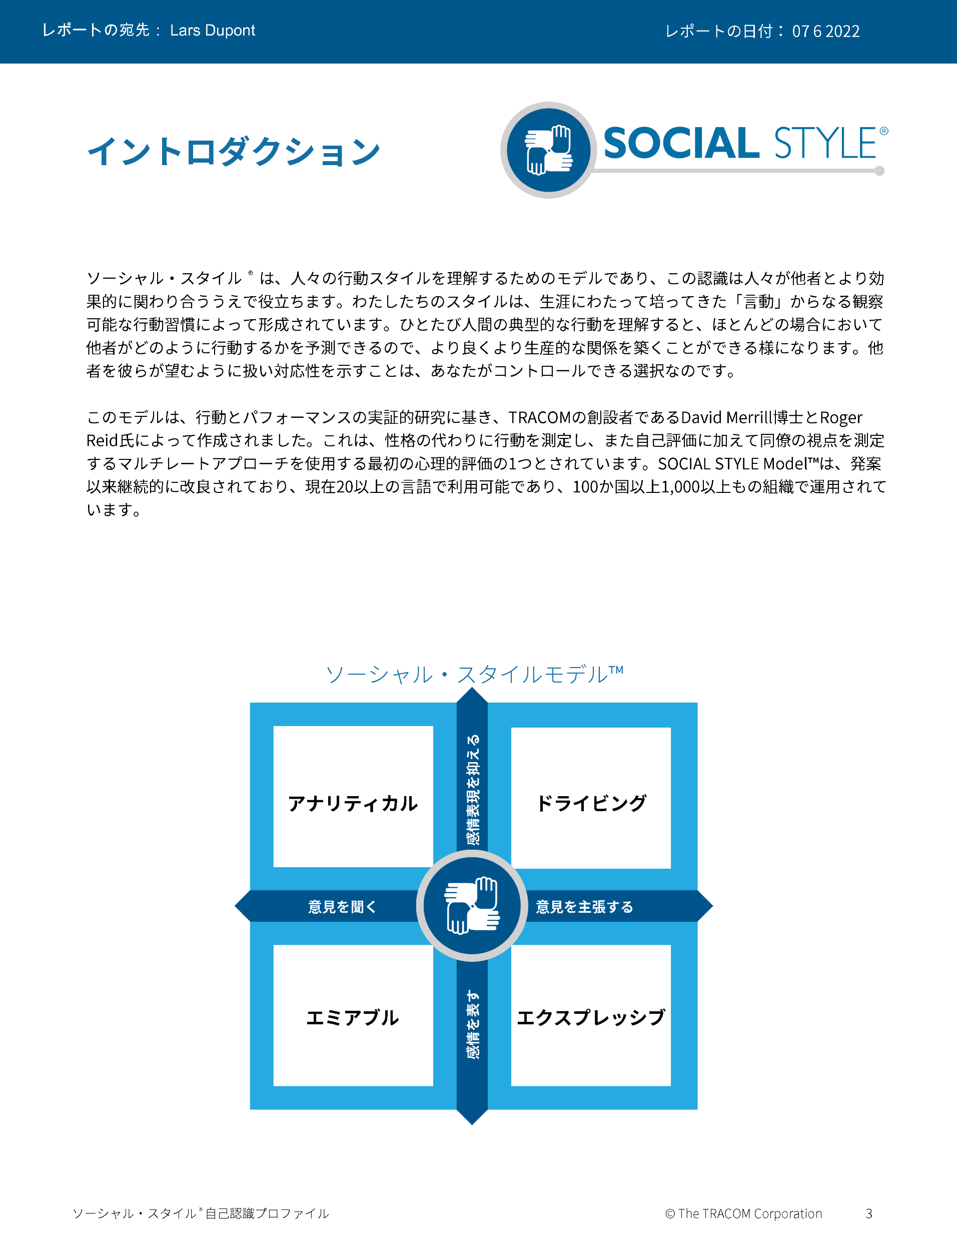
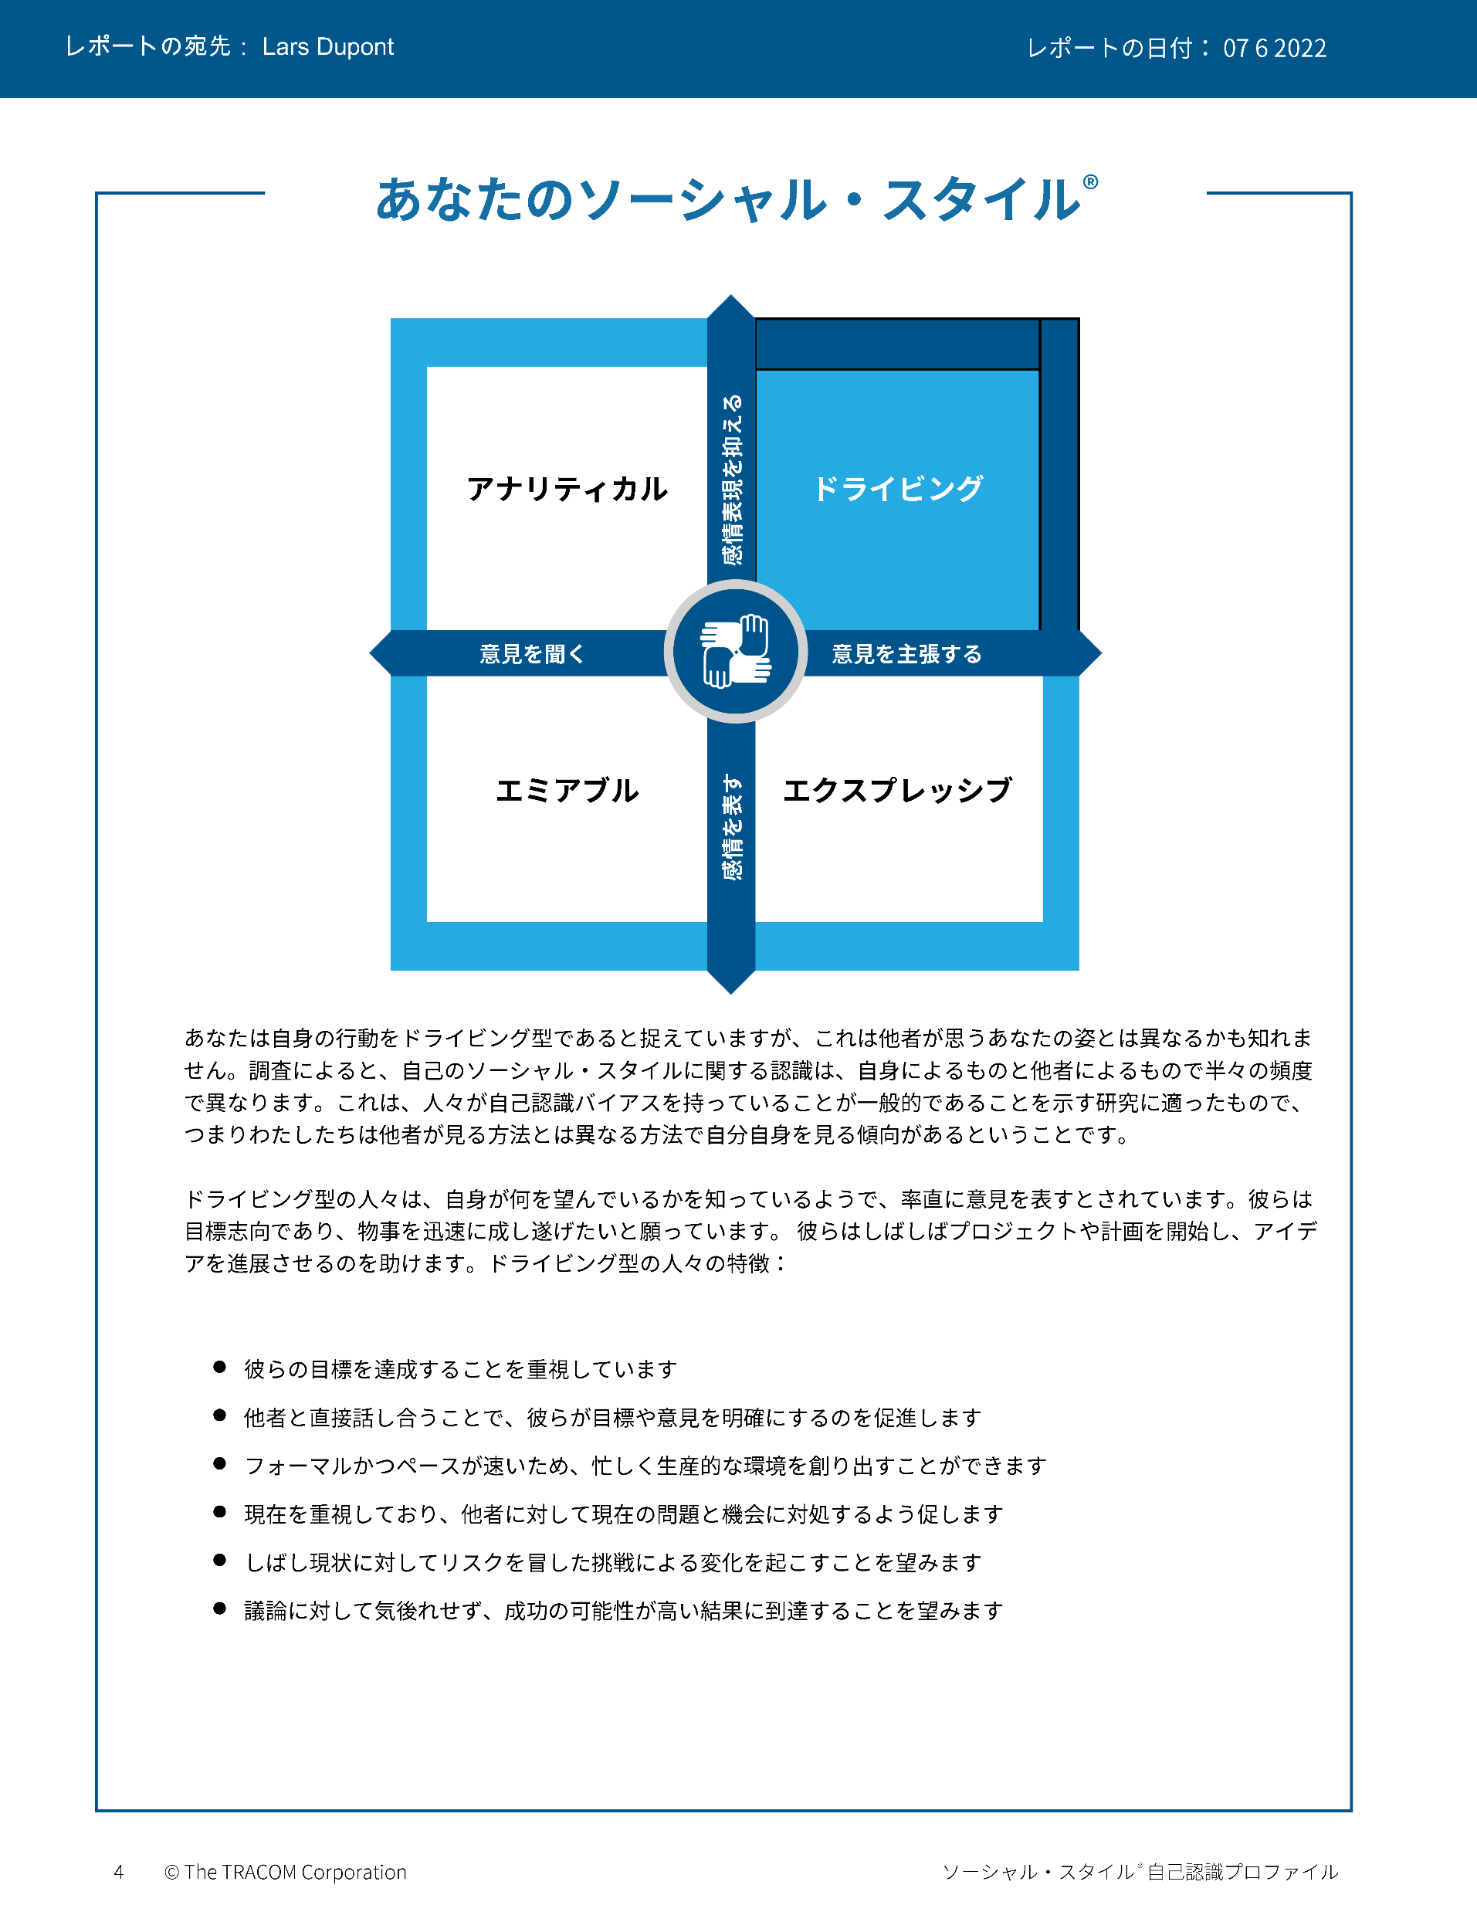
© The TRACOM Corporation. All Rights Reserved.
16
Notes:
These slides show pages of the SOCIAL STYLE profile and can be displayed to assist with conversation during the exercise debrief.

Slide 17
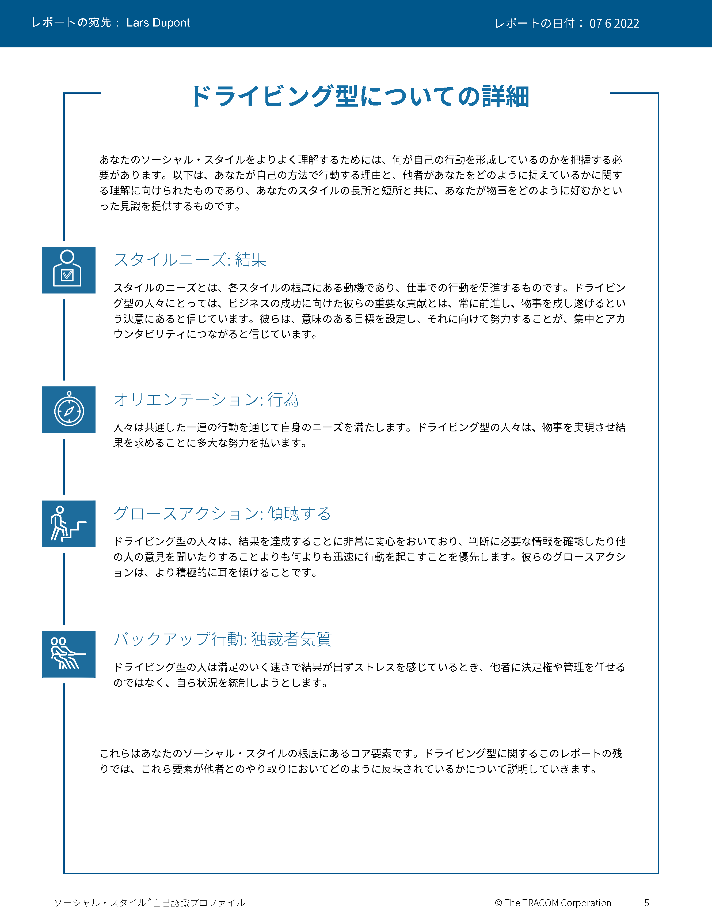
© The TRACOM Corporation. All Rights Reserved.
17
Notes:
These slides show pages of the SOCIAL STYLE profile and can be displayed to assist with conversation during the exercise debrief.

Slide 18
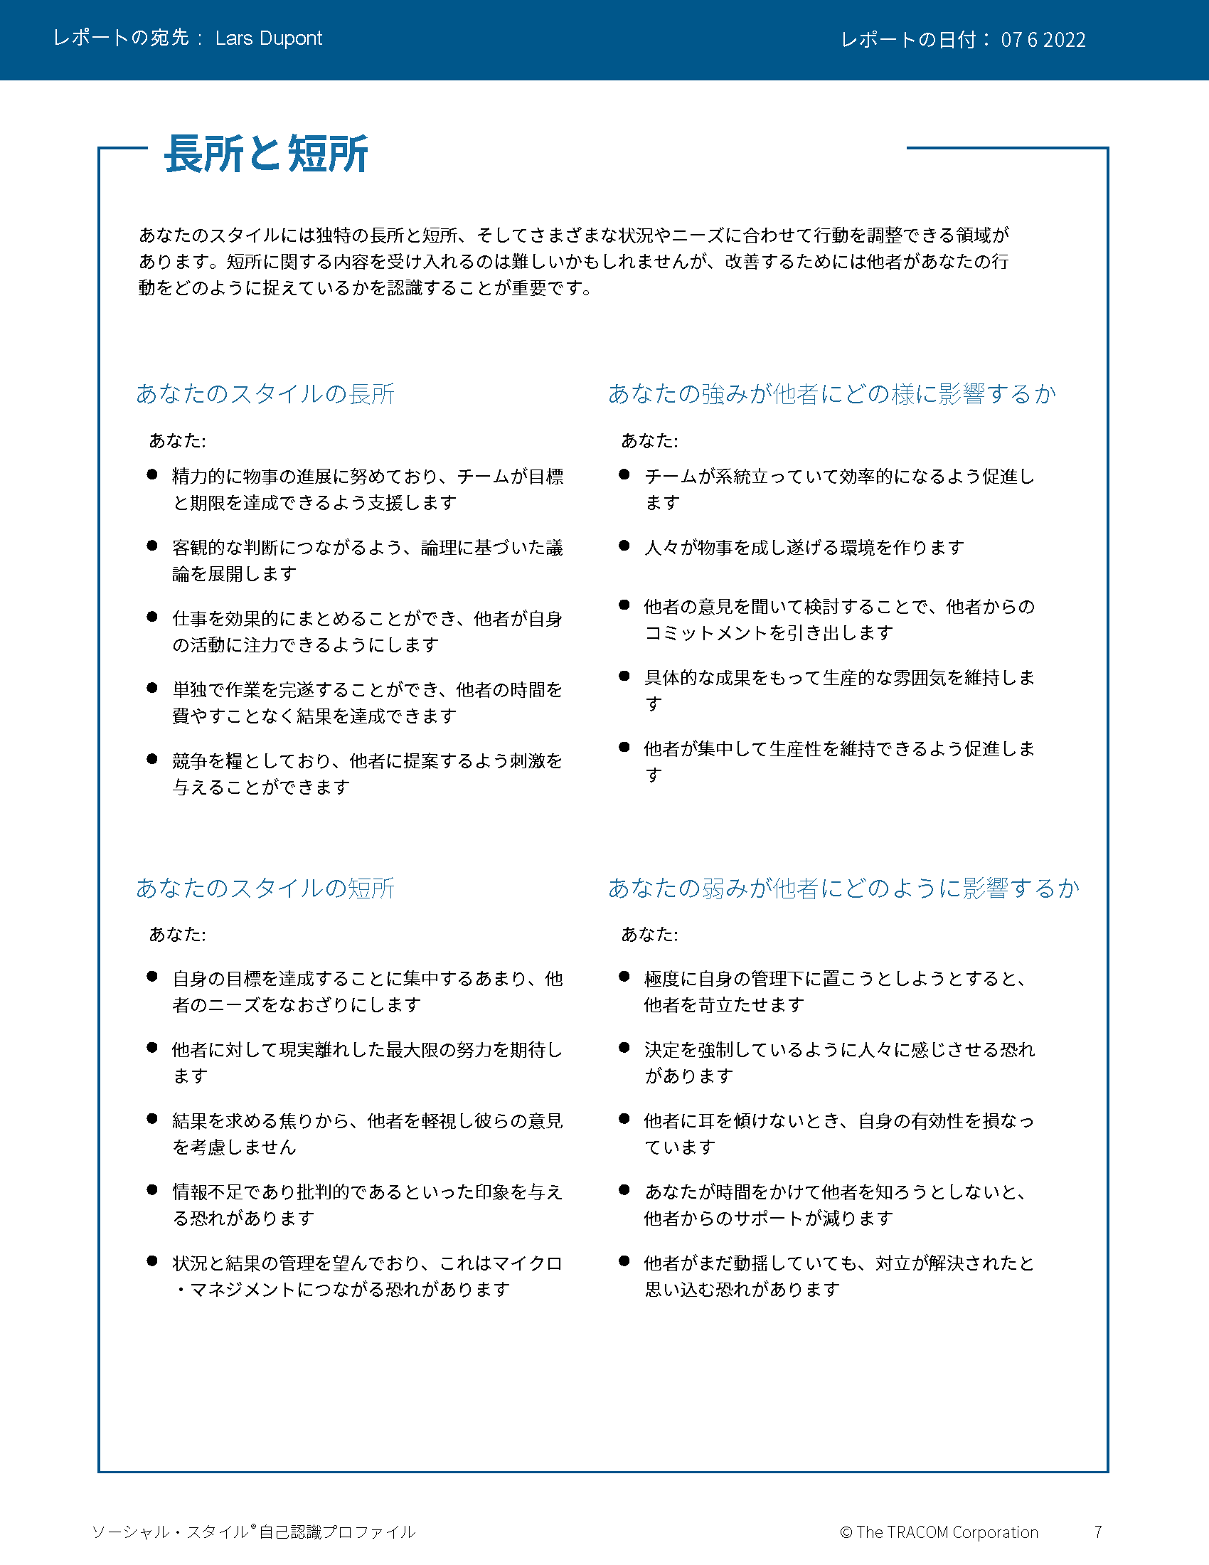
© The TRACOM Corporation. All Rights Reserved.
18
Notes:
These slides show pages of the SOCIAL STYLE profile and can be displayed to assist with conversation during the exercise debrief.

Slide 19
© The TRACOM Corporation. All Rights Reserved.
19
Notes:
These slides show pages of the SOCIAL STYLE profile and can be displayed to assist with conversation during the exercise debrief.

Slide 20
印刷版ソーシャル・スタイル 自己認識プロファイル
Notes:
If using the paper assessment, use the following slides.
FACILITATOR NOTE: To extend their learning beyond the classroom, participants who complete the Paper Survey can register for free, unlimited access to SOCIAL STYLE Navigator. See Slide #42 for details.

Slide 21
ソーシャル・スタイルの自己認識
例：
C
ミシン目に沿って紙を裂き、開きます
各質問の応答を転記します
列の合計を計算します
自分のソーシャル・スタイルをプロット します
アナリティカル
ドライ ビング
A
T
エミアブル
エクスプレッシブ
E
自己認識したスタイルとほかの人から見た スタイルが異なる場合があります。
Notes:
10 MINUTES – PAPER PROFILE ONLY
If your participants completed the Online Profile:
DO NOT DISPLAY this slide.
FOLLOW INSTRUCTIONS in “Online Profile” section.
If your participants are using the Paper Assessment:
SAY Now, it’s time to score the SOCIAL STYLE questionnaire that you completed earlier. Score your questionnaire following the instructions on the slide.
ASK participants to plot their Assertiveness (A, T) score and Responsiveness (C, E) score as shown on the slide.
SAY The SOCIAL STYLE Self-Perception Profile reflects how you see yourself. Keep in mind that others may see you differently. TRACOM’s research indicates that about 50% of those who complete the Self-Perception Questionnaire differ in their perceptions from their reference group who complete a Multi-Rater Profile about them.
Leader Tip：You may get asked the question, “If the research indicates 50% of people see themselves differently, then what value does it have?”
Answer：The format of this course did not allow us to use the multi-rater profile. The reason we gave you a profile is that you can start to realize that others might see you differently than you see yourself. Even though receiving a multi-rater profile would give you more insight into how others perceive your behavior, this session is still useful and practical. By following the suggestions in this session you will be able to observe other people’s behavior to determine their SOCIAL STYLE. Then you can adjust your behavior to work more effectively with them.

Slide 22
自分のスタイルに 関する説明を読む
感情表現を抑える
アナリティカルスタイル
14～15ページ
ドライビングスタイル
8～9ページ
意見を聞く
意見を 主張する
エミアブルスタイル
12～13ページ
エクスプレッシブスタイル
10～11ページ
感情を表す
Notes:
15 MINUTES (Participant Workbook pages 8 to 15) – PAPER PROFILE ONLY
Purpose
The purpose of this exercise is to help participants learn more about their SOCIAL STYLE and to encourage them to think about how they can adjust their behavior to be more effective.
Materials Needed
Flip chart
Directions
ASK participants to read more about their Style in the workbook and to complete the two questions contained in each section. (10 minutes)
a. Driving Style, pages 8-9
b. Expressive Style, pages 10-11
c. Amiable Style, pages 12-13
d. Analytical Style, pages 14-15
ASK if anyone has any questions about their Style regarding (a) strengths of their Style and (b) things they need to work on.
ASK participants to share what they learned about their Style. Draw Style quadrants on the flip chart and record their answers for all to see and consider.

Slide 23
主な留意事項
スタイルに優劣はありません。
スタイルと性格は別のものです。
自分のスタイルは、自分の行動のテーマです。
各スタイルに合った、成長を促すアクションがあります。
あなたの課題は、 率先して効果的な対人関係を築き、強化することです。
Notes:
5 MINUTES ( Participant Workbook page 16)
ASK participants to turn to page 16 in the workbook.
REVIEW what has been covered so far, discussing Key Reminders.

Slide 24
対応性

Slide 25
対応性とは、ほかの人のスタイル別 ニーズにどれだけうまく適応できるかです
Notes:
3 MINUTES
SAY Versatility is a measure of your consistency in adjusting to the Style needs of others.
At the beginning of the program, we reviewed some statistics on Versatility. Research has found that Versatility is a strong predictor of successful job performance. Individuals who consistently show Versatility are rated more effective in their job performance than those who are inconsistent in their Versatility.
Versatility is completely within your control, so it is your choice to be versatile with others. You can be highly versatile with one group and show low Versatility with another group. It depends on the circumstances and how much you value your interpersonal effectiveness with each group.
It is completely independent of SOCIAL STYLE: Any Style can show Versatility and be successful.
Versatility is NOT the same as likeability. A person can be well liked but not have high Versatility. The opposite can also be true. Versatility helps you develop better working relationships, but it is separate from your personal likeability.

Slide 26
対応性の4つの源
適切に適用される
イメージ
プレゼン
テーション
コンピタンス
フィードバック
その結果が
高い対応性
Notes:
5 MINUTES (Participant Workbook page 19)
ASK participants to turn to page 19 in the workbook.
Image remains a part of the Versatility model because it’s important for building relationships. Describe Versatility in a timeline:
SAY You show Versatility in four areas.
Image – When you first meet a new person at work, you form an impression about this person based on what you see, consciously or not. Essentially Image is a first impression: Are you dressed appropriately for the situation, for the work culture, for the client, and so on?
ONLINE PROFILE: Note that Image is not measured as part of your Profile. This is because:
Image is difficult to observe in virtual environments. We can’t observe very well how people are dressed, and because there are a wide variety of dress codes, even within companies and teams, it is less relevant to measure Image in this way.
People don’t always like answering questions about Image without understanding the context of how Image is explained in training.
Image is still important for many people and companies, which is why it’s part of the model. However, you won’t receive a measure of your Image.
Presentation – When a person communicates in meetings or other public venues, you’ll notice how clear they are at helping people understand their points. Do they use clear language? Are their examples effective? Do they take others’ Styles into account?
Competence – Over time, you’ll observe this person in a variety of situations. Are they reliable and do they persevere during difficult times? Are they flexible when change happens? Are they optimistic most of the time? Do they show creativity?
Feedback – Finally, this is the most interpersonal part of Versatility. Are they a good listener? Do they show empathy for others’ situations? Do they meet the needs of other people’s Styles? Do they develop good relationships with others?

Slide 27
オンライン版 対応性自己認識プロファイル
Notes:
If using the online profile, use the following slides.
Note that if delivering virtually, participants will need to have received their profiles prior to the program.
Check the Status Report and Composite Report to understand which participants have completed their profiles, and the breakdown of Versatility within your program.

Slide 28
全般的な対応性
対応性の発揮に関する一貫性
W | 一貫性が欠如 | X | ある程度の 一貫性を保持 | Y | 通常は 一貫性を保持 | Z | 非常に高い 一貫性を保持
 |  |  |  | 自分
Notes:
5 MINUTES
THIS SLIDE IS USED ONLY WITH THE ONLINE PROFILE.
SAY We measure Versatility on a scale ranging from W to Z. These are normed quartiles, just like Assertiveness and Responsiveness.
When you are not consistent in your behavior, you’re usually focusing on your own Style needs. When you consistently show Versatility, you’re focusing on meeting others’ Style needs, which reduces their tension. When you are consistent, the more effective you will be.
Your profile will show your results on this scale, ranging from W (not consistent) to Z (very consistent).
Versatility is all about consistency of behavior. A lower Versatility score does NOT mean you lack ability or that you never demonstrate these abilities. What it DOES mean is that you aren’t showing consistency in your behavior.
By making small changes to your behavior and acting with more consistency, you can increase your Versatility. (The difference in values between W and Z are small but meaningful.)

Slide 29
各対応性ポジションの意味
 | 1 | 2 | 3 | 4 | 5
 | まったく 当てはまらない | 当てはまら ない | 一部当てはまり 一部当てはまらない | 当てはまる | 大いに 当てはまる
1. 前向きな見通しを持って、新しい状況に取り組みます。 | ◯ | ◯ | ◯ | ◯ | ◯
2. 同僚と良好な関係を築きます。 | ◯ | ◯ | ◯ | ◯ | ◯
3. 効果的な方法でグループにアイデアを提示します。 | ◯ | ◯ | ◯ | ◯ | ◯
W | X Y | Z
一貫性
Notes:
3 MINUTES
THIS SLIDE IS USED ONLY WITH THE ONLINE PROFILE.
Before delivering Versatility profiles, explain the meaning of the positions.
SAY Before reviewing your results in more detail, let’s put your results into context. This graph shows several sample items that measure Versatility.
You responded to these items using the scale ranging from ‘strongly disagree’ to ‘strongly agree’. TRACOM assigns values to each of these scale points: 1 to 5.
When rating Versatility, most people respond at the higher end of the rating scale. This makes sense since most people have at least some abilities in these areas. This means that the cutoff for achieving Z Versatility is very high, approximately 4.5 or higher.
Similarly, to score either an X or Y requires scores between 3.5 and 4.5. These are approximate values used for purposes of explanation.
Importantly, if you receive a W in Versatility, this DOES NOT mean that you evaluated yourself at the low end of the rating scale. On the contrary, almost nobody scores at the lowest end – 1 or 2. For people with a W result, most of their ratings fluctuate between 2 and 4, resulting in an average score of slightly less than 3.5.
So, putting this into context, a W rating means that you are not showing as much consistency in these behaviors as you could. With effort and more consistency, your evaluation would improve.
Set the context:
W does not mean that you lack ability.
It doesn’t mean that you evaluated yourself at the lowest end of the rating scale.
It does mean that you’re not highly consistent in your behavior; you do these things some of the time but could do them more often.
It does mean that you evaluated yourself between ‘disagree’ and ‘agree’, on average.
Note that these cutoff values (3.5 and 4.5) are only for demonstration – they aren’t the exact values in TRACOM’s norms, but they are close.
Giving the context is critical because it helps to ease people’s automatic reactions to the profile.
Help people focus on just one area to improve. This increases chances of success.
What is ‘low hanging fruit?’ Something they can improve quickly.

Slide 30
© The TRACOM Corporation. All Rights Reserved.
30
Notes:
15 MINUTES (5 MINUTES if Virtual Program)
Purpose
The purpose of this exercise is to help participants develop an action plan for showing Versatility more consistently.
Materials Needed
Versatility profile
Virtual Directions:
ASK participants to chat one way they can adjust their behavior to be more consistent in their Versatility. Encourage them to choose just one or two concrete steps they can take, based on the strategies they read about in their profiles.
In-Person Directions:
DISTRIBUTE the Versatility profiles.
ASK participants to read their profiles and consider ways they can adjust their behavior to be more consistent in their Versatility. Encourage them to choose just one or two concrete steps they can take, based on the strategies they read about in their profiles.
VIRTUAL DELIVERY: If delivering virtually, learners will have downloaded their profiles earlier.

Slide 31
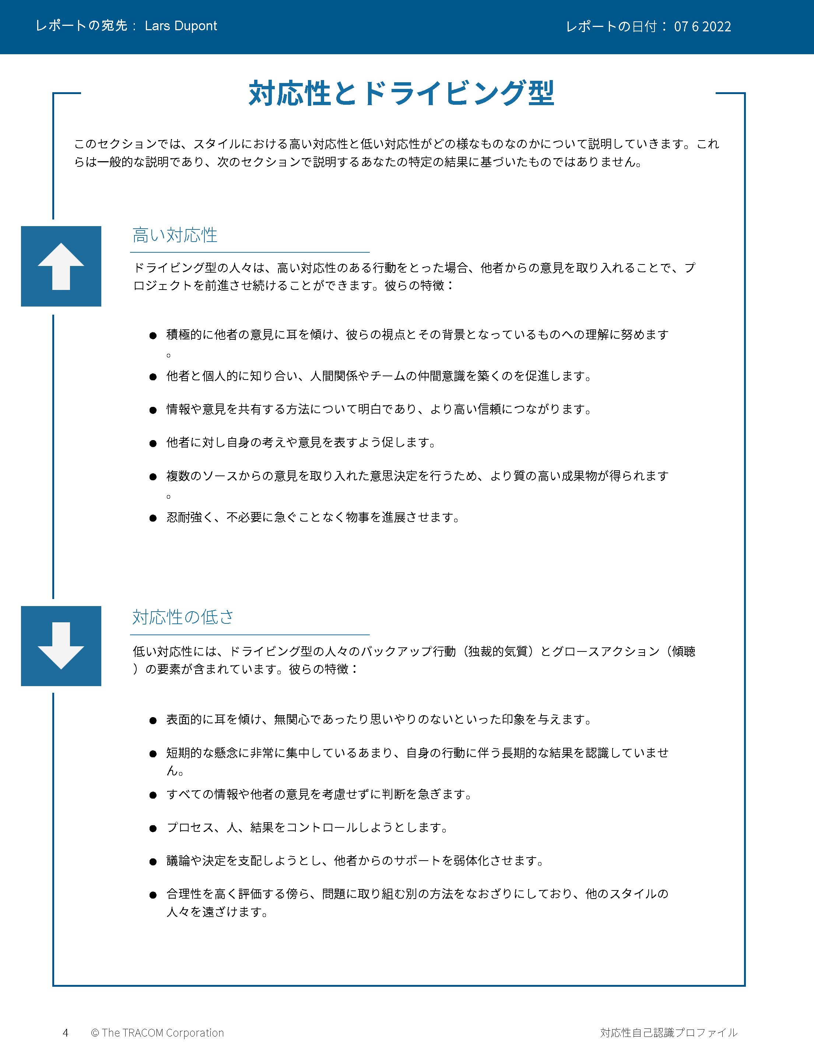
© The TRACOM Corporation. All Rights Reserved.
31
Notes:
These slides show pages of the Versatility profile and can be displayed to assist with conversation during the exercise debrief.

Slide 32
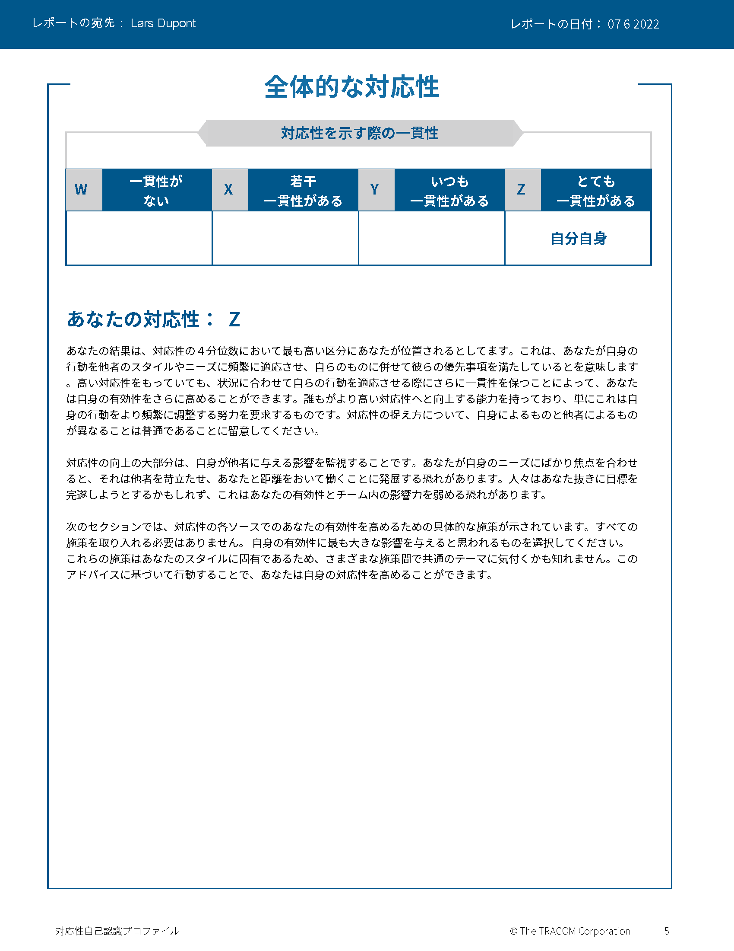
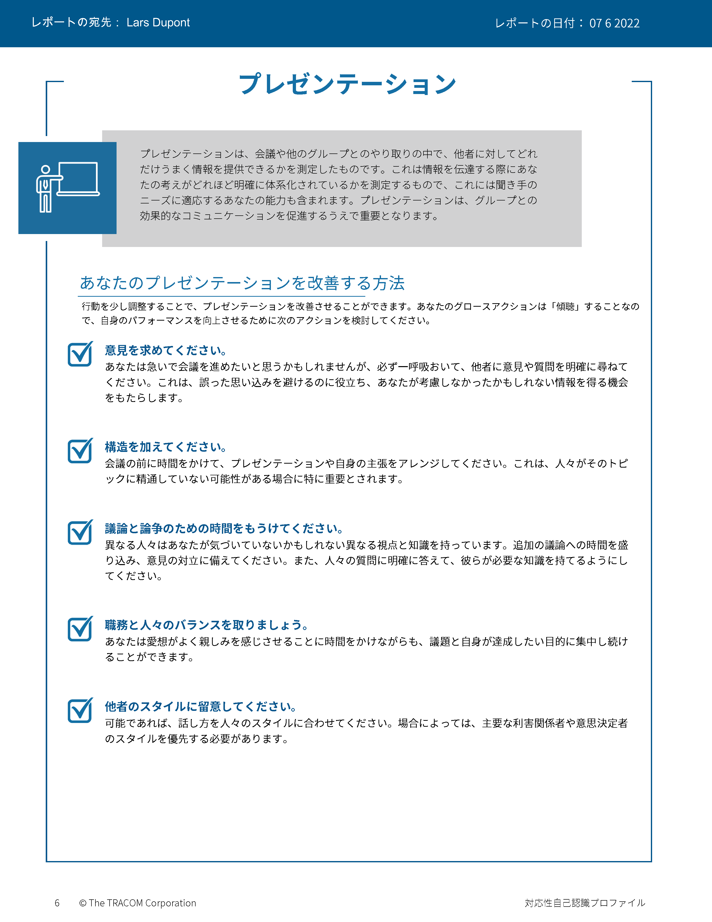
© The TRACOM Corporation. All Rights Reserved.
32
Notes:
These slides show pages of the Versatility profile and can be displayed to assist with conversation during the exercise debrief.

Slide 33
© The TRACOM Corporation. All Rights Reserved.
33
Notes:
These slides show pages of the Versatility profile and can be displayed to assist with conversation during the exercise debrief.

Slide 34
© The TRACOM Corporation. All Rights Reserved.
34
Notes:
These slides show pages of the Versatility profile and can be displayed to assist with conversation during the exercise debrief.

Slide 35
印刷版対応性プロファイル
Notes:
If using the paper assessment, use the following slides.

Slide 36
対応性
共同作業での対人効果を高める手段
行動から見た重視対象
低い
ふつう
高い
自分の緊張度
相手の緊張度
Notes:
2 MINUTES
THIS SLIDE IS USED ONLY WITH THE PAPER PROFILE.
SAY while identifying your SOCIAL STYLE can help you understand your behavioral preferences, by itself, knowing your Style doesn’t necessarily help you be more effective. As I’ve said, there is no good or bad Style. What is important is how you adjust your behavior when working with others. That’s where Versatility comes in.
Versatility is your ability to adjust your behavior to meet others’ Style preferences in the areas of Image, Presentation, Competence, and Feedback.
SAY When you are not consistent in your behavior, you’re usually focusing on your own tension and Style needs. When you consistently show Versatility, you’re focusing on meeting others’ Style needs, which reduces their tension. When you are consistent, the more effective you will be.

Slide 37
対応性の自己認識
ミシン目に沿って紙を裂き、開きます
網掛けされた列に入ったチェック マークの数を合計します
自分の対応性レベルに当てはまる 文字を丸で囲みます
例：
7以下 = 低い（「L」を丸で囲みます）
8～14 = ふつう（「M」を丸で囲みます）
15～21 = 高い（「H」を丸で囲みます）
L | M | H
自己認識したスタイルとほかの人から見たスタイルが異なる場合があります。
© The TRACOM Corporation. All Rights Reserved.
Notes:
8 MINUTES
THIS SLIDE ONLY USED WITH PAPER PROFILE.
1. ASK participants to score their Versatility Questionnaires following the instructions on the slide.
2. SAY before we discuss Versatility, I’d like you to score your Versatility Questionnaire.
After scoring is complete, ASK Is anyone surprised? Are there any questions or concerns?
The Versatility profile reflects how you see yourself. Keep in mind that others may see you differently.

Slide 38
学習目標
ソーシャル・スタイル™ モデルを理解する。
自己認識での評価を完了して、自分のソーシャル・スタイルを推定する。
自分の行動について、また自分と同じスタイルの人がほかの人からはどう見えるかについての理解を深める。
対応性を強化して対人効果を向上させる。
Notes:
2 MINUTES
REVIEW the Session objectives.
ASK Did we meet them?
HIGHLIGHT key points learned.
EMPHASIZE importance of verifying self-perception data and, if possible, comparing it to multi-rater feedback.

Slide 39
次のステップと学習のポイント
自分のソーシャル・スタイルを同僚に伝え、洞察を求めましょう。
次の 2 つの行動分析軸を探します。 自己主張度と感情表現度。
相手とのやり取りの中で、ほかの人のソーシャル・スタイルのニーズを満たす方法を講じます。
ほかの人が今後取る可能性の高い スタイル別の行動を予測します。
Notes:
3 MINUTES
As participants take their knowledge of Style back into the workplace, suggest that they do the following:
SHARE their Style with their colleagues and ask them for additional insights into how they can interact more effectively.
REMIND them that the most objective way to identify a colleague’s Style is by looking for behavior along Assertiveness and Responsiveness.
POINT OUT to participants that they can use the information in the workbook to help make their interactions with others more productive by following the guidelines for “Knowing Yourself, Controlling Yourself, Knowing Others, and Doing Something for Others.”
Finally, UNDERSCORE that being able to predict the probable future Style behavior of their colleagues is a powerful tool for interpersonal success. Participants now have valuable information to use in developing themselves into more effective individuals.

Slide 40
SOCIAL STYLE Navigator®
SOCIAL STYLE Estimator （ソーシャル・スタイル推定調査票） ほかの人のスタイルを推定するための簡単な アンケート
ソーシャル・スタイルアドバイザー
ミーティング、商談、プレゼンテーションの準備
多様な状況に応じたスタイルと対応性のベストプラクティス
eラーニングモジュール スタイルの概念をチームに適用し、対立の管理、コーチングを通じてさらに優れた対応性を実現
SOCIAL STYLE Navigator® は、TRACOM Corporationの登録商標です
Notes:
1 Minute
SAY You now have free and unlimited access to SOCIAL STYLE Navigator, the on-demand micro-learning tool that helps you apply Style and Versatility.
SOCIAL STYLE Navigator includes:
SOCIAL STYLE Estimator
The Estimator survey provides users with an interactive tool that evaluates observable behavior in others to determine their Style and helps you plan ahead for successful interactions.
SOCIAL STYLE Advisor
Use Advisor topics to prepare “just-in-time” for meetings, negotiations or sales presentations with advice on navigating Style and Versatility best practices to maximize high-performing relationships.
eLearning modules
Continue your learning journey via micro-learning that reinforces ways to apply SOCIAL STYLE and Versatility to Working in Teams, Coaching and Managing Conflict.

Slide 41
SOCIAL STYLE Navigator®への アクセス （オンライン版プロファイル限定）
tracomlearning.comから 利用可能
ユーザー名とパスワードでログインし、無制限のSOCIAL STYLE Navigatorに無料でアクセス
Notes:
1 Minute
THIS SLIDE FOR ONLINE PROFILES ONLY
SAY Available through www.tracomlearning.com
Enter your username and password for free, unlimited access to SOCIAL STYLE Navigator®

Slide 42
SOCIAL STYLE Navigator® へのアクセス （印刷版プロファイル限定）
アクセス先：
tracomlearning.com/registration-paper
メールアドレスとサブスクリプション コード_____-_____で登録
無制限のSOCIAL STYLE Navigarorに無料でアクセス
Notes:
1 Minute
THIS SLIDE FOR PAPER SURVEYS ONLY
SAY Go to tracomlearning.com/registration-paper and register with your email address and subscription code ______-______ for free, unlimited access to SOCIAL STYLE Navigator®
IMPORTANT FACILITATOR NOTE REGARDING SUBSCRIPTION CODES:
Your subscription code can be found on the “ATTENTION” colored flyer included in your participant materials shipment. The code is formatted in two sets of 4 numbers separated by a hyphen (EXAMPLE：xxxx-xxxx). If you do not have the “ATTENTION” flyer included with your materials shipment, please contact TRACOM to receive your subscription code.

Slide 43
Notes:
Optional demonstration, time permitting

Slide 44
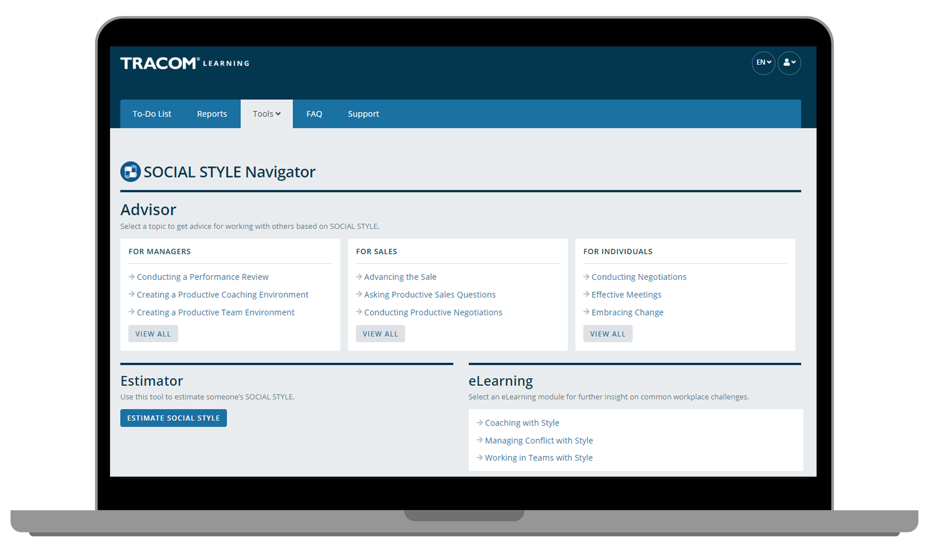
Notes:
Optional demonstration, time permitting

Slide 45
Notes:
Optional demonstration, time permitting

Slide 46
Notes:
Optional demonstration, time permitting

Slide 47
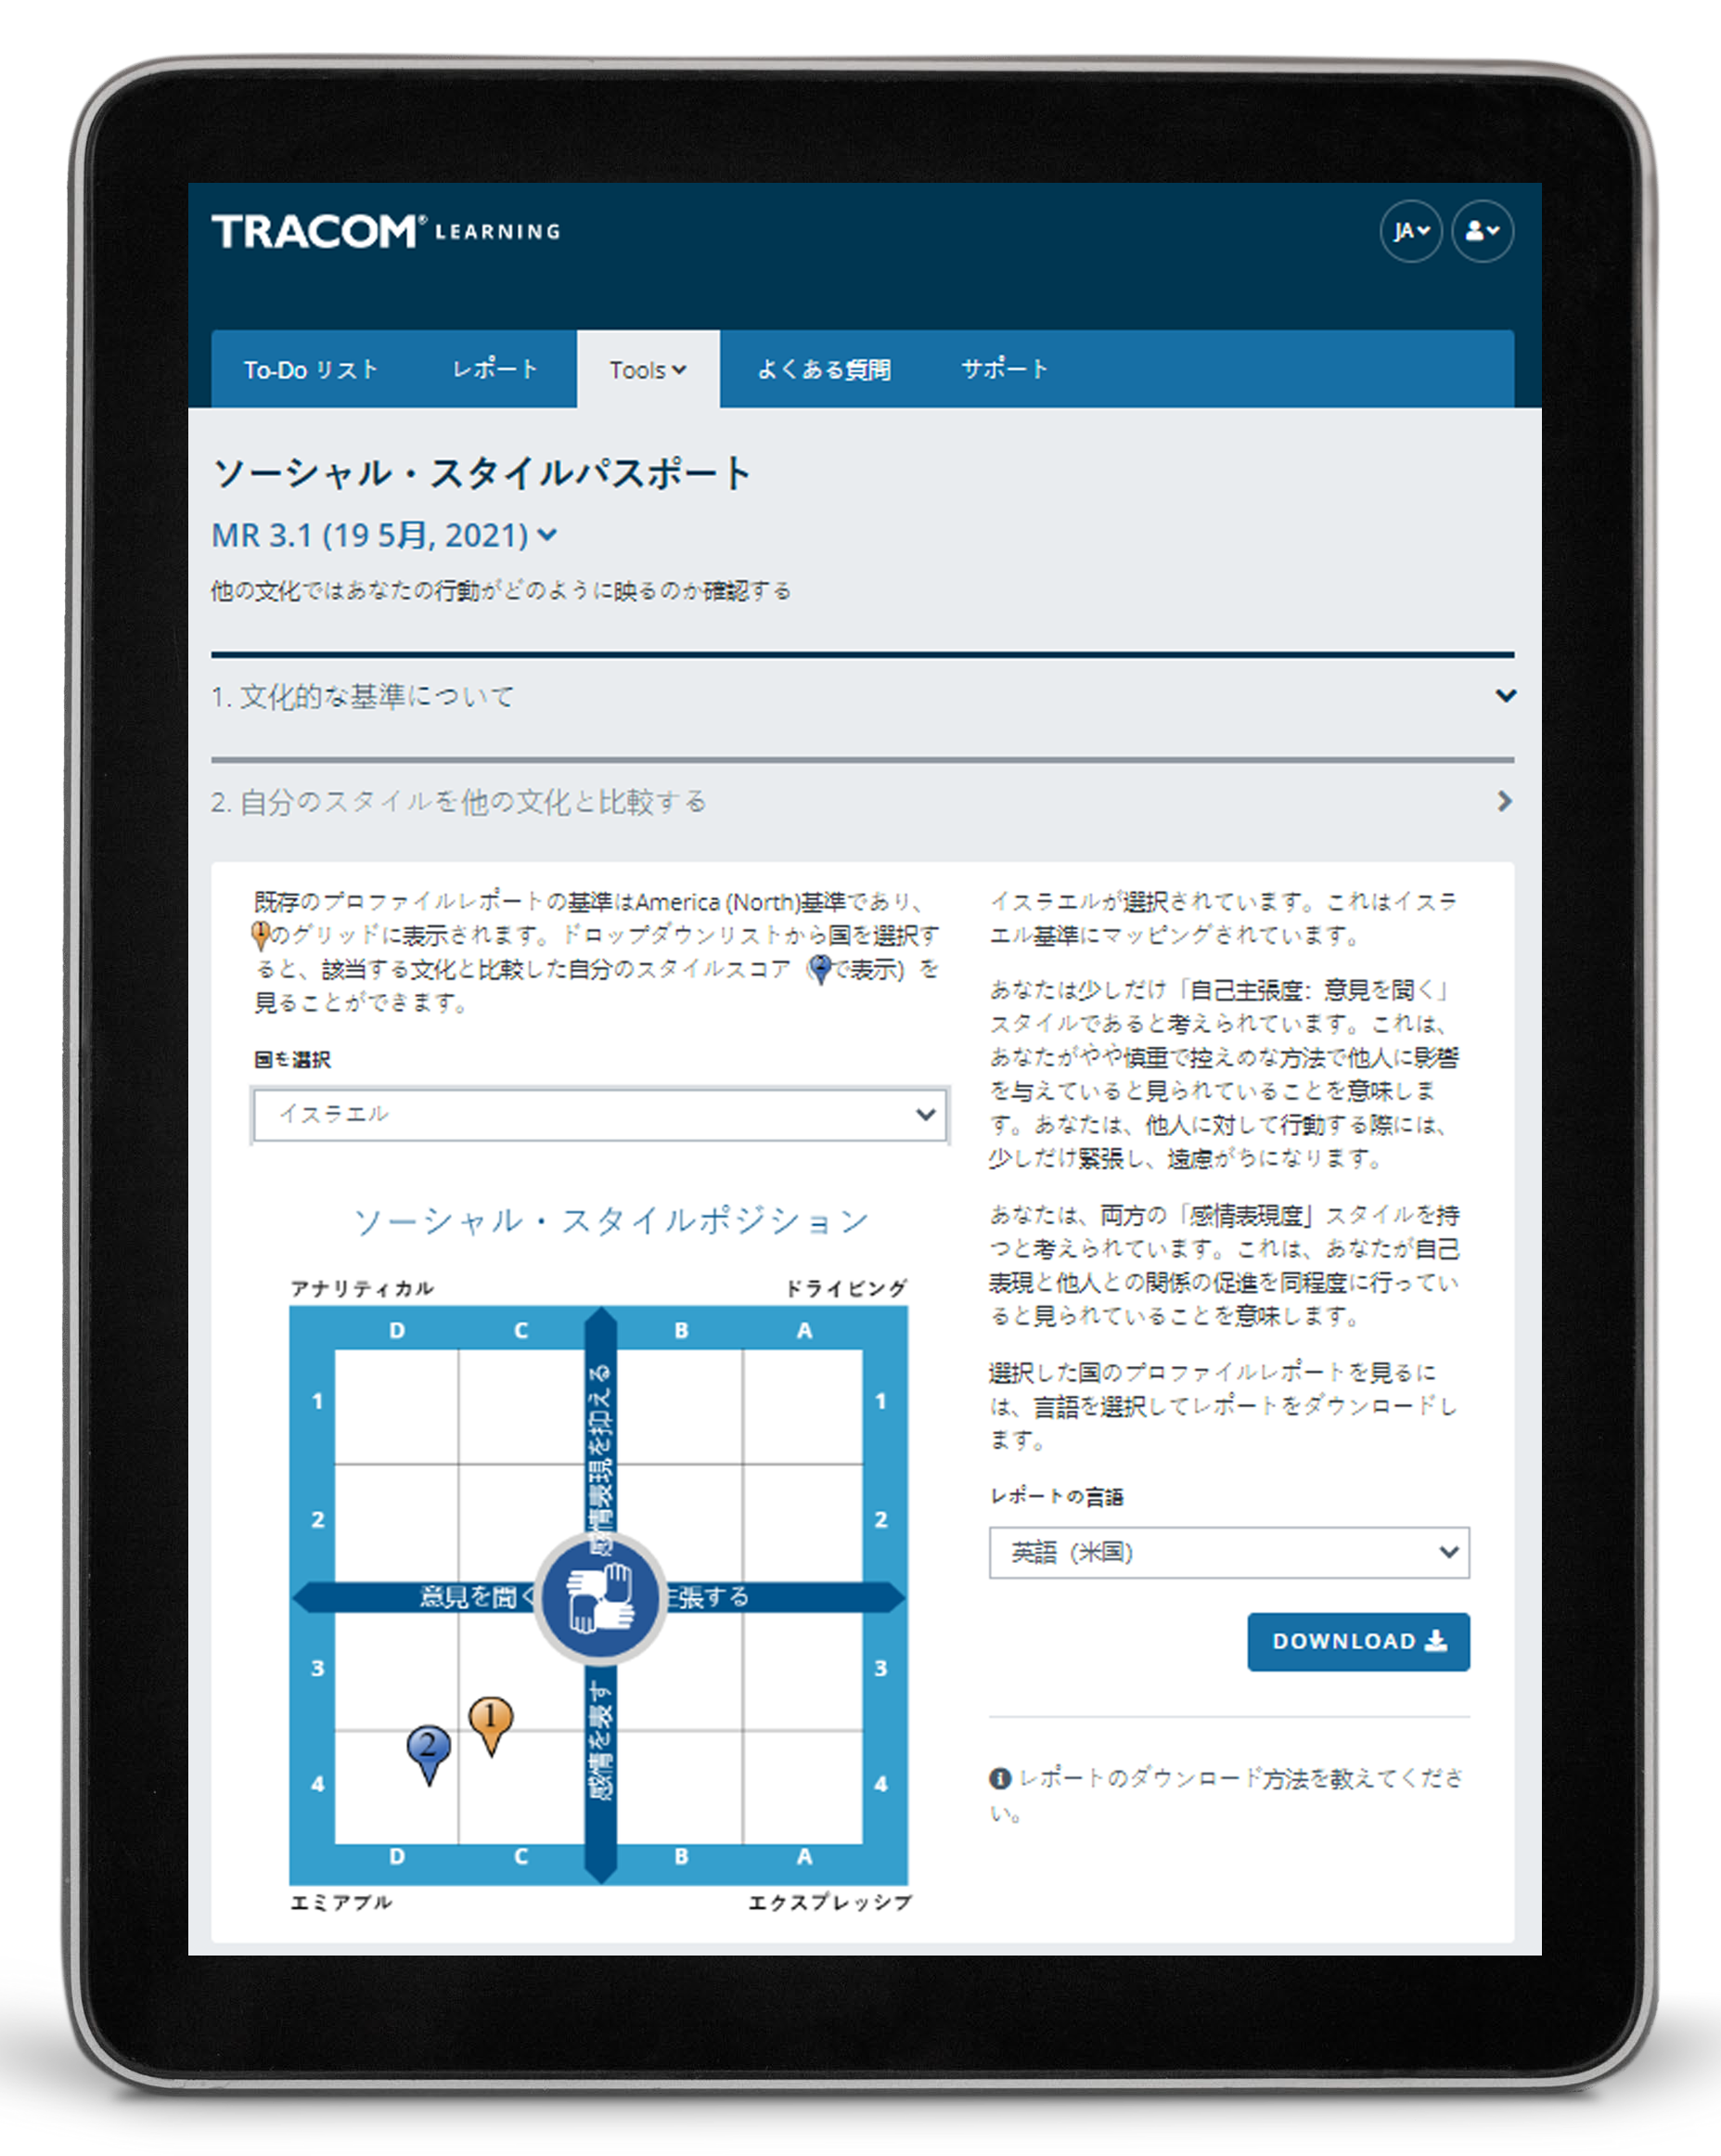
ソーシャル・スタイル・パスポート
Notes:
Optional demonstration, time permitting

Slide 48
48
Notes:
SAY Thank you. Do you have final questions?

Slide 49
オプション演習
オプション演習は、トレーニングのニーズと利用できる時間に応じて選択してください。
49
Notes:
You can use the following exercises to enhance the session to best meet the needs of your participants.

Slide 50
スタイル観察のテクニック
結論を急がない
客観性を保つ
スタイルによる行動を個人の役割や立場から切り離す
適度なストレス下に置くことで、各人のスタイルがわかり やすくなる
邪魔をしない（観察に専念）
1
2
3
4
5
Notes:
Guidelines for Observing Style
Purpose
The purpose of this exercise is to familiarize participants with the rules for identifying another person's SOCIAL STYLE.
Recommended Time:
10 minutes
Materials Needed
None
Directions
SAY The more accurately we are able to observe our colleagues’ Styles, the better we will be able to adapt our own behavior to display greater Versatility.
ASK participants to take notes on ways of implementing the best practices.
DESCRIBE the best practices:
Don’t jump to conclusions
Remain objective
Separate Style behavior from someone’s role or position
A moderate amount of stress can clarify someone’s Style
Get out of the way (be an observer)
ASK if there are any questions.

Slide 51
スタイルフォーラム
趣旨：自分が緊張してしまう正反対のソーシャル・スタイルの ポジションがどのようなものかを説明し、そのスタイルの人と より生産的に付き合う方法について洞察を深める機会を提供する。
指示：
割り当てられたグループで、自分に緊張を強いる正反対の ソーシャル・スタイルの行動について話し合い、該当する行動の リストを作成します。
自分たちのリストを正反対のスタイルのグループと共有します。
反対のスタイルとのやり取りを向上させるために取れる対策をグループで話し合います。
グループの話を反対のスタイルのグループやクラス全体にも 共有します。
51
Notes:
Style Forum
Purpose
The purpose of this exercise is to give participants an opportunity to describe what it is about the opposite SOCIAL STYLE position that creates tension for them when working with people of that Style and to develop insights into how to be more productive with a person who has that Style.
Recommended Time
30 minutes
Materials needed
None
Directions
Break participants into groups by SOCIAL STYLE position with a maximum of six per group.
Give each group 10 minutes to discuss and develop a list of behaviors that the opposite SOCIAL STYLE position manifests to create tension that leads to unproductive relationships.
After each group has developed its list, ask the Amiable and Driving Styles to get together to share their lists. Ask the Expressive and Analytical Styles to do the same thing. Each Style should spend five to ten minutes sharing its list and answering clarifying questions. Caution the groups that this is not a time to get defensive.
After each group has heard the other’s list, the original groups should get together by themselves to discuss what they can do to interact better with the opposite Style (e.g., those with Expressive Styles would develop a list of what they could do to make the relationship more productive with Analytical Styles). As each group shares its list of what it could do better, the opposite Style group should provide feedback and suggestions as to how appropriate the lists are.
After all groups have shared their information with the opposite Style, the whole class discusses what has been learned.
At the conclusion of the exercise, each group should have valuable information as to how to behave more appropriately with the diagonally opposite Style. In addition, after the general class discussions, each Style should have valuable information for working with each of the other SOCIAL STYLE positions.

Slide 52
対応性フォーラム
趣旨：難しい関係について説明し、その関係で相手に対して対応 性を発揮するために実行できる具体的方法をグループで協力して 特定する機会を提供する。
指示：
4つのスタイル別グループに分かれます。
それぞれ一度に1個ずつ、次の作業を行います。
相手と難しい関係にある同僚について説明し、相手のスタイルの特定を試みます。
同僚のどのような行動が不満を招いているかを共有します。
グループ全体で協力し、該当者が同僚への対応性を強化する ための具体的なアクションを特定できるようサポートします。
代表者を決めます。グループ全体で共有するべき独自性や洞 察に満ちたものは、ありますか？
52
Notes:
Versatility Forum
Purpose
This exercise helps learners prepare to apply Versatility with a challenging relationship. Each Style group helps one another identify specific actions they can take to show more Versatility.
Recommended Time
30 minutes
Materials needed
Style and Versatility profiles, to help discover specific strategies for showing Versatility.
Directions
DIVIDE participants into Style groups and assign them to virtual breakout rooms (or separate areas of a physical space).
PROVIDE instructions on the slide.
SAY Nominate a spokesperson to represent your Style group. Take note of anything unique or insightful that you want to share with the whole group. We don’t want you to repeat everything that was said, only key takeaways.
CONDUCT the activity, carefully monitoring time and adding value as appropriate.
CLOSE the Versatility Forum by ASKING for questions and EMPHASIZING any key insights participants made.

Slide 53
SOCIAL STYLE Navigator
趣旨：Navigatorを使用することで、自分の対人効果を向上させる。
指示：
自分がより効果的に対処したい相手や状況（チームミーティングなど）を決めます。
tracomlearning.comにログインし、「Tools」（ツール） タブで「SOCIAL STYLE Navigator」 を選択します。
「Estimator（ソーシャル・スタイル推定調査票）」を使用し、自分が特定した人物のスタイルを推定します。複数の人が関わっている場合は、一人ひとりに同じことをするか、当座はこのステップをスキップします。
「Advisor」セクションの下にリストアップされたトピックを調べ、関連するアドバイス領域を見つけてクリックします。
アドバイスを読み、必要に応じてそのページを印刷して手元に置いておきます。
得た洞察についてグループで話し合います。
53
Notes:
SOCIAL STYLE Navigator
Purpose
To use SOCIAL STYLE Navigator to improve your effectiveness.
Recommended Time
30 minutes
Materials Needed
Login to tracomlearning.com and navigate to the Tools tab
Directions
Determine a person or situation (such as team meetings) where you want to improve your effectiveness.
Login to tracomlearning.com and select SOCIAL STYLE Navigator from the Tools tab.
Use the “Estimator” to estimate the Style of the person you identified. If multiple people are involved, do this for each person or skip this step for now.
Examine the list of topics under the “Advisor” tab to find the relevant advice area and click on it.
Read the advice and print the page if needed to keep with you.
As a group, discuss any insights that were learned.

Slide 54
対応性強化アクションプラン
趣旨：対応性を高めるためのアクションプランを立てる。
指示：
自分の対応性プロファイルを読んで、自分の行動を理解します （オンライン版プロファイル限定）。
プレゼンテーションを向上させる方法、能力を向上させる 方法、フィードバックを向上させる方法の3セクションで実施する戦略を確認します（オンライン版プロファイル限定）。
各領域の具体的なアクションのうち、実行するものを1～2個決め、書き下します。
別の人（または少人数のグループ）とペアを組み、計画につい て話し合います。
54
Notes:
Versatility Action Plan
Purpose
To develop a specific action plan for increasing your Versatility.
Recommended Time
30 minutes
Materials Needed
Versatility Profile
Directions
Read your Versatility profile to understand your behavior.
Review the strategies provided in the three sections：Ways to Improve Presentation, Ways to Improve Competence, and Ways to Improve Feedback.
Within each area, decide on one or two specific actions that you will take, and write these down.
Pair up with another person (or small group) and discuss your plan.

Slide 55
対応性で他者への影響度を向上させるTM
バージョン4.0
Notes:
<<Copy and paste this table to notes pages on which you want participants to be able to take notes

