Slide 1
Steigerung der Effektivität durch AnpassungsfähigkeitTM
Version 4.0
Notes:
3 MINUTES (Participant Workbook, pages 1 and 2)
WELCOME participants to the session and REVIEW key points about TRACOM’s SOCIAL STYLE Model:
One of the most widely-used and highly-regarded behavioral models in use today.
Will help you develop insight about your behavioral strengths and weaknesses, and your co-workers’ behavioral preferences.
Originally developed in the 1960s by psychologists David Merrill and Roger Reid.
Used worldwide by millions of people.
PROGRAM BENEFITS
SAY Working successfully with others depends on developing good relationships. You can do this by understanding your own Style and, more importantly, other people’s Styles. This allows you to practice Versatility, adjusting your behavior to meet other people’s Style preferences. Research shows that people who consistently show Versatility are more effective in their jobs than people who don’t show Versatility.
ASK participants to turn to Pages 1 and 2 in the workbook to follow along.
Cite the proven effectiveness of increased Versatility (e.g., Sales and Management studies on page 2 of the IPEV Participant Workbook).
<<Copy and paste this table to notes pages on which you want participants to be able to take notes

Slide 2
Lernziele
Verständnis des SOCIAL STYLE-Modells™ gewinnen.
Bestimmen Ihres SOCIAL STYLE mithilfe eines Fragebogens zur Selbsteinschätzung.
Besseres Verständnis Ihres Verhaltens und darüber, wie andere Personen Ihren Stil wahrnehmen.
Erhöhen Ihrer Anpassungsfähigkeit, um effektiver mit anderen zu arbeiten.
Notes:
15 MINUTES TOTAL (Participant Workbook pages 1 and 2)
5 MINUTES
Going through this session you will:
• Gain an understanding of the SOCIAL STYLE Model.
• Estimate your SOCIAL STYLE by completing a self-perception assessment.
• Increase your understanding of your behavior and how others tend to view people with your Style.
• Increase your Versatility to become more effective with others.
SAY I want to emphasize the last point, number 4. While you’ll learn a lot about yourself, the goal of this program is to learn about the people you work with and how you can adjust your behavior to work more effectively with them. Versatility is about adjusting your behavior to help others meet their Style needs. When you do this, you increase your effectiveness and also make it easier for others to show Versatility toward you.
If your participants completed the Online Self-Perception assessment:
Make sure you have a profile for each participant who completed the assessment.
DO NOT pass out the profiles at this time.
VIRTUAL: Participants should already have their profiles available.
10 MINUTES
If you are using the Paper assessment:
SAY It’s critical that individuals understand their own behavior and how it affects others. So we’re going to do an exercise that will give you insights about yourself. You’re each going to complete a self-assessment of your SOCIAL STYLE. With that knowledge as a foundation, we’ll then look at how you can work more effectively with others.
1. DISTRIBUTE questionnaires.
2. ASK participants to complete the SOCIAL STYLE and Versatility Questionnaires.
3. DO NOT ask participants to score their questionnaires at this time.
VIRTUAL PROGRAM
If delivering virtually, you will not be able to use paper questionnaires and will need to prepare ahead of time to deliver online profiles. Arrange to have a notification sent to learners so they can download their profiles prior to the session.

Slide 3
SOCIAL STYLE & ANPASSUNGSFÄHIGKEIT
EIN SCHLÜSSELELEMENT DES ERFOLGS
Als Ergebnis des SOCIAL STYLE- und des Anpassungsfähigkeitstrainings berichten die Teilnehmer Folgendes:
88 %
74 %
71 %
berichteten eine
berichteten von einer
berichteten von einer
EFFIZIENTERE ZUSAMMENARBEIT MIT ANDEREN
VERBESSERUNG BEI KONFLIKTSITUATIONEN
VERBESSERUNG BEI SCHWIERIGEN ARBEITSBEZIEHUNGEN
Mit zunehmender Anpassungsfähigkeit steigt auch die Arbeitsleistung.
Notes:
2 Minutes
SAY In the first part of the program, you’ll learn about Style. This will help you understand your co-workers and how they prefer to get work done.
The second part of the program focuses on Versatility, which is how well you meet others’ Style needs.
Versatility is the application of SOCIAL STYLE—when you understand your co-workers’ Style needs, you can help them meet those needs. This helps them feel more valued and sets the stage for them to have a better relationship with you. If you consistently show Versatility, you can be more effective.
You can read the stats on this slide. Research has found that Versatility is a strong predictor of successful job performance. Individuals who consistently show Versatility are rated more effective in their job performance than those who are inconsistent in their Versatility.

Slide 4
Wahrnehmbares Verhalten vs. Persönlichkeit
Verhalten
Was Sie sagen (verbal) und was Sie tun (nonverbal)
SOCIAL STYLE® Ein bestimmtes Verhaltensmuster, das andere Personen an Ihnen beobachten können und mit dem sie Sie beschreiben würden
Wahrnehmbares Verhalten
Sagen / Tun
Persönlichkeit
Zwischenmenschliches Verhalten
Was Sie sagen und tun, wenn Sie mit einer oder mehreren Personen interagieren
Persönlichkeit
Alles, was eine Person ausmacht: ihre Ideen, Werte, Hoffnungen und Träume
Notes:
4 MINUTES (Participant Workbook page 3)
ASK participants to turn to page 3 of the workbook to follow along.
SAY Behavior and personality are not the same things. Observable behavior is like the crust of a pie. Personality is like the inside and outside of the pie.
ASK What makes up personality?
CONDUCT a quick facilitated discussion to solicit participants’ responses. They should say things such as:
Values, hopes, attitudes, beliefs.
Things that are not necessarily observable.
These internal qualities are more subjective in nature.
SAY Style is like the crust, because it’s on the outside and observable. By observing behavior, we can find ways to define and discuss what we see. Then, we can begin to understand how this behavior affects ourselves and others.

Slide 5
Sagen & Tun-Verhaltensweisen
Eigenschaften
Ehrlich
Intelligent
Arrogant
Motiviert
Egozentrisch
Aufrichtig
Kritisch
Wahrnehmbares Verhalten
Ruhig
Langsameres Tempo
Beherrschtere Mimik
Weniger modulierter Stimme
Weniger Augenkontakt
Lockere Haltung
Zurückgelehnt
Laut
Höheres Tempo
Lebhaftere Mimik
Stärker modulierter Stimme
Mehr Augenkontakt
Starre Haltung
Nach vorne gelehnt
Bewertungen
Ich mag ihn
Er nervt mich
Sie interessiert mich
Er ärgert mich
Ich traue ihr nicht
Ich hasse ihn
Ich vertraue ihm
SAGEN
TUN
Notes:
4 MINUTES (Participant Workbook page 4)
ASK participants to turn to page 4 of the workbook to follow along.
SAY When we first meet people, we often form immediate impressions, even after just a few seconds. This is sub-conscious (below our awareness) and happens immediately.
DESCRIBE
Traits Column: What we think we know about a person, based on interactions; subjective opinions.
Judgments Column: Our reactions to others; conclusions or evaluations we make, based on our subjective opinions.
Observable Behavior Column: Things others “Say and Do”; more objective and observable behaviors.
SAY Traits and Judgments are most subjective in nature and contain positive or negative descriptions.
Observable Behavior is objective and contains no positive or negative value.
Observable Behavior is an important tool for assessing others’ Styles. By focusing on Observable Behavior, you gain objectivity, which is critical for understanding people’s Styles.

Slide 6
Einflussnahme und Gefühlsausdruck
Notes:
SAY We measure observable behavior on two dimensions: Assertiveness and Responsiveness

Slide 7
Einflussnahme
Das Ausmaß, in dem wir in der Interaktion mit anderen „fragen“ oder „anordnen“
Stärker fragend
Fragend mit einigem Anordnen
Anordnend mit einigem Fragen
Stärker anordnend
Notes:
4 MINUTES (Participant workbook page 5)
ASK participants to turn to page 5 of the workbook.
SAY To become more effective with others, we follow a behavioral model. There are two dimensions of behavior that define SOCIAL STYLE: Assertiveness and Responsiveness.
Assertiveness is the degree to which we ask or tell when interacting with others. The two anchors for Assertiveness are Ask on the left side of the continuum and Tell on the right side of the continuum.
Assertiveness is a measurement of how we try to influence others to take action. If you are more “Tell” Assertive, you state your opinions directly. You tend to declare your viewpoints and try to direct the actions of others.
For example, if you want to have lunch with someone, you might say, “Let’s have lunch today!”
If you are more “Ask” Assertive, you tend to be more cautious and reserved about sharing your opinions. You attempt to influence others in a more quiet, low-key, questioning manner.
For example, if you want to have lunch with someone, you might say, “Would you like to have lunch with me today?”

Slide 8
Verhaltensweisen der Einflussnahme
SAGEN | Verbale Verhaltensweisen
Langsamer
Redegeschwindigkeit
Schneller
Weniger
Redemenge
Mehr
Leiser
Sprechlautstärke
Lauter
FRAGEND
ANORDNEND
Entspannt
Gebrauch der Hände
Anweisend
Lehnt sich zurück
Körperhaltung
Lehnt sich vor
Weniger direkt
Augenkontakt
Direkter
TUN | Nonverbale Verhaltensweisen
Notes:
3 MINUTES (Participant Workbook page 5)
SAY The Assertiveness scale helps predict a person’s behavior because it represents a “theme” or typical pattern. There are verbal and non-verbal clues to indicate a person’s Assertiveness.
ASK participants for examples of verbal and non-verbal clues for Ask-Assertive and Tell-Assertive individuals.
DESCRIBE the verbal and non-verbal indicators of Assertiveness:
Verbal: Ask-Assertive individuals use a slower pace, less quantity (fewer words), and quieter volume. Tell-Assertive individuals use a faster pace, talk more, and a louder volume.
Non-Verbal: Ask-Assertive individuals show relaxed hands and gestures, lean back, and use less direct eye contact. Tell-Assertive individuals have a directive use of hands, lean forward, and use more direct eye contact.
Optional Exercise: Do You Ask or Tell?
Virtual activity:
ASK participants to chat whether they see themselves as more asking or more telling, and to give examples of why they see themselves this way.
In-person activity:
1. ASK participants to go toward either the left side or right side of the room to indicate whether they see themselves as “more asking” (left) or “more telling” (right).
2. ASK participants to introduce themselves to people around them and to share examples of what they feel makes them more asking or more telling.
3. ASK participants to validate their self-assessment based on whether they asked questions or made statements during their discussions. (Ask Assertive individuals will tend to ask more questions; Tell Assertive individuals will tend to make more statements).
4. ASK if anyone feels as though they might have gone to the wrong place.

Slide 9
Gefühlsausdruck
Stärker kontrollierend
Kontrollierend und etwas emotional
Das Ausmaß, in dem wir Emotionen kontrollieren oder zeigen, wenn wir mit anderen interagieren
Emotional und etwas kontrollierend
Eher emotional
Notes:
4 MINUTES (Participant Workbook page 5)
Participants stay on page 5 of the workbook.
SAY Responsiveness is the degree to which people tend to control (don’t outwardly display emotions) or emote (outwardly display emotions).
The two anchors are Controls on the top of the continuum and Emotes on the bottom of the continuum.
Responsiveness is also the extent to which you react to emotional appeals or displays.
If you control your emotions, you usually don’t react to emotional appeals and are more likely to focus on ideas, data, and tasks. You are less likely to share your feelings publicly.
If you are more emoting, you share and display your emotions with others. You are more likely to respond to emotional appeals and displays from others.

Slide 10
Verhaltensweisen beim Gefühlsausdruck
SAGEN | Verbale Verhaltensweisen
TUN | Nonverbale Verhaltensweisen
Kontrolliert
Weniger Modulation
Aufgabe
Fakten/Daten
Weniger
Starr
Kontrolliert
Emotionen in der Stimme
Redethemen
Form der Beschreibungen
Gebrauch der Hände
Körperhaltung
Gesichtsausdruck
Mehr Modulation
Menschen
Meinungen/Geschichten
Mehr
Lässig
Animiert
Emotional
Notes:
3 MINUTES (Participant Workbook page 5)
SAY The Responsiveness scale, like the Assertiveness scale, helps us to predict a person’s behavior because it is a “theme” or typical pattern.
ASK participants for their opinions on the verbal and non-verbal clues of Control- and Emote-oriented individuals.
DESCRIBE the verbal and non-verbal clues to responsive behavior as noted on the slide.
SAY Responsiveness is neither a positive nor a negative quality; it is neutral.
Assertiveness and Responsiveness do not affect each other — they are independent of each other.
Optional Exercise: Do You Control or Emote?
Virtual activity:
ASK participants to chat whether they see themselves as more controlling or more emoting, and to give examples of why they see themselves this way.
In-person activity:
1. ASK participants to go toward the front of the room if they feel they are “more controlling” of their emotions or to the rear of the room if they feel that they are “more emoting” (display their emotions).
2. ASK participants to validate their self-assessments. Typically, “more emoting” individuals will be talking with one another more than the “less emoting” ones.
3. ASK if anyone feels as though they went to the wrong place.

Slide 11
SOCIAL STYLE-ModellTM
Kontrolliert
Fragende Einflussnahme Eher kontrolliert
Analytischer Stil
Anordnende Einflussnahme Eher kontrolliert
Treibender Stil
Fragend
Anordnend
Fragende Einflussnahme Eher emotional
Rücksichtsvoller Stil
Anordnende Einflussnahme Eher emotional
Expressiver Stil
Emotional
Notes:
5 MINUTES (Participant Workbook page 6)
ASK participants to turn to page 6 of the workbook.
CLICK TO REVEAL EACH QUADRANT
SAY By combining Assertiveness and Responsiveness, the four SOCIAL STYLEs are formed.
No individual will display one Style exclusively; but, over time, you can determine a person’s Style. Once you know a person’s Style, you can adjust your behavior to develop a more effective relationship.
Leader Tip: Note that there is no good or bad Style; each can be equally effective.

Slide 12
Bedarf, Orientierung und Wachstumsmaßnahme
Bedarf
Das Ziel eines jeden Stils
Orientierung Das übliche Verhalten zur Erreichung des Ziels
Wachstumsmaßnahme
Verhalten, das nur selten von den einzelnen Stilen verwendet wird. Eine häufigere Anwendung dieses Verhaltens würde die Wirksamkeit dieses Stils erhöhen
Notes:
2 MINUTES
SAY Remember that the Style descriptions are generalizations about each Style. While people with the same Style generally exhibit similar characteristics, each person is still unique.
SAY We’ve used some adjectives to describe the Styles. In addition, each Style has a Need, an Orientation, and a Growth Action.
DEFINE:
Need – The goal of each Style.
Orientation – The common behavior used to achieve the need.
Growth Action – Behavior that is rarely used by each Style. Using this behavior more often would increase this Style’s effectiveness.
SAY Understanding the Need, Orientation, and Growth Action of each Style will help you better relate to others’ Styles and enhance your effectiveness with them.

Slide 13
SOCIAL STYLE Hauptmerkmale
Kontrolliert
Analytisch
Bedarf: Recht haben
Orientierung: Überlegen
Wachstumsmaßnahme: Deklarieren
Treibend
Bedarf: Resultate
Orientierung: Maßnahmen
Wachstumsmaßnahme: Zuhören
Fragend
Anordnend
Rücksichtsvoll
Bedarf: Persönliche Sicherheit
Orientierung: Beziehungen
Wachstumsmaßnahme: Einleiten
Expressiv
Bedarf: Persönliche Anerkennung
Orientierung: Spontanität
Wachstumsmaßnahme: Überprüfen
Emotional
Notes:
6 MINUTES
CLICK TO REVEAL THE TEXT IN EACH QUADRANT.
REVIEW each Style.

Slide 14
Online-Profil zur SOCIAL STYLE-Selbstwahrnehmung
Notes:
If using the online profile, use the following slides.
Note that if delivering virtually, participants will need to have received their profiles prior to the program.
Check the Status Report and Composite Report to understand which participants have completed their profiles, and the breakdown of Style within your program.
FACILITATOR NOTE: By completing an online profile, Learners will immediately have free, unlimited access to SOCIAL STYLE Navigator through tracomlearning.com to help extend their learning beyond the classroom. See Slide #41 for details.

Slide 15
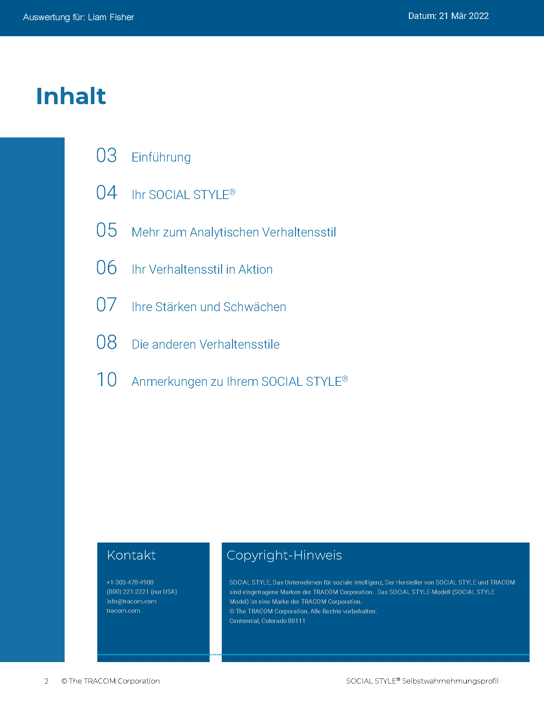
© The TRACOM Corporation. Alle Rechte vorbehalten.
15
Notes:
15 MINUTES (5 MINUTES if Virtual Program)
Purpose
The purpose of this exercise is to help participants learn more about their SOCIAL STYLE and to encourage them to think about how they can adjust their behavior to be more effective.
Materials Needed
SOCIAL STYLE profile
Virtual Directions:
ASK participants to chat their Style along with one adjustment to their behavior they can make to enhance their effectiveness with others.
In-Person Directions:
ASK participants to read their Style profile and begin to determine ways they can adjust their behavior to meet others’ Style needs. (They will continue this exercise when they read their Versatility profiles).
ASK participants to share what they learned about their Style and how they can adjust their behavior.

Slide 16
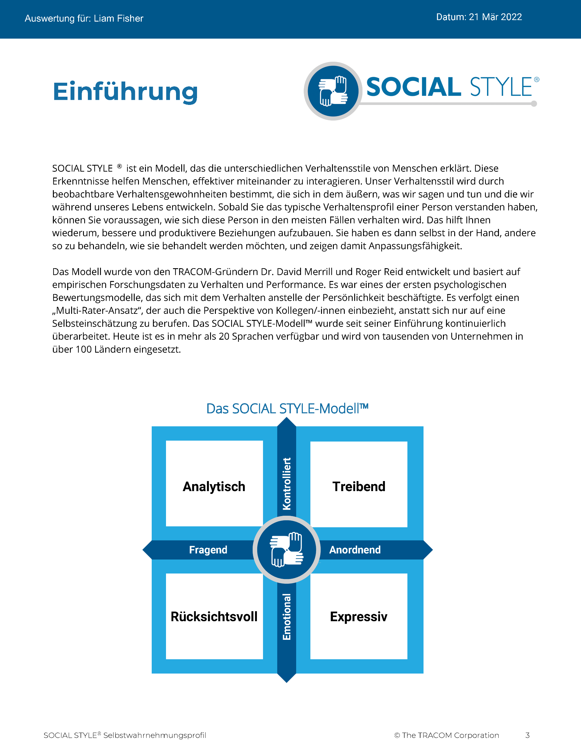
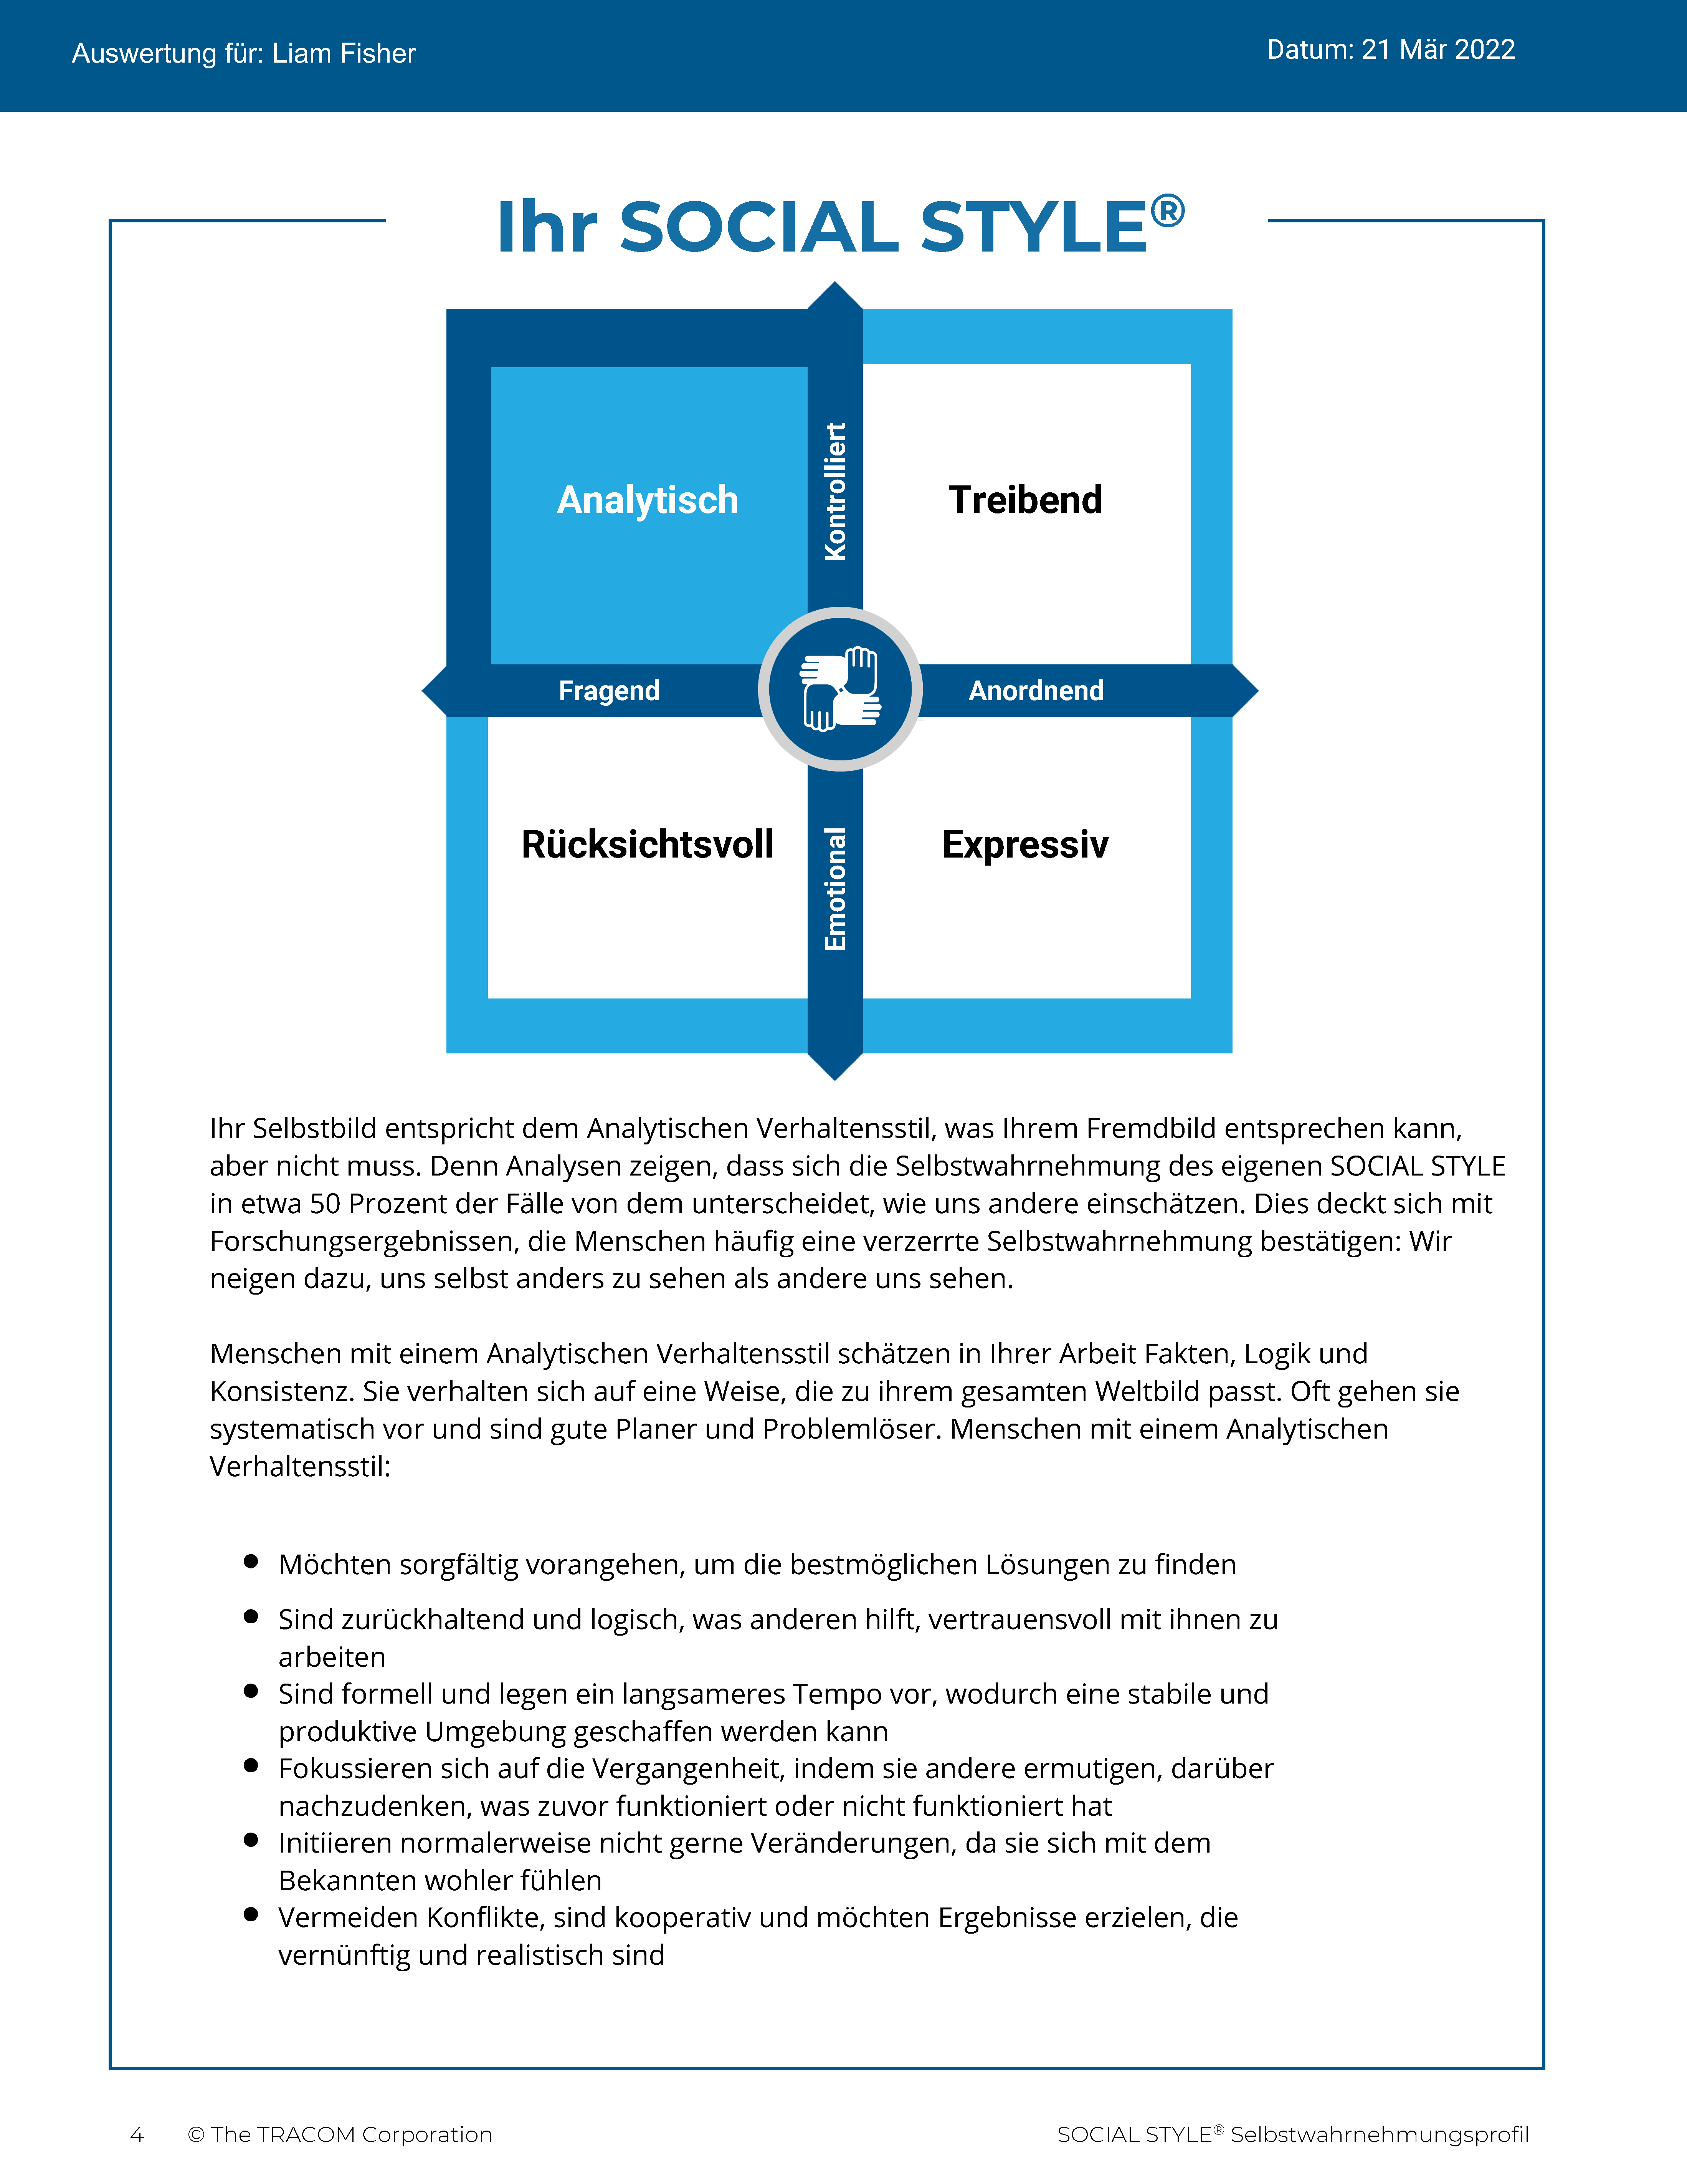
© The TRACOM Corporation. Alle Rechte vorbehalten.
16
Notes:
These slides show pages of the SOCIAL STYLE profile and can be displayed to assist with conversation during the exercise debrief.

Slide 17
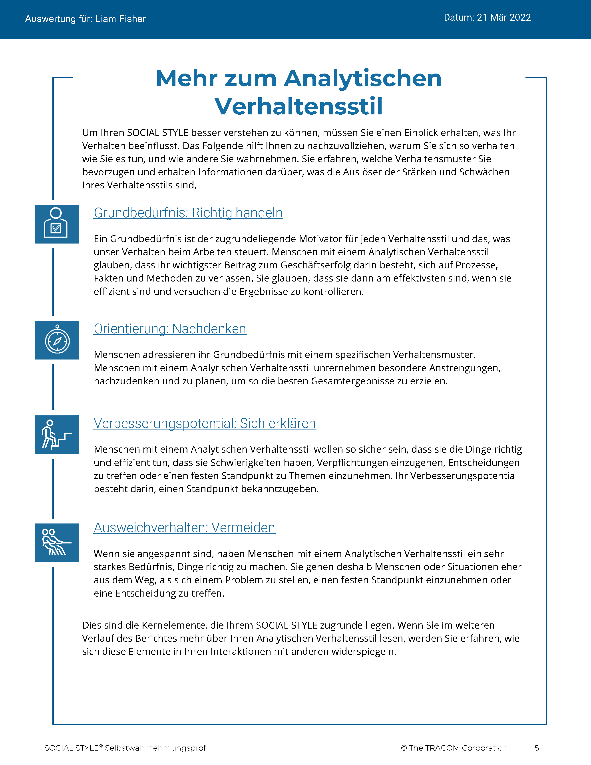
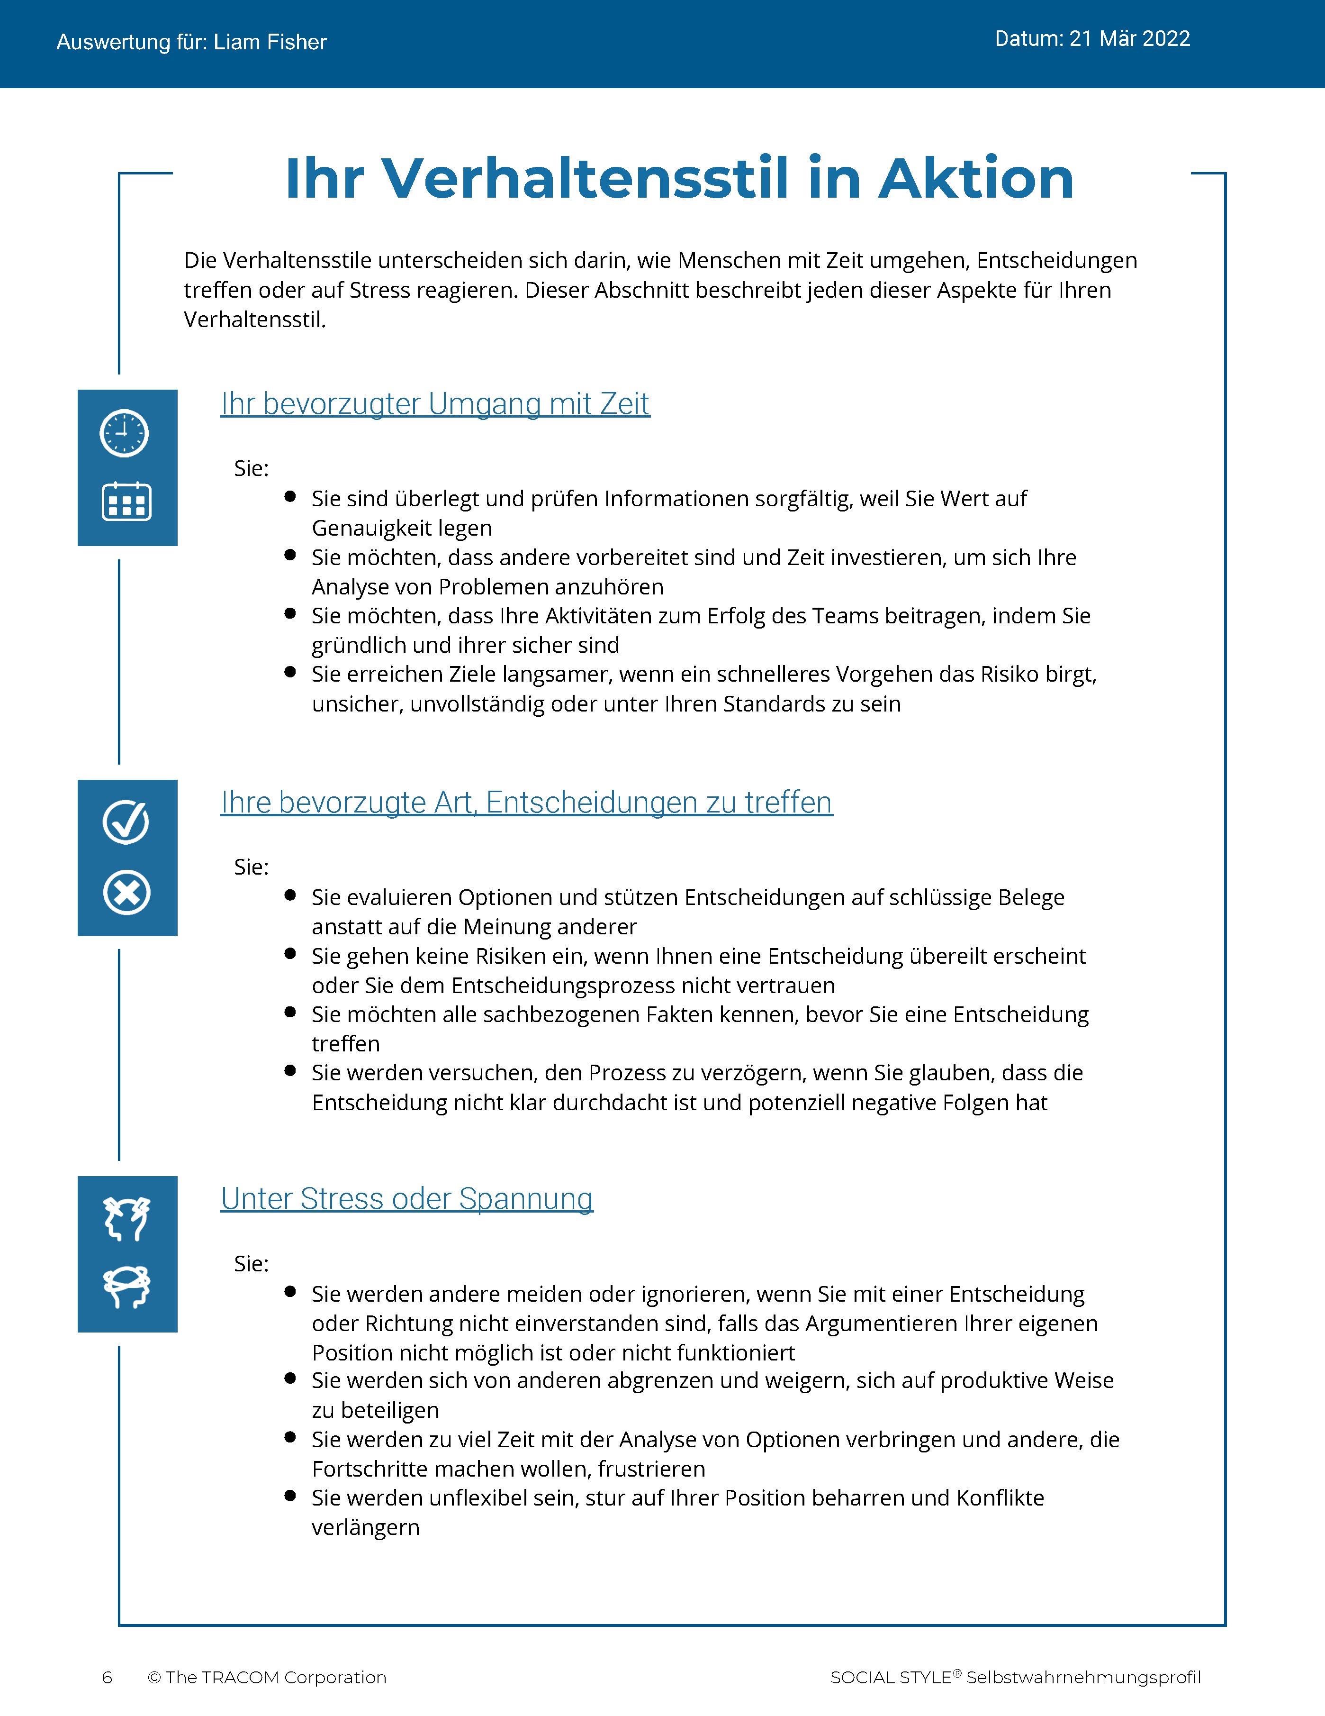
© The TRACOM Corporation. Alle Rechte vorbehalten.
17
Notes:
These slides show pages of the SOCIAL STYLE profile and can be displayed to assist with conversation during the exercise debrief.

Slide 18
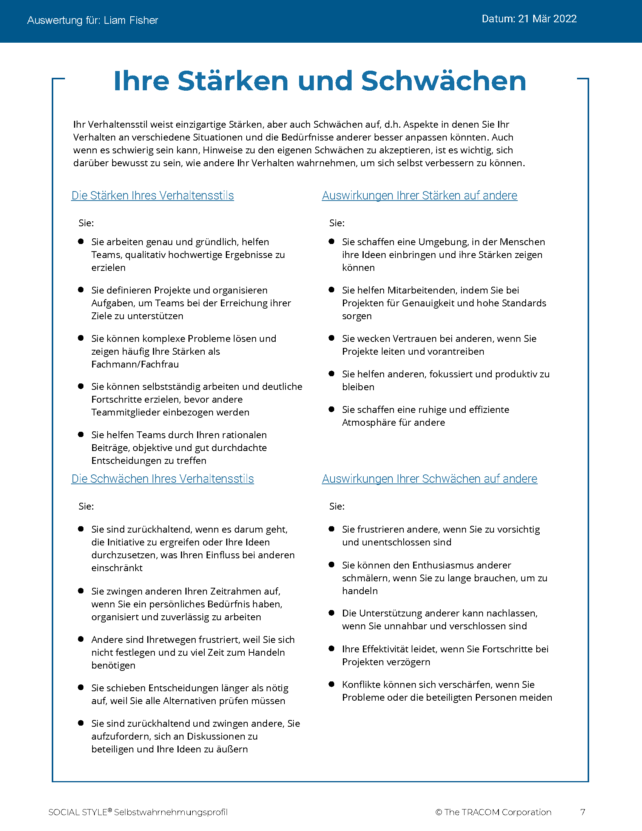
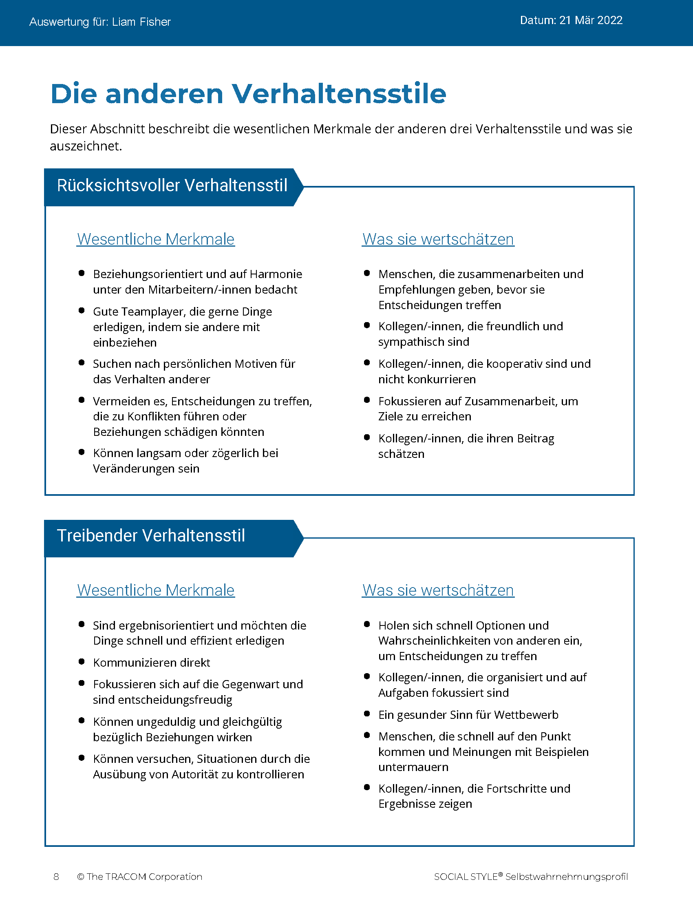
© The TRACOM Corporation. Alle Rechte vorbehalten.
18
Notes:
These slides show pages of the SOCIAL STYLE profile and can be displayed to assist with conversation during the exercise debrief.

Slide 19
© The TRACOM Corporation. Alle Rechte vorbehalten.
19
Notes:
These slides show pages of the SOCIAL STYLE profile and can be displayed to assist with conversation during the exercise debrief.

Slide 20
SOCIAL STYLE-Selbstwahrnehmungsprofil in Papierform
Notes:
If using the paper assessment, use the following slides.
FACILITATOR NOTE: To extend their learning beyond the classroom, participants who complete the Paper Survey can register for free, unlimited access to SOCIAL STYLE Navigator. See Slide #42 for details.

Slide 21
Ihre SOCIAL STYLE-Selbstwahrnehmung
BEISPIEL:
K
Perforation aufreißen
Übertragen Sie die Antwort auf jede Frage
Addieren Sie die Summen der Spalten
Planen Sie Ihren SOCIAL STYLE
Analytisch
Treibend
F
A
Rücksichtsvoll
Expressiv
E
Ihre Selbstwahrnehmung kann sich von der Wahrnehmung anderer unterscheiden!
Notes:
If using the paper assessment, use the following slides.
FACILITATOR NOTE: To extend their learning beyond the classroom, participants who complete the Paper Survey can register for free, unlimited access to SOCIAL STYLE Navigator. See Slide #42 for details.

Slide 22
Lesen Sie mehr über Ihren Stil
Kontrolliert
Analytischer Stil
Seiten 14–15
Treibender Stil
Seiten 8–9
Fragend
Anordnend
Rücksichtsvoller Stil
Seiten 12–13
Expressiver Stil
Seiten 10–11
Emotional
Notes:
15 MINUTES (Participant Workbook pages 8 to 15) – PAPER PROFILE ONLY
Purpose
The purpose of this exercise is to help participants learn more about their SOCIAL STYLE and to encourage them to think about how they can adjust their behavior to be more effective.
Materials Needed
Flip chart
Directions
ASK participants to read more about their Style in the workbook and to complete the two questions contained in each section. (10 minutes)
a. Driving Style, pages 8-9
b. Expressive Style, pages 10-11
c. Amiable Style, pages 12-13
d. Analytical Style, pages 14-15
ASK if anyone has any questions about their Style regarding (a) strengths of their Style and (b) things they need to work on.
ASK participants to share what they learned about their Style. Draw Style quadrants on the flip chart and record their answers for all to see and consider.

Slide 23
Wichtige Erinnerung
Es gibt keinen „besten“ Stil.
Stil ist nicht gleich Persönlichkeit.
Ihr Stil ist ein Motiv in Ihrem Verhalten.
Für Ihren Stil gibt es Wachstumsmaßnahmen.
Ihre Herausforderung: Ergreifen Sie die Initiative, um effektive Beziehungen zu anderen aufzubauen.
Notes:
5 MINUTES ( Participant Workbook page 16)
ASK participants to turn to page 16 in the workbook.
REVIEW what has been covered so far, discussing Key Reminders.

Slide 24
Anpassungsfähigkeit
Notes:
IPEV-24
IMEV-26
ISEV-28
ISS-44
UMBD-43 (different notes)
MFR-60 (1 minute; different notes)
SFR-58 (1 minute; different notes)

Slide 25
Anpassungsfähigkeit bedeutet, wie gut Sie sich an die Stil-Bedürfnisse anderer anpassen
Notes:
3 MINUTES
SAY Versatility is a measure of your consistency in adjusting to the Style needs of others.
At the beginning of the program, we reviewed some statistics on Versatility. Research has found that Versatility is a strong predictor of successful job performance. Individuals who consistently show Versatility are rated more effective in their job performance than those who are inconsistent in their Versatility.
Versatility is completely within your control, so it is your choice to be versatile with others. You can be highly versatile with one group and show low Versatility with another group. It depends on the circumstances and how much you value your interpersonal effectiveness with each group.
It is completely independent of SOCIAL STYLE: Any Style can show Versatility and be successful.
Versatility is NOT the same as likeability. A person can be well liked but not have high Versatility. The opposite can also be true. Versatility helps you develop better working relationships, but it is separate from your personal likeability.

Slide 26
Vier Quellen der Anpassungsfähigkeit
Die angemessene Verwendung von
Image
Präsentation
Kompetenz
Feedback
Führt zu
Höhere Anpassungsfähigkeit
Notes:
5 MINUTES (Participant Workbook page 19)
ASK participants to turn to page 19 in the workbook.
Image remains a part of the Versatility model because it’s important for building relationships. Describe Versatility in a timeline:
SAY You show Versatility in four areas.
Image – When you first meet a new person at work, you form an impression about this person based on what you see, consciously or not. Essentially Image is a first impression: Are you dressed appropriately for the situation, for the work culture, for the client, and so on?
ONLINE PROFILE: Note that Image is not measured as part of your Profile. This is because:
Image is difficult to observe in virtual environments. We can’t observe very well how people are dressed, and because there are a wide variety of dress codes, even within companies and teams, it is less relevant to measure Image in this way.
People don’t always like answering questions about Image without understanding the context of how Image is explained in training.
Image is still important for many people and companies, which is why it’s part of the model. However, you won’t receive a measure of your Image.
Presentation – When a person communicates in meetings or other public venues, you’ll notice how clear they are at helping people understand their points. Do they use clear language? Are their examples effective? Do they take others’ Styles into account?
Competence – Over time, you’ll observe this person in a variety of situations. Are they reliable and do they persevere during difficult times? Are they flexible when change happens? Are they optimistic most of the time? Do they show creativity?
Feedback – Finally, this is the most interpersonal part of Versatility. Are they a good listener? Do they show empathy for others’ situations? Do they meet the needs of other people’s Styles? Do they develop good relationships with others?

Slide 27
Online-Profil zur Selbstwahrnehmung der Anpassungsfähigkeit
Notes:
If using the online profile, use the following slides.
Note that if delivering virtually, participants will need to have received their profiles prior to the program.
Check the Status Report and Composite Report to understand which participants have completed their profiles, and the breakdown of Versatility within your program.

Slide 28
Allgemeine Anpassungsfähigkeit
Ihre Konsistenz beim Zeigen von Anpassungsfähigkeit
W | Nicht konsistent | X | Einigermaßen konsistent | Y | In der Regel konsistent | Z | Sehr konsistent
 |  | ANDERE |  | SELBST
Notes:
5 MINUTES
THIS SLIDE IS USED ONLY WITH THE ONLINE PROFILE.
SAY We measure Versatility on a scale ranging from W to Z. These are normed quartiles, just like Assertiveness and Responsiveness.
When you are not consistent in your behavior, you’re usually focusing on your own Style needs. When you consistently show Versatility, you’re focusing on meeting others’ Style needs, which reduces their tension. When you are consistent, the more effective you will be.
Your profile will show your results on this scale, ranging from W (not consistent) to Z (very consistent).
Versatility is all about consistency of behavior. A lower Versatility score does NOT mean you lack ability or that you never demonstrate these abilities. What it DOES mean is that you aren’t showing consistency in your behavior.
By making small changes to your behavior and acting with more consistency, you can increase your Versatility. (The difference in values between W and Z are small but meaningful.)

Slide 29
Die Bedeutung der Anpassungsfähigkeitspositionen
 | 1 | 2 | 3 | 4 | 5
 | Stimme überhaupt nicht zu | Stimme nicht zu | Stimme teilweise zu teilweise nicht zu | Stimme zu | Stimme voll und ganz zu
1. Geht mit einer positiven Einstellung an neue Situationen heran. | ◯ | ◯ | ◯ | ◯ | ◯
2. Baut gute Beziehungen zu seinen Kolleginnen und Kollegen auf. | ◯ | ◯ | ◯ | ◯ | ◯
3. Präsentiert seine Ideen wirkungsvoll vor Gruppen. | ◯ | ◯ | ◯ | ◯ | ◯
W | X Y | Z
Konsistenz
Notes:
3 MINUTES
THIS SLIDE IS USED ONLY WITH THE ONLINE PROFILE.
Before delivering Versatility profiles, explain the meaning of the positions.
SAY Before reviewing your results in more detail, let’s put your results into context. This graph shows several sample items that measure Versatility.
You responded to these items using the scale ranging from ‘strongly disagree’ to ‘strongly agree’. TRACOM assigns values to each of these scale points: 1 to 5.
When rating Versatility, most people respond at the higher end of the rating scale. This makes sense since most people have at least some abilities in these areas. This means that the cutoff for achieving Z Versatility is very high, approximately 4.5 or higher.
Similarly, to score either an X or Y requires scores between 3.5 and 4.5. These are approximate values used for purposes of explanation.
Importantly, if you receive a W in Versatility, this DOES NOT mean that you evaluated yourself at the low end of the rating scale. On the contrary, almost nobody scores at the lowest end – 1 or 2. For people with a W result, most of their ratings fluctuate between 2 and 4, resulting in an average score of slightly less than 3.5.
So, putting this into context, a W rating means that you are not showing as much consistency in these behaviors as you could. With effort and more consistency, your evaluation would improve.
Set the context:
W does not mean that you lack ability.
It doesn’t mean that you evaluated yourself at the lowest end of the rating scale.
It does mean that you’re not highly consistent in your behavior; you do these things some of the time but could do them more often.
It does mean that you evaluated yourself between ‘disagree’ and ‘agree’, on average.
Note that these cutoff values (3.5 and 4.5) are only for demonstration – they aren’t the exact values in TRACOM’s norms, but they are close.
Giving the context is critical because it helps to ease people’s automatic reactions to the profile.
Help people focus on just one area to improve. This increases chances of success.
What is ‘low hanging fruit?’ Something they can improve quickly.

Slide 30
© The TRACOM Corporation. Alle Rechte vorbehalten.
30
Notes:
15 MINUTES (5 MINUTES if Virtual Program)
Purpose
The purpose of this exercise is to help participants develop an action plan for showing Versatility more consistently.
Materials Needed
Versatility profile
Virtual Directions:
ASK participants to chat one way they can adjust their behavior to be more consistent in their Versatility. Encourage them to choose just one or two concrete steps they can take, based on the strategies they read about in their profiles.
In-Person Directions:
DISTRIBUTE the Versatility profiles.
ASK participants to read their profiles and consider ways they can adjust their behavior to be more consistent in their Versatility. Encourage them to choose just one or two concrete steps they can take, based on the strategies they read about in their profiles.
VIRTUAL DELIVERY: If delivering virtually, learners will have downloaded their profiles earlier.

Slide 31
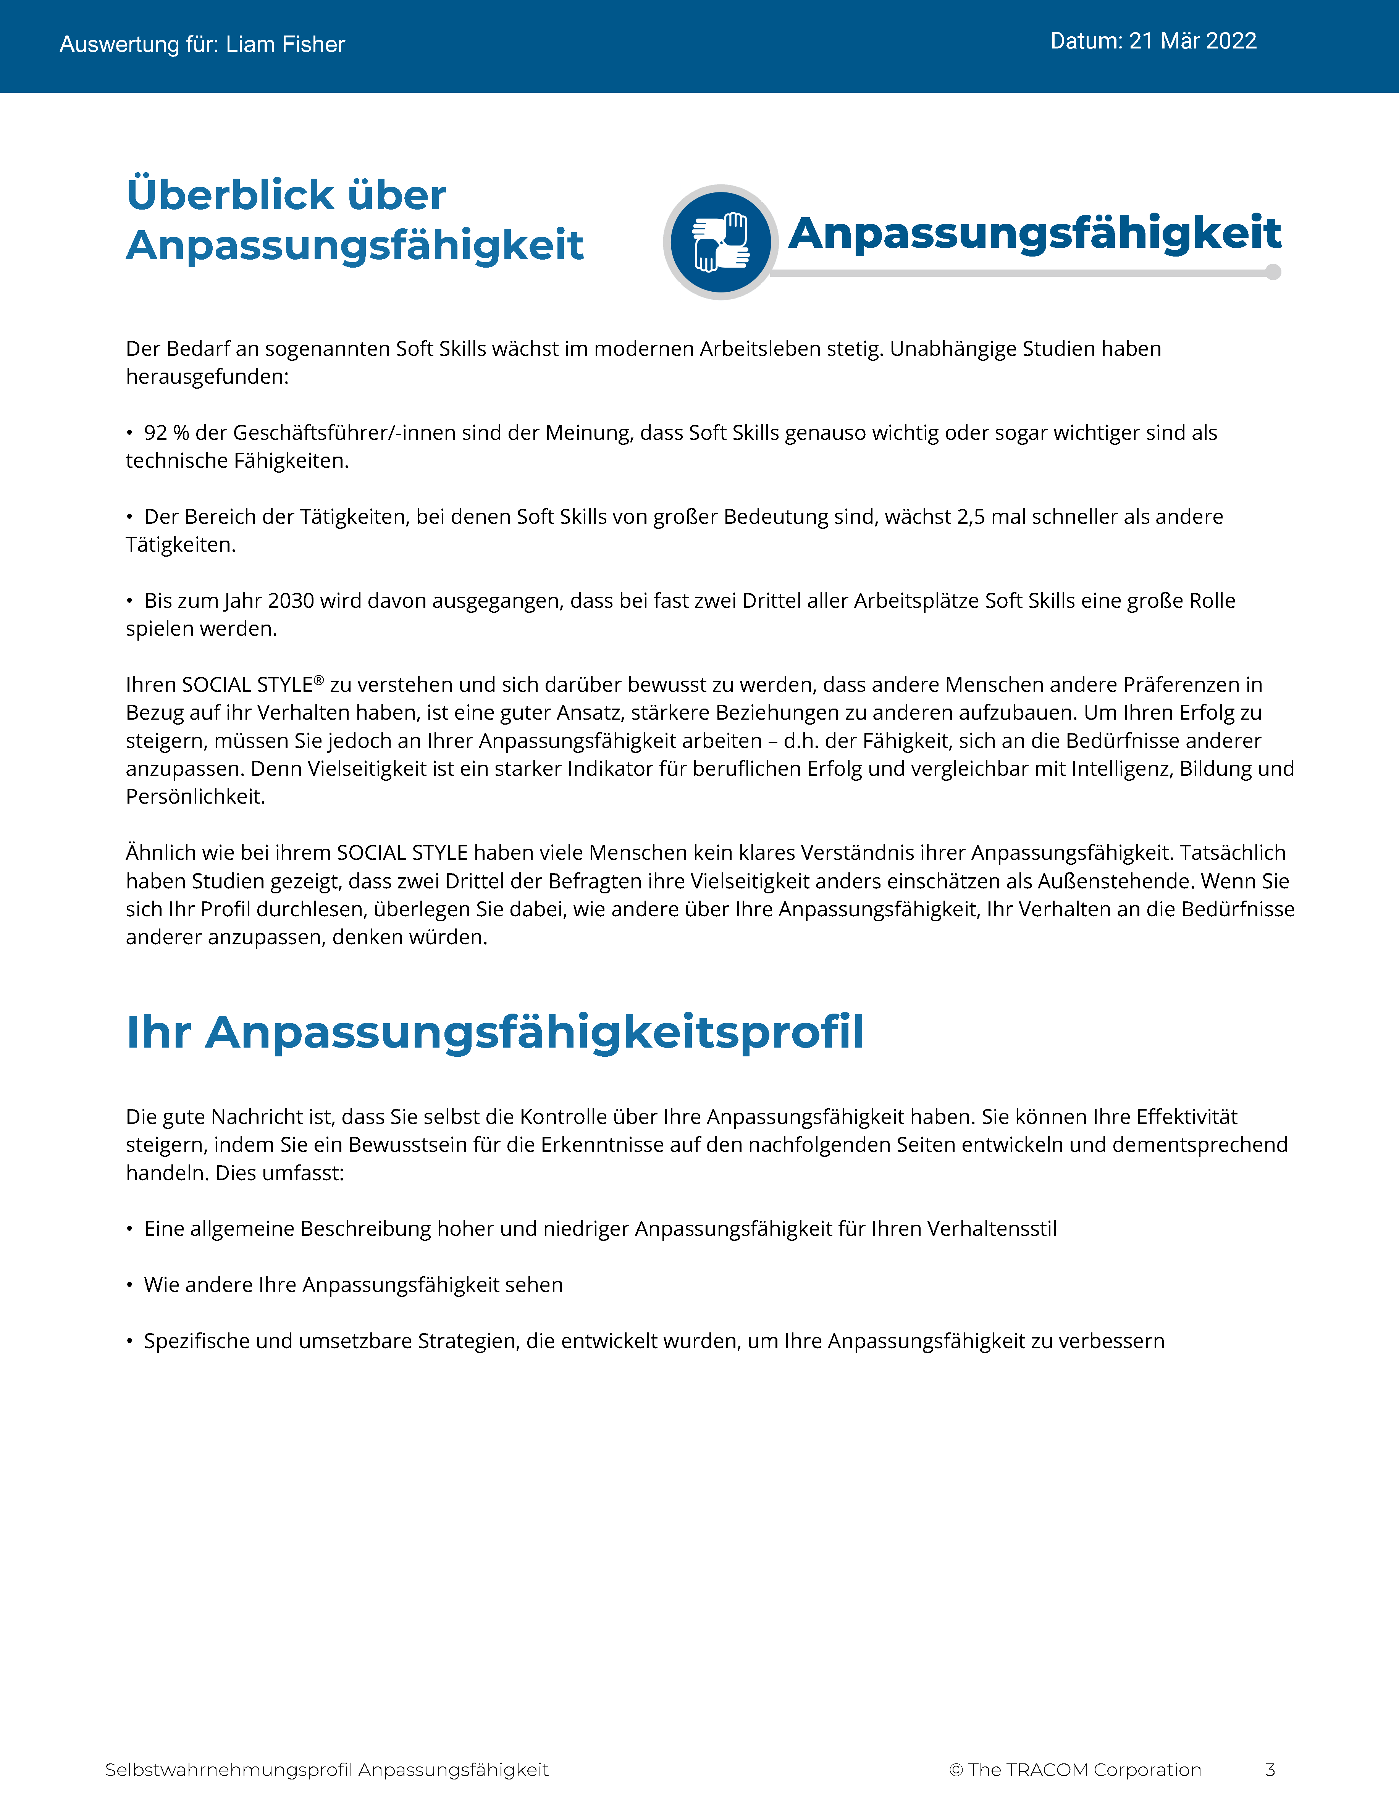
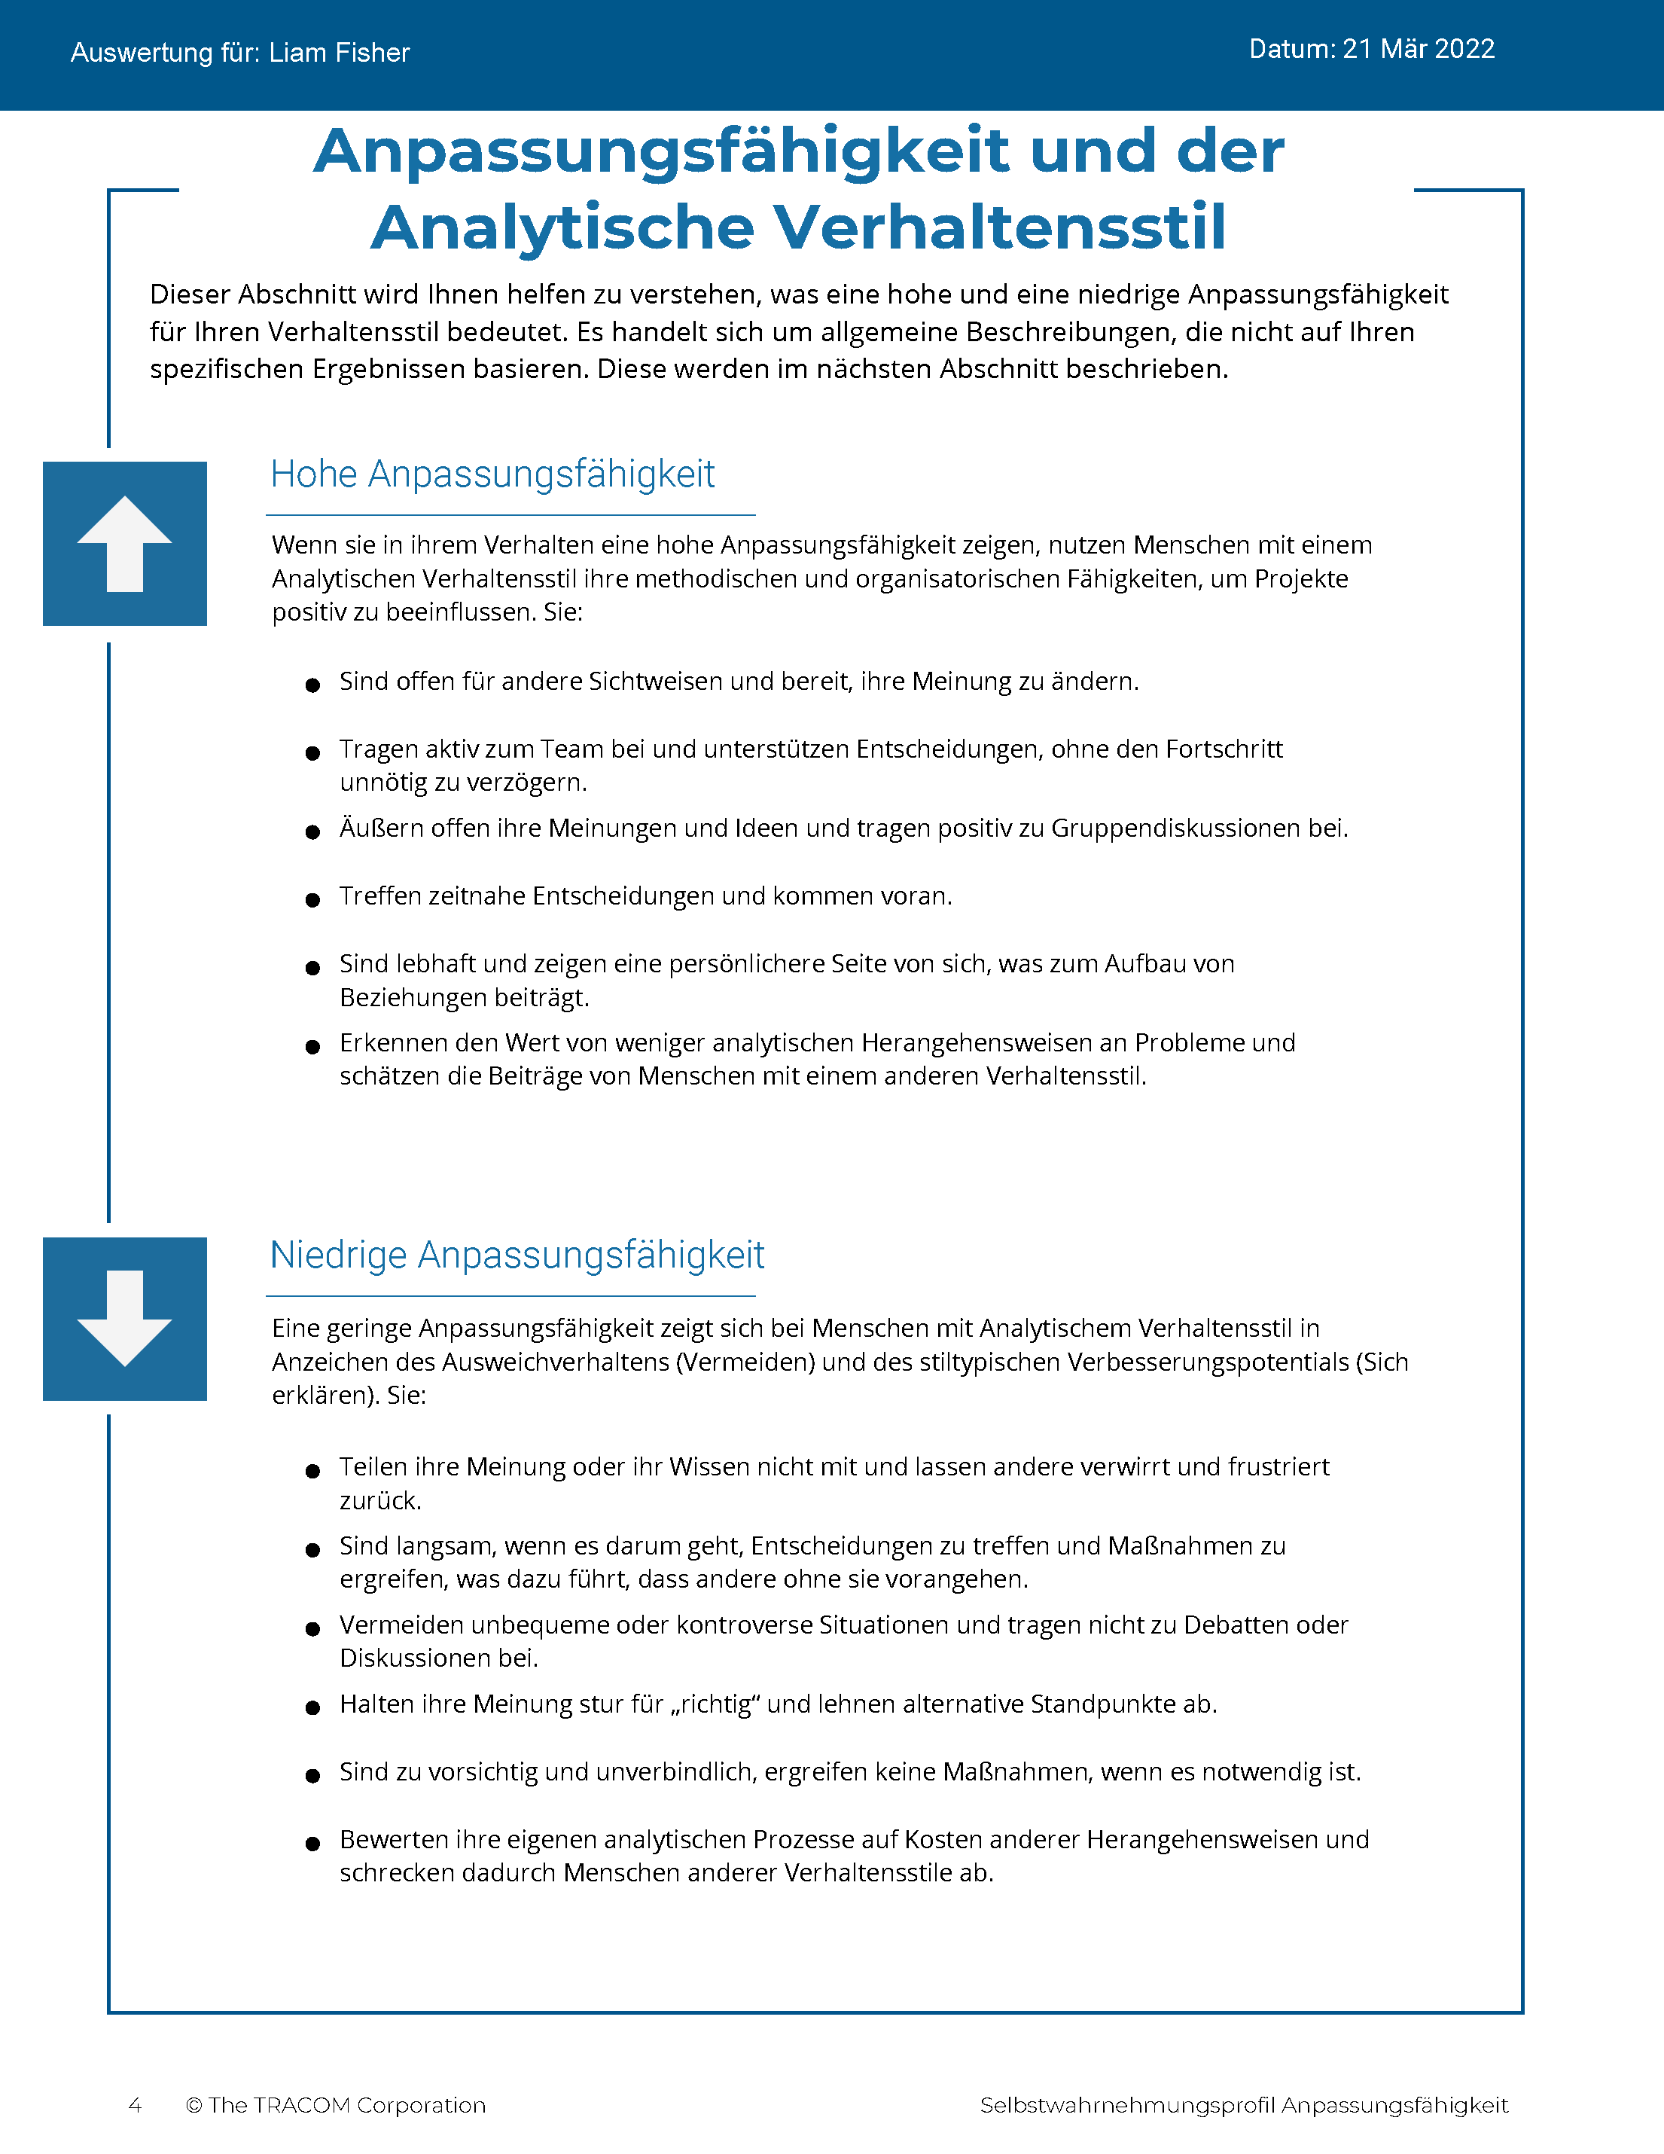
© The TRACOM Corporation. Alle Rechte vorbehalten.
31
Notes:
These slides show pages of the Versatility profile and can be displayed to assist with conversation during the exercise debrief.

Slide 32
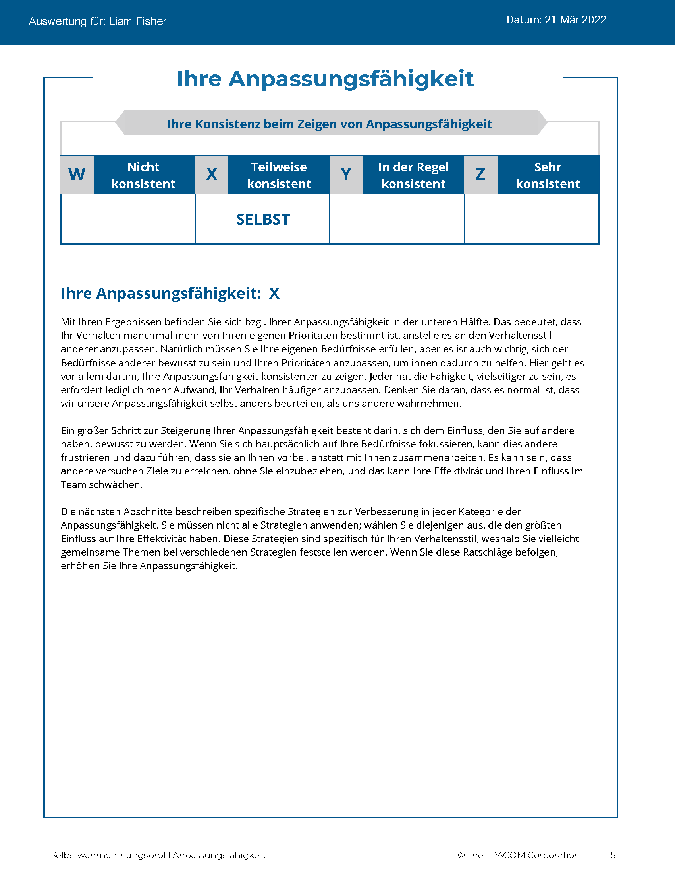
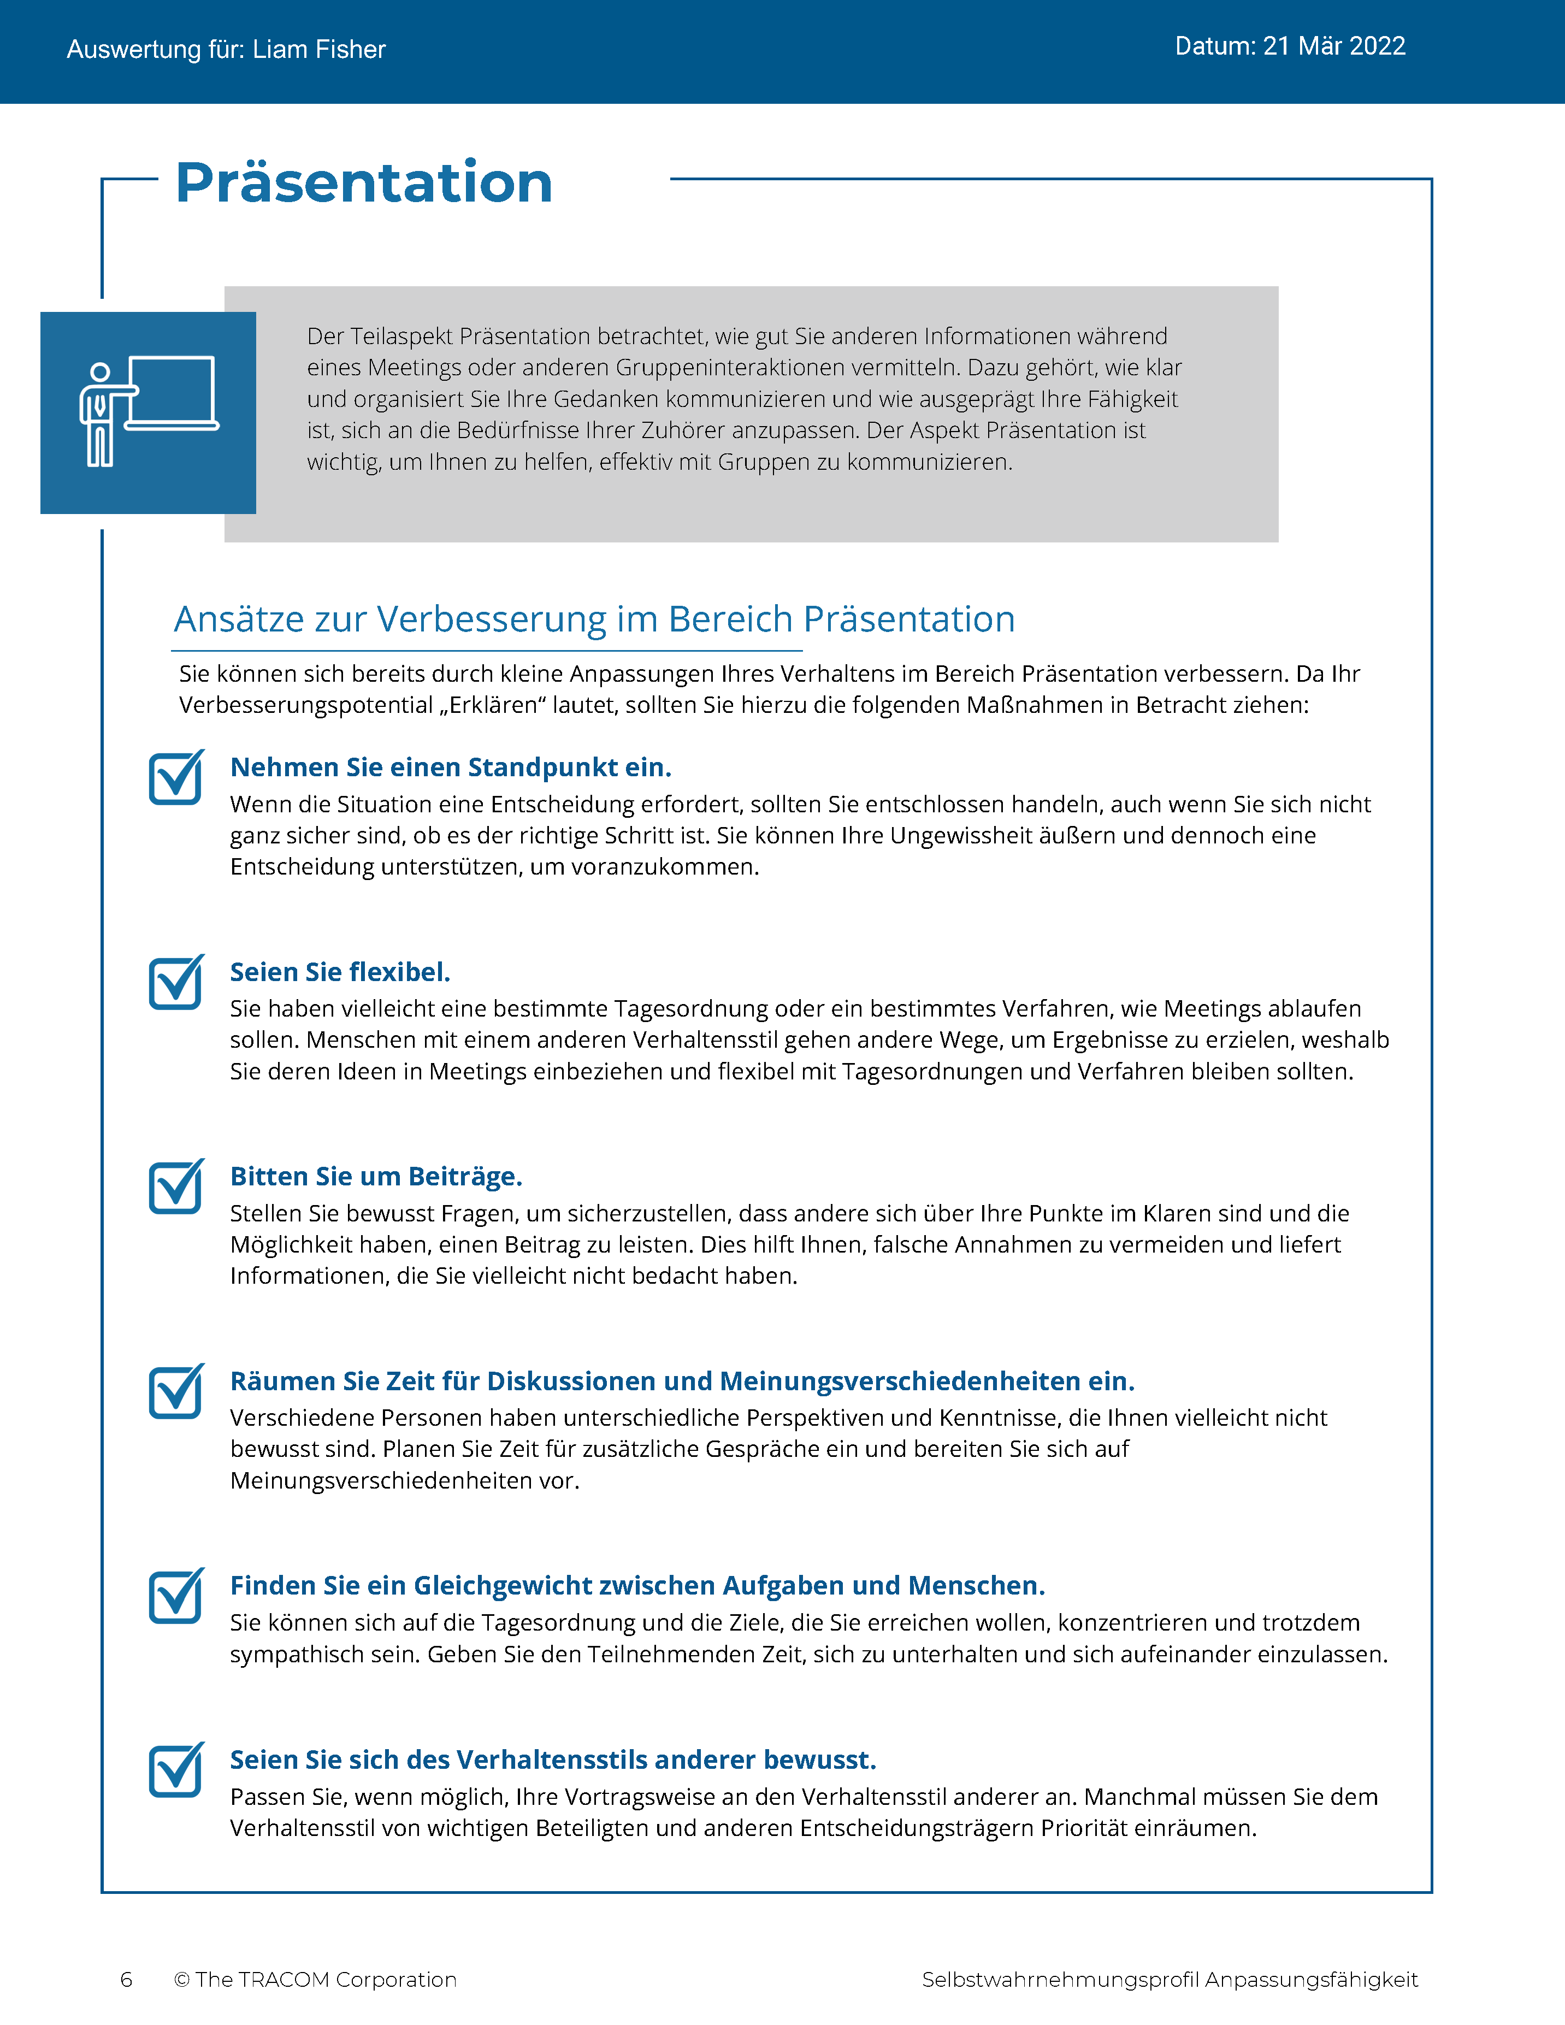
© The TRACOM Corporation. Alle Rechte vorbehalten.
32
Notes:
These slides show pages of the Versatility profile and can be displayed to assist with conversation during the exercise debrief.

Slide 33
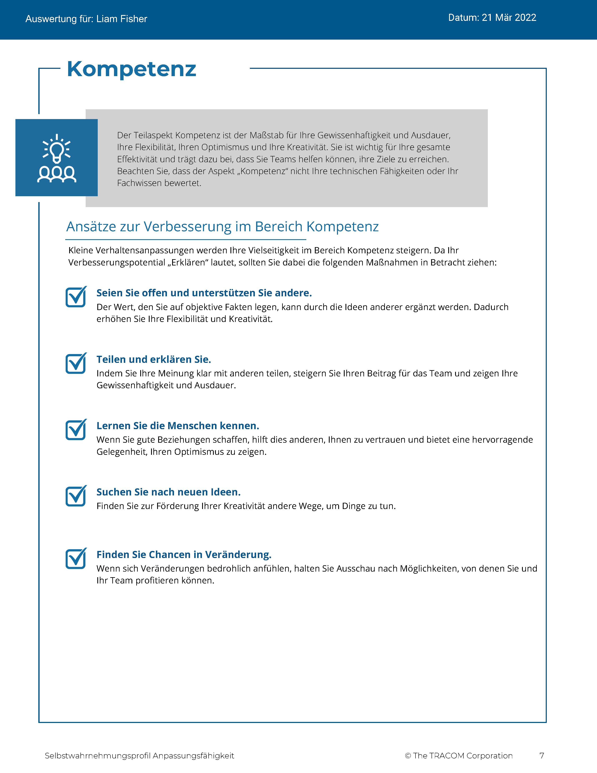
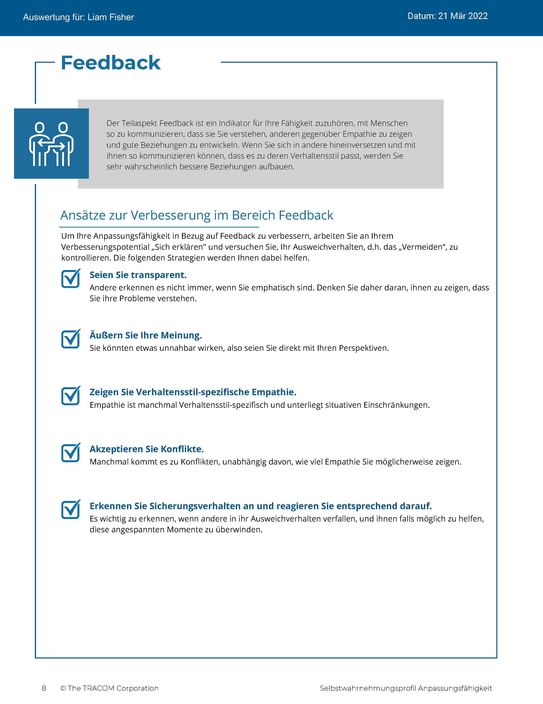
© The TRACOM Corporation. Alle Rechte vorbehalten.
33
Notes:
These slides show pages of the Versatility profile and can be displayed to assist with conversation during the exercise debrief.

Slide 34
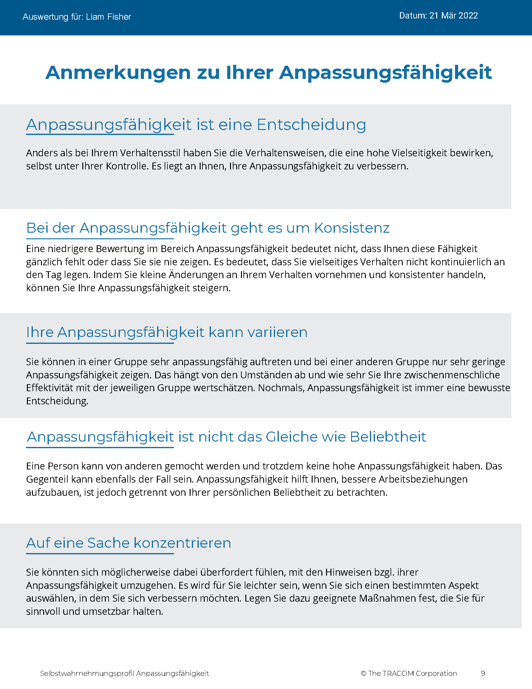
© The TRACOM Corporation. Alle Rechte vorbehalten.
34
Notes:
These slides show pages of the Versatility profile and can be displayed to assist with conversation during the exercise debrief.

Slide 35
Anpassungsfähigkeitsprofil in Papierform
Notes:
If using the paper assessment, use the following slides.

Slide 36
Anpassungsfähigkeit
Ein Maß für die zwischenmenschliche Effektivität in der Zusammenarbeit mit anderen
Verhalten wird betrachtet als Fokussierung auf...
Niedrig
Mittel
Hoch
Meine Anspannung
Anspannung anderer
Notes:
2 MINUTES
THIS SLIDE IS USED ONLY WITH THE PAPER PROFILE.
SAY while identifying your SOCIAL STYLE can help you understand your behavioral preferences, by itself, knowing your Style doesn’t necessarily help you be more effective. As I’ve said, there is no good or bad Style. What is important is how you adjust your behavior when working with others. That’s where Versatility comes in.
Versatility is your ability to adjust your behavior to meet others’ Style preferences in the areas of Image, Presentation, Competence, and Feedback.
SAY When you are not consistent in your behavior, you’re usually focusing on your own tension and Style needs. When you consistently show Versatility, you’re focusing on meeting others’ Style needs, which reduces their tension. When you are consistent, the more effective you will be.

Slide 37
Ihre Anpassungsfähigkeits-Selbstwahrnehmung
Perforation aufreißen
Fügen Sie die Häkchen in der schattierten Spalte ein.
Kreisen Sie den Buchstaben Ihrer Anpassungsfähigkeits-Punktzahl ein.
BEISPIEL:
7 oder weniger = Niedrig (kreisen Sie das „N“ ein)
8–14 = Mittel (kreisen Sie das „M“ ein)
15–21 = Hoch (kreisen Sie das „H“ ein)
N | M | H
Ihre Selbstwahrnehmung kann sich von der Wahrnehmung anderer unterscheiden!
© The TRACOM Corporation. Alle Rechte vorbehalten.
Notes:
8 MINUTES
THIS SLIDE ONLY USED WITH PAPER PROFILE.
1. ASK participants to score their Versatility Questionnaires following the instructions on the slide.
2. SAY before we discuss Versatility, I’d like you to score your Versatility Questionnaire.
After scoring is complete, ASK Is anyone surprised? Are there any questions or concerns?
The Versatility profile reflects how you see yourself. Keep in mind that others may see you differently.

Slide 38
Lernziele
Verständnis des SOCIAL STYLE-Modells™ gewinnen.
Bestimmen Ihres SOCIAL STYLE mithilfe eines Fragebogens zur Selbsteinschätzung.
Besseres Verständnis Ihres Verhaltens und darüber, wie andere Personen Ihren Stil wahrnehmen.
Erhöhen Ihrer Anpassungsfähigkeit, um effektiver mit anderen zu arbeiten.
Notes:
2 MINUTES
REVIEW the Session objectives.
ASK Did we meet them?
HIGHLIGHT key points learned.
EMPHASIZE importance of verifying self-perception data and, if possible, comparing it to multi-rater feedback.

Slide 39
Nächste Schritte und Schlüsselerfahrungen
Tauschen Sie sich mit Kollegen über Ihren SOCIAL STYLE aus und fragen Sie sie nach deren Einsichten.
Achten Sie auf zwei Verhaltensdimensionen: Einflussnahme und Gefühlsausdruck.
Ergreifen Sie Schritte, um den Bedürfnissen des SOCIAL STYLE von anderen gerecht zu werden, während Sie mit ihnen interagieren.
Prognostizieren Sie den wahrscheinlichen zukünftigen Stil und das Verhalten anderer.
Notes:
3 MINUTES
As participants take their knowledge of Style back into the workplace, suggest that they do the following:
SHARE their Style with their colleagues and ask them for additional insights into how they can interact more effectively.
REMIND them that the most objective way to identify a colleague’s Style is by looking for behavior along Assertiveness and Responsiveness.
POINT OUT to participants that they can use the information in the workbook to help make their interactions with others more productive by following the guidelines for “Knowing Yourself, Controlling Yourself, Knowing Others, and Doing Something for Others.”
Finally, UNDERSCORE that being able to predict the probable future Style behavior of their colleagues is a powerful tool for interpersonal success. Participants now have valuable information to use in developing themselves into more effective individuals.

Slide 40
SOCIAL STYLE-Navigator®
SOCIAL STYLE-Schätzer Eine kurze Umfrage, die den Stil der anderen einschätzt
SOCIAL STYLE-Ratgeber
Vorbereitung auf Besprechungen, Verhandlungen, Präsentationen
Stil und Anpassungsfähigkeit – beste Praktiken für viele Situationen
eLearning-Module Anwendung von Stilkonzepten auf Teams, Konfliktmanagement und Coaching
SOCIAL STYLE-Navigator® ist ein eingetragenes Warenzeichen der TRACOM Corporation.
Notes:
1 Minute
SAY You now have free and unlimited access to SOCIAL STYLE Navigator, the on-demand micro-learning tool that helps you apply Style and Versatility.
SOCIAL STYLE Navigator includes:
SOCIAL STYLE Estimator
The Estimator survey provides users with an interactive tool that evaluates observable behavior in others to determine their Style and helps you plan ahead for successful interactions.
SOCIAL STYLE Advisor
Use Advisor topics to prepare “just-in-time” for meetings, negotiations or sales presentations with advice on navigating Style and Versatility best practices to maximize high-performing relationships.
eLearning modules
Continue your learning journey via micro-learning that reinforces ways to apply SOCIAL STYLE and Versatility to Working in Teams, Coaching and Managing Conflict.

Slide 41
SOCIAL STYLE- Navigator® Zugang (nur Online-Profile)
Erhältlich über tracomlearning.com
Geben Sie Ihren TRACOM Nutzernamen und das Passwort ein, um KOSTENLOSEN und UNBEGRENZTEN Zugang zum SOCIAL STYLE-Navigator ® zu erhalten
Notes:
1 Minute
THIS SLIDE FOR ONLINE PROFILES ONLY
SAY Available through www.tracomlearning.com
Enter your username and password for free, unlimited access to SOCIAL STYLE Navigator®

Slide 42
SOCIAL STYLE- Navigator® Zugang (nur Papierprofile)
Gehen Sie zu:
tracomlearning.com/registration-paper
Registrieren Sie sich mit Ihrer E-Mail-Adresse und Ihrem Abonnement-Code _____-_____
für KOSTENLOSEN, UNBEGRENZTEN Zugang zum SOCIAL STYLE-NAVIGATOR
Notes:
1 Minute
THIS SLIDE FOR PAPER SURVEYS ONLY
SAY Go to tracomlearning.com/registration-paper and register with your email address and subscription code ______-______ for free, unlimited access to SOCIAL STYLE Navigator®
IMPORTANT FACILITATOR NOTE REGARDING SUBSCRIPTION CODES:
Your subscription code can be found on the “ATTENTION” colored flyer included in your participant materials shipment. The code is formatted in two sets of 4 numbers separated by a hyphen (EXAMPLE: xxxx-xxxx). If you do not have the “ATTENTION” flyer included with your materials shipment, please contact TRACOM to receive your subscription code.

Slide 43
Notes:
Optional demonstration, time permitting

Slide 44
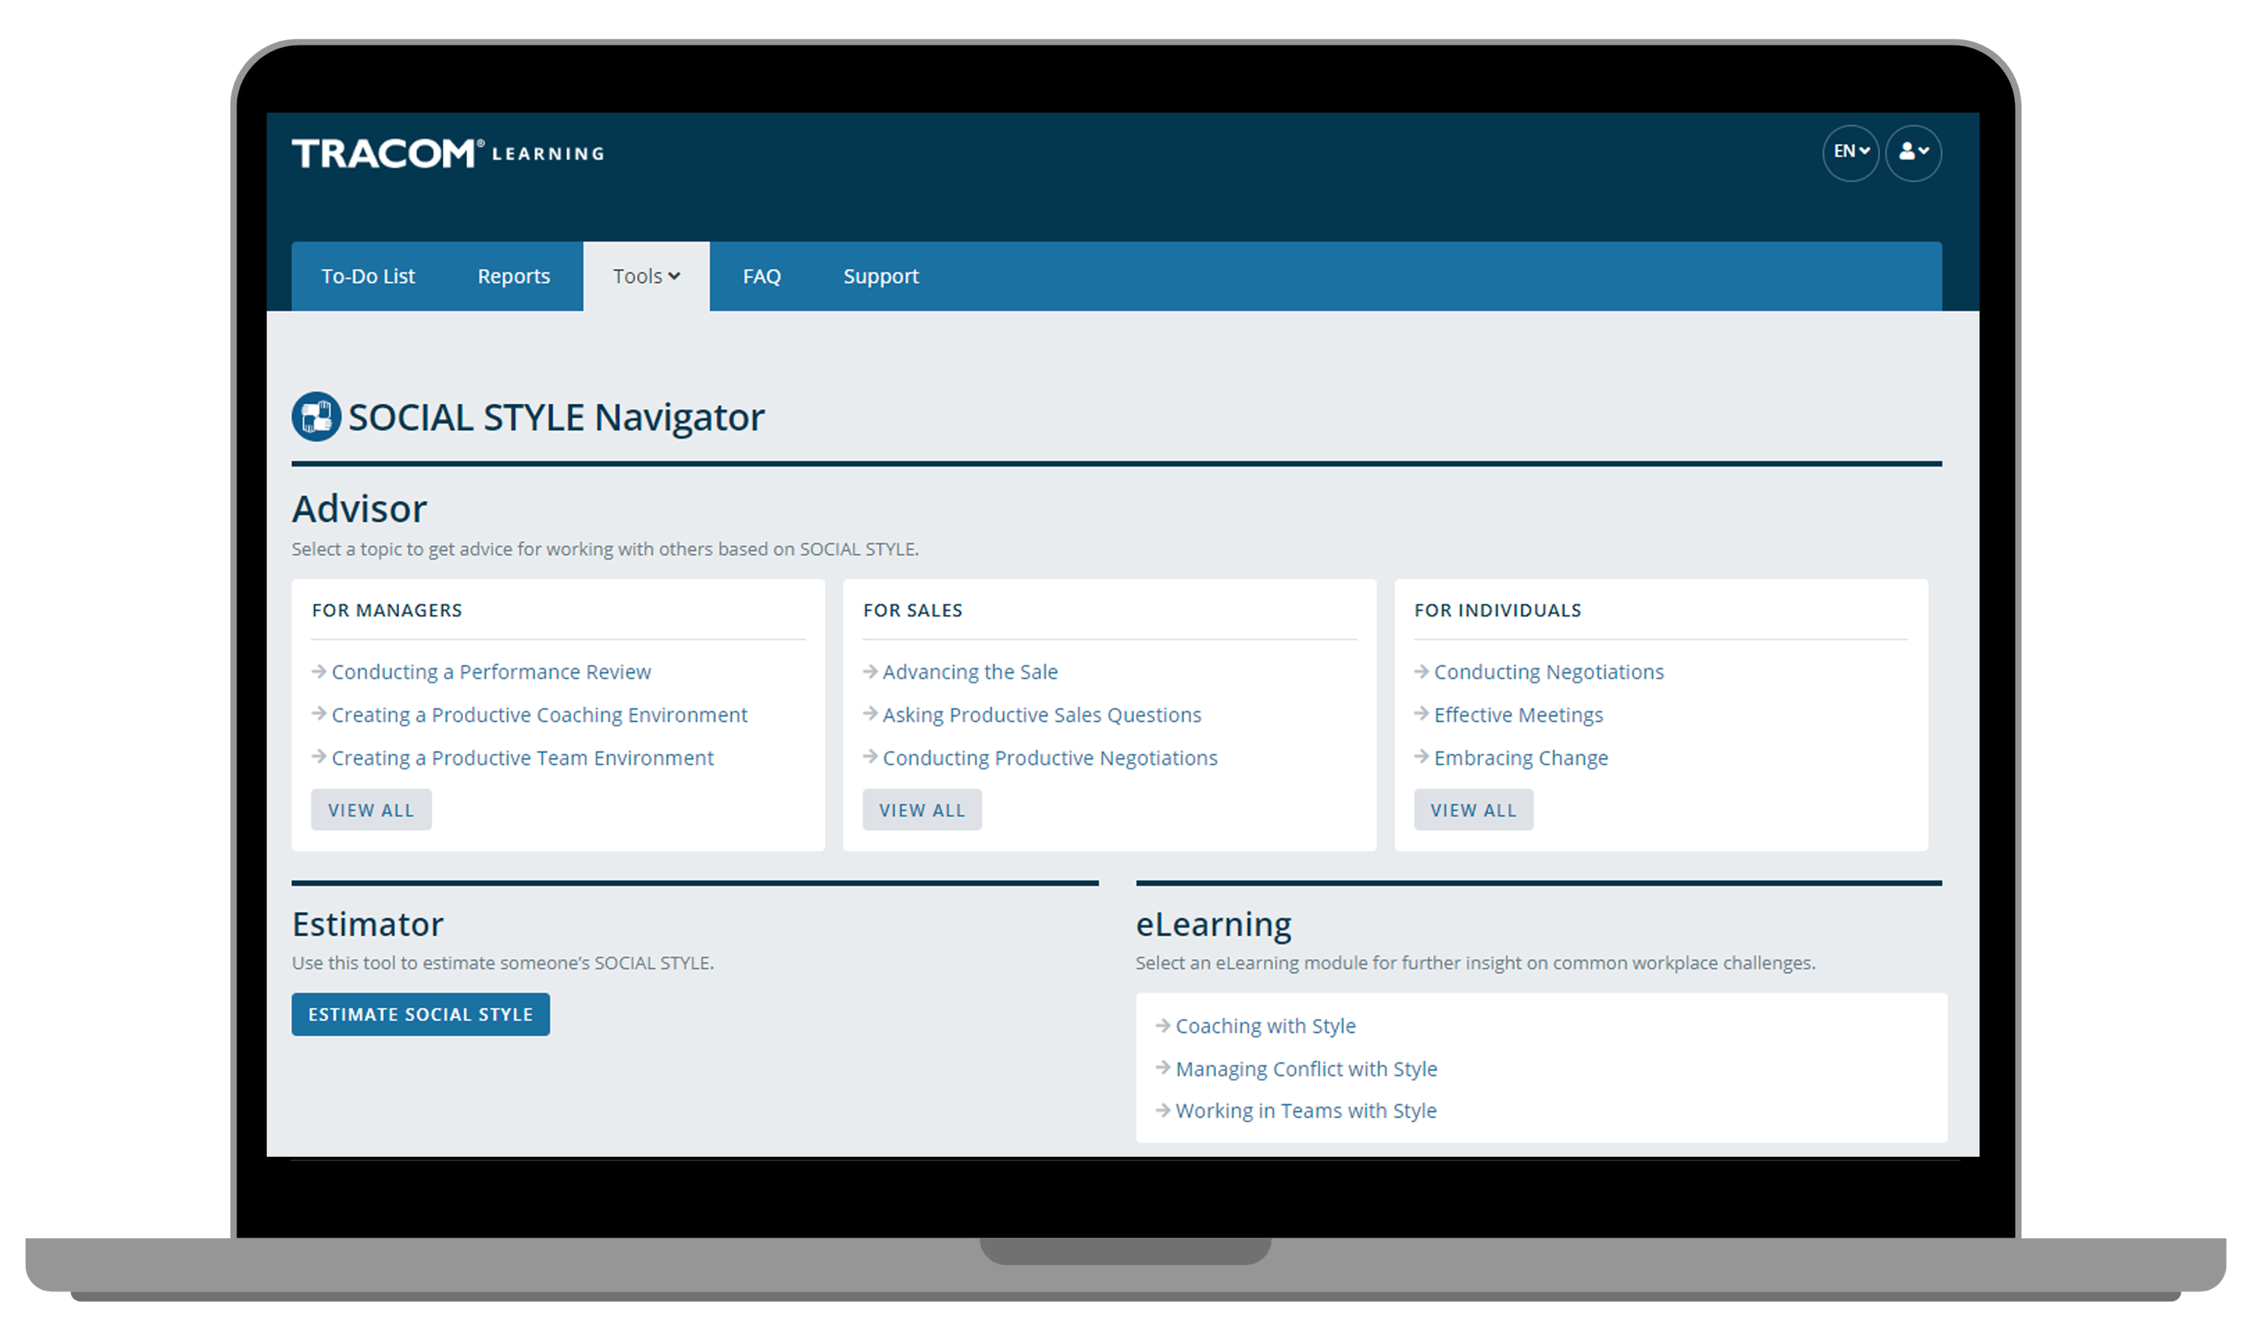
Notes:
Optional demonstration, time permitting

Slide 45
Notes:
Optional demonstration, time permitting

Slide 46
Notes:
Optional demonstration, time permitting

Slide 47
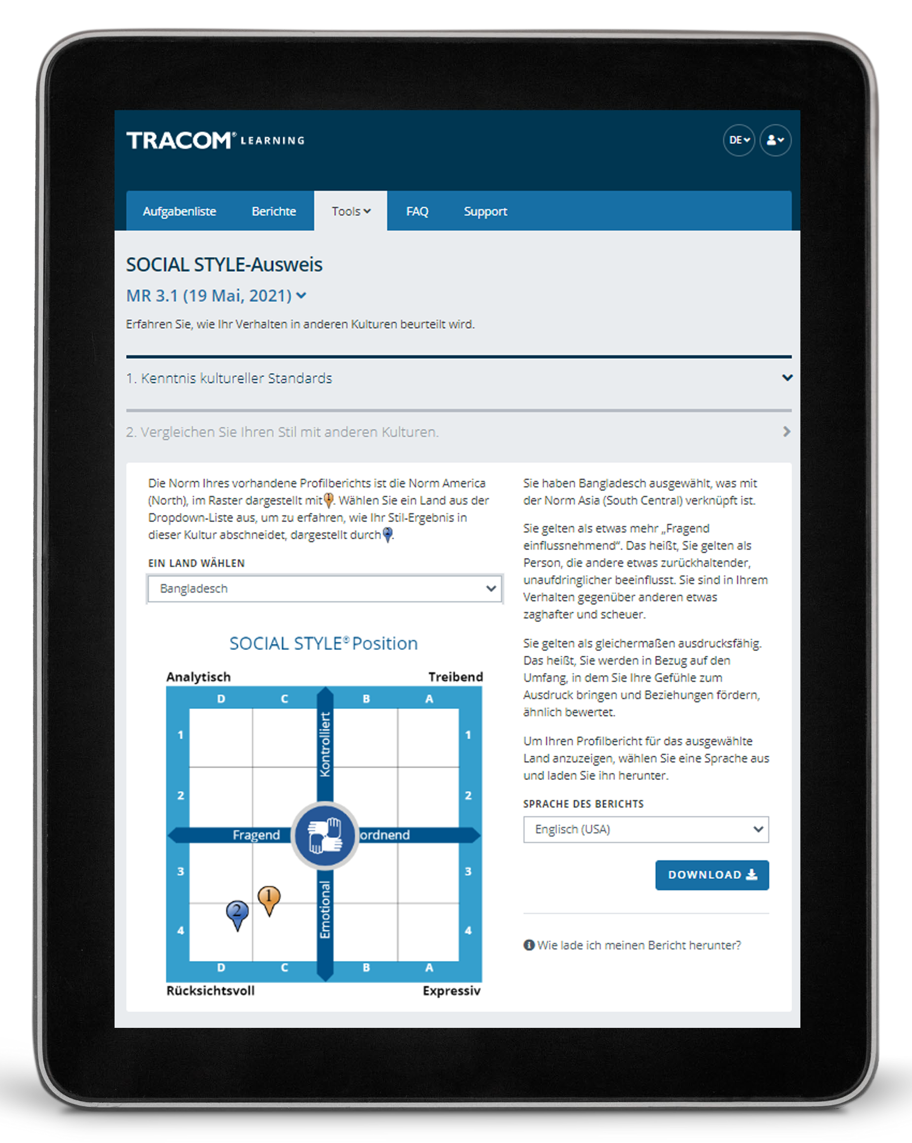
SOCIAL STYLE-Reisepass
Notes:
Optional demonstration, time permitting

Slide 48
48
Notes:
SAY Thank you. Do you have final questions?

Slide 49
Optionale Übungen
Wählen Sie optionale Übungsaufgaben aus, je nach Ihrem Schulungsbedarf und der Ihnen zur Verfügung stehenden Zeit.
49
Notes:
You can use the following exercises to enhance the session to best meet the needs of your participants.

Slide 50
Techniken zur Stilbeobachtung
Ziehen Sie keine voreiligen Schlüsse
Bleiben Sie objektiv
Trennen Sie Stil-Verhalten von der Rolle oder Position einer Person
Ein moderates Maß an Stress kann den Stil eines Menschen deutlicher zeigen
Aus dem Weg gehen (Beobachter sein)
1
2
3
4
5
50
Notes:
Guidelines for Observing Style
Purpose
The purpose of this exercise is to familiarize participants with the rules for identifying another person's SOCIAL STYLE.
Recommended Time:
10 minutes
Materials Needed
None
Directions
SAY The more accurately we are able to observe our colleagues’ Styles, the better we will be able to adapt our own behavior to display greater Versatility.
ASK participants to take notes on ways of implementing the best practices.
DESCRIBE the best practices:
Don’t jump to conclusions
Remain objective
Separate Style behavior from someone’s role or position
A moderate amount of stress can clarify someone’s Style
Get out of the way (be an observer)
ASK if there are any questions.

Slide 51
Stil-Forum
Zweck: Um Ihnen die Möglichkeit zu geben, zu beschreiben, was es mit dem SOCIAL STYLE der anderen Person, die bei Ihnen Anspannung erzeugt, auf sich hat und um Einsichten zu erlangen, wie Sie mit einer Person, die einen solchen Stil hat, produktiver umgehen können.
Anweisungen:
Besprechen und erarbeiten Sie in Ihrer Gruppe eine Liste der Verhaltensweisen, die ihren entgegengesetzten SOCIAL STYLE aufzeigt, der bei Ihnen Anspannung erzeugt.
Zeigen Sie Ihre Liste der Gruppe des entgegengesetzten Stils.
Diskutieren Sie in Ihrer Gruppe, was Sie tun können, um besser mit dem entgegengesetzten Stil zu interagieren.
Teilen Sie Ihre Informationen mit dem anderen Stil und allen Kursteilnehmern.
51
Notes:
Style Forum
Purpose
The purpose of this exercise is to give participants an opportunity to describe what it is about the opposite SOCIAL STYLE position that creates tension for them when working with people of that Style and to develop insights into how to be more productive with a person who has that Style.
Recommended Time
30 minutes
Materials needed
None
Directions
Break participants into groups by SOCIAL STYLE position with a maximum of six per group.
Give each group 10 minutes to discuss and develop a list of behaviors that the opposite SOCIAL STYLE position manifests to create tension that leads to unproductive relationships.
After each group has developed its list, ask the Amiable and Driving Styles to get together to share their lists. Ask the Expressive and Analytical Styles to do the same thing. Each Style should spend five to ten minutes sharing its list and answering clarifying questions. Caution the groups that this is not a time to get defensive.
After each group has heard the other’s list, the original groups should get together by themselves to discuss what they can do to interact better with the opposite Style (e.g., those with Expressive Styles would develop a list of what they could do to make the relationship more productive with Analytical Styles). As each group shares its list of what it could do better, the opposite Style group should provide feedback and suggestions as to how appropriate the lists are.
After all groups have shared their information with the opposite Style, the whole class discusses what has been learned.
At the conclusion of the exercise, each group should have valuable information as to how to behave more appropriately with the diagonally opposite Style. In addition, after the general class discussions, each Style should have valuable information for working with each of the other SOCIAL STYLE positions.

Slide 52
Anpassungsfähigkeits-Forum
Zweck: Sie haben die Möglichkeit, eine schwierige Beziehung zu beschreiben und in der Gruppe konkrete Schritte zu erarbeiten, die Sie unternehmen können, um dieser Person gegenüber mehr Anpassungsfähigkeit zu zeigen.
Anweisungen:
Teilen Sie sich in vier Stil-Gruppen auf.
Der Reihe nach wird nun jede Person:
Einen Kollegen beschreiben, mit dem sie eine schwierige Beziehung hat, und versuchen, dessen Stil zu erkennen.
Mitteilen, welche Handlungen dieses Kollegen sie frustrieren.
Helfen Sie als Gruppe der Person, konkrete Maßnahmen zu finden, mit denen sie ihrem Kollegen gegenüber mehr Anpassungsfähigkeit zeigen kann.
Benennen Sie einen Sprecher: Gibt es eine spezifische oder aufschlussreiche Erkenntnis, die Sie mit der ganzen Gruppe teilen möchten?
52
Notes:
Versatility Forum
Purpose
This exercise helps learners prepare to apply Versatility with a challenging relationship. Each Style group helps one another identify specific actions they can take to show more Versatility.
Recommended Time
30 minutes
Materials needed
Style and Versatility profiles, to help discover specific strategies for showing Versatility.
Directions
DIVIDE participants into Style groups and assign them to virtual breakout rooms (or separate areas of a physical space).
PROVIDE instructions on the slide.
SAY Nominate a spokesperson to represent your Style group. Take note of anything unique or insightful that you want to share with the whole group. We don’t want you to repeat everything that was said, only key takeaways.
CONDUCT the activity, carefully monitoring time and adding value as appropriate.
CLOSE the Versatility Forum by ASKING for questions and EMPHASIZING any key insights participants made.

Slide 53
SOCIAL STYLE-Navigator
Zweck: Sie können den Navigator zur Verbesserung Ihrer Effizienz einsetzen.
Anweisungen:
Bestimmen Sie eine Person oder eine Situation (z. B. Teambesprechungen), in der Sie Ihre Effektivität verbessern wollen.
Loggen Sie sich auf tracomlearning.com ein und wählen Sie SOCIAL STYLE-Navigator auf der Registerkarte Tools.
Verwenden Sie den „Schätzer“, um den Stil der von Ihnen identifizierten Person zu schätzen. Wenn mehrere Personen beteiligt sind, führen Sie diesen Schritt für jede einzelne Person durch oder überspringen Sie ihn vorerst.
Suchen Sie in der Liste der Themen unter der Rubrik „Ratgeber“ (Advisor) den entsprechenden Beratungsbereich und klicken Sie ihn an.
Lesen Sie die Ratschläge und drucken Sie die Seite bei Bedarf für sich aus
Diskutieren Sie die gewonnenen Erkenntnisse in der Gruppe.
53
Notes:
SOCIAL STYLE Navigator
Purpose
To use SOCIAL STYLE Navigator to improve your effectiveness.
Recommended Time
30 minutes
Materials Needed
Login to tracomlearning.com and navigate to the Tools tab
Directions
Determine a person or situation (such as team meetings) where you want to improve your effectiveness.
Login to tracomlearning.com and select SOCIAL STYLE Navigator from the Tools tab.
Use the “Estimator” to estimate the Style of the person you identified. If multiple people are involved, do this for each person or skip this step for now.
Examine the list of topics under the “Advisor” tab to find the relevant advice area and click on it.
Read the advice and print the page if needed to keep with you.
As a group, discuss any insights that were learned.

Slide 54
Aktionsplan zur Anpassungsfähigkeit
Zweck: Entwicklung eines Aktionsplans zur Verbesserung Ihrer Anpassungsfähigkeit.
Anweisungen:
Lesen Sie Ihr Anpassungsfähigkeitsprofil, um Ihr Verhalten zu verstehen. (nur Online-Profil)
Gehen Sie die in den drei Abschnitten beschriebenen Strategien durch: Wege zur Verbesserung der Präsentation, Wege zur Verbesserung der Kompetenz und Wege zur Verbesserung des Feedbacks. (nur Online-Profil)
Entscheiden Sie sich in jedem Bereich für ein oder zwei konkrete Maßnahmen, die Sie ergreifen werden, und schreiben Sie diese auf.
Suchen Sie sich eine andere Person (oder eine kleine Gruppe) und besprechen Sie Ihren Plan.
54
Notes:
Versatility Action Plan
Purpose
To develop a specific action plan for increasing your Versatility.
Recommended Time
30 minutes
Materials Needed
Versatility Profile
Directions
Read your Versatility profile to understand your behavior.
Review the strategies provided in the three sections: Ways to Improve Presentation, Ways to Improve Competence, and Ways to Improve Feedback.
Within each area, decide on one or two specific actions that you will take, and write these down.
Pair up with another person (or small group) and discuss your plan.

Slide 55
Steigerung der Effektivität durch AnpassungsfähigkeitTM
Version 4.0
Notes:
<<Copy and paste this table to notes pages on which you want participants to be able to take notes

