Slide 1
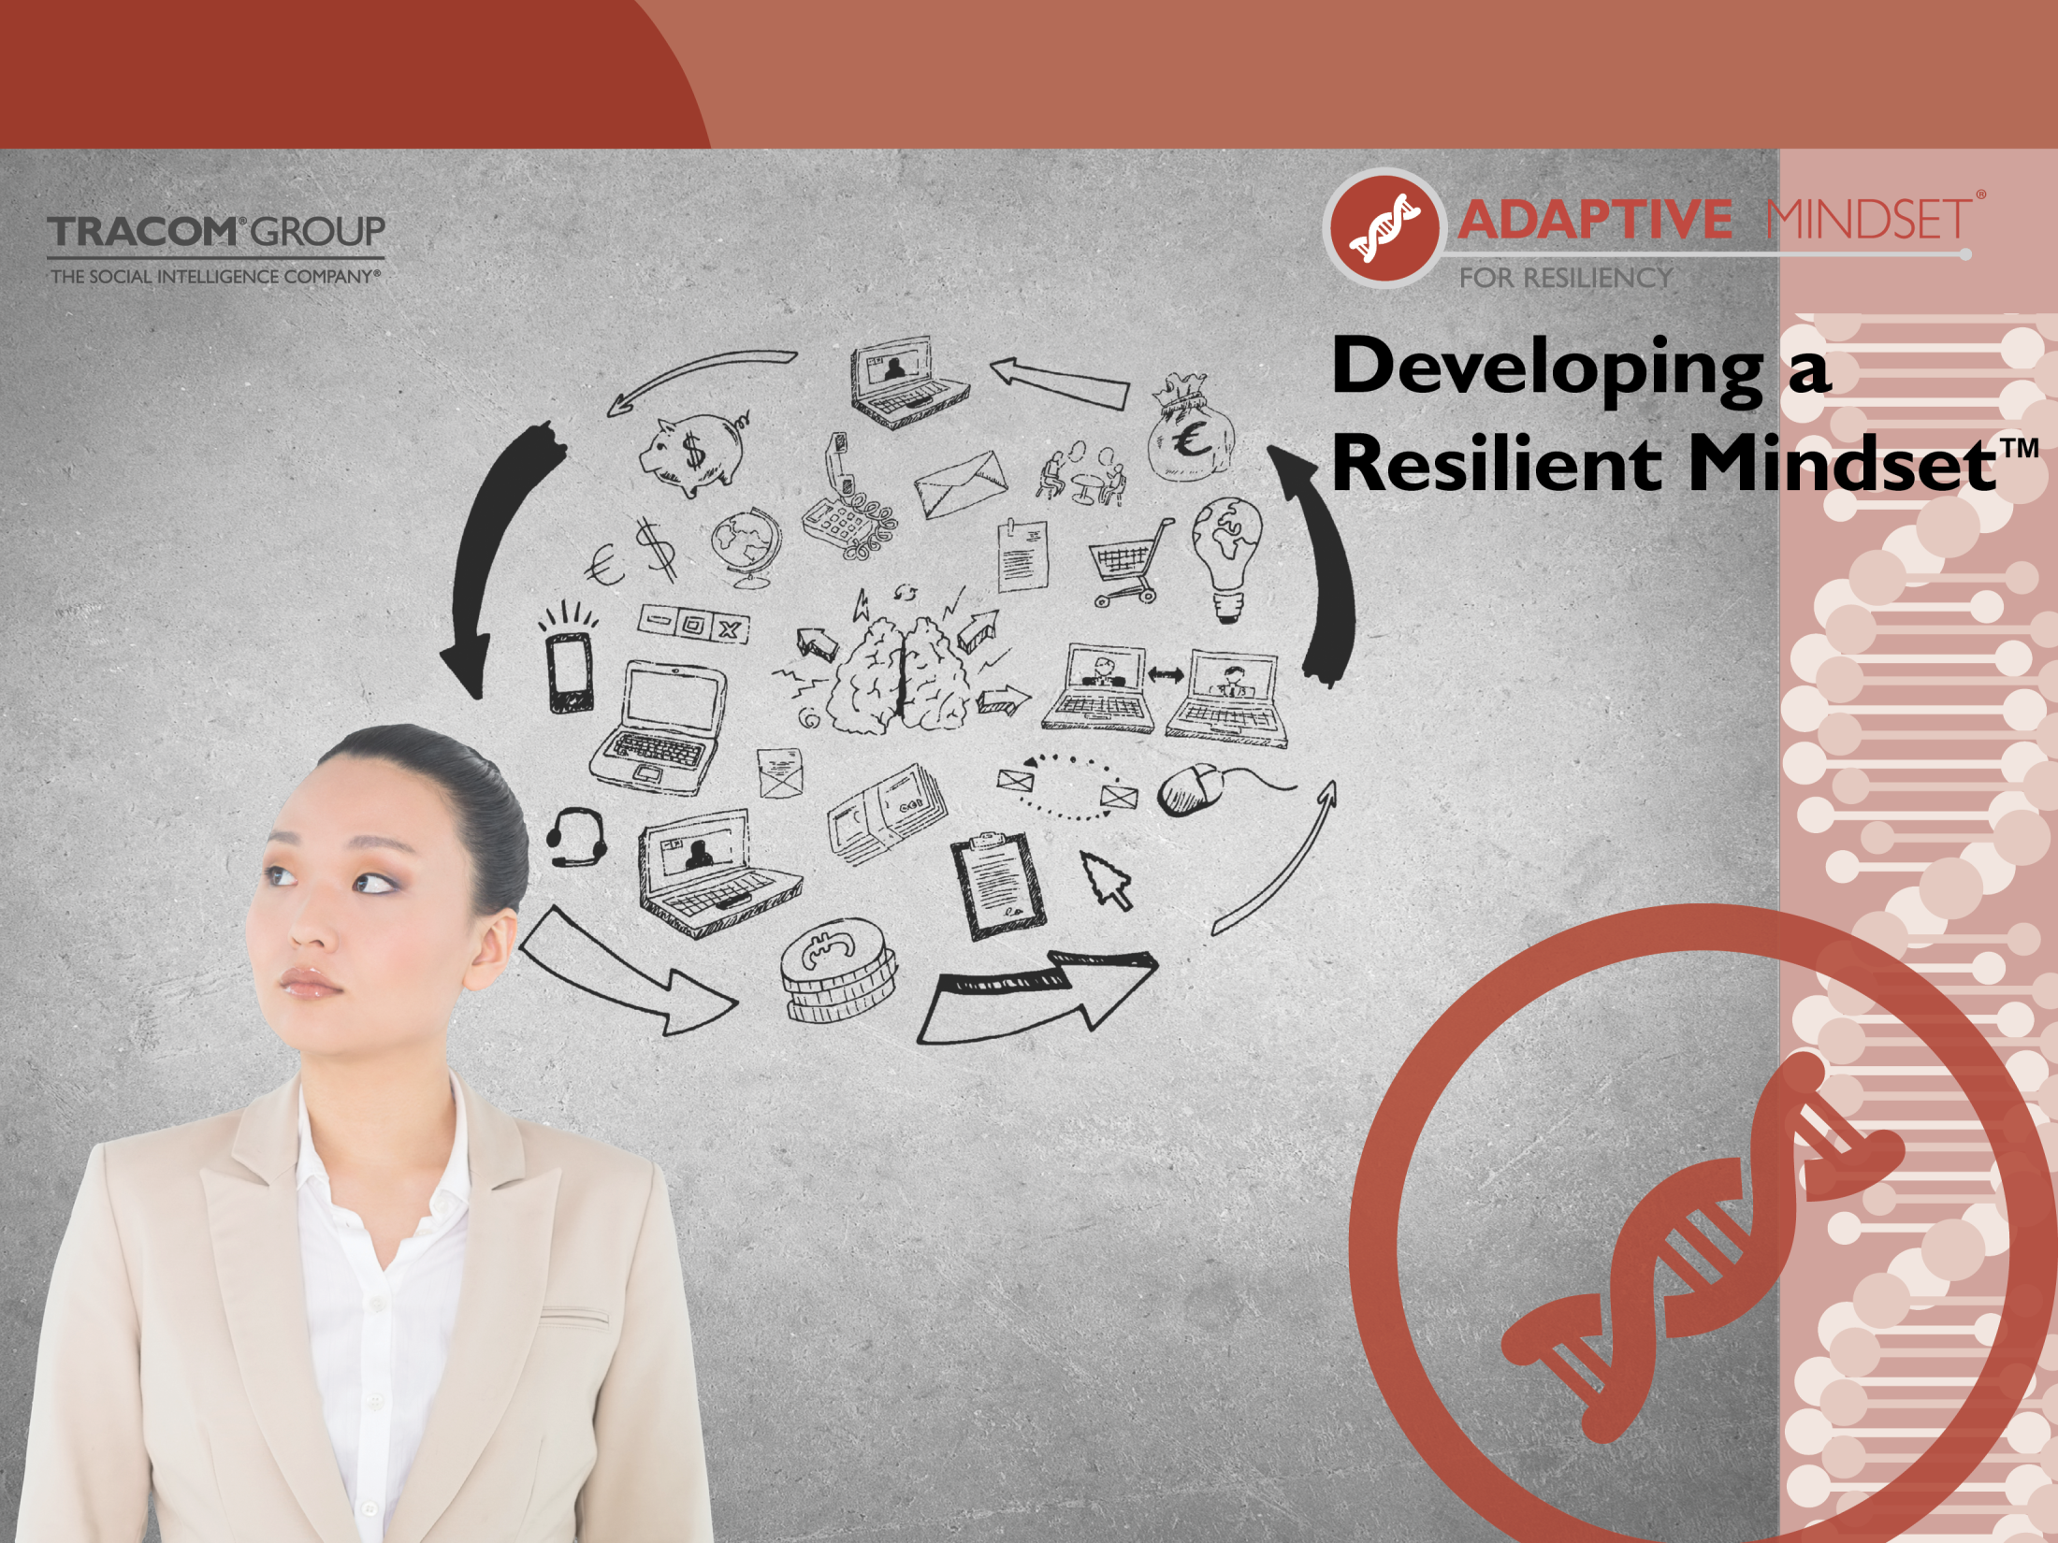
Audio updated Mar 2018

Slide 2
Logistics
Restroom locations
Breaks
Emergency exits
Other items

Slide 3

Agreements
Be present
and participate
Phone etiquette
Ask questions

Slide 4

What is resilience and why is it important?
What holds us back from being resilient?
Strategies for enhancing resilience

Slide 5
Objectives
Recognize your personal stress and the effect it has on your behavior.
Identify your own strengths in terms of personal resilience.
Enhance resilience in yourself and others using certain key strategies.

Slide 6
Introductions
Your name
Title/team/department
What does "resilience" mean to you?

Slide 7
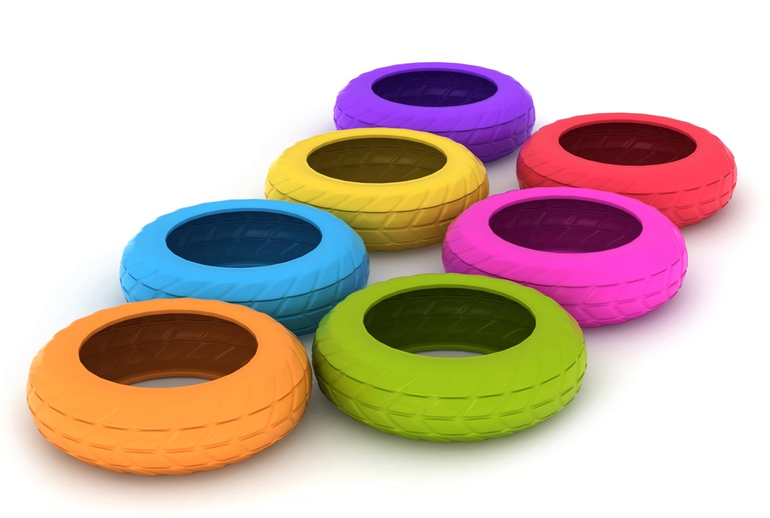
Obstacle Course!

Slide 8

Today’s Workplace
69% — work is significant source of stress
51% — say they are less productive due to stress
52% — say that stress impacts career decisions
#1 — Job pressure top cause of stress
in the United States
SIX — Stress is linked to the six leading
causes of death
Research Reference:
(Stress Statistics, 2014)
(American Psychological Association Practice Organization, 2010)
(American Psychological Association, 2009)
(American Psychological Association, 2007)
(Sapolsky, 1996)
(Schneiderman, Ironson, & Siegel, 2005).
Notes:
Today’s workplace is stressful.
Recent American Psychological Association survey (2009):
69% of employees report that work is a significant source of stress and 41% say they typically feel tense or stressed out during the workday.
51% of employees said they were less productive at work as a result of stress.
52% have made a decision about their career such as looking for a new job, declining a promotion or leaving a job based on workplace stress.
Job pressure (coworker tension, bosses, work overload) is cited as the #1 cause of stress in the US (APA, 2013)
Stress is linked to the six leading causes of death--heart disease, cancer, lung ailments, accidents, cirrhosis of the liver, and suicide
(Association, A. (2007). How Does Stress Affect Us?. Psych Central. Retrieved on October 2, 2013, from http://psychcentral.com/lib/how-does-stress-affect-us/0001130)

Slide 9
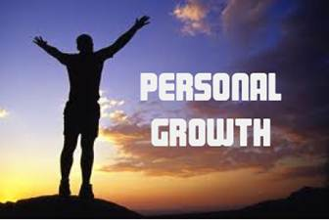
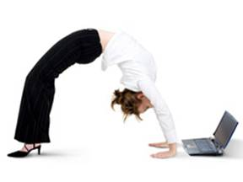

What is Resilience?
“All the adversity I’ve had in my life, all my troubles and obstacles, have strengthened me .”
– Walt Disney
Find opportunities for
growth within challenges
Beyond bouncing back to bouncing forward.
Flexible, adaptable to change

Slide 10
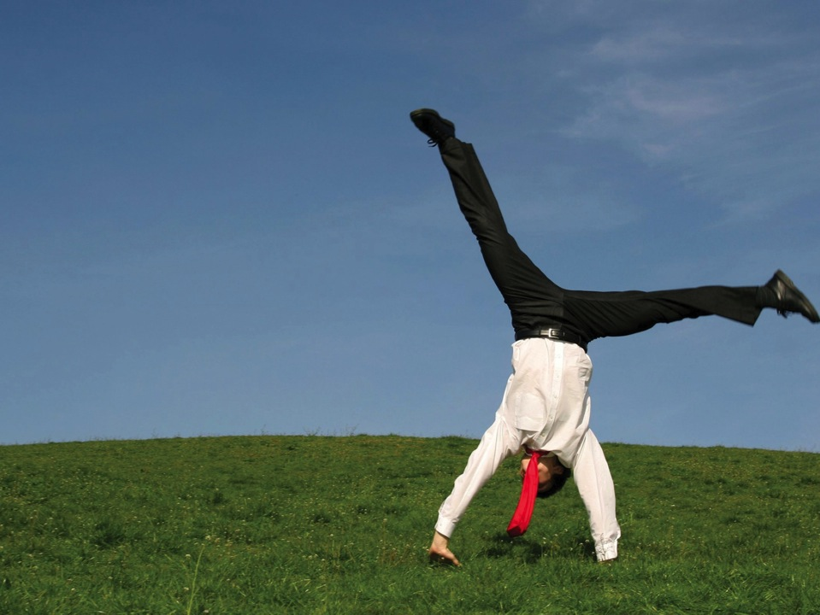

Why does resiliency matter?
© TRACOM Corporation. All Rights Reserved.
Notes:
Our programs are research-based. Resilience linked to key outcomes.

Slide 11

Why does resiliency matter?
Research Reference:
(Luthans, Avolio, Avey, & Norman, 2007)
(Youssef & Luthans, 2007)
(Resilience Alliance, 2011)
© TRACOM Corporation. All Rights Reserved.
Notes:
Job performance.

Slide 12

Why does
resiliency
matter?
Research Reference:
(Youssef & Luthans, 2007)
Notes:
Commitment to the organization.
People who are committed perform better and are more engaged with their work.

Slide 13

Why does resiliency matter?
Research Reference:
(Siu, Hui, Phillips, Lin, Wong, & Shi, 2009)
© TRACOM Corporation. All Rights Reserved.
Notes:
Work-life integration.
Might be most relevant to you. Looking for ways to manage stress and be more engaged in both spheres of life.

Slide 14
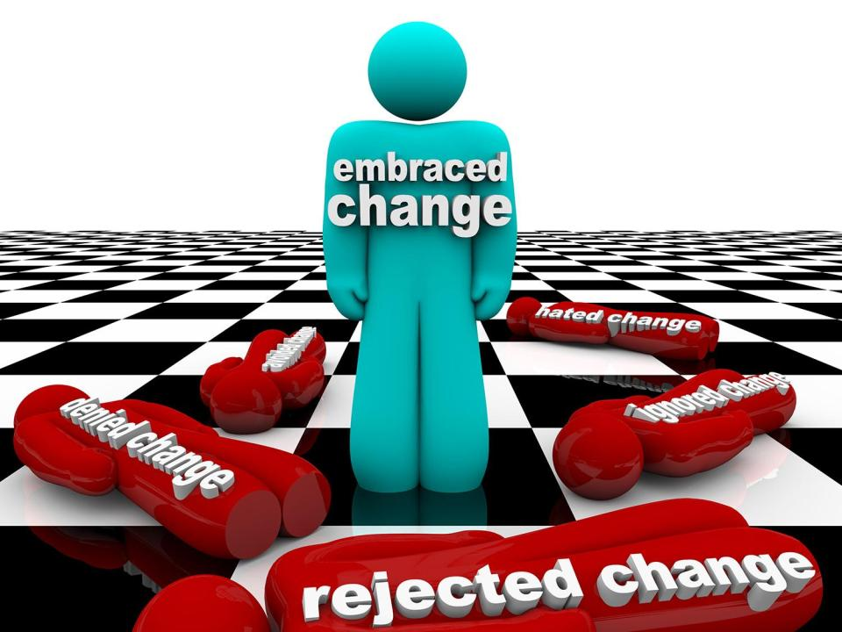
Why does resiliency matter?
Research Reference:
(Shin, Taylor, & Seo, 2012)
© TRACOM Corporation. All Rights Reserved.

Slide 15
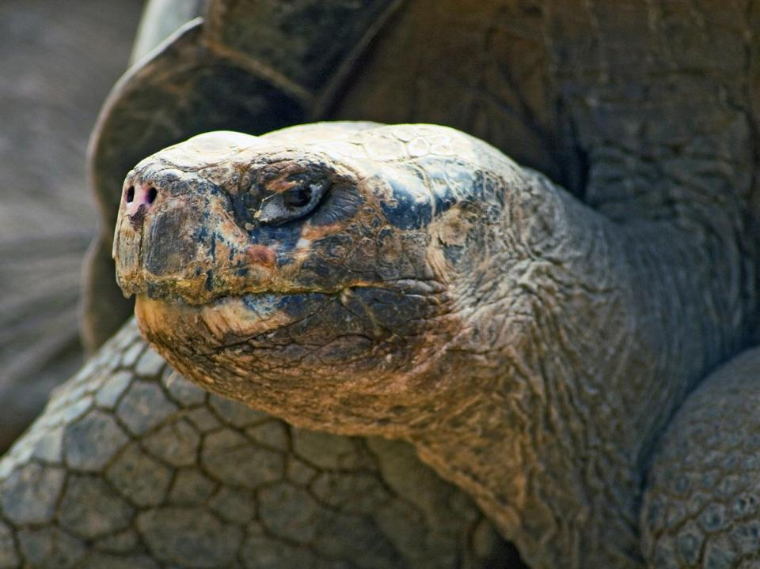
“It’s not the strongest of the species that survive nor the
most intelligent, but the one most responsive to change.”
- Charles Darwin
© TRACOM Corporation. All Rights Reserved.

Slide 16

Resilience Benefits
Exercise
(pg. 3 in your workbook)
© TRACOM Corporation. All Rights Reserved.

Slide 17

What Do You See?

Slide 18
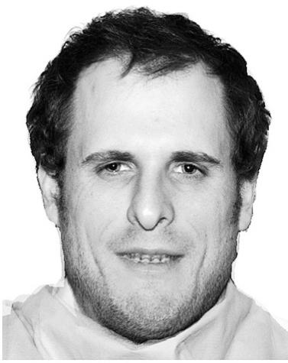
What Do You See?

Slide 19
What Did You See?

Slide 20
What Did You See?

Slide 21

Negativity Bias
Research Reference:
(Baumeister, Bratslavsky, Finkenauer, & Vohs, 2001)
© TRACOM Corporation. All Rights Reserved.
Notes:
Humans are hard-wired to focus on negativity more than positivity. This is evolutionary and is the result of the influence our amygdalas have over our emotions and behavior.
We perceive threats more easily than rewards or potentials.

Slide 22

Your Brain and the Negativity Bias
Research Reference:
(Ito, Larsen, Smith, & Cacioppo, 1998)
Notes:
In a study, researchers showed participants pictures of positive, negative, and neutral stimuli and found that electrical activity in the cerebral cortex was stronger toward the negative stimuli compared to positive or neutral stimuli. So, we are wired to focus on negative things.

Slide 23
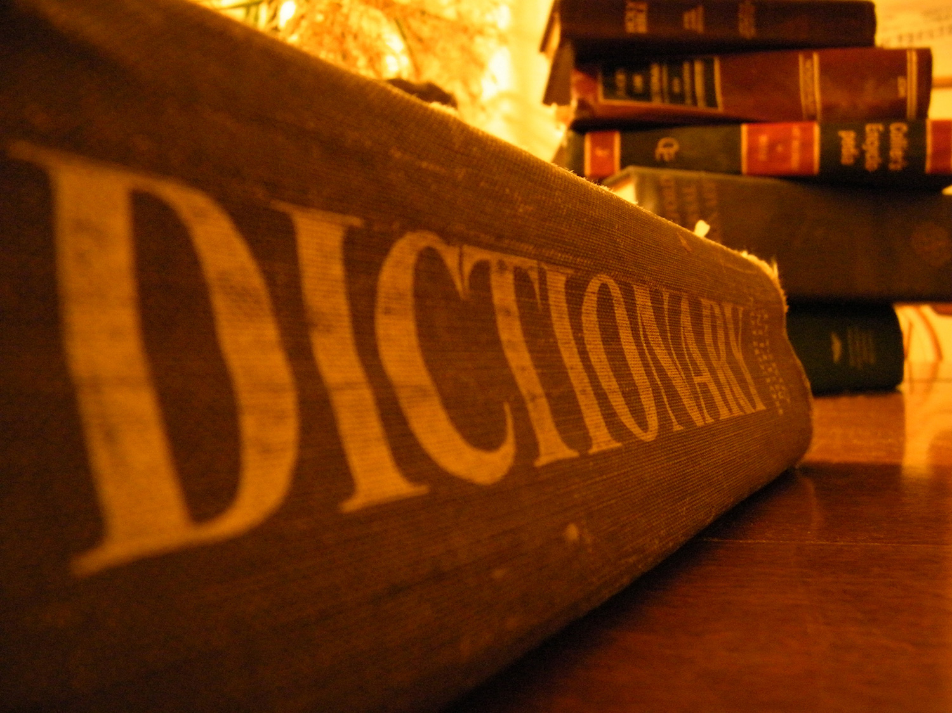
Research Reference:
(Averill, 1980)
© TRACOM Corporation. All Rights Reserved.
Notes:
This negativity bias is even evident in our language. For example, of the 558 emotion words in the dictionary, 62% of them are negative and only 38% of them are positive. And, of the most common emotion words that people use, 70% of them are negative.

Slide 24
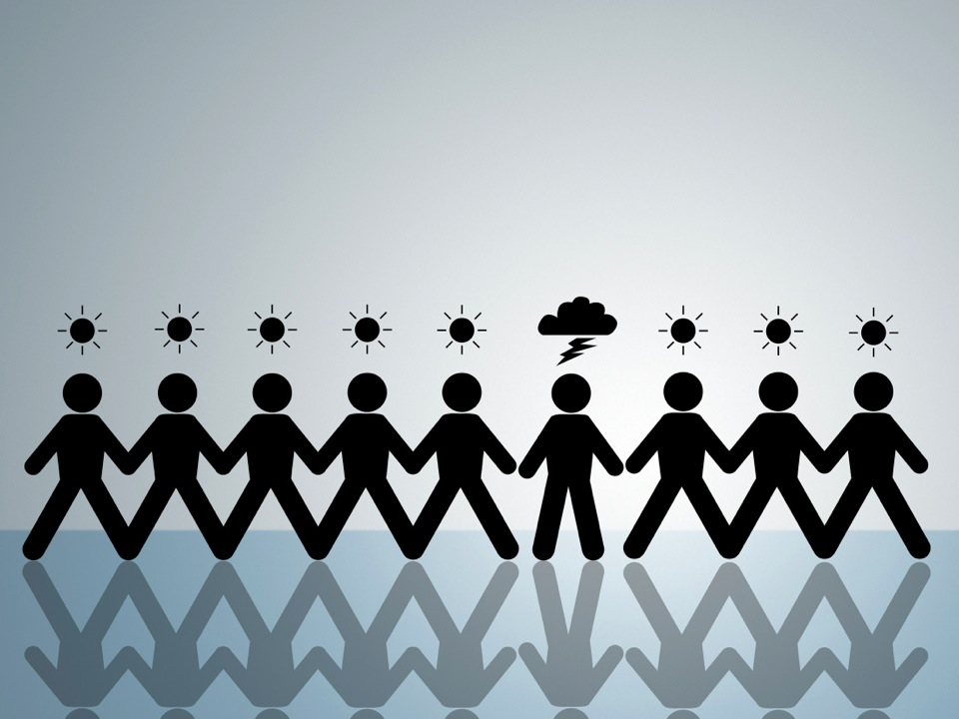
Mood Hangover
Research Reference:
(Sheldon, Ryan, & Reis, 1996)
© TRACOM Corporation. All Rights Reserved.
Notes:
If you have a good day, are you in a good mood the next day? What about when you have a bad day?
There’s evidence that having a bad day is associated with lower well-being the following day, but having a good day is not associated with higher well-being the following day. So, bad events have effects that are longer-lasting compared to good events.

Slide 25
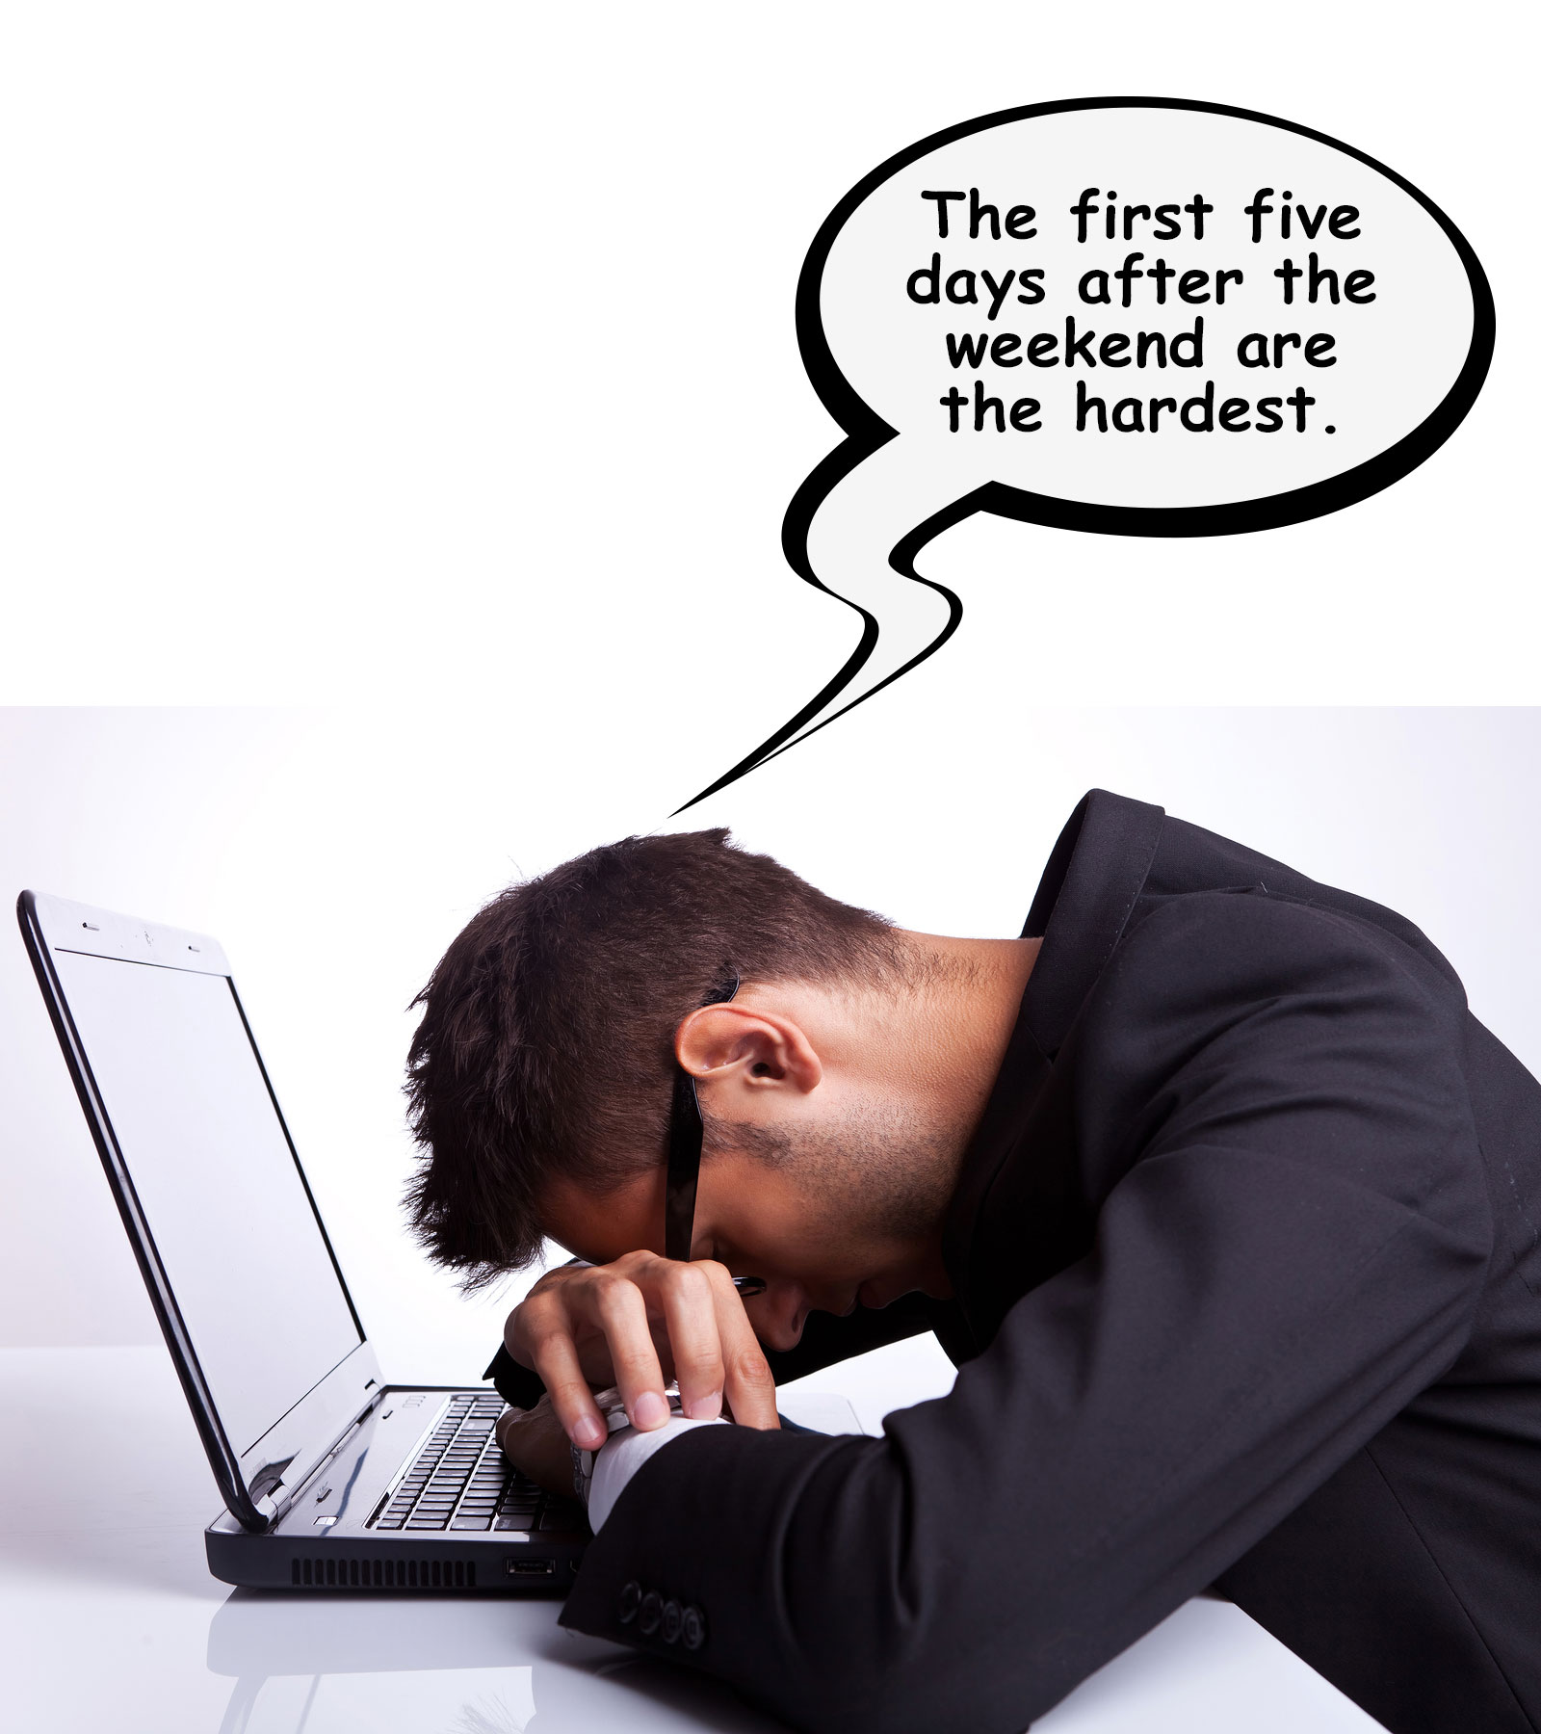

Slide 26
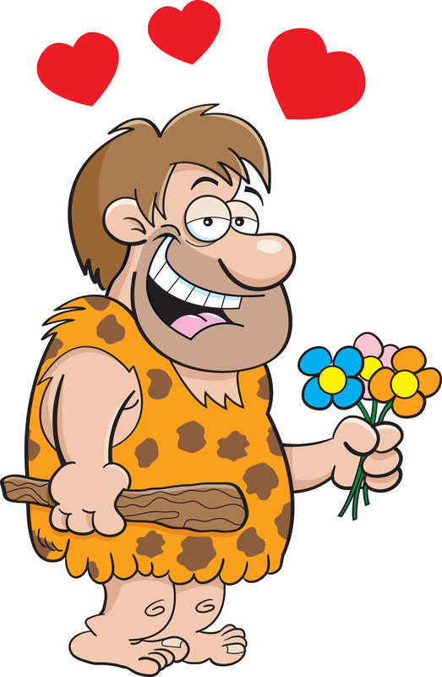
Notes:
Thought exercise:
Imagine you’re in ancient times and you hear a sabertooth tiger. What do you feel? What do you do?
Answer: the amygdala fired, releasing stress hormones (primarily adrenaline). It’s a good response to danger because it mobilizes us for activity – fight, flight, fright. Increased heart rate, blood pressure, breathing – all are adaptive mechanisms for survival.
Concern of ancient people was not on the pleasures of life, falling in love, etc. They needed to survive and pay attention to threats. The humans that survived in ancient times were the ones who could best focus on danger/threats and avoid them.

Slide 27
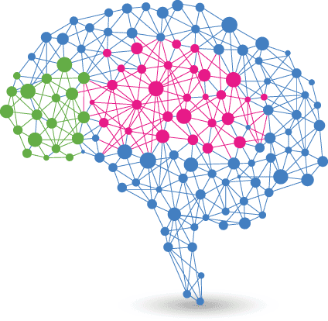
Our Emotional and Logical Brain
Neocortex
(New Brain)
Prefrontal Cortex
(Logical Brain)
Limbic System
(“Primitive” Emotional Brain)
Research Reference:
(Rock, 2009)
Notes:
Our brain evolved like an onion – at the central core, we have an ancient part (what we call the “emotional brain”) that’s hard-wired to exhibit negative, obsessional thinking and a fight or flight survival-based response.
The amygdala fires when we feel threatened. In modern times this is more psychological than physical (threats to self-esteem, ego, self-control).
Later in evolution, however, we developed the prefrontal cortex. The PFC is the logical, rational part of our brains. The PFC is directly connected with the emotional brain. This means we can train our PFC to exert control over the amygdala during stressful times, in order to remain calm and rational. This helps prevent us from being overwhelmed by stressors, and to be better problem-solvers, and to enhance resiliency.

Slide 28

© TRACOM Corporation. All Rights Reserved.
Notes:
A way to think of this, instead of emotional brain and PFC, is “low road vs. high road.”
Low road is easy, takes no effort, but it’s dangerous. Fender-benders and might injure others.
High road requires more thought and effort, but you’ll get where you’re going without wrecking your car or running over pedestrians.

Slide 29

Workplace Amygdala Triggers
Lack of respect
Not heard
Unfair treatment
Unrealistic deadlines
Underappreciated
Research Reference:
(Goleman, 2011)
© TRACOM Corporation. All Rights Reserved.
Notes:
In modern times, physical threats are less common - threats are more psychological in nature (e.g., threats to our ego, threats to our sense of control, etc.) but they still trigger this kind of acute negative emotional response and this part of the brain still exerts control over us. Therefore, even when we experience a lot of positive events in our day, one negative event can dramatically affect our mood. Negative events are more likely to draw our attention and have a stronger and more long-lasting impact on us.
Research shows these are the top 5 workplace amygdala triggers.

Slide 30
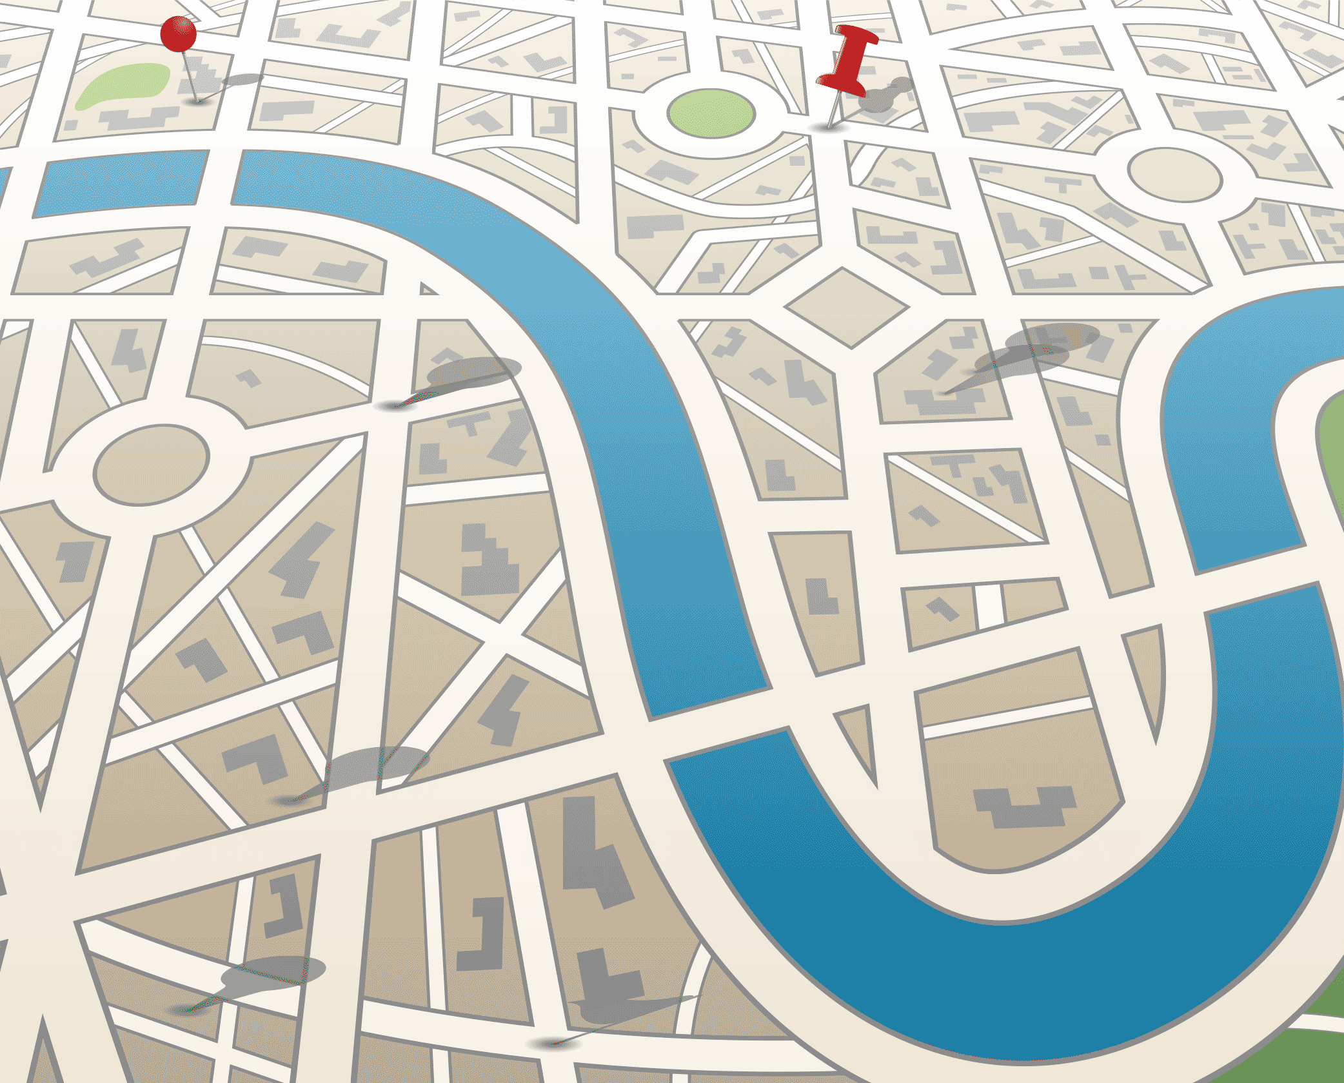
Resiliency Roadmap
(pg. 20-21 in workbook)

Slide 31
Given a choice, would you rather…
?

Slide 32
Lottery vs. Disability
70 –
60 –
50 –
40 –
30 –
20 –
10 –
0
Set-point of happiness before event
Happiness:
1 Year Later
Lottery
Winners
Permanently Disabled
Research Reference:
(Brickman, Coates, & Janoff-Bulman, 1978)
(Gilbert, 2004)

Slide 33

What Does Resiliency Look Like?
(pg. 10 in your workbook)
© TRACOM Corporation. All Rights Reserved.
Notes:
In this next activity, we will explore what resiliency looks like. Please divide into groups of 4. I will give each group a large piece of paper from the easel and ask you to write out 5 action statements that are most illustrative of resilient people. These actions should be observable.
Each group will also draw a picture and choose a song that represents resiliency. You can write your action statements, draw your picture, and write your song on this one piece of paper. When each group is done, members will stick their paper to the wall, and present their action statements, picture, and song choice to the larger group.
During your presentation, make sure you explain why you chose each symbol (statements, picture, and song).
(Keep them updated on time)

Slide 34
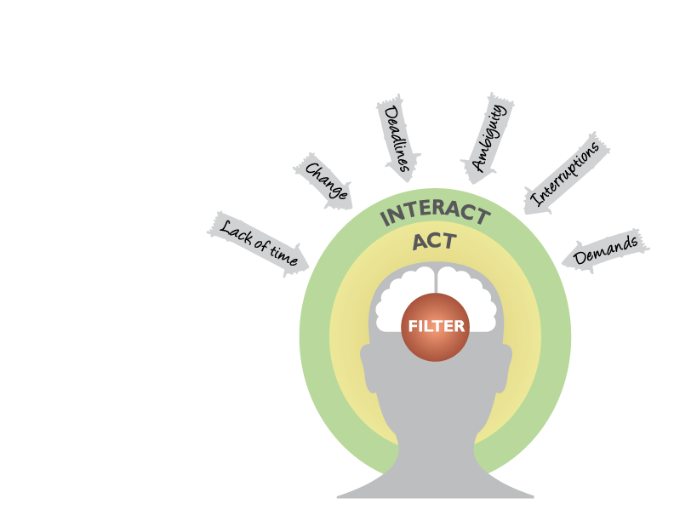


Elements of Resiliency
Filter – how you filter information and interpret the world
Act – how you handle challenges
FILTER
Interact – how you communicate and connect with others
INTERACT
(pg. 11-13 in your workbook)

Slide 35
Elements of Resiliency
Exercise
(pg. 12 and 13 in your workbook)
35
© TRACOM Corporation. All Rights Reserved.

Slide 36

36

Slide 37

Resilience: Filter
Personal Responsibility
High
Control own destiny Active approach to life Initiate projects Make connections Prepare

Slide 38

Resilience: Filter
Realistic Optimism
High
Expect things to turn out well Establish safeguards

Slide 39

Resilience: Filter
Personal Beliefs
High
Everything occurs for a reason Strong personal values Connected to larger causes

Slide 40

Resilience: Act
Self-Assurance
High
Confidence to deal with challenges Deeper interest in tasks Stronger commitment Stronger performance

Slide 41
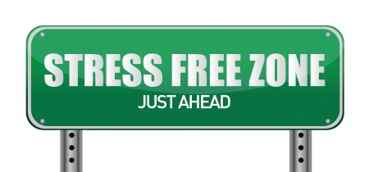
Resilience: Act
Self-Composure
High
Maintain calm, focus and commitment More productive

Slide 42
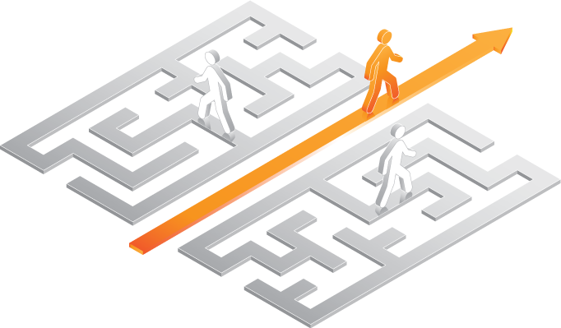
Resilience: Act
Problem Solving
High
Think critically Invent unusual solutions Plan effectively Resolve conflicts Move forward

Slide 43
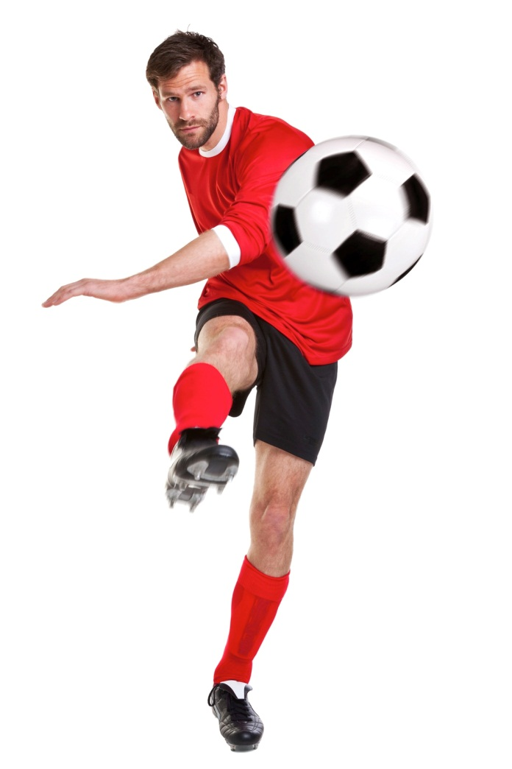
Resilience: Act
Goal Orientation
High
Set appropriate goals Regulate themselves Evaluate progress

Slide 44
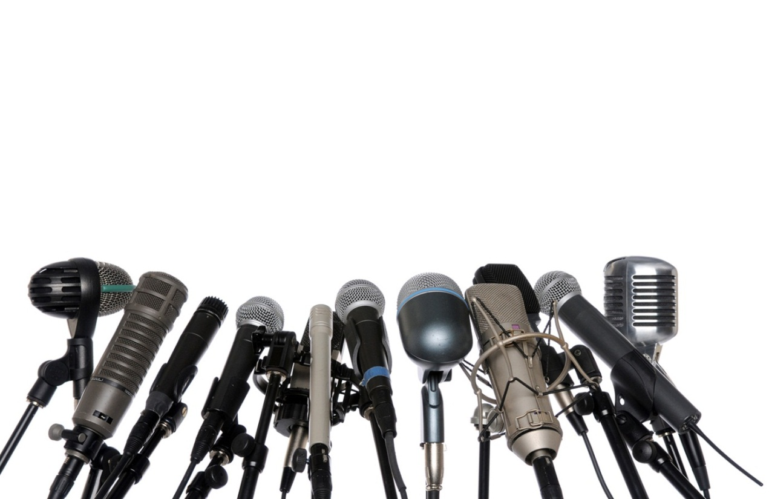
Resilience: Interact
Courageous Communication
High
Candid, open, and honest Share ideas and ask questions Not afraid to engage in difficult conversations

Slide 45

Resilience: Interact
Social Support
High
People to confide in Share feelings Discuss important matters

Slide 46
Discussion
Can you think of people who are resilient (that is, people who have gone through challenges and emerged stronger) but who may not have a high level of all nine resiliency elements?
-What carries them through difficult times?
-Stories?
(pg. 14 in your workbook)

Slide 47

Profile Review and Debrief

Slide 48
Statistical Norms
33.33% of the norm group falls into each category. Your score was compared to the norm group and your results categorized.
33.33%
33.33%
33.33%

Slide 49
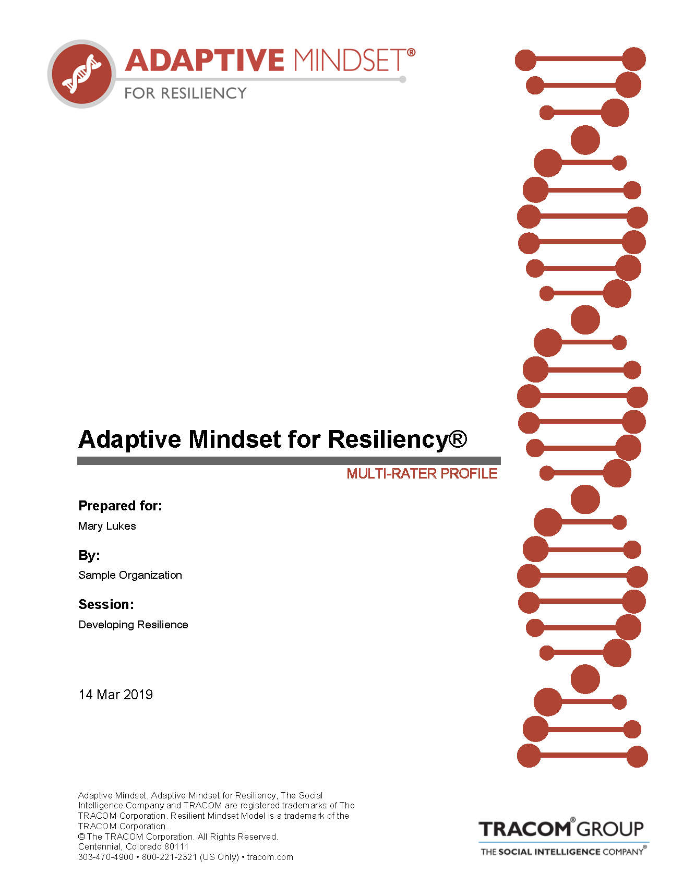
Multi-Rater Profile Report

Slide 50

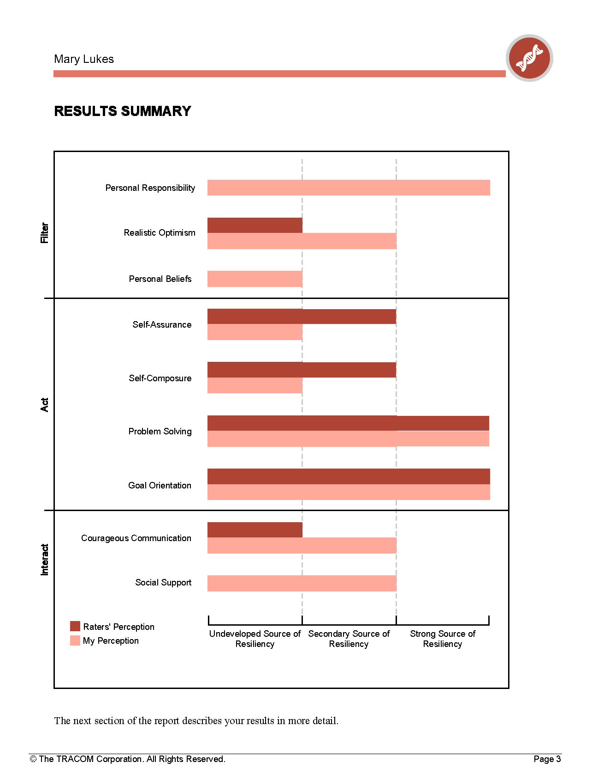
Results Summary

Slide 51
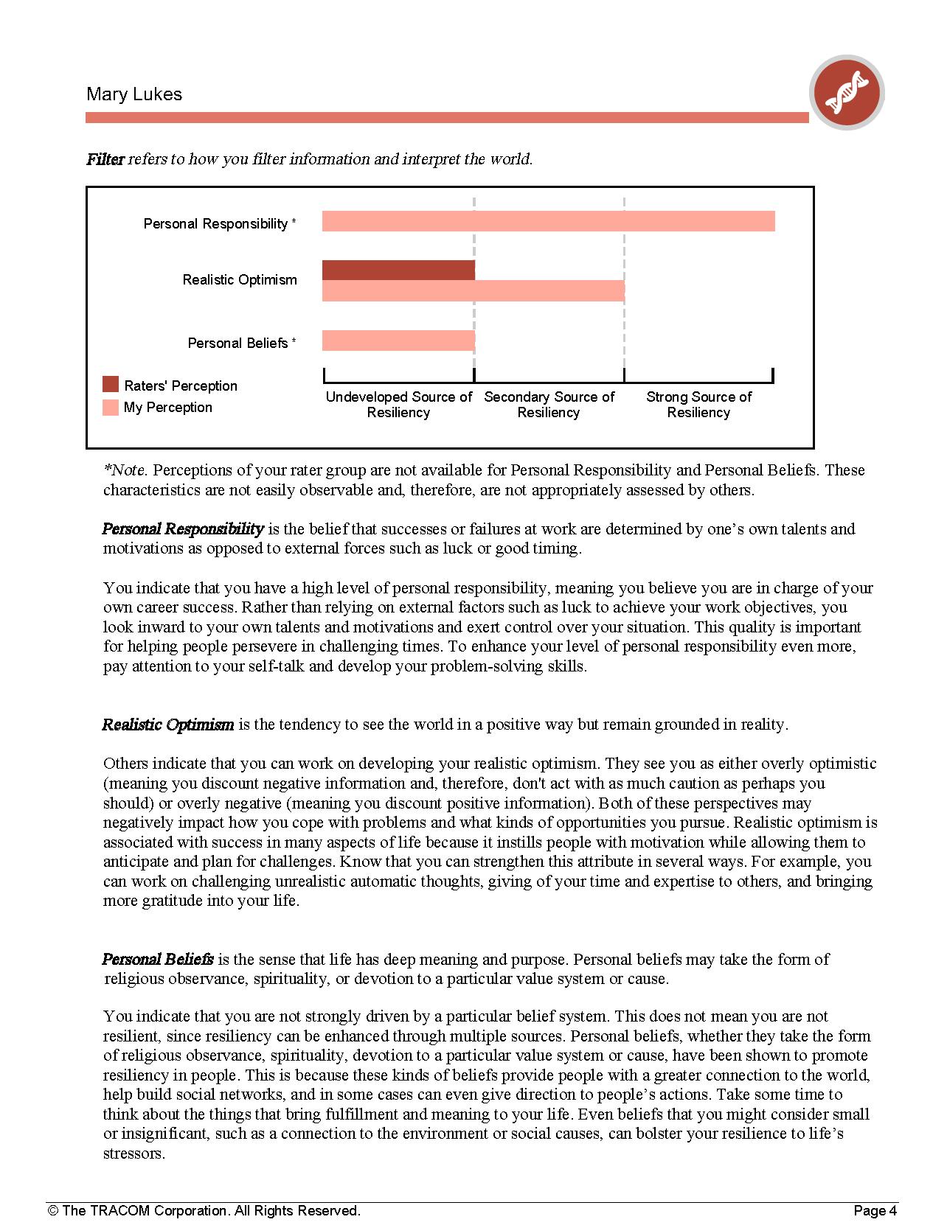
Filter

Slide 52
Definitions and Interpretations of Scores

Slide 53
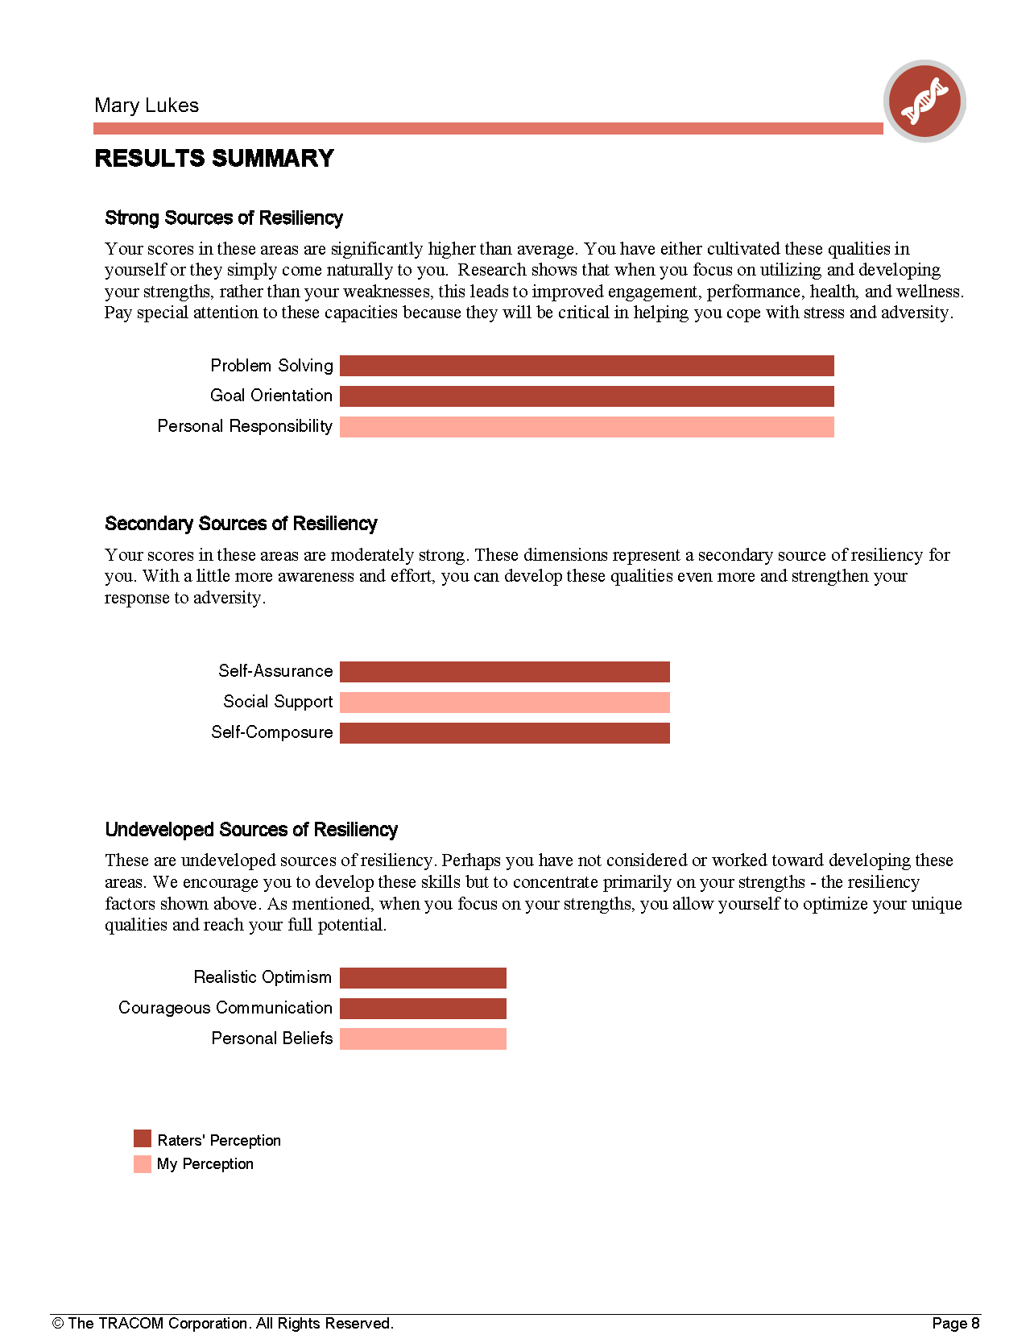
Results Summary

Slide 54

Multi-Rater
Profile Report Discussion/Breakout
(pg. 18-19 in workbook)

Slide 55
Resiliency Roadmap
(pg. 20-21 in workbook)

Slide 56
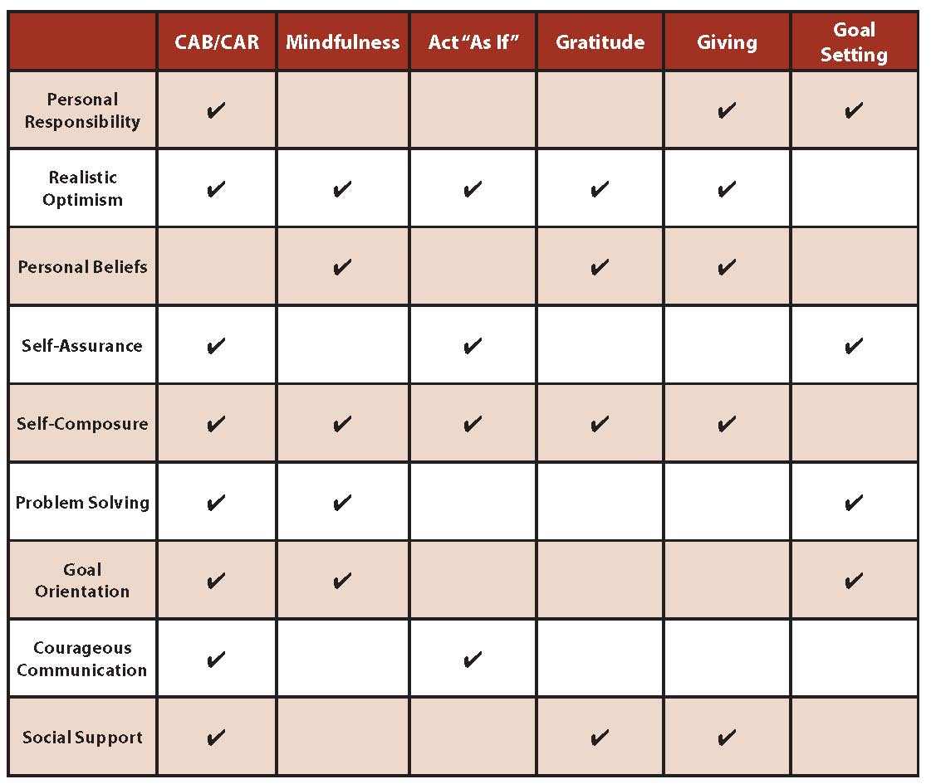
Building Resilience

Slide 57

C
B
Challenge
Behavior & Emotion

Slide 58

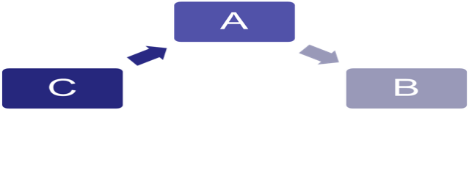
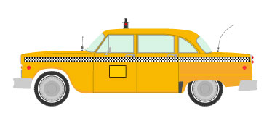
C.A.B.
Automatic
Thinking
Challenge
Behavior & Emotion

Slide 59

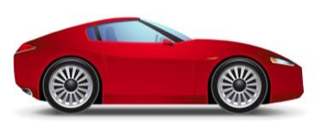
C.A.R.
C
A
R
Active Thinking
Challenge
Realistic Response

Slide 60
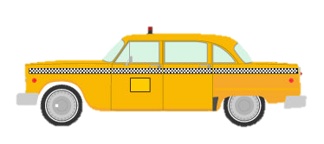
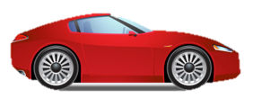
C = Challenge
A = AUTOMATIC Thinking
B = Behavior & Emotion
C = Challenge
A = ACTIVE Thinking
R = REALISTIC Response
(pg. 24 in your workbook)

Slide 61
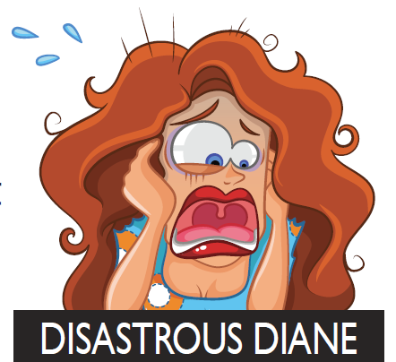
Patterns of Automatic Thinking are
A
C B
D
R
A
I
N
I
N
G
(pg. 25 in workbook)
Research Reference:
(Reivich & Shatte, 2002)

Slide 62
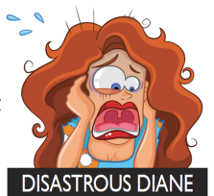

Patterns of Automatic Thinking are
A
C B
D
R
A
I
N
I
N
G

Slide 63
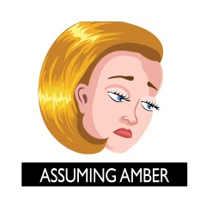
Patterns of Automatic Thinking are
A
C B
D
R
A
I
N
I
N
G

Slide 64
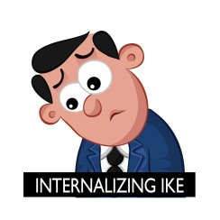
Patterns of Automatic Thinking are
A
C B
D
R
A
I
N
I
N
G

Slide 65
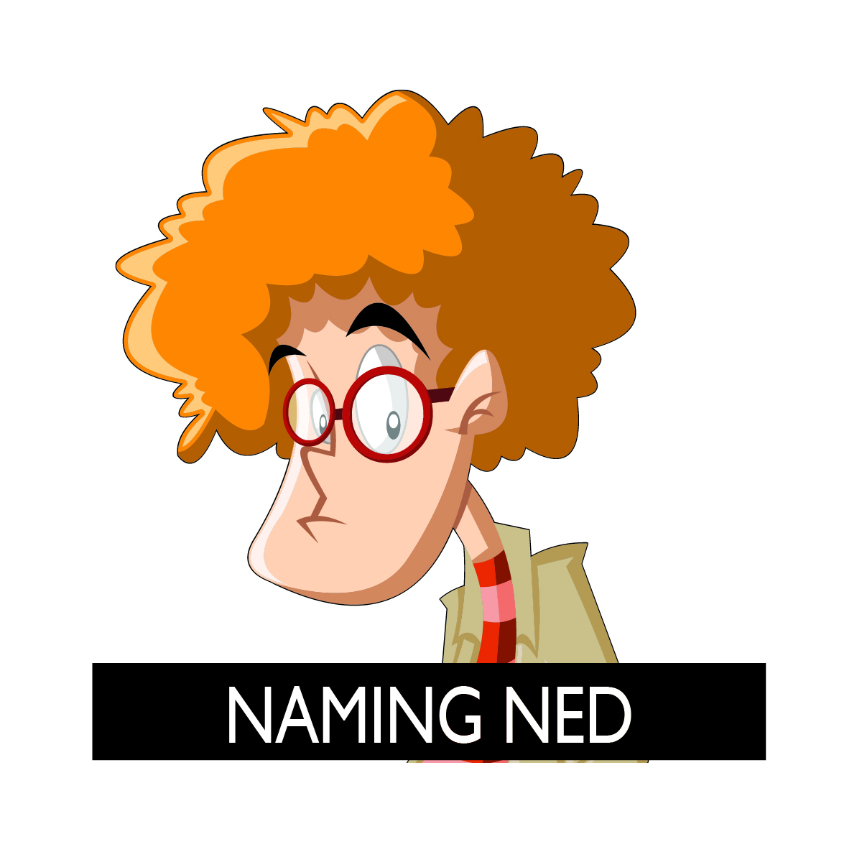
Patterns of Automatic Thinking are
A
C B
D
R
A
I
N
I
N
G

Slide 66
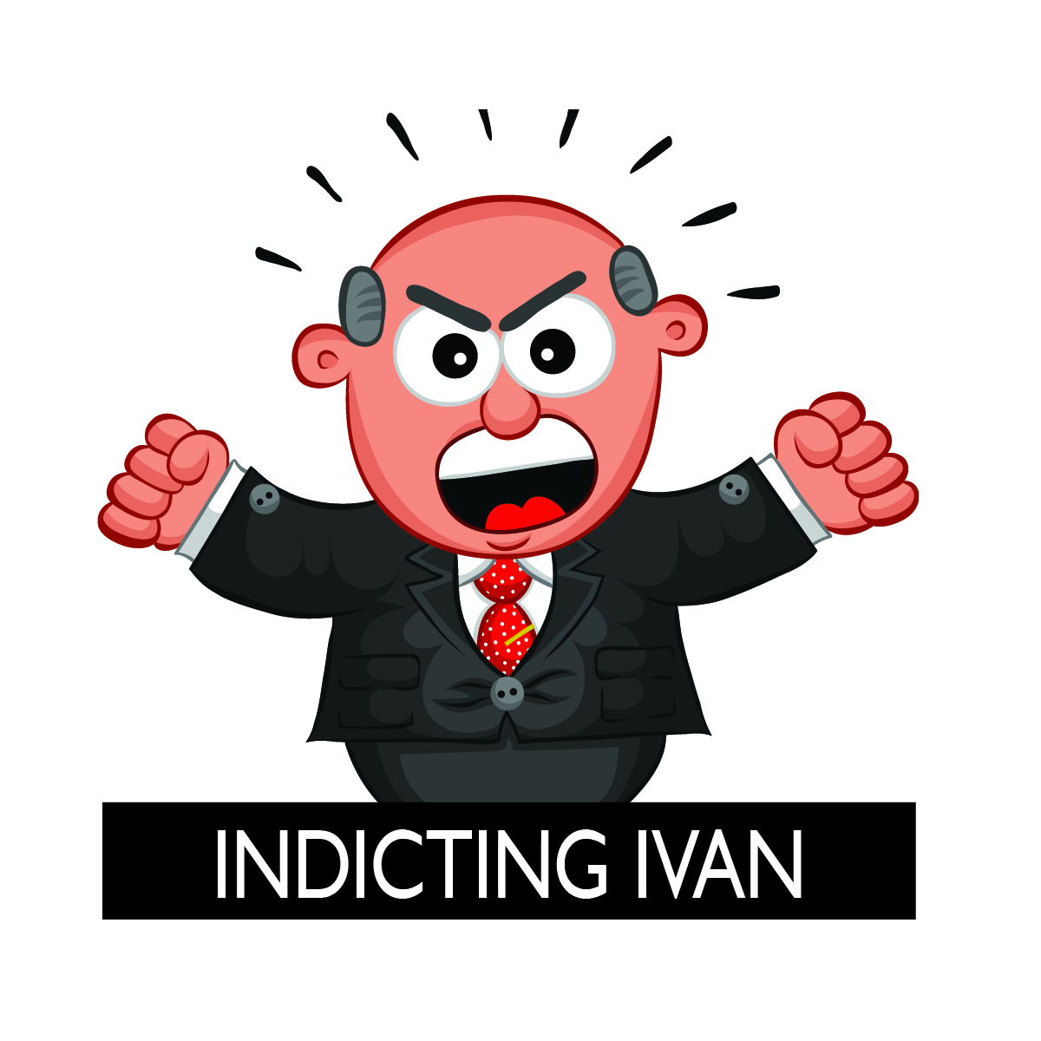
Patterns of Automatic Thinking are
A
C B
D
R
A
I
N
I
N
G

Slide 67
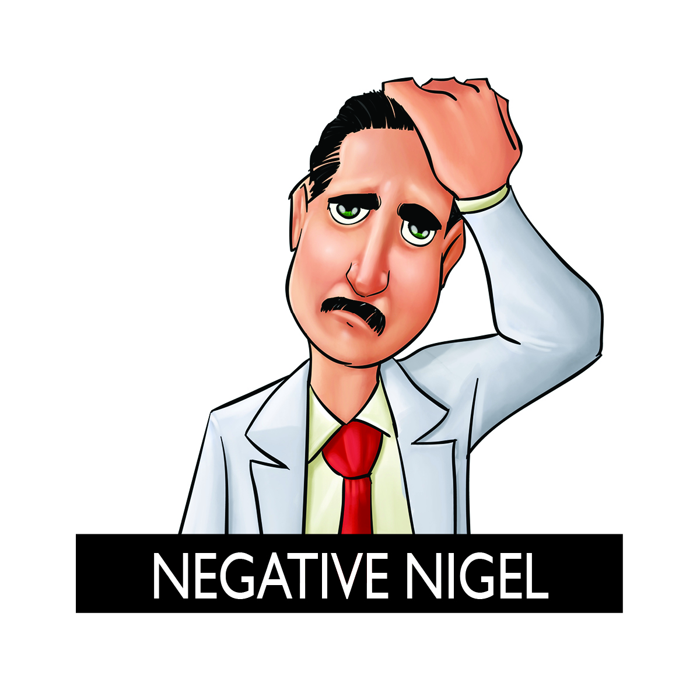
Patterns of Automatic Thinking are
A
C B
D
R
A
I
N
I
N
G

Slide 68
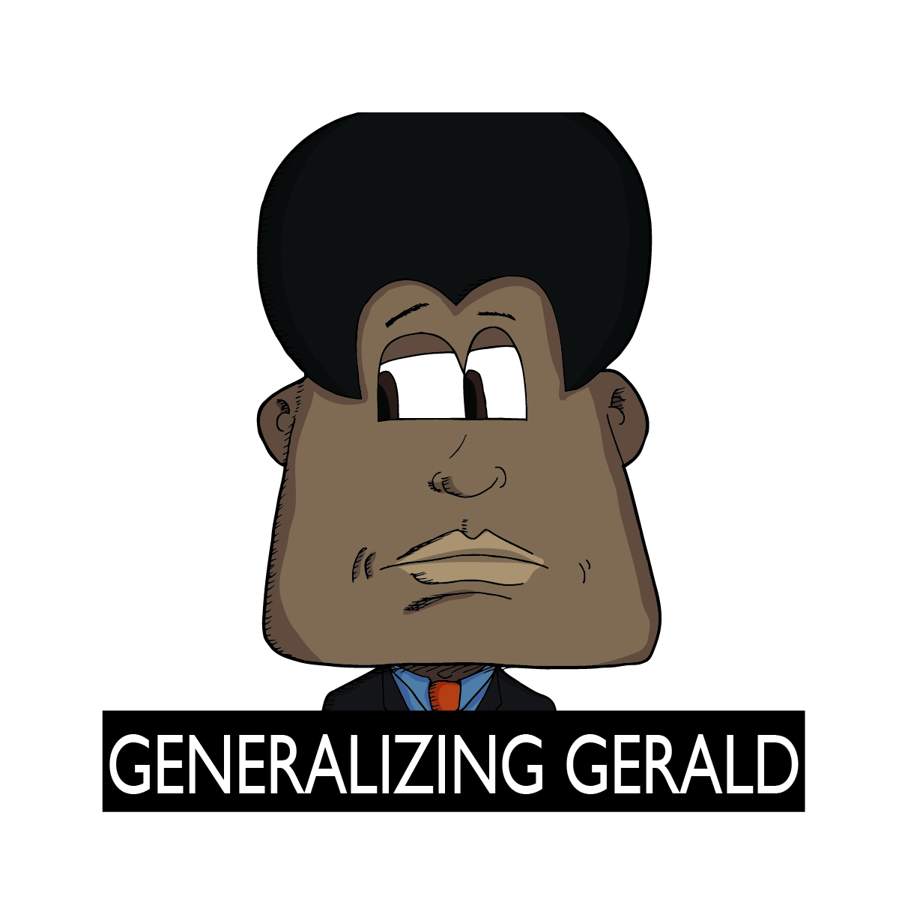
Patterns of Automatic Thinking are
A
C B
D
R
A
I
N
I
N
G

Slide 69
Patterns of Automatic Thinking are
A
C B
D
R
A
I
N
I
N
G

Slide 70
Automatic Thinking
Identification Exercise
(pg. 26 in workbook)
© TRACOM Corporation. All Rights Reserved.

Slide 71
Automatic Thinking Exercise
“It’s my supervisor’s fault that I performed poorly this quarter.”

Slide 72

Automatic Thinking Exercise
“It’s my supervisor’s fault that I performed poorly this quarter.”
“I know that if I deliver this presentation, I will just make a fool of myself.”

Slide 73
Automatic Thinking Exercise
“It’s my supervisor’s fault that I performed poorly this quarter.”
“I know that if I deliver this presentation, I will just make a fool of myself.”
“My boss just told me I led the meeting well, but he gives compliments to everyone.”

Slide 74

Automatic Thinking Exercise
“It’s my supervisor’s fault that I performed poorly this quarter.”
“I know that if I deliver this presentation, I will just make a fool of myself.”
“My boss just told me I led the meeting well, but he gives compliments to everyone.”
“It’s all my fault that my company’s earnings went down this year.”

Slide 75

Automatic Thinking Exercise
“It’s my supervisor’s fault that I performed poorly this quarter.”
“I know that if I deliver this presentation, I will Just make a fool of myself.”
“My boss just told me I led the meeting well, but he gives compliments to everyone.”
“It’s all my fault that my company’s earnings went down this year.”
“Our department budget has been cut in half, but I don’t think we’ll have any problems meeting our goals for Q2.”

Slide 76
Automatic Thinking Exercise
“It’s my supervisor’s fault that I performed poorly this quarter.”
“I know that if I deliver this presentation, I will just make a fool of myself.”
“My boss just told me I led the meeting well, but he gives compliments to everyone.”
“It’s all my fault that my company’s earnings went down this year.”
“Our department budget has been cut in half, but I don’t think we’ll have any problems meeting our goals for Q2.”
“I’m a loser.”

Slide 77
Automatic Thinking Exercise
“It’s my supervisor’s fault that I performed
poorly this quarter.”
“I know that if I deliver this presentation, I will
just make a fool of myself.”
“My boss just told me I led the meeting well,
but he gives compliments to everyone.”
“It’s all my fault that my company’s earnings
went down this year.”
“Our department budget has been cut in half,
but I don’t think we’ll have any problems
meeting our goals for Q2.”
“I’m a loser.”
“If I goof up on this, I will be the office fool.”

Slide 78
Automatic Thinking Exercise
“It’s my supervisor’s fault that I performed
poorly this quarter.”
“I know that if I deliver this presentation, I will
just make a fool of myself.”
“My boss just told me I led the meeting well,
but he gives compliments to everyone.”
“It’s all my fault that my company’s earnings
went down this year.”
“Our department budget has been cut in half,
but I don’t think we’ll have any problems
meeting our goals for Q2.”
“I’m a loser.”
“If I goof up on this, I will be the office fool.”
“Everything is always so hard for me.”

Slide 79
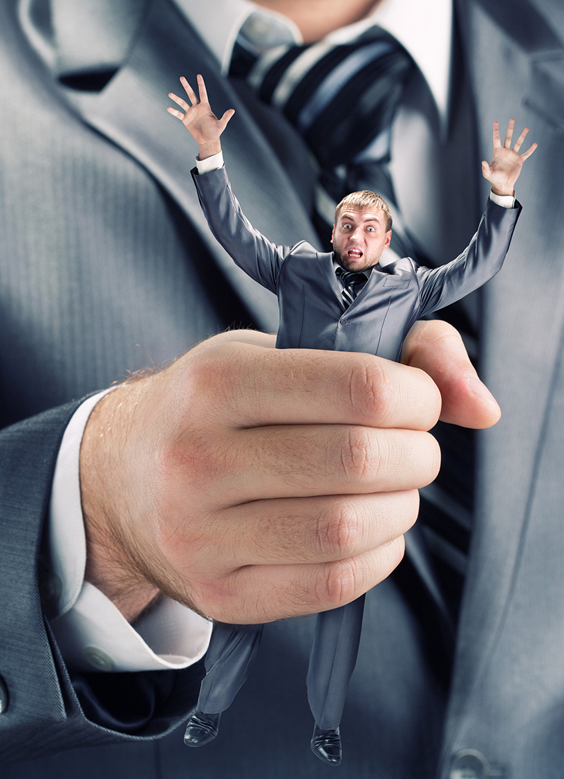
Practice. Practice.
— Challenge —
Boss assigned a difficult and
stressful last minute task
Stayed up all night to complete
Expecting praise
Got none
Given revisions due at the
end of the day
— EMOTION/BEHAVIOR —
Angry Sulk
Worthless Complain
Depressed Isolate myself
Notes:
We are going to go through an activity to help solidify these categories of automatic beliefs in your head. I’m going to read a statement (for example, “Everything is always so hard for me.”) For each statement, the first person who can write the correct automatic thought associated with the statement will earn a point. At the end, the person with the highest score wins.
(Start with about 3 practice statements).
-“It’s my supervisor’s fault that I performed poorly this quarter.” (The answer is “Blaming”)
-“I know that if I deliver this presentation, I will just make a fool of myself.” (The answer is “Assuming”)
-“My boss just told me I led the meeting well, but he gives compliments to everyone.” (The answer is “Magnifying or Minimizing”)
-“It’s all my fault that my company’s earnings went down this year.” (The answer is “Personalizing”)
-“If this project doesn’t go well, I will never be able to move up in the company.” (The answer is “Overgeneralizing”)
-“I’m a loser.” (The answer is “Labeling”)
-“If I goof up on this, I will be the laughing stock of the office.” (The answer is “Catastrophizing”)
-“Everything is always so hard for me.” (The answer is “Overgeneralizing”)

Slide 80
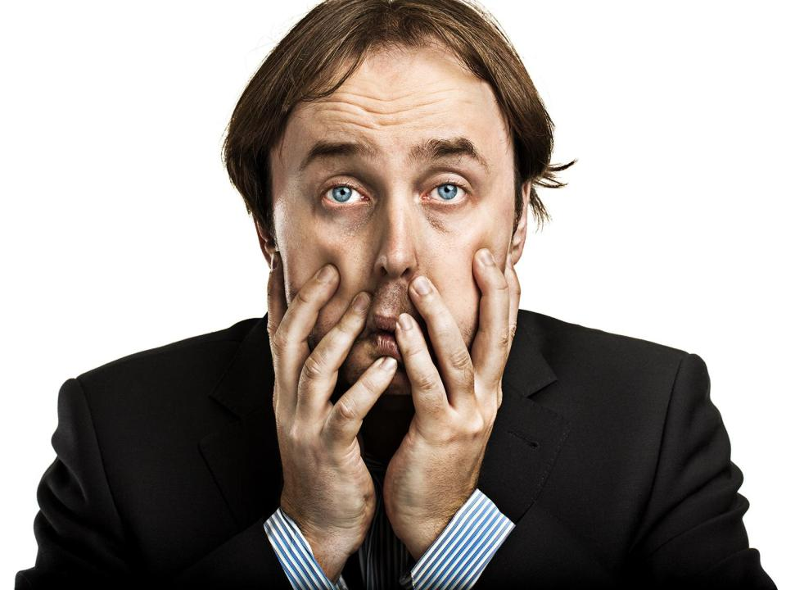
Automatic Active
Thinking Thinking

Slide 81

Automatic Active
Thinking Thinking
© TRACOM Corporation. All Rights Reserved.

Slide 82

Challenge
Behavior & Emotion?

Slide 83

— Automatic Thinking—
—Active Thinking—

Slide 84
Recognizing Your Draining Pattern &
Challenging Your
Automatic Thoughts
(pg. 27 and 28 in workbook)
© TRACOM Corporation. All Rights Reserved.

Slide 85
Resiliency Roadmap
(pg. 20-21 in workbook)

Slide 86
Building Resilience

Slide 87

Mindfulness
“When you sit on that jetty and stop to pay attention to the warmth of the sun on your skin, you soon notice the breeze, too… Noticing more information lets you see more options, which helps you make better choices, which makes you more effective at work.”— David Rock, Your Brain at Work

Slide 88
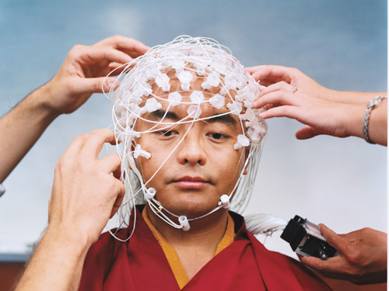

Slide 89


Rita the Researcher
Research Reference:
(Davidson, Kabat-Zinn, Schumacher, Rosenkranz, Muller, Santorelli, Urbanowski, Harrington, Bonus, Sheridan, 2003)
Notes:
Script:
Clip 1 - Those who meditate recover more quickly when presented with a distressful event. In response to a stressor, their amygdala produces a response but goes back to baseline much more quickly compared to the amygdala of normal controls. This means that meditators are less likely to ruminate or get stuck on a particular stressor- they are able to accept an adverse circumstance as it is and effectively move forward.
Clip 2 - It’s important to know that the positive effects of meditation emerge rather quickly. Researchers have shown that after just eight weeks of mindfulness meditation practice, meditators experienced more positive emotions, reductions in negative emotions, and even improved functioning in the immune system. If meditation isn’t for you, there are many other ways you can engage the mind so it is in the present moment. Try interacting with young children, putting yourself in a new environment (for example, taking a new route to work or joining a committee in a professional organization), or learning a new skill.

Slide 90
Resiliency Roadmap
(pg. 20-21 in workbook)

Slide 91
Building Resilience

Slide 92

Act “As If”
Research Reference:
(Carney, Cuddy, Yap, 2010)

Slide 93
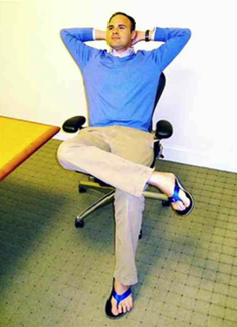
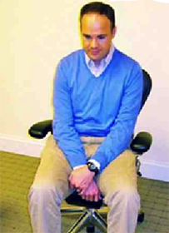
Act “As If”
“I’ve got big dreams for this department and I plan to see them through.”
“I don’t want to bother anyone in the department with this dumb question.”
High-Power Pose
Low-Power Pose

Slide 94
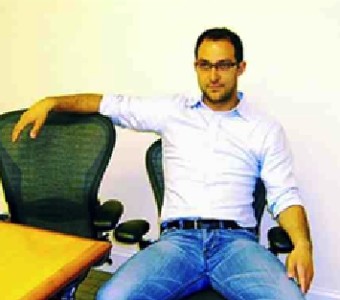
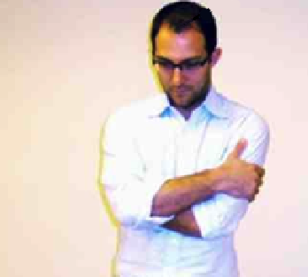
Act “As If”
“My presentation is going to blow everyone’s mind.”
“It’s just little old me. How am I going to handle this project?"
High-Power Pose
Low-Power Pose

Slide 95
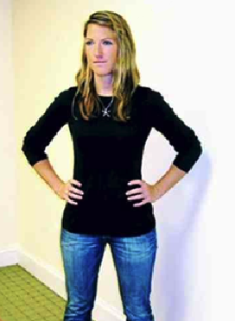
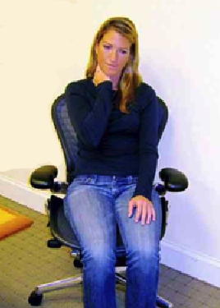
Act “As If”
“I’ve just been given an opportunity to show them what I’ve got.”
“I don’t know if I can run this meeting. It’s too much pressure.”
High-Power Pose
Low-Power Pose

Slide 96
Resiliency Roadmap
(pg. 20-21 in workbook)

Slide 97
Building Resilience

Slide 98
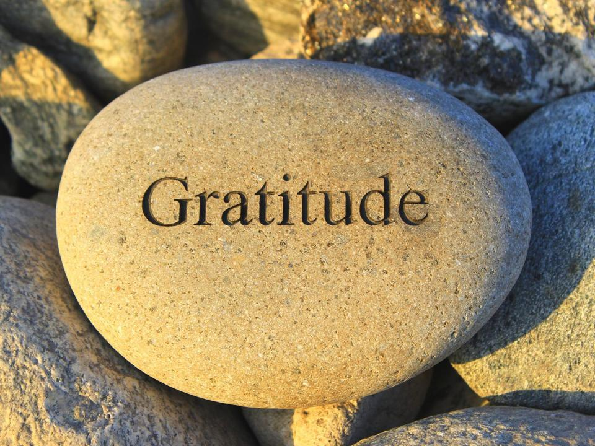
Research Reference:
(Emmons & McCullough, 2003)

Slide 99
Rita the Researcher
Notes:
Script
Clip 1 - One of the easiest positive emotions to develop is gratitude, and researchers have found that it has strong benefits. In one study, participants wrote down five things they were grateful for each week, for ten weeks. At the end of the study this group was 25% happier than a control group who simply listed five events from the week (Emmons and McCullough, 2003). The positive effects of gratitude are not only strong, but long-lasting. In another study, participants wrote down three things that went well each day for a week, along with what led to these things. This simple intervention increased their happiness and decreased their depressive symptoms for six months. (Seligman, Steen, Park and Peterson, 2005).
Clip 2 - Gratitude makes us happier, but it can also generate other, outcomes. Gratitude is associated with deeper relationships, improved health, sleep and energy, higher self-esteem, and reduced self-centeredness and materialism. Grateful people are also less likely to retaliate or act aggressively toward others. In one interesting study, researchers asked students to turn in a piece of writing. Some students received praise for their writing while others received criticism. All of the students then played a computer game against their evaluator. The winner of the game could blast white noise on the loser. Not surprisingly, students who had been criticized retaliated against their raters with particularly loud blasts. However, those students who had written essays about things for which they were grateful weren’t as bothered by the criticism and showed less inclination to punish their rater. (DeWall, Lambert, Pond, Kashdan, & Fincham, 2012)
http://happierhuman.com/benefits-of-gratitude

Slide 100

The Science of Gratitude
Gratitude is associated with:
Increased optimism and happiness
Fewer negative physical symptoms
Increased motivation to exercise
Reduced likelihood of retaliating
against criticism
Lower aggression
Greater empathy

Slide 101
Resiliency Roadmap
(pg. 20-21 in workbook)

Slide 102
Building Resilience

Slide 103

Giving
“Giver burnout” is a myth
Giving is energizing…
So is asking for help
Research Reference:
(Grant, 2013)

Slide 104
Rita the Researcher
Notes:
Script
Clip 1 - Research shows that giving adds meaning to our lives and helps us feel valued by others, and in this way, boosts resiliency. We can see the benefits of giving even on a neurological level. It’s been shown that when people give support to others in pain, they experience increased activity in reward regions of the brain. Not only that, they show a decrease in amygdala activity and consequently, reductions in stress.
Clip 2 - Giving has significant impacts on our health and longevity. In one large scale study, researchers tracked 1,000 adults in the U.S. and found that every major stressful life experience increased an individual’s risk of dying by 30%. However, those who spent time helping and caring for others showed no stress-related increase in dying. Giving and caring generated resilience.

Slide 105

Giving
"The best way to cheer yourself up is to try to cheer somebody else up."
– Mark Twain
(1935, p. 310. “Mark Twain’s Notebook” by Mark Twain,
Edited by Albert Bigelow Paine. Harper & Brothers: New York.)

Slide 106
Resiliency Roadmap
(pg. 20-21 in workbook)

Slide 107
Building Resilience

Slide 108

Goal Setting
(pg. 34 of your workbook)
Research Reference:
(Wax article)
(McGonigal, 2012)
(Whitmore, 2002)

Slide 109

The GROW Model*
(pg. 35 of your workbook)
*Whitmore et al., 2003

Slide 110




What is your Goal?
What is the current Reality?
What are the Obstacles and Options
for achieving your goals?
What is the Way forward?

Slide 111
Resiliency Roadmap
(pg. 20-21 in workbook)

Slide 112

Building Resilience in your Team
(p.36 in workbook)
Being a Role Model
Communicating a Higher Purpose
Stimulating your People
Knowing your People
Rewarding your People
Research Reference:
(Harland, Harrison, Jones & Reiter-Palmon, 2005)

Slide 113
If you want these nine things….
…then do these six things.

Slide 114
Summary/Review
What is Resilience?
What holds us back from being resilient?
Strategies to develop resilience

Slide 115

Breaking News!
(p.40 in workbook)

Slide 116

Next Steps
Monitor your progress in terms of the commitments you made on your resiliency roadmap
Revisit your
workbook
Additional resources
Share what you’ve learned!

Slide 117
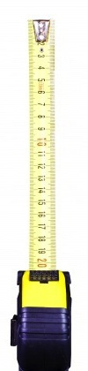
How’d We Do?
+

